Slide 1
SDG Coordination Group Report
Brian Killough, NASA, SEO
Marc Paganini, ESA, SIT Chair
Agenda Item 3.1
CEOS SIT-37
Virtual Meeting
29-31 March 2022

Slide 2

New SDG Coordination Group
Background: CEOS endorsed the transition of the CEOS SDG Ad Hoc Team to a "CEOS SDG Coordination Group" at the 2021 CEOS Plenary.
Group GOAL: The CEOS SDG Coordination Group will liaise with GEO and internally within CEOS (e.g. Agencies, WGs, VCs) to communicate our current and planned resources (e.g., analysis ready satellite data, tools, guidance, capacity building) and to understand the evolving needs of U.N. Custodian Agencies and country-based users to address the U.N. Sustainable Development Goals (SDG).
Strategic Lead – SIT Chair Team (Ivan Petiteville, Marc Paganini)
Implementation Lead – SEO Team (Brian Killough, David Borges)
Former SIT Chair Team (CSIRO) – Alex Held, Flora Kerblat
CEO – Marie-Claire Greening
CEOS-GEO liason – Argie Kavvada
* Support from Symbios (George Dyke, Matt Steventon)

Slide 3
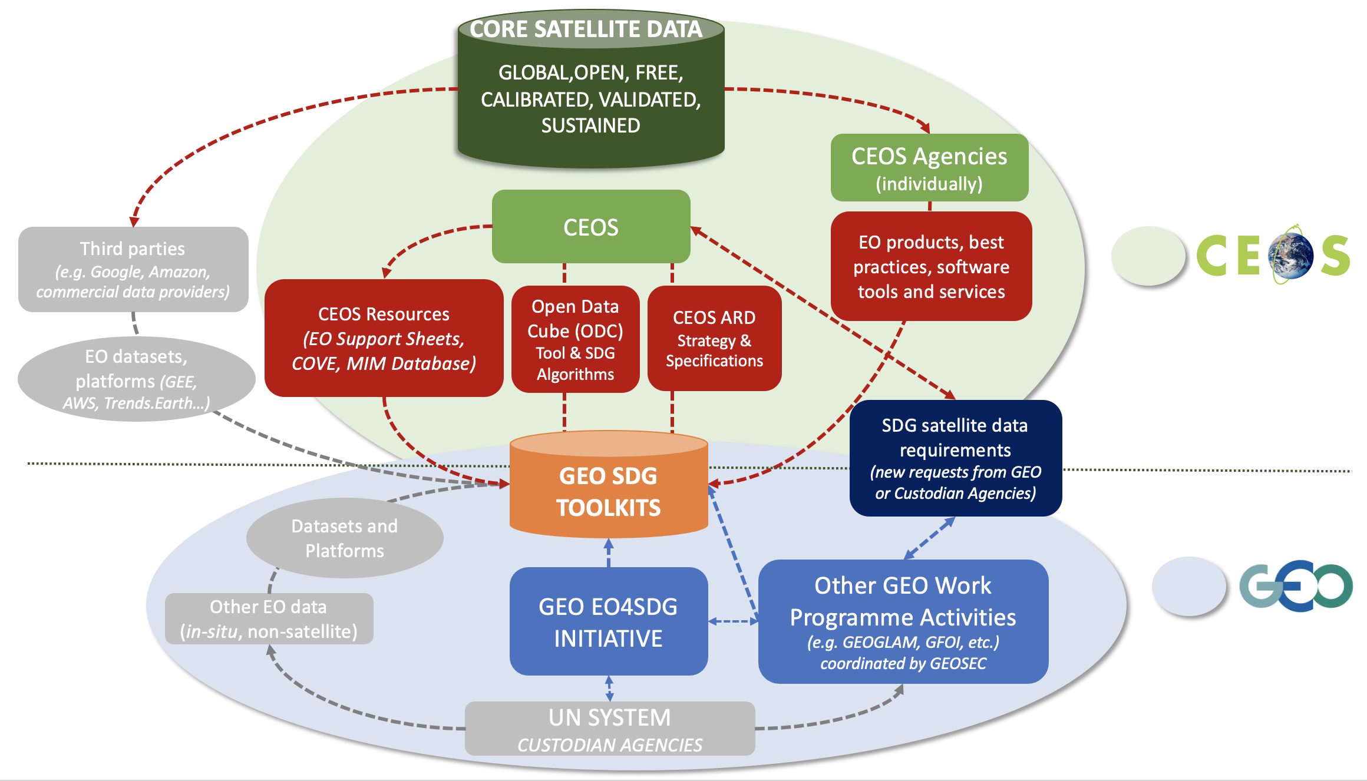
CEOS and GEO Roles
Notes:
Recalling the SDG Data Supply Analysis and Strategy document (June 2022, former SDG AHT) we designed this diagram which was agreed with GEO 2 years ago. This shows how we work with GEO. We are working now to improve that relationship and get more direct information from UN Custodian Agencies and country users.

Slide 4
CEOS-GEO Relationship
The CEOS-GEO Coordination Meeting was held on Feb 8-9.
CEOS suggested a need for 3-way communications between CEOS, GEO, and Custodian Agencies to better understand evolving countries needs related to EO.
GEO requested they would directly interact with SDG Custodian Agencies and communicate those outcomes to CEOS.
CEOS
SDG
+
Countries
GEO
Custodian
Agencies
ACTION: CEOS will develop a one-pager to address "What CEOS can do to support the U.N. 2030 Agenda and the SDGs". This document would serve as a "guide" for future discussions between CEOS and the Custodian Agencies (via GEO).
ACTION: CEOS will develop a one-pager to address "CEOS Expectations for the GEO Secretariat regarding support of the SDGs". This document would define the expectations of CEOS regarding GEO communications with Custodian Agencies.
DRAFTS of these documents are available for review on the
SIT Meeting webpage. Feedback is desired by April 15 (2 weeks).
Notes:
These draft documents are for information and no formal approval is desired or needed. If Principals have any feedback, we would like it by April 15 (2 weeks). After that date, we will share them with GEO.

Slide 5
What can CEOS do for SDGs?
A high-level guide for discussions between GEO and Custodian Agencies regarding CEOS support of the SDGs.
We are a “best efforts” organization and any new work is guided by our “External Requests Process” and “New Initiatives Process”.
Below is a list of services that CEOS could provide to Custodian Agencies or Member Countries to improve the use and impact of satellite data for SDG reporting.
Solve issues associated with CEOS ARD access from CEOS Agencies or 3rd-party cloud providers.
Provide guidance and best practices regarding the use of satellite datasets
Facilitate the development of new missions, data services, tools, and enabling infrastructures (e.g. Open Data Cube)
Contribute to GEO SDG Earth Observation (EO) Toolkits (e.g., Urban Toolkit)
Conduct capacity development activities to support satellite data use
Utilize CEOS social media to advance communications of SDG impact or pending SDG events using EO data

Slide 6
CEOS Expectations for GEO
Defines the expectations of CEOS regarding GEO communications with Custodian Agencies to support the SDGs.
CEOS does not expect to have regular interactions with Custodian Agencies and will depend on GEO to maintain those interactions and represent the capabilities of CEOS.
Below is a list of topics addressed in the document:
CEOS Capabilities –GEO should use the previous document as a reference during external SDG interactions.
CEOS Internal Processes - GEO should communicate potential requests to the CEOS SDG Coordination Group and work with CEOS to determine a resolution. CEOS will use its external processes and consider existing commitments to address such requests.
Meetings with Custodian Agencies - GEO should provide CEOS a summary of the outcomes and communicate any data-related issues, needs for new tools or services, and needs for capacity building following any meetings with Custodian Agencies or Countries.
Meetings between CEOS and GEO - CEOS would like to have regular (e.g. monthly) meetings between the CEOS SDG Coordination Group and the GEO Secretariat SDG Coordinator.

Slide 7
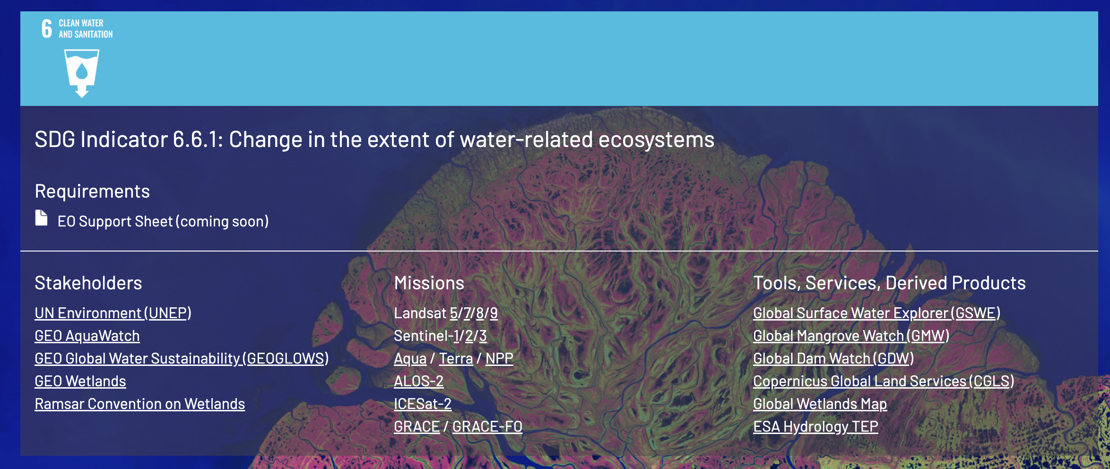

SDG Communications Plan
A dedicated SDG webpage has been created on the CEOS website (www.ceos.org/sdg).
The new webpage summarizes 4 specific SDGs including high-level requirements (EO Support Sheets), key stakeholders, relavant missions and tools/services/products.
The News section of the CEOS website will release a series of articles focused on SDGs in the coming months. The first article was released in Dec 2021 (summary of CEOS support to SDGs) and the 2nd article was released in March 2022 (SDG 6.6, Water). Three more articles and an SDG video are planned before the end of 2022.

Slide 8
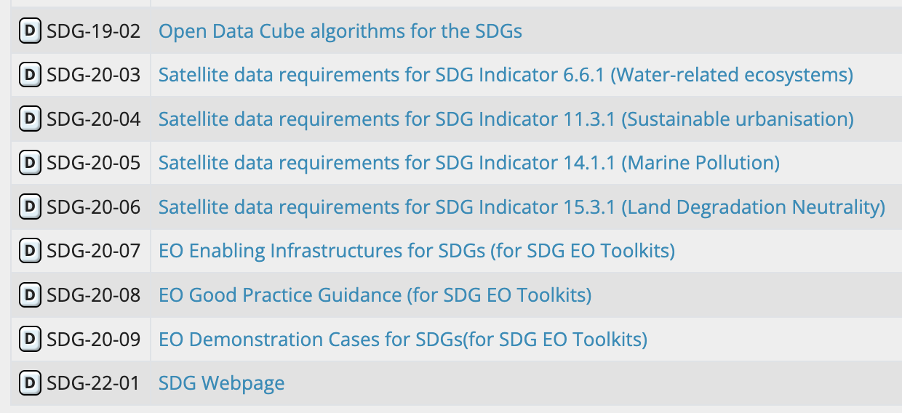
Deliverables
All SDG deliverables are planned for completion by the end of 2022.
SDG-20-04 (EO Support Sheet for 11.3.1 – Urbanization) was completed last week.
SDG-22-01 (SDG website) has released a draft version of the website and we will ensure the essential older content remains available.
CB-20-01 (Urban Toolkit Training) – Completed Q1 2022 (WGCapD deliverable).
The future plans beyond 2022 are under review (including CEOS impact monitoring). Should we add more SDGs? Should we consider more detailed work for the current set of SDGs?
Notes:
SDG-20-03 and SDG-20-06 are near completion. Items 7,8,9 all deal with the EO Toolkits and we will discuss these in the coming months. For CB-20-01, this 3-part webinar series included a demo and training and 3 use-cases from Colombia, Greece and South Africa. There were over 1200 participants from over 100 countries !!!

