Slide 1
Climate & Carbon Session
Session 2
CEOS SIT-37
Virtual Meeting
29-31 March 2022

Slide 2
Session overview
5 Mins
Session 2
CEOS SIT-37
Virtual Meeting
29-31 March 2022

Slide 3
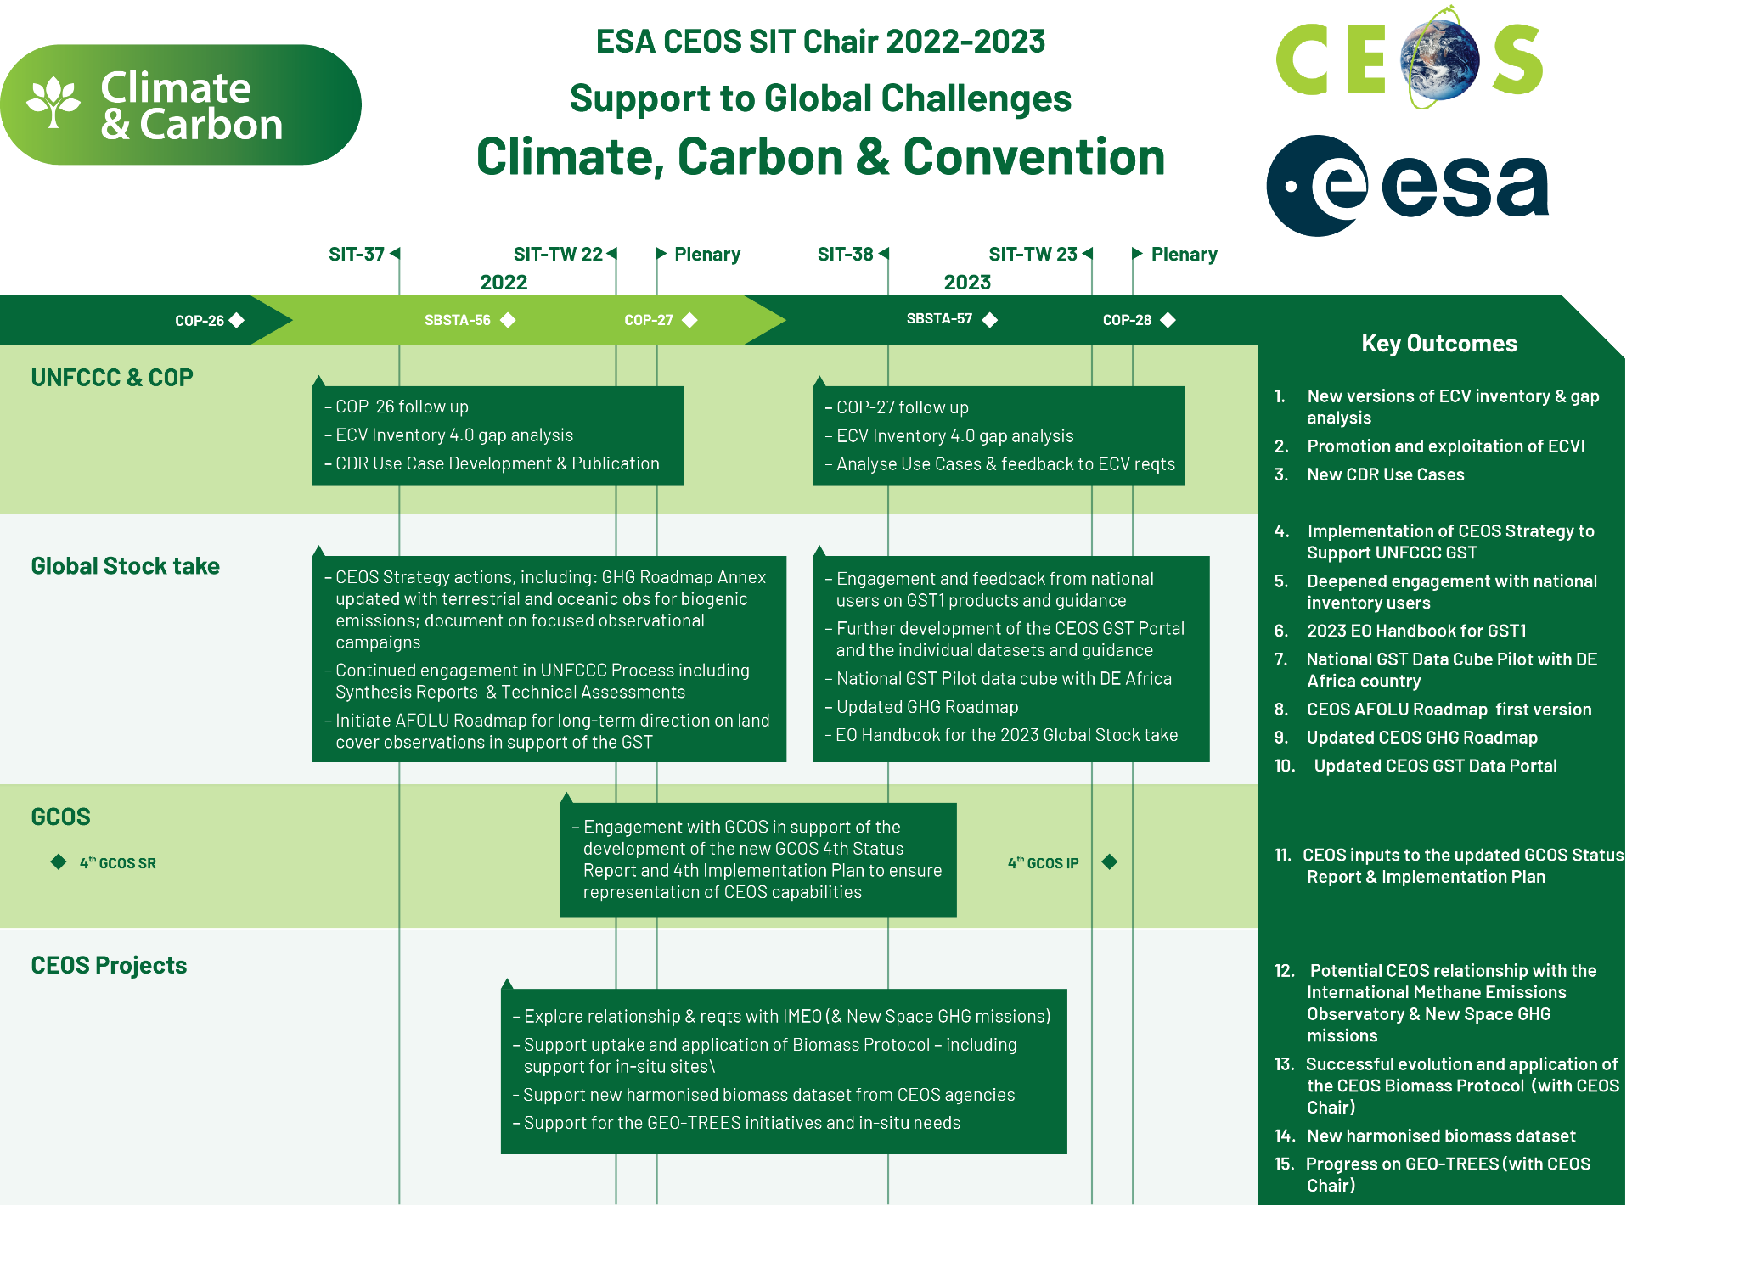
A SIT Chair Term Priority
Slide ‹#›

Slide 4
Session objectives & decisions
Objectives:
Review of the multiplicity of activities right across the CEOS structure in relation to our support to the UNFCCC, the Paris Climate Agreement and its Global Stocktake process. This includes opportunities around Agriculture, Forestry and Other Land Uses (AFOLU), greenhouse gases (GHG), and above ground biomass.
Decision Points:
Next steps on the CEOS inputs to the Systematic Observations synthesis report with UNFCCC SEC.
AFOLU Roadmap feedback, next steps, and intra-CEOS links
Latest on the GST Strategy and the resulting action status
Slide ‹#›

Slide 5
Session Agenda
2.1 Session Overview [5 mins]
2.2 WGClimate Report on COP-26 Outcomes & Use Case Studies progress [10 mins]
2.3 GHG Roadmap Update [10 mins]
2.4 AFOLU Roadmap Update [15 mins]
GEO-TREES update
2.5 National Inventory User Engagement [15 mins]
2.6 CEOS Strategy for the Global Stocktake [10 mins]
2.7 GST Process & Systematic Observations Synthesis Report [15 mins]
2.8 Summary, outlook & coordination
Slide ‹#›

Slide 6
WGClimate Report on COP-26 Outcomes & Use Case Studies progress
10 Mins
Albrecht von Bargen, WGClimate Agenda item 2.2
CEOS SIT-37
Virtual Meeting
29-31 March 2022

Slide 7
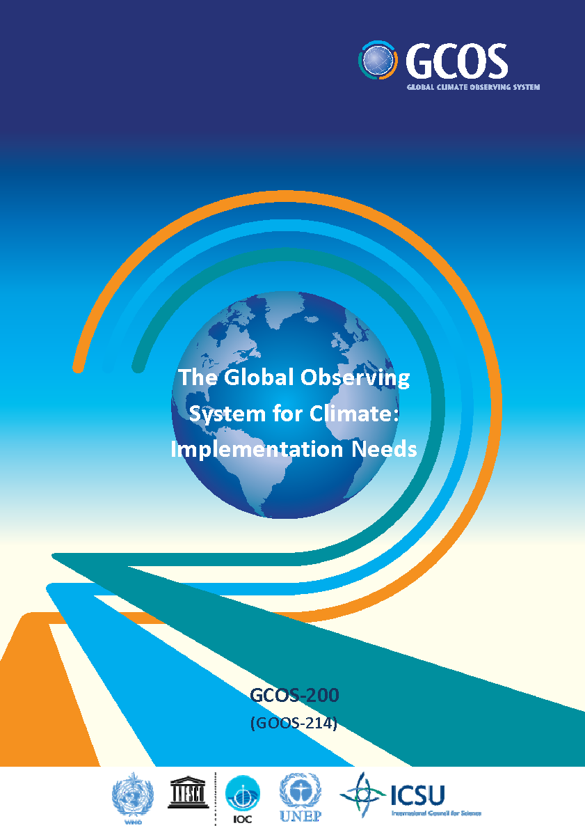
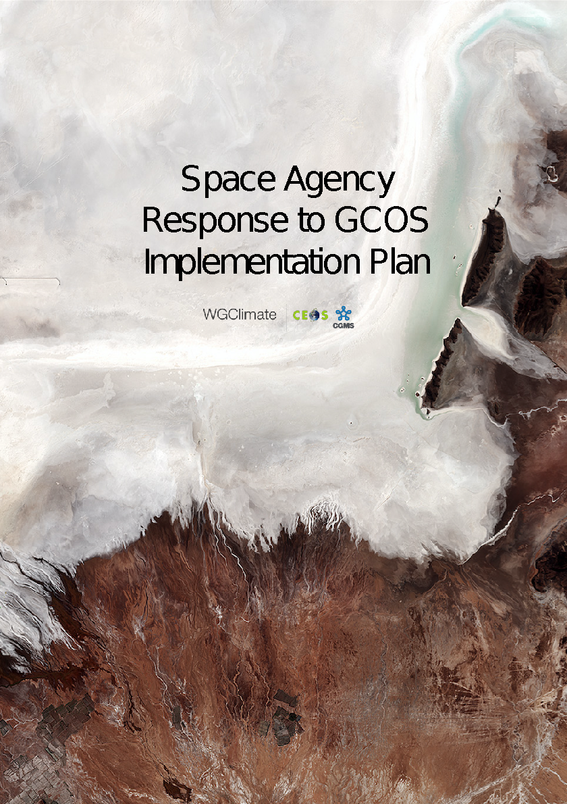
Addressing Observational Needs of Climate, cf. UNFCCC
COP-21 Paris Agreement: Adaptation (Article 7(c)):
Strengthening scientific knowledge on climate, including research, systematic observation of the climate system and early warning systems, in a manner that informs climate services and supports decision-making.
Reports on Progress
@ SBSTA/COP
Needs and Requirements
Coordinated Response

Slide 8
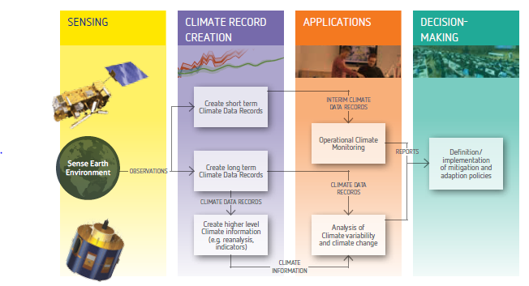
The Architecture for Climate Monitoring from Space
Related WGClimate activity
ECV inventory
Use Cases

Slide 9
Update on Use Cases (Objectives)
Demonstrate the value of climate data records for decision/policy making, e.g., usage of satellite data in a use case with UNFCCC Parties to support the Global Stocktakes (GHG use case)
Understand the application needs to provide feedbacks towards quality improvements for the ECV requirements defined by GCOS
Validate the top-down architecture for climate monitoring from space with a down-top approach ensuring traceability from usage to space-based observing system
Optimize the use of climate data records in applications relevant for climate services and science
Support capacity building by providing/receiving use cases for/from training activities, e.g., for developing countries (link to CGMS and CEOS capacity building activities)

Slide 10
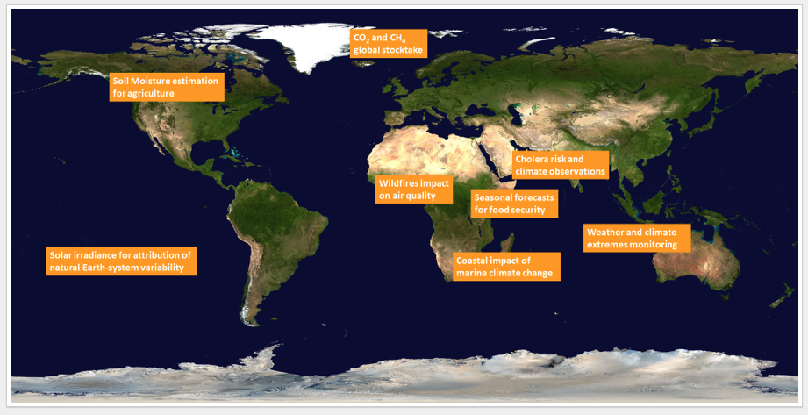
Update on Use Cases (Status)
20 cases received
8 use cases published
1 declined
All others in preparation
Another use cases announced
Link to other sources initiated (C3S, CCI)

Slide 11
WGClimate and GCOS
WGClimate represents the “space component” of/to GCOS
GCOS Status Report published in 2021
Update of GCOS Implementation Plan in 2022
Changes in structure of ECVs expected
Continuous discussion with GCOS: agenda topic of WGClimate
Informal pre-review (Mid-April) by WGClimate
Public review planned for May 2022 (?)
Publication at 2nd Climate Observation Conference co-hosted by GCOS and EUMETSAT (17-19 Oct 2022, Darmstadt)
Presentation of GCOS IP during COP-27
2023/4: Preparation of CEOS Response to GCOS IP

Slide 12
COP-26 contributions from CEOS/CGMS and agencies
UNFCCC / Earth Information Day
Presentation by WGClimate
In addition, presentation of Synthesis Report of Systematic Observations (see agenda topic 2.7)
7 poster contributions by WGClimate and individual agencies
UNFCCC / Structured Expert Dialogue: 1 poster
WMO booth: presentation & discussion with high virtual attendance
UK / Earth Information Day
Further agency events (ESA, JAXA, NASA,….)

Slide 13
COP-26 Pledges
Global Methane Pledge US-EU led initiative, emission reduction of 30% by 2030 compared to 2020; > 100 countries joined
Race to Zero campaign: Commitment to halve emissions by 2030 with aim of a zero carbon world
Forests: Declaration on forests and land use aiming to halt and reverse forest loss and land degradation by 2030; > 140 countries joined
Finance: significant pledges, e.g. to the adaptation fund ($ 356 million); global forest finance pledge: 12 countries / $ 12 billion for 2021-2025
Race to resilience campaign: a metrics framework to verify the climate resilience impact
Glasgow breakthrough agenda: Countries to work on clean technologies & sustainable solutions

Slide 14
UNOOSA / UKSA survey
UNOOSA / UKSA aims to collect information about space & climate
Motivation twofold
It is quite difficult for “newcomers” to have get an overview
UNOOSA wants to sharpen its Space4Climate programme
WGClimate will complete the form with emphasizing its specific role

Slide 15
Conclusion
Awareness to IPCC, UNFCCC & COP needs led to rapid changes in requirements, also valid for GCOS and space observations
Note GCOS-143 (requirements definition) are in some part dated
Hence, the “working environment” of WGClimate is currently under evolution (ECV inventory, GCOS requirements & response)
Use cases establish a link to stakeholder / user community
The COP-26 pledges opens a variety of opportunities for CEOS to provide its capabilities

Slide 16
GHG Roadmap Update
& GHG-AFOLU Workshop
10 Mins
Mark Dowell, GHG Task Team
With input from John Worden and Yasjka Mejier
Agenda item 2.3
CEOS SIT-37
Virtual Meeting
29-31 March 2022

Slide 17
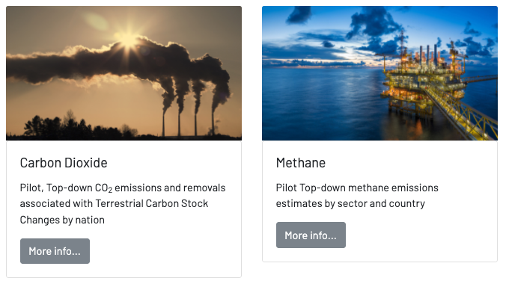
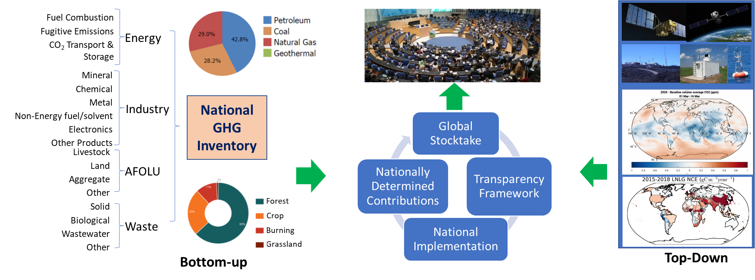
Input to COP-26
https://ceos.org/gst/ghg.html

Slide 18
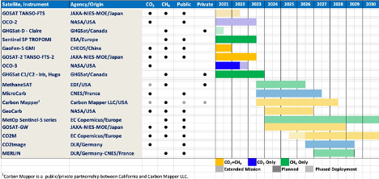
Growing fleet of GHG Satellite

Slide 19
Meeting Outcomes (1/2)
Follow-on workshop on CEOS Stock-take contribution and how to report satellite-based emissions and uncertainty attribution.
Need to define requirements for reporting fluxes / emissions from satellite data for policy / science.
Next steps are TBD for operationalizing reporting of emissions / fluxes based. Prototype contributions to Global Stock-take demonstrate nascent capability. CoCO2/CAMS demonstrates that the European Commission, in collaboration with ESA, EUMETSAT and ECMWF, is operationalizing capability. USA is in discussion for operationalizing capability.

Slide 20
Meeting Outcomes (2/2)
Need to identify and exercise links in which science community can interact and contribute to WMO and UN sponsored efforts to use atmospheric data for quantifying emissions (e.g. IG3IS, IMEO).
Growing number of results showing how using wide-area missions (e.g. TROPOMI) with high-res imaging (e.g. GHG-SAT) can be used to attribute emissions and reduce emissions uncertainty.
EM-27’s uplooking spectrometers are about as accurate as a TCCON site but much cheaper. To what extent can these be used to characterize and adjust XCO2 and XCH4 biases in challenging areas?

Slide 21
GHG-AFOLU Workshop Context
GHG Constellation paper & EC CEOS Chair 2018
Developments in Copernicus (+ research projects CHE, VERIFY, CoCO2, REDDCopernicus)
CEOS GHG roadmap development & increased interest in AFOLU
GST Strategy
Systematic Observation Adhoc group on support to GST
GEO new CC WG (Mitigation SG)

Slide 22
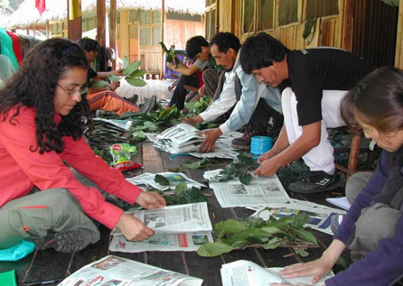
Foster Collaboration, Share the Cost

Slide 23
GHG-AFOLU Workshop
Workshop on Systematic Observation contributions and synergies for GHG & AFOLU in support of UNFCCC
Started dialogue between the different Earth Observation communities addressing the needs of UNFCCC
In particular, atmospheric GHG monitoring and those addressing aspects of the AFOLU sector
15th, 18th,19th November 2021 CET pms
Involved many relevant International coordination mechanisms
Addressed the "soft" coordination and stakeholder engagement aspects i.e. interface with the Convention, the UNFCCC Secretariat and Party user groups, but also more technical aspects of reporting, outputs datasets, formats, avoiding "double - accounting" and the longer-term ambition of using diverse earth observation datasets in the modelling and MVSs being developed
Topic => Questions => Discussion => Recommendations (report)

Slide 24
Evolving policy needs
A global (data assimilation) system supporting monitoring and verification Paris Agreement should be able to rely on earth observation data for a comprehensive picture for the decades to come.
Assuming that the proposed legislative efforts are implemented as planned such an integrated observation and modelling capacity should be able to discern fossil GHG emission plumes reduce and disappear over the next 15-30 years
But also monitor the remaining emissions, in a regime where unavoidable sources (e.g. from agriculture) are compensated by critical carbon sinks of the global biosphere.
Thus, it is fundamentally important to address both GHG and AFOLU and their synergistic and integrated use in this MVS capacity (also implications for satellite constellation planning and development)

Slide 26
Example topics
Empower Parties to use products. Address management level , satellite AND insitu (i.e. integrated products Soil Organic Carbon).
Transition to more routine/operational product generation.
Additional products managed/unmanaged land, disturbance monitoring. Consistency of products in time (ECV-type). Use EO to constrain emission factors especially in less-developed regions (Biomass). Better use of AFOLU in Priors for GHG Inverse-modelling. Feedbacks GHG to AFOLU and AFOLU to GHG (closure, internal consistency, targeted field studies). DVGMs fit-for-purpose, CO2 fert. & land management areas to address. EO for model parameterisation.
So far a lot of focus on “F” in AFOLU, more effort/development on A & OLU. Agriculture: managed/unmanaged,
EAV developments and implementation could be useful, World Cereal needs to be transitioned to operations. A consistent Landcover Framework bringing together different land characteristics
We should think of how product/services requirements will change (over next 20 yrs) if emission reduction policies are successful. Spatialised inventories.

Slide 27
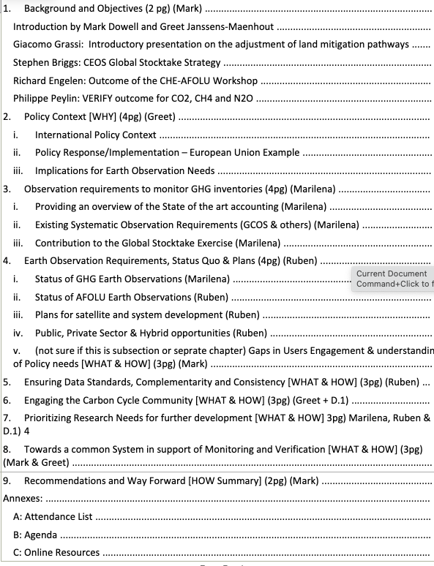
Report Outline
Around 50 pages
JRC producing first draft
Should be sent to attendees in May
Comments before Summer
Ready for SIT TW

Slide 28
AFOLU Roadmap Update
10 Mins
Osamu Ochiai (JAXA)
Frank Martin Seifert (ESA) Ben Poulter (NASA)
LSI-VC Forests and Biomass Team
Agenda item 2.4
CEOS SIT-37
Virtual Meeting
29-31 March 2022

Slide 29
Global Stocktake
Space agencies (CEOS & CGMS) have emphasised ECVs and Physical Climate via the GCOS framework very effectively for the past decade
The importance of NDCs to Paris Agreement, and specifically the Global StockTake (GST), raises new challenges around country needs and implications for using EO data with greater emphasis on mitigation and adaptation, and national-level datasets
A whole new dimension to our climate coordination - both a huge opportunity and a significant challenge
“...if Land Use, Land Use Change and Forestry targets involved in the initial NDCs were implemented in full, this would represent approximately a quarter of pledged mitigation efforts up to 2030“
SIT-35 action: JAXA and ESA explore the development of a CEOS AFOLU (Agriculture, Forestry and Other Land Uses) Roadmap. The aim of the Roadmap is to assess the will, direction and capability of the relevant CEOS Agencies, with the SIT Chair team supporting communications with Principals and identifying team nominees.

Slide 30
AFOLU Team Participation - under LSI Forest & Biomass team
❖Co-Leads:
Osamu Ochiai, JAXA & GFOI Co-Lead
Frank Martin Seifert, ESA & GFOI Co-Lead
Benjamin Poulter, NASA
Richard Lucas, ESA/CCI
Shaun Quegan, UK & ESA/CCI
Heather Kay, ESA/CCI
Ian Jarvis, GEOGLAM
Stephen Ward, JAXA
Ake Rosenqvist, JAXA
Takeo Tadono, JAXA
Steven Labahn, USGS
Michael Falkowski, NASA
Laura Duncanson, UMD
Christine McMahon-Bognor, NASA
Brian Killough, NASA
Michael Cherlet, JRC
Martin Herold, GFZ Potsdam
Mark Dowell, JRC
Albrecht von Bargen, DLR
Joana Melo, SilvaCarbon
Sylvia Wilson, SilvaCarbon
Sven Gilliams, GEOGLAM
Alessandro Cescatti, JRC
Nancy Harris, WRI
Fred Stole, WRI
Zoltain Szantoi, ESA
Alyssa Whitcraft, GEOGLAM
Kevin Gallo, NOAA

Slide 31
Heritage & 2021 Approach
SIT-35 action in March 2020
Discussion Paper prepared for October 2020 Plenary
A CEOS AFOLU Initiative for the UNFCCC Global Stocktake Process:
A Discussion Paper for CEOS Plenary to explore the development of a CEOS AFOLU Roadmap
2021 accomplishments (well-recognized by CEOS-35 Plenary)
Assessment of latest AFOLU products that could be readied for COP-26
Engagement of relevant product teams and identification of team leads for our purposes
Coordination with SIT Chair Team and GHG Team on the new CEOS GST Portal – as a unified point of entry to explain and offer our data
New engagement axis with national inventory users, building on our GFOI experience and in the spirit of the ambition cycle of the Paris Agreement to learn together and grow together
Significant input to SO GST on Mitigation, Adaptation and Means of Implementation.

Slide 32
AFOLU Dataset Summary
 | COP-26 (Nov 2021) | GST1 (2021-23) | Beyond (2024+)
Forest - Above Ground Biomass | Individual existing datasets Tool for visualisation of global AGB products developed, with country use case examples and capacity for product assessment | Synthesized, jurisdictional level biomass, emission factors (and prototype biomass change) | Synthesized spatially explicit, annual biomass, emission factors and biomass change
Land Cover & Forest (Area) | - Copernicus annual global land cover - C3S/CCI Land Cover - WorldCover, HILDA+ - Global Forest Watch tree cover loss and forest fluxes | Synthesised map products and estimates of land cover and change at regional, and global levels Global tree cover and forest emissions and removals | Statistically robust activity data estimates (6 IPCC classes) at national and global levels Global annual forest emissions and removals at 30-100 m resolution.
Mangroves & Wetlands | - Global Mangrove Watch cover and change (1996-2020) - Global Mangrove biomass (2000) | - Global mangrove cover and change at 25 m (1996-2022) - Global mangrove biomass at 12 m (2015) | Global annual mangrove emissions and removals at 10-25 m resolution.
Agriculture | Demonstration WorldCereal products for at least 5 countries (Argentina, Spain, France, Ukraine and Tanzania) | Initial WorldCereal map and analytical system. On-going seasonal analysis products | Continual system improvement and production of seasonal state and change products

Slide 33
2022 Plans

Slide 34
AFOLU Roadmap scope and objectives
Provide a framework for long-term (~ 15+ years) coordination of CEOS agency observing programmes in support of the needs of society for AFOLU-related information, with a focus on the needs and ambition cycle of the Global Stocktake of the Paris Climate Agreement. A guiding vision for long term space agency coordination around AFOLU. Characterises the needs, the services and applications required, the products and observing systems that can support. Explain the need to plan for ground segment, space segment and services.
An effective means for communicating our intentions to society, UNFCCC, national inventory community etc
Addresses basic observation continuity and the necessary agency coordination to achieve it
Identifies questions to be answered in circa 2035 and reverse engineers the value chain necessary for required observations.
Provides guidance to Agencies as to the technologies and capabilities that will be needed in 15 years time to ensure policy relevance of public EO
Strategic and authoritative - but not exhaustive. Identify issues like the continuity outlook, known technology trends and what these will provide, and offer expert assessment for each thematic area as to the adequacy of the CEOS plans and what further should be encouraged.
National inventory user community a key readership but also need to cover global assessments

Slide 35
AFOLU Roadmap Outline
Section 1: Background, Motivation & Objectives
Section 2: CEOS AFOLU activity
Section 3: CEOS GHG and CEOS AFOLU integration (CO₂, CH₄, N₂O)
Section 4: User engagement
Section 5: Beyond CEOS
Section 6: Implementation
Section Leads: Team co-leads (Ben, Osamu, Frank Martin), Stephen Briggs, Martin Herold, Ian Jarvis, Ake Rosenqvist, Richard Lucas, Shaun Quegan, Laura Duncanson, Sylvia Wilson, Stephen Ward - with help from many others…!

Slide 36
Agency Support
Agency Mission contribution and continuity (e.g., GEDI as a key mission to continue)
Agency experts to join the Product Harmonisation Teams - AGB, Land Use and Land Cover, Agriculture, OLU (Mangrove, Wetlands)
Engage with key stakeholders “beyond CEOS” (e.g., IPCC, model community, National Inventory officer)
Activity based on Volunteer, virtual-only team thus far
Hoping for in-person meeting in ESRIN (12 Sep) around SIT TW
Proceeding as best we can with virtual mode calls meantime
Likely a multi-year endeavour
Please support your experts and section leads, including for future in-person meetings!

Slide 37
GEO-TREES
Status
5 Mins
Klaus Scipal (ESA) GEO-TREES Team
Agenda item 2.4
CEOS SIT-37
Virtual Meeting
29-31 March 2022

Slide 38
Global Forest Biomass Reference System
Equitable and sustainably-funded recurrent site-based measurements building on existing initiatives
https://earthobservations.org/documents/gwp20_22/GEO-TREES.pdf

Slide 39
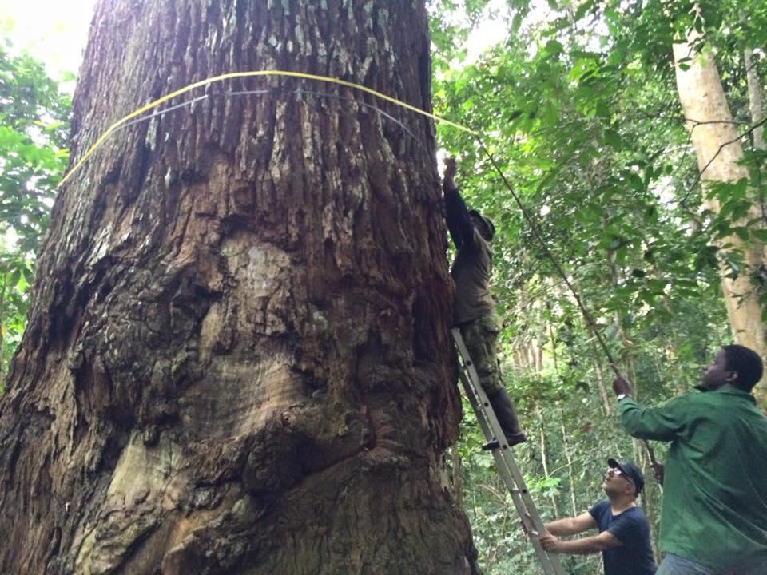
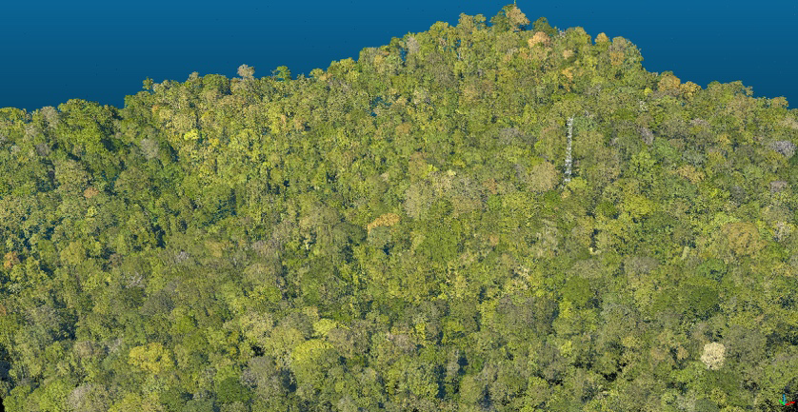
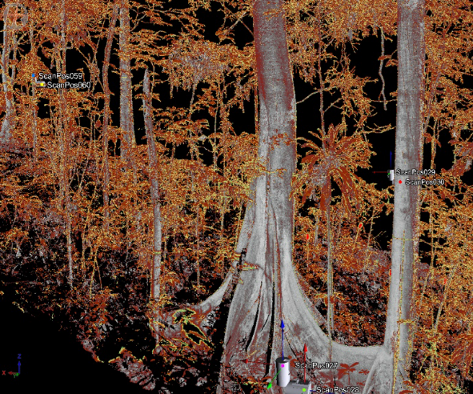
Reference Site Requirements
Field Plot Specs
Preferably square (⟹ easier to link to gridded products)
Min plot size of 1 ha in tropics (⟹ minimizes edge effects)
Permanent, well geopositioned, tagged, and identified
Stem-mapped where possible
Smaller than 0.25 ha in temperate and boreal OK provided airborne lidar
Spatial Distribution of Field Plots
Covering gradients sampled by airborne lidar (e.g. topography, biomass range, etc.)
Sufficient number to train a lidar model (10-30 plots)
Airborne Lidar Specs
Minimum 4 shots /m²
Preferably acquired in same season as field plots
Acquired within ~2 years of field acquisition
Area min ~3x3 km (but less OK if using drone)
Covers plots + local environmental, land history, and forest and structure gradients
Terrestrial Lidar Specs
Sample in existing long-term plots
1 ha plots preferable
Grid pattern
Spacing 10 m in dense areas, 20 m in open areas, or whatever yields consistent sampling and minimizes occlusion
Instrument must have ability to range to tallest trees (e.g. Riegl vz400 or greater)
CEOS LPV Cal/Val Best Practices Protocol for Above Ground Biomass
Recommendations for all data collections
Data should be fair, to engage and support contributors based on mutual respect and deliver mutual benefits,
Data should be open, to allow for transparent and reproducible remote sensing product validation
Data should be acquired in collaboration with long-term field plot networks and local partners wherever possible to increase data consistency, longevity and capacity building
Repeated every ~5 years of when disturbance detected

Slide 40
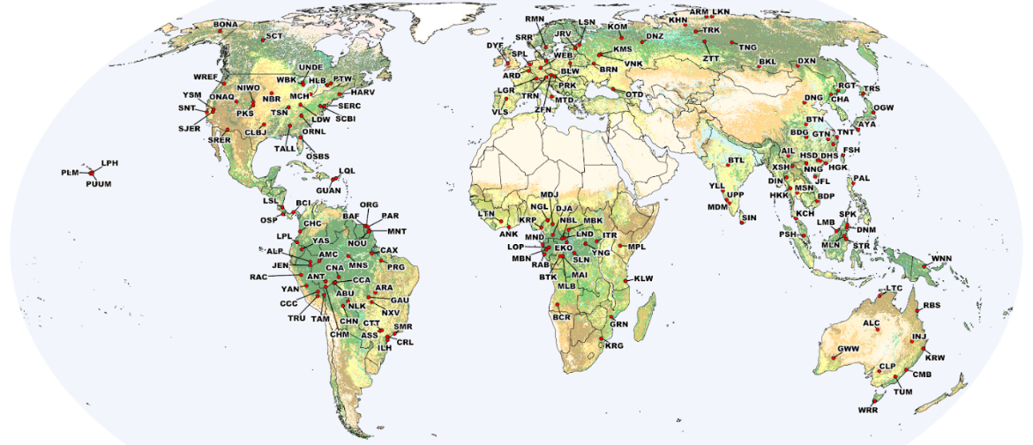
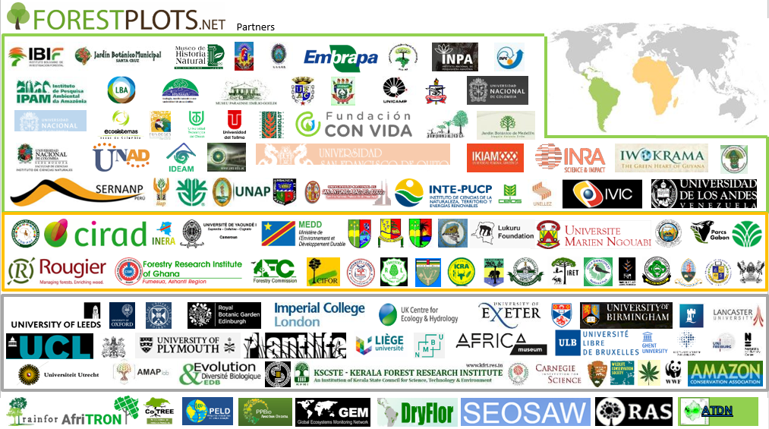
Global Forest Biomass Reference System
… and others
J. Chave et al., Biomass Validation Strategy Document

Slide 41
GEO-TREES in a nutshell
GEO-TREES
Supports data
consolidation
Donors
Manages the donations through a trust fund
Direction &
Bureau
Priorizes the site funding strategy
https://forest-observation-system.net/
Supports data acquisition

Slide 42
GEO-TREES status
Activity accepted in March 2021 for the 2021-2022 GEO work programme.
First Achievements
CNES committed to fund a project office for two years
Candidate was selected last year and should have taken up duty on 1st March but stepped down.
Position is reopened https://bit.ly/3Ju5AFs
CNES committed to fund two reference site.
ESA ForestScan activity kicked off to set up 3 reference sites (French Guiana, Gabon, Malaysia).
Filed work on hold since two years due to COVID.
First discussions to engage Space Agencies, third parties and new networks
CONAE, ISRO
World Bank, NICFI
Total
TERN
To be done (short term)
Establish a Project Structure & Governance.
Set up of the Trust Fund (currently ongoing).
Develop a narrative why it matters

Slide 43
National Inventory User Engagement
15 Mins
Sylvia Wilson Joana Melo
USGS SilvaCarbon
Agenda item 2.5
CEOS SIT-37
Virtual Meeting
29-31 March 2022

Slide 44
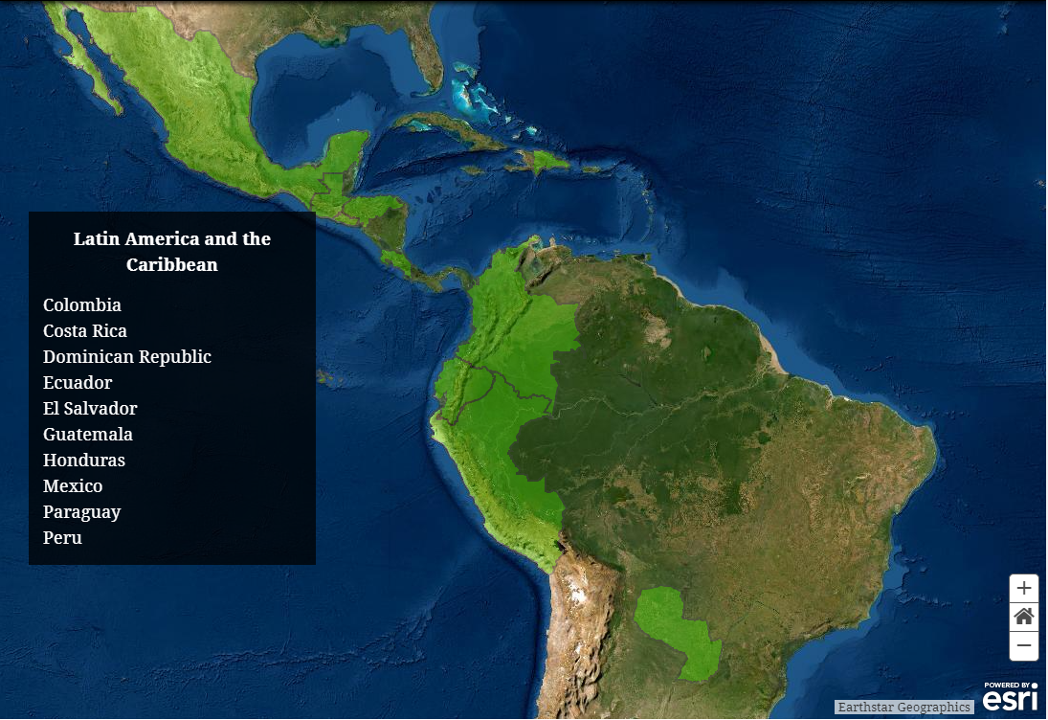
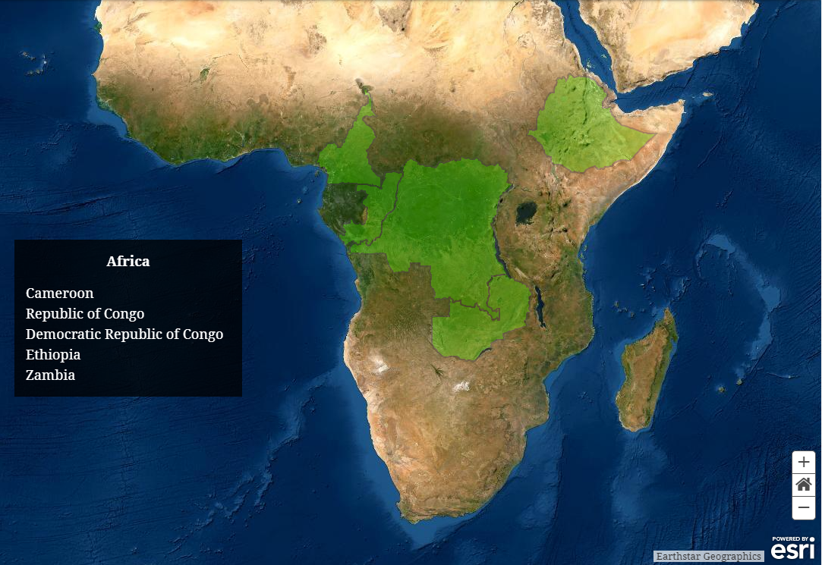
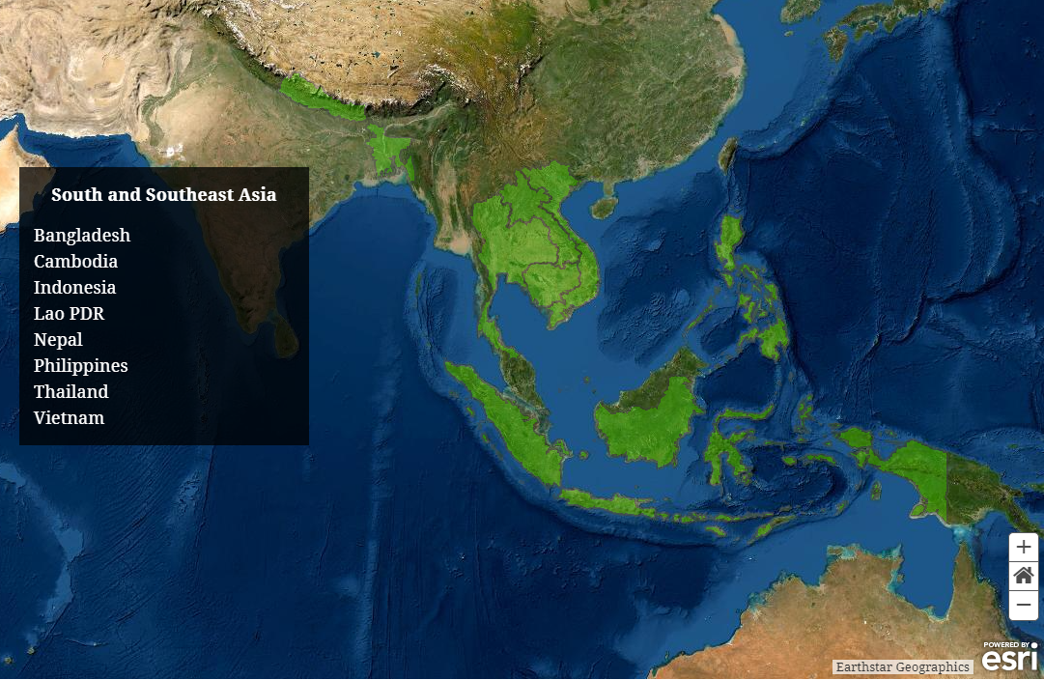
National User Engagement
Overarching Goals
Demonstration of uptake of satellite-based data and derived products in country reporting to the UNFCCC
validation of the available biomass maps / “harmonized” map (additional NFI data)
Provide national feedback on, and contribute to the refinement of, available products derived from satellite-data.
Solomon Islands

Slide 45
National Inventory User Engagement
Activities (in the context of the AFOLU roadmap):
Document the existing examples of data and products use in MRV: Mostly Land Cover Datasets.
Preliminary engagement to introduce the CEOS AFOLU initiatives and products
Regional Workshops
Collaboratively develop demonstrations of Earth Observations uptake

Slide 46
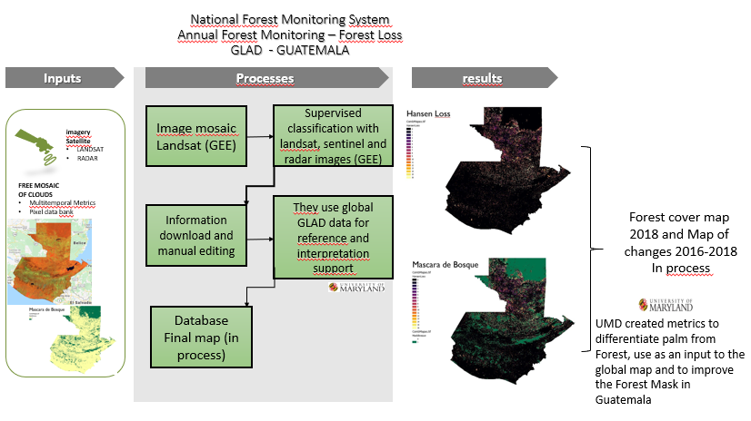
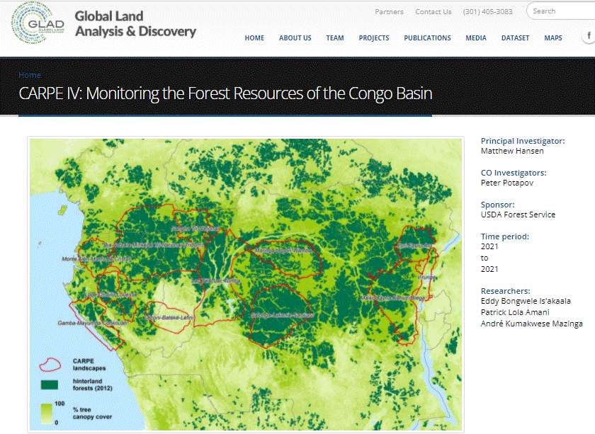
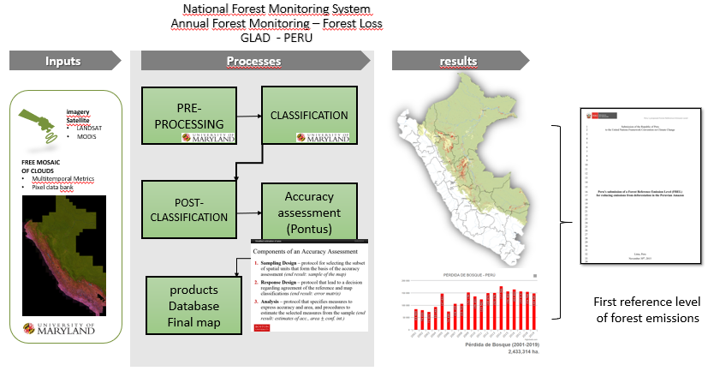
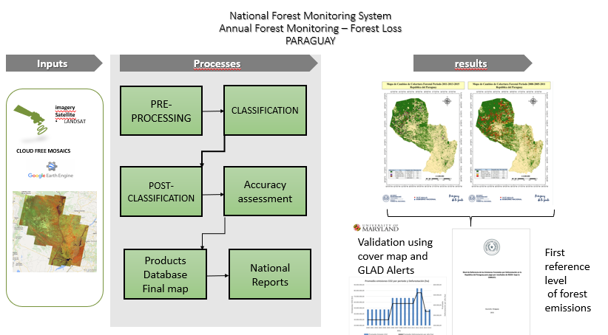
Notes:
I picked a couple of examples for this presentation. With this example I want to show how a global land cover map was validated in countries. We use the Global Tree Cover and canopy cover loss map from the GLAD team at University of Maryland, This team is lead by Dr. Matt Hansen. This map has been available with annual updates since 2015. With this exercise we find out that many countries use this map as an estratificator. They use it as their base map, and they classify on top of it. Other countries use it off the shelve for areas where there isn’t enough ground-based data, and also where the cloud cover is dense, for example the pacific coast or Gabon, or Ecuador. Other countries use it for validation. So many different uses. Even though this change map is based in optical data, the period of change can be as long as 20 years and there will be clear images to characterize the land cover during that period, so it’s a good example of how useful global datasets can be.

Slide 47
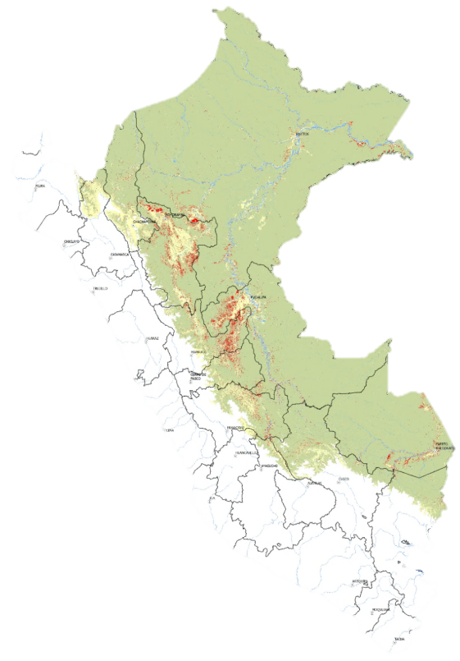
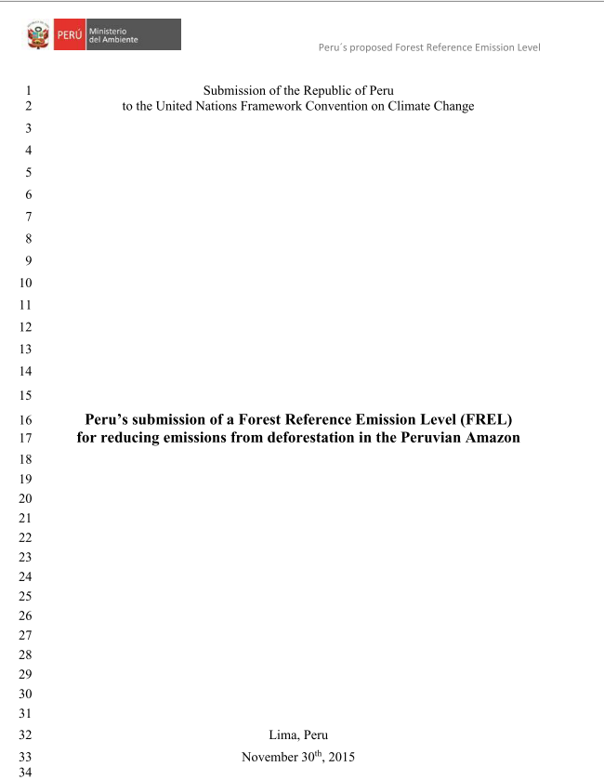
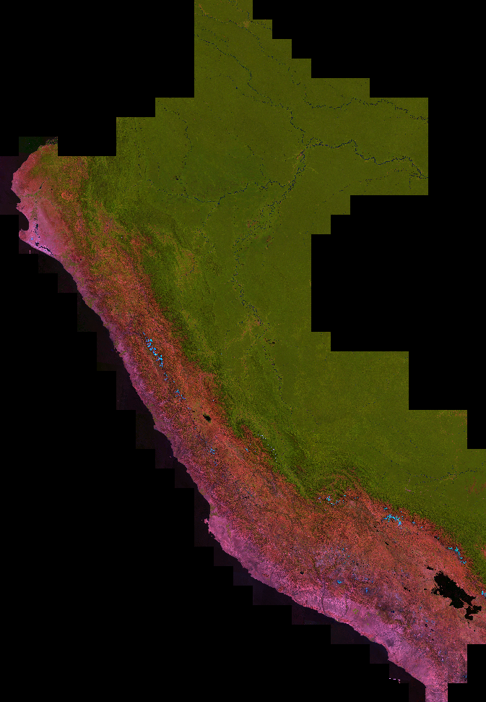
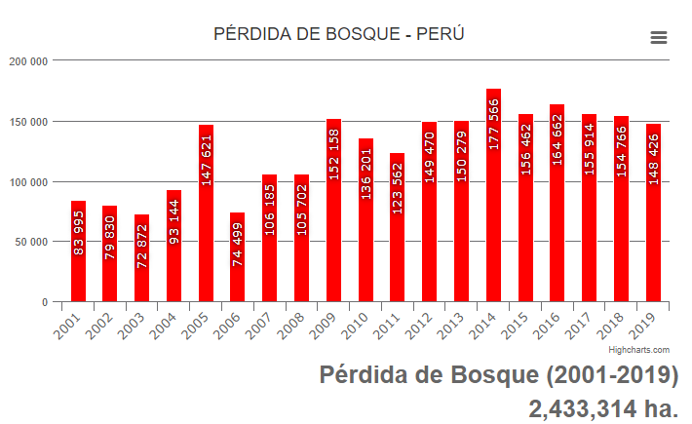
National Inventory User Engagement
Existing examples of data and products use in MRV
Inputs
Processes
results
National Forest Monitoring System Annual Forest Monitoring – Forest Loss GLAD - PERU
PRE-PROCESSING
CLASSIFICATION
imagery
Satellite
LANDSAT
MODIS
FREE MOSAIC
OF CLOUDS
Multitemporal Metrics
Pixel data bank
POST- CLASSIFICATION
Accuracy assessment (Pontus)
First reference level
of forest emissions
products
Database
Final map

Slide 48
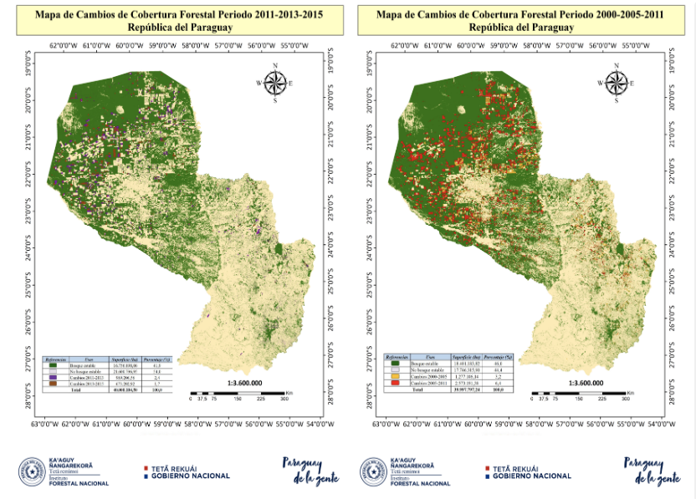
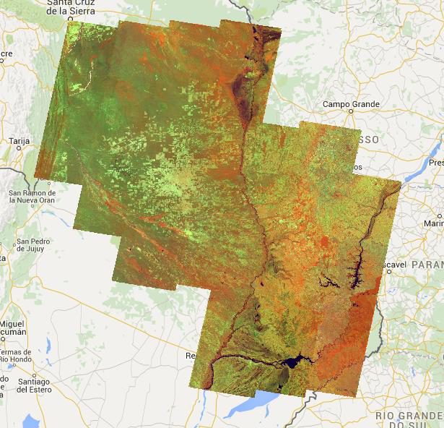
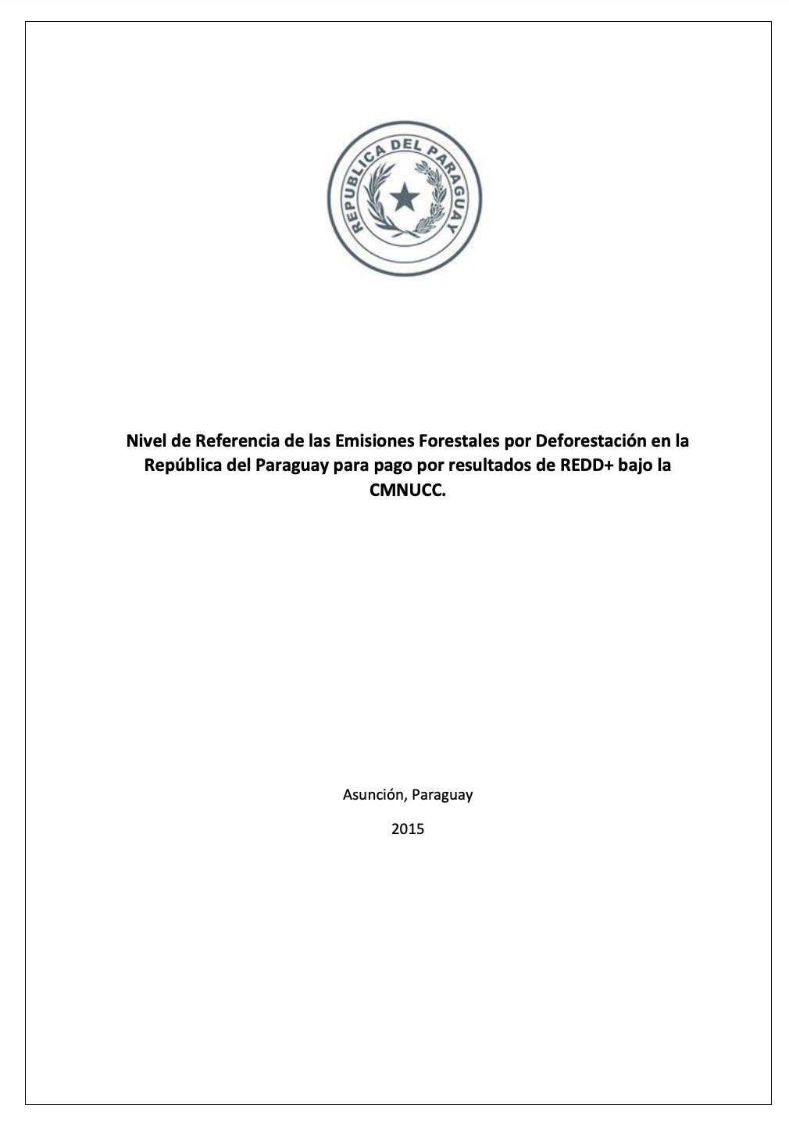
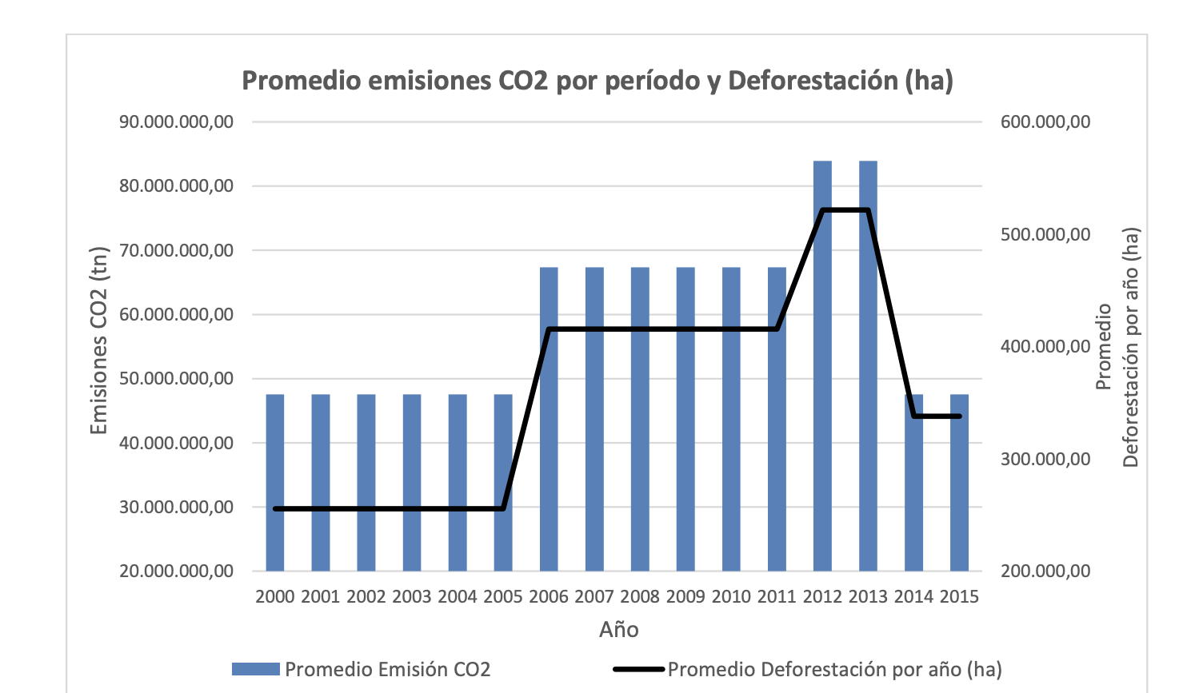
National Inventory User Engagement
Existing examples of data and products use in MRV
National Forest Monitoring System Annual Forest Monitoring – Forest Loss
PARAGUAY
Inputs
Processes
results
PRE-PROCESSING
CLASSIFICATION
imagery
Satellite
LANDSAT
CLOUD FREE MOSAICS
POST- CLASSIFICATION
Accuracy assessment
First and second? reference level
of forest emissions
Validation using cover map and GLAD Alerts
Products
Database
Final map
National Reports

Slide 49
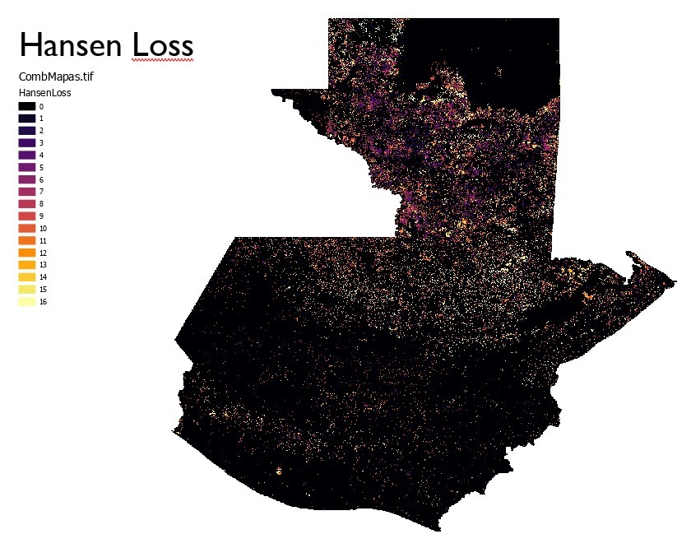
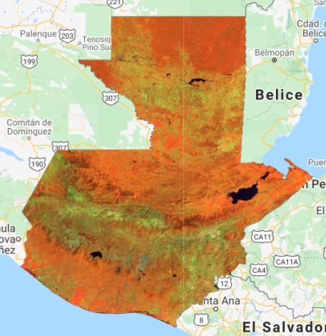
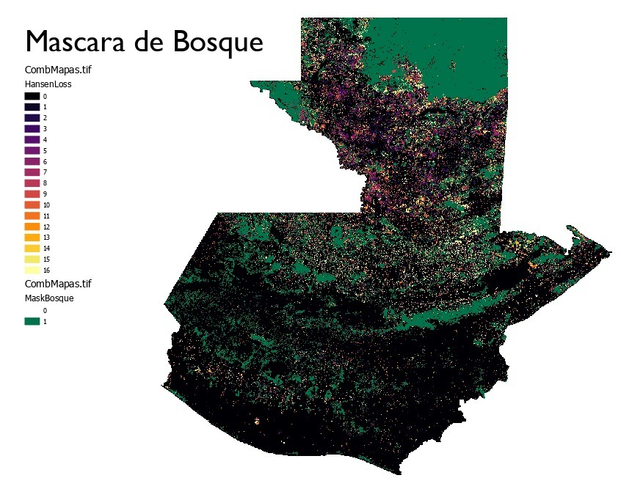
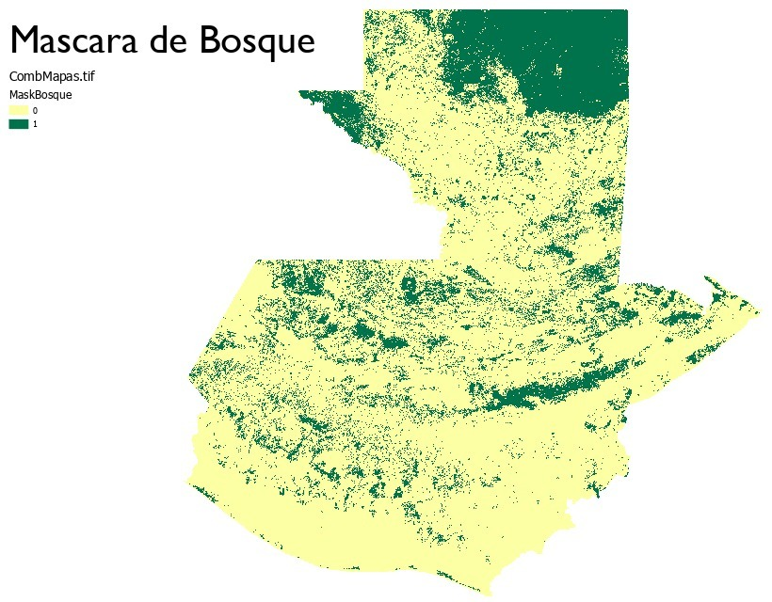
National Inventory User Engagement
Existing examples of data and products use in MRV
Inputs
Processes
results
National Forest Monitoring System Annual Forest Monitoring – Forest Loss GLAD
GUATEMALA
Image mosaic Landsat (GEE)
Supervised classification with landsat, sentinel and radar images (GEE)
imagery
Satellite
LANDSAT
RADAR
FREE MOSAIC
OF CLOUDS
Multitemporal Metrics
Pixel data bank
Forest cover map
2018 and Map of
changes 2016-2018
In process
They use global GLAD data for reference and interpretation support
Information download and manual editing
First reference level
of forest emissions
Database
Final map (in process)
UMD created metrics to differentiate palm from Forest, use as an input to the global map and to improve the Forest Mask in Guatemala

Slide 50
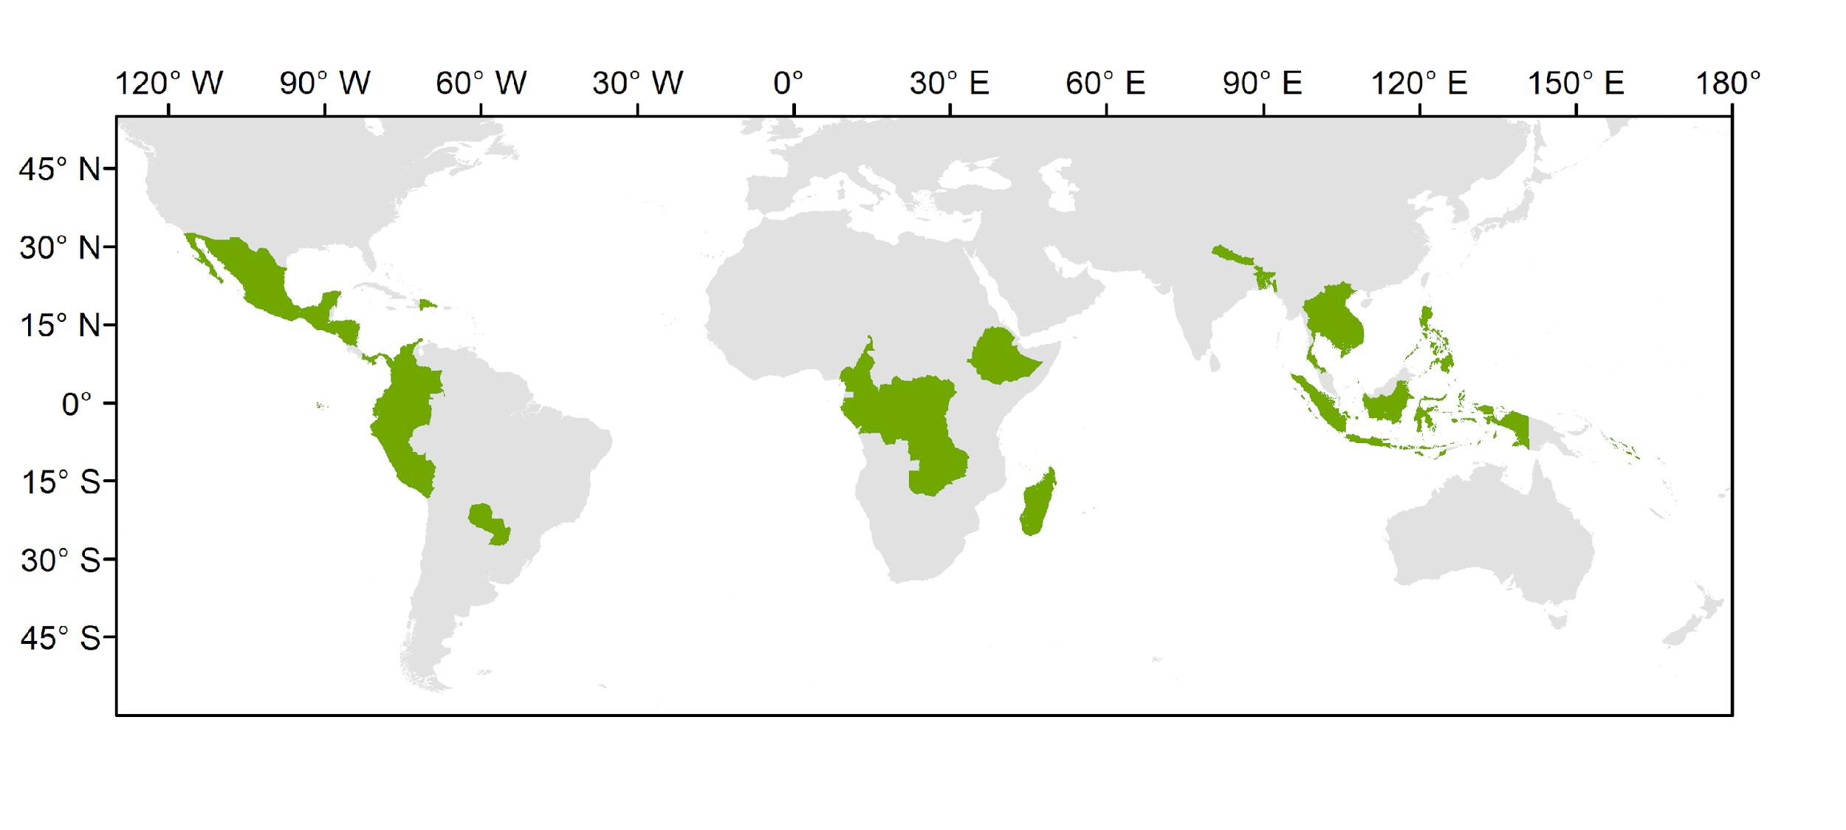
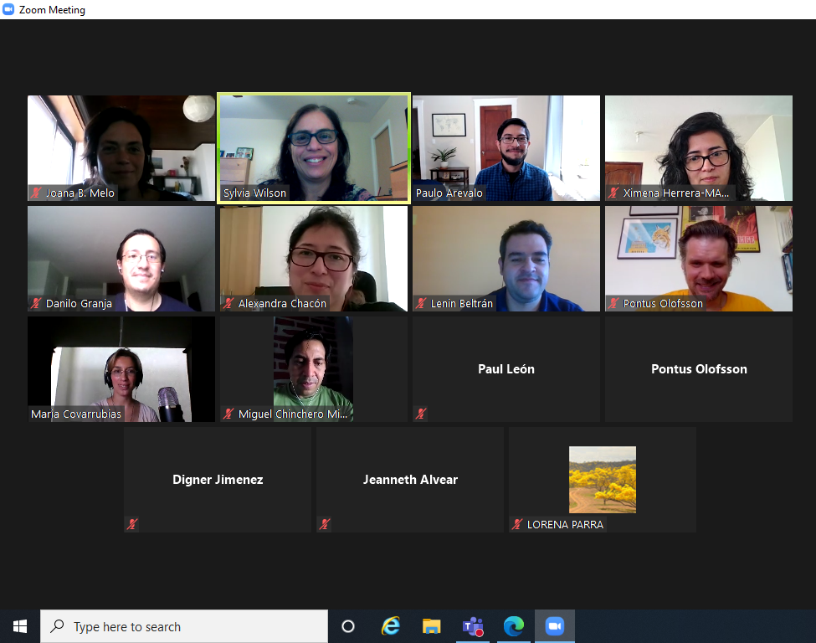
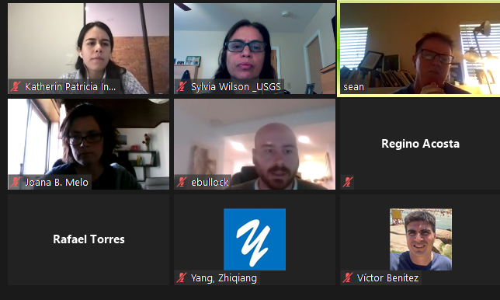
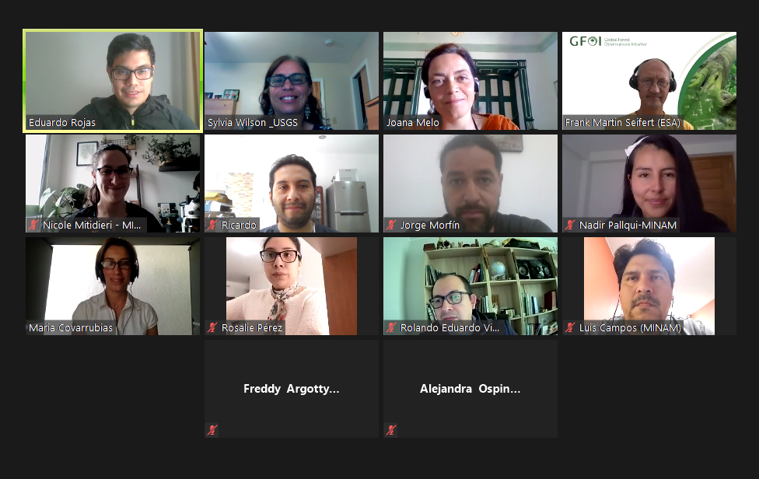
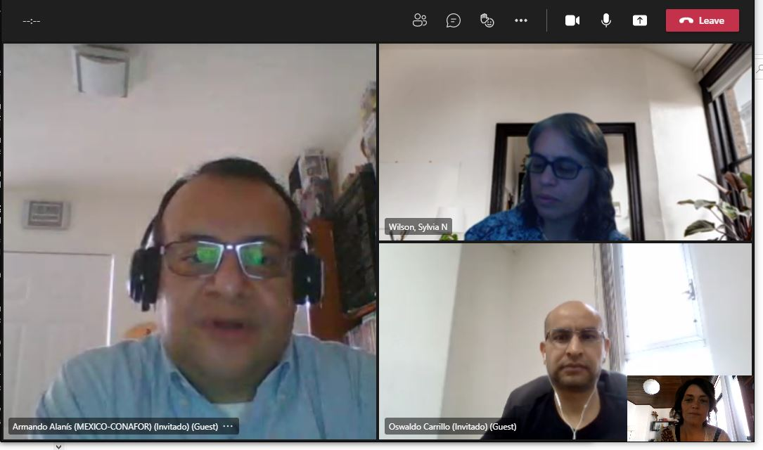
National Inventory User Engagement
Preliminary engagement to introduce the CEOS AFOLU initiatives and products
Colombia Costa Rica Dominican Republic Ecuador El Salvador Guatemala Honduras Mexico Nicaragua Panama Paraguay Peru
Congo DRC Cameroon Ethiopia Gabon Madagascar Zambia
Bangladesh Cambodia Indonesia Lao PDR Nepal Philippines Solomon Islands Thailand Viet Nam
Notes:
What we did and what we planned to do starting with a few selected countries
Ahead of each call, we prepared a summary of the country REDD+ MRV capacity and identify the areas of future technical improvement highlighted in submissions to the UNFCCC. Summary sheet is used as a starting point to discuss the potential of available products to address some of these priority areas - the objective is to collaboratively explore a demonstration activity that is nationally appropriate of product/data uptake in national reporting to the UNFCCC
Invite countries to provide feedback on global products to their specific national circumstances and share their NFI data to test/validate the available biomass maps - the biomass harmonization group is still finalizing a mechanism to the sharing and handling of the data and a clear statement of how national teams are acknowledged

Slide 51
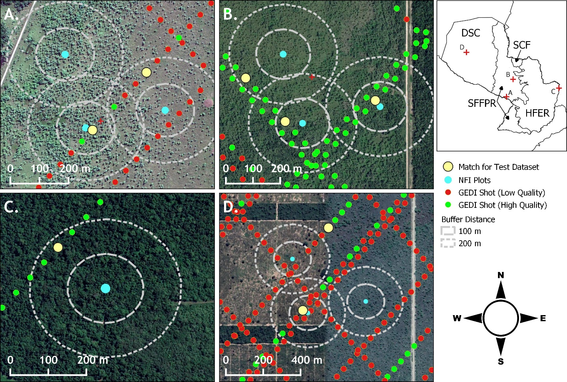
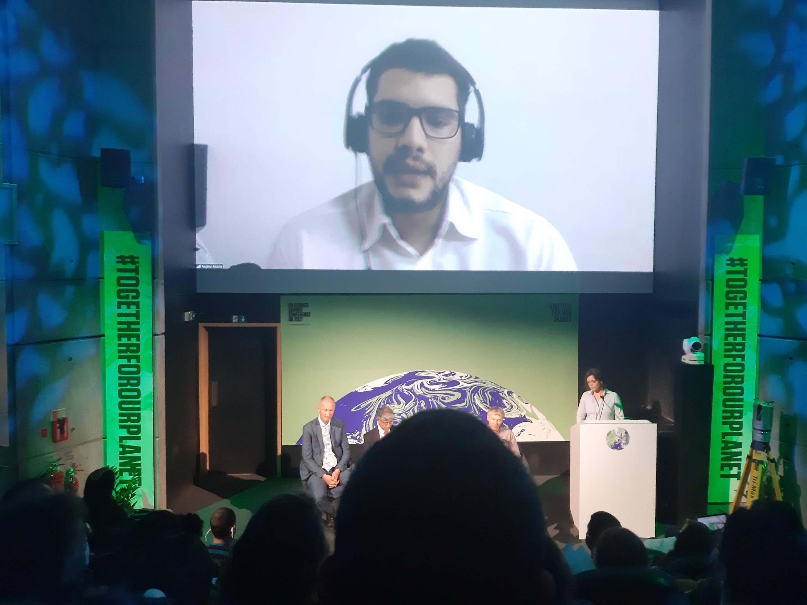
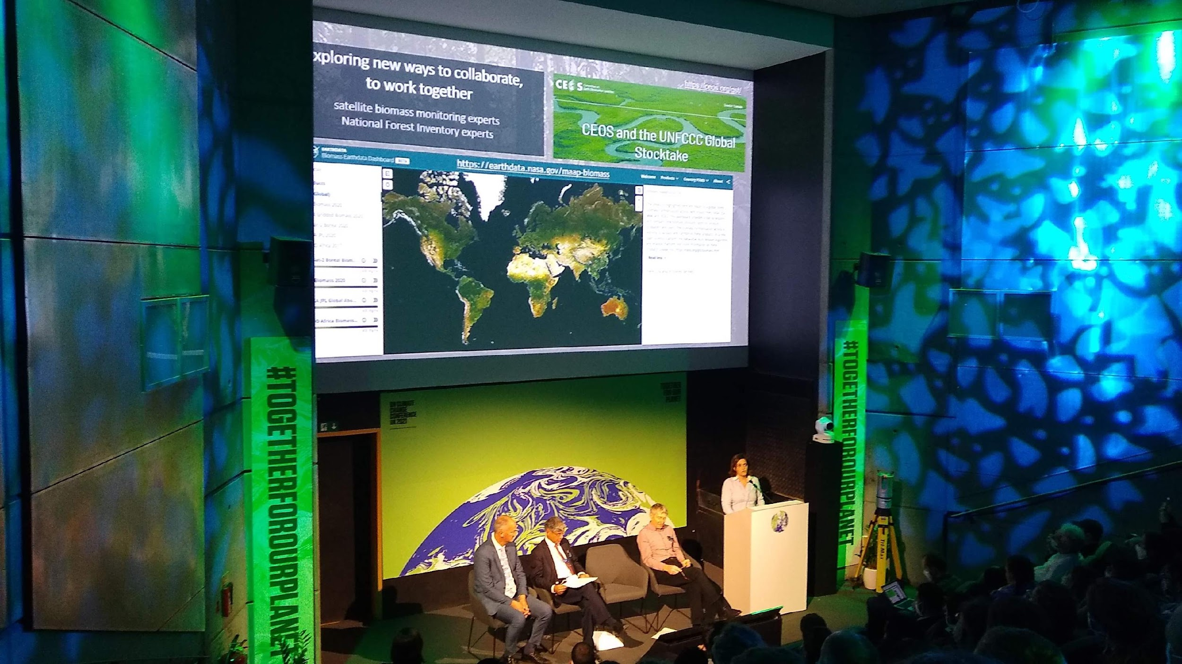
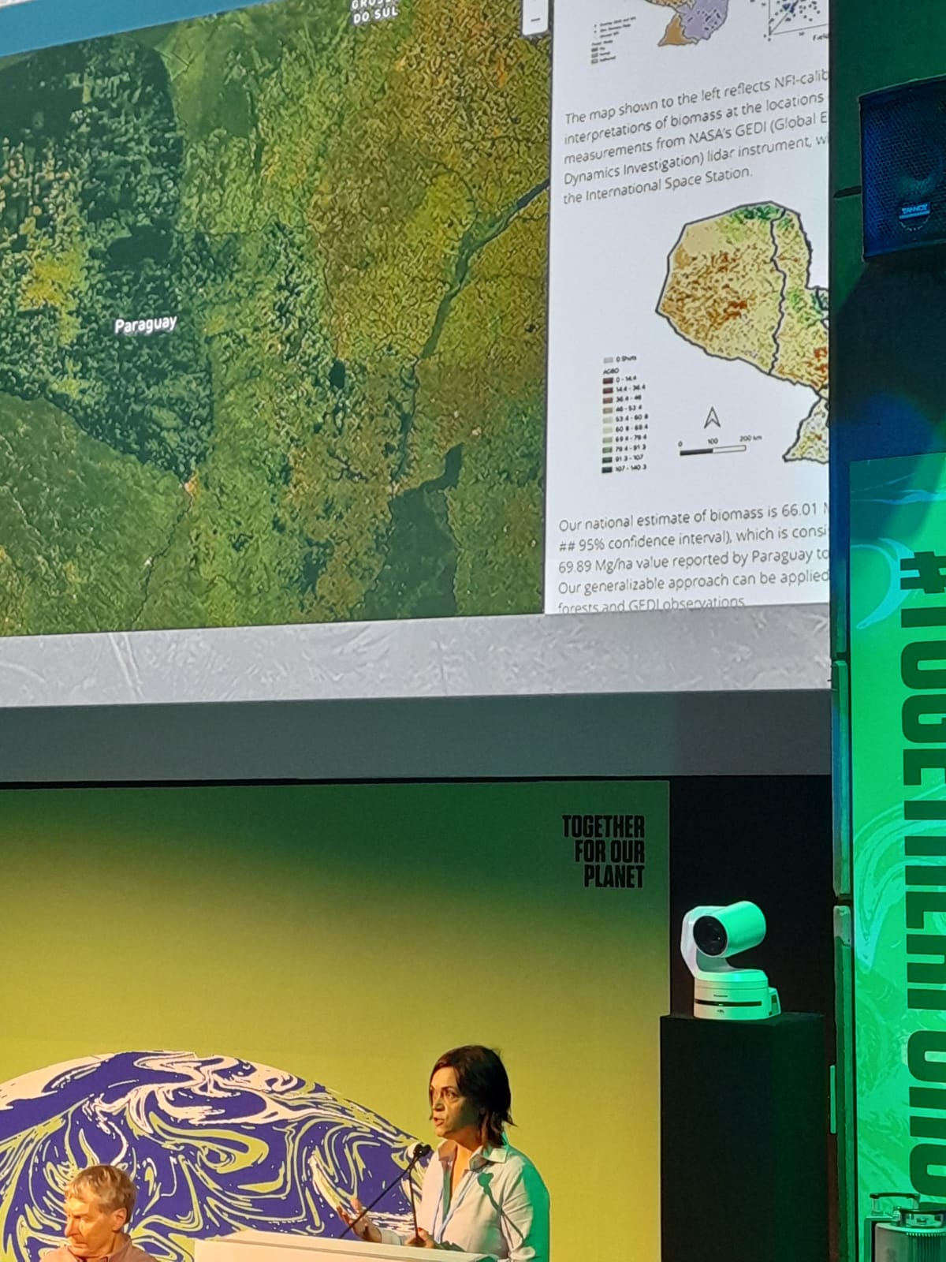
National Inventory User Engagement
Collaboratively develop demonstrations of Earth Observations uptake
National technical teams + global monitoring experts (CEOS) + LULUCF experts in IPCC guidance
Practical implementation of the 2019 Refinement to the 2006 IPCC Guidelines
Using GEDI and Landsat to Evaluate and Improve Paraguay’s National Forest Inventory for Estimating Forest Carbon Stocks
COP26 Forests and Carbon from Space Event, 6 Nov, Green Zone

Slide 52
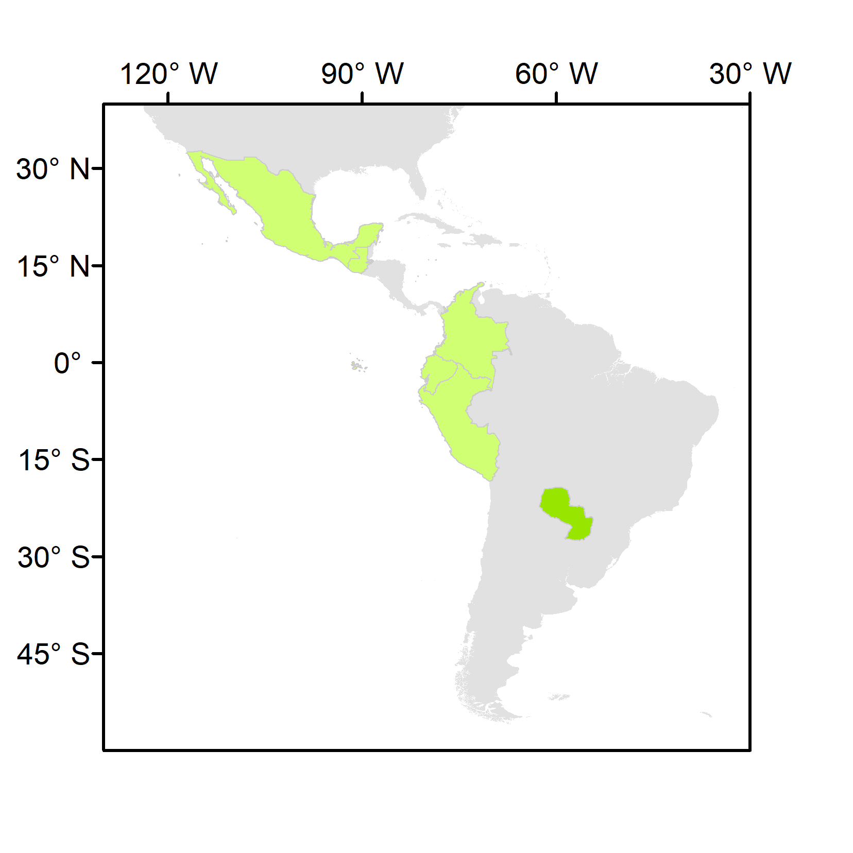
National Inventory User Engagement
1st SilvaCarbon/CEOS Regional Workshop – Biomass measurements
Paraguay, June 2022
 | Country | REDD+ FRL latest submission | REDD+ FRL previous submissions | BUR REDD+ Annex | BUR | NIR | NFI
Latin America and the Caribbean | Colombia | 2020 | 2015 | 2016, 2019 | 2015, 2018, 2022 | 2019 | Yes
 | Ecuador | 2020 | 2015 | 2016 | 2016 | 2017 | Yes
 | Guatemala | 2022 | n.a. | n.a. | n.a. | n.a. | partial
 | Mexico | 2020 | 2015 | n.a. | 2015, 2019 | 2019 | Yes
 | Paraguay | 2022 | 2016 | 2019 | 2015, 2018, 2021 | n.a. | Yes
 | Peru | 2021 | 2016 | n.a. | 2014, 2019 | 2019 | Yes
National teams to present their NFIs, and the data and methods currently used in reporting and domestic MRV
JAXA, ESA, NASA to present:
the available datasets and methodologies to measure land use GHG fluxes
demonstrations of opportunities for their uptake
a clear plan for sharing of NFI data and collaborating in the calibration/validation of products
LULUCF experts in IPCC guidance (nominated in the UNFCCC roster by their Governments or contributors to the 2019 refinement of the IPCC guidelines)
Colombia Ecuador Guatemala Mexico Paraguay Peru
Call for support to CEOS agencies to contribute their expertise to the workshop

Slide 53
In conclusion and moving Ahead….
Request of NFI or ground-based data for calibration and validation of pantropical and global biomass datasets (ABG) – 27 countries – regional workshops
Include more case studies of Biomass in NASA Biomass Dashboard
Validation of other CEOS datasets (World Cover, Hilda+ and Copernicus)
Engagement with other partners (GFOI and FAO)
Thanks!
Sylvia Wilson Joana Melo
snwilson@usgs.gov joana.lx.bm@gmail.com
Notes:
We are not stopping this initiative now. We have raised interest from many countries now and as a next steps we are requesting inventory data from 27 countries to improve biomass global and pantropical maps. We will also include case studies in the NASA Biomass Dashboard. We will move forward with understanding the uptake of other CEOS datasets in all SilvaCarbon countries. Last, we will join forces with other partners to have a greater impact. Thank you!

Slide 54
CEOS Strategy for the Global Stocktake
10 Mins
Stephen Briggs
ESA SIT Chair Team
Agenda item 2.6
CEOS SIT-37
Virtual Meeting
29-31 March 2022

Slide 55
GST Status
GST Strategy Document V3.1 approved at CEOS Plenary Nov 2021
Document contains 9 Recommendations for specific actions on CEOS Agencies and CEOS bodies to support the GST
Actions derived from the recommendations are included in the overall CEOS Work Plan and are complementary to those already carried out by CEOS bodies in support of the GST. The recommendations are additions/augmentations to ongoing work.
In other areas there had been less explicitly identified action undertaken to date, although ongoing work can contribute significantly in areas such as adaptation.
Many different elements of CEOS (WGs, VCs and others) contribute under SIT Chair leadership

Slide 56
GST Actions - update
GST Recommendations 1,2: Update WG Climate GHG Task Force Report Annex C: Contributions to updates (already have, or will) include those from:
WGClimate Workshop on Gap Analysis 18-20 May 2022
AFOLU/GHG Workshop Nov 2021, JRC/virtual
Ocean Carbon Workshop Feb 14-18 2022 (virtual) (see later Aquatic Carbon Item 5.2))
Carbon from Space IV October 2022, Exeter
WMO workshop 10-12 May 2022 (tbc, Geneva) on Carbon Monitoring
GCOS Science Conference October 2022
Increased involvement from Copernicus CO₂ programme in WGC GHG Task Force

Slide 57
GST Actions - update
Recommendation 3: Inform the report of CEOS to UNFCCC/RSO discussion on observations to support the implementation of the Paris Agreement and should pro-actively flow into (b) the consultancy process of the UNFCCC / Ad hoc group for the Synthesis Report on Observations for the GST. CEOS should also report on this at the Earth Information Day at COP26. Actions undertaken include:
Multiple contributions by CEOS agencies to Earth Information Day at COP26, Glasgow
Representation from WG Climate, GHG Task Force and AFOLU Task Team at RSO discussion at COP
Major contributions from all these to the Synthesis Report on Systematic Observations for UNFCCC currently in preparation and to be discussed at SBSTA in Bonn, June 2022

Slide 58
GST Actions - update
Recommendation 4: CEOS should consider, in conjunction with modellers, setting up one or more focussed observational campaigns as a major contribution to the understanding of trends in natural GHG emissions and removals in key areas.
NASA/ESA conducted AMPAC Campaign aimed at understanding methane emissions from tundra under warming conditions. Included airborne, satellite (TROPOMI) and model data. Training school to be held in Fall 2022.
Further work being proposed in this area, with new AOs emerging
Discussions on possible campaigns with both public sector and private sector in oil and gas extraction locations eg Permian Basin.
Further possibilities for such campaigns in eg Amazon Basin exist and can be considered with science community through e.g. Carbon from Space Workshop, WMO Carbon Workshop

Slide 59
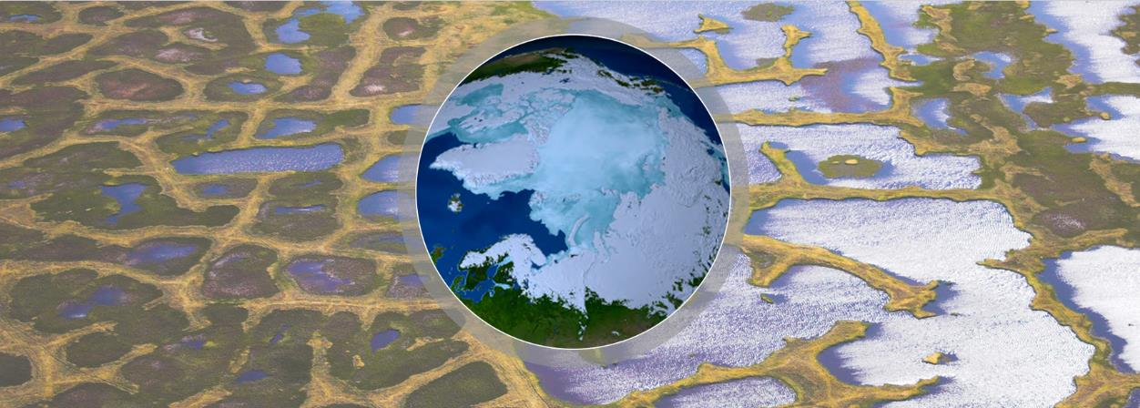
Arctic Methane and Permafrost Challenge (AMPAC)
Fall 2021/Winter 2022 Updates
Arctic methane was characterized during the MAGIC2021 (Kiruna SWE) airborne campaign in Northern Scandinavia August 2021
AMPAC was featured at the ESA Cryosphere Pavilion and at the US Pavilion during the COP26 meeting in Glasgow, Scotland, Nov 2021
An Arctic Methane and Permafrost Research and Fieldwork training school will be held at the Abisko, SWE field station in Fall 2022 (delayed from Spring 2022)
ESA are evaluating proposals to support AMPAC objectives
AMPAC WG Synthesis Activities
The joint CoMet 2.0 Arctic/ABoVE airborne campaign is planned for Alaska and NW Canada July – Sep 2022
An AMPAC special session “A9.03 The NASA-ESA Arctic Methane and Permafrost Challenge (AMPAC) Initiative” will be held at the ESA Living Planet Symposium, May 2022
Synthesis and review publications:
Permafrost Carbon Emissions in a Changing Arctic, KR Miner, et al. (2022), Nature Reviews in Earth and Environment, https://doi.org/10.1038/s43017-021-00230-3
Emergent Biogeochemical Risks from Arctic Permafrost Degradation, KR Miner et al. (2021), Nature Climate Change, https://doi.org/10.1038/s41558-021-01162-y
Additional Information on the Arctic Methane and Permafrost Challenge (AMPAC) NASA-ESA collaborative community initiative may be found at:
https://cce.nasa.gov/methane_challenge.html
https://eo4society.esa.int/communities/scientists/arctic-methane-and-permafrost/
Notes:
These three sessions were organized under the following topics:
Session 1 / Tuesday 27.10 (17 - 18:30 CET) - Enhanced retrievals, observations and data sets: Enhances satellite retrievals over land and atmosphere, enhanced collection of data and in situ observations, validation, inter comparisons, building a pan-Arctic constant data set
Session 2 / Wednesday 28.10 (17 - 18:30 CET) - Reconciling observation strategies and modelling approaches: Advance in the effective integration and reconciliation of data and modelling approaches, reconciling bottom up and top down approaches, promoting synthesis analysis of models and data driven results and integrated process studies at different scales, from local scale to pan-Arctic scale studies
Session 3 / Thursday 29.10 (17 - 18:30 CET) - Future observations and next generation of missions: Preparing for future missions, future observations, future campaigns, exploiting advanced technologies..

Slide 60
GST Actions - update
Recommendation 5: The AFOLU Roadmap Team and WGClimate GHG Task Team should work together to ensure consistency between data for emissions reported via AFOLU and for prior biogenic terrestrial emissions, and those due to changing land use, in implementing monitoring and verification systems.
Joint AFOLU – GHG Workshop held at JRC/virtual in Nov 2021
Outcomes inform WG Climate discussion on GHG TF Annex C requirements
Continued close cooperation between AFOU and GHG groups including on development of Systematic Observations paper for UNFCCC

Slide 61
GST Actions - update
Recommendation 6: It is recommended that to help in ensuring the take-up of satellite-based methods for AFOLU (and indeed in the context of MVS) CEOS should work with a few selected demonstrator countries to assist them in their national reporting under AFOLU (the model of GFOI can be compared).
Silvacarbon has led action in this area, fully reported here by Sylvia
Recommendation 7: CEOS should work with various partners (GEO, WMO etc) to identify data requirements and actions for CEOS in relation to adaptation.
Ongoing work in eg WG Disasters, LSI-VC, SDG Coordination group, ARD Oversight group etc.
WG Climate Use Cases for climate services provide examples of adaptation
Wider collaboration on adaptation with GEO through its Working Group on Climate Change - Sub-group on Adaptation.

Slide 62
GST Actions - update
Recommendation 8: CEOS should maintain a watch over the implementation of projects funded through climate fund mechanisms to ensure that all appropriate assistance is given by agencies in their implementation and governance.
Joint work on climate finance with GEO proposed at GEO-CEOS annual briefing, January 2022
Recommendation 9: CEOS must continue all efforts to provide the necessary baseline
climate data records which support the long term modelling of the Earth system, its response to changing GHG emissions and other drivers, and impacts of climate change.
Supported through WGClimate gap analysis
Cooperation with GCOS on GCOS IP 2022 satellite elements
Further discussion with GCOS and WMO through WMO ESS Carbon Workshop (May 2022) and GCOS Science Conference (Oct 2022)
Continues ongoing support of CEOS over many years to climate science

Slide 63
GST Process & Systematic Observations Synthesis Report
15 Mins
Jo Post, UNFCCC SEC
Frank Martin Seifert, ESA
Agenda item 2.7
CEOS SIT-37
Virtual Meeting
29-31 March 2022

Slide 64
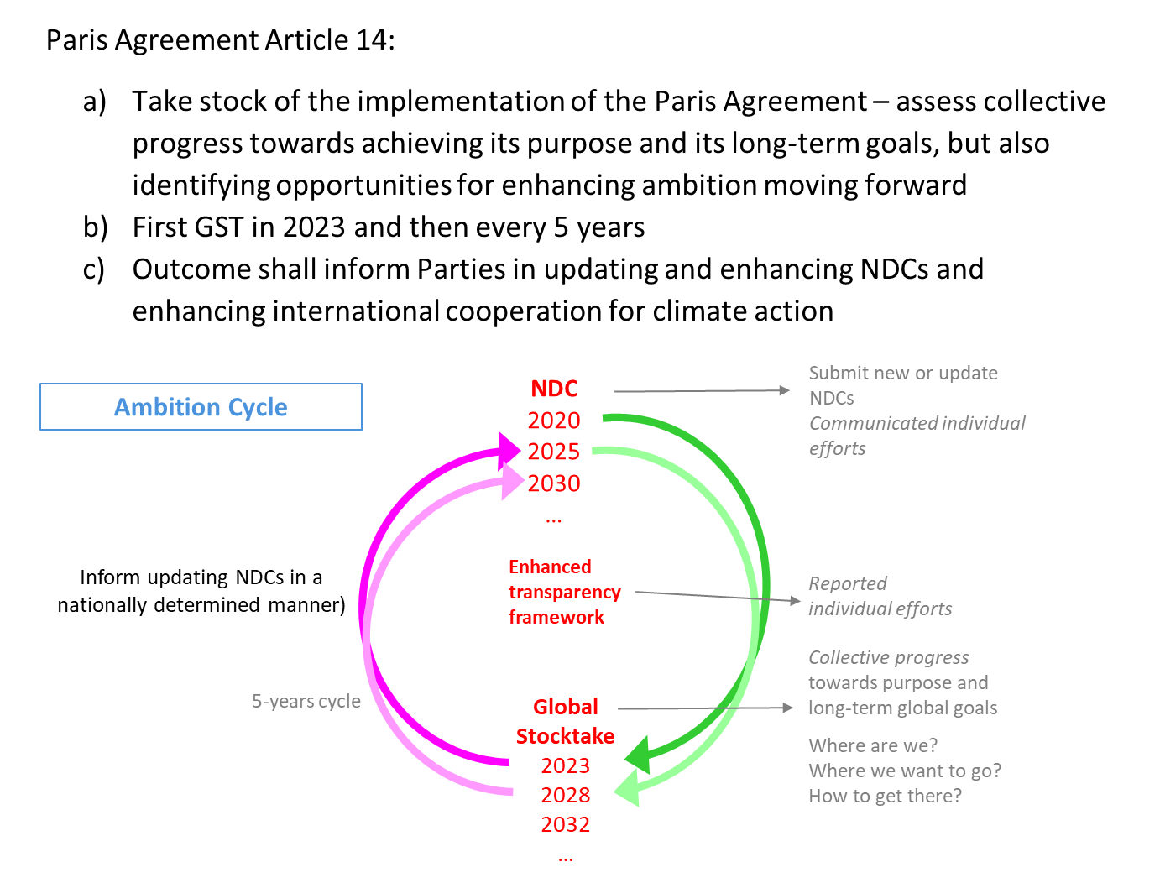
Global Stocktake - the What

Slide 65
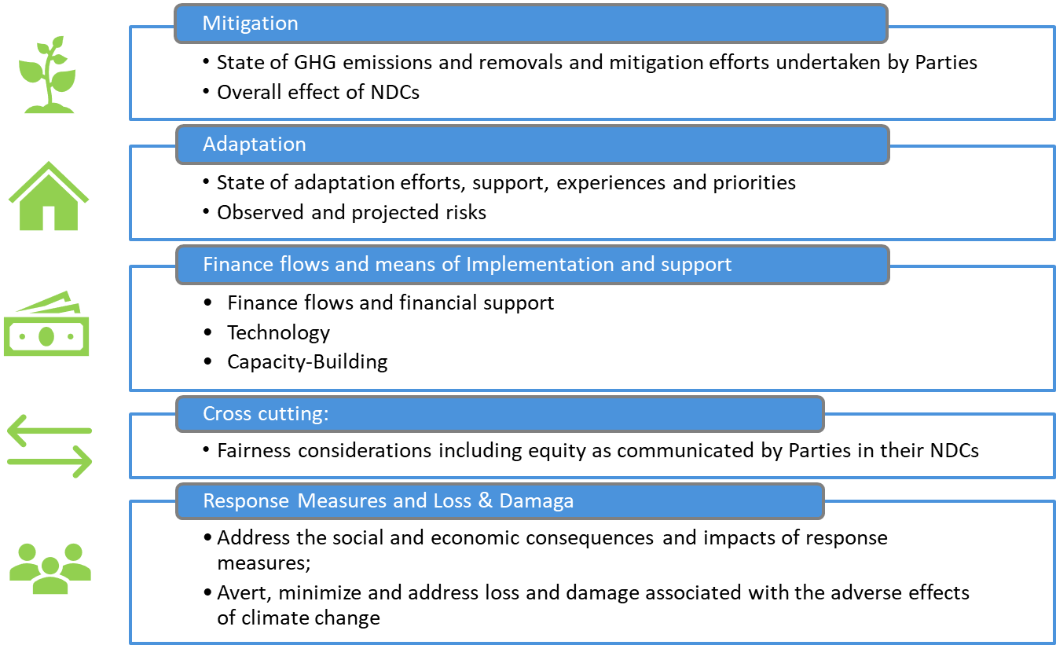
Global Stocktake - the Themes

Slide 66
Global Stocktake - the How

Slide 67
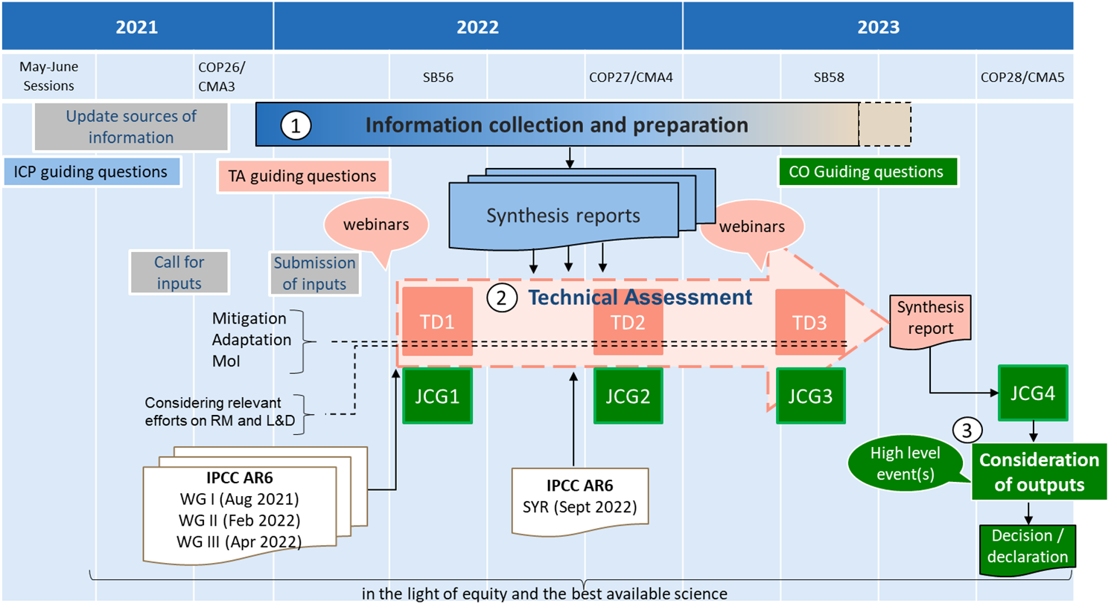
Global Stocktake - the When

Slide 68
Global Stocktake - the Governance
The CMA has the overall responsibility to conduct the GST.
The Chairs of the SBSTA and SBI are mandated to organize the global stocktake in a flexible and appropriate manner
The Technical Dialogue will be facilitated by two co-facilitators
A High-Level Committee consisting of the CMA Presidencies and the Chairs of the SBSTA and SBI will chair the high-level events of the last component

Slide 69
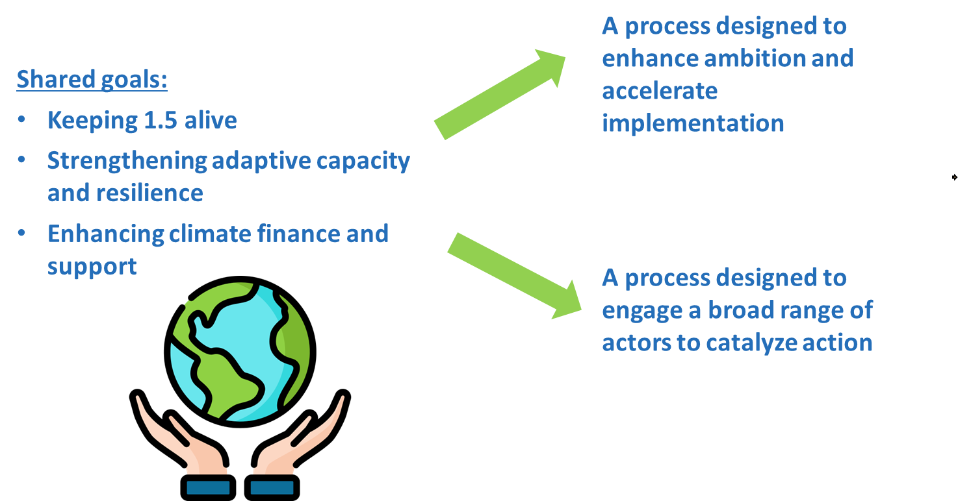
Why does it matter?

Slide 70
Why does it matter for SO community?
There is no FCCC without observation
The report provides an aggregate information on state of the climate and its observation
Shows the VALUE of EO for both mitigation and adaptation as the start of the value chain for decision making
Lays the groundwork for ADVOCATING a greater role of EO in the FCCC process for information for and on mitigation and adaptation & on GHG MRV
Provides OPPORTUNITIES for future directions and communicates these to Parties

Slide 71
Overview of submissions to GST
Title: Call for inputs from Parties and observer States, UN Agencies and other international organizations and non-Party Stakeholders and observer Organizations, to the first global stocktake:
77 Submissions: 8 from Parties, 4 from UN Agencies, 6 from IGOs, 59 from NGOs
https://www4.unfccc.int/sites/submissionsstaging/

Slide 72
Systematic Observations Synthesis Report for the first Global Stocktake
Frank Martin Seifert (ESA), David Crisp (JPL/NASA-retired)
and the SO Writing Team on behalf of the SO Community
CEOS SIT– 37
28 March 2022
ESA UNCLASSIFIED – For Official Use
European Space Agency

Slide 73
Systematic Observations
Paris Agreement
Systematic Observations Community
Transparency Framework
Global Stocktake
Means of Implementation: Finance, Technology, Capacity Building
Cross-cutting: Response measures, Loss & Damage, Equity
Mitigation
Adaptation
Notes:
Systematic Observation Community, represented by national and international research centers, universities, meteorological organizations, space agencies and intergovernmental and United Nations organizations

Slide 74
Systematic Observations Community Synthesis Report for GST
How can the Systematic Observation Community support the Global Stocktake on global and national level?
SOC established a writing team (~12 participants) in May 2021
SB Chairs issued a "non-paper" on 27 May 2021, revised on 15 Sept 2021 with dedicated guiding questions for synthesis reports.
Presentation at UNFCCC’s Earth Information Day at COP 26 on 3 Nov 2021
The submitted Synthesis Report of the Systematic Observation Community (SOC) is part of UNFCCC’s information collection and preparation phase for GST, and feed into the first Technical Assessment
🡺 https://www4.unfccc.int/sites/SubmissionsStaging/Documents/ 202203012343---SO-in-GST-2022-final.pdf
Notes:
UNFCCC initiated dialogue in August 2020

Slide 75
Structure & Contributors
Executive Summary
Introduction
The Global Climate Observing System (GCOS)
Mitigation – Systematic Observations Supporting Atmospheric greenhouse gas emission monitoring and improved Inventories for AFOLU
Adaptation – Systematic Observations to Improve Resilience to the Adverse Impacts of climate change
Means of Implementation - Systematic Observations supporting Finance, Technology Transfer & Capacity Building
Cross-cutting Issues - Systematic Observations to Support Reporting and Best Practices Across Thematic Areas, including Loss and Damage
Main Contributors
David Crisp (NASA/JPL-retired)
Maxx Dilley (WMO)
Sara Venturini (GEO)
Anthony Rea (WMO/GCOS)
Frank Martin Seifert (ESA)
Carlo Buontempo (ECMWF)
Mark Dowell (EC/JRC)
Osamu Ochiai (JAXA)
María José Sanz Sánchez (BC3)
Jürg Luterbacher (WMO)
Ian Jarvis (GEOGLAM)

Slide 76
Main Messages of the Report
Systematic Observations underpin climate science and services
A basic set of Essential Climate Variables has been defined by GCOS
Use of top-down atmospheric GHG and bottom-up space-based AFOLU data reduces gaps and enable a more complete and transparent GST
Systematic Observations are vital for adaptation
underpinning the identification, planning, implementation and monitoring of adaptation measures, and are
a first step in the value chain towards successful decision making.
Systematic Observations strengthen the evidence base for the climate rationale, which enables funding from the public and private sector.

Slide 77
Key Roles of Systematic Observation Community
The Systematic Observation Community can contribute by:
Identifying best products and producing harmonized EO datasets to facilitate their adoption by users on national and global levels
Ensuring free and open data, access to cloud computing and knowledge exchange lower the barrier to access information and reduces the capacity gap for developing countries and support the Enhanced Transparency Framework and GST
Tracking Slow-onset events, enhancing understanding and enabling adaptation
Monitoring extreme events and improving climate projections and risk assessments over time and address Losses and Damages.
Creating Use Cases show concrete interaction with Parties, which is key to facilitate further uptake of systematic observations.
⇒ Systematic Observation community is engaged to support the GST.

Slide 78
What's Next?
Encourage and support interactions between Parties and the Systematic Observations community
Promote the Systematic Observations report and stimulate discussion
Interact with SBSTA to emphasize key points of the report and identify follow-on activities
Side Event request submitted for UNFCCC SB 56 in Bonn in June
Identify gaps and inconsistencies in systematic observations and their application to the GST
Revise and update Systematic Observation report for 2nd or 3rd Technical Assessment period.

Slide 79
Summary, Outlook, & Coordination
SIT Chair Team
Agenda item 2.7
CEOS SIT-37
Virtual Meeting
29-31 March 2022

Slide 80
Any summary points..
WGClimate continues its excellent long-term systematic work around partnership with GCOS/UNFCCC through GCOS IPs etc.
GHG-AFOLU Workshop covered many topics of interactions not addressed elsewhere
AFOLU work is newer but has made good progress
Excellent progress has been made in many areas of climate/carbon, with good coordination between diverse groups working on support to UNFCCC in particular
Partnerships among CEOS agencies and with eg UNFCCC, GEO, GCOS, WMO, and other players (IMEO, science community, private sector) etc are key to success
Engagement with individual countries critical to demonstrate practical value of EO in AFOLU process for LDCs
Importance of SO process in UNFCCC

