Slide 1
SIT-37
Welcome and Opening Session
Session 1
CEOS SIT-37
Virtual Meeting
29-31 March 2022

Slide 2
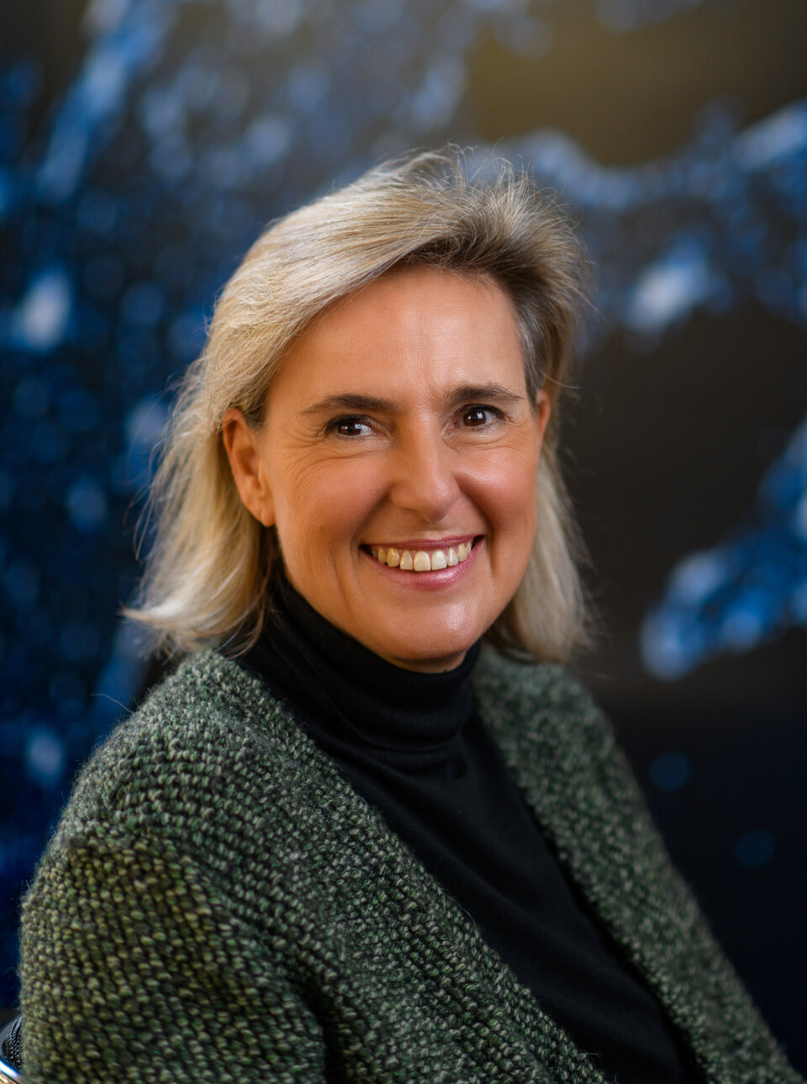
Welcoming Remarks
Simonetta Cheli
CEOS SIT Chair 2022-2023
ESA Director of Earth Observation Programmes
Head of ESA/ESRIN
Agenda Item 1.1
CEOS SIT-37
Virtual Meeting
29-31 March 2022

Slide 3
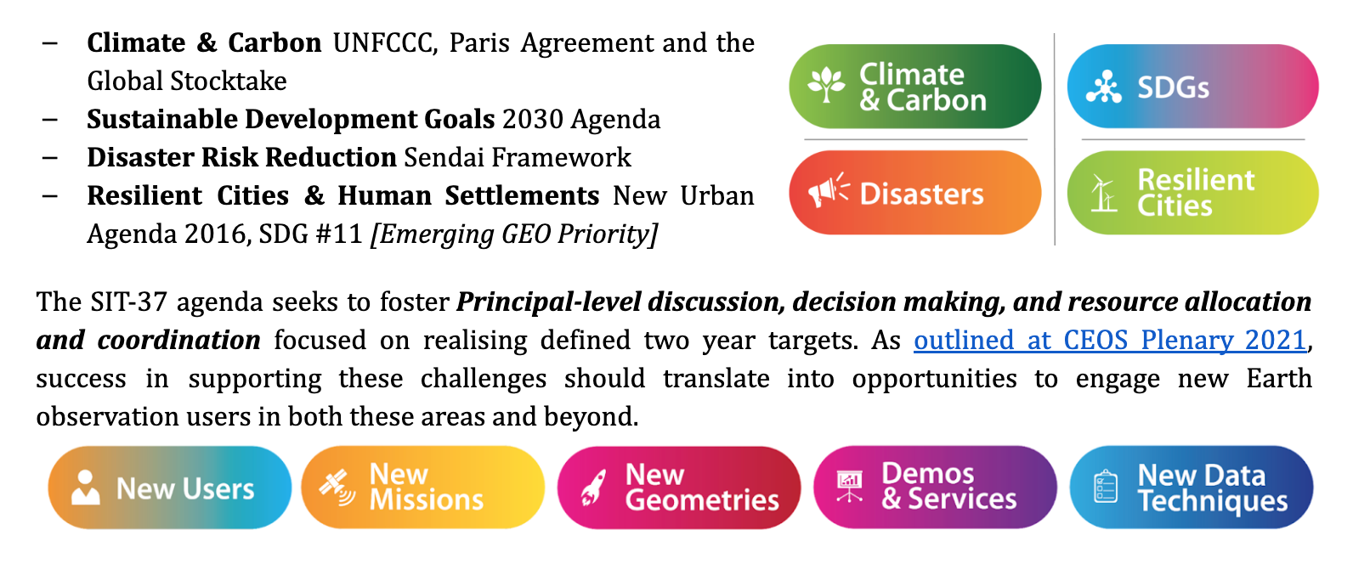
SIT-37 Topics and Objective

Slide 4
SIT-37 Topics
CEOS Chair: Paths to Sustainability: from strategy to practical measures
Delivery and Key Relationships: CEOS Work Plan, CEOS-GEO relationship, GEO’s emerging Resilient Cities
Carbon and Climate: Global Stocktake Process under the Paris Agreement, AFOLU, greenhouse gases (GHG), CEOS Carbon Strategy, GEO-TREES.
Sustainable Development Goals: Efficiency in the dialogue with Custodian Agencies
Biodiversity: Preliminary results: Role of EO in addressing CBD needs
Disasters: Recovery Observatory, Wildfire Pilot
New Space: CEOS engagement for the next decade, agency case studies, practical next steps.
Working Team Nominated Topics: ARD Oversight, Aquatic Carbon, AC-VC
Oceans and Coasts: CEOS oceans and coasts coordination, UN Decade of Ocean Science

Slide 5
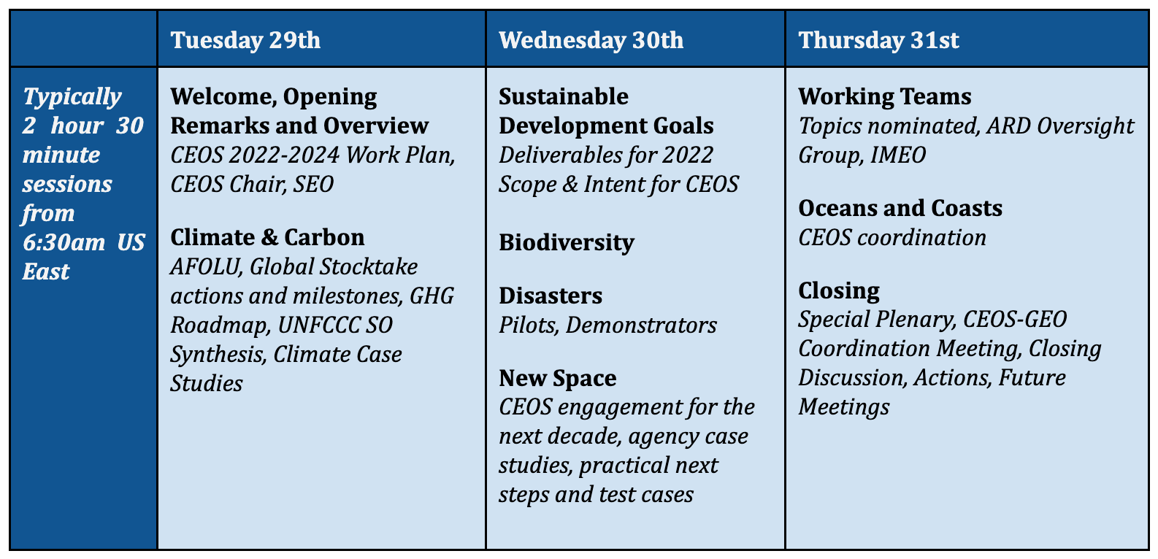
SIT-37 Agenda at a Glance

Slide 6
Session Agenda
1.1 Welcome and Opening Remarks [10 mins]
1.2 2022-2024 CEOS Work Plan - Highlights [5 mins]
1.3 Progress on CEOS Chair Priorities [15 mins]
1.4 SEO Report [10 mins]

Slide 7
Item Summary Slides
We will have a summary discussion session on day 3 (Item 7.3)
Agenda item leads are asked to make additions to this summary slide deck following their agenda items to be covered during the summary discussion
There is a set of template slides for this item in the shared folder
  https://docs.google.com/presentation/d/1AaB7xa37h0kW4uksAR3j93jlp0GfRhx3_Xi-zy8X2Ls/edit

Slide 8
Meeting Protocols
There will be no tour de table
  Participants are asked to review the Google Sheet and make additions/revisions
  https://docs.google.com/spreadsheets/d/17jODk7UulKLN190_r8EzX0TJOFD9Z-anZfqfrJM_PPg/edit?usp=sharing
Please do not activate your webcam unless you are presenting
  If your bandwidth is slow while presenting, please turn off your webcam
Please mute if you are not presenting or making an intervention
If you want to intervene, please, send a message in the chat
Presentation slides will be displayed/advanced by SIT Chair Team by default to save handover time
  If you would like to display your own slides, please request
  If you do present, please share your full screen (not window) due to an apparent GTM bug
  Presentations are available here in a shared folder: here.
    https://drive.google.com/drive/folders/19U3u7vZwDonvi2-wEqvRE1y3ab1dL-Br?usp=sharing

Slide 9
CEOS
2022-2024
Work Plan
Marie-Claire Greening, CEO
Agenda item 1.2
CEOS SIT-37
Virtual Meeting
29-31 March 2022

Slide 10
Progress on CEOS Chair Priorities
Selma Cherchali, CNES CEOS Chair
Agenda item 1.3
CEOS SIT-37
Virtual Meeting
29-31 March 2022

Slide 11
SEO Report
Brian Killough, SEO
Agenda item 1.4
CEOS SIT-37
Virtual Meeting
29-31 March 2022

