Slide 1
Systems Engineering Office (SEO) SIT-37 Report
Brian Killough
NASA, CEOS-SEO
Agenda Item 1.4
CEOS SIT-37
Virtual Meeting
29-31 March 2022

Slide 2
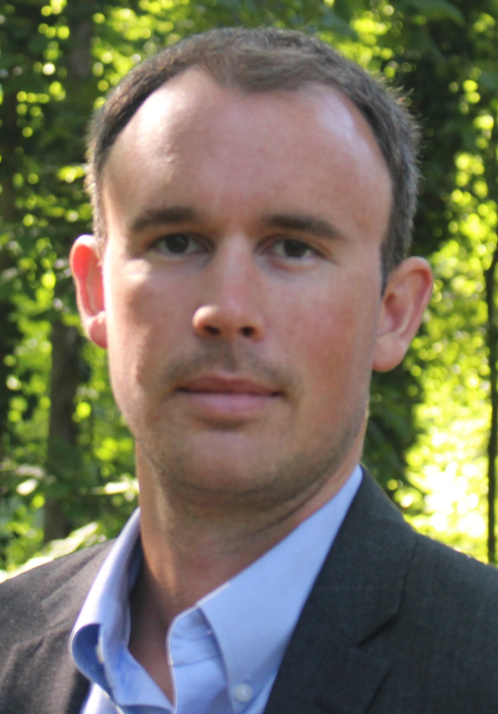
SEO ... 15 Years of Support to CEOS
The CEOS Systems Engineering Office (SEO) was established in April 2007 and has reached its 15-year anniversary!
The SEO is a deliberate contribution by NASA to support the CEOS organization and facilitate global space agency initiatives.
The SEO has a new Deputy Lead ... David Borges!
The SEO work is always changing based on the needs of CEOS. We work on a mix of technical initiatives and management initiatives. A summary of a few of the latest activities and our “strategy” for doing these activities are in the coming charts.
Notes:
SEO desires to identify "value added" tasks within CEOS that align with our mission ... promotion and coordination of data from our Agencies for improved decision-making.

Slide 3
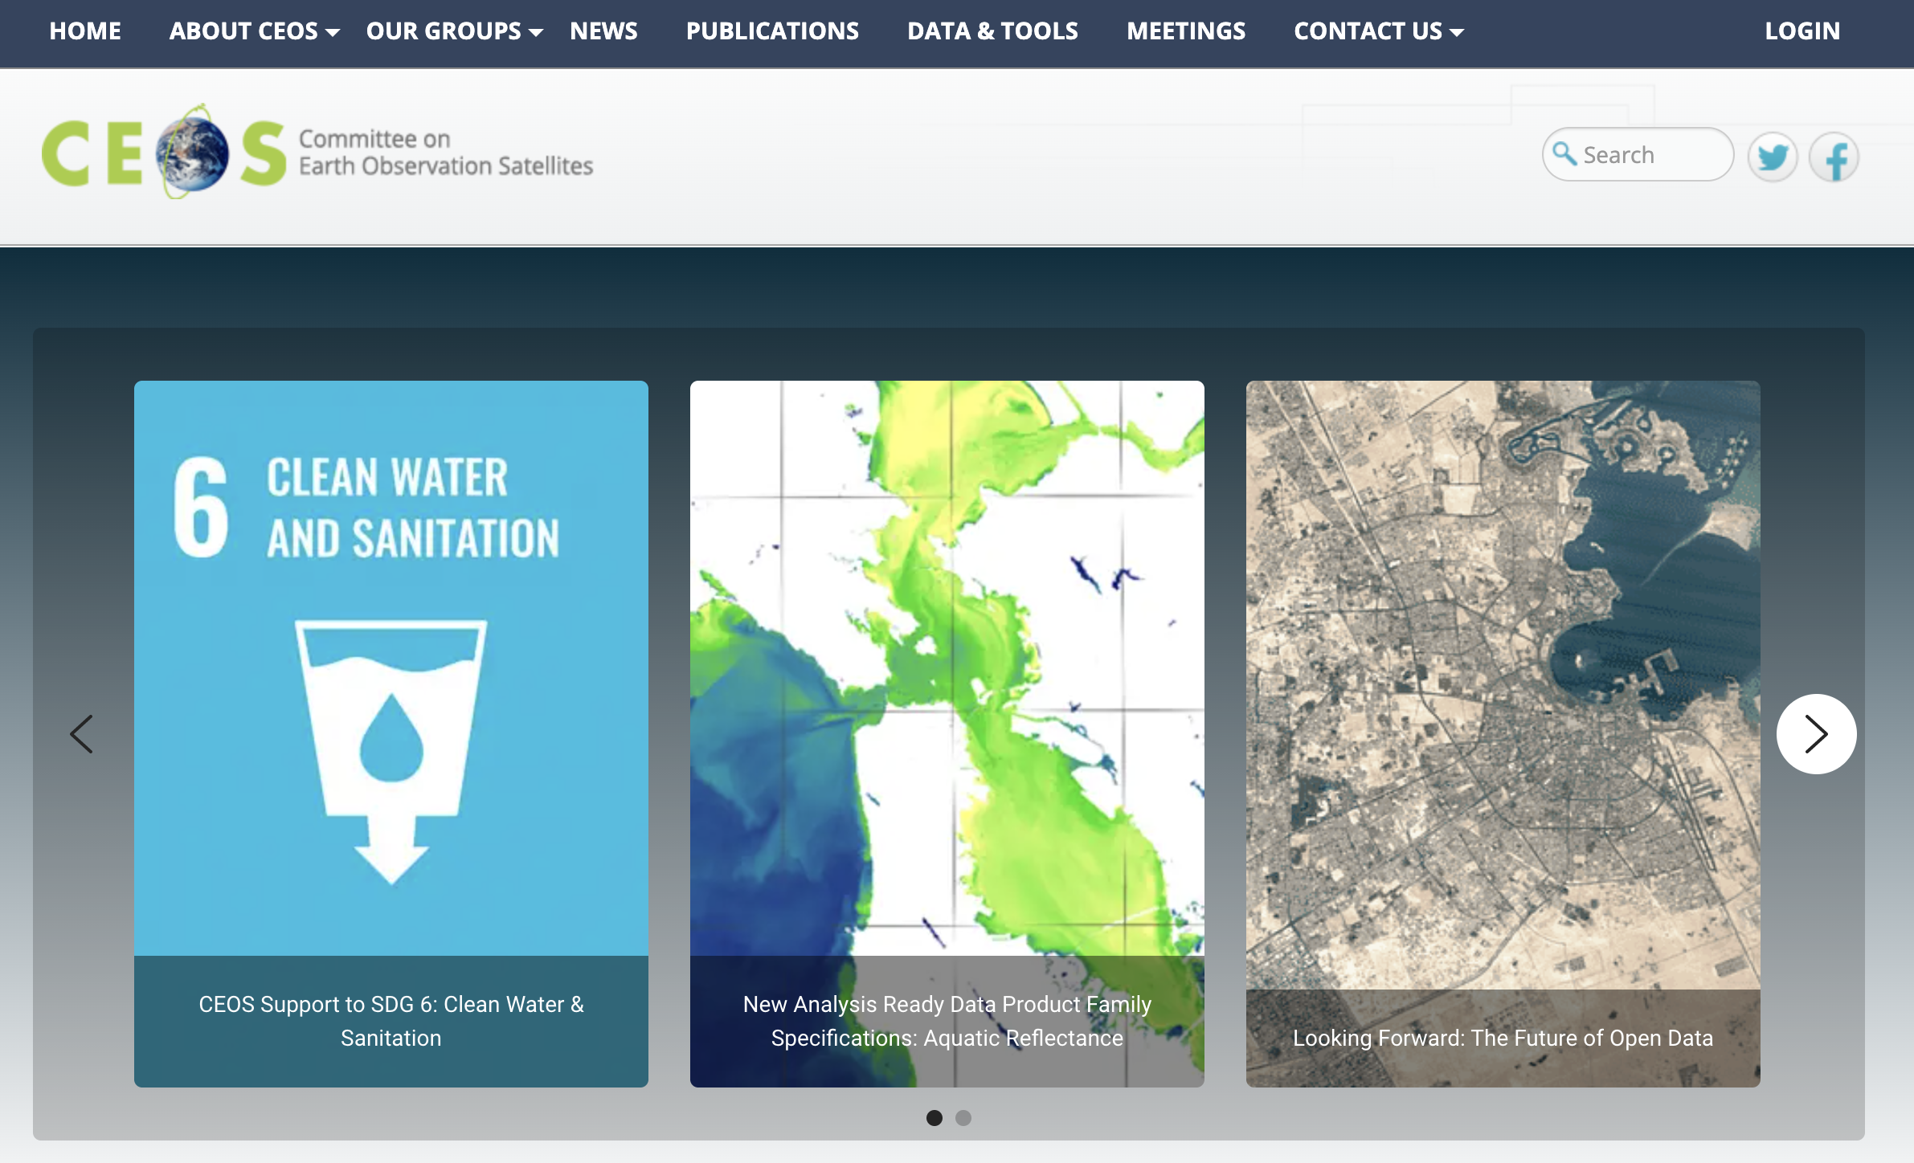
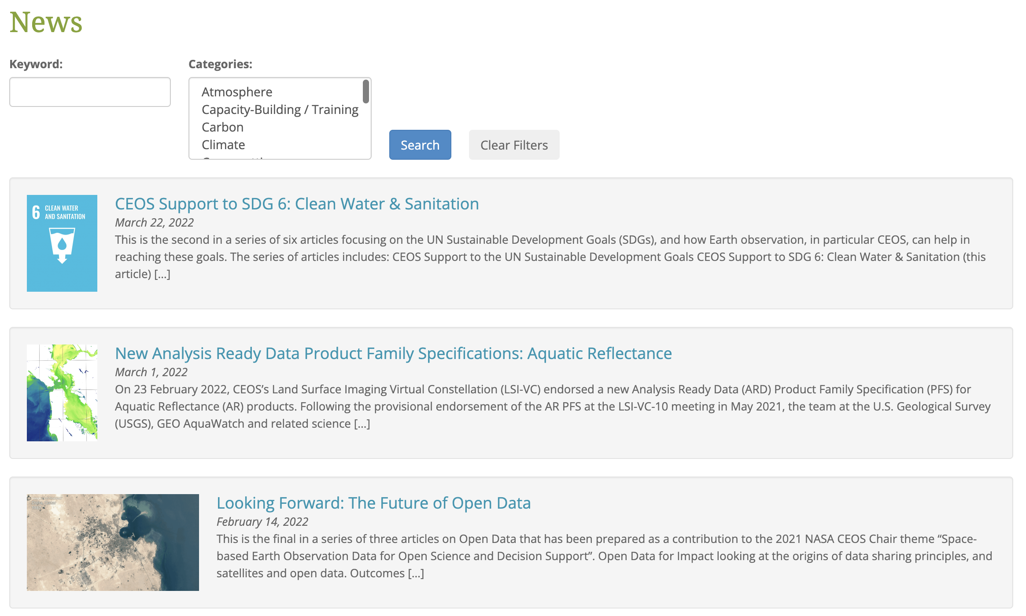
CEOS Communications
Kim Holloway is no longer working for the SEO as she has accepted a new assignment at NASA.
Libby Rose (Symbios) is now leading the CEOS Communications efforts for CEOS with some additional support from Matt Steventon and George Dyke. Several CEOS Communications meetings have been held since the Plenary.
Since the CEOS Plenary ... there have been many changes to the CEOS website. You will notice the content is reorganized and new content has been added.
The largest change is how we manage CEOS News. You will see a new list of rotating articles and links to the CEOS newsletters (from JAXA).
Let us know how we can improve CEOS communications and advertise the work you are doing!

Slide 4
SEO Activities (1 of 2)
Open Data Cube (ODC) Sandbox – A free/open Jupyter notebook interface running the ODC on Google Colab and connecting to CEOS satellite data in Earth Engine. Strategy: The ODC Sandbox facilitates Open Science and demonstrates the use of many CEOS Agency datasets in an interoperable cloud framework. Its use for capacity building and training is growing in popularity.
ODC Integration on the Sentinel Hub – Demonstrate the operation of ODC on the Sentinel Hub by working with Sinergise. Strategy: Demonstrate that ODC is cloud agnostic. Connect the ODC to more European users and expand the development and use of ODC algorithms.
Regional Data Cube Initiatives – Provide support to Digital Earth (DE) Africa, DE-Pacific Islands, and DE-Americas Strategy: These large-scale initiatives demonstrate the value of CEOS satellite data for regional decision-making. CEOS can facilitate access to the latest datasets, promote ARD, and demonstrate multi-mission interoperability. There are also benefits connecting to many new stakeholders.
Notes:
ODC Sandbox – 11 current application notebooks with 8 more coming soon. Flooding notebook of interest to Disasters Charter.
Regional Data Cubes – Stakeholders include DE-Africa (UNECA), DE-Americas (INEGI, ECLAC, AmeriGEO), DE-Pacific (SPC)

Slide 5
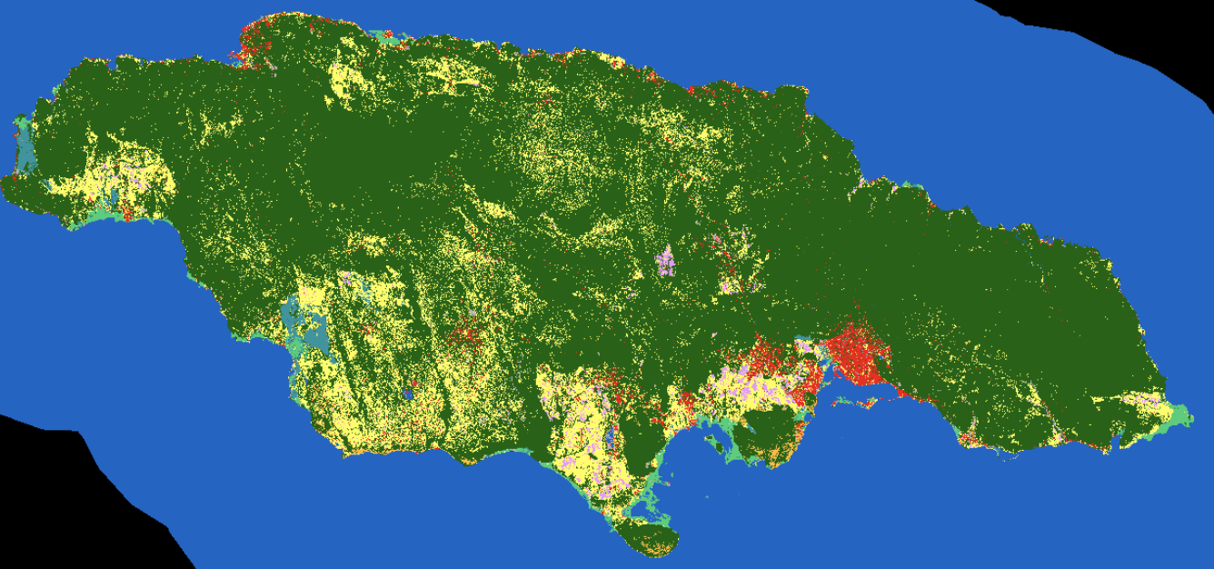
SEO Activities (2 of 2)
Soil Organic Carbon for Agriculture – Working with Alyssa Whitcraft (GEOGLAM) to develop a global digital soil organic carbon stock and flux product using the Open Data Cube, Jupyter notebooks and machine learning. Strategy: The results of this project will directly support AFOLU and the Global Stocktake (GST) initiative and could be a CEOS community contribution to Carbon accounting. The project also demonstrates Open Science.
Earth Analytics Interoperability Lab (EAIL) – Working with CSIRO to demonstrate how EAIL can be used to support several CEOS initiatives (COAST, WGDisasters) Strategy: CEOS does not have a tool to enable interoperable testing of CEOS datasets. This tool will allow CEOS to learn the value of such a tool to test cloud operations and analysis-ready data products.
Land Cover Dataset Assessment – Compare several land cover datasets to determine their spatial and temporal inconsistencies and demonstrate their use through a pilot study in Africa. Strategy: Many global users will need land cover datasets to support GST, Carbon Accounting or SDGs. Understanding their access and constraints could be a valuable CEOS contribution.

