Slide 1
Virtual Constellation Showcase
Committee on Earth Observation Satellites
Name (s), Organization, CEOS Affiliation
CEOS SIT-36
Session # 7
Virtual Meeting
23-25 March 2021

Slide 2
Atmospheric Composition

Slide 3
AC-VC
Click here for slides.

Slide 4
Land Surface Imaging

Slide 5
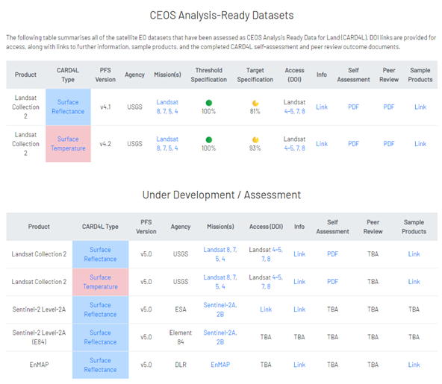
LSI-VC
CARD4L product assessments
USGS Landsat Collection 2 Surface Reflectance / Temperature ✅
ESA Sentinel-2 Level-2A Surface Reflectance
Element-84 Sentinel-2 Level-2A Surface Reflectance
DLR EnMAP Surface Reflectance
New CARD4L PFS under development
Aquatic Reflectance
Nighttime Light Surface Radiance
Interferometric SAR & Geocoded SLC
LiDAR
Interactions with other data providers
INPE: Landsat/CBERS (call on 16/03)
ISRO: Resourcesat-2/-2A
SANSA/PCI/Catalyst: Spot 1-7
Maxar: WorldView (TBD)
EC: S-1 CARD4L
2nd CARD4L Workshop - SAR (February 2021)
Supporting CEOS ARD beyond land discussions
OGC, COAST, DEAfrica Interactions & Pilots
CARD4L Guidance Materials / Advisory Notes with WGISS & WGCV/IVOS
Observation requirements
Expecting to support the AFOLU Roadmap / Global Stocktake work
USGEO Satellite Needs Working Group
Community Engagement: ARD20 Workshop, JACIE, VH-RODA, ESIP, IGARSS, …
http://ceos.org/ard/

Slide 6
Precipitation

Slide 7
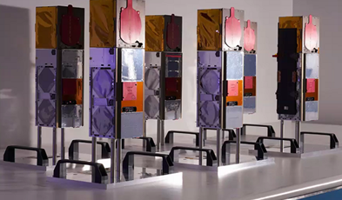
P-VC
Satellites & sensors
GPM now 7 years old; DMSP F16 SSMIS now 17+ years old (older than TRMM)
TROPICS – Pathfinder due for launch June 2021, Astra Space to launch remaining 6 in Q1/2 2022.
NOAA GOES-T 2021, JPSS-2 2022; EUMESAT EPS-SG -A MWS (Oct 2023) -B MWI/ICI (Oct 2024)
AMSR-3 - GOSAT-GW Preliminary Design Review (PDR) completed 12 March 2021. Launch JFY 2023.
CIMR – contract signed Nov.2020, with several workshops held/organised/planned.
AWS (Arctic Weather Satellite) ESA awarded contract to OHB Sweden. Launch foreseen early 2024
Data processing
NASA PPS/DISC continues output of ARD data sets and products (pps.eosdis.nasa.gov)
JAXA precipitation products from JAXA Climate Rainfall Watch; new GSMaP version due May 2021
NOAA continues to produce and disseminate operational precipitation products in near real-time
NASA, NCEP and NESDIS have ongoing projects to create precipitation climate datasets
Virtual meetings and outreach,
IPWG - webinars reaching international audiences - The Precipitation Constellation and Precipitation Validation with 120/87 attendees from 20/28 countries respectively, and WMO RTC Training Event NOAA precipitation products developers engaging NWS weather forecasters through seminar series
JPSS Hydrology Initiative fostering collaboration between precipitation product developers and users
NASA Applications and Outreach team - applications packages - freshwater management, micro- insurance, animal migration, and transportation/logistics sector. https://gpm.nasa.gov/applications

Slide 8
Ocean Colour Radiometry

Slide 9
OCR-VC
Aquatic Carbon from Space
⇒ towards CEOS Aquatic Carbon Roadmap
Community Workshop and White Paper, Q1 2022, under the leadership of ESA and NASA
Earth Science Reviews special issue, Q4 2022
Letter of intent deadline: Aug 1, 2021
Manuscript submission: Mar 1, 2022
Anticipated publication: Dec 1, 2022
Carbon
OCR-VC
Climate
Water Quality
OCR System Vicarious Calibration infrastructures
⇒ coordination on SVC infrastructures, new IOCCG SVC Task Force
NOAA maintenance of MOBY – SVC baseline; CNES/ESA – BOUSSOLE
NASA development of SVC infrastructure for PACE
Copernicus/EUMETSAT development of SVC infrastructure for Sentinels
Requirements and preliminary design completed; location studies ongoing
Detailed design to start in Q4 2021; operations planned for 2025 pending EU approval

Slide 10
Ocean Surface Topography

Slide 11
2020 TOSCA-ROSES
OSTST calls
Selection of the PIs/CoIs, members of the OSTST for the 4 coming years
TOSCA call (CNES/EUMETSAT)
30 received proposals
16 French & 14 International (3 from Germany, 3 from UK and one per following country: Argentina, Australia, Denmark, Greece, India, Japan, Netherlands, Portugal).
All projects recommended by TOSCA committee then selected by CNES/EUMETSAT
65 investigators, 39 from French organizations and 26 from foreign organizations
ROSES call (NASA/NOAA)
38 received proposals – 19 new projects are selected
65 investigators from 27 institutions
55 from US institutions, 7 from French organizations

Slide 12
Sentinel-6
EUMETSAT/ESA/NASA/NOAA/CNES

Slide 13
Ocean Surface Vector Wind

Slide 14
OSVW-VC

Slide 15
Sea Surface Temperature

Slide 16
SST-VC
Christo Whittle (SANSA) joined Oct 2020 as new co-lead
Co-leading and participating in ARD framework review team
See Report in ARD Beyond Land session
Participating in CEOS COAST initiative
Collaborating with NASA on ARD reviews and data services
Co-organized NASA ARD workshop and reviewed NASA datasets assessed with CARD4L
Contributed to ARD Workshop Report summary
Co-organized ESIP Winter meeting session on “ARD for science and industry”
Upcoming: Invited ARD presentation for the 2nd Operational Satellite Oceanography Symposium (May 2021)
Upcoming: Preparing for annual meeting in conjunction with GHRSST-22 Science Team Meeting (June 2021)
Working on improved SST-VC Terms of Reference document
Reflect collaborative efforts with other VC’s/initiatives such as COAST and COVERAGE
Update list of core missions prioritized for coordination by SST-VC
Update 3-year and 5-year horizon

