Slide 1
Atmospheric Composition Virtual Constellation (AC-VC)
Committee on Earth Observation Satellites
Barry Lefer (NASA), Ben Veihelmann (ESA), Hiroshi Tanimoto (NIES), AC-VC Co-Chairs
CEOS SIT 36 2021
Session 7.1, Agenda Item 1
Virtual Meeting
23-25 March 2021

Slide 2
AC-VC News
Leadership / Meetings
Barry Lefer (NASA) new Co-Chair succeeding Jay Al-Saadi (NASA, now retired)
Topical leads: Diego Loyola (DLR) for Tropospheric Ozone, Shobha Kondragunta (NOAA) for AQ Aerosol, Dave Crisp (JPL) for GHG
AC-VC#17 meeting planned 9-11 June (if physical) / 7-11 June (if virtual) 2021

Slide 3
AC-VC News
Activities (for details see ANNEX)
GHG Roadmap implementation (🡪 Agenda Item 3.1)
Tropospheric O₃ dataset validation and harmonization (VC-20-01): participation in Tropospheric O₃ Assessment Report – Phase II, kick-off WS Jan/Feb 2021
AQ trace gases coordination of validation (VC-20-02, -03, -04): Sentinel-4 and -5 Cal/Val Plan, GEMS announcement of opportunity for Cal/Val activities
AQ aerosol coordination (VC-20-05): whitepaper on Monitoring Surface PM2.5, An International Constellation Approach to Enhancing the Role of Satellite Observations
COVID-19 impact on emissions and of GHG and air pollutants seen by satellite: dashboard by ESA-NASA-JAXA (https://eodashboard.org)
EOS article on Disseminating scientific results in the age of rapid communication by S. Kondragunta, D. Crisp, and C. Zehner (https://eos.org/opinions/disseminating-scientific-results-in-the-age-of-rapid-communication)
ARD: Possible contributions in atmosphere domain (🡪 Agenda Item 5.3): participation in ARD framework meetings 21 January and 1 March 2021

Slide 4
ANNEX

Slide 5
Linkages to CEOS Work Plan
ID | Title | Due | Description | Responsible
VC-20-01 | Tropospheric ozone dataset validation and harmonization | 2022 Q4 | Production of peer-reviewed papers on intercomparisons and harmonization of tropospheric column ozone data sets | AC-VC | Diego Loyola
VC-20-02 | Air quality constellation validation coordination | 2024 Q4 | Coordinate implementation of recommendations expressed in CEOS document “Geostationary Satellite Constellation for Observing Global Air Quality: Geophysical Validation Needs”. | AC-VC, WGCV | Ben Veihelmann
VC-20-03 | Air quality constellation validation coordination: validation plans | 2022 Q4 | Coordinate the writing of harmonized GEO-AQ mission validation plans. | AC-VC, WGCV | Ben Veihelmann
VC-20-04 | Air quality constellation validation coordination: announcements of opportunity | 2023 Q4 | Coordinate the formulation of harmonized GEO-AQ Announcements of Opportunity supporting mission validation activities. | AC-VC, WGCV | Ben Veihelmann
VC-20-05 | Aerosol air quality coordination | 2021 Q4 | Production of a white paper or peer-reviewed paper on satellite-informed products for air quality associated with aerosol | AC-VC | Shobha Kondragunta
CARB-21-01 | GST1 Prototype Products and Guidance |  | Develop prototype CEOS data products and associated user guidance material in support of national and global level users for the 1st GST | AC-VC, WGClimate | David Crisp

Slide 6
Status Current AC-VC Activities
GHG (🡪 Agenda Item 3.1, summary in Annex II)
Tracking status of GHG sensors, products, retrieval algorithm, flux inversion capabilities, validation infrastructure
Contribution to implementation of CEOS/CGMS WGClimate GHG Roadmap
Global, space-based inventories of CO2 and CH4 🡪 CARB-21-01
Example products for local emission hot spots
Linkage to WGClimate, GHG Task Team and AFOLU Team
Participation in UNFCCC Ad Hoc Coordination Group on Systematic Observations
Ozone
Tropospheric O₃ datasets, validation and harmonization 🡪 VC-20-01
Participation in Tropospheric Ozone Assessment Report – Phase II (TOAR-II), Kick-Off Workshop January 25 - February 3 2021
Linkage to IGAC
Atypical ozone in 2019 and 2020

Slide 7
Status Current AC-VC Activities
AQ Trace Gases
Highlights from GEMS and S5P
Coordination of validation 🡪 VC-20-02
S4&S5 Cal/Val Plan 🡪 VC-20-03
GEMS AO 🡪 VC-20-04
Linkage to WGCV
AQ Aerosol
Status of current research and approaches to constrain particulate pollution
Status of observations, operational and future satellite missions
Whitepaper on satellite-informed estimates of aerosol-related AQ 🡪 VC-20-05
Linkage to AEROSAT/AEROCOM
Linkage to GSICS on radiometric consistency of sensors

Slide 8
Status Current AC-VC Activities
Interdisciplinary
GHG-AQ co-benefits
COVID-19
Observed impact on emissions and of GHG and air pollutants
Communication strategy / rapid response to future high interest events
EOS article on Disseminating scientific results in the age of rapid communication, by S. Kondragunta, D. Crisp, and C. Zehner (https://eos.org/opinions/disseminating-scientific-results-in-the-age-of-rapid-communication)
COVID-19 impact on emissions and of GHG and air pollutants seen by satellite: dashboard by ESA-NASA-JAXA (https://eodashboard.org)
ARD possibilities (🡪 Agenda Item 5.3)
Possible contributions to ARD in atmosphere domain
Participation in ARD framework meetings 21 January and 1 March 2021
Regular topical webinars considered

Slide 9
ANNEX II

Slide 10
AC-VC GHG Contributions to WGClimate GHG Task Team
Committee on Earth Observation Satellites
David Crisp, NASA JPL
AC-VC, WGClimate Greenhouse Gas Task Team
CEOS SIT-36
Virtual Meeting
23-25 March 2021

Slide 11
Work Flow for Pilot Inventory Products for COP-26
Global CO₂ Inventory development by OCO-2 Flux MIP Team
OCO-2 Flux MIP Team is initiating effort to generate fluxes from OCO-2 v10 products spanning 2015 – 2020
Initial products expected by end of August 2021
OCO-2 v9 MIP products are being used to support development of tools to create CO₂ inventories from Flux MIP products
Demonstration products available for review by 2021 SIT TW, followed by final products ready by 2021 Plenary
Global CH₄ inventory development by CMS (J. Worden, NASA/JPL)
Global flux products based on new, bias-corrected TROPOMI data
Bayesian partitioning algorithms employing tracers (fire emissions, in situ CH₄ isotope and ammonia data) to quantify emissions by sector
Demonstration products available at the SIT TW
Local Hot Spot Emissions (JAXA, ESA, NASA)
Products managed by individual PI Teams
CARB-21-01

Slide 12
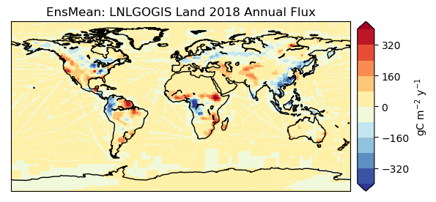
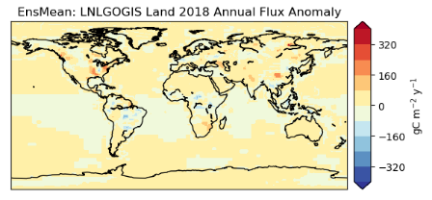
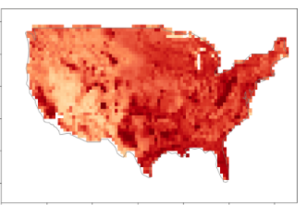
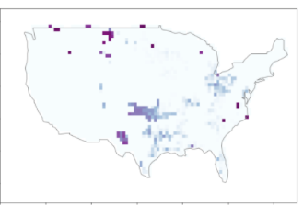
GHG Flux Inventories for the Global Stocktake
Regional-scale Global CO₂ Inventories,
based on OCO-2 Flux products (OCO-2 MIP Team)
Regional-scale Global CH₄ Inventories
based on CMS TROPOMI flux inversions (J. Worden, JPL)
Localized Emission Hot Spots
Examples provided by individual PI Teams
2018 non-Fossil Fuel Fluxes
Flux Uncertainties
Gas
Gas
1
10²
10⁴
-80
-40
0
CH₄ emissions (kg h⁻¹)
Error reduction (%)
OCO-2 XCO₂ and TROPOMI NO₂ quantify CO₂ emission by large South African power plants (Reuter et al., ACP 2020)

