Slide 1
Earth Observation Training Education and Capacity Development Network (EOTEC DevNet)
Committee on Earth Observation Satellites
Nancy D Searby, PhD, NASA, WGCapD Chair
CEOS SIT-36
Session 6 WG Showcase, Agenda Item 6.1
Virtual Meeting
23-25 March 2021

Slide 2
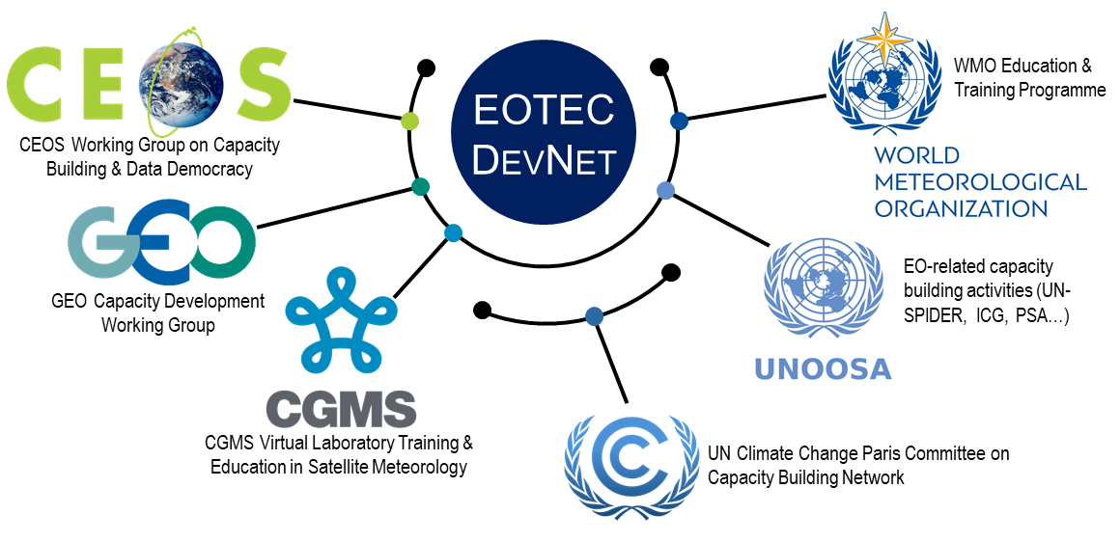
Earth Observation Training, Education, and Capacity Development Network (EOTEC DevNet)
Primary Focus:
Network to network leadership & coordination
Provide a community of practice for capacity building
Ongoing capacity gap, overlap, & resources assessments
Pilot Activity Focus:
Nexus of sustainability frameworks:
Disaster risk reduction plans,
Climate adaptation & mitigation plans, &
Associated vulnerability assessments
WGCapD-10 pilot discussions around flooding
Timeline:
Today: Endorse EOTEC DevNet Initiation Plan
Phase 1 (Mar-Oct 2021) – Initiation, Resources, Flooding focus
Phase 2 (Oct 2021– Mar 2023) – Full pilot focus, Sustainability plan
Notes:
Called out explicitly in 2021 CEOS Chair Theme Space-based Earth Observation Data for Open Science and Decision Support.
Phase 1: Now through CEOS Plenary (October 2021)
Continue outreach
Develop Theory of Change as well as Monitoring & Evaluation approach
Continue to refine concept of operations, and define resource requirements
In addition to current endorsements, get broader network leadership endorsement
Hold next regional meetings and first leadership coordination meeting
Collect training, education, and capacity development gaps, overlaps, and resources to use satellite and other space-based asset data to address the pilot topic of floods
Define approach to collect training, education, and capacity development gaps, overlaps, and resources that inform disaster risk reduction planning, climate adaptation and mitigation planning, and associated vulnerability assessments
Summarize Phase 1 results to inform respective network planning and the global stocktake.
Plan network of networks signing ceremony in CEOS Plenary timeframe
Phase 2: Post-CEOS Plenary (October 2021 – March 2023)
Implement approaches to collect training, education, and capacity development gaps, overlaps, and resources that inform disaster risk reduction planning, climate adaptation and mitigation planning, and associated vulnerability assessments.
Develop plans to address gaps using existing resources and/or by identifying network partners who can develop new ones.
Track metrics to determine value of continuing EOTEC DevNet beyond a two-year pilot phase.
Create a sustainability plan to ensure the initiative can continue to grow beyond the pilot phase if evaluation deems it to be successful
Continue periodic regional and leadership meetings
Summarize Phase 2 results and report to the network partner leadership to inform the future of EOTEC DevNet

