Slide 1
Session 5: Analysis Ready Data (ARD) and Future Data Architectures
Committee on Earth Observation Satellites
CEOS SIT-36
Session #5
Virtual Meeting
24 March 2021

Slide 2
Session Overview
Session Chair: Adam Lewis
Objectives:
Review implementation of the CEOS ARD Strategy including:
Progress on CEOS ARD beyond land
Discussion of CEOS support for uptake of ARD through advanced technologies activities such as the Open Earth Alliance
CEOS ARD Strategy progress update
Decision Points:
None identified.

Slide 3
CEOS ARD Strategy & CARD4L Update
Committee on Earth Observation Satellites
Andreia Siqueira / SIT Chair Team
CEOS SIT-36
Session #5, Item #1
Virtual Meeting
24 March 2021

Slide 4
CEOS ARD Strategy
The CEOS ARD Strategy has directed CEOS work on ARD since its adoption at CEOS Plenary 2019.
Covers four main areas:
CEOS ARD User Needs & Specifications
Assured Production & Access
Pilots & Feedback
Communication & Promotion
An updated Strategy is planned for presentation (for endorsement) at CEOS Plenary 2021, reflecting all of the great progress made and charting the way forward for future years.
SIT Chair Team will seek contributions from all CEOS entities in the preparation of CEOS ARD Strategy v2.0.
–> Covered further under item 5.2

Slide 5
Strategy Progress Update
Status of CARD4L PFS: Current
Surface Reflectance (v5.0)
Surface Temperature (v5.0)
Normalised Radar Backscatter (v5.0)
Polarimetric Radar (v3.0)
Status of CARD4L PFS: In-Development
Aquatic Reflectance
Nighttime Light Surface Radiance (NLSR)
Geocoded SLC (SAR)
Interferometric Radar
LIDAR
See http://ceos.org/ard for further details

Slide 6
Aquatic Reflectance PFS
Coordinated by: Andreia Siqueira (GA) & Chris Barnes (USGS/KBR)
Technical Lead: Arnold Dekker
Development began in March 2020 with endorsement targeted for LSI-VC-10 in April 2021
Applies to data collected by multispectral and hyperspectral sensors operating in the VIS/NIR/SWIR wavelengths over coastal and inland water bodies
Using the Surface Reflectance PFS as a baseline, GEO-Aquawatch, Water-ForCE and subject matter experts around the world met virtually to modify and/or generate new threshold and target requirements

Slide 7
New SAR PFSs: Geocoded SLC &
Interferometric Radar
Coordinated by: Ake Rosenqvist (JAXA/soloEO)
Geocoded Single-Look Complex (GSLC)
Technical Leads: Howard Zebker (Stanford U) & Bruce Chapman (JPL)
The CARD4L Geocoded SLC (GSLC) product describes the complex radar reflectivity (amplitude + phase) with all non-target related propagational phases removed, to represent backscatter properties of the ground surface only.
CARD4L GSLC products are presented in a common geographical coordinate system (e.g. UTM) rather than in slant range radar coordinates, to facilitate use by non-radar specialists.
Development began in Q3/2018 with endorsement targeted for Q3/2021.
Interferometric Radar (INSAR)
Technical Lead: Matthew Garthwaite (Geoscience Australia)
A suite of three products generated by InSAR processing of two images captured of the same geographic area at different times: Wrapped interferogram, Unwrapped interferogram, Interferometric coherence.
Development began in Q3/2018 with endorsement targeted for Q1/2022.

Slide 8
Nighttime Light Surface Radiance
CARD4L-NLSR
Coordinated by: Brian Killough (CEOS SEO, NASA)
Technical Leads: - Miguel Roman (Universities Space Research Association) - Zhousen Wang (University of Maryland) - Chanyoung Cao (NOAA).
Zero draft translated previous materials into CEOS ARD Product Family Specifications format
Development began in December 2020 with endorsement targeted for Mid-2021.
The CARD4L-NLSR product applies to data collected with nighttime light sensors operating in the VIS/NIR wavelengths. These typically operate with ground sample distance and resolution in the order of 10-1000m; however, the specification is not inherently limited to this resolution.

Slide 9
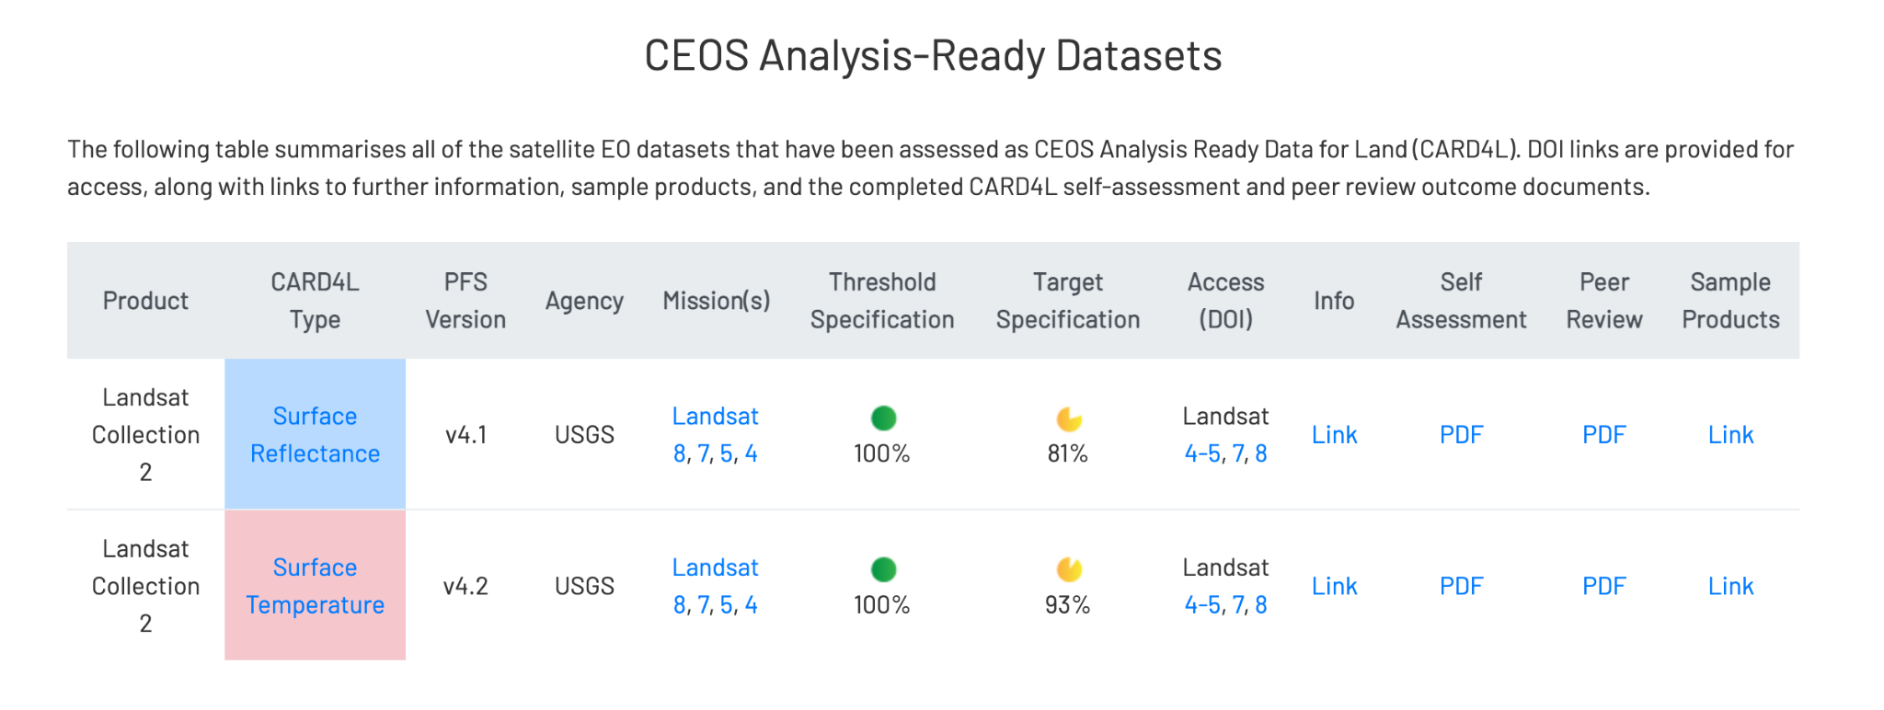
Strategy Progress Update Status of CARD4L datasets
First CARD4L compliant Datasets
USGS Landsat Collection 2 SR & ST
From: http://ceos.org/ard

Slide 10
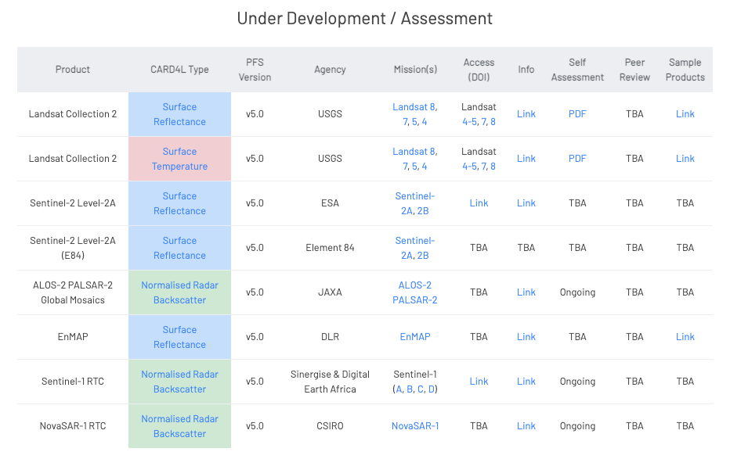
Strategy Progress Update
Status of CARD4L datasets
Under development / assessment datasets
USGS Landsat Collection 2 SR & ST (PFS version 5.0)
Sentinel-2 Level-2A, Sentinel-2 Level-2A (E84) - (PFS version 5.0)
EnMAP (PFS version 5.0)
Normalised Radar Backscatter (PFS v5.0): JAXA (ALOS-2); CSIRO (NovaSAR-1); Sinergise/Digital Earth Africa (Sentinel-1)
From: http://ceos.org/ard

Slide 11
Strategy Progress Update
PFS Annual Review Cycle
2021 review started
Common set of ARD specifications applicable to all community ARDs
Cooperative processes to assess and peer-review
WGCV have been pivotal
Peer reviews have been completed or are in train
Revision of the current peer-review process
Terminology report
Endorsed at CEOS Plenary 2020
CEOS Paper on the Interplay of Industry and CEOS ARD
Endorsed at CEOS Plenary 2020

Slide 12
Strategy Progress Update
ARD Website updates
ARD Webinars materials (e.g. recording)
ARD Frequently Asked Questions (following from the Webinar)
Samples of CARD4L compliant datasets
Table of dataset compliance
Communication & Promotion
2nd ARD webinar: CARD4L SAR ( 1&2 Feb 2021)
2021 IGARSS Invited Session (CEOS and the Private Sector: interactions and early progress on Analysis Ready Data)
2021 IGARSS CEOS ARD Paper
Pilots: DE Africa data flows (Sentinel-2, Landsat, Sentinel-1)
DE Africa is establishing continental coverage of CEOS ARD (CARD4L compliant where possible)
Industry is playing key roles in production (Sinergise, Element-84)

Slide 13
Strategy Progress Update
ARD beyond land
CEOS-COAST uptake of ARD
CEOS ARD Framework review/expected outcomes
Draft PFS for Aquatic Reflectance
Provisional Aquatic Reflectance Product from USGS
Efforts underway to explore expansion of the CEOS ARD concept to domains beyond land.
–> Will be covered under Item 5.3.

Slide 14
Current PFS Assessment Workload
USGS Landsat Collection 2 SR & ST (PFS version 5.0) - under WGCV peer-review
ESA Sentinel-2 Level-2A - submission being assessed
Element84 (Sentinel-2 Cloud-Optimized GeoTIFF datasets) - submission being assessed
DLR EnMAP Hyperspectral SR - submission being assessed
INPE (Sentinel-2, CBERS-4, Landsat-8) - request for guidance
KARI - request for guidance
CNES/Theia products - request for guidance
JAXA (ALOS-2) - NRB self-assessment in progress
CSIRO (NovaSAR-1) - NRB self-assessment in progress
Sinergise / Digital Earth Africa (Sentinel-1) - NRB self-assessment in progress

Slide 15
Status of CARD4L PFS
For now, CEOS ARD == CEOS ARD for Land, which has been developed by the LSI-VC.
Efforts underway to explore expansion of the CEOS ARD concept to domains beyond land.
–> Will be covered under Item 5.3.
CARD4L is built around the concept of Product Family Specifications, which provide specifications that certain types of products must meet to be considered CARD4L.
Not prescriptive regarding exact processing approach, but rather detail minimum requirements and what supporting information must be provided with a product.

Slide 16
CARD4L Advisory Notes
Considering how to tie the work of WGISS on guidance materials related to data policy, data formats, interoperability, etc. to CEOS ARD under
the CEOS ARD Strategy and CARD4L Framework.
These documents are seen as a possible existing way to address the feedback that we need to consider adding ‘Advisory Notes’ as a fourth component of the CARD4L Framework to address data policy, data formats, interoperability, etc.

Slide 17
CEOS ARD Strategy v2.0
Committee on Earth Observation Satellites
Adam Lewis / SIT Chair Team
CEOS SIT-36
Session #5, Item #2
Virtual Meeting
24 March 2021

Slide 18
CEOS ARD Strategy v1
The first version of the CEOS ARD Strategy has been a helpful resource to direct and focus CEOS efforts on ARD.
We are seeing good traction on the development and continued evolution of Product Family Specifications
Initial CARD4L assessments have been completed, CARD4L products out in the wild (e.g., Landsat Collection 2), increasing number of assessments in progress
Two key documents accomplished:
CEOS Interoperability Terminology Report
CEOS Paper on the Interplay of Industry and CEOS ARD
Held talks regarding standardisation and agreed a position on this question
Extensive communication and promotion at key events and dedicated CEOS ARD webinars.
Increasing awareness of CEOS ARD across community including industry
Significant resources being collated: https://ceos.org/ard/

Slide 19
Early ideas for v2 – for discussion and development
Update the Strategy to reflect progress and developments in the space
Formalisation of a comprehensive framework for CEOS ARD in general (i.e., beyond land)
Continued promotion to users, data providers, data distributors
webinars, key meetings
SDG applicability
Advisory Notes to provide guidance on key topics as complements to the non-prescriptive PFS
Continued pilot activities (incl. EAIL)
Increased linkage between WGISS systems and CEOS ARD and the cloud – discovery of and access to CEOS Agency ARD
MIM Database links to CEOS ARD products
In general: topics related to accessibility and utilisation of CEOS ARD – increasing impact of CEOS data, including via an increased scope of the CEOS ARD concept

Slide 20
CEOS ARD Beyond Land
Committee on Earth Observation Satellites
Adam Lewis / LSI-VC & Ed Armstrong / SST-VC
CEOS SIT-36
Session #5, Item #3
Virtual Meeting
24 March 2021

Slide 21
ARD Beyond Land Status
ARD Beyond Land, Review and Status
ARD Beyond Land presentations from CEOS SIT-TW encouraged review of CARD4L from non-Land discipline perspectives
Covered SST, atmospheric, coastal and inland waters use cases
Decision CEOS-34-13 (2020 Plenary):
SIT Chair and Ed Armstrong (SST-VC Co-Lead) to form a team of experts to review the CEOS ARD Framework (Definition, Specifications and processes around CEOS ARD) for completeness and suitability (including looking at changes that make it amenable to non-land domains)
Team formed from VC and other Working Group stakeholders December 2020
SST-VC, LSI-VC, P-VC, AC-VC, WGCV, CEOS SIT, COAST and COVERAGE
Stakeholders on working on a number of ARDs within CEOS (e.g., LSI-VC), and beyond (e.g., NOAA, NASA, SANSA)
The work will continue until Plenary 2021
Two meetings in 2021 so far

Slide 22
ARD Beyond Land Status
Themes of discussion so far
Converge on key data requirements rather than on data packaging or services (for now). This is consistent with CARD4L.
Communities work with different processing levels and datasets that have differing co-registration and accuracy characteristics - clarity is needed on if and how the ARD framework caters for these
There are, or appear to be, competing and diverging needs in the ARD spectrum. The challenge is to satisfy them.
A significant amount of the discussion is around finding a common language and understanding of the existing CARD4L framework
Next steps
Move the discussion from ‘divergence’ to ‘convergence’
The LSI and WGCV teams will document and share the governance approaches around CARD4L
Identified a need to converge across different disciplines to “core” PFS requirements - LSI team will provide a ‘bare bones’ PFS

Slide 23
Future Data Architectures Activity Updates
Committee on Earth Observation Satellites
Brian Killough / SEO & Rob Woodcock / WGISS
CEOS SIT-36
Session #5, Item #4
Virtual Meeting
24 March 2021

Slide 24
Open Earth Alliance (OEA)
What is the OEA and why was is formed?
The Open Earth Alliance (OEA) was created by the Open Data Cube (ODC) founding partners to expand the impact of the ODC, support the concept of a regional network of data cubes, allow more agility to explore open source solutions, and attract external funds and cloud credits from interested donors.
Since the start in late 2020, no donor or direct funding has been received but there have been several discussions with interested parties (e.g., Americas, Pacific Islands, World Bank).
What has been achieved by the OEA?
A new User Forum (https://www.openearthalliance.org/forum) is now available to support several ODC initiatives (e.g., Americas, Pacific Islands) and the Earth Analytics Interoperability Lab (EAIL).
A new ODC Sandbox is nearing release. This tool is a free and open programming interface that will connect users to common satellite datasets (e.g., Landsat, Sentinel-2). Users can run Python application algorithms using Google's Colab notebook environment. The satellite data is global, but there are limitations in analysis size. This tool will be ideal for training and capacity building and can be easily scaled to many users.
Various technology research and development projects are in work, including looking at visualization and data presentation techniques to improve the understanding of ODC analysis.
OEA Website: https://www.openearthalliance.org

Slide 25
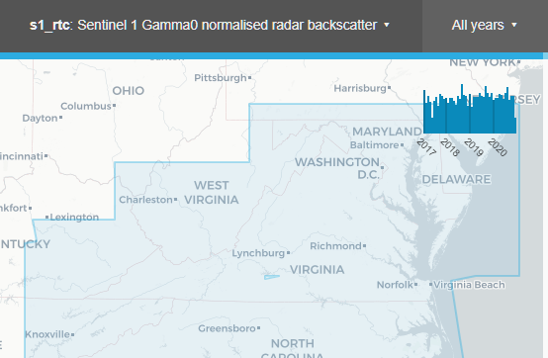
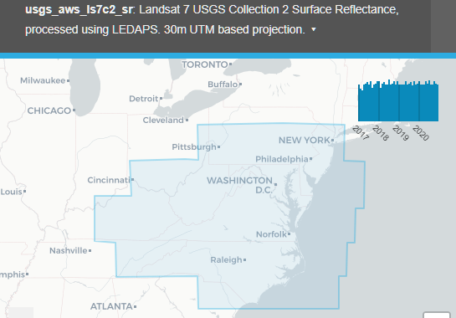
Earth Analytics Interoperability Lab (EAIL)
What is the EAIL and why was it created?
Supports CEOS WG/VC projects in the use of ARD and FDA by deploying via a Cloud scalable Python based earth analytics environment using ODC, Machine Learning and other scientific libs.
Actual use in real CEOS collaborative projects tests ARD and FDA technologies and specifically interoperability approaches which can be used by WGISS and SEO to advance CEOS.
What has been achieved by the EAIL?
EAIL fully deployed in 2021 (https://hub.eail.easi-eo.solutions/) and users from CEOS projects are being added now.
Support forum (via OEA) and support team (CEOS SEO, CSIRO Australia and Chile) in place and providing Jupyter Notebooks for training.
Data is available for a trial region over the eastern USA using ARD on Cloud supplied by USGS Landsat Collection 2, Element 84 Sentinel 2 and Sinergise S1 ARD. All are examples of FDA/ARD data services. (Collection Explorer: https://explorer.eail.easi-eo.solutions/s2_l2a )
CEOS COAST, WGDisasters Flood Pilot and DEMIX projects are currently identifying additional data inventories for their Regions of Interest along with any additional software libraries that may be required.

Slide 26
Data Discovery and Use
Changes in Data Discovery
Cloud based copies of data radically alter the accessibility and cost-of-use of CEOS EO data (e.g. USGS Landsat Collection 2 results in a substantially reduced operating cost for EAIL and ODC related projects)
Discovery of Cloud based copies of CEOS source data must result in multiple copies (multiple providers & regions).
STAC metadata format is one mechanism being explored and being new is more amenable to incorporating new requirements (e.g. ARD PFS needs).
CEOS Discovery needs to adapt and WGISS is now investigating these issues.
Cloud data format
Cloud based storage utilises an Object rather than File based approach. Object based methods have a very different performance and access profile compared with Files and direct use of common File formats in Cloud often results is extremely poor performance. This is increasingly important to understand when data is being used directly in Cloud and may require CEOS agencies to supply Cloud based data in a Cloud format (e.g. USGS Collection 2 uses Cloud Optimised Geotiffs).
Various technology research and development projects are underway providing both enhanced conventions (COGS) and Cloud native formats (Zarr). WGISS 51 will have a special session on Cloud formats in use/trial by CEOS agencies and will consider developing a Best Practice.

