Slide 1
Sustainable Development Goals
Committee on Earth Observation Satellites
Session Chair: Alex Held, CSIRO, CEOS SIT Co-Chair
CEOS SIT-36
Session 4
Virtual Meeting
23-25 March 2021

Slide 2
Session 4: SDGs
Agenda
Welcome and overview of the session
SDG Ad Hoc Team Current Work (Marc Paganini/ESA)
Summary of subgroup work
SDG Indicators supported
SDG Support Options Paper (Alex Held/CSIRO)
Brief review of process, participants, synthesis paper
Overview on the two options “Full scale WG” and “Federated”
Discussions and decision

Slide 3
Session 4: SDGs
Objectives and expected outcomes
Objectives:
Detailed discussion on options for the future of CEOS engagement with the Sustainable Development Goals process including GEO’s activities in the area.
Decision Points:
CEOS Principals to make a decision on the request from the SDG AHT to further develop the two most favourable future scenarios in order to come with a substantiated proposal to be reviewed and finalised with all key stakeholders during the CEOS SIT Technical Workshop in September, before its formal submission for approval to CEOS Principals at the 35th CEOS Plenary.

Slide 4
SDG Ad Hoc Team Current Work
Committee on Earth Observation Satellites
Marc Paganini, ESA, SDG AHT
CEOS SIT-36
Session 4 / Agenda Item #4.1
Virtual Meeting
23-25 March 2021

Slide 5
SDG AHT Work Plan 2020-2021
Work organisation
Starting with an analysis of the satellite data needs for 4 SDG Indicators :
6.6.1 (water-related ecosystems) in partnership with GEO Wetlands, GEO AquaWatch, GEO GLOWS
11.3.1 (urban land consumption) in partnership with GEO HPI, GEO GUOI
14.1.1 (coastal eutrophication) in partnership with GEO Blue Planet GEO AquaWatch
15.3.1 (land degradation) in partnership with GEO LDN
Selected by SDG-AHT because:
need to focus on a limited number of SDG indicators. “Start small, Think big”
selected by UN IAEG-SDGs WGGI as primary indicators for EO uptake. “Use SDG channels to maximise Impact”
EO recognised as data sources by UN custodian Agencies in the indicator monitoring guidelines. “Build on proven EO technologies”

Slide 6
SDG AHT Work Plan 2020-2021
Deliverables
Number | Objective / Deliverable | Completion | Responsible Entity
SDG-19-02 | Open Data Cube algorithms for the SDGs | 2021 Q4 | SEO
SDG-20-01 | GEO Federated Approach on SDGs | 2020 Q1 | SDG AHT
SDG-20-02 | SDG EO Toolkit Specification | 2020 Q1 | SDG AHT
SDG-20-03 | Satellite data requirements for SDG Indicator 6.6.1 (Water-related ecosystems) | 2021 Q4 | SDG AHT (Water Sub-team)
SDG-20-04 | Satellite data requirements for SDG Indicator 11.3.1 (Sustainable urbanization) | 2021 Q4 | SDG AHT (Urban Sub-team)
SDG-20-05 | Satellite data requirements for SDG Indicator 14.1.1 (Marine Pollution) | 2021 Q4 | COAST (with the support of SDG AHT)
SDG-20-06 | Satellite data requirements for SDG Indicator 15.3.1 (Land Degradation) | 2021 Q4 | SDG AHT (Land Degradation Sub-team)
SDG-20-07 | EO Enabling Infrastructures for SDGs (for SDG EO Toolkits) | 2021 Q4 | SDG AHT| (with support of WGISS, SEO)
SDG-20-08 | EO Good Practice Guidance (for SDG EO Toolkits) | 2021 Q4 | SDG AHT
SDG-20-09 | EO Demonstration Cases for SDGs (for SDG EO Toolkits) | 2021 Q4 | SDG AHT, SEO
SDG-20-10 | Data Supply Analysis and Strategy Document | 2020 Q2 | SDG AHT, SIT Chair

Slide 7
WATER sub-team
Water-related ecosystems (6.6.1): M. Paganini/ESA, A. Carbonniere/CNES
Sub-Team members: M. Paganini/ESA, A. Carbonnière/CNES, Alice Andral/CNES, A. Kavvada/NASA, Nima Pahlevan/NASA, B. Killough/NASA, Luca De Felice/COM JRC C. Ishida/JAXA, K. Hamamoto/ JAXA, Norman Muller/GA, F. Kerblat/CSIRO, E. Smail (NOAA) H. Kim/WMO, D. Cripe/GEO, GEO Wetlands (9 experts), AQUAWATCH (2 experts), GEO GLOWS
Key findings
Two pathways: production of global datasets and development of national capacities.
Strong contribution from EO to many 6.6.1 sub-indicators and associated variables (GSWE, GMW, CLMS).
Progress in EO solutions for wetland mapping. Transferability/generalisation studies on-going.
Multi-sensor approaches needed for most sub-indicators (e.g. water, wetlands, mangroves, WQ) to address limitation of single sensor approaches and better capture temporal dynamics.
Advances in the integration of WSE from Radar Altimetry to infer changes in lake volumes.
OCR sensors provide good data basis for Eutrophic/Turbidity state at 300m resolution but too coarse for smaller water bodies and rivers. Need to integrate multi-spectral sensor data (L8/S2).
Key issues
Needs for a Research agenda, e.g. integration of WSE in hydrological models to infer changes in river flow discharge, use of TIR (e.g. wetland mapping and WQ), changes in aquifer content.
Uncertainty estimates as important as measurements. Required by the statistical community.
Key Updates since 34th CEOS Plenary
Launch of a Round Robin intercomparison of Surface Water Detection algorithms at 10m spatial resolution (2 years, permanent and seasonal waters, 5 sites) organised by the ESA WordWater project.
Plan for 2021
Complete satellite data analysis with outreach to custodian agencies (UNEP and Ramsar).

Slide 8
LAND DEGRADATION sub-team
Land degradation (15.3.1): N. Sims/CSIRO, U. Heiden/DLR
Sub-Team members: N. Sims/CSIRO, U. Heiden/DLR, F. Kerblat/CSIRO, B. Killough (NASA), N. Mueller (GA), M. Paganini (ESA), C. Ishida (JAXA), K. Hamamoto (JAXA)
Key findings:
GEO LDN minimum data quality standards provide useful guidance on user needs
Development of new products for C stocks above and below ground required
Consistent & frequent observations for all sub-indicators is still a challenge
Key issues
Improved coverage globally is needed (e.g.Pacific Islands)
Higher spatial resolution – larger pixels OK at continental scale
Structural information for quantifying SOC stock (SAR, Lidar, integration with optical)
Plan for 2021
Finalisation of the Satellite data and observation requirements documents in light of revisions to the Good Practice Guidance document for SDG Indicator 15.3.1 and outcomes from activities in the GEO LDN Initiative

Slide 9
SDG 15.3.1 Good Practice Guidance updates
15.3.1 sub-indicators’ calculation methods updated to provide more detailed information on land productivity condition and trend for LDN analysis:
More detailed z-score analysis for land productivity state and trend.
Spatial aggregation for calculating land productivity performance using Land Cover/Ecosystem Functional Unit (LCEU) spatial data.
Recommended land cover default data remains CCI-LC but now also includes Copernicus CGLS –LC100
Includes new guidance on:
Reporting degradation and identifying false positives
Recalculating the time series to accommodate new methods and/or datasets
Assessing the magnitude (not just extent) of degradation
Mentions Water Use Efficiency methods by Andrea Markos & Greg Giuliani (paper in press)

Slide 10
URBAN sub-team
Sustainable Urbanization (11.3.1): A. Kavvada/NASA, N. Mudau/SANSA
Sub-Team members: A. Kavvada/NASA, N. Mudau/SANSA, B. Killough/NASA, B. Chen/CIEISN, G. Yetman/ CIESIN, C. Ishida/JAXA, K. Hamamoto/ JAXA, A. Baklanov/WMO, Thomas Kemper/JRC, Yifang Ban/KTH, P. Caccetta/CSIRO, M. Marconcini/DLR, M. Paganini/ESA
Key findings
Rigorous validation and data set inter-comparison to evaluate the quality and suitability of global EO data sets and tools for sub-national, national and regional monitoring and reporting is required
Multi-sensor efforts (e.g., harmonized global data sets of Landsat 8 and Sentinel-2) can generate higher-frequency imagery products for land surface monitoring and land cover classification
Key issues
Rigorous 3-D methods to detect vertical built-up need to be further developed
No weighting on type of land being consumed or type of built-up assessed (e.g., informality may be misinterpreted as compactness of a city) included in current methodology
Need to consider multi-scale approaches of using open EO datasets + national built-up inventory from public domain data, in complement with detailed built-up inventories based on commercial high-resolution imagery
Accomplishments since 34th CEOS Plenary
EO4SDG and UN Habitat launched the EO Toolkit for Sustainable Cities and Human Settlements at a UN Statistical Commission side event.
Hosted by UN Habitat, with contributions from over 40 organizations. Includes EO data products, tools, country/city use cases on 4 themes: adequate housing, open spaces for public use, access to public transport and spatial urbanization. Visit: https://eo-toolkit-guo-un-habitat.opendata.arcgis.com/.
Plans for 2021
Finalize satellite data analysis and indicator support sheet with outreach to UN Habitat & Toolkit contributors
Support Toolkit Steering Committee in suitability testing of urban EO data sets for application at local, city, and national level, and integration of new data sets/ tools as they become available
Support capacity development for urban EO Toolkit (introduction to toolkit portal, short tutorials on EO data & tools)
Notes:
Over 40 organizations have contributed to the Toolkit, including representatives from national statistical offices, national mapping agencies, city authorities, academic, research institutions, non-governmental organizations, space agencies, GEO Work Programme Activities, and the private sector.

Slide 11
COASTAL sub-team
Coastal eutrophication (14.1.1): E. Smail/NOAA/CEOS-COAST
Sub-Team members: Led by CEOS COAST team and has participants from NOAA, JAXA, NASA, GEO Blue Planet and GEO AquaWatch
Key findings
Satellite data to be included in 2021 UN SDG report: In collaboration with Esri and GEO Blue Planet, chlorophyll-a data for two global sub-indicators have been submitted to UN Environment and will be included in the 2021 UN SDG report.
Need for regional capacity development for regional/national potential eutrophic zones based on chlorophyll-a concentrations to be developed for regions in collaboration with JAXA and the Northwest Region Environmental Cooperation.
Using satellite data for identifying changes over time in coastal areas that lack in situ data is resonating with stakeholders.
Key issues
Validated higher resolution products closer to the coastline are needed.
Uncertainty estimates as important as measurements. Required by the statistical community.
Plan for 2021
Work with UN Environment and the Regional Seas Programmes to develop regional potential eutrophic zone analyses.
Identify ancillary data sets that can provide information about the drivers of eutrophication such as land use change and hydrography data.

Slide 12
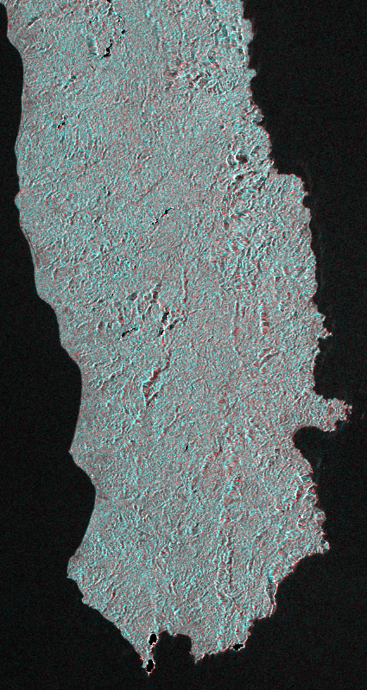
Open Data Cube (ODC) Contributions to SDGs
Open Data Cube Sandbox – A new ODC Sandbox is nearing release. This tool is a free and open programming interface that will connect users to common satellite datasets (e.g., Landsat, Sentinel-2). Users can run Python application algorithms using Google's Colab notebook environment. This tool will be ideal for training and capacity building and can be used to support SDGs.
Open Data Cube Users Forum – The SEO has released a new ODC User Forum under the Open Earth Alliance (OEA) community activity to support several ODC initiatives (e.g., Americas, Pacific Islands) and the Earth Analytics Interoperability Lab (EAIL). This could also be used to support SDGs. (openearthalliance.org/forum)
Water (SDG 6.6.1) – The SEO plans to participate in the ESA WorldWater Surface Water Detection Algorithm Intercomparison Study. Open source algorithms from this study could be implemented in the ODC sandbox for global SDG users.
Land Degradation (15.3.1) – The SEO is working with Neil Sims and the LDN team to explore ODC contributions. Possible options include calculating the baseline land degradation in 2015 (state and trend) using historic Landsat data. This is critical information not currently addressed in the Good Practice Guidance Doc.
Sentinel-1 ARD – The SEO has collaborated with DE-Africa to develop a Sentinel-1 ARD processing tool to support ODC users. Such data could be ideal for SDG users in cloudy regions around the world.

Slide 13
SDG Support Options Paper
Committee on Earth Observation Satellites
Alex Held, CSIRO, CEOS SIT Co-Chair
CEOS SIT-36
Session 4 / Agenda Item #4.2
Virtual Meeting
23-25 March 2021

Slide 14
SDG AHT Background
Informal SDG discussions (2015),
SDG AHT established at 2016 CEOS Plenary,
SDG AHT extension at 2017, 2018 and 2019 CEOS Plenaries,
SDG AHT subgroups created in 2020 focusing on water, urbanization, marine pollution and land degradation,
SDG AHT extension until end 2021 at 2020 CEOS Plenary (with Transition Roadmap)
SDG AHT Future Workshop (Feb 2021)

Slide 15
SDG-AHT Transition Roadmap 2021
SDG AHT Future Workshop (1/2 day)
Review and discuss the future options, reduce to 2 scenarios (including variants if needed)
Extended discussions in CEOS and GEO
Develop the 2 scenarios in the synthesis paper, identifying resources
34th Plenary Approval of SDG AHT extension until end 2021 (with Transition Roadmap) by CEOS Principals
35th Plenary
Seek CEOS Principals endorsement of the recommended permanent mechanism
Transfer Documentation V1
Draft the documentation
for the transfer to the permanent structure (ToRs, work plan and strategy outline)
Final round for comments + consolidation of the V2 documentation
OCT
NOV
DEC
JAN
FEB
MAR
APR
MAY
JUN
JUL
AUG
SEP
OCT
NOV
Synthesis Paper V1 substantive analysis of the pros and cons of the different future options (at least 4 options), recalling the results of the AHT survey (Sept. 2020)
Synthesis Paper V2 incl. compelling justifications for the selection of the 2 best scenarios
SIT-36
SDG AHT side meeting
Present conclusions of the extended discussions and choose the best scenario to be recommended to SIT-36
Liaise with relevant CEOS/GEO entities to finalize arrangements for
the recommended option
Transfer Documentation V2
Develop a V2 documentation on the future permanent structure
SIT TW
Present and review details of the recommended option and relevant documentation
SIT-36 SDG session
seek CEOS Principals recommendation to Plenary

Slide 16
SDG AHT Future Options
Synthesis Paper
First draft, seeking to capture main elements for future options. (Nov 2020)
Refinement of pros and cons for proposed 6 (six) future options. (Dec 2020)
Paper updated (version 1.2) following SDG AHT group meeting call on 21 December 2020 and decision to reduce the number of future options from 6 scenarios (as proposed in version 1.1) to 3 scenarios. (Jan 2021)
Further refinement (version 1.3) on the 3 proposed options presented at the "CEOS SDG-AHT Future workshop”. (Feb 2021)
Further development (version 1.4) on the two most favorable (voted) options to be presented at SIT-36. (Mar 2021)

Slide 17
SDG AHT Future Options
Options presented at the workshop
# | Future Options | Description | Coordination | Work
OPTION 1 | Full-scale option | Create a new CEOS Working Group on SDGs. | The Working Group would perform the full coordination function for CEOS support to GEO on SDGs, including the supervision of the CEOS Work Plan Deliverables and the detailed work plans of the new Working Group | The new Working Group would have its own capacity and resources to perform SDG tasks, in coordination with other CEOS bodies when specific competencies are required and available.
OPTION 2 | Federated option | Transfer the CEOS work on SDGs into existing CEOS entities under an internal CEOS coordination mechanism. | There would be an identified SDG Coordinator or Coordination Team (single individual or group of persons) to which the CEOS coordination role on SDGs would be delegated. | CEOS work in support of the SDGs would be fully decentralised and performed across existing CEOS working teams and entities.
OPTION 3 | On-demand option | Reduce the scope of CEOS support to GEO on SDGs to a responsive model, in line with CEOS External Request process. | The response coordination will be provided by CEOS, in accordance with the CEOS External Request Process Paper. | CEOS would only take action if requested by GEO or by the SDG community (e.g. UN agencies) and essentially for activities in line with the work plans of existing CEOS entities.

Slide 18
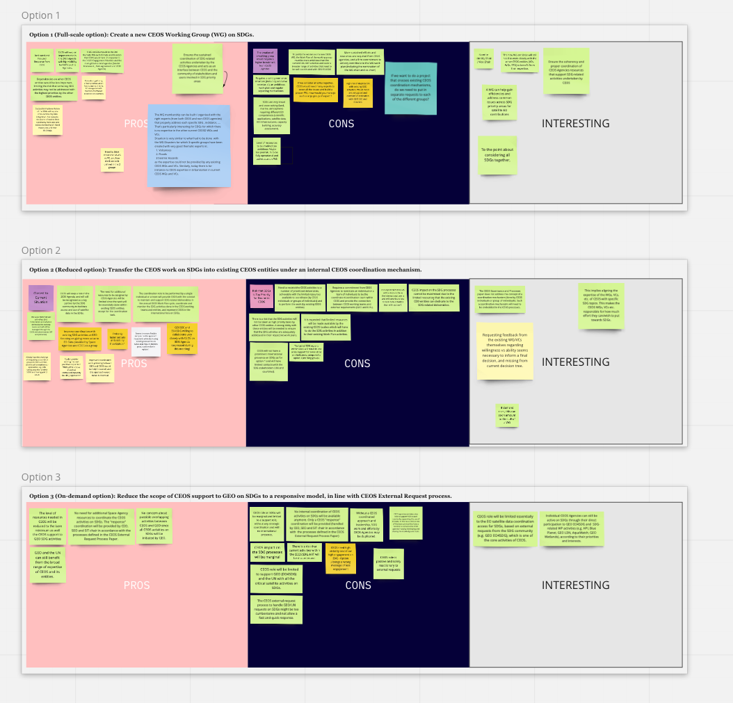
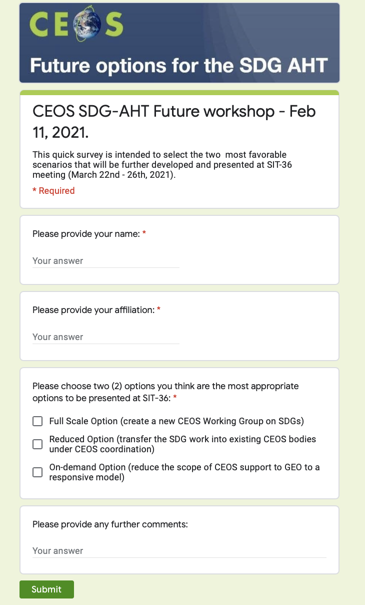
SDG AHT Future Options
Workshop
Review Pros and Cons of the 3 proposed options
Vote for most appropriate options

Slide 19
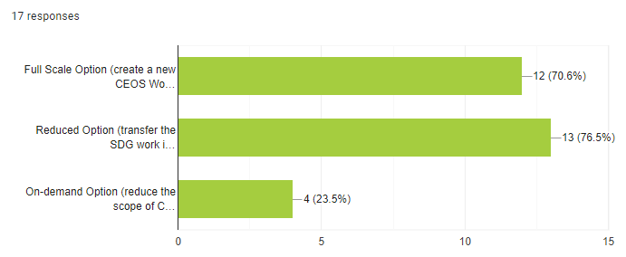
SDG AHT Future Options
Survey
Workshop participants were requested to express preferences from the available 3 options, with a maximum of 2 votes,
17 individuals from different agencies, including ESA, SIT Chair, GA, EC-JRC, JAXA, CEOS, CSIRO, CNES, NASA, GEO Secretariat,
Survey results:
Full-scale option: 70.6%
Federated option: 76.5%
On-demand option: 23.5 %

Slide 20
Full Scale Option
pros and cons
Create a new CEOS Working Group on SDGs
Pros | Cons
CEOS will keep an important role in the 2030 Agenda, with high visibility for CEOS and its Agencies. Maximises the impact on SDGs for CEOS and its Agencies. A Working Group on SDGs would be the 3rd thematic WG on the GEO Engagement Priorities. The WG membership can be built with the right experts (from both CEOS and non-CEOS agencies) to properly address each specific SDG target and indicator. Dependencies on other CEOS entities would be less important, limiting the risk that some key SDG activities may not be addressed with the highest priorities. | More sustained investment and efforts are required by CEOS agencies, with a firm commitment to actively contribute to the WG work plan. Requires a solid governance structure (including Lead and co-Lead and executive secretariat), an ambitious work plan and regular reporting mechanisms. SDGs are very broad and cross-cutting, requiring a large range of EO competences. The new WG on SDGs would need many experts to cover all the issues that the WG will address. The new WG on SDGs will still need to work closely with the other CEOS entities (VCs, WGs, SEO) to benefit from their expertise.
Notes:
R

Slide 21
Federated Option
pros and cons
Transfer the SDG work into existing CEOS entities under CEOS coordination
Pros | Cons
Can be the most flexible, cost-effective and practicable solution, allowing CEOS to stay responsive, while best using resources and expertise available within existing CEOS bodies. Could be considered as a transition solution towards the creation of a working group on SDGs (option 1), should the interests grow within CEOS agencies. The need for additional resources to be assigned by CEOS Agencies will be limited since the work will be essentially done within existing CEOS entities, except for the coordination task. The CEOS Work Plan will still reflect SDG deliverables and activities defined and will still be managed through the CEOS annual processes. | Existing CEOS bodies (WGs and VCs) may be overcommitted already and adding extra activities and deliverables on SDGs may be an unacceptable additional burden. Need to restrict the CEOS activities to a number of prioritized deliverables achievable with the limited resources available to coordinate and perform the work. The CEOS Governance and Processes paper does not address the concept of a coordination mechanism which will need to be embedded in the CEOS processes. Requires a commitment from CEOS Agencies to nominate an individual or a team of individuals to be the SDG coordinator within CEOS. It is expected that limited resources will be made available by the CEOS bodies which will have to do the SDG activities in addition to their existing Work Plan responsibilities.

Slide 22
For SIT Endorsement
The CEOS SDG AHT invites the CEOS Principals to:
“”endorse the request from the SDG AHT to further develop the two most favourable future scenarios (full scale option and federated option), through extended discussions with all stakeholders in order to come with a substantiated proposal to be reviewed and finalised with all key stakeholders during the CEOS SIT Technical Workshop in September, before its formal submission for approval to CEOS Principals at the 35th CEOS Plenary.””

