Slide 1


GHG Roadmap Update
Committee on Earth Observation Satellites
David Crisp, NASA JPL, Mark Dowell, EC
WGClimate Greenhouse Gas Task Team
CEOS SIT-36
Session 3: Carbon and Biomass, Item #3.1
Virtual Meeting
23-25 March 2021
Notes:
Greetings. This is Dave Crisp. I am honored to represent the Greenhouse Gas Task team of the joint CEOS/CGMS Working Group on Climate to give an update on our progress in the implementation of the Greenhouse Gas Roadmap

Slide 2
Topics to be Covered
Near term deliverables for the 2023 Global Stocktake (GST) – the GHG Inventory development progress, plans and schedule
  Global, regional scale CO₂ and CH₄ inventories
  Pilot inventories for local emissions hot spots
Coordination with CEOS AFOLU and SIT contributions to the GST
Coordination with Stakeholders and customers
  UNFCCC Ad Hoc Group on Systematic Observations
Near-term opportunities for interactions
  Plans for the AC-VC, IWGGMS-17 and JRC GHG/AFOLU meetings;
  Plans for Earth Information Day 2021
Notes:
The overall objectives and approach described in the Greenhouse Gas Roadmap were presented at last year’s SIT and Plenary and are summarized in the backup slides. Here, we will focus primarily on our progress in the development of the near-term deliverables to the 2023 Global Stocktake, the pilot, space-based carbon dioxide and methane inventories that will be delivered later this year at COP-26.
I will also quickly highlight some interactions between the Greenhouse Gas Task Team and other activities within CEOS that are supporting the Global Stocktake. These include the LSI-VC Agriculture Forestry and Other Land Use (AFOLU) Initiative and the strategy developed by the CEOS-SIT chair and Vice Chair to coordinate all CEOS contributions to the Global Stocktake. You will hear much more about those efforts later in the Carbon and Biomass Session.

Slide 3
GHG Roadmap Objectives
  The CEOS/CGMS WGClimate Greenhouse Gas Task Team is coordinating efforts among member agencies to:
  Work with the atmospheric CO₂ and CH₄ measurement and modeling communities, stakeholders and national inventory compilers to define requirements and plans for atmospheric flux inventories;
  Deliver pilot atmospheric CO₂ and CH₄ flux inventories in 2021 to inform the 2023 Global Stocktake (GST);
  Use lessons learned from these pilot inventory products to refine requirements needed to implement a purpose-built, operational, atmospheric inventory system for future Global Stocktakes.
Here, we report progress since the 2020 Plenary on steps 1 and 2.
Notes:
The WGClimate Greenhouse Gas Task Team is coordinating efforts among member agencies to address three objectives: We will:
work with the atmospheric CO₂ measurement and modeling communities, stakeholders and national inventory compilers to define requirements and plans for top-down atmospheric flux inventories designed to support the global stocktakes;
develop and deliver pilot atmospheric carbon dioxide (CO₂) and methane (CH₄) flux inventories at COP-26 in 2021 to inform the 2023 Global Stocktake (GST);
use the lessons learned from these pilot inventory products to refine the requirements for a purpose-built, operational, atmospheric inventory system to support future Global Stocktakes.
Here, we report progress since the 2020 Plenary on steps 1 and 2.

Slide 4
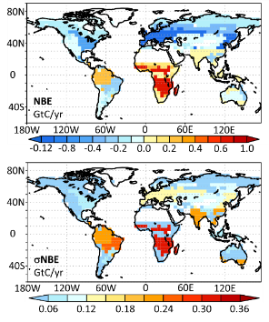
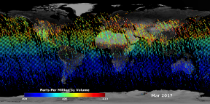
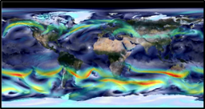
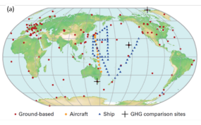
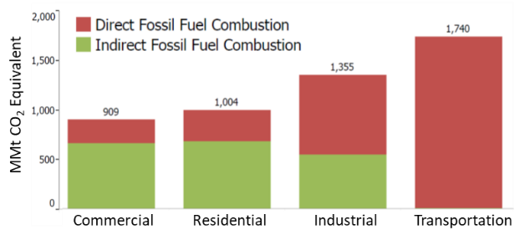
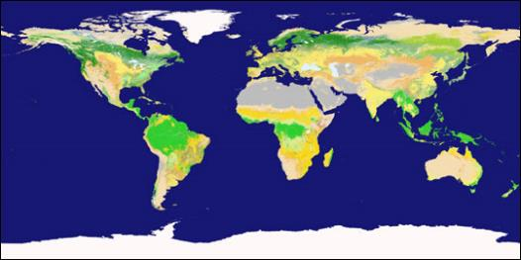
Greenhouse Gas Inventories for the Global Stocktake (GST)
Top-Down Inventories
Atmospheric Obs.
Inversion System
Observations of atmospheric CO₂ provide an integral constraint on emissions
Can track emission hot spots and rapid changes
Can detect emission changes from the natural carbon cycle caused by human activities and climate change
The 2006 and 2019 IPCC Guidelines for National Greenhouse Gas Inventories divide anthropogenic emissions into 5 sectors
  Energy, Industrial Processes and Product Use (IPPU), Agriculture, Forestry and Other Land Use (AFOLU), Waste and “Other” sectors
Space-based XCO₂
Transport Model
CO₂ Flux
Inverse Model
Ground-based CO₂
Uncertainty
Bottom-Up Inventories
Provide sector-specific estimates of emissions from known sources.
Earth Observations play a critical role for tracking land use change.
Land Use Map
Notes:
I will start with a quick review of the requirements for the greenhouse gas inventories delivered to support the global stocktake, and explain were CEOS might contribute.
As you all know, starting in 2021, the Parties to the Paris Agreement will start to compile inventories of greenhouse gas emissions to assess their progress toward their Nationally Determined Contributions (NDCs) for the first Global Stocktake.
These inventories will be based primarily on Bottom-up statistical methods specified by the 2006 and 2019 Intergovernmental Panel on Climate Change (IPCC) Guidelines for Greenhouse Gas inventories.
The 2006 and 2019 IPCC Guidelines divide all anthropogenic greenhouse gas emissions into 5 sectors: Energy, Industrial Processes and Product Use (IPPU), Agriculture, Forestry and Other Land Use (AFOLU), Waste and a sector simply called “Other.” Each sector is subdivided into categories. For example, transportation is a category within the Energy sector.
Bottom-up statistical inventories estimate greenhouse gas emissions from the number tons of coal or barrels of oil consumed by specific categories. They estimate AFOLU emissions using statistics such as the number of acres converted from forest to crops or vice versa, but only consider changes on managed land.
Additional details on the inventory reporting process are summarized in the backup slides.
In the developed world, these bottom-up techniques usually provide accurate estimates for fossil fuel emissions, but are somewhat less reliable for tracking changes in emissions from AFOLU. They also sometimes miss emissions in regions experiencing rapid economic changes or land areas responding to disturbance or climate change.
Next timestep:
Top-down atmosphere inventories estimate emissions from direct measurements of the carbon dioxide or methane concentrations in the atmosphere at high spatial and temporal resolution, and then use an inverse modeling system to derive the emissions distribution needed to maintain the observed concentrations in the presence of the winds.
These top-down atmospheric inventories complement the conventional bottom-up statistical inventories to provide a more complete and transparent assessment of emissions.

Slide 5
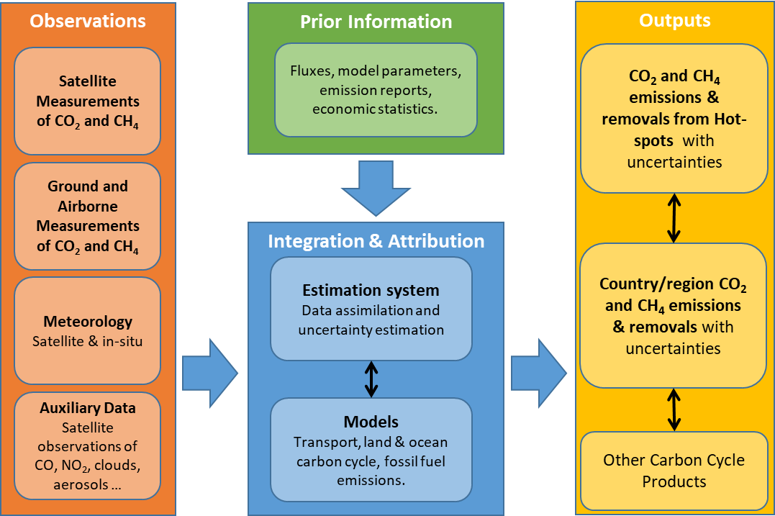
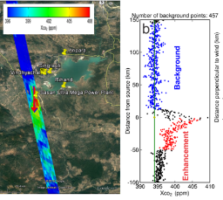
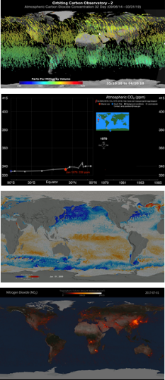
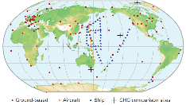
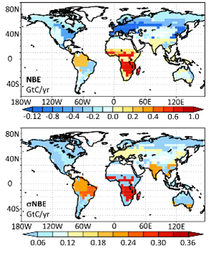
A System Approach for Generating Inventories
Inverse Modeling System
Measurements
Models
Emissions
Notes:
Here, we propose to use a state-of-the art, global, inverse modeling system to generate top-down atmospheric inventories from ground-based and space-based data. This approach assimilates greenhouse gas measurements into a modeling architecture that incorporates atmospheric transport from state-of-the-art meteorological models with an inverse system that optimizes the distribution of CO₂ and CH₄ emissions and uptake needed to simulate the observed distribution of these gases in the presence of the wind field.
This approach produces spatially resolved maps of greenhouse gas fluxes. These maps form the primary input for the top-down atmospheric greenhouse gas inventories that we will be delivering for use in the Global Stocktake.

Slide 6
Pilot Global Atmospheric Inventories
For the 2023 Global Stocktake, pilot top-down inventories are limited by available space-based measurements and inverse models
Pilot CO₂ inventory requirements and products
  IPCC Verification activities can be performed on national or multi-national spatial scales at annual, bi-annual and 5-year time scales
    Product: CO₂ and CH₄ Flux maps at 4°x5° resolution at monthly intervals
  National inventory development requires higher spatial resolution
    Product: CO₂ and CH₄ flux maps at 1°x1° resolution at monthly intervals
  Localized emission hot spots
    Product: CO₂ and CH₄ fluxes from large urban areas or discrete sources
Inventory quantities derived from flux products
  Optimized total emissions: Total net CO₂ and CH₄ flux and stock change
  Fossil fuel emissions: Input (not optimized) emissions with uncertainties
  Non-Fossil Fuel emissions (AFOLU + Natural): Optimized fluxes and stock changes with uncertainties
Notes:
For the 2023 Global Stocktake, the information content of our pilot top-down inventories is limited by the available space based measurements and inverse modeling capabilities. However, we can still generate three types of inventory products will be developed to support this Global Stocktake:
The first includes regional to global scale products that can be used by the IPCC to assess how well the combined efforts by all nations are meeting the overall greenhouse gas emission reduction goals. For this application, we will deliver CO₂ and CH₄ Flux maps with uncertainties at 4°x5° resolution at monthly intervals.
The second set of inventories are nation-scale products for use by inventory developers to compile their bottom-up inventories and assess their progress toward their Nationally-Determined Contributions (NDCs). For this application, we will deliver CO₂ and CH₄ flux maps at 1°x1° resolution at monthly intervals. These maps should provide insight into the emissions from medium to large countries (countries larger than France or Turkey). Future space-based systems, such as the Copernicus CO2M constellation will provide the data needed to support higher resolution products.
The third set of inventory products will be derived from observations of emission plumes from a few localized sources, such as large urban areas or power plants.
These regional, national, and local inventories will quantify three classes of emissions:
The first is optimized total emissions of CO₂ and CH₄ with their uncertainties for regional-scale verification efforts;
The second will include fossil fuel emissions – These emissions will be prescribed in the flux inversion experiment and will not be optimized, but will be reported with their uncertainties. Future atmospheric inventory systems will optimize fossil fuel emissions;
Finally, we will report non-fossil fuel emissions – These estimates will incorporate AFOLU as well as emissions and uptake by the natural biosphere.
As we prepare these inventory products, we will collaborate with the CEOS AFOLU group to determine how we might use their emission inventories to attribute AFOLU contributions to the non-fossil fuel emissions.

Slide 7
Pilot Inventory Inputs and Work Flow for COP-26
Global CO₂ Inventory development by OCO-2 Flux MIP Team
  OCO-2 Flux MIP Team is initiating effort to generate fluxes from OCO-2 v10 products spanning 2015 – 2020
    Initial products expected by end of August 2021
    OCO-2 v9 MIP products are being used to support development of tools to create CO₂ inventories from Flux MIP products
      Demonstration products available for review by 2021 SIT TW, followed by final products ready by 2021 Plenary
Global CH₄ inventory development by CMS (J. Worden, NASA/JPL)
  Global flux products based on new, bias-corrected TROPOMI data
  Bayesian partitioning algorithms employing tracers (fire emissions, in situ CH₄ isotope and ammonia data) to quantify emissions by sector
    Demonstration products available at the SIT TW
Local Hot Spot Emissions (JAXA, ESA, NASA)
  Products managed by individual PI Teams
Notes:
The global flux input products for regional and national inventories have been selected.
For carbon dioxide, the global, regional-scale and national-scale inventories will be based on flux estimates being developed by the Orbiting Carbon Observatory Flux Multi-model Intercomparison Project (OCO Flux MIP). This international effort currently includes participation by a dozen modeling teams from the US, Europe, and Australia. These teams use a broad range of transport model architectures, meteorological inputs, and flux optimization methods to assess the impact of these choices on the estimated fluxes and their uncertainties.
Each team derives flux maps based on ground-based in situ CO₂ measurements alone, and combinations of these measurements with estimates of the column average CO₂ dry air mole fraction from the Orbiting Carbon Observatory-2 mission.
We have flux products based on the OCO-2 version 9 CO₂ products. These fluxes are adequate for supporting tool development activities, but only cover 2014-2019 and have known biases over the ocean.
The Flux MIP team has started deriving fluxes from the OCO-2 version 10 CO₂ products. Those products have improved accuracy and extend over the full mission duration, from September 2014 to present. Version 10 MIP products through 2020 will be delivered in late summer of 2021 for use in the inventories presented at COP-26. This product will be extended through 2021 during the GST Information Collection period in 2022.
For Methane, the global, regional-scale and national inventories will be based on flux estimates produced by the NASA Carbon Monitoring System Flux group (CMS-Flux). This team will combine ground-based in situ measurements of methane with column average methane dry air mole fraction estimates from the Copernicus TROPOMI mission.
The CMS-Flux team is developing inversion algorithms that incorporated advanced methods for attributing top-down emissions to known surface emission sources. This approach is especially useful for methane because of its diverse range of sources, including fossil fuel extraction activities, leaky pipes, wetlands, wet agriculture, livestock, landfills, etc.
Space-based measurements of carbon dioxide and methane do not yet have the spatial resolution and coverage to track all local hot spots. However, they can provide numerous examples including large urban areas, individual power plants, and oil and gas extraction areas. Products developed by several individual PI teams are being reviewed to provide examples of the utility of space-based measurements for monitoring emission hot spots.
The current plan is to generate initial examples of regional, national and local products in time for review at the SIT Technical Workshop in September. These products will then be refined between the SIT-TW and the Plenary. The next three slides show examples of each of these product types.

Slide 8
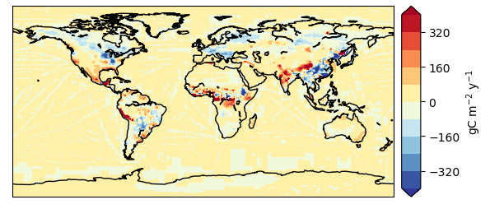
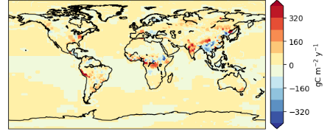
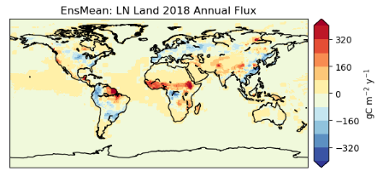
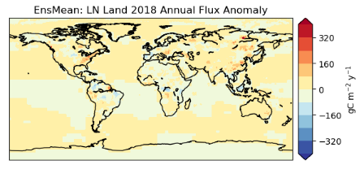
Global 1°x1° CO₂ Flux Products from OCO-2 v9 MIP
2018 non Fossil Fuel Fluxes
Flux Uncertainties
In situ only
OCO-2 Land Nadir
Non-fossil fuel fluxes (left column) and their uncertainties (right column) based on in situ CO₂ and OCO-2 version 9 (v9) XCO₂ products from the v9 MIP.
10 different inverse models used to assess impact of transport and model architecture.
Experiments using only in situ CO₂ or observations for specific space-based datasets show impact of accuracy and coverage on fluxes and uncertainties.
Notes:
Here, we show examples of the non-fossil fuel CO₂ flux maps from the OCO-2 v9 Flux MIP system. These maps show the median CO₂ fluxes from the 10-model ensemble used in this MIP. The uncertainties were derived from variance among the model outputs.
The top two plots show CO₂ fluxes and their uncertainties that were derived using only ground-based in situ CO₂ measurements. In some parts of the world, such as the tropics, the uncertainties are as large as the fluxes because there are very few in situ measurements there. The lower pair of plots show fluxes derived using the OCO-2 v9 land nadir observations. OCO-2 collects about a half million CO₂ estimates over tropics each month. These experiments indicate that tropical regions are now a net source of carbon dioxide.

Slide 9
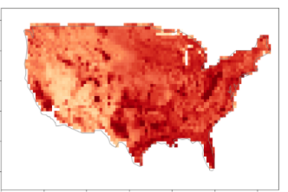
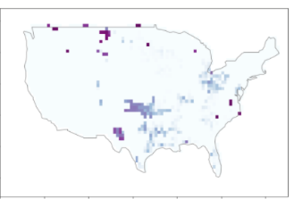
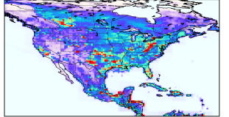
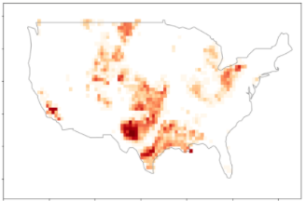
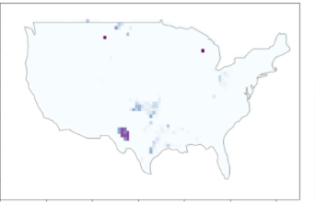

Methane Fluxes and Inventories
Advanced flux inversion algorithms use satellite observations to update the emissions and quantify their uncertainties
  Requires the inversion to provide well characterized uncertainties, their covariance, and spatial sensitivity (this has traditionally been computationally expensive)
CH₄ emissions (kg h⁻¹)
Error reduction (%)
Total flux “posterior”
Bayesian partitioning
1
10²
10⁴
Gas
-80
-40
0
Gas
1
10²
10⁴
Oil
-80
-40
0
Oil
By quantifying error reduction, they can also assess how well our current observing system performs, and where additional observations may be needed.
Notes:
Here, we show examples of methane flux maps from the CMS Flux project, assimilating TROPOMI methane products. Some of the largest fluxes are seen over fossil fuel extraction areas, such as the Permian Basin in West Texas. The CMS Flux team is evaluating methods for attributing these and other methane emissions to specific sources.

Slide 10
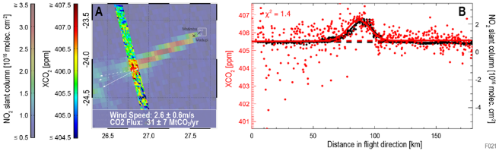
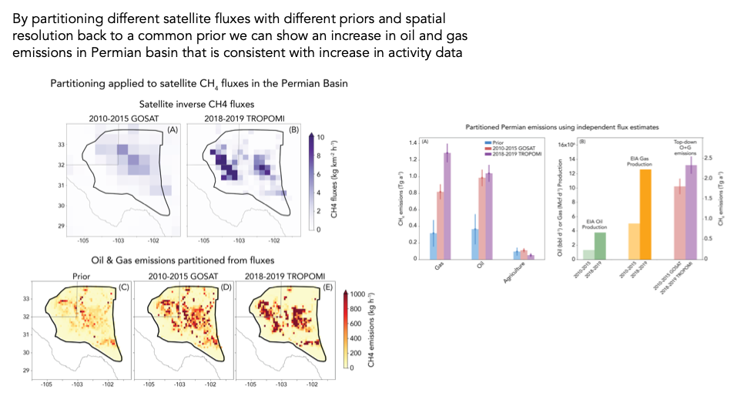
Pilot Products for Localized Hot Spots
In addition to global, national-scale atmospheric inventories, we are developing pilot products for localized sources including large urban areas, power plants and oil fields
OCO-2 and TROPOMI observations are combined to quantify emissions from powerplants and large urban areas
The CMS-Flux team is tacking methane emissions from fossil fuel extraction
These products illustrate methods for tracking hot spots for future GST’s
Reuter et al., ACP 2020
OCO-2 XCO₂ and TROPOMI NO₂ quantify CO₂ emission by large South African power plants
J. Worden et al.
CH₄ emissions changes over Texas oil fields
Notes:
Here we show examples of CO₂ and methane fluxes derived using a variety of methods.
The top plot shows CO₂ emissions estimates from a power plant plume, derived by combining TROPOMI NO₂ measurements and OCO-2 CO₂ data.
The bottom plot shows spatial variations in methane emissions over the oil fields in Western Texas and New Mexico.
These and other products from individual teams are being reviewed for use as demonstration products for local emission hot spots for the GST.

Slide 11
CEOS GHG Pilot Inventory Development Progress
The top-down atmospheric CO₂ and CH₄ inventory development process summarized at the 2020 CEOS Plenary continues on schedule
Global carbon dioxide (CO₂) products from the OCO-2 Flux Multi-model Intercomparison Project (Flux MIP) have been adopted as the baseline input for the 2023 Global Stocktake (GST)
  Combine in situ CO₂ measurements with space-based estimates of the column-averaged CO₂ dry air mole fraction (XCO₂) from OCO-2 v10 product to predict fluxes and stock changes
Global methane (CH₄) product from the NASA Carbon Monitoring System (CMS) team adopted for 2023 GST
  Uses in situ CH₄ and GOSAT and TROPOMI products
Urban-scale emission products from OCO-2, GOSAT, and TROPOMI teams are being considered for demonstration products
CARB-21-01
Notes:
The top-down atmospheric CO₂ and CH₄ inventory development process summarized at the 2020 CEOS Plenary continues on schedule.
The OCO Flux MIP team has adopted the CO₂ inventory development effort for the GST as a major focus of its work this year.
John Worden (NASA/JPL) has volunteered to lead the development of the CMS methane flux products for the GST.
We are working with individual PIs on the OCO, GOSAT and TROPOMI teams to develop example local flux products as demonstration products for the GST.
We plan to present initial products from these efforts at the SIT-Technical Workshop in September.

Slide 12
Interactions with Other CEOS GST Activities
Collaboration with the CEOS AFOLU team to identify target audiences, refine requirements, and coordinate products
  Comparisons of the CEOS GHG and AFOLU inventories could:
    Facilitate attribution of GHG fluxes to specific sectors
    Quantify relative roles of AFOLU and natural fluxes on regional scales
    Provide a closure experiment to improve the accuracy and reliability of Terrestrial Biospheric models (TBMs) and Dynamic Global Vegetation Models (DGVMs) used diagnose the natural carbon cycle and predict its response to disturbances and climate change
CEOS Strategy to Support the Global Stocktake
  Contributed to discussion of IPCC methodology, products and uses of the space based contributions to the GST
    GHG inventories more directly relevant to IPPC Stocktake validation
    AFOLU products more directly relevant to national inventory development
  Identified potential synergies between the GHG and AFOLU contributions to the mitigation efforts
CARB-20-01
CARB-20-02
CARB-21-04
Notes:
While we have been focusing primarily on our deliverables to the Global Stocktake, the WGCllimate Greenhouse Gas Task Team has been collaborating with the ongoing efforts by the CEOS LSI-VC AFOLU initiative and the CEOS Strategy to Support the Global Stocktake.
For both efforts, we have attempted help identify the primary GST methodologies, customers and requirements for the Global Stocktake. We have also highlighted the contributions that CEOS can make by clearly identifying both the best available space-based products for use in the inventories and the best practices for their integration with conventional bottom-up inventories.
Finally, we have helped to identify potential synergies between the GHG and AFOLU contributions to the mitigation efforts. In this context, we hope to start a discussion of possible closure experiments that combine these products to improve the Terrestrial Biospheric models (TBMs) and Dynamic Global Vegetation Models (DGVMs) that are being used diagnose the natural carbon cycle and predict its response to disturbances and climate change.

Slide 13
Interactions with Stakeholders
UNFCCC Ad Hoc Coordination Group on Systematic Observations
  Jeff Privette, Jörg Shulz, and I were nominated to represent WGClimate
  Mark Dowell and Osamu Ochiai are also serving on this group
  Participated in planning meetings
  Participated in 2020 Earth Information Day
    Contributed a poster describing CEOS GHG inventories
    Participated in panel: “Recent advances in Earth observation technology and data processing to support decision making.”
  Coordinating contributions to Synthesis Paper on Systematic Observations
CARB-20-02
Notes:
As announced at the Plenary, Jeff Privette, Jörg Shulz, and I were nominated to represent WGClimate on the UNFCCC Ad Hoc Coordination Group on Systematic Observations. Other CEOS colleagues who are working with this group include Mark Dowell and Osamu Ochiai. We have participated actively in the initial meetings of this group and are now contributing to the outline of a synthesis paper on systematic observations.
The GHG Task Team was also invited to participate in the 2020 Earth Information Day on 30 November 2020. We participated in a panel, and contributed a poster describing our atmospheric greenhouse gas inventory development efforts. This coming year, we are hoping to present a series of posters, describing the regional scale, national scale and local scale inventory products.

Slide 14
Decisions, Outcomes and Action
Decisions
  None requested at this time.
Outcomes
  Recognize the growing connections between CEOS GHG, AFOLU and other efforts in support of the Global Stocktake
Actions
  Continuing support for inventory development activities
Notes:
At this time, the greenhouse gas inventory development activities are on track and we are not requesting any additional Decisions, Outcomes or new Actions by CEOS Principals, but we very much appreciate your continuing support for our ongoing efforts.

Slide 15
Upcoming Meetings and Interaction Opportunities
19-30 Apr: EGU - Science-based Greenhouse Gas Emission Estimates in Support of National and Sub-National Climate Change Mitigation
  Crisp and Dowell - Top-down Atmospheric Inventories of CO₂ and CH₄ to Support the Global Stocktakes
7-11 June: AC-VC Annual Meeting
  Opportunity to report progress and review inventory development activities
15-18 June: 17th International Workshop on Greenhouse Gas Measurements from Space (IWGGMS-17)
  Meeting with 200-300 members of the science community, spanning space-based GHG measurement, analysis and flux inversion
22-24 June: Earth Observation contributions on GHG and AFOLU in support of the Paris Agreement: Synergies and Opportunities
  Opportunity to coordinate GHG and AFOLU inputs across the carbon cycle, national inventory, and stakeholder communities
Notes:
Finally, besides the CEOS SIT, SIT Technical Workshop and Plenary, and Earth Information Day, there are a number of opportunities to meet with stakeholders and members of the science community. Some are listed here.

Slide 16
Backup

Slide 17
IPCC Guidelines for Reporting Emission Inventories
The 2006 and 2019 IPCC Guidelines for National Greenhouse Gas Inventories divide anthropogenic emissions into 5 sectors
  Energy, Industrial Processes and Product Use (IPPU), Agriculture, Forestry and Other Land Use (AFOLU), Waste and “Other” sectors
Bottom-up statistical inventories form the basis for tracking emissions in each category of each sector
  Energy and AFOLU are the dominant emission sectors
  Energy sector typically has the lowest relative uncertainties while those from AFOLU have the largest
  AFOLU reports only include emissions from “managed land”
The 2019 update to the IPCC Guidelines for National GHG Inventories
  acknowledges advances in ground-based and space-based measurements and atmospheric inverse models
  Recognizes the value of top-down atmospheric inventories as an independent method for verifying bottom-up inventories

Slide 18
Top-down Atmospheric Inventories for the GST
Top-down atmospheric inventories
Describe the total net emissions and uptake of CO₂ and CH₄ from all processes, including:
  Anthropogenic sources from all sectors listed by the IPCC
  Natural processes such as the solubility of CO₂ in the ocean, biospheric uptake and release of CO₂ by photosynthesis and respiration, respectively, or CH₄ emissions from natural wetlands
Are less source specific than bottom-up statistical inventories, but
  Can be combined with coincident observations of reactive gases (CO, NO₂), vegetation indices or solar induced chlorophyll fluorescence (SIF), to partition net carbon fluxes between combustion, anthropogenic, and natural sources
Directly link national net carbon emissions to the CO₂ growth rate and its impact on the climate
  Climate physics only cares about the total CO₂ budget

Slide 19
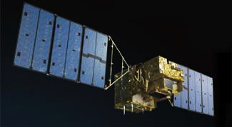
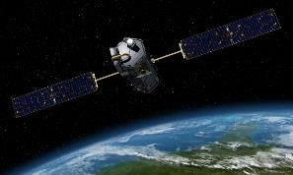
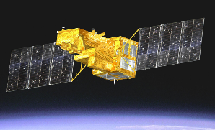

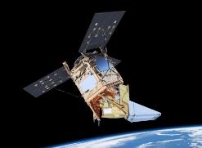
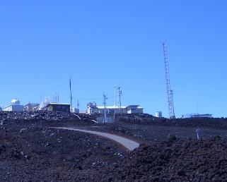
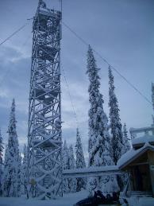
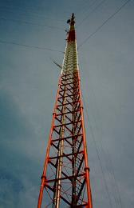
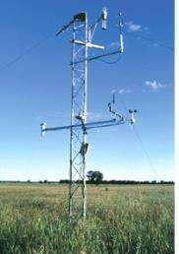
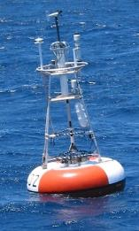
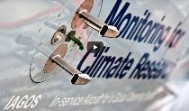
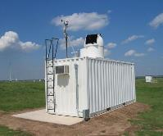

Growing Capabilities in GHG Measurements
Space-based measurements of CO₂ and CH₄ from a growing fleet of satellites are less precise and accurate but provide high spatial and temporal resolution and greater coverage of the globe.
Ground-based measurements of GHGs from the WMO Global Atmospheric Watch (GAW) Network and its partners provide accurate estimates of atmospheric CO₂ and CH₄ concentrations and their trends on global scales.
Notes:
The Growing Atmospheric Greenhouse Gas Measurement Capabilities
Frequent, high-resolution, global measurements of carbon dioxide and methane are essential for creating atmospheric inventories. Since 1958, atmospheric carbon dioxide, methane and other greenhouse gases have been routinely measured from a growing network of ground-based, airborne and space based sensors. Ground-based and airborne measurements of GHGs from the World Meteorological Organization’s Global Atmospheric Watch (GAW) Network and its partners provide the most accurate estimates of these greenhouse gas concentrations and their trends on global scales. The capabilities of these ground-based and airborne systems are improving as they incorporate new technologies, but this network still does not provide the resolution and coverage needed track emissions on sub-national to national scales.
Next timestep.
Meanwhile, space-based measurements of CO₂ and CH₄ are now being collected from a growing fleet of satellite sensors operated by CEOS and CGMS agencies. Currently Japan’s GOSAT and GOSAT-2, NASA’s Orbiting Carbon Observatories 2 and 3, and the European Copernicus Sentinel 5 Precursor TROPOMI spectrometers are returning CO₂ and CH₄ measurements. These space-based measurements are less precise and accurate that their ground-based counterparts, but complement those data with much higher spatial and temporal resolution and much greater coverage of the globe.

Slide 20
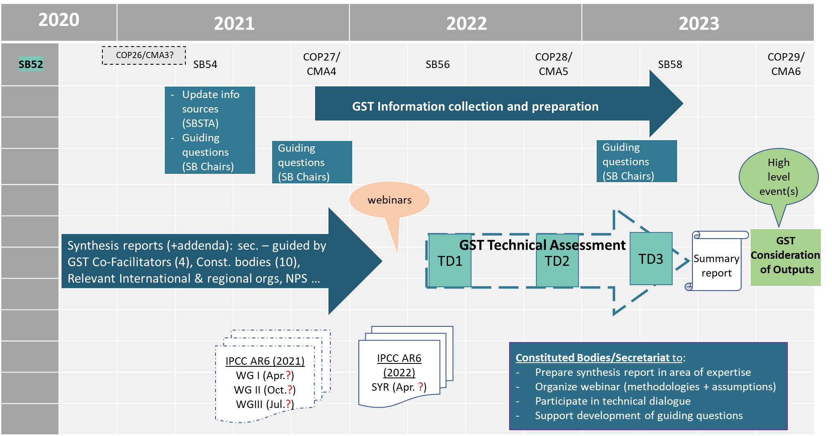
2023 Global Stocktake Timeline
COP26
Revised from Joanna Post,
Programme Officer UNFCCC secretariat

Slide 21
Providing Tools, Creating Interfaces, Capacity Building
The objective of this activity is to provide a product that starts a conversation with the relevant players and establishes the role of atmospheric inventories in future Global Stocktakes
While existing space-based infrastructure and analysis capabilities are still evolving rapidly and are providing key insights into the emissions and uptake of CO₂ and CH₄ by natural processes and human activities, they are not expected to fully address the requirements of the first UNFCCC Global Stocktake in 2023
However, these tools are adequate for generating products that illustrate the capabilities of future space-based greenhouse gas monitoring and analysis systems
These pilot products are expected to foster the development of requirements with CEOS stakeholders (UNFCCC, GCOS) and interfaces with users in the national inventory communities who will be using the outputs of the much more capable system coming on line to support the 2028 and future GSTs at 5-year intervals

Slide 22
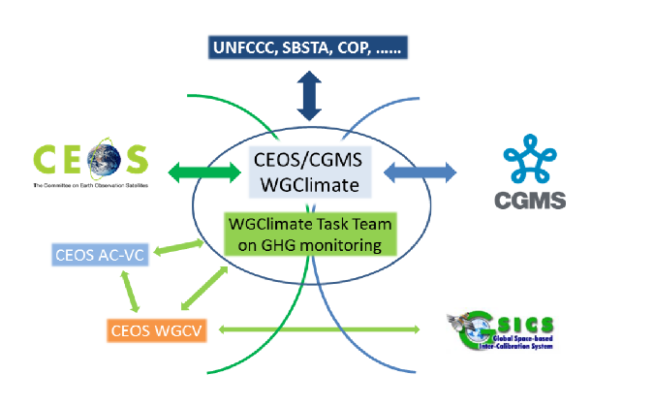


WGClimate GHG Task Team
Mark Dowell (EC, WGClimate, Task Team Lead)
Albrecht von Bargen (DLR, WGClimate Vice-chair, deputy Task Team lead ex officio)
Frederic Chevallier (LSCE/IPSL)
David Crisp (NASA, CEOS AC-VC)
Carole Deniel (CNES)
Richard Engelen (ECMWF)
Hiroshi Suto (JAXA)
Akihiko Kuze (JAXA, CEOS WGCV)
Rüdiger Lang (EUMETSAT)
Yasjka Meijer (ESA)
Paul Palmer (UKSA)
Hiroshi Tanimoto (NIES)
Alisa Young (NOAA)
Others are being nominated by CGMS and GSICS

Slide 23


High Level GHG Roadmap Timeline for the 2023 Global Stocktake
Global Stock
Take 1
Global Stock
Take 2
using inventories through 2021
using inventories through 2026
2015
2017
2019
2021
2023
2026
2028
CEOS GHG Whitepaper
Pilot
atmospheric
CO₂/CH₄
Data sets
Atmospheric
GHG data sets
from operational system
Initial
Operational
GHG
Constellation
Deployment
Compile
Inventory
Requirements
Refine
atmospheric
GHG
requirements

Slide 24
Top-down Emission Attribution
Attributing top-down emissions to specific sources is challenging, but new methods are being developed to project optimized emissions back to known emission sources.

Slide 25
Participants in the OCO-2 CO₂ MIP
Model | Contact | Institution | Transport Model | Meteorology | Inverse Method
Ames | Matthew Johnson and Sajeev Philip | NASA Ames Research Center | GEOS-Chem | MERRA-2 | 4D-Var
CAMS | Frédéric Chevallier | LSCE France | LMDz | ERA-interim | 4D-Var
CMS-Flux | Junjie Liu | NASA JPL | GEOS-Chem | GEOS-FP | 4D-Var
CSU | Andrew Schuh | Colorado State University | GEOS-Chem | MERRA-2 | Bayesian synthesis
CT | Andy Jacobson | University of Colorado and NOAA ESRL | TM5 | ERA-interim | EnKF
G5APR | Brad Weir | NASA GMAO | GEOS5 | MERRA-2 | n/a
OU | Sean Crowell | University of Oklahoma | TM5 | ERA-interim | 4D-Var
PCTM | David Baker | Colorado State University | PCTM | MERRA-2 | 4D-Var
TM5-4DVAR | Sourish Basu | University of Maryland and NASA GMAO | TM5 | ERA-interim | 4D-Var
UT | Feng Deng | University of Toronto | GEOS-Chem | GEOS-FP | 4D-Var
https://www.esrl.noaa.gov/gmd/ccgg/OCO2_v9mip/

Slide 26
Linkages to CEOS Work Plan Cited
ID | Title | Due | Description | Responsible
CARB-20-01 | Develop a CEOS AFOLU roadmap | 2021 Q4 | Provides a more integrated, end-to-end system for interaction between space data providers and policy users including UNFCCC;IPCC etc. | LSI-VC, WGClimate GHG TT | Osamu Ochiai
CARB-20-02 | Integrated Carbon Cycle interface between CEOS and the UNFCCC | 2021 Q4 | This task will explore enhancement of the relationship between space data providers and the policy needs of conventions and the parties to the conventions | SIT Chair | Mark Dowell
CARB-21-01 | GST1 Prototype Products and Guidance | 2021 Q4 | Develop prototype CEOS data products and associated user guidance material in support of national and global level users for the 1st GST | AC-VC, WGClimate GHG TT | David Crisp
CARB-21-04 | CEOS UNFCCC GST Strategy | 2021 Q2 | Prepare an outline strategy paper proposing the CEOS approach to support for the UNFCCC GST process | SIT Vice-Chair | I. Petiteville, S. Briggs
Note: all of the Deliverables cited here are in progress.

