Slide 1
Carbon & Biomass Session
Committee on Earth Observation Satellites
CEOS SIT-36
Session 3, 23rd March
Session Chair: Adam Lewis
Virtual Meeting
23-25 March 2021

Slide 2
Carbon & Biomass Session
Introduction & Objectives
Australian SIT Chair Team
3 mins
Committee on Earth Observation Satellites
CEOS SIT-36

Slide 3
A SIT term priority
Supporting the GHG Roadmap process – escalating, elevating, and accelerating progress towards major milestones, including for the 2023 Global Stocktake. 2021 prototype flux products.
Encouraging stronger and more systematic CEOS engagement with convention frameworks – building on IPCC outreach
And national inventory communities as our future users
Reflecting large investment (2018-2024) in Above-Ground Biomass missions and seeking to accelerate the policy relevance of these new data (GFOI, GEOGLAM…)
Promote uptake of biomass datasets beyond science community – forest monitoring, inventories…

Slide 4
What do we hope to achieve?
(Very) big picture… an optimally efficient and effective partnership between space data providers and the main UN and national stakeholders that use our data to make and manage policy.
CEOS exploring more integrated and pro-active relationships with major stakeholders in conventions and national inventories - to accelerate the policy impact and application of our data
Shine a light on the underlying technical work underway in the organisation and agencies and advocate for support from Principals for it to realise its full potential. Elevate, escalate, accelerate.

Slide 5
Specific objectives/agenda today
Focus on our work in support of UNFCCC and the Global Stocktake
GHG Task Team (Dave & Mark - recorded presentation, focus on questions)
AFOLU Task Team (Osamu & Frank Martin)
CEOS Strategy for the Stocktake, to bring broad context and coordination across the CEOS structure (SIT Vice-Chair, ESA)
Endorsement of the CEOS Biomass Protocol
WGCV LPV Team (Laura)
Update on the Reference Network concept
15 mins
20 mins
30 mins
20 mins
Add comments and questions via GTM chat at any time in the session

Slide 6
GHG Roadmap Summary
15 mins
Committee on Earth Observation Satellites
David Crisp, NASA JPL, Mark Dowell, EC
AC-VC, WGClimate Greenhouse Gas Task Team
CEOS SIT-36
Virtual Meeting
23-25 March 2021

Slide 7
Global Atmospheric CO₂ Inventories
Pilot CO₂ inventory requirements and products
IPCC Verification activities can be performed on national or multi-national spatial scales at annual, bi-annual and 5-year time scales
Capability: Available data and models limits global inverse models to ~2°x2° at monthly time scales (most models run at 4°x5°)
Product: CO₂ Flux maps at 4°x5° resolution at monthly intervals adopted to facilitate more complete uncertainty quantification
National inventory development requires higher spatial resolution
Product: CO₂ flux maps at 1°x1° at monthly intervals
Quantities delivered in pilot inventories
Optimized total emissions: Total net CO₂ and CH₄ flux and stock change
Fossil fuel emissions: Input (not optimized) emissions with uncertainties
Non-Fossil Fuel Fluxes (AFOLU + Natural): Optimized fluxes and stock changes with uncertainties
If possible, estimates produced by the CEOS AFOLU team will be used to estimate AFOLU contributions to non-fossil fuel flux

Slide 8
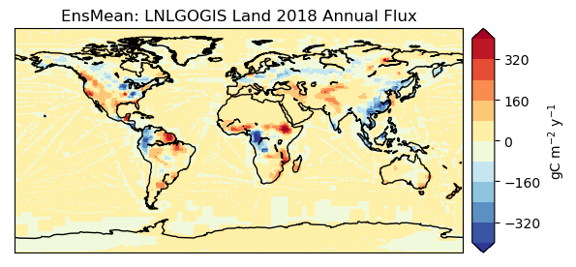
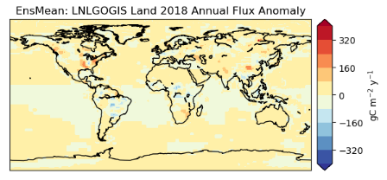
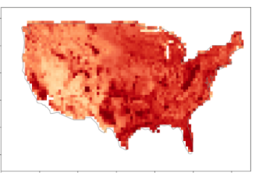
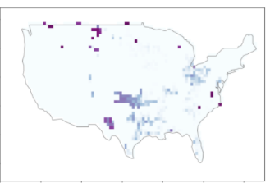
Flux Inventories
Regional-scale Global CO₂ Inventories,
based on OCO-2 Flux products (OCO-2 MIP Team)
Regional-scale Global CH₄ Inventories
based on CMS TROPOMI flux inversions (J. Worden, JPL)
Localized Emission Hot Spots
Examples provided by individual PI Teams
2018 non-Fossil Fuel Fluxes
Flux Uncertainties
Gas
Gas
1
10²
10⁴
-80
-40
0
CH₄ emissions (kg h⁻¹)
Error reduction (%)
OCO-2 XCO₂ and TROPOMI NO₂ quantify CO₂ emission by large South African power plants (Reuter et al., ACP 2020)

Slide 9
Questions submitted in advance (others welcome via chat as time permits)
SIT Chair Team
We assume we need a coordinated comms effort targeting COP-26 and the EID? Can SIT Chair and CEOS Chair help coordinate this during 2021?
Will the June GHG-AFOLU meeting explicitly address the compatibility needed between the atmosphere and land products or do we need some special further effort?
ESA
Could you say something more about the very promising combination of TROPOMI and OCO-2 observations and how these could be used most effectively?
Re COP26 (references here and elsewhere) could UKSA say something about UK preparations and whether they could afford further opportunities for communications events?
UKSA
It would be good if you could comment on whether we should synthesize key results or findings (in addition to data sets) for GHGs in time for COP-26 and how might we do this as CEOS?
Notes:
Here are our specific objectives and the supporting agenda items. Talk through briefly…
Q&A break after Biomass on any topics that featured prior. And again after the UNFCCC/policy discussion. Please keep to time. We wish to cover all ground even if this format is more of a preliminary discussion than we would have liked. Use sli.do to input comments and questions that arise and we will moderate those for an efficient Q&A.

Slide 10
CEOS AFOLU Roadmap Update
Task Team
Osamu Ochiai (JAXA) &
Frank Martin Seifert (ESA)
20 mins
Committee on Earth Observation Satellites
SIT-36 Virtual Meeting
Agenda item 3.2
23-25 March 2021
Notes:
Welcome to the Carbon and Biomass session. This was intended to be the largest of our sessions in Hobart auss how CEOS might consider strengthening the policy relevance of our datasets with the main UN and national stakeholders that use our data to make and manage policy. We still have a substantial agenda with significant points for discussion by Principals.
nd featured a number of external speakers to bring some alternative perspectives to our work and to equip us to disc

Slide 11
Background
Recognised for land sector issues in recent IPCC reports - substantial capabilities of CEOS agencies in this area and needs raised by UNFCCC
AFOLU Task Team, led by LSI-VC Forests and Biomass, established
Discussion paper prepared for 2020 CEOS Plenary
A CEOS AFOLU Initiative for the UNFCCC Global Stocktake Process: A Discussion Paper for CEOS Plenary to explore the development of a CEOS AFOLU Roadmap
Provide a clear statement of the technical capabilities of CEOS agency EO satellite data and their characteristics - capabilities and datasets for inclusion in the UNFCCC Synthesis Report on Systematic Observations
Propose a specific way forward for 2021 and deliverables for GST1 as the critical first deadline
Significant interest expressed at Plenary on coordination of the CEOS activities for the GST & ensuring necessary communication, inc between GHG and AFOLU
CEOS-34-07 : CEOS Agriculture, Forestry, and Other Land Use (AFOLU) Roadmap Team to follow up with CEOS Agencies to determine their willingness to contribute to the development of an AFOLU Roadmap. In 2021, the effort will prioritise AFOLU Products for the first UNFCCC Global Stocktake give the urgency, followed by a longer-term vision in a CEOS Roadmap document.
Notes:
Here are our specific objectives and the supporting agenda items. Talk through briefly…
Q&A break after Biomass on any topics that featured prior. And again after the UNFCCC/policy discussion. Please keep to time. We wish to cover all ground even if this format is more of a preliminary discussion than we would have liked. Use sli.do to input comments and questions that arise and we will moderate those for an efficient Q&A.

Slide 12
AFOLU Team Participation
Co-Lead: Osamu Ochiai, JAXA & GFOI Co-Lead
Co-Lead: Frank Martin Seifert, ESA & GFOI Co-Lead
Member
Shanty Reddy, Australia
Kostas Papathanassiou, DLR
Richard Lucas, ESA/CCI
Shaun Quegan, UK & ESA/CCI
Heather Kay, ESA/CCI
Zoltan Szantoi, EC & LSI VC
Ian Jarvis, GEOGLAM
Alyssa Whitcraft, GEOGLAM
Martin Herold, GOFC-GOLD & ESA/CCI
Stephen Ward, JAXA
Ake Rosenqvist, JAXA
Takeo Tadono, JAXA
Benjamin Poulter, NASA
Michael Falkowski, NASA
Krishna P Vadrevu, NASA
Sassan Saatchi, NASA
Laura Duncanson, UMD
Ritvik Sahajpal, UMD
Brad Doorn, NASA
Christine McMahon-Bognar, NASA
Brian Killough, NASA
Kevin P Gallo, NOAA
Steven Labahn, USGS
Chris Barber, USGS
Sylvia Wilson, USGS
John Remedios, UKSA
SIT Vice Chair Team
Ivan Petiteville, ESA
Stephen Briggs, ESA
GHG Task Team
David Crisp, NASA
Mark Dowell, EC/JRC
WGClimate
Albrecht Von-Bergen

Slide 13
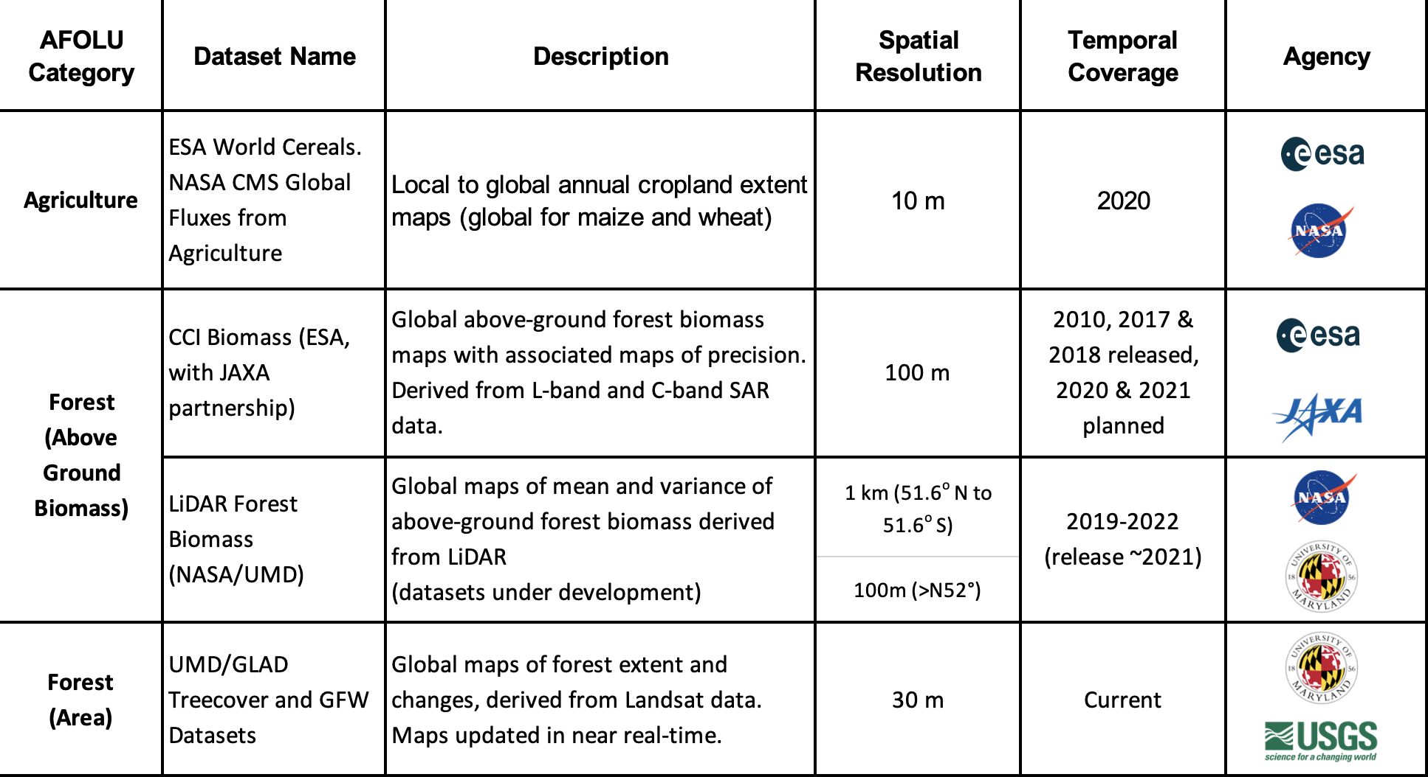
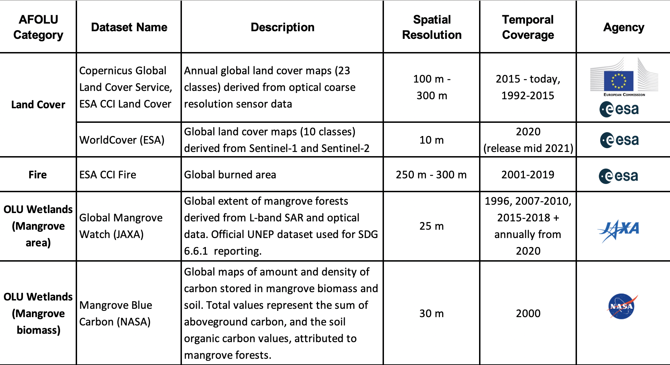
2021 Activities
Top priority to the availability of relevant datasets in time for COP-26 (early Nov 2021) along with the prototype GHG products
A comprehensive roadmap can follow successful completion of GST1 deliverables
Task team agreed to focus on - a small number of mature AFOLU products, complete with comprehensive guidance and communication materials to the UNFCCC Synthesis Report. Both national and global scale products are in scope.
2020 capabilities review identified a number of promising candidates
Notes:
Here are our specific objectives and the supporting agenda items. Talk through briefly…
Q&A break after Biomass on any topics that featured prior. And again after the UNFCCC/policy discussion. Please keep to time. We wish to cover all ground even if this format is more of a preliminary discussion than we would have liked. Use sli.do to input comments and questions that arise and we will moderate those for an efficient Q&A.

Slide 14
2021 Activities
Further prioritisation considered to identify key datasets being communicated (the process should be by on-going elaboration)
The AFOLU Team tasked small expert teams in each key dataset (below) formed by ideally most relevant agencies and with different geographic balance
The expert teams prepared a short report outlining the CEOS coordinated input to GST1 (what may be possible given more time after GST1)
Solicit CEOS Principals necessary support in order to deliver the datasets by COP-26
Above Ground Biomass: Laura Duncanson / Sassan Saatchi (NASA), Martin Herold (GOFC/GOLD & ESA/CCI)
Land Cover & Change - inc Forests and Mangroves: Martin Herold (GOFC-GOLD & ESA/CCI), Ben Poulter (NASA), Michael Cherlet (EC), Ake Rosenqvist (JAXA) and Frank Martin Seifert (ESA)
Agriculture: Ian Jarvis (GEO Sec) and GEOGLAM colleagues
Expert Teams will present 1-2 slides with their suggestions as to both default and optimal outcomes for their product type for GST1 and what is required from CEOS agencies to achieve each one
Notes:
Here are our specific objectives and the supporting agenda items. Talk through briefly…
Q&A break after Biomass on any topics that featured prior. And again after the UNFCCC/policy discussion. Please keep to time. We wish to cover all ground even if this format is more of a preliminary discussion than we would have liked. Use sli.do to input comments and questions that arise and we will moderate those for an efficient Q&A.

Slide 15
Concept of GST1 Inputs
There is no ‘one size fits all’. Each dataset is at a particular state of maturity. There may be obvious champions and capacity to do customisation work which can be a synthesised product for one dataset. And there may be in some cases for off the shelf products.
The GST will be an ongoing iterative process and a learning experience for all concerned. Therefore, building user relationships and understanding of our data is important. In some cases, a demo product may suffice with more comprehensive or sophisticated products later
GHG Task Team is aiming to provide products for 2015 – 2020 at COP-26, and then extend these products through 2021. Ideally we would aim to replicate this across the AFOLU set of products. The GHG-AFOLU Workshop planned for June 2021 at JRC (Virtual) will help to build relationships across the different communities
Notes:
Here are our specific objectives and the supporting agenda items. Talk through briefly…
Q&A break after Biomass on any topics that featured prior. And again after the UNFCCC/policy discussion. Please keep to time. We wish to cover all ground even if this format is more of a preliminary discussion than we would have liked. Use sli.do to input comments and questions that arise and we will moderate those for an efficient Q&A.

Slide 16
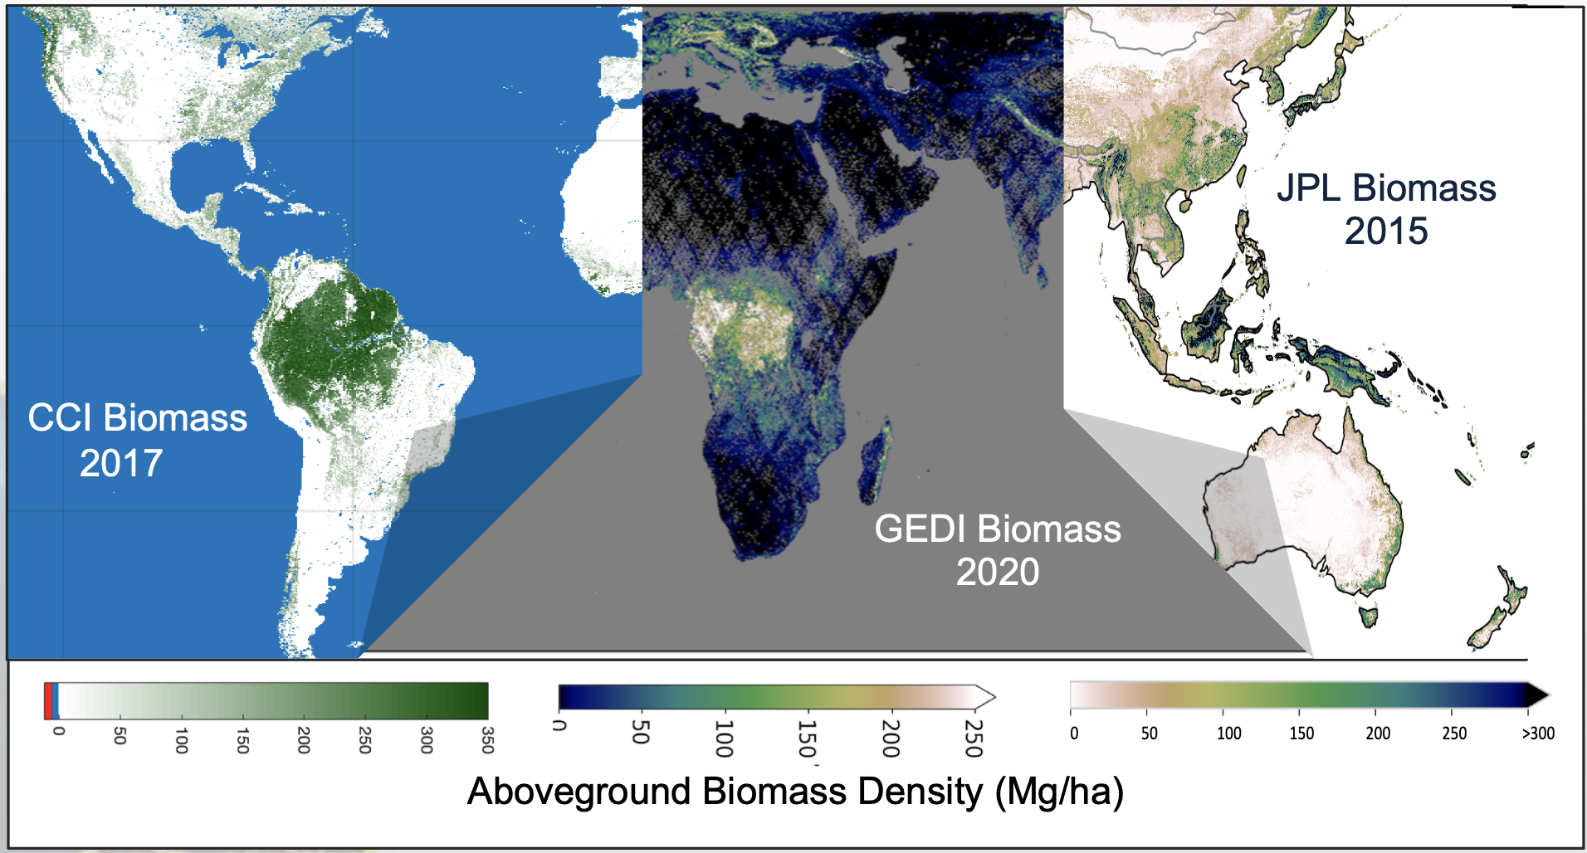
Proposed Biomass Product Harmonization Activity for the GST1
Several biomass products will be publicly available in advance of the GST (e.g. NASA’s GEDI, ESA’s CCI Biomass)
To bolster uptake of these considerable CEOS agency investments, a single CEOS-endorsed biomass product is desirable.

Slide 17
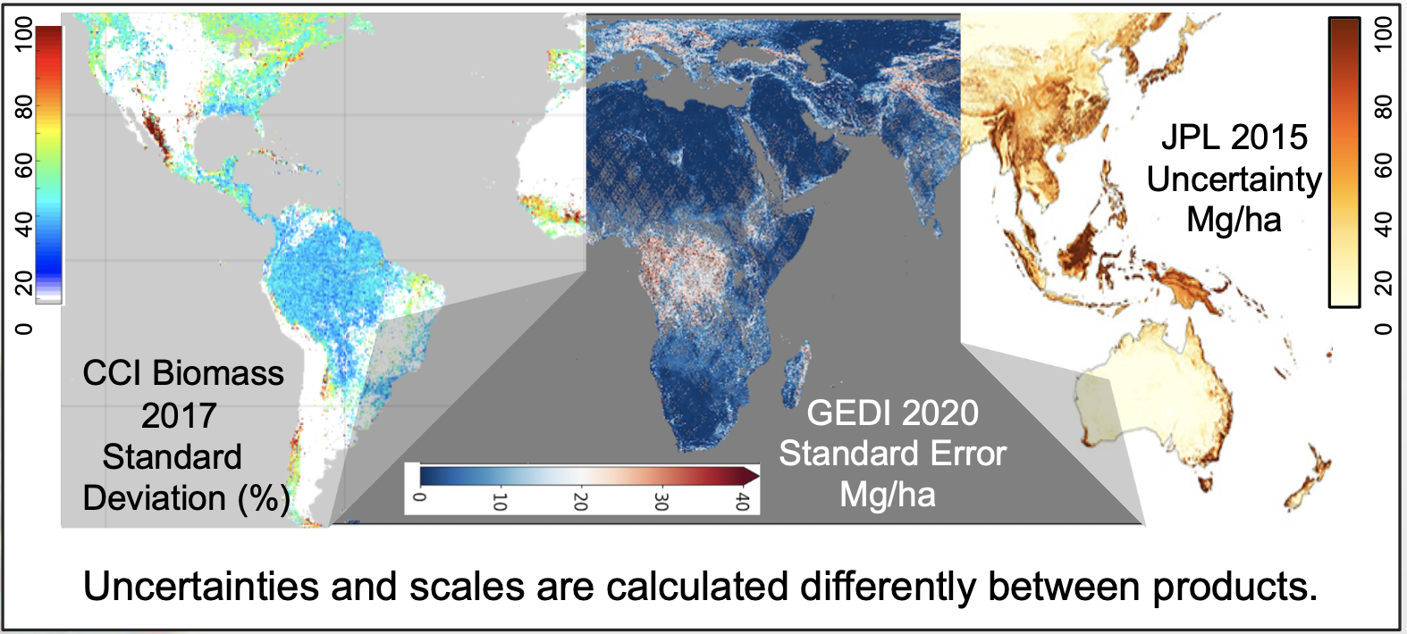
Proposed Biomass Product Harmonization Activity for the GST1
Open Science activity proposed to use ESA-NASA Multi Mission Algorithm and Analysis Platform (MAAP) for inter-comparison and harmonization of biomass products for the GST.
Products will be assessed following the WGCV biomass protocol using available reference data in pilot USGS Silvacarbon countries
Time | Activity
March 2021 | Solicit feedback and secure support from CEOS agencies
April 2021 | Discuss technical details of the implementation
May/June 2021 | Data collection/refinement Methods selection MAAP trials Candidate country engagement
July 2021 | Finalize technical framework and compilation of all data sources
Aug/Sept/Oct 2021 | Implement validation, harmonization and estimation by various teams
Nov 2021 | Derive prototype biomass estimates and solicit feedback from key partners and countries
Dec’21- Feb ‘22 | Finalized biomass estimations and document in scientific paper
Goal to have a pilot harmonization framework (and product) by COP-26 (Nov 2021).

Slide 18
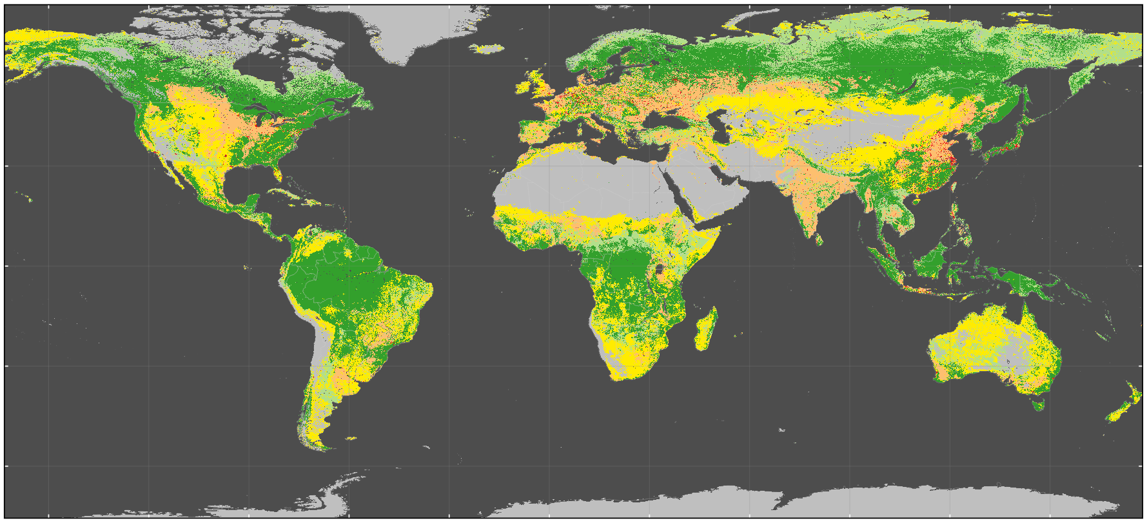
GST1 Input - Land Cover,
Forest, Wetlands and Change
Forest/land cover/wetland and change essential for national GHG inventories estimating activity data and to global AFOLU modeling and assessments
Many agencies producing relevant data and products; aim of a joint effort is to provide synthesis of available products and experiences in three main areas:
Support of national GHG inventories for activity data estimation following the IPCC GPG: showcase experiences of countries using satellite-derived activity data and demonstrate progress in novel products related to land use change, wetlands, forest/land degradation, fire/burnt area
Improved global land change data for AFOLU and modeling assessments: Present long-term harmonized global land cover change data and novel, next generation global land cover/change products at higher spatial/temporal/thematic detail
Enhance consistency/comparability of national GHG inventories and global GHG estimates: Develop best available global land cover change estimates at regional level for statistical comparison with country-reported data
Activities: expert meetings, coordinate input from CEOS partners, synthesis towards COP26 presentation
Coordination builds upon GOFC-GOLD land cover implementation team
Notes:
Here are our specific objectives and the supporting agenda items. Talk through briefly…
Q&A break after Biomass on any topics that featured prior. And again after the UNFCCC/policy discussion. Please keep to time. We wish to cover all ground even if this format is more of a preliminary discussion than we would have liked. Use sli.do to input comments and questions that arise and we will moderate those for an efficient Q&A.

Slide 19
GST1 Input - Land Cover,
Forest, Wetlands and Change
The following products are proposed as the most suitable choices to present the dedicated CEOS agency support for the GST by UNFCCC COP26 in Nov. 2021:
Useful for countries and national reporting:
Copernicus annual global land cover service (2015-onwards, 100 m, EC)
WorldCover (2020, 10 m, ESA)
Global Forest Watch tree cover loss (annual from 2000 onwards, 30 m, NASA)
Global Mangrove Watch data on cover and change (25 m, JAXA)
LCLUC Global Mangrove Mapping data on AGB and Total Biomass (30 m, NASA JPL/GSFC)
For (longer-term) global modeling and GHG assessments:
LC CCI annual 1992-2015 (now continued under Copernicus climate service C3S until today, 1 km change, ESA/EC)
HILDA+ 1960-2019 global, annual land cover change harmonized with FAO statistics (synthesis product for modeling community)
For linking national reporting with global estimation (in a statistical sense)
Nancy Harris/GFW forest fluxes data 2000-2019 (NASA)
Copernicus annual global land cover service and regional land cover change statistics (using reference data for estimation, EC/ESA)
Notes:
Here are our specific objectives and the supporting agenda items. Talk through briefly…
Q&A break after Biomass on any topics that featured prior. And again after the UNFCCC/policy discussion. Please keep to time. We wish to cover all ground even if this format is more of a preliminary discussion than we would have liked. Use sli.do to input comments and questions that arise and we will moderate those for an efficient Q&A.

Slide 20
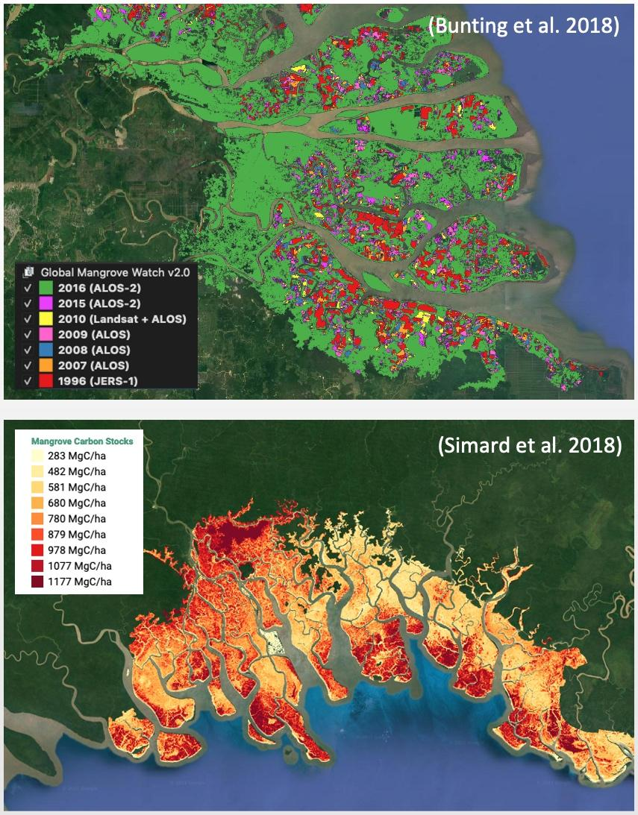
GST1 Input - Land Cover,
Forest, Wetlands and Change
Mangroves (Forest / OLU-Wetlands)
Activity Data – Global Mangrove Watch (JAXA K&C)
Global maps of mangrove area and annual changes at 25 m derived from L-band SAR and optical data. Open access in public domain.
1996–2018 available for COP-26. 2019-2021 for GST1.
Official UNEP SDG 6.6.1 mangrove dataset.
Emission Factors - LCLUC Global Mangrove Mapping (NASA JPL/GSFC)
Global maps of mangrove Height, AGB and Total Biomass at 30 m. Open access in public domain.
Baseline year 2000 derived from SRTM DEM.
New 2015 baseline at 12 m from TanDEM-X DEM available for GST1.

Slide 21
GST1 Input - Agriculture (GEOGLAM)
Background
GEOGLAM is a coordinated global effort, encompassing major producers and food insecure Least Developed Countries (LDCs)
Considerable effort directed at the development of global land cover products in recent decades
Existing products are not suitable for assessments under the Global Stocktake, or NDC’s in LDCs
Open science is transforming the monitoring landscape and enabling new solutions and the WorldCereal initiative capitalizes on this
WorldCereal, A Major Step Forward
WorldCereal is a consortium effort, project funded by ESA, led by VITO and supported by the GEOGLAM community
Most important, it is building a WorldCereal system, not just one-off products, that will:
Produce Global cropland maps at 10 m resolution, accuracies 80% +, on a seasonal basis (2022)
Focus on maize and wheat for global application
Initiate a global in situ reference dataset for agriculture
Develop and test state-of-the-art classification algorithms
WorldCereal, A two years project: A major step forward, but just a first step…
Notes:
Here are our specific objectives and the supporting agenda items. Talk through briefly…
Q&A break after Biomass on any topics that featured prior. And again after the UNFCCC/policy discussion. Please keep to time. We wish to cover all ground even if this format is more of a preliminary discussion than we would have liked. Use sli.do to input comments and questions that arise and we will moderate those for an efficient Q&A.

Slide 22
GST1 Input - Agriculture (GEOGLAM)
Moving towards a systematic approach to agricultural monitoring…
WorldCereal will develop the initial system, but several activities required to ensure delivery to the GST are outside current plans
Gaps Include:
A reference network for in situ data
Harmonized global data sets of Landsat 8 and Sentinel 2, including full archive validated satellite-driven agricultural data products addressing Essential Agriculture Variables
Algorithms to address a wider range of crops important for global food security, carbon accounting and stocktaking
Incorporation of new data streams as they become available
Articulation of evolving user requirements for agricultural monitoring
Capacity (co)development for LDC’s to collect and provide the information needed for their national mitigation and adaptation planning and response programs
Notes:
Here are our specific objectives and the supporting agenda items. Talk through briefly…
Q&A break after Biomass on any topics that featured prior. And again after the UNFCCC/policy discussion. Please keep to time. We wish to cover all ground even if this format is more of a preliminary discussion than we would have liked. Use sli.do to input comments and questions that arise and we will moderate those for an efficient Q&A.

Slide 23
AFOLU Dataset summary
 | COP-26 (Nov 2021) | GST1 (2021-23?) | Beyond (2024+) | Notes
Biomass | Fall back is individual existing datasets Synthesised biomass product providing estimates at a jurisdictional level globally | Synthesized, jurisdictional level biomass, emission factors (and prototype biomass change) | Synthesized spatially explicit, annual biomass, emission factors and biomass change | Work plan and schedule provided
Land Cover | - Copernicus annual global land cover - C3S/CCI Land Cover - WorldCover, HILDA+ | Synthesised map products and estimates of land cover and change at regional, and global levels | Statistically robust activity data estimates (6 IPCC classes) at national and global levels | GOFC-GOLD coordination proposed
Forest & OLU- Wetlands | - Global Forest Watch tree cover loss and forest fluxes - Global Mangrove Watch cover and change (1996-2016) - Global Mangrove biomass (2000) | Global tree cover and forest emissions and removals Global mangrove cover and change at 25 m (2019+) Global mangrove biomass at 12 m (2015) | Global annual forest emissions and removals at 30-100 m resolution. Global annual mangrove emissions and removals at 10-25 m resolution. | In coordination with GMW
Agriculture | Demonstration WorldCereal products for at least 4 countries (Argentina, Spain, Ukraine and Tanzania) | Initial WorldCereal map and analytical system. On-going seasonal analysis products | Continual system improvement and production of seasonal state and change products | In coordination with GEOGLAM
Indicates off the shelf datasets possible. Indicates additional resources needed.
Notes:
Here are our specific objectives and the supporting agenda items. Talk through briefly…
Q&A break after Biomass on any topics that featured prior. And again after the UNFCCC/policy discussion. Please keep to time. We wish to cover all ground even if this format is more of a preliminary discussion than we would have liked. Use sli.do to input comments and questions that arise and we will moderate those for an efficient Q&A.

Slide 24
2021 Activities
National Inventory Test User Group - floated as an idea to help develop feedback from countries and other users as to the utility of the CEOS products for their engagement in the GST process
USGS/SilvaCarbon asked to further develop the concept - building on their 10+ years of experience, including through the GFOI programme
Phase 1: Compile information of country status based on categories of REDD Compass. Completed by March 2021
Phase 2: Participative Process - Online meetings with countries
Phase 3: Country Case Studies in more depth
Notes:
Here are our specific objectives and the supporting agenda items. Talk through briefly…
Q&A break after Biomass on any topics that featured prior. And again after the UNFCCC/policy discussion. Please keep to time. We wish to cover all ground even if this format is more of a preliminary discussion than we would have liked. Use sli.do to input comments and questions that arise and we will moderate those for an efficient Q&A.

Slide 25
SIT action and 2021 Next Steps
Solicit CEOS Principals firm and strong support to deliver the key datasets by COP-26: follow up coordinated by SIT Chair Team through 2021 (part of GST Strategy, agenda 3.4)
2021 Next steps:
Work with expert dataset teams and dataset producer agencies to establish viable plans for COP-26 delivery - and progress consensus on options beyond COP-26
Engage with UNFCCC Secretariat in contributing to Synthesis Report on Sytematic Observations
Engage in the GHG-AFOLU workshop in June
Engage with SIT Chair, CEOS Chair, WGClimate, GHG task team and others (eg UKSA) in planning communication and outreach related to COP-26 and its Earth Information Day
Longer term AFOLU Roadmap considered when COP-26 deliverables assured
Notes:
Here are our specific objectives and the supporting agenda items. Talk through briefly…
Q&A break after Biomass on any topics that featured prior. And again after the UNFCCC/policy discussion. Please keep to time. We wish to cover all ground even if this format is more of a preliminary discussion than we would have liked. Use sli.do to input comments and questions that arise and we will moderate those for an efficient Q&A.

Slide 26
CEOS Biomass Protocol
and Reference Network
WGCV LPV Team
Laura Duncanson
NASA/University of Maryland
20 mins
Committee on Earth Observation Satellites
SIT-36 Virtual Meeting
Agenda item 3.3
23-25 March 2021
Notes:
Welcome to the Carbon and Biomass session. This was intended to be the largest of our sessions in Hobart auss how CEOS might consider strengthening the policy relevance of our datasets with the main UN and national stakeholders that use our data to make and manage policy. We still have a substantial agenda with significant points for discussion by Principals.
nd featured a number of external speakers to bring some alternative perspectives to our work and to equip us to disc

Slide 27
CEOS WGCV LPV
Biomass Validation Protocol
Protocol Authors:
Laura Duncanson, John Armston, Mat Disney
Avitabile, V., Barbier, N., Calders, K., Carter, S., Chave, J., Herold, M., MacBean, N., McRoberts, R., Minor, D., Paul, K., Réjou-Méchain, M., Roxburgh, S., Williams, M., Albinet, C., Baker, T., Bartholomeus, H., Bastin, J.F., Coomes, D., Crowther, T., Davies, S., de Bruin, S., De Kauwe, M., Domke, G., Dubayah, R., Falkowski, M., Fatoyinbo, L., Goetz, S., Jantz, P., Jonckheere, I., Jucker, T., Kay, H., Kellner, J., Labriere, N., Lucas, R., Mitchard, E., Morsdorf, F., Næsset, E., Park, T., Phillips, O.L., Ploton, P., Pultini, S., Quegan, S., Saatchi, S., Schaaf, C., Schepaschenko, D., Scipal, K., Stovall, A., Thiel, C., Wulder, M.A., Camacho, F., Nickeson, J., Román, M., Margolis, H.
We gratefully acknowledge several expert reviewers:
S. Bauwens, M. Hayashi, A. Held, A. Hudak, N. Knapp, S. Maier, C. Patnaik, P. Patterson, A. Rosenqvist, S. Saarela, P. Montesano

Slide 28
Timeline of the
Biomass Protocol Development
Timeline | Protocol Development Activities
2017 | Formation of new biomass focus area within WGCV LPV Charge for biomass protocol development within LPV Biomass co-leads draft protocol structure, invite chapter leads
2018 | Chapter leads confirmed, writing groups developed Chapter draft development
2019 | Chapter draft completion Collation of chapter drafts Review paper on biomass validation (Duncanson et al., 2019)
Spring 2020 | Protocol internal review Development of Executive Summary Presentation at SIT-35
Summer 2020 | Revisions after internal review Development of associated strategy document Final collation of potential reference sites
Fall 2020 | Presentation at CEOS SIT-TW and plenary (September) Protocol public review (September – December)
2021 and beyond | Seek CEOS endorsement at SIT-36 (March 2021) Adoption by ICESAT-2 & GEDI biomass products Work toward a Forest Biomass Reference System

Slide 29
We are at the beginning of a new wave of forest biomass products
Forests play a critical role in the global carbon cycle, and increasingly climate mitigation strategies involve curbing deforestation, facilitating forest restoration, and tree planting.
These efforts critically require reliable estimates of forest carbon stocks and fluxes, yet to date no reliable global forest biomass products have been available due to a dearth of appropriate data.
GEDI Mean Biomass
GEDI Std. Error
Several agencies are filling this data gap through new missions, the first of which is NASA’s GEDI (above). We anticipate a multitude of new biomass products will soon come online. The biomass protocol provides good practice guidance on validation, with the goal of facilitating uptake of high quality products.

Slide 30
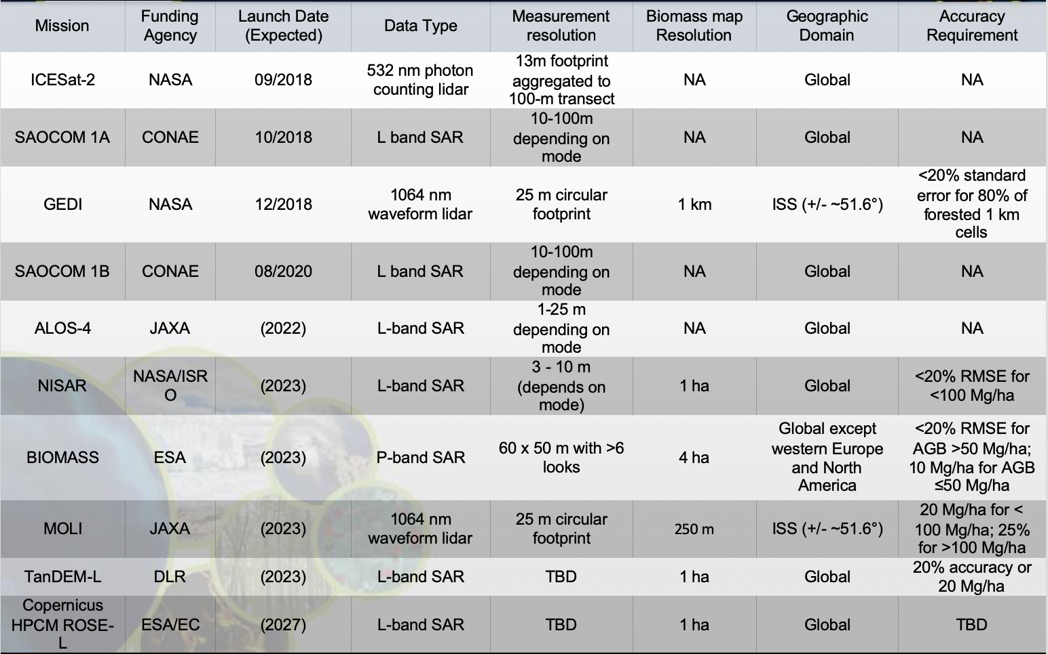
Many Upcoming Missions will Provide Data Used to Map Biomass

Slide 31
WGCV LPV Biomass Protocol Completed and Seeking Endorsement
The protocol is a good practices guide to biomass model calibration and product validation at a global (or near global) scale
Guidance for:
Map producers on how to estimate, propagate and report errors
Map users on how to interpret errors
How to collect reference data (field and airborne lidar)
How to use reference data to conduct independent biomass product validation
Summary of:
State of knowledge of biomass mapping
Community identified research and tool development priorities
Recommendations for protocol implementation

Slide 32
Biomass Protocol Structure

Slide 33
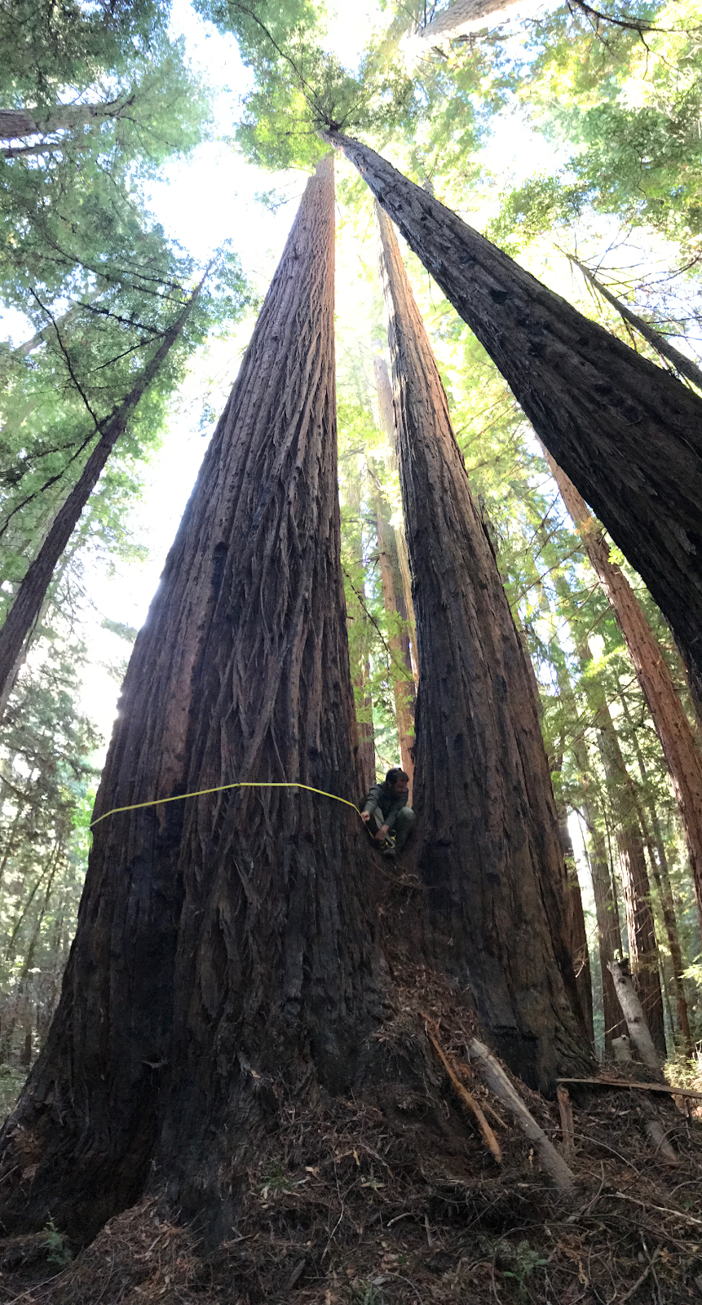
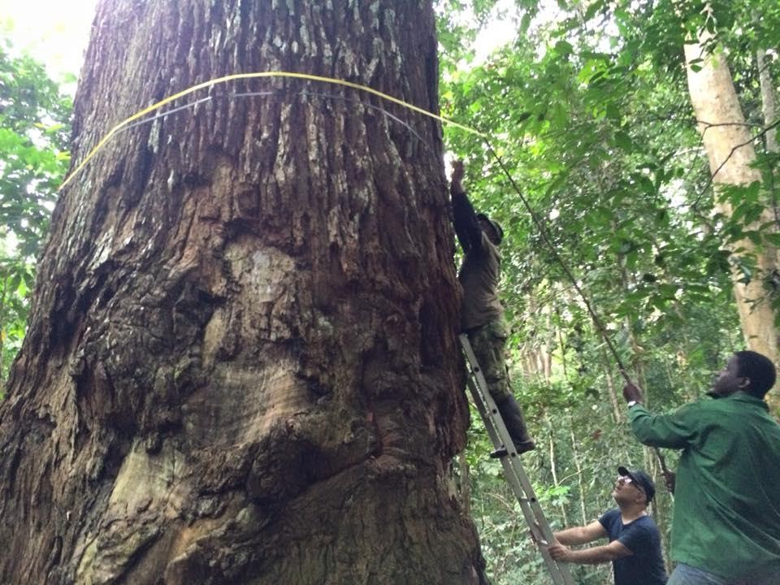
Recommendations for Field Measurements
Field Measurements and derived estimates are not truth – there can be large errors.
Need transparent handling and reporting of errors, consistent definitions
Recommendations for measurements
Summary of uncertainties in allometric models, recommendations for improving allometries
Terrestrial Laser Scanning (TLS) where possible
Jerome Chave, Kim Calders, Keryn Paul et al.

Slide 34
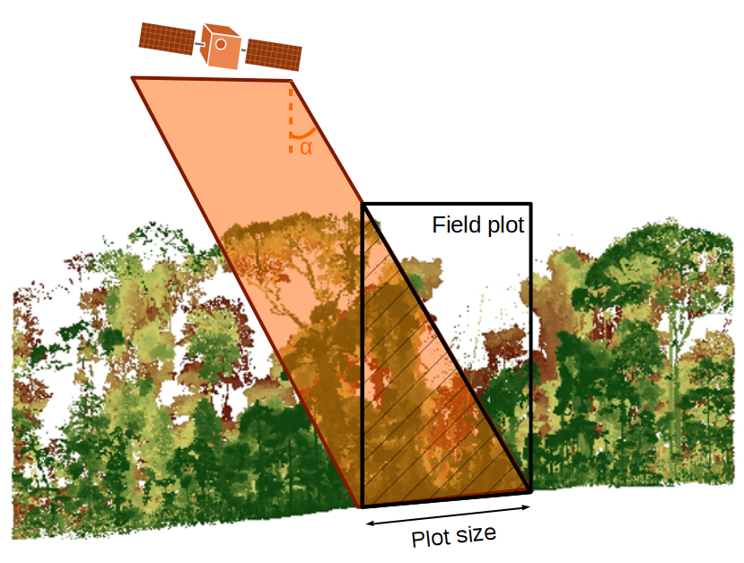
We Recommend Large Plots in Closed Canopy Forests (Especially in Tropics)
Small plots with poor geolocation are not useful for validation at the pixel-level
Large plots reduce errors, particularly from large crowns/edge effects and geolocation
20 m
50 m
1 ha
0.25 ha – 1 ha in tropics; smaller (~25 m) sufficient in temperate/boreal assuming good geolocation
Maxime Réjou Méchain, Nicholas Barbier et al.

Slide 35
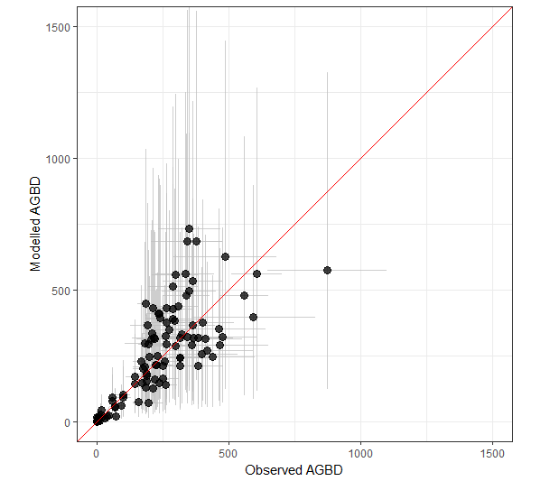
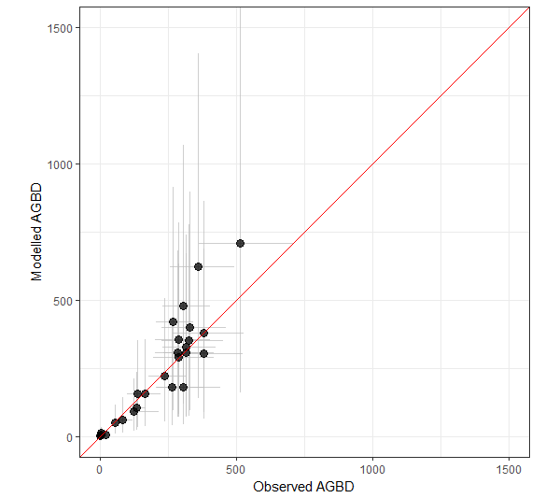
Airborne Lidar is Critical for Multi-mission Validation and Fusion
Airborne lidar maps can provide multi-resolution validation (provided they are calibrated with local high-quality field plots over the range of environmental conditions covered by the lidar)
0.25 ha
R² = 0.72 RMSE = 114.07
1 ha
R² = 0.82
RMSE = 84.94
John Armston et al.

Slide 36
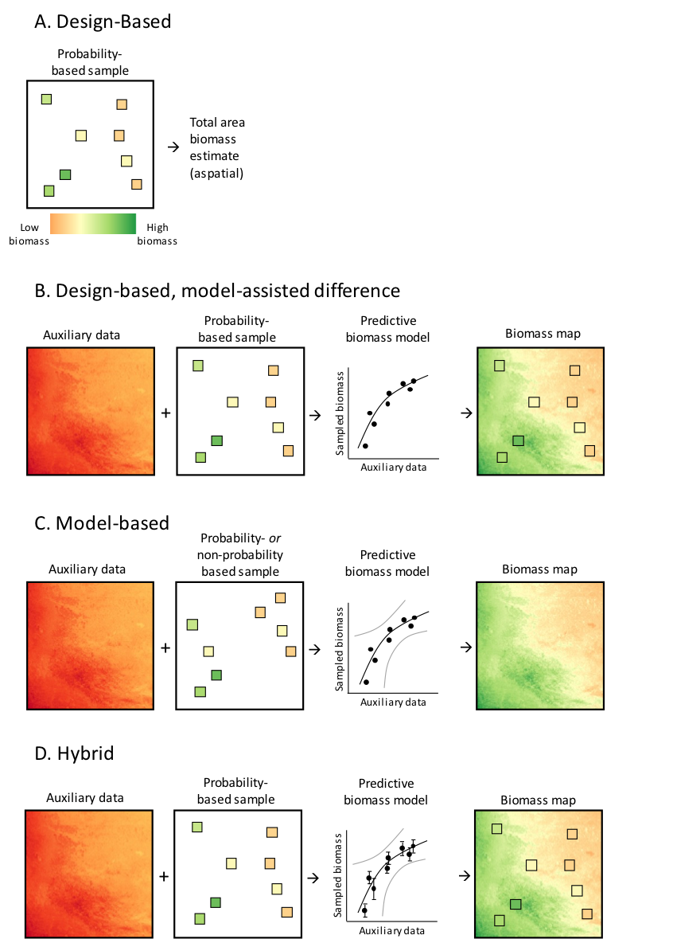
Uncertainties and Errors Should be Estimated as Consistently as Possible
Error reporting should comply with IPCC Good Practices Guidelines and GFOI Methods and Guidance Documents.
Measurement and modeling errors should be estimated following appropriate inference method and propagated to mapped products (both reference and satellite)
Stephen Roxburgh and Ron McRoberts

Slide 37
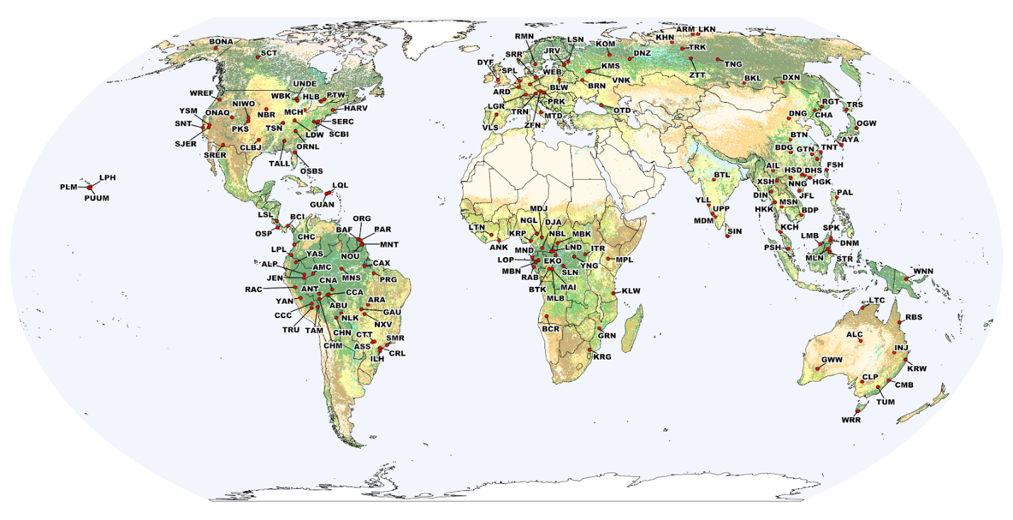
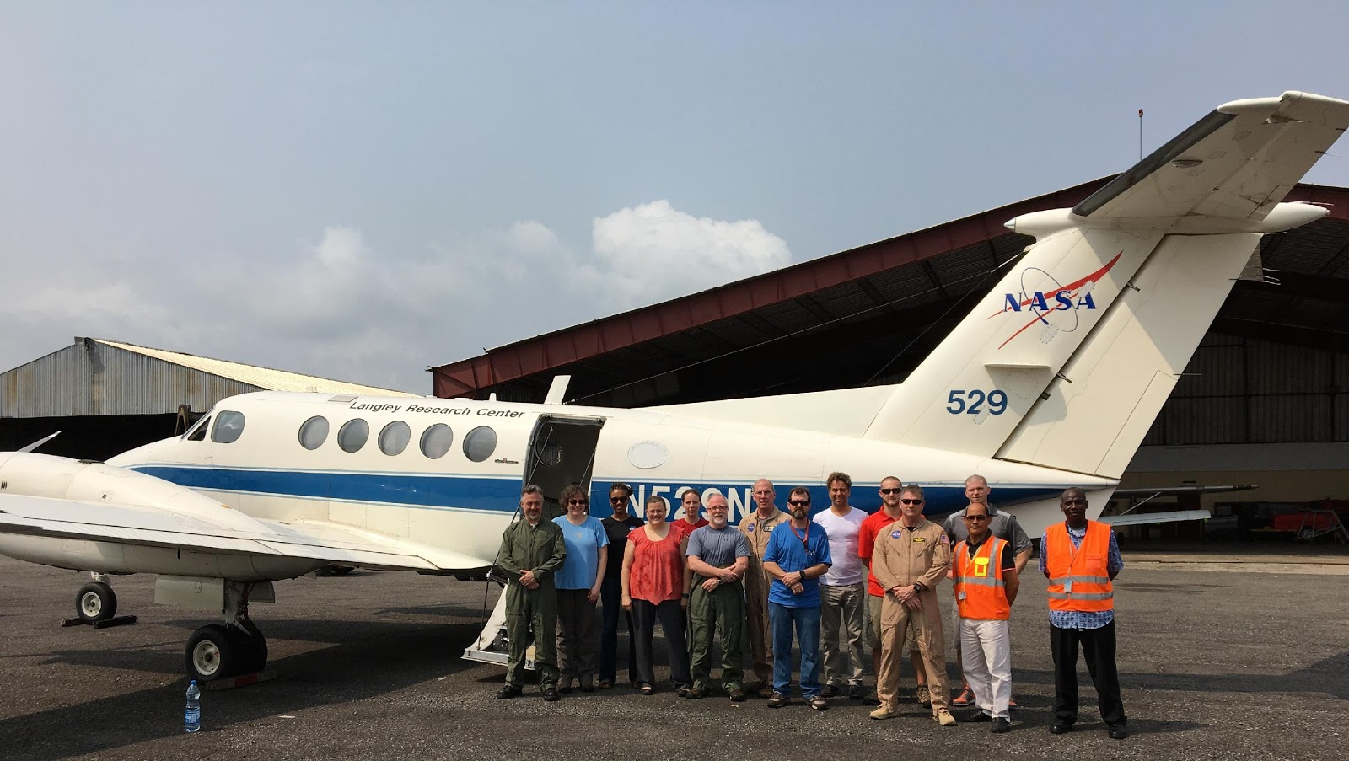
Updated Reference Data Remain Critically Important
New proposed GEO activity: Forest Biomass Reference System for Tree-by-Tree Inventory Data (GEO-TREES). Supporting coordinated collection of new high-quality reference measurements for validation of biomass products.
Potential
Reference Sites
We encourage CEOS agencies to coordinate on data collection for biomass validation following recommendations from the biomass protocol (open high-quality field, TLS, and airborne lidar).
‹#›

Slide 38
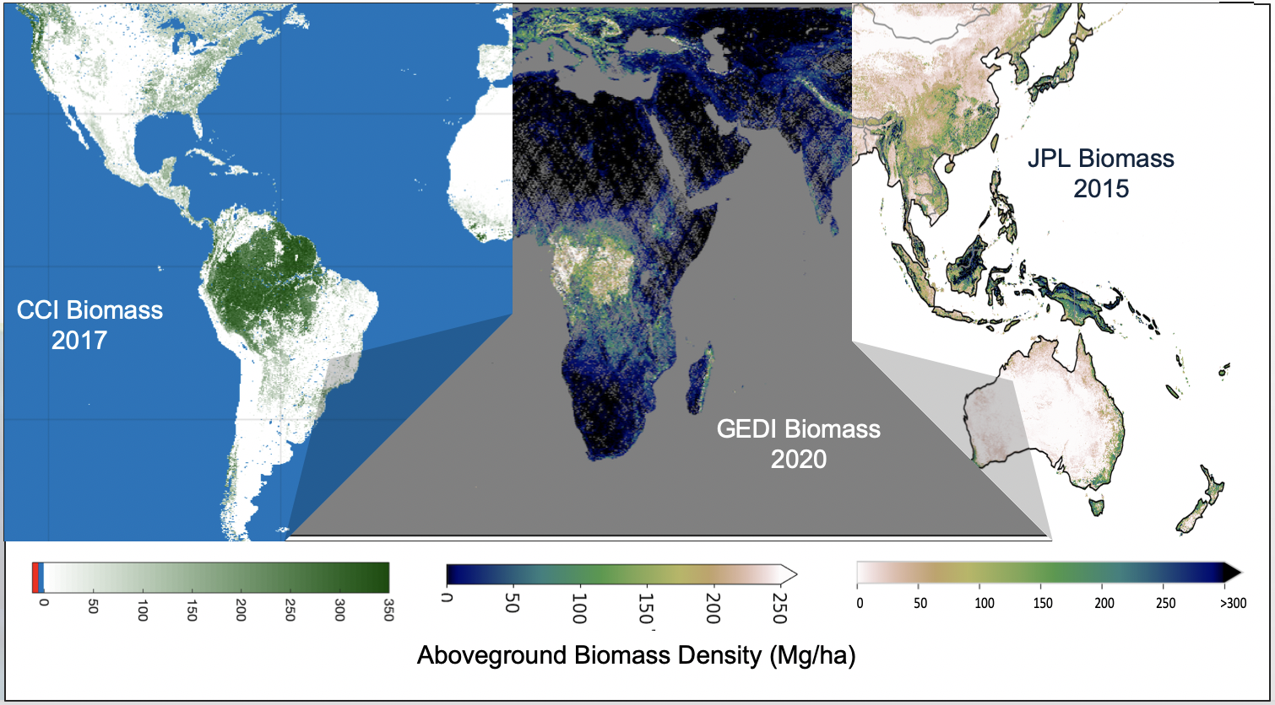
We Encourage Protocol Uptake for Validation of New Biomass Products
As new biomass products come online, the protocol can serve as a guide for their uncertainty estimation, validation, and harmonization.

Slide 39
Conclusions and Recommendations from the Biomass Community
The large number of new biomass data and products could reduce product uptake by user community unless validation activities are user-friendly, transparent, and well-coordinated.
Collection of reference data following shared protocols enables data to be used by the global community, not only one mission or agency
Where possible, large forest plots, TLS, and airborne lidar should be collected following technical guidance in protocol document
The use of airborne lidar allows scaling of field data, thus reference sites can validate any resolution of biomass product
User-led validation with existing reference data should be conducted with caution given spatial and temporal, and definition discrepancies
Reference data should be free and open to allow for transparent, reproducible product validation.

Slide 40
Thank you to the many protocol co-authors
and supporting CEOS Agencies.
This is a community-driven activity!
Thank you!
We seek CEOS endorsement of the WGCV LPV Biomass Protocol.

Slide 41
SIT Chair GST Study Team
CEOS Support to GST
ESA SIT Vice-Chair
SIT 36
ESA UNCLASSIFIED – For Official Use

Slide 42
Background
SIT Chair convened a study team in November 2020 to address demand raised at Plenary for a comprehensive look at the opportunity presented by the Global Stocktake, at what work is in train, and what still needs to be done
CEOS has appointed 3 reps to the UNFCCC SEC Working Group set up for the GST. AFOLU (Osamu), GHG (Dave) and general (Jorg). Representing the different dimensions we are working on to support the GST. WGClimate remains the main UNFCCC interface for our annual reporting to SBSTA/COP.
Series of dedicated calls to support drafting of a CEOS strategy
Thanks to the many participants: CEOS Chair team, SIT Chair team, SIT Vice-chair team, WGClimate incl. GHG Task Team, LSI-VC Forest & Biomass team, AC-VC, WGCV, SEO, CEO, and GEO Climate WG
SIT Vice-Chair team (ESA) volunteered to lead drafting of a strategy paper, reflecting the coordination needing across many arms of the CEOS structure
Draft strategy paper circulated by SIT Chair on 9th March

Slide 43
Global Stocktake Elements
There are four areas of the GST to be considered by CEOS:
Mitigation, i.e. reporting, measurement and tracking secular decrease of GHG emissions
Adaptation to ongoing climate change and its consequences and impacts
Finance of mechanisms for adhesion
(Equity among Parties for implementation as a cross-cutting theme)
Of these four topics, mitigation of emissions has been the most actively pursued by the scientific modelling community. Adaptation has not yet been as closely studied. Finance & Equity are less immediately relevant to CEOS, but remain to be considered.
ESA UNCLASSIFIED – For Official Use

Slide 44
A CEOS Strategy to Support the
Global Stocktake of the
UNFCCC Paris Agreement
SIT Vice-Chair Team Stephen Briggs
20 mins
Committee on Earth Observation Satellites
SIT-36 Virtual Meeting
Agenda item 3.4
23-25 March 2021
Notes:
Welcome to the Carbon and Biomass session. This was intended to be the largest of our sessions in Hobart auss how CEOS might consider strengthening the policy relevance of our datasets with the main UN and national stakeholders that use our data to make and manage policy. We still have a substantial agenda with significant points for discussion by Principals.
nd featured a number of external speakers to bring some alternative perspectives to our work and to equip us to disc

Slide 45
Mitigation
Nationally Determined Contributions (NDCs) are statements of anthropogenic emissions from within the national territory of each Party, reported in tempo with the five-yearly GST cycle
NDCs have two components of emission reporting: fossil fuel emissions (FFEs) from national consumption and emissions due to land cover change (as referenced through AFOLU)
FFEs are determined through bottom-up inventories of all types of fossil fuel burnt, and do not depend on EO data.
Emissions from land use conversion are also categorised as anthropogenic and are documented and reported via AFOLU reporting procedures defined by the IPCC 2006 Guidelines, taking into account the 2019 Update.
Progress against NDCs is assessed nationally through Biennial Transparency Reports (BTRs) of Parties. The Global Stocktake will assess consistency of BTRs with observed global GHG emissions.
Satellite atmospheric composition observations include both anthropogenic and natural GHG emissions. Models of natural carbon emissions/removals are informed by satellite observations. Requirements for these have been studied by the modeling community (e.g. via CHE, RECCAP) as well as in the previous work of the WGClimate GHG Task team, and done well, but we should check with partners for completeness.
Inversions based on satellite GHG data support the global stocktake of spatially disaggregated emissions and may help individual national reporting through BTRs. This process requires a wide range of atmospheric, terrestrial and ocean observations supplied by CEOS agencies. (Recommendations 1-4).
ESA UNCLASSIFIED – For Official Use

Slide 46
AFOLU
AFOLU is a well-established mechanism for reporting anthropogenic emissions due to anthropogenic changes of land use.
Required data essentially comprises two elements: activity data (how much of each defined cover type is converted to each other type in the period in question) and emissions factors (emissions generated per unit area of each element of the conversion matrix). CEOS can clearly assist in the former, and possibly the latter through e.g. biomass estimates.
Note AFOLU says nothing about the instantaneous fluxes from any part of the terrestrial biosphere and is therefore in a separate class of measurement from that needed for carbon flux modeling and inversion of atmospheric GHG observations
These two aspects should not be confused. They can only be reconciled by confronting the integration, over a fixed period, of the inferred fluxes from land use change with AFOLU computation of the delta between carbon stocks in the biosphere. (Recommendation 5-6).
ESA UNCLASSIFIED – For Official Use

Slide 47
Adaptation
A second important element of the GST is the assessment of progress on adaptation of countries to climate change. It is probably the most important element for many less developed and small island states.
Important areas of vulnerability include agriculture and food security, coastal vulnerability, exposure to increased climate extremes (flooding, hurricanes, storm surges..) etc. plus more frequent events such as wildfires
Adaptation requires multiple datasets on many spatial scales, and includes many non-physical data eg demographic, economic, social data. However, (i) some common datasets would be helpful in almost all cases (e.g. land cover) and (ii) best practice/methods can be established for general use, and these could be supported by CEOS
Partnership with a variety of other agencies, including CEOS Associates such as WMO and GEO, will be necessary to ensure all appropriate data are made available and represents an efficient way forward.
Work could be undertaken across CEOS, chiefly in the land surface VCs, Task Teams and in the WGs to reconcile available and future data to the needs of adaptation.
There is a strong link to finance mechanisms and loss and damage under PA.
Adaptation is addressed through Recommendation 7.
ESA UNCLASSIFIED – For Official Use

Slide 48
Finance and Equity
Finance mechanisms are a critical element in the PA and in the UNFCCC process in general. Many of the planned funded actions will use satellite data both for implementation and for validation of results, mainly through National Adaptation Plans (NAPs) and possibly, in due course, for verification of valid expenditure of funds.
This should be borne in mind and CEOS should keep a watching brief on how it might best support such financial instruments. Equity among Parties is a further element consonant with inter-Party funding and includes sharing of expertise, systems, science and technology, and WGCap could maintain a view on this (Recommendation 8).
Ongoing support to IPCC
The ultimate objective of the Paris Agreement is couched in terms of limiting future temperature rise that can only be related to GHG emissions and their reduction through long term climate models. This requires the continued provision of satellite data to provide the Essential Climate Variables on which the modelling and prediction of climate is based. (Recommendation 9)
ESA UNCLASSIFIED – For Official Use

Slide 49
Recommendations summary:
Recommendations 1-2: Check for completeness current requirements for carbon modeling and GHG inversion.
Recommendation 3: Concerns communications with UNFCCC Sec., SBSTA/RSO and Parties
Recommendation 4: Consider setting up large scale (IMBIE class) field experiments on naturally occurring terrestrial GHG fluxes
Recommendations 5-6: Review requirements for observations for AFOLU, consistency with biogenic emission modelling and pilot implementation with several test countries
Recommendation 7: Concerns actions of CEOS in support of Adaptation
Recommendation 8: Maintains a watching brief on issues of finance and support to less developed countries.
Recommendation 9: Continues ongoing support to ECVs for future climate modeling.
The Recommendations are set out below in the form of a Table of Actions, including nomination of responsible agents, timescales and deliverables.

Slide 50
Actions for Next Steps
Management
SIT Chair & Vice-Chair Teams: Provide ongoing coordination and oversight for the GST Strategy actions
Mitigation
# | Actionee | Action | Milestone & Deliverable
1 | WGClimate GHG Task Team. LSI-VC, GCOS, other relevant CEOS associates, representatives of relevant modelling groups | Develop a statement of products for terrestrial observations needed to support mitigation estimates of biogenic emissions as priors for Monitoring and Verification System (MVS) such as CoMVS | First draft for SIT TW, report to CoP26
2 | WGClimate GHG Task Team, Oceans VCs, COAST Team, GCOS, GOOS, other relevant CEOS Associates, representation from GOBM modelling community | Develop a statement of products for ocean models in support of emissions modelling and fluxes | First draft for SIT TW, report to CoP26
3 | WGClimate as interface to SBSTA/RSO, CEOS reps to the UNFCCC GST ad-hoc WG: Dave Crisp, Osamu Ochiai, Jorg Schulz. WGClimate Chair. | Deliver results of GST Strategy actions to key meetings in the UNFCCC Calendar, including SBSTA and COP, and meetings of the GST Ad-hoc WG on SO. Early action may be needed to identify and secure event opportunities at COP-26 and the Earth Information Day to promote and communicate the CEOS GST1 datasets. UKSA may be able to assist. | UNFCCC AD Hoc Meetings and SBSTA/RSO meetings
4 | CEOS Agencies at SIT, WGCV, WGClimate, LSI-VC, AC-VC.. | Discussion among agencies to consider large-scale field experiments on GHG fluxes (cf IMBIE) | SIT & SIT TW

Slide 51
Actions for Next Steps
AFOLU
# | Actionee | Action | Milestone & Deliverable
5 | LSI-VC Forest and Biomass Team. GHG Task Team | Deliver prototype products for GST1 with associated guidance and communication materials. | COP-26
6 | USGS/SilvaCarbon (Sylvia Wilson), LSI-VC Forest and Biomass Team | Establish National Inventory Test User Group and channels for country feedback on CEOS products and their application | CEOS Plenary 2021
Adaptation
Finance & Equity
Ongoing support to IPCC
7 | SIT Chair coordination with thematic contributions: WGDisasters, WGClimate, LSI-VC, GEO Climate WG etc | Identify a specific process to explore requirements and actions for CEOS in relation to adaptation aspects of the GST. | SIT TW
8 | SIT Chair, WGCapD | As part of a GST Strategy update, provide periodic updates at Plenary and SIT meetings on CEOS actions relevant to Finance and Equity aspects of the GST, including technology transfer. | update at CEOS Plenary and SIT 2022
9 | WGClimate | Ongoing use of the ECVI and the related analyses to address the climate data record requirements. | Report to CEOS Plenary

Slide 52
Thank you for your attention
www.esa.int
ESA UNCLASSIFIED – For Official Use

Slide 53
Wrap up
SIT Chair
Adam Lewis
20 mins
Committee on Earth Observation Satellites
CEOS SIT-36
Notes:
Welcome to the Carbon and Biomass session. This was intended to be the largest of our sessions in Hobart auss how CEOS might consider strengthening the policy relevance of our datasets with the main UN and national stakeholders that use our data to make and manage policy. We still have a substantial agenda with significant points for discussion by Principals.
nd featured a number of external speakers to bring some alternative perspectives to our work and to equip us to disc

Slide 54
Wrap up Points to address
Carbon Strategy Update (Mark)
SIT Chair Team will follow up with each Topic Lead to craft a single slide that will feature in a summary reel during Thursday’s SIT-36 summary review session
GHG Roadmap
AFOLU Roadmap
Biomass Protocol Endorsement
Forest Biomass Reference Network
CEOS GST Strategy and Next Steps

