Slide 1
Committee on Earth Observation Satellites
COVERAGE
CEOS Ocean Variables Enabling
Research & Applications for GEO
https://coverage.ceos.org
Vardis Tsontos & Jorge Vazquez (NASA)
CEOS SIT-36
Session 2, Agenda Item 2.1
Virtual Meeting
23-25 March, 2021

Slide 2
Status & Next Steps
CEOS Initiative: Cross-cutting, interagency collaboration involving Ocean VCs, GEO-MBON & GEO-Blue Planet
Motivation & Goals
Enable more widespread, integrated use of interagency satellite data in support of ocean science & applications for societal benefit
Address key constraints to access and synergistic use of multi-sensor/parameter Earth Observations across agency data repositories, particularly amongst emerging science and decision support user communities with a need for such information
Accomplishments at the conclusion of Phase-B (prototype implementation)
Technology platform providing access to complementary satellite & in-situ datasets from distributed sources via value-added data services (integrated search, visualization, analytics)
Access to a coherent, curated set of global, interagency data products from the 4 Ocean VCs at a common resolution as a baseline dataset
Demonstrates utility of the system in the context of an example use case and thematic Ecosystem application with a Marine Biodiversity & Fisheries focus
Phase-C Elements
18 month follow-on project building on prior efforts and partnerships, with continued CEOS stakeholder and Advisory Board engagement
Harden & expand upon current technical capabilities
Support additional application use cases of a more regional nature involving higher resolution datasets
Development of an operationalization concept & sustainability plan
Support CEOS efforts on the UN Decade of the Ocean for Sustainable Development, including advancement of the COVERAGE Ocean-Shot concept

Slide 3
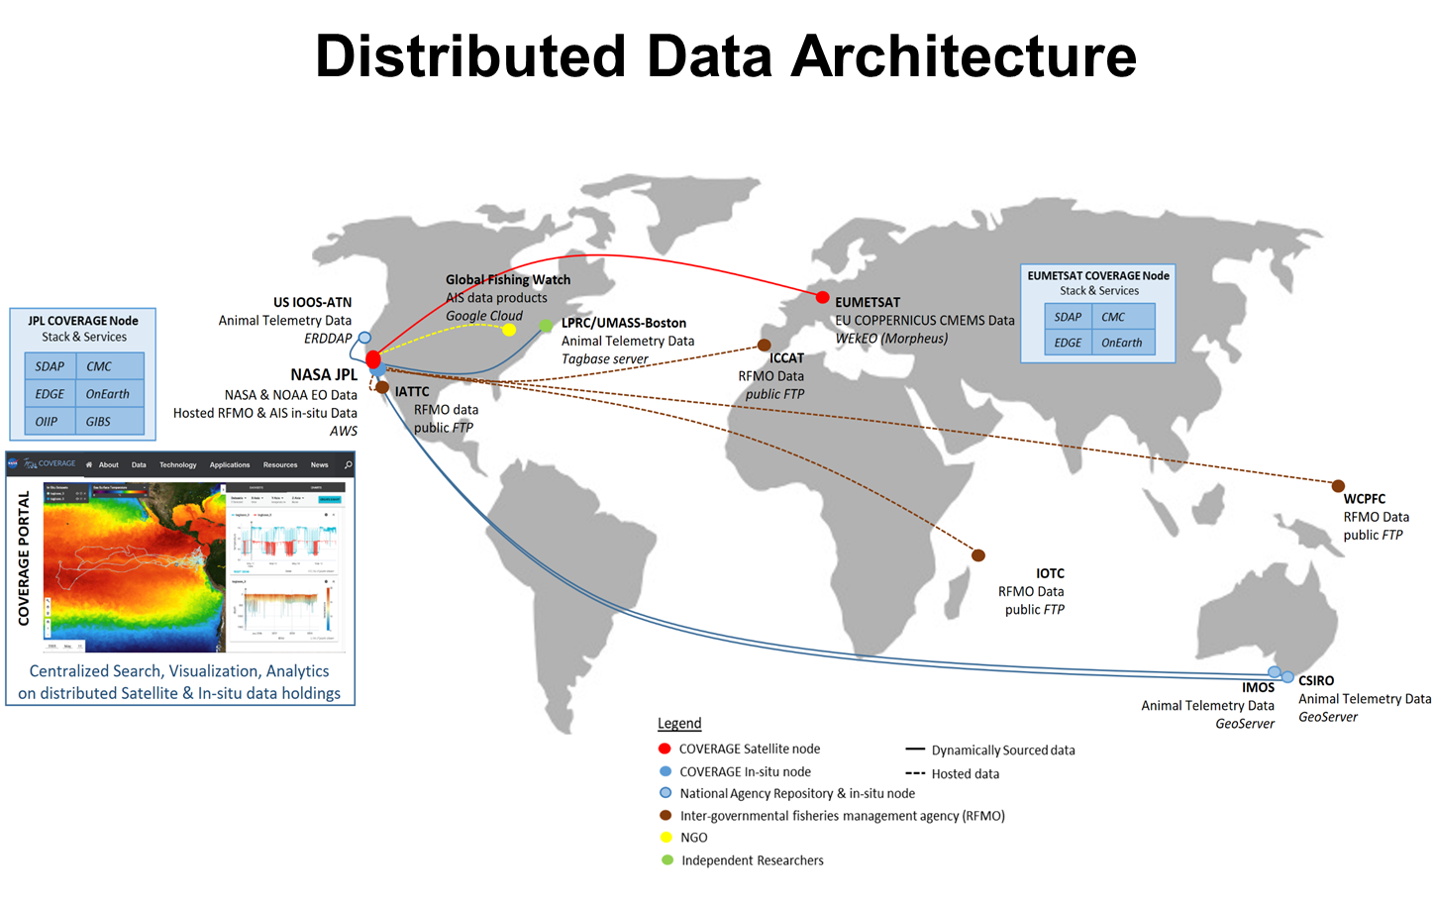
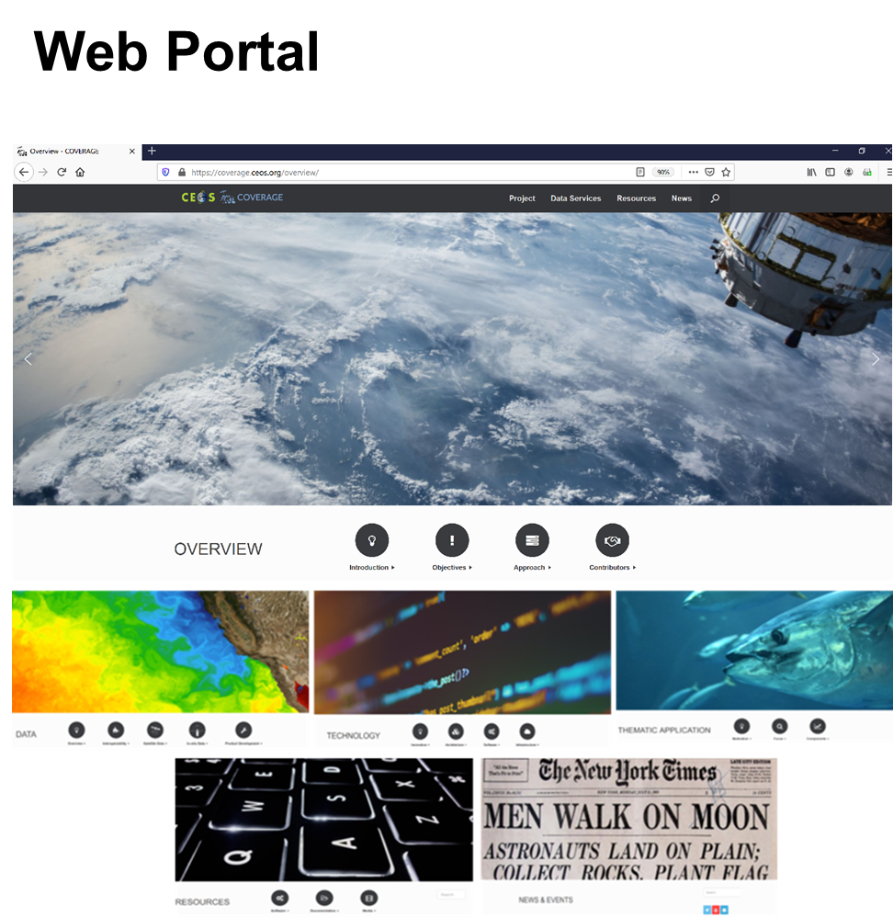
BACKUP
COVERAGE Phase-B Prototype Capabilities
https://coverage.ceos.org

