Slide 1
CEOS Work Plan - Highlights
Committee on Earth Observation Satellites
Marie-Claire Greening, CEOS Executive Officer
CEOS SIT-36
Session 1, Agenda Item 1.2
Virtual Meeting
23-25 March 2021

Slide 2
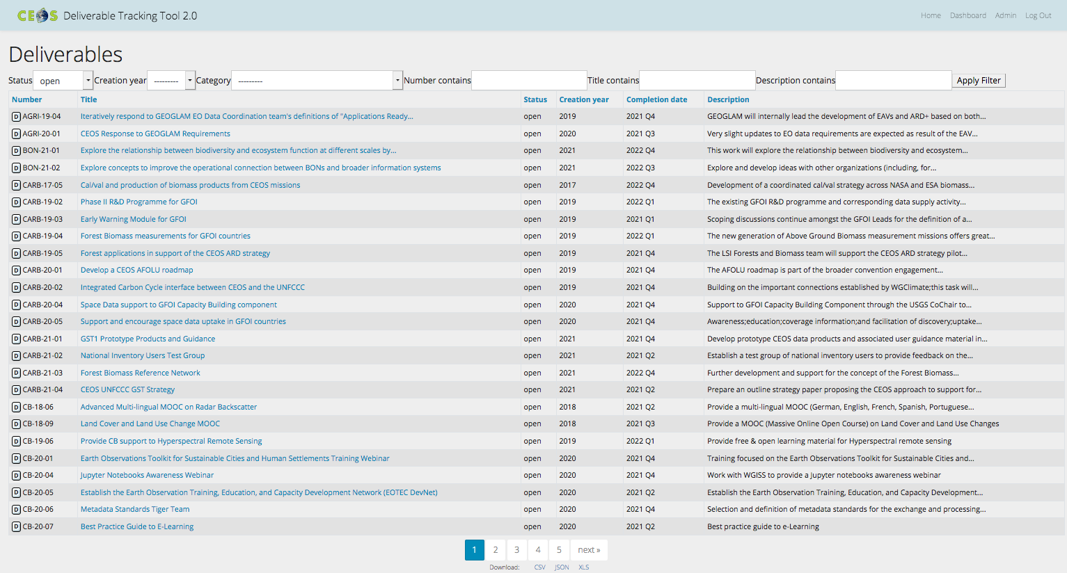
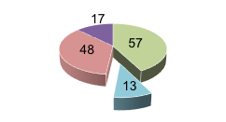
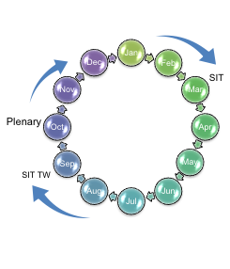
CEOS Work Plan 2021-23
One of CEOS’s suite of 13 governing documents
Vital for CEOS leadership
Endorsed Mon 22nd March 2021
All sections reviewed & updated
Deliverables updated in WP & reconciled in CEOS deliverables tracking tool
122 active deliverables
Back on track for the regular annual Work Plan update schedule
THANK YOU!

