Slide 1
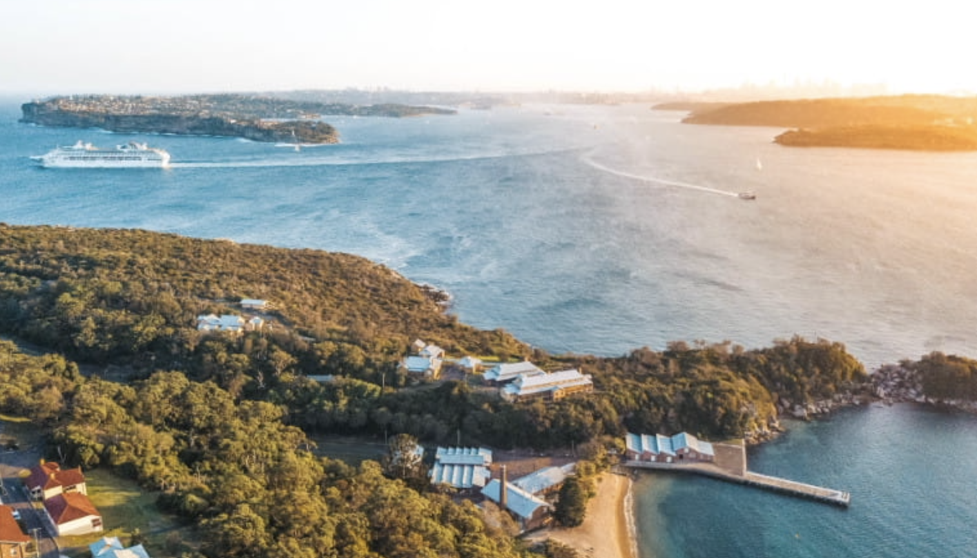
Welcome and Opening Remarks
Committee on Earth Observation Satellites
Adam Lewis/GA, Alex Held/CSIRO - SIT Co-Chairs
CEOS SIT-36
Session and Agenda Item #1.1
Virtual Meeting
23 March 2021

Slide 2
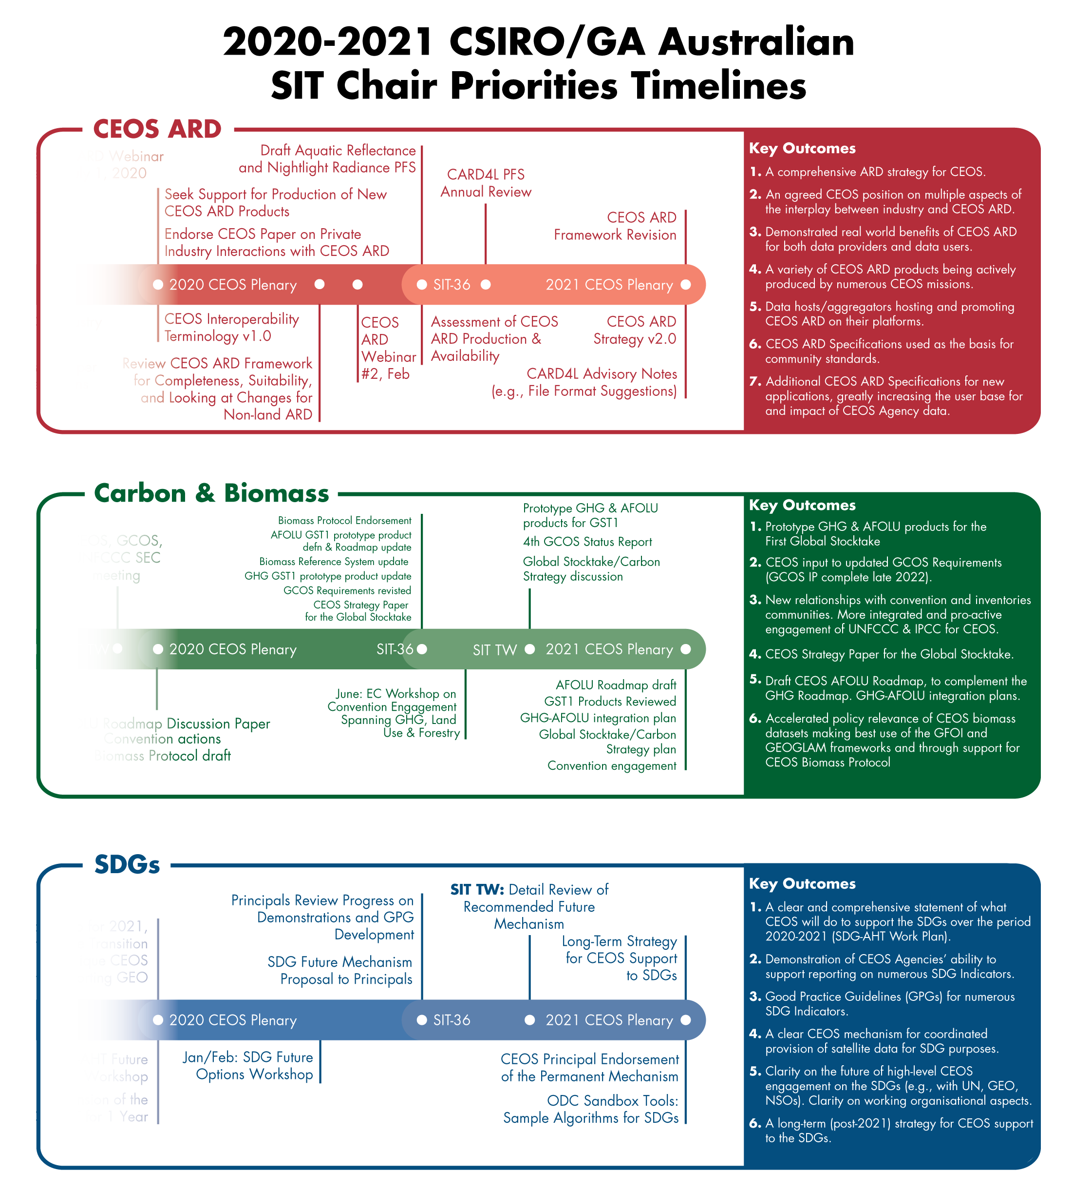
SIT Chair Priorities
Analysis Ready Data – supporting effectiveness of public EO programmes with a broad ARD strategy, with evolution of CARD4L, new thematic areas and exploring industry engagement.
Carbon and Biomass – prototype GHG products for the first global stocktake; new relationships with conventions and inventories communities; accelerated policy relevance of new above-ground biomass observing capabilities, incl. with GFOI; support to the GCOS documents update.
SDGs - organisational clarity, and a few focused demos for good practice, methods; establishing longer-term strategy for CEOS support to SDGs.

Slide 3
Meeting Objectives
Space-based EO Data for Open Science and Decision Support: Support 2021 CEOS Chair focus.
Delivery and Key Relationships: Highlight CEOS Work Plan, priorities emerging from the CEOS-GEO relationship, SIT Vice Chair’s (ESA) proposed priorities.
Working Team Engagement: Showcasing achievements, discuss opportunities and risks, current and emerging synergies across teams.
Oceans and Coasts: Coordination of COVERAGE and CEOS-COAST, UN Intergovernmental Oceanographic Commission Decade of Ocean Science for Sustainable Development.
Sustainable Development Goals: Discussion and decision on options for the future of CEOS engagement with the Sustainable Development Goals.
Carbon and Biomass: Approach to the Global Stocktake Process under the Paris Agreement, update on the CEOS Carbon Strategy, CEOS Biomass Validation Protocol.
Analysis Ready Data and Future Data Architectures: CEOS ARD Strategy, CEOS ARD beyond land, uptake through advanced technologies.
Tuesday 23rd | Wednesday 24th | Thursday 25th
1. Welcome, Opening Remarks and Overview Work Plan, CEOS-GEO, CEOS Chair, SIT Vice Chair 2. Oceans and Coasts COVERAGE, CEOS-COAST, UN Decade Engagement 3. Carbon & Biomass CEOS approach to Global Stocktake, Biomass Protocol | 4. Sustainable Development Goals Options for future engagement 5. Analysis Ready Data and Future Data Architectures CEOS ARD Beyond Land, CARD4L Implementation, Open Earth Alliance, EAIL 6. Working Group Showcase - Part 1 | 6. Working Group Showcase - Part 2 7. Virtual Constellation Showcase 8. Working Team Coordination Synergies across VCs, WGs and AHTs 9. Closing Special Plenary, Closing Discussion, Actions, Future Meetings

Slide 4
Meeting venue!
SIT-36 was planned to be held in Sydney, Australia
The venue was to be…. Q-station. Namely the old ‘Quarantine Station’!!!
Check it out… https://www.qstation.com.au/our-story.html

Slide 5
Tour de Table
1. The SIT Co-Chair will identify a participating CEOS Agency by name, and invite the Principal or head of delegation to introduce themselves.
2. The Principal or head of delegation will identify themselves. The Principal or head of delegation may choose to use one of the following methods to manage introductions for their Agency:
a. Refer to a written list of Agency attendees that has been circulated in advance to the SIT Chair Team.
b. Introduce other participants from that Agency, noting any CEOS Leadership roles they occupy (e.g. Virtual Constellation Co-Lead, Working Group Chair, etc).
3. The Principal or head of delegation will indicate that introductions for their Agency are complete.
The SIT Co-Chairs will follow alphabetical order in passing to registered CEOS Agencies. Once all registered CEOS Agencies have had an opportunity to introduce themselves, there will be a final call for any other introductions.
Once this is complete, the SIT Co-Chairs will ask all attendees to open their mics and say “hello” simultaneously.

