Slide 1

CEOS 2020-2022 Work Plan Deep Dive
Committee on Earth Observation Satellites
Kerry Ann Sawyer, NOAA, CEOS Executive Officer
CEOS SIT-35, Agenda 4.2
Virtual Meeting
25 – 26 March 2020

Slide 2
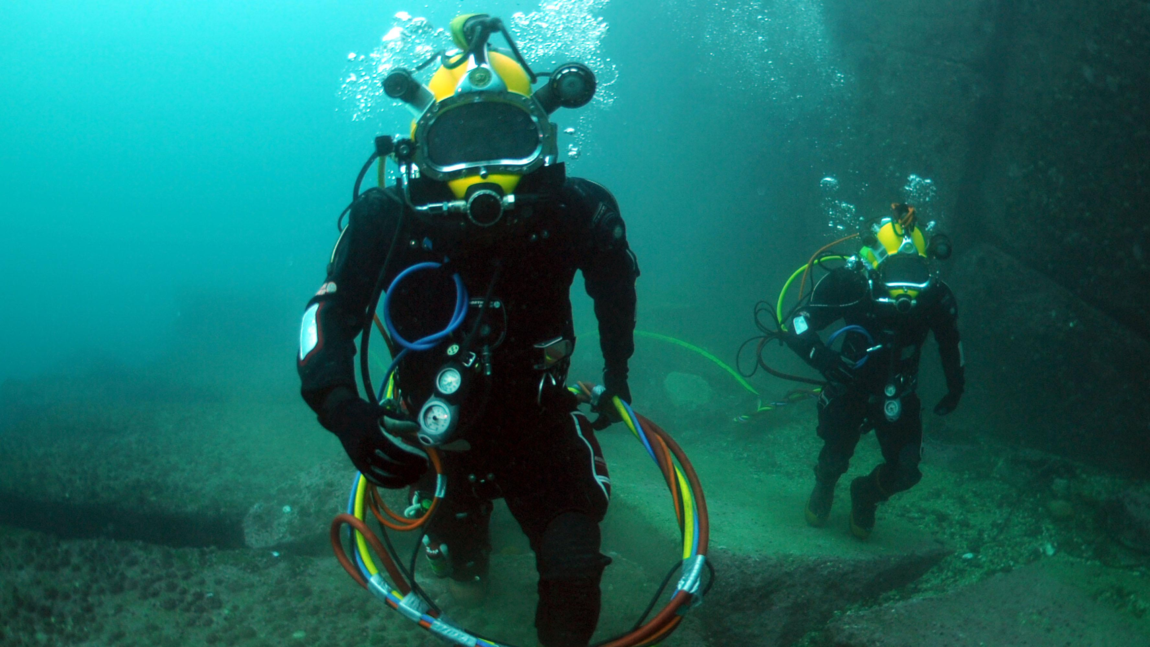
Session Overview
Climate Monitoring, Research and Services
Capacity Building and Data Democracy
Advancement of the CEOS Virtual Constellations
Carbon Observations, Including Forested Regions
Support to Other Key Stakeholder Initiatives
Observations for Agriculture
WGs/VCs/ AHT/Experts
CEO
Observations for Disasters
Data Discovery, Access, Preservation, Usability and Exploitation…
CEOS Services
Data Quality
Observations for Water

Slide 3
CEOS 2020-2022 Work Plan
BLUF*: DELAYED
*Bottomline up front
BTGN*: CEOS Entities are still accomplishing activities in the absence of a physical Work Plan
*But the Good News

Slide 4
Key Details of 2020-2022 CEOS Work Plan
149 Deliverables (64 Existing, 85 New!!)
CEO Proposals for Refined CEOS Work Plan
  Update Renaming/Renumbering Convention to facilitate tracking and “statusing” of Deliverables
    XX(XX)-YY-01 (2 to 4-character identifier-2-digit year-2-digit number, beginning at 01 for each year)
    For example: CARB-20-01
  Separate category for CEOS Services
    Routine actions and services of CEOS such as the CEOS Newsletter, the Missions, Instruments, and Measurements Database, the Essential Climate Variables Inventory, and other organizational actions with annual and concrete deadlines
Utilizing the CEOS Online Tracking Tool to full effect
  Challenges to encouraging CEOS community to “self-update” the online tool
  Will prepare a “users guide” as an Appendix to the Work Plan detailing required actions of various users of the online tool
  Will facilitate a streamlined Work Plan with less duplicate information

Slide 5

Breakdown of Deliverables
The “Deep Dive”
Climate Monitoring, Research, and Services (6) | Existing | New
 | 4 | 1
 |  | CMRS-20-01
Carbon Observations, Including Forested Regions (11) | Existing | New
 | 6 | 5
 |  | CARB-20-01
Observations for Agriculture (1) | Existing | New
 | 1 | 0
Observations for Disasters (12) | Existing | New
 | 6 | 6
 |  | DIS-20-01
Observations for Water (1) | Existing | New
 | 1 | 0
Data Quality (10) | Existing | New
 | 6 | 4
 |  | CV-20-01
Capacity Building and Data Democracy (31) | Existing | New
 | 8 | 24
 |  | CB-20-01
Data Discovery, Access, Preservation, Usability (11) | Existing | New
 | 10 | 1
 |  | DATA-20-01
Advancement of the CEOS VCs (39) | Existing | New
 | 10 | 29
 |  | VC-20-01
Support to Other Key Stakeholder Initiatives (21) | Existing | New
 | 7 | 14
 |  | SDG-20-01
CEOS Services (6) | Existing | New
 | 5 | 1

Slide 6
Sample of New Deliverables

Slide 7
Next Steps
CEO to update the CEOS Online Tracking Tool with updated information provided by CEOS entities (which was provided in a very timely manner by CEOS entities!)
Update explanatory paragraphs in the Work Plan and refine, keeping information concise and on point
  CEO will be reaching out to each CEOS entity to update text
Update tables in Work Plan for all 149 Deliverables, reflecting new renumbering convention
Draft for entity review by 15 April 2020
Virtual endorsement by 15 May 2020

Slide 8
CEOS Water Strategy
In the absence of a GEOSS Water Strategy

Slide 9
Sea Surface Temperature Virtual Constellation (SST-VC) White Paper

Slide 10
CEOS Support for Disaster Risk Reduction

Slide 11
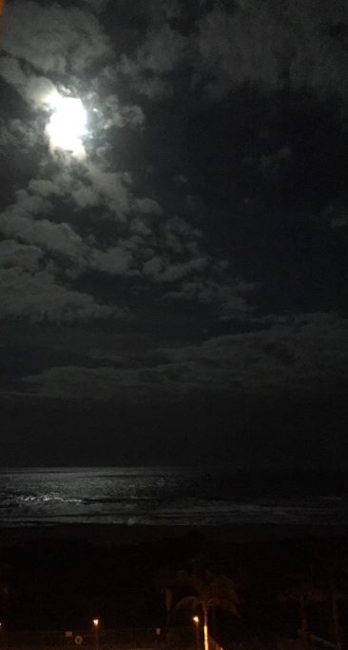
Thank you!

Slide 12
Session Overview
CEOS 2020-2022 Work Plan (K. Sawyer – 10 min)
Review of proposed CEOS Work Plan
  Highlights of links to GEO and other external stakeholders
  Updates/requests/issues for specific CEOS Deliverables requiring Principal attention
Timeline for endorsement of Work Plan
Deep Dive Sessions:
CEOS Water Strategy: future in context of obsolete GEOSS Water Strategy (D. Cripe – 3 min presentation; 8 min discussion)
SST-VC White Paper: Delivering on the Vision (E. Armstrong, 4 min presentation; 8 min interventions)
CEOS Support for Disaster Risk Reduction (D. Green, 4 min presentation, 7 min interventions)

