Slide 1
GEO LDN Activities and data needs
Committee on Earth Observation Satellites
Neil Sims
Co-Chair GEO LDN Initiative, CEOS SDG Ad hoc team
CEOS SIT-35 Virtual Meeting
25 – 26 March 2020

Slide 2
Land degradation measurement
SDG 15.3.1: Proportion of land that is degraded over total land area
Three sub-indicators
Land cover and land cover change
Land Productivity (NPP)
Carbon Stocks, above and below ground*
Currently using Soil Organic Carbon stock as a surrogate – need full C method
UN Convention to Combat Desertification (UNCCD) Custodians
Also proponents of the Land Degradation Neutrality framework
UNCCD approached GEO for support at GEO-XIV (Washington, 2017)
GEO LDN Initiative inaugurated at GEO-XV (Kyoto, 2018)

Slide 3
GEO LDN Initiative
GEO LDN Steering Committee
Co-Chairs (Antje Hecheltjen, Amos Kabo-bah, Neil Sims)
Country members, POs, other stakeholders/shareholders
Management and Functional Support Unit
GEO Sec (Douglas Cripe), secondments, shareholders
Capacity Building (WG1)
Amos Kabo-bah, Joost Teuben
Data quality standards (WG2)
Antje Hecheltjen, Sasha Alexander
Data Analytics (WG3)
Alex Zvoleff, Neil Sims
Working Groups

Slide 4
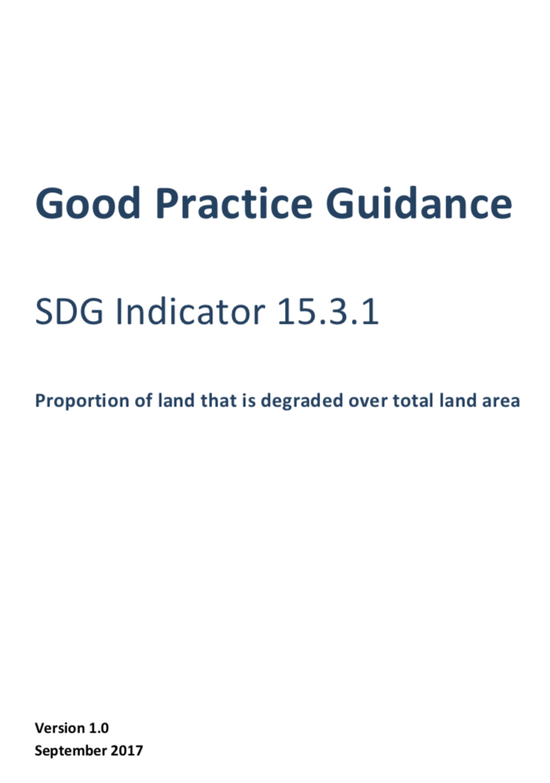
Data quality standards and protocols (WG2)
1. Develop “minimum” data quality standards, ensure consistency, coherence and comparability of data sets supplied by various data providers in support of country efforts to monitor SDG 15.3.1.
2. Review existing standards & global consultation: taking into account the perspectives & requirements of Data providers and end-users
3. Revision of existing GPG: specification of data quality standards and related requirements, practical decision trees to guide countries in selecting datasets that meet their specific need
4. Reconciling global data quality standards and national ownership, global comparability and national usability.
5. Synergies with existing initiatives such as CARD4L, FAO Global Soil Partnership (GSP), other GEO Inititatives

Slide 5
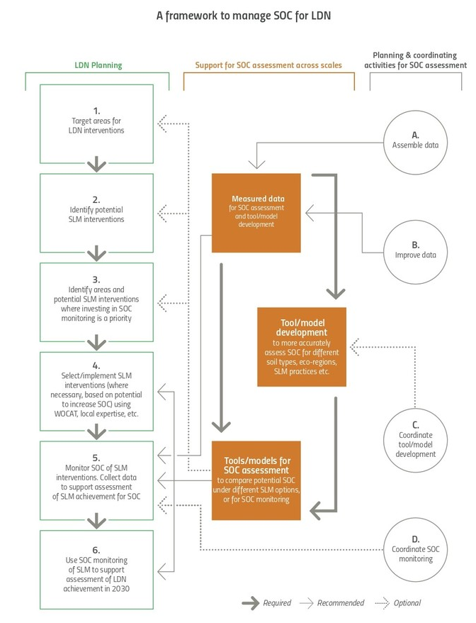
Data decision trees
Process to help countries identify best datasets for their needs
Data decision trees coming soon (Alastair Graham)
Opportunity for CEOS to contribute to this process
Deeper engagement in data decision process for an environmental challenge of significant global importance
https://knowledge.unccd.int/knowledge-products-and-pillars/access-capacity-policy-support-technology-tools/decision-trees-soc

Slide 6
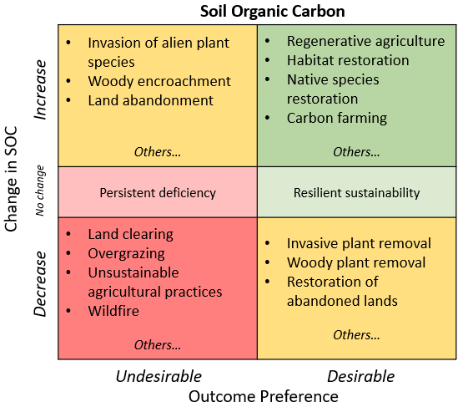
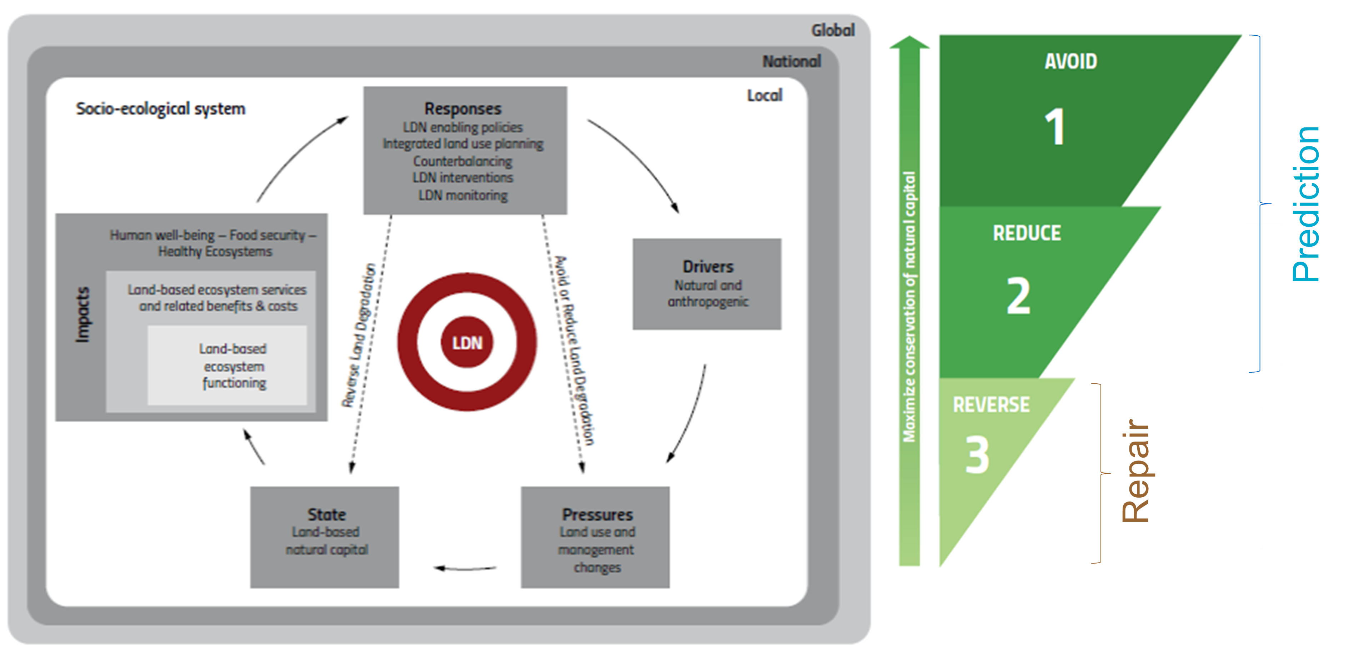
Dataset and product needs
Countries reporting counter-intuitive LDN assessment outcomes
Characterise drivers, pressures, state, impacts and responses
Sims, Barger, Metternicht, England (submitted)
Predict areas vulnerable to land degradation
Link to planning, climatic and social data

Slide 7
Potential CEOS support
Carbon stocks above and below ground
SOC stocks in soils
Root-to-shoot ratio models modified by species, climate, soils etc
Plant height, cover, wood density, condition, growth phase etc
Contribute to GPG review
Guidance on dataset availability at local, regional and global scales
Formal response on decision trees
Specify datasets for particular regions/circumstances using decision tree approach
Predicting degradation
Linking EO with social datasets – viewing land from a human use perspective (land use to supplement land cover)
Land potential vs condition

Slide 8
Thanks!
Neil Sims
Program Manager, Space Technology Future Science Platform, CSIRO Astronomy and Space Science
Co-Chair, GEO Land Degradation Neutrality Initiative
Neil.Sims@csiro.au
Acknowledgements: Antje Hecheltjen, Amos Kabo-bah, Alex Zvoleff, Sasha Alexander, Graciela Metternicht, Nichole Barger, Jacqui England, Douglas Cripe, Bill Sonntag

