Slide 1
USGS Landsat Collection 2
Steve Labahn, USGS, LSI-VC Co-Lead
CEOS SIT-35
Agenda Item #: 3.1
Hobart, Tasmania, Australia
25-26 March 2020

Slide 2
Topics
USGS Landsat Collection 2 Definition Summary & Schedule
CEOS ARD for Land (CARD4L) Self-Assessments
USGS submitted Surface Reflectance (SR) and Surface Temperature (ST) self-assessments via LSI-VC in late 2019
CEOS WGCV peer review team assembled and evaluating submission
ESA and USGS self-assessments informing annual SR/ST Product Family Specification (PFS) review/updates
Trial Production (AWS) – Digital Earth Africa Lessons Learned

Slide 3
USGS Landsat Collection 2 Definition Summary
Improved Geometric Accuracy, including utilizing Sentinel-2 Global Reference Image (GRI)
Improved Digital Elevation Model (DEM)
Improved Radiometric Calibration
Global Level-2 Data and Atmospheric Auxiliary Products
Consistent Quality Assessment Bands
Updated and Consistent Metadata Files
Scene-Based Cloud Optimized GeoTIFF (COG) File Format
USGS Landsat Missions Web Site Collection 2 documentation, including a high-level summary table describing the major differences between Collection 1 and Collection 2, is located here:
https://usgs.gov/land-resources/nli/landsat/landsat-collection-2
Public announcement:
https://www.usgs.gov/news/landsat-data-moving-public-cloud-early-2020

Slide 4
USGS Landsat Collection 2 Schedule
✔ Project Kick-Off September 2017
✔ Preliminary Design Review April 2019
✔ Critical Design Review August 2019
✔ Test Readiness Review (Level-2) January 2020
Test Readiness Review (Collection 2) April 2020
Operational Readiness Review May 2020
Internal Product Validation Period May-June 2020
Public Collection 2 Data Availability ~June 2020
Collection 2 Tiled U.S. ARD Availability September 2020

Slide 5
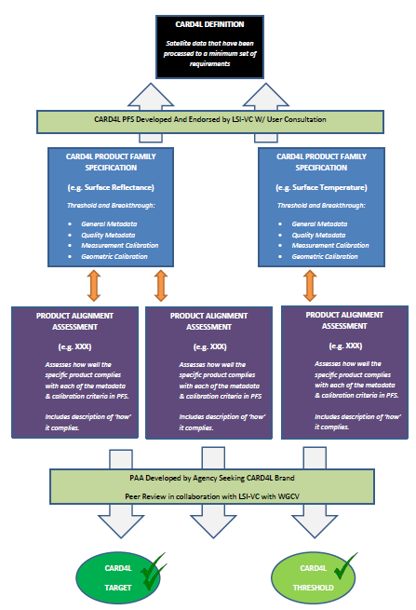
CARD4L Framework http://ceos.org/ard/
CARD4L Definition
Product Family Specifications (PFS)
Optical Surface Reflectance (CARD4L-OSR)
Surface Temperature (CARD4L-ST)
Normalized Radar Backscatter (CARD4L-NRB)
* Additional radar PFSs are under consideration
* Additional LiDAR PFS is under consideration
* Additional Aquatic Reflectance PFS is under consideration
Providers self-assess how well their products meet the specifications
Providers submit self-assessment to CEOS WGCV for peer review
CARD4L-compliant stamp!

Slide 6
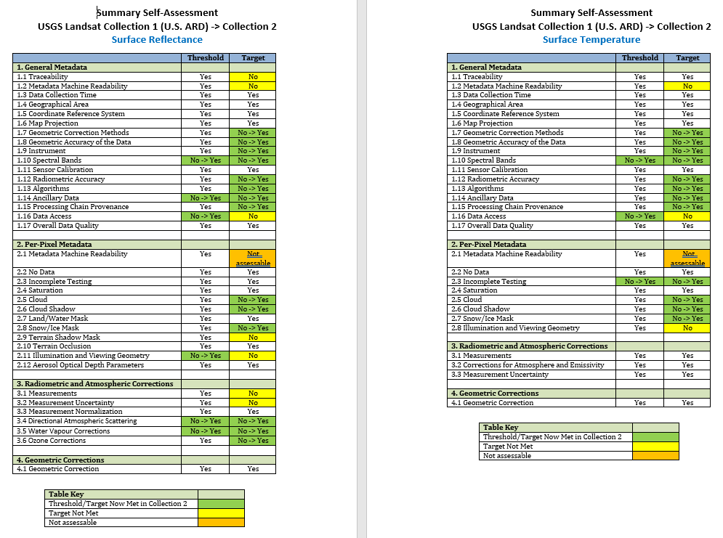
CARD4L Self-Assessments Landsat Collection 1 (U.S. ARD) to Collection 2 Improvements

Slide 7
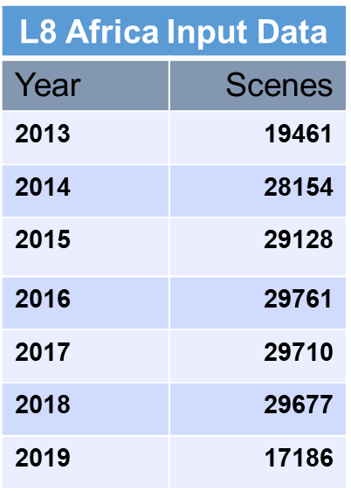
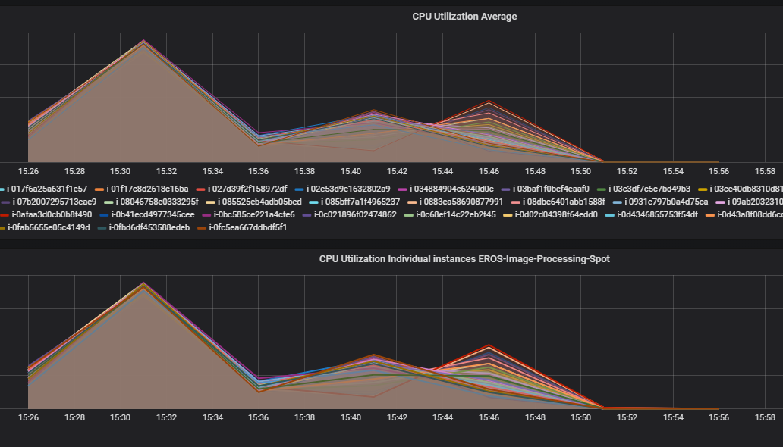
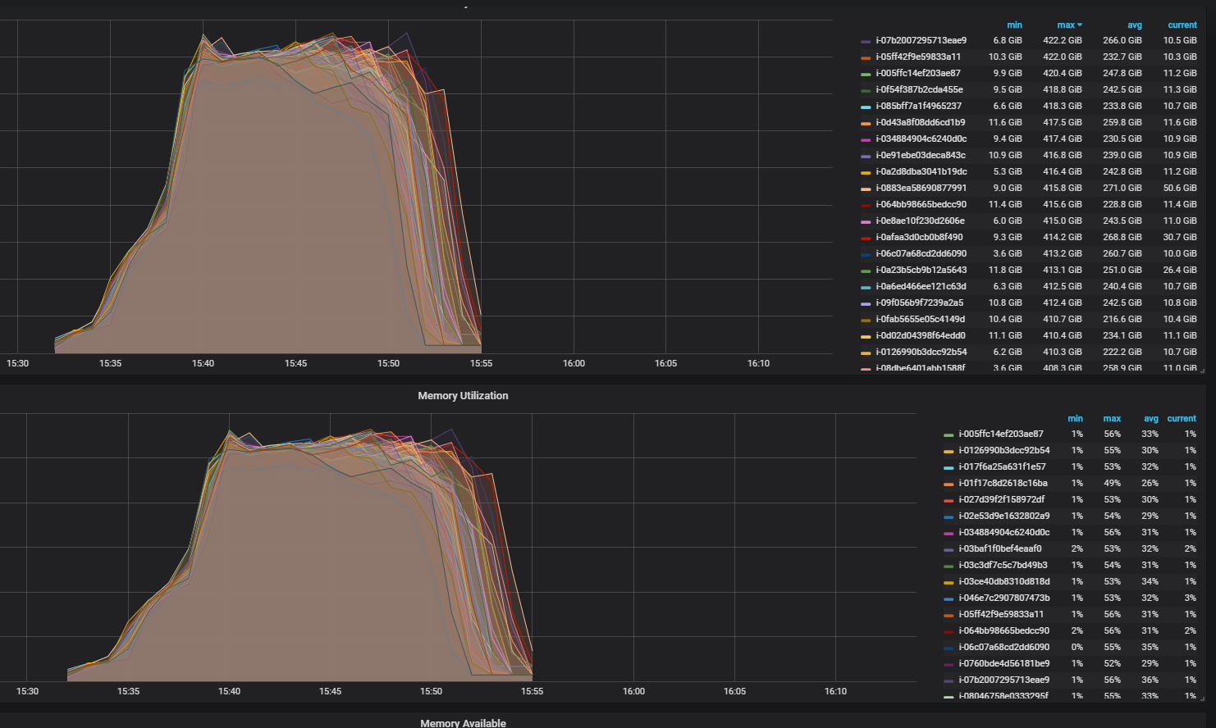
Trial Production (AWS) Digital Earth Africa Lessons Learned
Used as first scaling test in Landsat Collection 2 development
Processed 183,077 Landsat 8 scenes from 2013-2019 over Africa to Level-2 for ~$5,700 USD
AWS Instance Type Limits
USGS environment had limited ability to scale using Spot instances (Issue resolved)
AWS Instance Type Choices
r5d and m5d (lower processing time, lower costs, attached solid state drive)
r4 and m4 (higher processing time, older type, adding block storage increases costs, other limits)
AWS Resource Issues
Out of Memory errors (Added swap space and increased container memory size, Issue resolved)
AWS Simple Storage Service (S3) Issues
Unable to see files during processing (Files are on S3 but unable to see at times, Issue resolved)
Failure with rclone piped to tar (Resulted in truncated input data)
Adding S3 transfer acceleration to the buckets was good
AWS Command Line Interface (CLI) Segmentation Faults
Issue came up at times copying a job control file (Re-ran without any issues but still investigating)

Slide 8
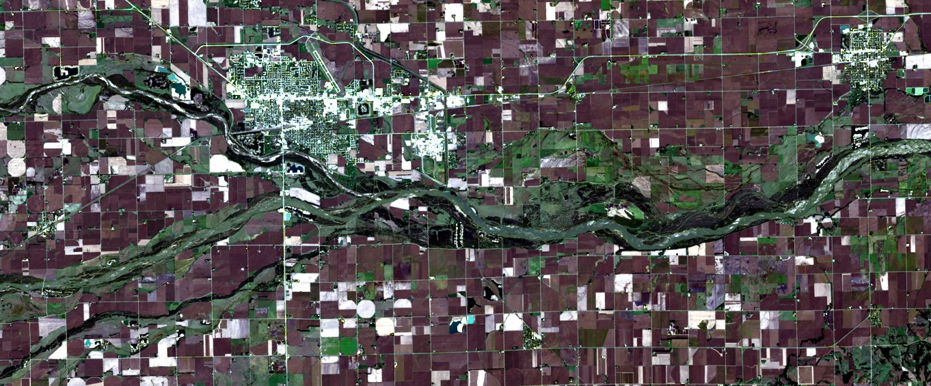
USGS Landsat Collection 2 Landsat 8 Level-2 Surface Reflectance
Columbus, NE USA
Path 29 / Row 31
October 8, 2016
True-color RGB (4/3/2)
LPGS v15.2.0 (7/22/2019)
LaSRC 1.4.1 (SR)
Single-Channel 1.3.0 (ST)

Slide 9
Questions?

