Slide 1
GCOS – Plans

Slide 2
WMO Strategic Plan Goals
WMO commissions reduced to two:
Commission for Observation, Infrastructure and Information Systems (Infrastructure Commission)
Commission for Weather, Climate, Water and Related Environmental Services & Applications (Services Commission)
Research Board on Weather, Climate, Water and the Environment (Research Board)
ALSO
Joint Collaborative Board (IOC and WMO)
Hydrological Coordination Panel
WMO Secretariat:
Observation, Infrastructure and Information Systems Department (Infrastructure Department)
Weather, Climate, Water and Related Environmental Services and Applications (Services Department)
Science and Innovation Department
Member Services
Corporate Support
1: Better serve societal needs: delivering, authoritative, accessible, user-oriented and fit-for-purpose information and services
2: Enhance Earth system observations and predictions: Strengthening the technical foundation for the future
3: Advance targeted research: Leveraging leadership in science to improve understanding of the Earth system for enhanced services
4: Close the capacity gap on weather, climate, hydrological and related environmental services: Enhancing service delivery capacity of developing countries to ensure availability of essential information and services needed by governments, economic sectors and citizens
5: Strategic realignment of WMO structure and programmes for effective policy- and decision-making and implementation

Slide 3
GCOS
Governance
Currently GCOS is led by a steering committee guided by its four sponsors (WMO, IOC of UNESCO, UNEP and ISC). This will continue.
A WMO study group including the four Co-sponsors and major partners will consider the future governance arrangements and make proposals in 2023
The GCOS secretariat will be based in the Infrastructure Department reporting to its director at WMO (previously it was in the Climate and Water Department)
GCOS and WMO
WMO is strongly committed to GCOS and its continuing work, including
Reviewing and reporting on the needs for, and state of, climate observations
The GCOS Panels
The ongoing review of the ECVs, updates to the Status Report & Implementation Plan
The operation and integration of the GCOS networks
Regional activities and national support
WMO would also like to strengthen
The input of GCOS into WMO regulatory and guidance activities
Its consideration of ocean climate needs
WMO recognises the range of organisations GCOS cooperates with and the importance of this approach
Notes:
4th GCOS Review Cycle
GCOS regularly reviews the status of monitoring of Essential Climate Variables (ECV) and user needs. It produces a series of Status Reports and Implementation Plans that describe the observations that are needed and actions required to improve the observational systems and networks.
GCOS is now starting its 4th cycle by launching a public consultation on the ECV requirements in January 2020 followed by a Status Report in 2021 and Implementation Plan in 2022. All these outputs will be publicly reviewed to ensure that they capture as many views and needs as possible. The time line is shown below.
The revision will not aim to make radical changes, most will be minor, but in some areas clarification of the definitions and feedback form monitoring systems on what is feasible will need to be accounted for. Rather than a single value to be met this revision will present a range form the minimum needed to be useful for climate issues to the maximum resolution beyond which no benefits are expected. Intermediate values may also be presented which may be useful for specific applications.

Slide 4
Timeline for Status Report (SR4) and Implementation Plan (IP4)
SEPTEMBER (?) 2020:
Panel Meetings
Consider Requirements
MARCH 2021: Panel Meetings
Agree revised Status Report
SEPTEMBER 2021: 4th Status Report published
OCTOBER 2021:
2nd Climate Observation Conference
(11-15 October 2021, Darmstadt, Germany)
2022 March Panel Meetings
Agree revised Implementation Plan
OCTOBER: Steering Committee Meeting: 4th Implementation Plan published
Jan 2020
Jan 2021
Jan 2022
Jan 2023
Jan 2024
panels draft SR4
Review SR4
UNFCCC Global Stocktake
Public consultation
Panels consider comments on requirements
panels draft IP4
Review IP4
ECV Stewards and IP Action rapporteurs update panels on progress, issues and gaps.
Develop work on monitoring impacts and responses, regional support, gaps in climate cycles
Notes:
4th GCOS Review Cycle
GCOS regularly reviews the status of monitoring of Essential Climate Variables (ECV) and user needs. It produces a series of Status Reports and Implementation Plans that describe the observations that are needed and actions required to improve the observational systems and networks.
GCOS is now starting its 4th cycle by launching a public consultation on the ECV requirements in January 2020 followed by a Status Report in 2021 and Implementation Plan in 2022. All these outputs will be publicly reviewed to ensure that they capture as many views and needs as possible. The time line is shown below.
The revision will not aim to make radical changes, most will be minor, but in some areas clarification of the definitions and feedback form monitoring systems on what is feasible will need to be accounted for. Rather than a single value to be met this revision will present a range form the minimum needed to be useful for climate issues to the maximum resolution beyond which no benefits are expected. Intermediate values may also be presented which may be useful for specific applications.

Slide 5
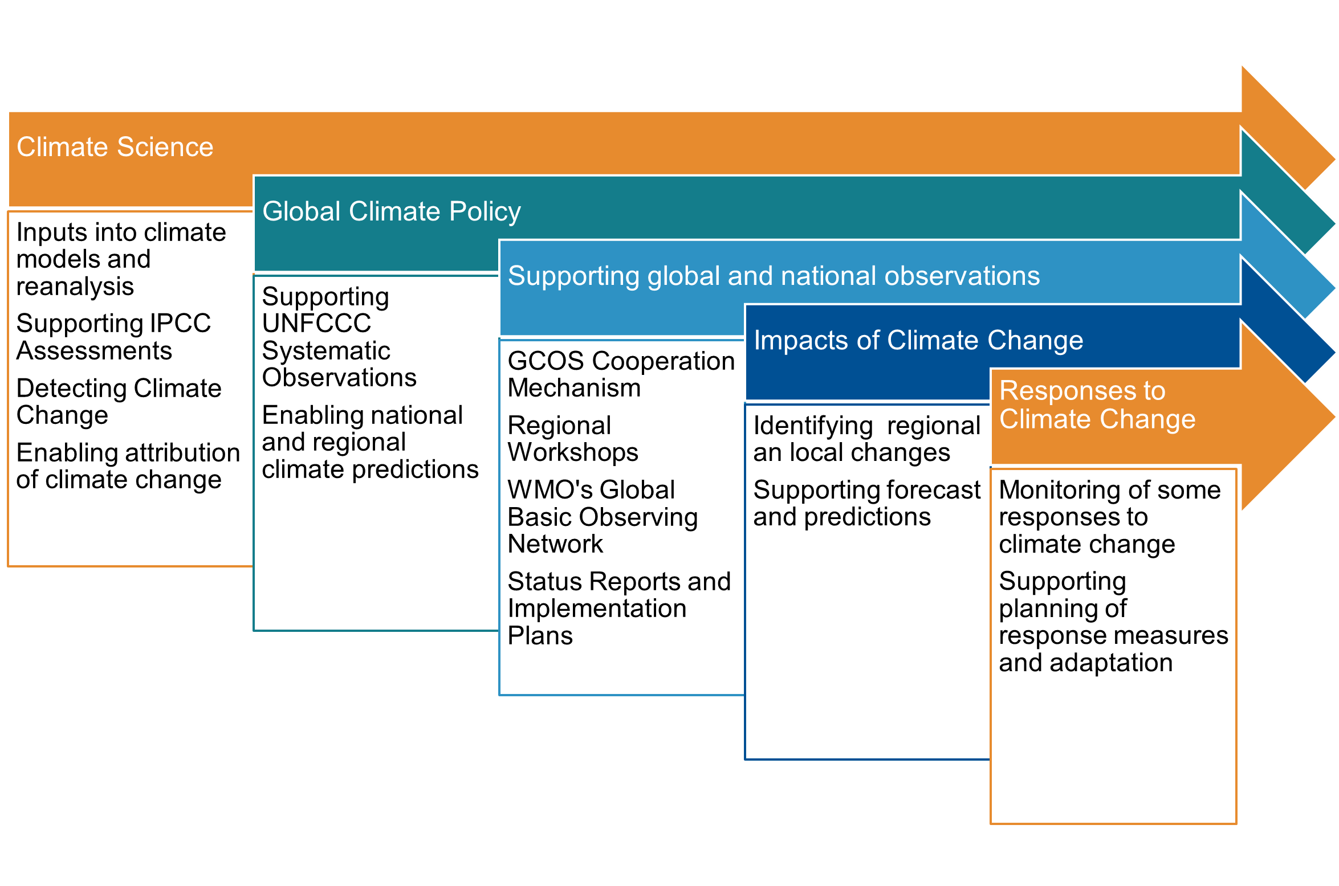
New Challenges
Climate Science
Global Climate Policy
Inputs into climate models and reanalysis
Supporting IPCC Assessments
Detecting Climate Change
Enabling attribution of climate change
Supporting global and national observations
Supporting UNFCCC Systematic Observations
Enabling national and regional climate predictions
Impacts of Climate Change
GCOS Cooperation Mechanism
Regional Workshops
WMO's Global Basic Observing Network
Status Reports and Implementation Plans
Responses to Climate Change
Identifying regional an local changes
Supporting forecast and predictions
Monitoring of some responses to climate change
Supporting planning of response measures and adaptation
Notes:
New Challenges
To date, GCOS has concentrated on climate monitoring that supports climate science and the assessments of the IPCC. Now that anthropogenic climate change is clear it is important for GCOS to ensure that other demands on global climate monitoring are met.
These include:
Ensuring monitoring of the entire climate system, the Earth’s carbon and water cycles and energy balance.
Monitoring impacts of climate change, changes in means and extremes.
Monitoring responses to climate change
Ensuring urban areas (where most people live) are adequately monitored

