Slide 1
SEO Report
Brian Killough
NASA Langley Research Center
CEOS Systems Engineering Office (SEO)
CEOS SIT-35, Virtual Meeting March 25-26, 2020

Slide 2
SEO Near-Term Tasks
Digital Earth Africa ... The SEO is working with the Digital Earth Africa team to transition the Africa Regional Data Cube prototype. A recent meeting in South Africa included discussions about maintaining Landsat data flows until the Collection-2 release, creating a new help desk, and engaging with power users and country stakeholders.
SDG Ad Hoc Team ... The SEO has been working on data cubes tools and algorithms that will support urbanization (SDG 11.3.1), water detection (SDG 6.6.1a) and land degradation (SDG 15.3.1). In addition, we are working on a satellite data requirements template. All of these outputs will go into the new SDG toolkits.
Data Flows ... The SEO is working with Albrecht Schmidt (ESA, support to SEO) on Sentinel data flows to support numerous global initiatives. We are also working with the LSI-VC team on ARD specifications and working with egeos (Italian contractor) on solutions for Sentinel-1 data cube creation.
Capacity Building ... supporting two future webinars .... COVE tool and Jupyter Notebooks. See other charts ...
GEO support ... The SEO is supporting two projects in GEO. One is the GEO-Amazon project where we have supported data cube development in Ukraine and Mexico. The other is a new GEO-Google project.
Virtual Meetings ... With the COVID-19 situation, there is an increasing need for virtual meetings and telecons. The SEO has 5 Go-To-Meeting licenses to support CEOS, so if you need this support for any of your meetings, let us know.
Mission Database ... The SEO maintains a list of active CEOS missions for communications. We have 164 active missions with 30 new missions from 2018, 15 new missions from 2019, and ~40 possible new missions in 2020. It is often very difficult to get the status of decommissioned missions. For example, we are uncertain about the status of 33 of our 164 active missions.

Slide 3
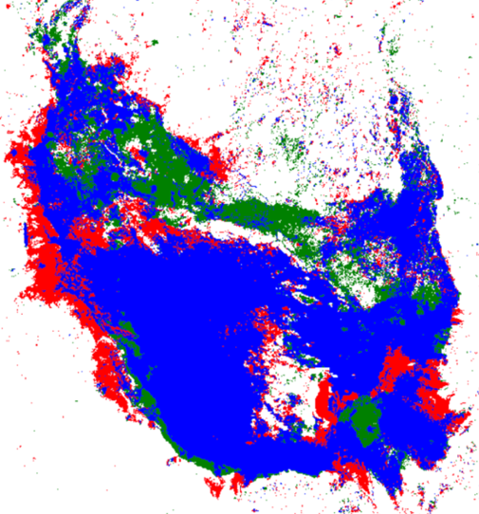
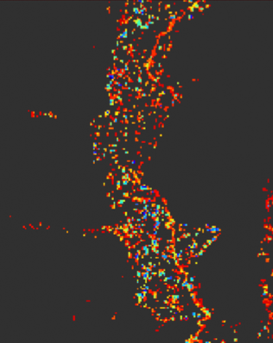
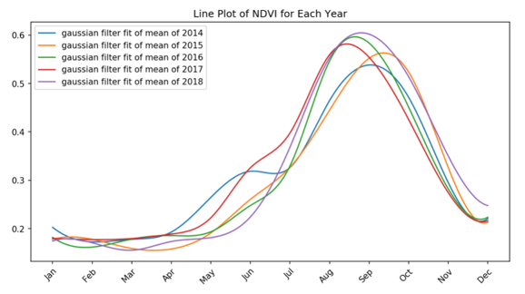
Open Data Cube
ODC is operational in 10 countries, in development in 19 countries + 49 more countries in DE-Africa, and 28 more countries have expressed interested ... the impact is 106 countries !!!
Core code development is focused on moving the initiative to the OSGeo (Open Source Geospatial) Foundation
The ODC teams recently completed a hackathon in Australia (Feb 24-28) with a focus on data interoperability
The SEO team recently completed an El Slavador prototype to initiate work in Latin America. This effort is being coordinated by Mexico and supported by GEO and CSIRO.
The SEO continues to work on enhancements for tools and algorithms that will support the growing number of ODC deployments around the world.
COAST ... The SEO is supporting early discussions and planning and this effort may take advantage of the ODC infrastructure for data and analyses.
www.opendatacube.org

Slide 4
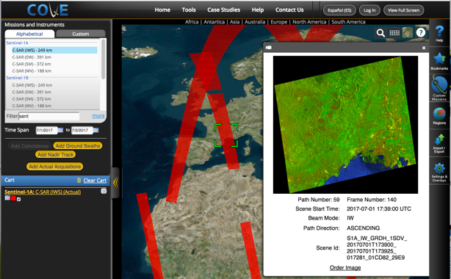
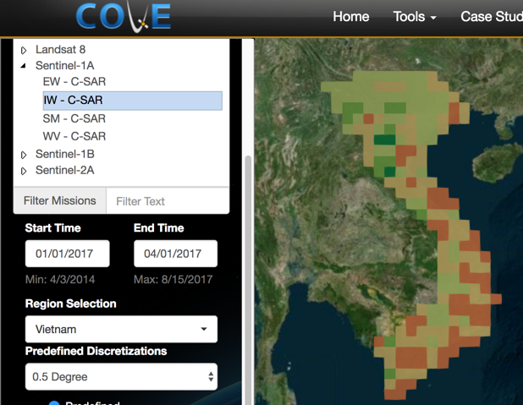
COVE Analysis Tool
The CEOS Visualization Environment (COVE) is a browser-based suite of tools for searching, analyzing, and visualizing actual and potential satellite sensor coverage.
COVE is FREE and OPEN for anyone to use! The tools includes over 130 missions and is linked to several mission archives for metadata and browse images: Landsat, Sentinel-1, and Sentinel-2.
Many updated and new analysis tools, including: Acquisition Forecaster (past and future groundtracks) Coverage Analyzer (past acquisitions and browse images) Revisit Calculator (coverage statistics) Coincidence Calculator (multiple missions) Data Browser (data filtering) Data Policy (link to portal) Country Coverage Reports (annual country-level summaries) Utilities (swath calculator)
www.ceos-cove.org

Slide 5
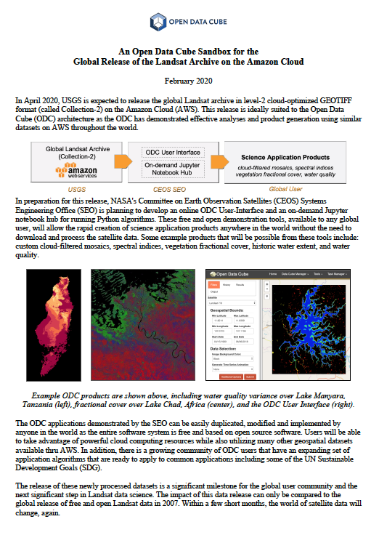
Landsat Collection-2 Sandbox
The SEO is working on a new initiative (unsolicited, not part of the CEOS work plan) to create an online cloud-based “Data Cube Sandbox” tool to support the Landsat Collection-2 release (~April 2020)
This free/open Amazon cloud demo will allow users to rapidly run analyses anywhere in the world and demonstrate the power of Landsat ARD with several common applications (custom cloud-filtered mosaics, spectral indices, vegetation fractional cover, historic water extent, and water quality variability).
This creates a new opportunity for webinars and tutorials and may be linked to the CEOS CB-45 task (Jupyter Notebooks Webinar)

