Slide 1
2020-2021 SIT Chair Proposed Priorities
Committee on Earth Observation Satellites
Alex Held, CSIRO
Adam Lewis, GA
CEOS SIT-34
Session 8.3
Miami, FL, USA
3 – 4 April 2019

Slide 2
Introduction
Shortlist for the Australian 2020-2021 SIT Chair Proposed Priorities
Analysis Ready Data
Global carbon observations - inc biomass
SDGs
Inland freshwater quality and quantity
GEO-LEO

Slide 3
Analysis Ready Data
The SIT Chair will ensure effective progress on existing work and propose and promote a broader CEOS ARD strategy, encompassing:
CEOS Analysis Ready Data for Land (CARD4L)
existing foundations established by LSI-VC
ARD Stocktake and outlook
build confidence and support investment
Technical Specification Development and Maintenance
an orderly queue for different thematic areas
Pilots and feedback
persuade providers, distributors and users
Promotion
build awareness

Slide 4
Carbon observations
The 2018 AC-VC report will have enduring impact and marks a milestone in cooperation towards anthropogenic emissions monitoring.
It includes a clear indication of the required ambition that CEOS (and CGMS) need to address - and provides a list of forward looking actions that are required to establish a roadmap.
SIT Chair will ensure the next steps are supported and the necessary actions expedited within the CEOS Work Plan. The high profile of this activity will be sustained during the term.
JAXA (and other agencies) highlighted importance of space agency connection to the Convention processes, through IPCC, SBSTA etc. This should be progressed and scope for support to Global Stocktakes and National Inventories explored, through the integration of all work CEOS is doing in support of the Convention (i.e. GFOI, GHG monitoring, Systematic Observations)
Notes:
Biomass timeline figure original: https://docs.google.com/presentation/d/1ysPY6qiQuC2mUiZtrdSK3rnaE1WWAufno1xXeGJr-44/edit?usp=sharing

Slide 5
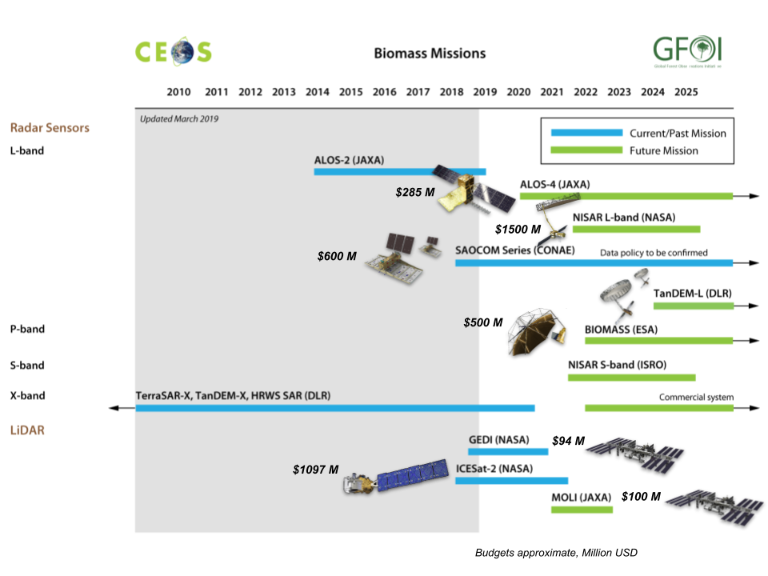
Carbon observations - Biomass
Substantial investment ($4Bn+!) in above ground biomass mission launches 2018-2024
Strong interest in biomass from sectors related to carbon emissions and forests
Need to optimise the policy relevance of the space data - through fora such as GFOI and World Bank
SDCG, WGCV-LPV and individual agencies met last week
CARB-16 (WGCV): Cal/Val and production of biomass products from CEOS missions - Development of a coordinated cal/val strategy across NASA and ESA biomass missions that rationalizes protocols, data sharing, and the establishment of ground-based carbon super-sites.
CARB-17 (WGClimate) : Engaging with IPCC inventories and promoting satellite EO.
Notes:
Biomass timeline figure original: https://docs.google.com/presentation/d/1ysPY6qiQuC2mUiZtrdSK3rnaE1WWAufno1xXeGJr-44/edit?usp=sharing

Slide 6
Others
SDGs: SIT Chair will seek to expedite progress in a small number of priority indicators for demonstration of the value of EO for SDG Indicators.
Inland Freshwater quality and quantity: Will take stock of the planned CEOS workshop, of the progress in GEOGLOWS, of the recommendations in the March 2018 CEOS Report, and explore a way forward, including in support of SDG requirements
GEO-LEO: Will take stock of the GEO-LEO progress achieved under NOAA and explore next steps.

Slide 7
SIT 2020 Dates
CEOS SIT-35: 31 March - 2 April 2020 in Hobart, Australia
CEOS SIT TW: 8 - 10 September 2020 in Zagreb, Croatia
Mark your calendars!

