Slide 1
Analysis Ready Data Strategy for CEOS
Committee on Earth Observation Satellites
Adam Lewis, Geoscience Australia SIT Vice Chair Team, LSI-VC Co-Lead
CEOS SIT-34
Session 5.4
Miami, FL, USA
3 – 4 April 2019

Slide 2
Introduction
The CEOS Future Data Architectures report included an excellent review of the changing landscape and context for CEOS agency EO programmes and the way in which they service their user communities
Common concerns highlighted by the FDA team report:
Need for significant simplification of data handling and uptake by users
Changing expectations around Big Data systems and cloud storage and computing
The pursuit of CEOS standards for Analysis Ready Data can address these concerns
Data suppliers can remove many of the fundamental data correction and processing tasks from the users, so that more users and more uses of the data are possible
LSI-VC has taken on the responsibility for the first CEOS coordination in this area through the development of the Product Family Specifications (PFS) for the CEOS Analysis Ready Data for Land (CARD4L) set of products.

Slide 3
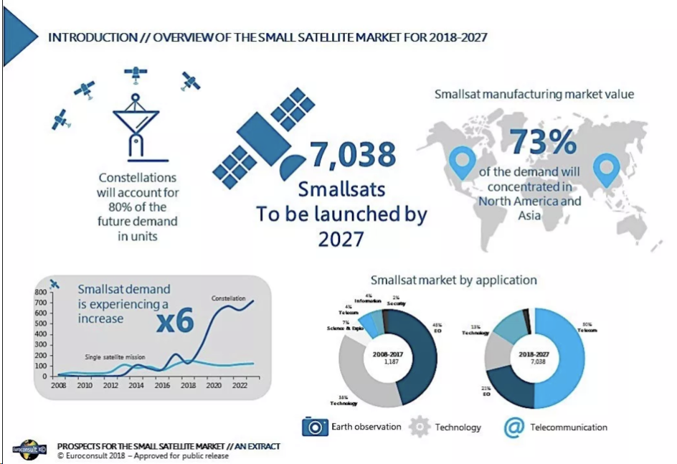
Context

Slide 4
Context & Trends
Many short life smallsats with relatively poor geometric and radiometric quality and limited calibration - huge volumes of data
AI, on-board and on ground
Machine learning - with easy access to and operation with EO data
Still a role for the large and long-lived reference platforms
Standardisation and ARD an essential part of managing data volumes, data interoperability, the interaction with machines, and the mainstreaming of EO data into society
competitiveness measure for public EO programmes

Slide 5
CEOS ARD Strategy Objectives
to ensure continued competitive performance of public EO programme data and information, leveraging the availability of all relevant CEOS agency missions to meet user needs for information, amidst an explosion in provision of commercial smallsat constellations providing EO data;
to meet the changing expectations of the user base, which is increasingly non-technical and more accustomed to simplicity in geospatial data sourcing, integration and application; thus to support the mainstreaming of EO data in society through removal of user burden and data complexity;
to allow CEOS agency data to benefit from the increasing interaction with machines – through machine learning and artificial intelligence methods – which can handle large amounts of data, and allow these data to be integrated and interoperable with minimal intervention;
to establish a broad understanding of, and participation in, CEOS efforts to define, produce, apply, and promote ARD in support of societal needs;

Slide 6
CEOS ARD Strategy Objectives
to ensure effective engagement of the three key stakeholder groups: EO data providers (both public and private); Big Data hosters and aggregators who stage increasing amounts of CEOS agency free and open data; and data users;
to manage expectations of all stakeholders as to the status and outlook for ARD availability – so that all might plan and invest with confidence in capabilities to best exploit the CEOS agency ARD;
to establish priorities for which products and applications might follow on from the current CARD4L PFS – forming a rational and orderly queue for future efforts;
to ensure appropriate organisational responsibilities across the CEOS structure for the definition and execution of the way forward on ARD; the Strategy is seen as a fairly informal grouping of relevant CEOS activities which SIT Vice Chair proposes to oversee and promote during their coming SIT Chair term – with new tasks identified as needed.

Slide 7
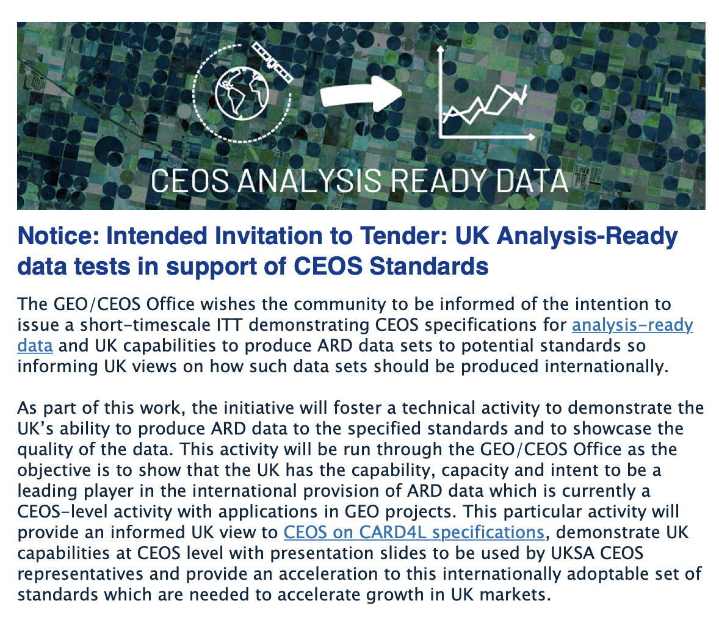
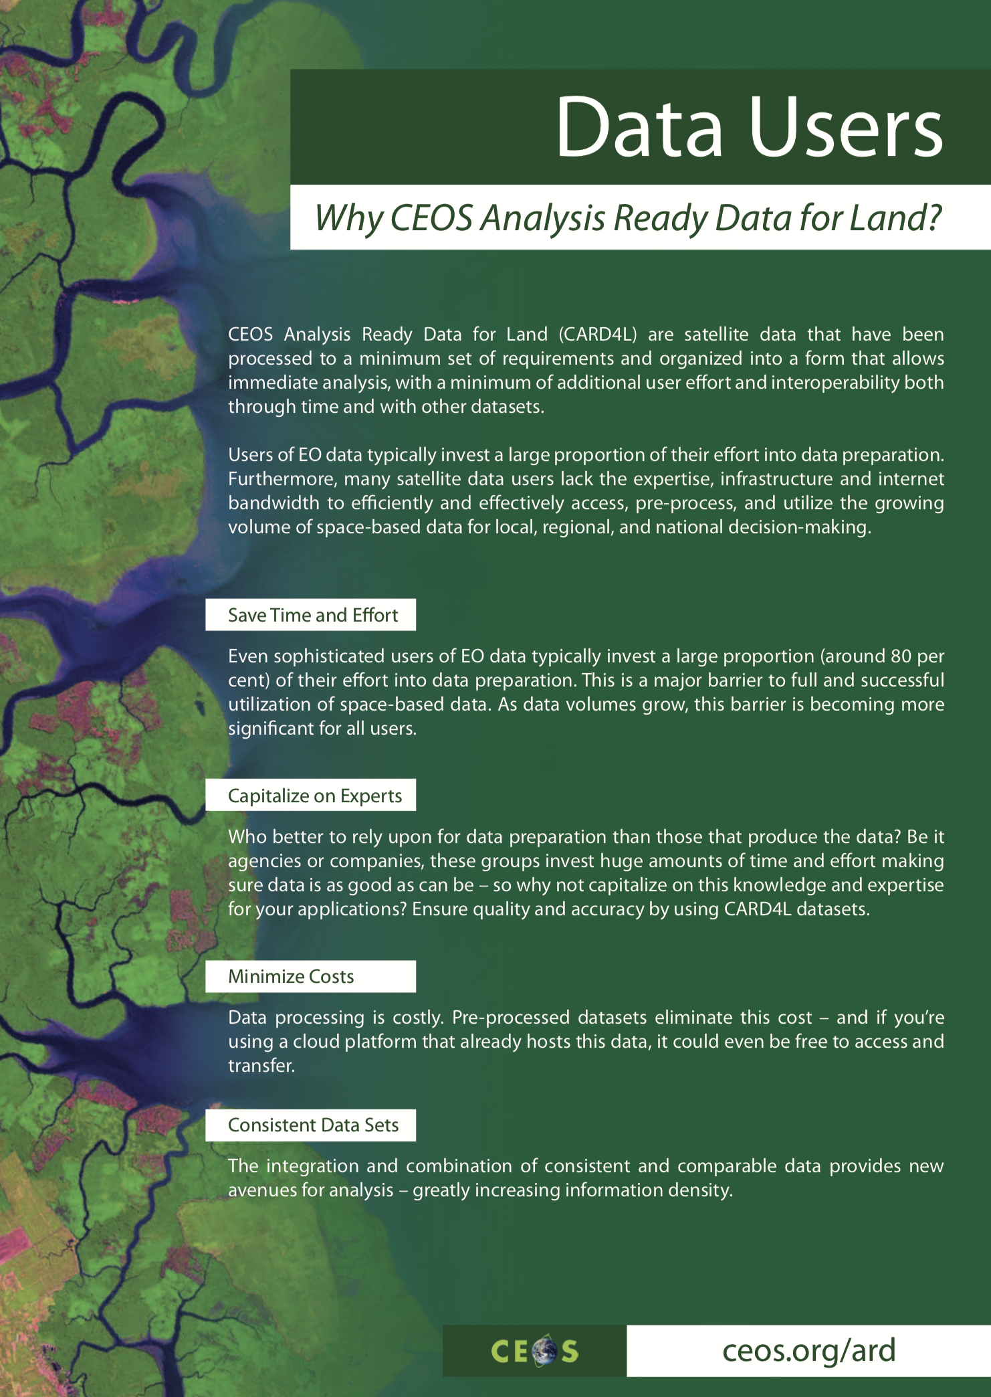
CEOS ARD Strategy Components
CEOS Analysis Ready Data for Land (CARD4L)
CARD4L will include: technical specifications; trial production of data; pilot programmes for stakeholder engagement and feedback; and continued refinement of the standards
ARD Stocktake and outlook
CEOS should define and maintain a clear statement as to the current and future availability of the different datasets produced to its ARD standards, and how to access them. This should include a current snapshot and forecast for 1, 2, and 3 years hence
Technical Specification Development and Maintenance
The first steps for any new ARD standards across CEOS will be the development of the Product Family Specification
A systematic and effective process will be required to ensure consistency and performance across the relevant standards and datasets
Priorities driven by user demand (eg oceans or atmosphere or forests or machine learning….)
Pilots and feedback
Practical experience in the production, provision and application of CEOS ARD will be essential
An important driver in these trials will be to ensure data discovery, access and integration is optimal
Promotion
Active promotion of the benefits of ARD will be an essential part of achieving that critical mass for the standards to succeed - to data providers, data hosters and aggregators, and data users

Slide 8
Next Steps
SIT Vice Chair Team will bring a fleshed-out Strategy and tasks to the SIT TW in September
Strategy is informal, with light oversight and direction by SIT Chair of related tasks across the CEOS WP - and identification of new tasks as needed
SIT Vice Chair Team will bring a refined version to the CEOS Plenary in Vietnam in October - where CSIRO/GA will assume the SIT Chair role
VCs, WGs, and AHTs and all are encouraged to provide a reply to the short questionnaire that has already been provided to if they have not already. Thanks to SST-VC, AC-VC, WGDisasters for initial responses!
Feedback is welcome at any stage

