Slide 1
Working Group on Information Systems and Services (WGISS)
Committee on Earth Observation Satellites
Mirko Albani, ESA, WGISS Chair
CEOS SIT-34
Session 5: Data, Agenda Item #5.2
Miami, FL, USA
3 – 4 April 2019

Slide 2
WGISS Structure
WGISS
Chair, Mirko Albani, ESA
Vice-Chair, Robert Woodcock, CSIRO
WGISS Principals
AOE/CAS: Guangyu Liu
CCMEO: Patrick King
CNES: Richard Moreno
CONAE: Homero Lozza
CSIRO: Robert Woodcock
DLR: Katrin Molch
EC: Astrid Koch
ESA: Mirko Albani
EUMETSAT: Michael Schick
GA: Simon Oliver
HSO: Gabor Remetey
INPE: Lubia Vinhas
ISRO: Nitant Dube
JAXA: Yosuke Ikehata
NASA: Andrew Mitchell
NOAA: Kenneth Casey
NRSCC: Chuang Liu
RADI: Lizhe Wang
ROSCOSMOS: Pavel Tischenko
USGS: Kristi Kline
UKSA: Bertie Archer
WGISS Secretariat
Michelle Piepgrass, ESA
WGISS Infrastructure Services Project
Martin Yapur, NOAA – until end April 2019
Data Preservation and Stewardship Interest Group
(Mirko Albani, ESA)
Discovery and Access - WGISS Connected Assets System Level Team (Yonsook Enloe, NASA)
- IDN (Michael Morahan, NASA)
- FedEO (Andrea Della Vecchia, ESA ; Yves Coene, ESA)
- CWIC (Yonsook Enloe, NASA)
- OpenSearch II (Andrea Della Vecchia, ESA; Olivier Barois, ESA)
Interoperability and Use Interest Group
(Robert Woodcock, CSIRO; Richard Moreno, CNES)
- Future Data Architectures (Robert Woodcock, CSIRO; Richard Moreno, CNES; Kristi Kline, USGS)
- Carbon Portal (Kenneth Casey, NOAA, Liping Di, NOAA)
- Open Source SW and Tools (Iolanda Maggio, ESA)
Technology Exploration Interest Group
(Chris Lynnes, NASA; Yosuke Ikehata, JAXA)
Notes:
WGISS promotes collaboration in the development of systems and services that manage and supply Earth Observation data;
The activities and expertise of WGISS span the full range of the information life cycle from the requirements and metadata definition for the initial ingestion of satellite data into archives through to the incorporation of derived information into end-user applications.
WGISS Structured around four interest groups plus WISP project.

Slide 3
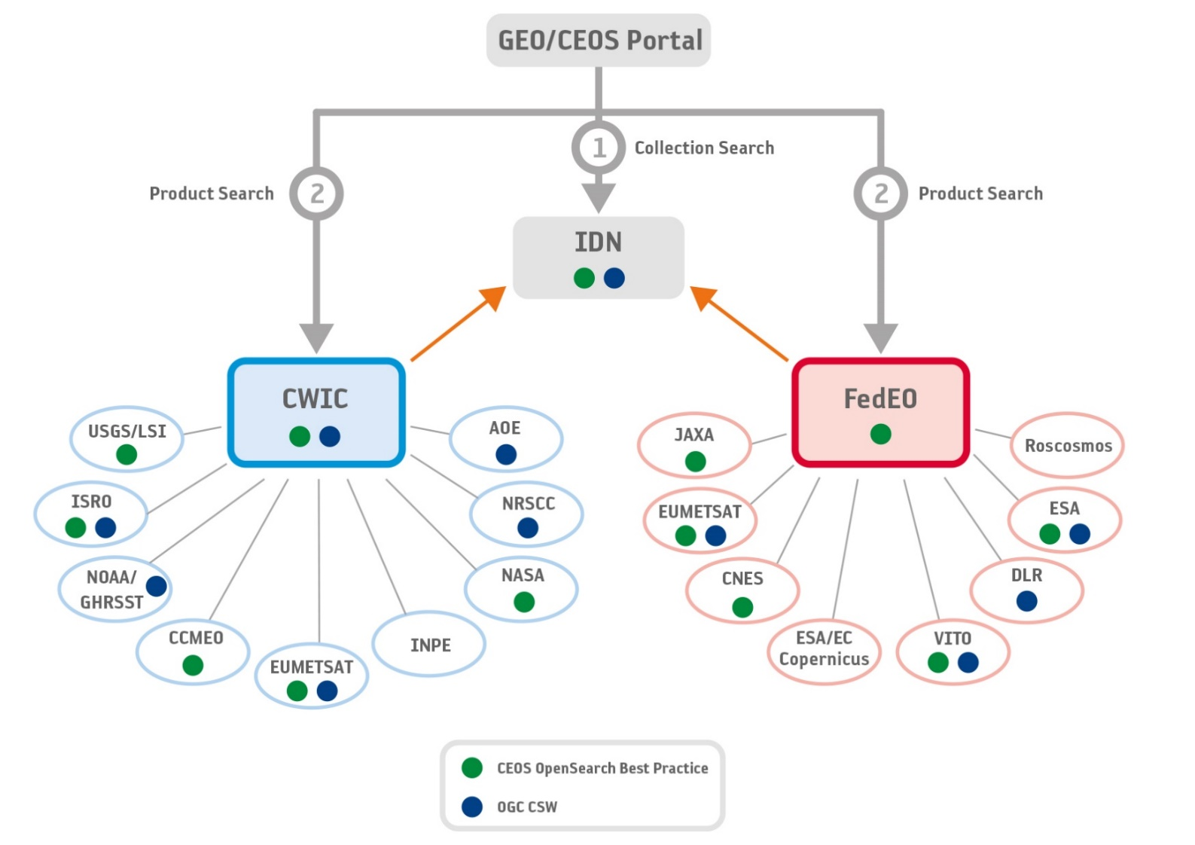
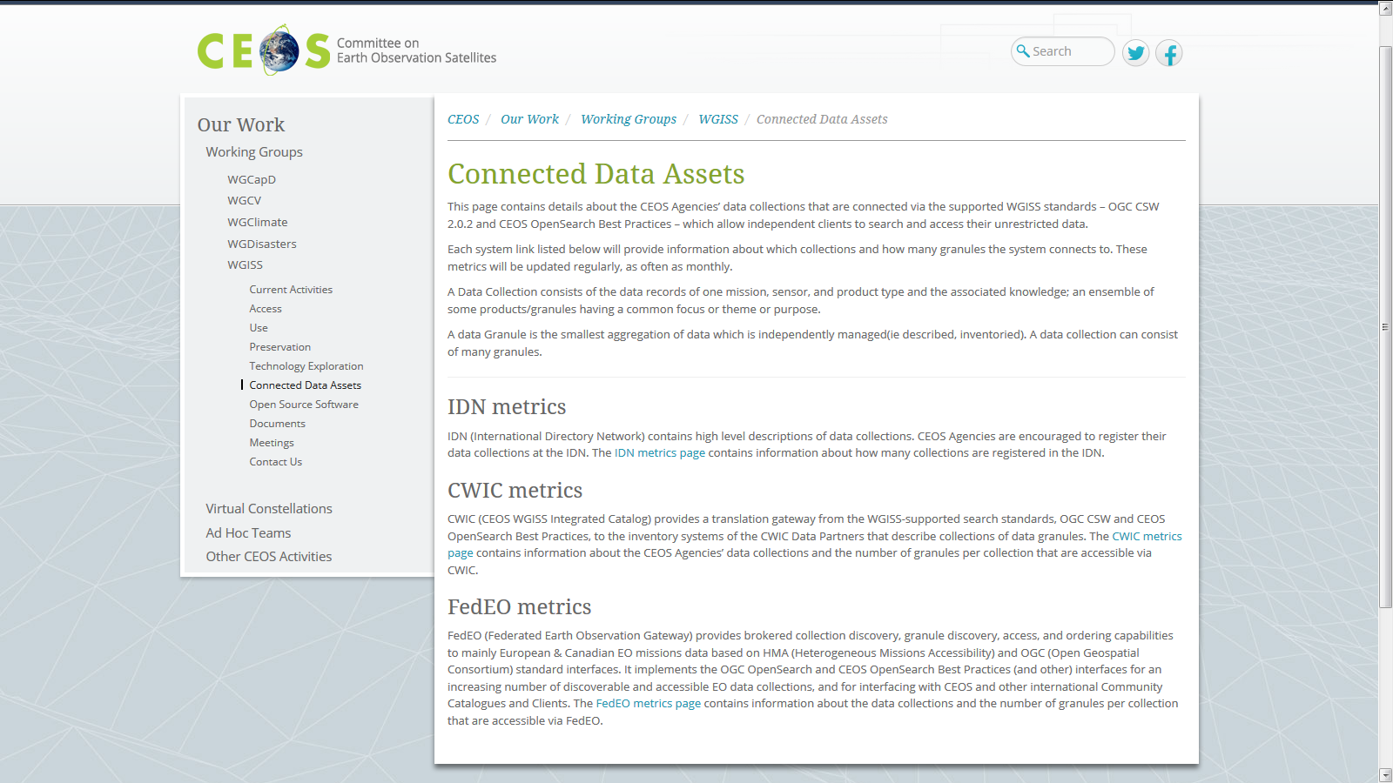
Discovery and Access
WGISS Connected Data Assets (CDA)
Single entry point for external clients to discover/access CEOS agencies data
Search over 32,000 collections in the IDN (collection search)
Access over 5000 collections with associated over 300+ million granules (granule search)
CEOS Service
DATA-2: Full representation and accessibility of CEOS Agency datasets through WGISS Standards and Connected Data Assets Infrastructure (i.e. IDN, CWIC, FEDEO).
DATA-9: ECVs/CDRs Discovery and Access through WGISS Systems.
FDA-14: Facilitate discovery and access for end users to data analytics and processing tools and services through the WGISS Connected Data Assets Infrastructure.

Slide 4
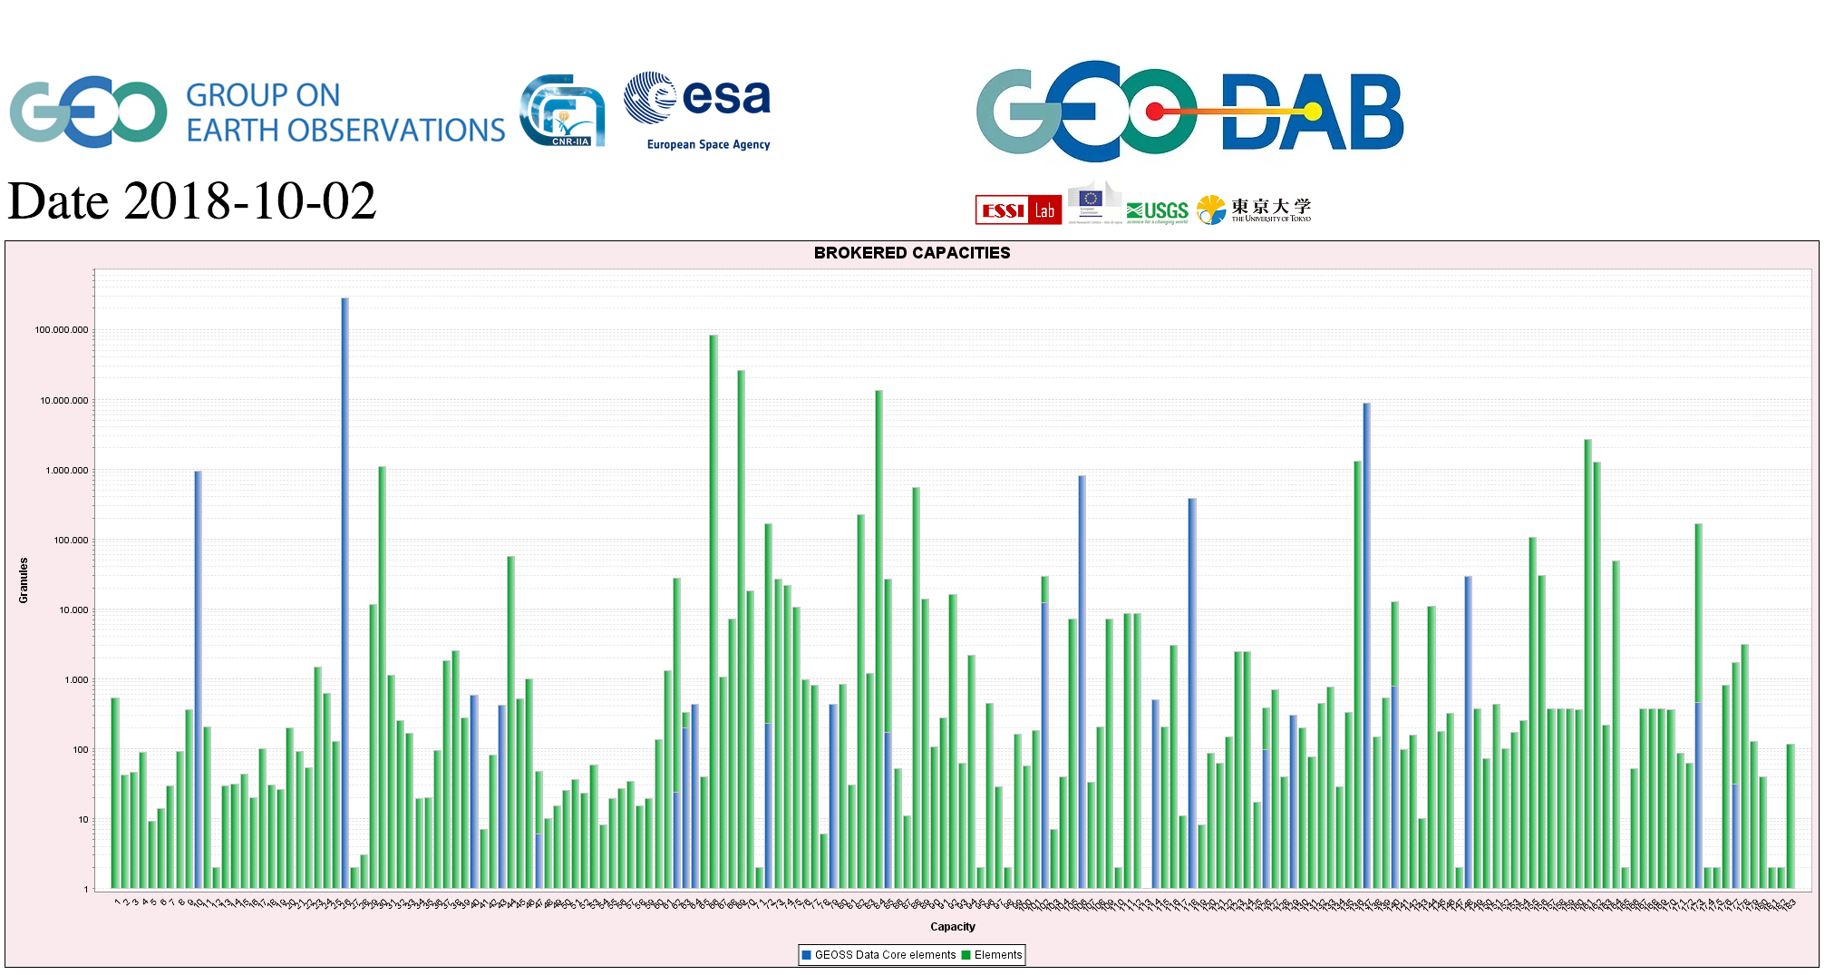
CEOS data in GEOSS
GEOSS PLATFORM DISCOVERABLE DATA PRODUCTS
CWIC
FedEO
DATA-16: CEOS data holdings reported and accessible in GEO and other international relevant contexts.

Slide 5
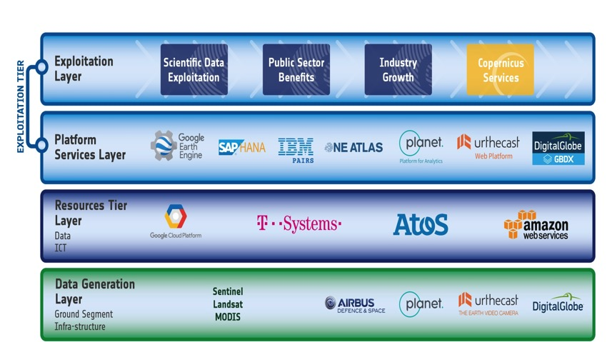
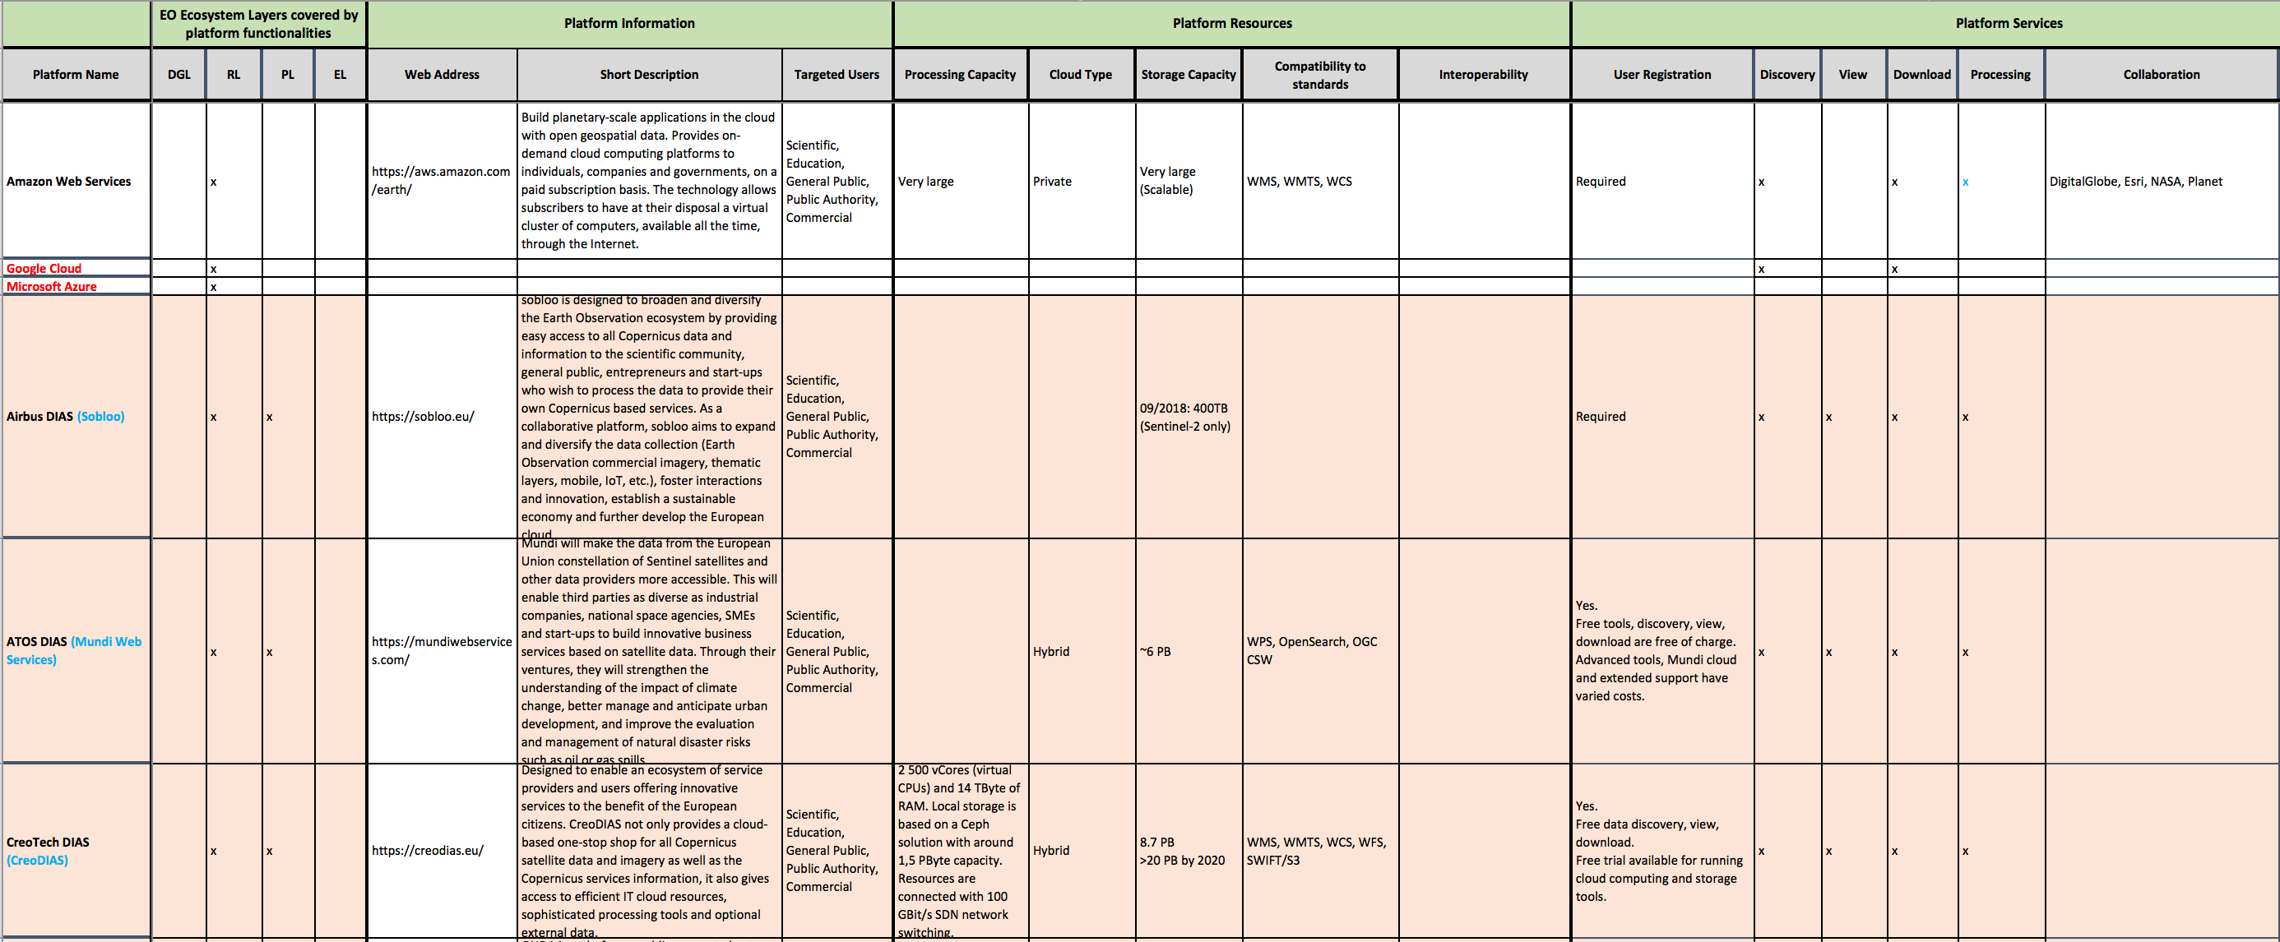
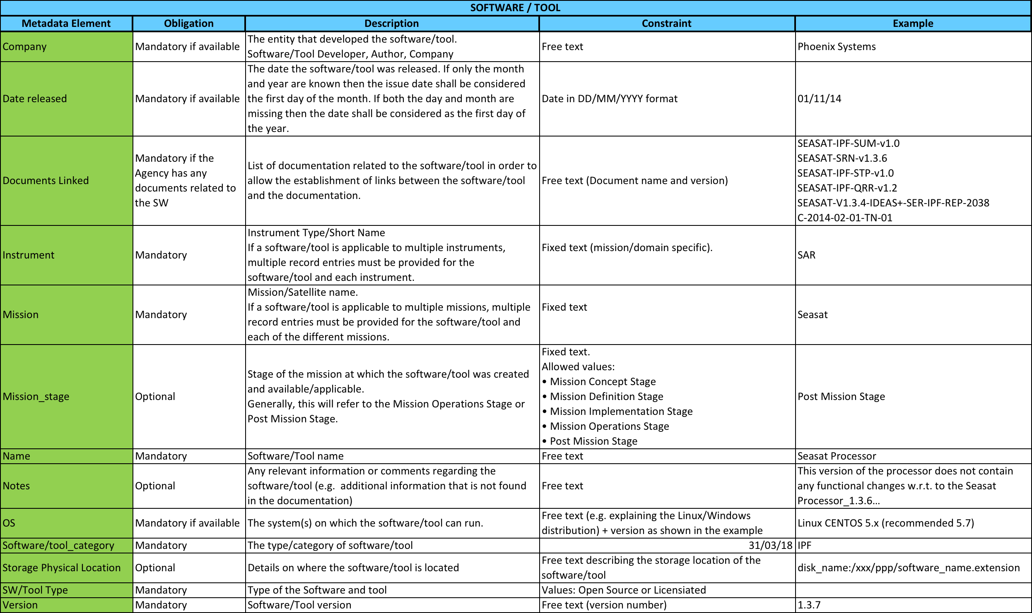
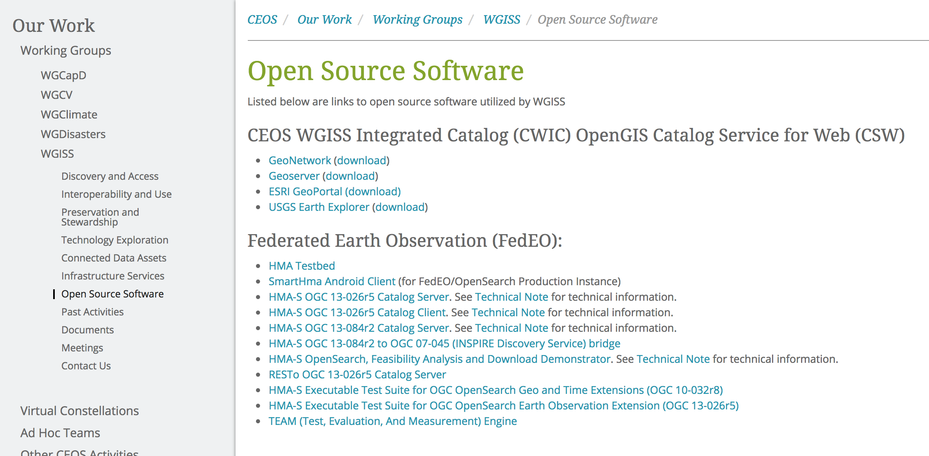
Future Data Access and Analysis Architecture (FDA)
FDA-8: Establish a common description of Future Data Architecture functional blocks and identify interfaces and interoperability approaches.
FDA-9: Inventory and characterize existing FDAs operated by both public and private entities.
FDA-10: Finalise inventory of CEOS agencies (Open Source) Software and Tools and implement a mechanism for discovery and access.

Slide 6
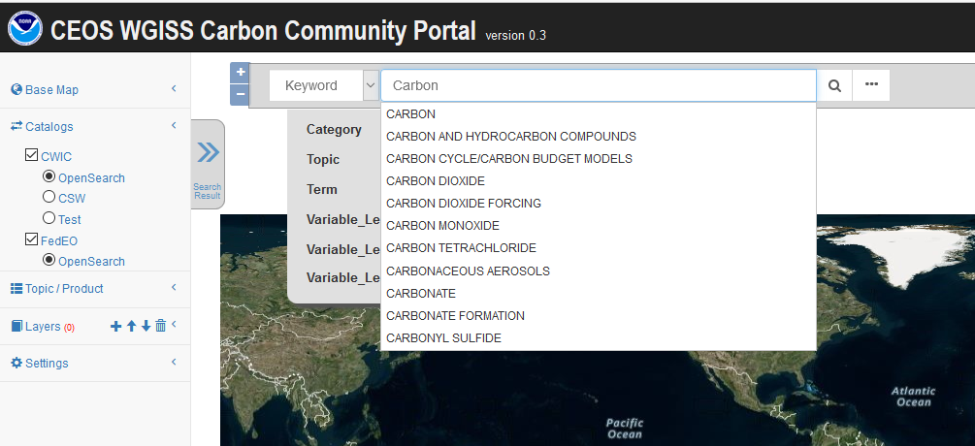
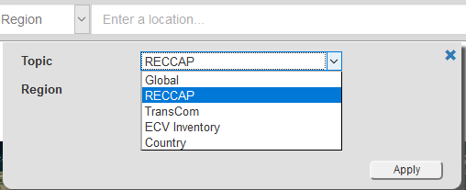
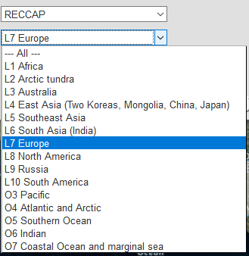
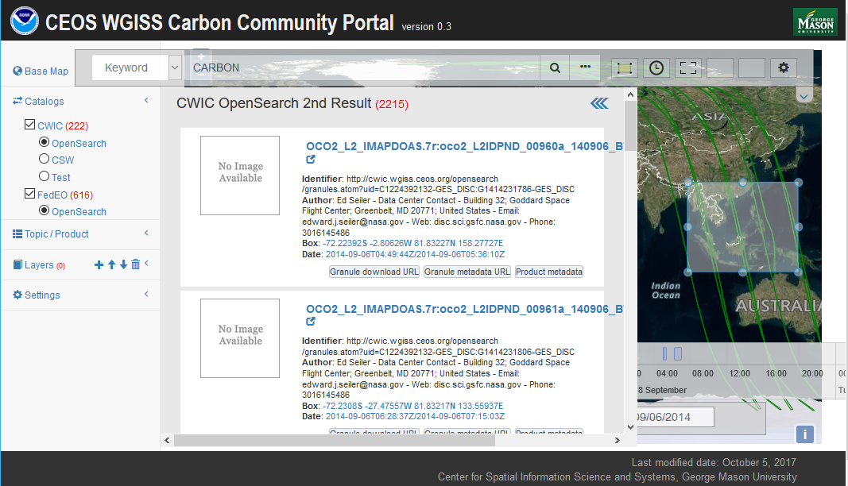
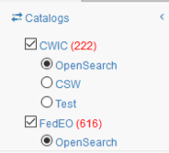
WGISS Carbon Community Portal
Special regions: Global, RECCAP, TransCom, Country Names, ECV Inventory)
Temporal Searches: support for time range and specific date
Pre-defined Carbon topics/datasets: (Atmospheric, Ecosystem, Ocean, Mixed-Theme)
Keywords (auto-completion with IDN Science Keywords)
Return records from both CWIC and FedEO
CARB-15: Carbon Data Portal prototype
Discussions ongoing with CEOS Chair Team to evaluate possible use of Carbon Portal in support to Chair Initiative in the Mekong area.

Slide 7
Technology Exploration
Technology Webinars
Joint webinars and advertising with:
WGCapD
NextGEOSS
GEOSS Evolve
Federation of Earth Science Information Partners (ESIP)
http://ceos.org/ourwork/workinggroups/wgiss/technology-exploration/
DATA-11: Data and Technology Exploration webinars and workshops
FDA-5: Promote awareness of
FDAs (with SEO and WGCapD)
DATA-13: Develop a White Paper on Single Sign-On (SSO) authentication.
DATA-15: Explore emerging trends and disrupting technologies for adoption in EO. Summarise as white papers.

Slide 8
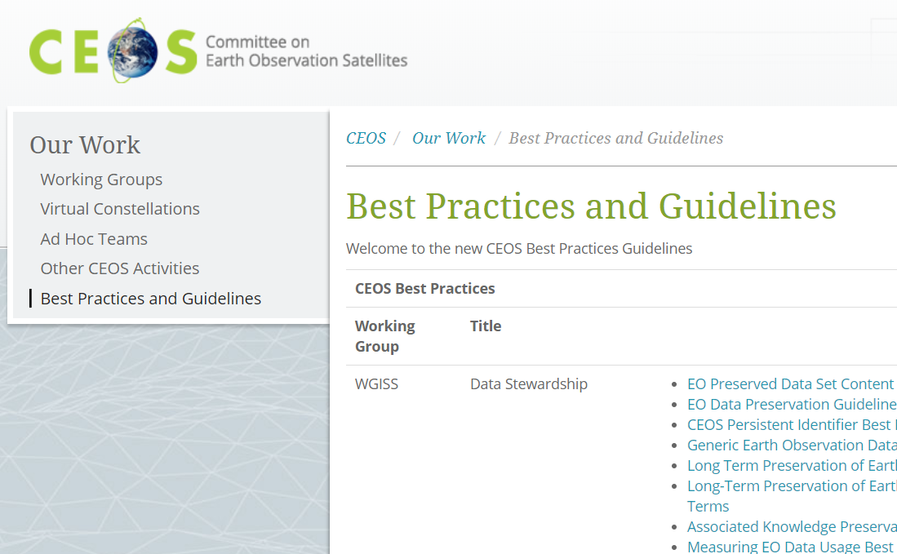
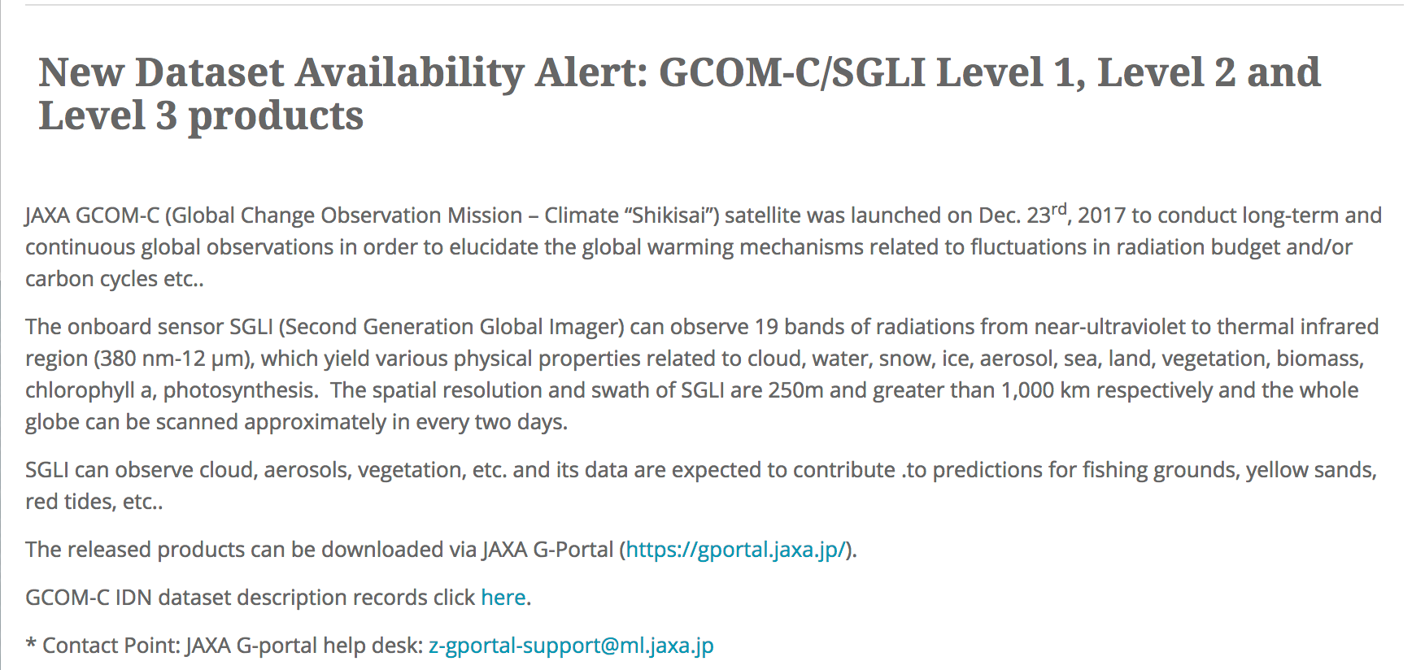
Additional Outcomes
Dedicated web-page was initiated on the CEOS website under "Our Work” to facilitate discovery and access to Best Practices and Guidelines developed by CEOS.
WGISS coordinating population from WGs/AHT/VCs in cooperation with SEO team. Contribution so far from WGISS, LSI-VC, WGCapD. Others to come…
New Data Set Availability Alert Procedure defined and implemented with SEO team to publicize new available data

Slide 9
Cooperation with other groups
CEOS Carbon Team - ongoing development of prototype Carbon Portal
WGClimate - ECV/CDRs registration in IDN in parallel with ECV inventory v3 update agreed during WGClimate-10 meeting
WGDisasters - possible cooperation on generic recovery observatory
WGCV - ongoing with two data cube prototypes (ESA and GA/CSIRO) supporting CAL/VAL activities through providing access to ACIX (16 sites), RadCalNet (4 sites) and LPV (3 sites) sites cal/val data.
Virtual Constellations - inventory of VC data to be updated to ensure discoverability/accessibility through WGISS infrastructure
WGCapD - joint organization of technology webinars and FDA events
SEO - COVE tool harvesting WGISS metadata, data cubes coordination
SDG AHT - SDGs platforms & data interoperability pilot under discussion

Slide 10
Cooperation with other groups
GSICS - WGISS presented at GSICS annual meetings, cooperation areas with Data and Research WG identified
ESIP - exchange of information and best practices on data stewardship
GEO
GEOSS Platform accessing CEOS agencies data via WGISS CDA
WGISS contributing to GEOSS-EVOLVE initiative
WGISS participation & support to 4th GEO Technology Workshop
WGISS membership in GEO Expert Advisory Group (EAG)
WGISS represented in NextGEOSS Advisory Board and working with NextGEOSS on federated authentication technology solutions
Joint Workshop on GEOSS-WGISS interoperability and FDA held at WGISIS#43 and WGISS#46

Slide 11
WGISS Health Status
Interagency coordination working well, very good cooperation spirit
Healthy participation to meetings (average 20 people)
Some members attending all meetings (e.g. NASA, NOAA, USGS, CNES, ESA, CSIRO, JAXA, RADI, AOE CAS, RSCC, HSO)
Others attending only some meetings depending on location and discussed topics (e.g. EUMETSAT, ROSCOSMOS, INPE, CONAE, DLR, UKSA, ISRO)
Additional agencies contacted expressed interest in WGISS activities with potential future participation (e.g. GISTDA, VNSC/VAST, ASI, CSA, CCMEO)
Stable participation from more agencies would increase WGISS activities impact and capability to respond to CEOS 2019-21 Work Plan
Targeted events during WGISS weeks attracted more participants
Promotional material developed & actions undertaken to enlarge engagement
WGISS Vice Chair Nomination
October 2019 – October 21

Slide 12
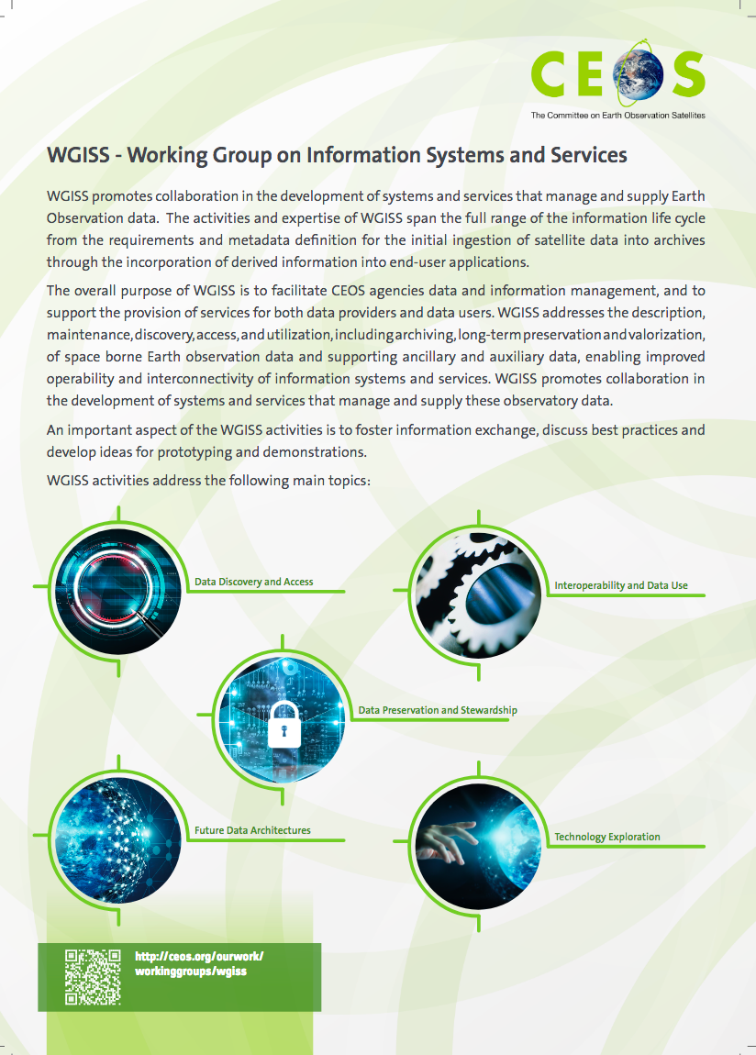
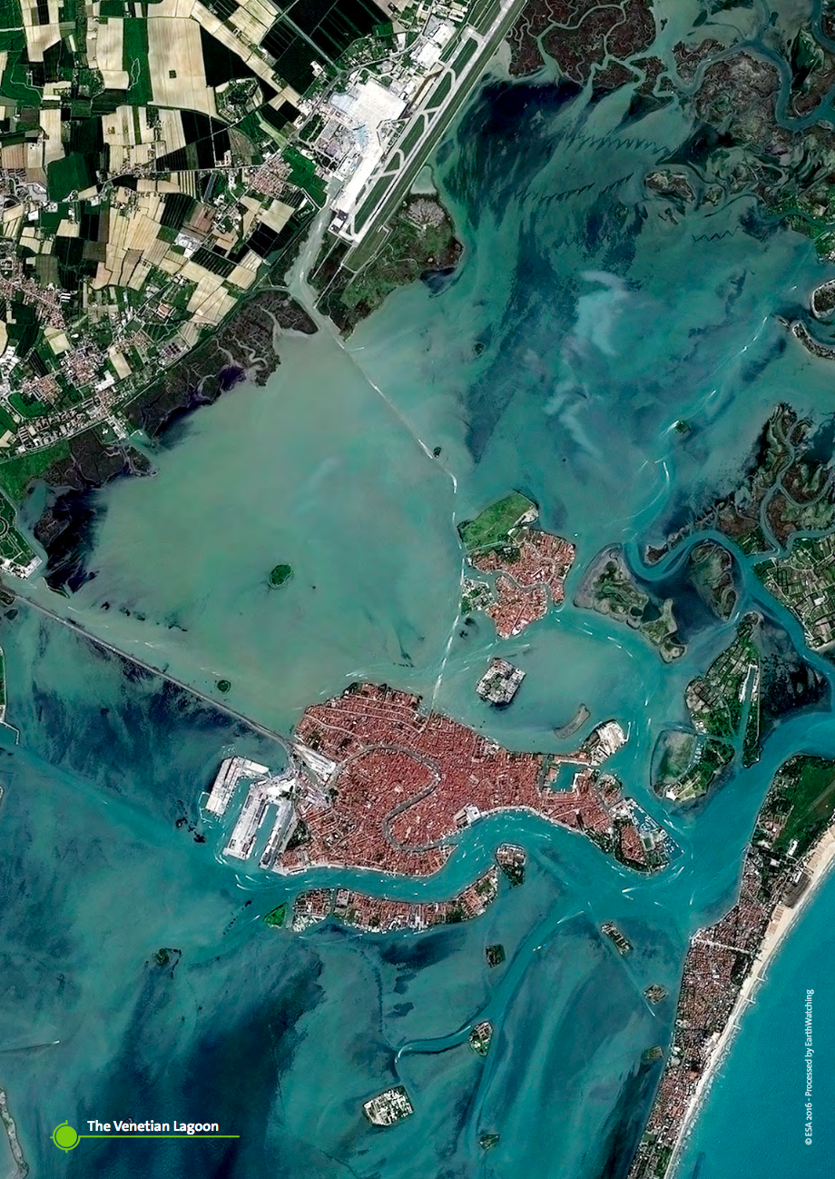
WGISS Brochure

Slide 13
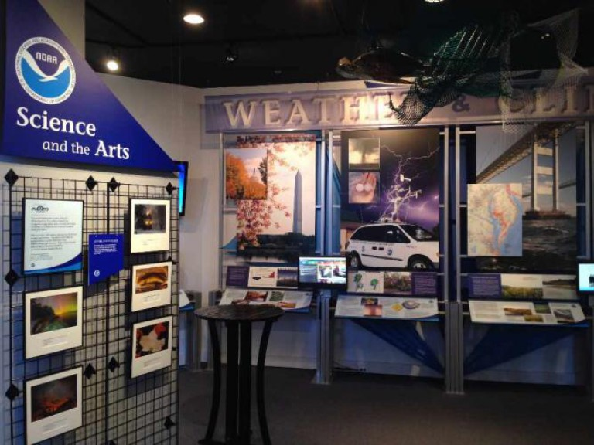
WGISS-47 meeting
Hosted by NOAA - Silver Spring, USA (29 April- 2 May 2019)
Full-day “FDA Elements Demo & Interoperability Workshop”
Data Services in the Cloud Session
AI & ML Technology Sessions

Slide 14
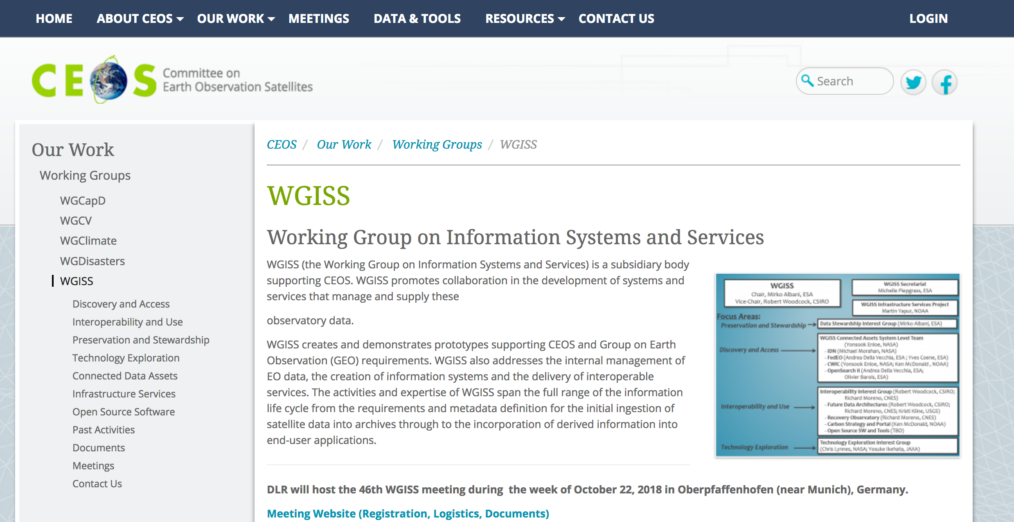
WGISS Information
http://ceos.org/ourwork/workinggroups/wgiss/
Contact: Mirko.Albani@esa.int

