Slide 1

WG Disasters
Committee on Earth Observation Satellites
Simona Zoffoli, ASI, WG Disasters Chair
CEOS SIT-34
Session 4, Agenda Item 4.5
Miami, FL, USA
3 – 4 April 2019

Slide 2
Linkages to CEOS Work Plan
WG Disasters has no open SIT and Plenary actions. Coordinates with NOAA and WGCapD on the flood monitoring initiative for GEO-LEO (see session 3, item 3.7)
CEOS Workplan 2019-2021 v1 – WG Disasters, 9 deliverables
  GEO Initiatives
    GSNL, DIS-10 Data coordination for GSNL
    GEODARMA, DIS-15, Identification of DRM priorities
  CEOS WG Disasters DRM Initiatives
    Landslide Pilot, DIS-16, Final report
    Recovery Observatory, DIS-12 (early evaluation), DIS-22 (final rep.)
    Volcano Demonstrator, DIS-18 (report)
    Seismic Demonstrator, DIS-21 (report)
  CEOS WG Disasters Cross-cutting Initiatives
    GeoHazards Lab, DIS-19 (e-collaboration), DIS-20 (standardiz.)

Slide 3
WG Disasters Achievements
Major achievements since SIT-33
  Thematic products for Recovery
  Products for landslide monitoring and deformation mapping
  Advanced science products for crisis response (i.e. Hawaii/ Sulawesi, Indonesia/ Zakynthos, Greece, Nepal)
  Validation of methodology for new products generation
  Launch of the Generic-RO ad hoc team (UNDP/GFDRR/WB/EC)
  Facilitated data access and processing
  Collaboration with mission operators to optimize EO coverage
  Approved the continuation of Hawaii and Enceladus Supersites
  Engagement with End Users
  Promoted awareness raising (Understanding Risk, Cities on Volcanoes, LPS, AGU, EGU) and capacity building activities (on site training in Haiti, South America, Greece)

Slide 4
WG Disasters Planned Outputs
Planned future outputs
  Review existing Working Group Terms of Reference
  Review and update of Consensus Report/ EO for DRM Strategy (consider new themes, e.g. coastal risk, climate change impacts, cascading risk, risk vs hazard,..)
  Input to GEO workplan, Community Activity “EO for DRM”
  Consolidate cooperation with Charter
  Landslide final report
  Recovery Observatory early evaluation report
  Advocacy paper on G-RO, and planning collaboration with UNDP, GFDRR/WB, and EC on future recovery efforts
  Volcano Demonstrator Implementation Plan
  GSNL review of SAF NL, Virunga and Southern Andes Supersites

Slide 5
Synergies Among Teams
Started the practice to invite others WGs to WG Disasters meetings
  Remote participation of WGISS Chair the WG Disasters #10
  Joint Session (by telcon) with WG CapD at WG Disasters #11.
    Shared deliverables of mutual interest. WG CapD will consider WG Disasters collaboration in their next CEOS workplan.
Coordination with NOAA and WG CapD on GEO-LEO flood monitoring initiative
Started looking at synergies between CEOS ARD effort and WG Disasters initiatives
Coordination and exchange of good practises between working group Disasters teams

Slide 6
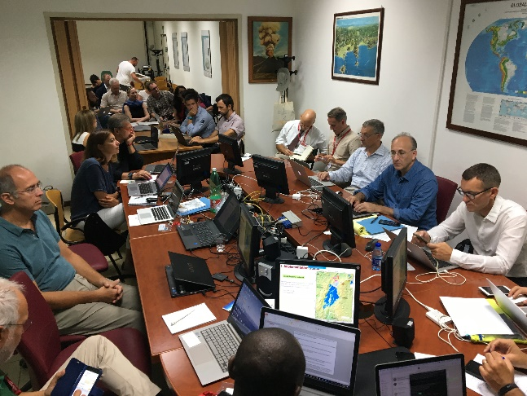
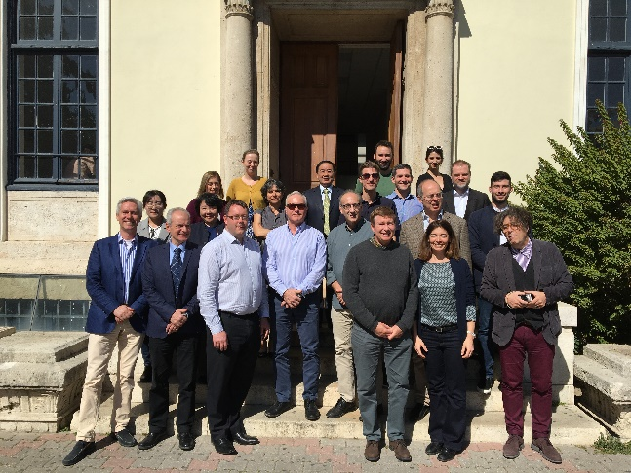
Sustainable Commitment
WG Disasters meets two times per year, bimonthly telecon.
Last two meetings held in September 2018 in Naples, Italy and March 2019 in Athens, Greece.
  Total of 20-25 attendees
  Strong implication of organisations outside CEOS as
  intermediary and end users (e.g. BRGM, INGV, NOA,
  WB, Universities, Volcan. Observatories…)
Active Agencies:
  America: CONAE (recently joined), CSA, NASA,
  USGS
  Europe: ASI, CNES, DLR, EC, ESA, UK SA
  Asia-Pacific: CAS
  Africa: none
Global organizations: GEO, UNOOSA, UNDP,
World Bank/ GFDRR
Opportunity for dedicated efforts on CEOS activities
is always a challenge (as is the case for all WGs)

Slide 7
Consideration for SIT TW and Plenary deliverables
Need increased engagement from other CEOS agencies
  Right time: WG Disasters is reviewing its ToR and DRM observation strategy – new agencies with disaster activities are welcome!
  Varied participation
    Gap Analysis
    Demonstrate methodologies, techniques and tools
    Data contribution (i.e. L-band SAR, high resolution DEM, high resolution radar and optical data, ..)
    Capacity building and awareness raising
Draft ToR planned for discussion at the next SIT TW

Slide 8
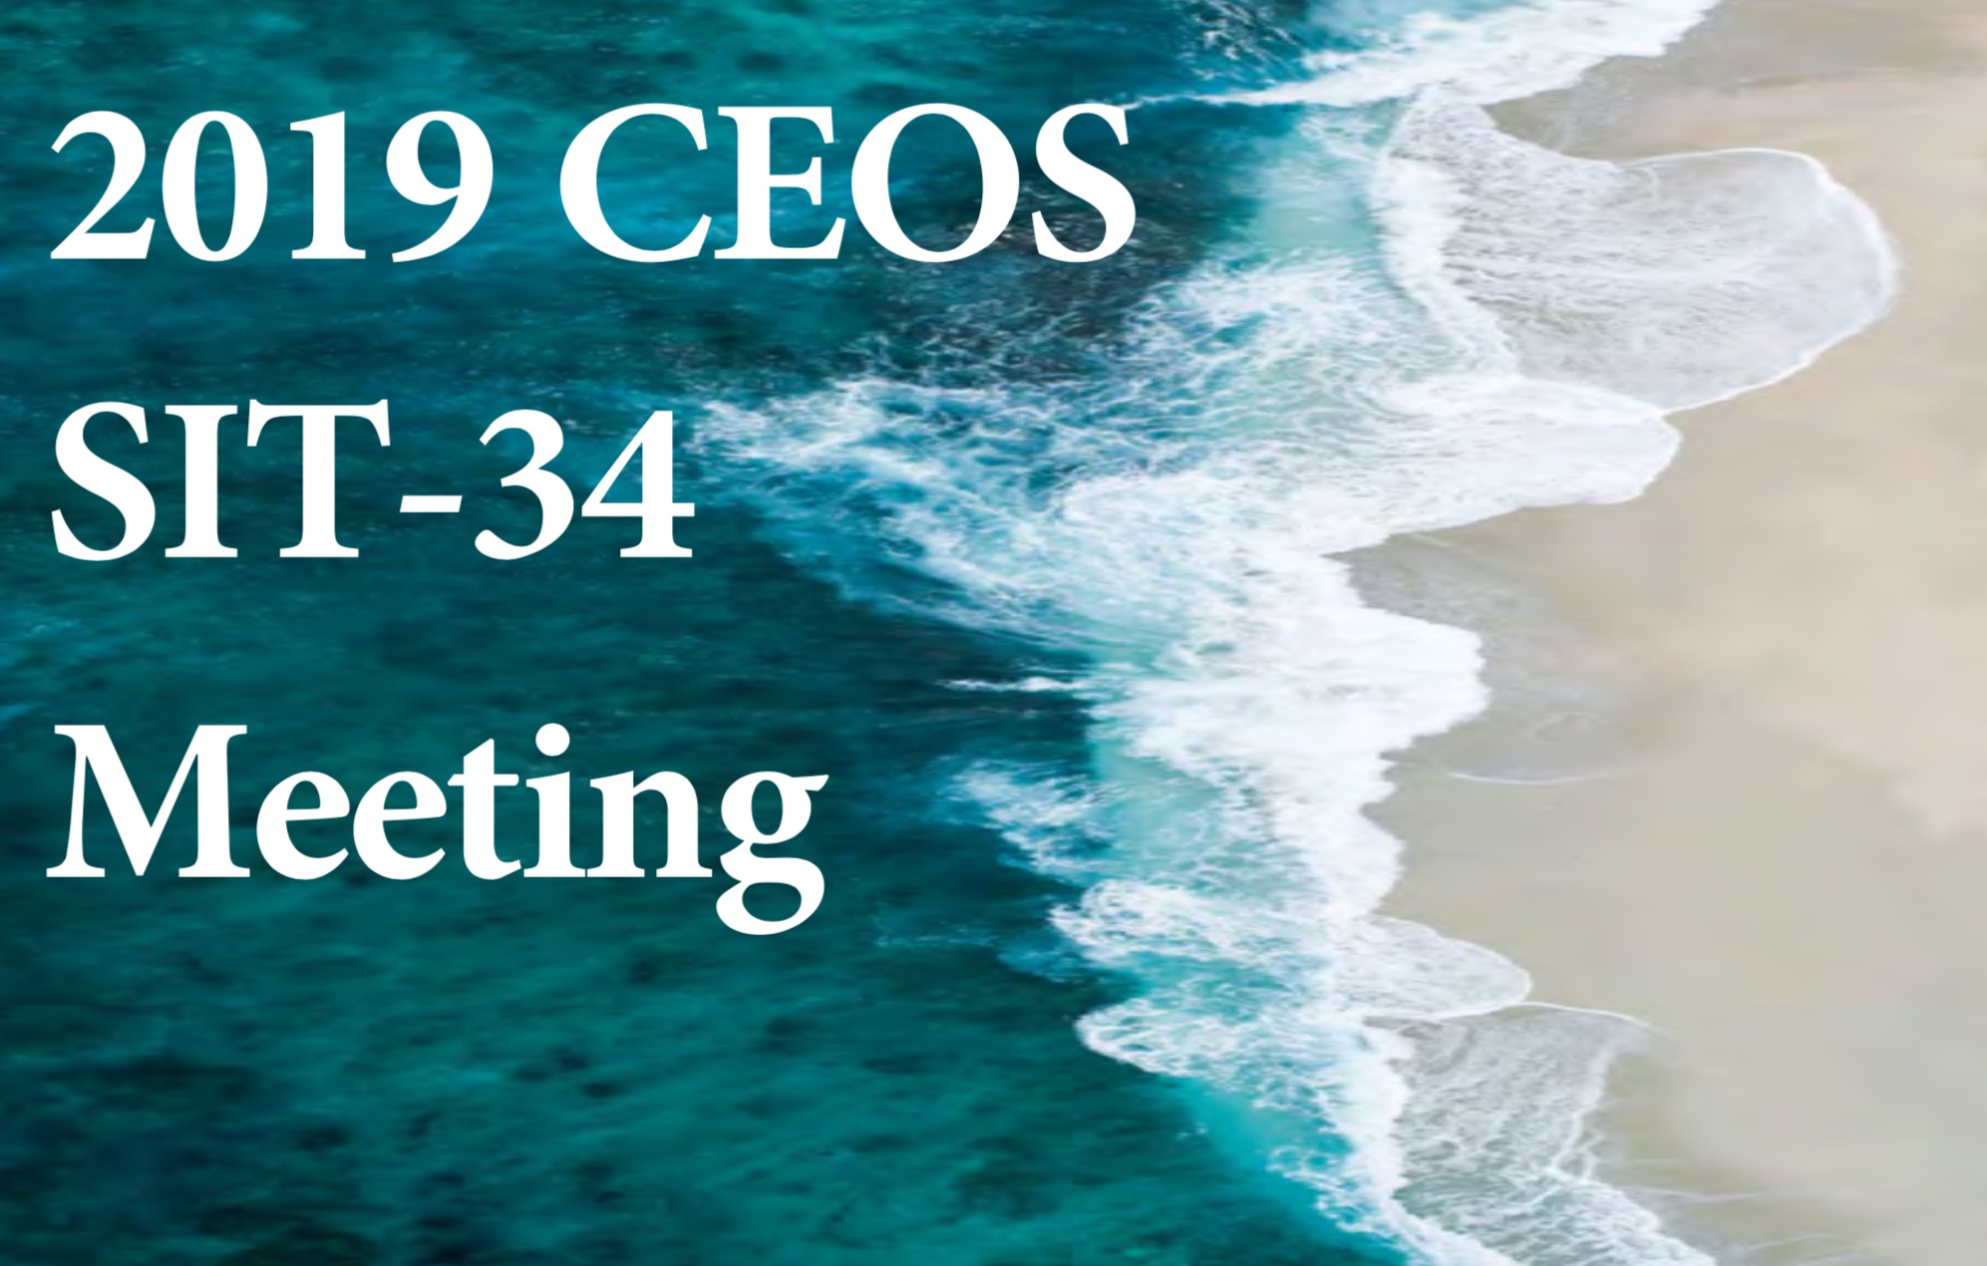
Thanks!
Questions?
  simona.zoffoli@asi.it
  david.green@nasa.gov

