Slide 1

WG Capacity Building & Data Democracy (WGCapD)
Committee on Earth Observation Satellites
Nancy D. Searby, PhD., NASA & Prakash Chauhan, ISRO, WGCapD Vice-Chair & Chair
CEOS SIT-34
Session and Agenda Item # 3.9
Miami, FL, USA
3 – 4 April 2019

Slide 2
WGCapD Linkages to Work Plan, SIT, SIT TW Actions
CEOS Work Plan 2019-2021v0 – WGCapD’s 17 deliverables, 13 in 2019, 4 in 2020; * new this year
  Global activities
    CB-28, 30, 31: MOOCs on Radar Backscatter (Q1), SAR applications (Q1), LCLUC (Q4 2019 – delayed, in procurement, now likely 2020)
    CB-29: Webinar series on multiple topics, e.g. GEOGLAM, Hyperspectral Remote Sensing and Disasters (Q4), LCLUC (Q3 2020)
  Regional activities – training in GEO regions
    CB-35, 36: AmeriGEO (Aug 19-23) (Q3), AfriGEO (Aug 13-16) (Q3)
    CB-27: AOGEO (Q4 2020)
    CB-32: Regional hands-on training in Land Cover Land Use Change (Q4)
  *National in-person training
    CB-33: SAR and EO data training for VNSC Chair initiative (Q3 – completed 1 of 2 workshops)
    CB-39: hands-on training on forest monitoring & Orfeo Tool Box for AEM (Q1)
    CB-40: hands-on training on flood monitoring for Vietnam School of Earth Observation (Q3)
Notes:
Provide max total of five slides to address these points in your final presentation
Suggestion - 1 slide each to address
Linkages to CEOS Work Plan (e.g. action numbers), open SIT and Plenary actions
Indication of required decisions and discussion points
Team Achievements and Planned Outcomes [See slide 9]
Synergies amongst teams (e.g. VC-VC, VC-WG, WG-VC, WG-WG, other) [See slide 10]
Sustainable commitment [See slide 11]
Proactive Consideration of Plenary and SIT TWS deliverables and discussion items

Slide 3
WGCapD Linkages to Work Plan, SIT, SIT TW Actions, cont’d
CEOS Work Plan 2019-2021v0 – WGCapD’s 17 deliverables, 13 in 2019, 4 in 2020; * new this year
  CB infrastructure
    CB-21: portal-based access to CB and training resources (Q4 2020)
  * CB training materials
    CB-38: hyperspectral training resources on line (Q2 2020)
  WG collaborations
    CB-41: with SDG AHT, promote use of EO for SDG’s (Q3)
      Hands-on with AmeriGEO Week on SDG 6.6.1/6.3.2
    FDA-5: FDA´s awareness building and outreach (Q3)
  Broader CB collaborations
    CB-37: white paper describing how CB networks, e.g. UN’s, can work together with WGCapD (Q2 – provided to SIT for discussion)
CEOS-32-10 & SITTW-2018-14: GEO-LEO project coordination with CGMS, WGDisasters - ongoing
Notes:
Provide max total of five slides to address these points in your final presentation
Suggestion - 1 slide each to address
Linkages to CEOS Work Plan (e.g. action numbers), open SIT and Plenary actions
Indication of required decisions and discussion points
Team Achievements and Planned Outcomes [See slide 9]
Synergies amongst teams (e.g. VC-VC, VC-WG, WG-VC, WG-WG, other) [See slide 10]
Sustainable commitment [See slide 11]
Proactive Consideration of Plenary and SIT TWS deliverables and discussion items

Slide 4
2018 Accomplishments and Lessons Learned
Completed 3 deliverables
  CB-20 AmeriGEOSS Week in person training
  CB-26 AfriGEOSS Symposium in person training
  CB-19 SDG Awareness webinar
Lessons learned
  Needed improved outreach and possible funding of participants to improve attendance at AmeriGEO Week training
  Good participation in SDG awareness webinar; not much response to post-webinar survey
  Clarity of needs and sufficient lead time essential for training success
Planned outcomes in 2019
  Execute and deliver deliverables per the Work Plan

Slide 5
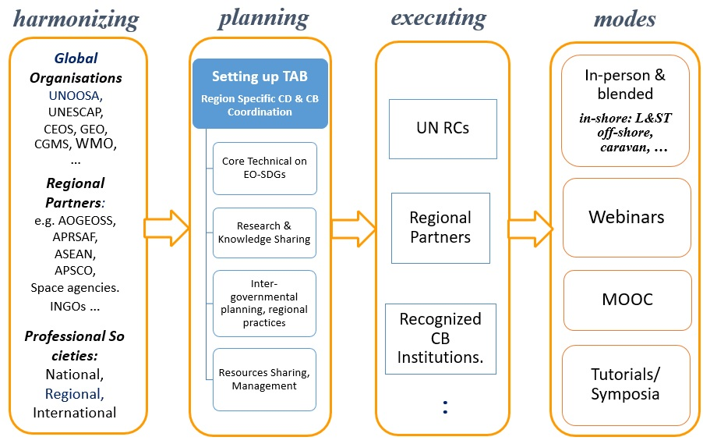
CB-37: white paper describing approaches for CB networks, e.g. UN’s, can work together (due Q2 ‘19)
White paper drafted provided for capacity building community review
  WGCapD, GEO, WMO, Vlab
  Incorporated suggestions
  Now provided to SIT for discussion
Framework for coordinated capacity building

Slide 6
Synergies Among Teams
Existing synergies – strengthened since last SIT
  WGISS/SEO – participation in each others’ meetings, joint FDA-5 deliverable
  SDG AHT – joint awareness webinar delivered December 2018
  WGDisasters – joint virtual meeting discussion in March, discussing joint deliverables
  GEOGLAM AHT – overlapping people engaged in both, potential to strengthen further
  WGClimate, WGCV – have explored synergy but have not (yet) identified collaborative opportunities
  VCs – no engagement
Obstacles/barriers and how to overcome them
  Travel constraints prohibit attending other WG/AHT/VC meetings – arrange virtual meetings to discuss work planning

Slide 7
Sustainable Commitment
Active agencies in your team:
  WGCapD Core has 13 Deliverables due this year: CNES, DLR, ESA, INPE, ISRO, NASA, VNSC
  Annual meeting virtual participation also included: SANSA, UK’s National Centre for Earth Observation (UK NCEO), CRECTEALC, GODAN, GEO Sec CD Coordinator, AfriGEO, AmeriGEO, VLab
Obstacles to the future viability of your team meeting its objectives?
  Need a new Vice Chair this fall!
Status and outlook
  We have a well-engaged core group, and we are growing.

Slide 8
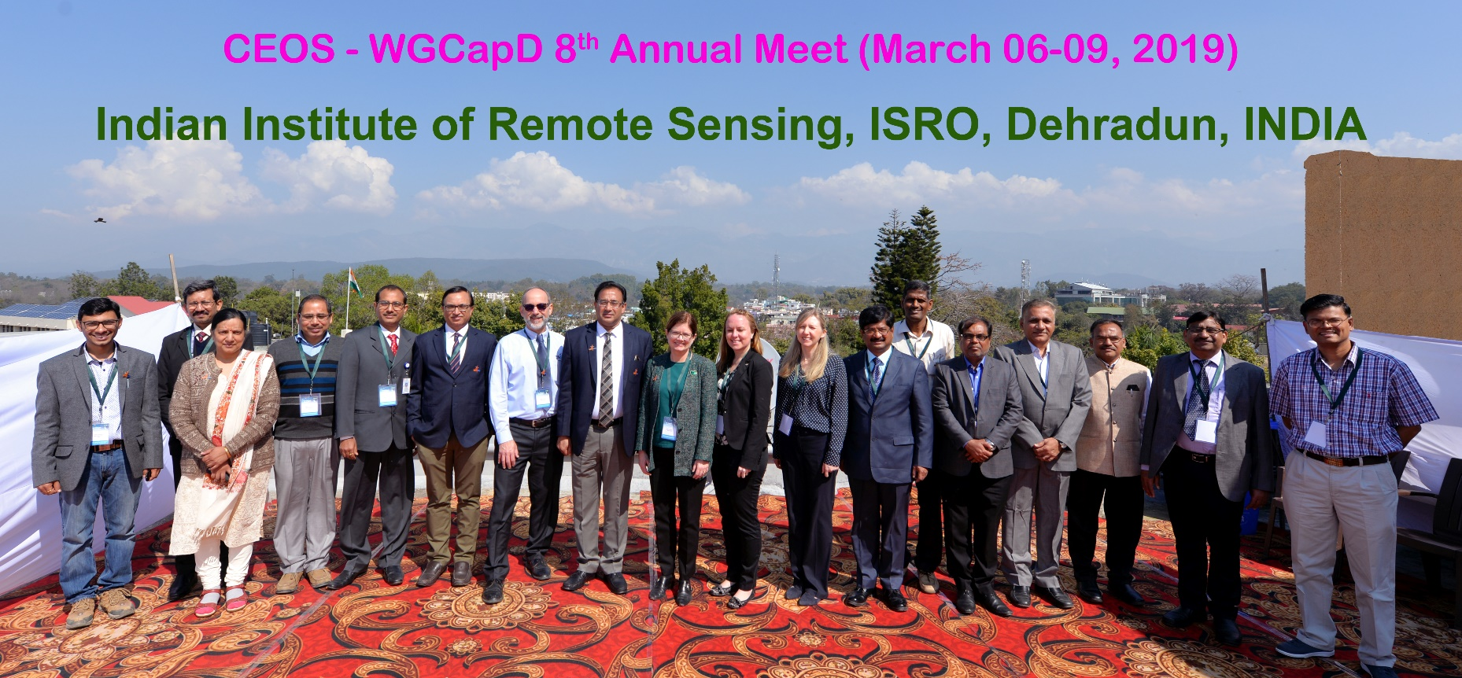
Thanks
Chair: Dr. Prakash Chauhan
Vice Chair: Dr. Nancy Searby
& WGCapD Members

