Slide 1

Committee on Earth Observation Satellites
The CEOS Ocean Variables Enabling Research and Applications for GEO (COVERAGE) Initiative:
Status Update
Drs. Eric Lindstrom, Vardis Tsontos & Jorge Vazquez
NASA
CEOS SIT-34
Oceans & Water Cycle #6.7
Miami, FL, USA
3 – 4 April 2019

Slide 2
The CEOS COVERAGE Initiative
Cross-cutting, collaborative effort within CEOS relevant to the 4 Ocean Virtual Constellations (SST, OST, OCR, OSVW) and GEO projects (MBON, Blue Planet, GOOS) to enable more widespread use of ocean satellite data in support of applications
Response to needs of the ocean community for improved, more integrated data access for societal benefit in support also of SDG-14 relating to marine biodiversity & ecosystem-based resource management
COVERAGE aims to develop a data rich Tech. platform for more seamless delivery of analysis ready ocean data in order to demonstrate the value added of multivariate ocean data integration in support of science, applications, and public engagement
- “Fusion environment” leveraging emerging Cloud infrastructure & open source software
- Curated aggregation of high quality, interagency multi-parameter observations
- Near real-time & longer-term series, collocated to a common grid, thematically organized
- Access via value-added data services (data discovery, visualization, subsetting)
- Illustrated in the context of demonstration applications
Development concept: 4 Phases aligning with inputs to CEOS work plan (COV1-6)
A. Scoping (9mo)
B. Prototype Development (1yr)
C. Full Implementation (1yr)
D. Evaluation (6mo)

Slide 3
COVERAGE Phase A Status
Phase A, the scoping & planning phase of the project, has concluded.
Associated technical work completed has included:
Inventory/review of target Interagency datasets
Processing of the MUR-SST product at 0.25 degrees for inclusion in COVERAGE
Planning to address identified L4 ocean color product gap in coordination with OCR-VC
Design of prototype COVERAGE technical system architecture for implementation in Phase B
Specification of a focal COVERAGE pilot application in support of GEO-MBON for implementation in Phase B
Formulation of a Phase B task plan & proposal
Phase A has also involved extensive stakeholder engagement and outreach activities, including:
  Interactions with the COVERAGE advisory board, CEOS VCs and Secretariat
  Inputs to CEOS Reporting & Work plan activities (closeout of COV-1 to 3 WP items)
  Workshop side-meeting event at 2018 SIT-TW (Darmstadt)
  Numerous presentations to broader applications/user communities at conferences, including the recent Sargasso Sea Commission workshop (Bermuda, March 2019)

Slide 4
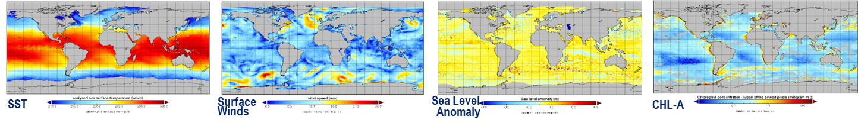
COVERAGE Next Steps
Currently in transition to Phase B as COVERAGE follow-on proposal is being finalized
Initiate Phase B prototype development activity (COV-4) per the project task plan pending approval
Explore further the potential hosting of a COVERAGE “Nexus” node with target European datasets from CMEMS within WEKEO cloud environment (EUMETSAT):
  Serve as proof of concept of the COVERAGE distributed system architecture
  Facilitate interagency technical collaboration on CEOS COVERAGE initiative
Continue active stakeholder engagement
  Reconnect with the COVERAGE Advisory Board & VCs for Phase B
  Engage COVERAGE demonstration application target community & stakeholders
  (RFMOs, Global Fishing Watch, GEO-MBON, OBIS)

Slide 5
Backup

Slide 6
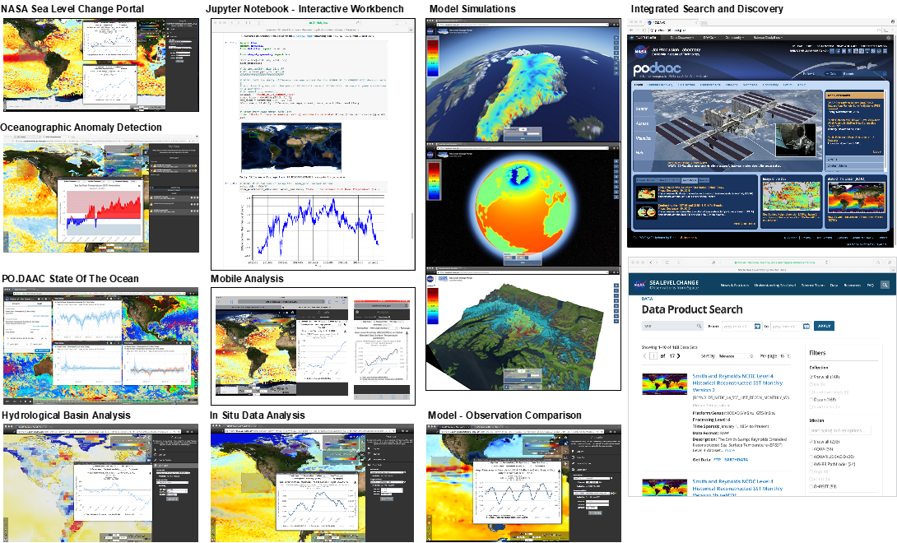
COVERAGE Technology & System Features
Leverage JPL’s existing “Big Data” NEXUS/SDAP” open source Technology stack but adapt as necessary
Distributed architecture, cloud enabled
(reduce large data movements)
Emphasis on Earth science data interoperability
standards (CF, ACDD, ISO19115)
Web-based Access via value-added data services
  Search
  Visualization (raster & vector data)
  Subsetting (space-time bounding box/polygon)
  Analytics (eg. time-series, area average maps, correlation)
Interfaces
COVERAGE project Portal
Interactive GUI-based tools & services
Jupyter notebooks (user coding support)
Data access Web service APIs

Slide 7
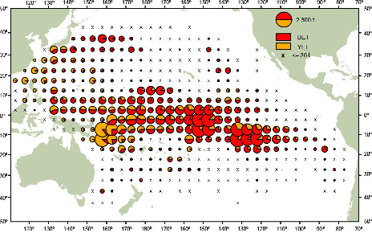
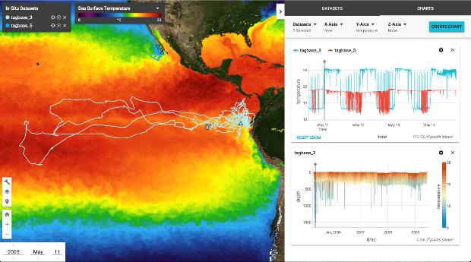
Phase B Demonstration Application:
High Seas Tuna Fisheries and the Environment
High Seas & Regional Fisheries Applications involving integration of ocean remote sensing, physical model and in-situ datasets enabling decision support and research investigations
Habitat analysis for Highly Migratory Species (HMS)
Tuna Spatial catch forecasting
By-catch mitigation
Integration of environmental information in support of fisheries
science & ecosystem-based assessment
Beneficiaries:
RFMOs, Fisheries Agencies, Research community
Spatial distribution of commercial tuna catch RFMO data by species in the Pacific
Supporting Data
Interagency satellite products prioritized by COVERAGE
RFMO monthly spatial catch/effort time series by species, aggregated spatially at 1 & 5deg. resol., 1952-2018 (higher resolution data possible by arrangement)
Electronic tagging datasets: high resol. trajectory-profile series
AIS fishing vessel movement data products by category
(daily, since 2012 from Global Fishing Watch)
Web-based Visualization of 4-year, minute resol.
ETP Bigeye tuna eTag data (Schaffer & Fuller, IATTC)

