Slide 1
The SST-VC
Committee on Earth Observation Satellites
Kenneth S. Casey, NOAA, and Anne O’Carroll, EUMETSAT, on behalf of the SST-VC
CEOS SIT-34
Session 6: Oceans and Water Cycle
Agenda Item 6.6
Miami, FL, USA
3 – 4 April 2019

Slide 2
Linkages to CEOS Work Plan, SIT, and Plenary Actions
CEOS Work Plan, VC-19 (Documented plan for the SST VC):
Next generation SST constellation, including on-orbit assets, measurement methods (MW and IR, Geo and Polar), fiducial reference measurements, and data management systems
Final draft in preparation with publication planned in 2019
Finalization delayed due to change in position of key contributor and preparation for OceanObs ‘19 community white papers
Writing task assignments completed over the last year
Final figures in progress
CEOS Work Plan, COV-4, 5, 6:
SST-VC agreed to serve as “responsible CEOS entity”
COVERAGE team will manage reporting directly to CEOS
CEOS-32-06 (on Analysis Ready Data)
SST-VC responses provided on 1 March 2019
CEOS-32-12 (on VC leadership rotation)
See later slide
No Decisional Items Requested

Slide 3
Team Achievements and Planned Outputs
Focus on activities, outcomes and lessons learned since SIT-33, reflecting 2018 SIT TW discussion -
SST-VC continues to focus on narrow group of objectives, some close to completion, and others in the first stages. New members have been welcomed. SST-VC operates well as a SST-only focused VC.
SST-VC contributions to the global observing architecture and national planning purposes
Community White paper for OceanObs ‘19, “Observational needs of Sea Surface Temperature”
Constellation White paper (action VC-19)
95 standardized GHRSST products, spanning 7.07 million CF/ACDD netCDF data files, 158 TB, from Sep 1981 – Mar 2019
Progress on Regional/Global Task Sharing (R/GTS) framework, with ongoing pilot leading toward federated system (bonus slide)
Updated fly-out charts and continued PMW advocacy (bonus slides)
All of these are available to contribute to future coordination efforts by CEOS or Agency mission planning activities

Slide 4
Synergies Among Teams
Identify synergies that exist, or should exist, between the VCs and the WGs to support the broader CEOS objectives
WGClimate: GHRSST has an active ECV component, and includes two CDRs for SST in its collection of compliant datasets. The SST-VC has also supported the ECV Inventory and Gap Analysis
CARD4L, WGISS, and Future Data Architectures: excellent synergies due to heavy emphasis in SST-VC on effective data sharing infrastructures, data standards, and interoperability
Ocean VCs: new coastal strategy; informal VC working days
Identify also any obstacles/barriers to progress and suggestions for how to overcome those obstacles/barriers.
If CEOS had clear direction on an ocean-related, cross-VC collaborative project, it would prove useful in helping us coordinate SST community contributions. Heat content? Coastal data? Expansion of data cube/ARD concepts to ocean domain? Right now it is not clear what CEOS wants from the oceans

Slide 5
Plenary Action CEOS-32-12 Sustainable Commitment
Identify the active agencies in your team and whether this implies a viable team for your objectives
The current membership comprises: NOAA, EUMETSAT, ESA, CSIRO, SANSA, ISRO, CMA, KMA, JAXA, UKSA and NASA
The whole team is active and focused with regard to discussions / meetings / year-round contributions, and recently expanded, welcoming new members
ESA, EUMETSAT, JAXA, NOAA and NASA are active in submitting GHRSST-compliant data through the data sharing framework
How frequently does your team physically meet?
Once a year alongside the annual GHRSST science team meeting
Are their any obstacles to the future viability of your team meeting its objectives?
Ongoing challenges for travel to the annual in-person meetings
Optimizing new agency involvement requires bottom-up interest and top-down directives from CEOS principles to “meet in the middle”

Slide 6
Virtual Constellation –
Plenary Action
The SST-VC Terms of Reference indicate:
The Co-Chairs shall be responsible for the overall management of the CEOS SST-VC, supported by the Secretary and SST-VC members.
Co-chairs and Secretary shall be elected by the SST-VC members on a 3 year renewable term following candidate proposal by a CEOS Agency Member. Election shall be by majority vote.
In order to maintain continuity, only one co-chair shall be replaced on a single occasion with at least 1 year between successive replacements where feasible.
As a principle, Co-Chairs shall rotate throughout CEOS Agencies with SST capability.
SST-VC members shall be proposed by CEOS principals.
The current membership list is identified and updated annually in the separate SST-VC Implementation Plan document
Notes:
Proactive consideration of SIT TW and Plenary deliverables and discussion items
Plan/way forward to achieve between now and October Plenary

Slide 7
Thank-you! Questions?

Slide 8
Bonus Material

Slide 9
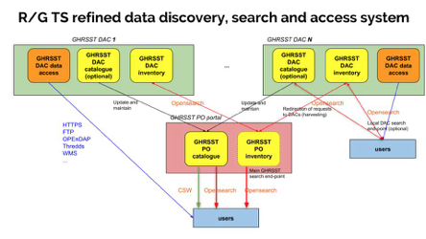
R/GTS Evolution
GHRSST Regional/Global task sharing (R/GTS) framework evolution continues, toward implementation of a federated distribution architecture
Draft report on R/GTS evolution prepared and ready for final consolidation with the GHRSST science team in June 2019
Pilot phase in progress, demonstrating federated catalog at IFREMER capable of consolidating discovery from NASA and NOAA
Implementation phase to follow in 2020

Slide 10
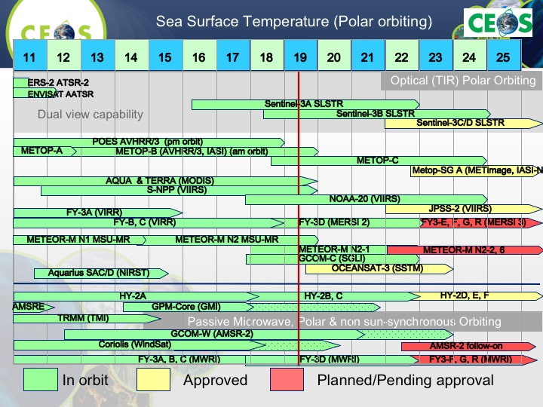

Slide 13
Continued PMW Advocacy
AMSR-3 Status
From JAXA:
AMSR3, the AMSR2 follow-on sensor for GOSAT-3, in the pre-project phase (Phase A) since Sep. 2018
JAXA just completed the System Requirement Review in January 2019
System Definition Review and Project Approval Review to be held in autumn 2019.
AMSR3 expected to become "official" after approval by the Project Approval Review
Orbit of the satellite will be 666 km altitude (same as GOSAT-1) and 13:30 LT in Ascending node (same as GCOM-W)
AMSR3 is almost equivalent to the current AMSR2 (antenna size, channels) except it has additional higher frequency channels of 166 and 183 GHz for snowfall retrievals

Slide 14
Continued PMW Advocacy
CIMR Status
From ESA:
Starting from prioritised user needs managed by the European Commission, a Copernicus Imaging Microwave Radiometer (CIMR) candidate mission is under study by the European Space Agency. CIMR will uniquely observe a wide range of floating sea ice parameters, sea surface temperature, thin sea ice thickness, snow products, sea surface salinity, surface roughness and wind speed with 95% global coverage every day and priority over the polar oceans. The mission will provide high spatial resolution (4-15 km), temporal resolution (sub-daily) and excellent geophysical accuracy. Additional measurement and other parameters (eg. soil moisture, precipitation) having global coverage may also be included. The CIMR mission will carry a wide-swath (>1900 km) conically scanning multi-frequency microwave radiometer. CIMR measurements will be made over a forward scan arc followed ~260 seconds later by a second measurement over a backward scan arc. Full Stokes vector channels centered at 1.414, 6.925, 10.65, 18.7 and 36.5 GHz are included in the mission design. The real-aperture resolution of the 6.925/10.65 GHz channels is <15 km and 5.5/4 km for the 18.7/36.5 GHz channels respectively. The 1.414 GHz channel will have a real-aperture resolution of ~60 km (fundamentally limited by the size of the ~8m deployable mesh reflector). However, all channels will be oversampled allowing gridded products to be generated at much better spatial resolution. Channel NEdT is 0.2-0.8 K with a goal absolute radiometric accuracy of 0.5K. CIMR will fly in a dawn-dusk orbit providing ~95% global all weather coverage every day with one satellite and complete (no hole-at –the-pole) sub-daily coverage of the polar regions. CIMR will operate in synergy with the EUMETSAT MetOp-SG(B) mission so that over the polar regions (>60N and 60S) collocated and contemporaneous measurements between CIMR and MetOp MWI/ICI and SCA measurements will be available within +/-10 minutes. Two satellites are foreseen to be launched in succession with the first launch anticipated in 2027/28 with sustained operations until 2037. The mission Phase A has been successfully completed in early 2019 and the Phase B1 activities are now in progress. Performance budgets presented at the preliminary Requirements Review (PRR) are consistent with the mission objectives and the wide set of products specified to address Mission Requirements (see Mission Requirements Document athttp://cimr.eu). A Phase B2 is now being planned with an expected kick off in 2020.

