Slide 1

OCR-VC
Committee on Earth Observation Satellites
Paul DiGiacomo, NOAA, on behalf of
Ewa Kwiatkowska, EUMETSAT
Marie-Helene Rio, ESA
OCR-VC co-chairs
CEOS SIT-34
Session and Agenda Item #6.2
Miami, FL, USA
3 – 4 April 2019

Slide 2
OCR-VC Linkages to CEOS Work Plan
3.1 Climate Monitoring, Research, and Services
  Provided final recommendation for OCR Essential Ocean Variables (EOVs) to GOOS and IOCCP
  Defined OCR EOVs as a transversal and contributing to both Biological and Chemical EOV Panels
  Provided new IOCCG in situ protocols for publication as best practices in the updated IOCCP version:
    IOCCG Ocean Optics & Biogeochemistry Protocols for Satellite Ocean Colour Sensor Validation Volume 1.0: Inherent Optical Property Measurements and Protocols: Absorption Coefficient
    IOCCG draft protocols currently available for public comment
      Best Practices for the Collection and Processing of Ship-Based Underway Flow-Through Optical Data
      Protocols for Satellite Ocean Color Data Validation: In situ Optical Radiometry
      Inherent Optical Properties Measurements and Protocols: Beam Transmission and Attenuation Coefficients
  Advocated consistency between OCR ECV and EOV; with ECV update for the next GCOS IP
3.2 Carbon Observations, Including Forested Regions
  Planning within IOCCG of “Aquatic Carbon From Space” special journal issue
3.5 Observations for Water
  IOCCG recent report “Earth Observations in Support of Global Water Quality Monitoring”
  IOCCG reports are contribution to “CEOS Strategy for Water Observations from Space” and “CEOS Feasibility Study on Satellite Missions/Instruments Focused on Water Quality Measurements”
3.7 Capacity Building, Data Access, Availability and Quality
  IOCS-2019 Symposium – 9-12 April, Busan, South Korea
  Capacity building and open data access provided by agencies and coordinated across the agencies

Slide 3
OCR-VC SVC Achievements and Planned Outcomes
Ocean Colour System Vicarious Calibration (OC-SVC) based on modular approach coordinated across the agencies
Development of OC-SVC in situ infrastructure for the ongoing and next generation of OCR missions
  NOAA – MOBY ongoing operations and technology refreshment
  NASA – completed the first phase of PACE SVC development, 3 projects funded (3-year/US$8M investment)
  NASA – call open for the second phase PACE SVC with the goal for the infrastructure to be in water about 2021
  ESA – FRM4SOC SVC workshop in Feb 2017 produced Copernicus OC-SVC recommendations, FRM4SOC final workshop in Oct 2018
  ESA / CNES / Copernicus – BOUSSOLE ongoing operations
  JRC – peer-review publications, OC-SVC requirements
  EUMETSAT – Copernicus OC-SVC roadmap, 1st step available “Requirements for Copernicus OC-SVC Infrastructure”
  EUMETSAT – Copernicus OC-SVC roadmap, 2nd step ongoing “Preliminary design of Copernicus OC-SVC Infrastructure”

Slide 4
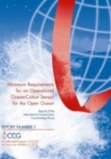
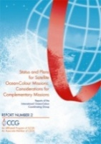
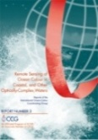

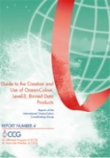
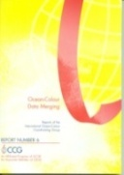
OCR-VC Team Achievements and Planned Outcomes
Climate dataset provision – ESA Ocean Colour Climate Change Initiative (OC-CCI+), multi-mission merged datasets
Copernicus Marine Environment Monitoring Service (CMEMS) – Ocean Colour Thematic Assembly Centre products available
Continuous consolidation & update of in situ measurement protocols
  IOCCG Ocean Optics & Biogeochemistry Protocols for Satellite Ocean Colour Sensor Validation Volume 1.0: Inherent Optical Property Measurements and Protocols: Absorption Coefficient
  IOCCG draft protocols for public comment
    Best Practices for the Collection and Processing of Ship-Based Underway Flow-Through Optical Data
    Protocols for Satellite Ocean Color Data Validation: In situ Optical Radiometry
    Inherent Optical Properties Measurements and Protocols: Beam Transmission and Attenuation Coefficients
  ESA – FRM4SOC radiometry protocols documented, final workshop 4-5 October 2018
Working groups on cal/val and algorithm evolutions
  Permanent working group on satellite sensor calibration
  Harmful Algal Blooms
  Intercomparison of Atmospheric Correction Algorithms over Optically-Complex Waters
  Role of Ocean Colour in Biogeochemical, Ecosystem and Climate Modelling
  Uncertainties in Ocean Colour Remote Sensing

Slide 5
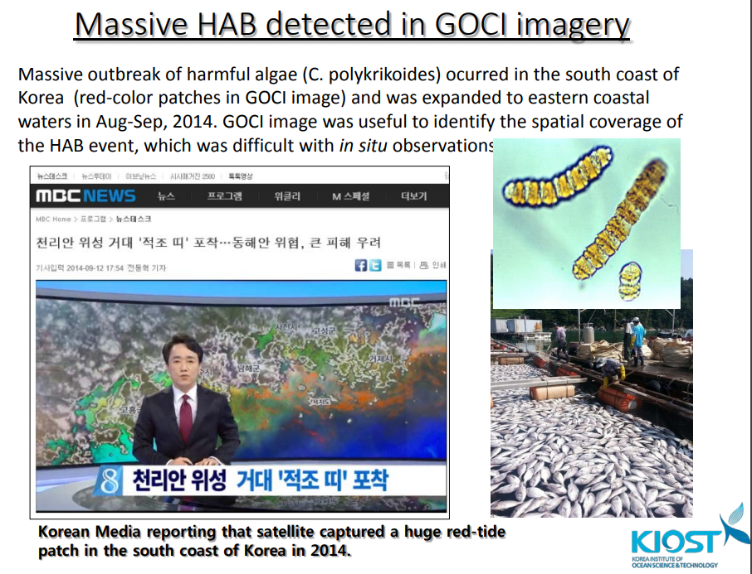
OCR-VC Geostationary Applications and Combined Products
“STRATEGIC DIRECTIONS AND PARTNERSHIPS FOR CEOS DISCUSSION PAPER”
Promotion of OCR geostationary activities across the agencies
Socio-economic applications
  coastal management, fisheries, water quality, invasive species, tracking of hazards such as HABS and oil spills, mapping of phytoplankton blooms, ecosystem health, improving models for forecasting
KIOST GOCI – the first geostationary OCR sensor, successful demonstration of geostationary benefits, GOCI-II to be launched soon
Early studies
  CNES OCAPI phase-A studies available
  NASA GEO-CAPE phase-A accomplishments and lessons learned available
‘Non meteorological applications of the Geostationary EO satellites’ demonstrations
  JAXA Himawari-8 AHI hourly bio-optical product demonstration
  EUMETSAT MSG SEVIRI water turbidity products, MTG FCI chlorophyll and other bio-optical product feasibility

Slide 6
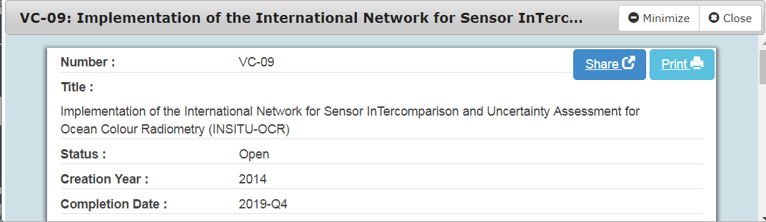
OCR-VC Sustainable commitment
All IOCCG/OCR-VC agencies are actively engaged, including NOAA, CSA, JAXA, KIOST, SIO, ESA, NASA, EC CMEMS, EUMETSAT etc.
Agencies/members meet 2-3 times per year, including at the annual IOCCG meetings and 1-2 Executive Committee meetings (in conjunction with other meetings IOCS, Ocean Sciences, Ocean Optics, and through telecons)
Strong synergies with WGCV, WGClimate, COVERAGE initiative, and other aquatic VCs
VC-09 deliverable realized in modular and coordinated manner across the OCR-VC agencies
No obstacles to the future viability –activities supported under IOCCG

Slide 7
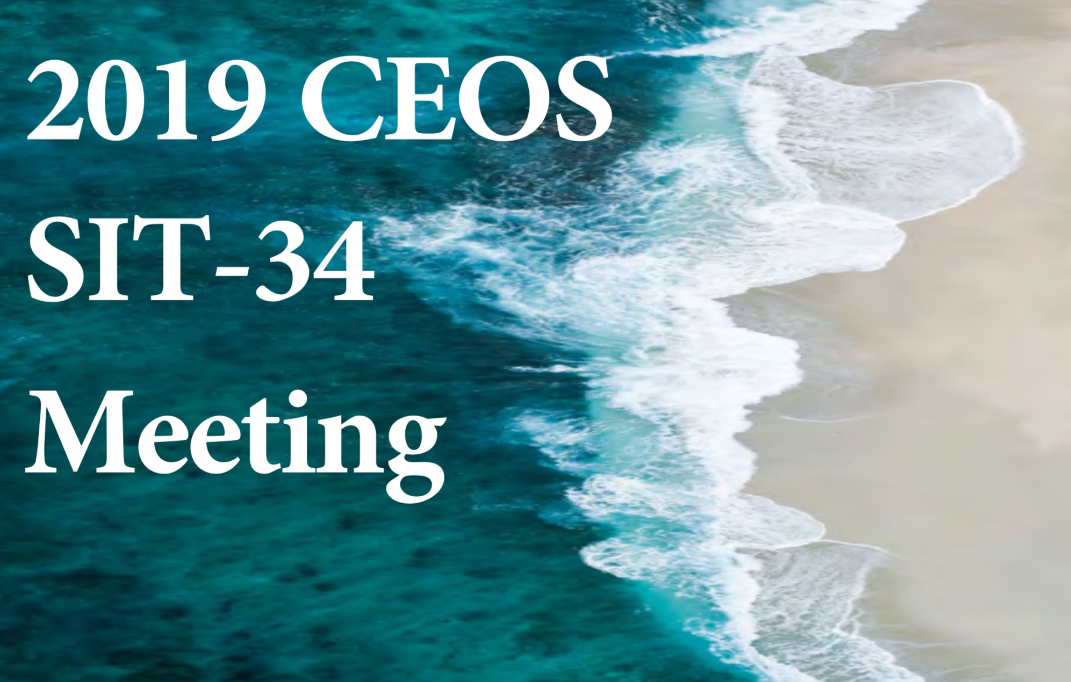
Thanks! See you in Miami!
Questions?
  Kerry.Sawyer@noaa.gov
  george@symbioscomms.com

