Slide 1

Observations for Water
Committee on Earth Observation Satellites
Paul M. DiGiacomo, NOAA, SIT Chair Team
CEOS SIT-34
Session 6: Oceans and Water Cycle, #6.11
Miami, FL, USA
4 April 2019

Slide 2
Overview
Brief Review of Water-related GEO and other International Activities:
GEOGLOWS Water Initiative for GEO
AquaWatch Water Quality Initiative for GEO
Blue Planet: Oceans and Coasts Initiative for GEO
First International Operational Oceanography Symposium (OSO)
Notes:
Combined VC / AHT / WG effort(e.g. AHWG) focused on Coastal research and applications.
Need for a CEOS Coastal strategy, bringing in multiple parameters / teams, including coordinating on Cal/Val along coasts (e.g. SS Temp/Ocean Color/SS Height/Salinity/OVW)
VCs already have a start on fresh / coast / ocean strategies but there is a need to coordinate with other AHTs and groups on progressing.
Freshwater from Space workshop should recognize CEOS VC’s/WG’s are have active water efforts which could use coordination.
Emphasize in-situ needs to CEOS agencies AND GEO/applications
Opportunity for inclusion aspect in GEO 2020 work plan, and CEOS work plan.
Possibility for new ad-hoc team on coastal issues focused on the organization and planning.
Target potential coastal applications e.g. aquaculture / disasters / Global Delta management / Harmful Algal Bloom’s. Intersection of need and capabilities.
Emphasize forecasting (integrated observations) versus monitoring (often single datasets)

Slide 3
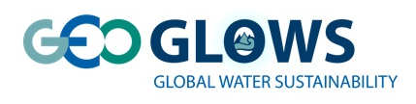
GEOGLOWS Initiative
Most significant contributions
of GEOGloWS as of March 2019:
  The implementation of the GEOGloWS Global streamflow forecasting service at ECMWF. (BYU-ECMWF leads)
  Response to the GEOSS Water Strategy and moving forward with the definition of EWVs (NASA- CNES leads)
  Improving the integrated water resources management and climate change adaptation schemes within the Space Climate Observatory over the main African basins and in close cooperation with national agencies and basin organizations. (CNES leads)
  Through a partnership with the AmeriGEOSS Platform, GEOGLOWS is pursuing the development of the “Water Accounting Framework” in the Américas (Regional lead).
  Increasing the contributions of hydrometeorological products by GEO members in the regional GEOSS projects through GEONETCast-A, SERVIR, TAHMO (primarily through the H2020 TWIGA project) and other GEO systems (Various leads)
Notes:
The Global Streamflow forecasting services are being implemented in the operational environment of ECMWF with funding provided by the World Bank. Many derivative applications such as reservoir management, flood mapping, irrigation control have been demonstrated from this service.

Slide 4
GEOGLOWS Initiative
Selected upcoming GEOGLOWS
Activities for 2019 - 2022
  Use of disruptive technologies (web services) in the way that actionable satellite data can be delivered locally for making water resources decision (BYU leads)
  The implementation of the GEOGloWS technical development for the Global meteorological and streamflow forecasting service from the NOAA’s GFS are being piloted to deliver output through web services. (Esri-BYU-Aquaveo leads).
  AIP/Disaster Pilot: Lead by OGC and NEXTGEOSS with the support of the WMO. (OGC-WMO collaboration)
  A Drought operational system for Latin America: CEMADEN-ICHARM-NOAA Collaboration (CEMADEN-ICHARM-NOAA leads)
  Through the H2020 TWIGA project, development of new sensors, to improve and extend in situ networks and provide actionable information for water management and flood risk reduction in sub-Saharan Africa (TWIGA-African partners leads)
  Capacity Building: AmeriGEO (AmeriGEO Week - August 19 - 23 Lima, Peru -GEOGloWS Services for Global Streamflow and other water data services in support of National/Regional Water Priorities)

Slide 5
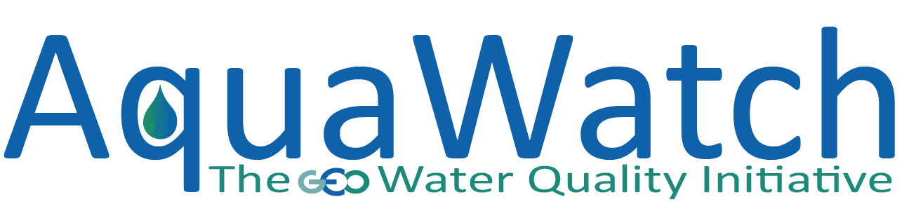
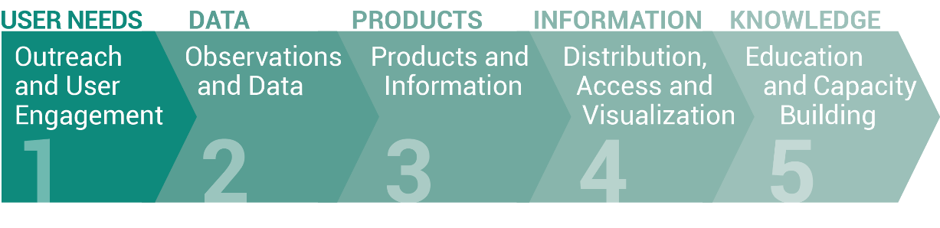
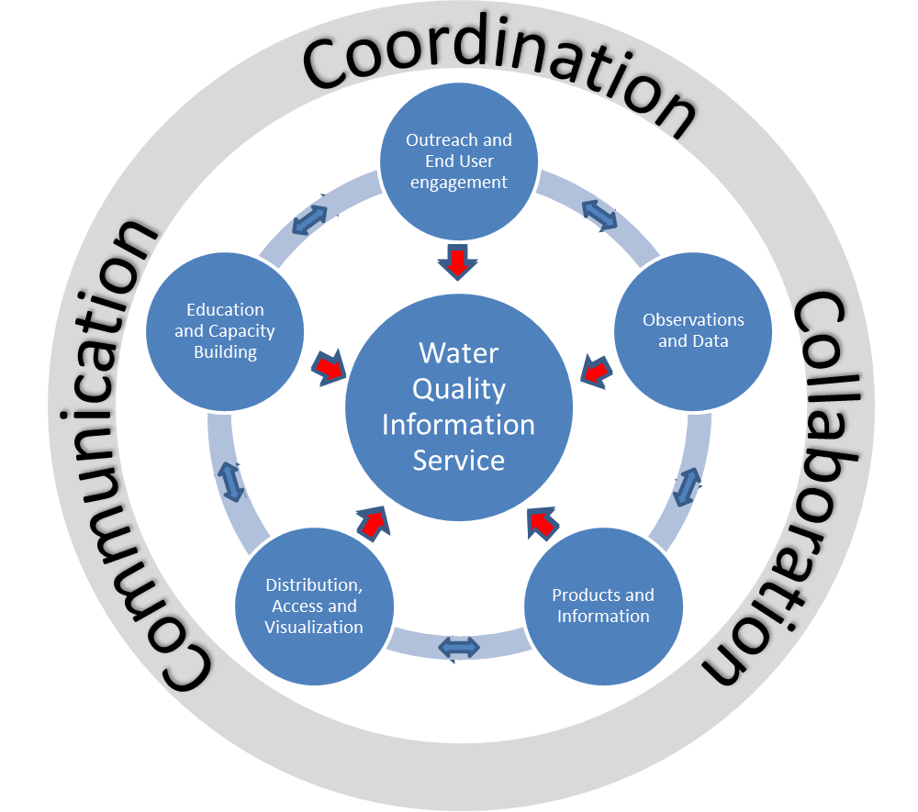
AquaWatch Initiative
FIVE WORKING GROUPS :
www.geoaquawatch.org
Mission:
The mission of the AquaWatch Initiative is to improve the coordination, delivery and utilization of water quality information for the benefit of society.
Flagship Water Quality Information Service
Goal:
The goal of AquaWatch is to develop and build the global capacity and utility of Earth Observation-derived water quality data, products and information to support water resources management and decision making.
AquaWatch is working to produce a global water quality monitoring and forecasting service by 2025. Tasks to develop this service are organized around seven work packages. This effort will enable users open access to readily available water quality data through data sharing & capacity building, particularly
in developing countries.
AquaWatch Leads:
Steven Greb, University of Wisconsin Madison USA srgreb@wisc.edu
Dr. Paul DiGiacomo, NOAA USA Paul.DiGiacomo@noaa.gov
Dr. Arnold Dekker, SatDek Pty Ltd, Australia Arnoldgdekker@gmail.com
AquaWatch Secretariat: info@geoaquawatch.org
Our current efforts are focused on developing a baseline product and end-to-end prototype demonstration.

Slide 6
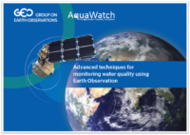
AquaWatch Initiative
Planned Activities for 2019
CEOS WGISS/AquaWatch Collaboration
  Future Data Architecture, Interoperability needs, Validation and Potential Pilot
Presenting at the GEO Data Technology Workshop in Vienna in May 2019
  Showcase LIMNADES validation database project
Poster at ESA - Living Planet in April 2019
Capacity Building Survey will be shared globally
  Identifies training & outreach needs
  Use of EO in Water Quality reporting
  In French, Spanish, English, German, Mandarin
We will host a Knowledge Hub on our website to encourage best practices and showcase:
  Review Paper: Integrating inland and coastal
  water quality measures: merging data for
  actionable knowledge (In Prep)
  Citizen science applications (3+)
  Algorithm library, optical standards for optical properties, inventory of protocols
  Fit-for-Purpose Brochure of available products & services
  “AquaWatch Recommended” training guidelines
www.geoaquawatch.org
Recent Accomplishments
Booklet: Advanced Techniques
for Monitoring Water Quality
Using Earth Observation
Successful joint AquaWatch-GloboLakes biennial meeting at University of Stirling, UK Hosted by Andrew Tyler, UK, Aug. 29-31, 2018
  workshop report now available and links to talks on website
Arnold Dekker chaired the CEOS Freshwater From Space Workshop in November 2018
Ocean Optics Town Hall 2018
Continuation of the popular webinar series
Advertising for a 2 year NASA-postdoc opportunity
  Emphasis on Validation
  Stationed with Dr. Stephanie Schollaert-Uz at NASA-Goddard, Greenbelt, MD
Updated In Situ Inventory available on website

Slide 7

Blue Planet Initiative
Recent Activities
Publications/Reports
  GEO Blue Planet (in press). Ocean Observing for Societal Benefit. Journal of Operational Oceanography
  B. Mackenzie et al. (2019) The role of stakeholders and actors in creating societal value from coastal and ocean observations. Frontiers in Marine Science
  E.A. Smail et al. (Manuscript submitted for publication). Ocean Observations to Underpin Policy: Examples of Ocean Observations in Support of the Sendai Framework, UNFCCC, and Sustainable Development Goal 14. In A. Kavvada and D. 557 Cripe (Eds.), Earth Observation Applications and Global Policy Frameworks. Washington, DC: AGU
  GEO Blue Planet (2018). What can the ocean tell us? Why ocean observation products and services are vital for us and our planet.
SDG 14.1.1
  GEO Blue Planet currently has a task team working to support the United Nations Environment Programme on the methodology development of SDG 14.1.1 (Index of coastal eutrophication and floating plastic debris density).
4th GEO Blue Planet Symposium
Various user engagement workshops & project spin-ups
Publications & Reports
Supporting UN Environment on SDG 14.1.1
Expanding Secretariat
2020 – 2022 Implementation Plan Draft submitted and available at:
https://geoblueplanet.org/about/
Notes:
SDG 14.1.1 task team: This task team provides UN Environment with information about existing data methods for monitoring coastal eutrophication and marine debris and provides. The team also provides networking support to link Earth Observation experts with relevant stakeholders.

Slide 8
Blue Planet Initiative
Upcoming GEO Blue Planet Projects & Activities
Multi-Hazard Information and Forecasting System for the Wider Caribbean: monitoring and alerting the region to oil spills and floating sargassum beachings. Provide a publicly available monitoring and alert system based openly available satellite and in-situ data.
Early Warning System for Marine Flooding in Reef-lined Islands: to provide short-term forecasts of flooding for proper evacuation and preparedness time. Determining reef and island geography & in-situ model validation (waves, water level, flooding obs) is key.
Marine Debris Working Group: Monitor, classify and quantify the flow of plastics into the ocean. Need to understand the impact to the health of the ocean
Library of ocean observation use cases: working in collaboration with U.S. IOOS to develop a map-based library of ocean observation use cases
Oceanscape: this oceanscape project will be an interactive web-based interface to display information about ocean observing organizations.
Notes:
-MHAS is working on the in-situ validation portion currently and looking to develop an app for citizen science involvement in identifying on-shore sargassum, while working with maritime organizations to aid in off shore oil spill and sargassum validations
-EWS goal is to have first version pilot in by 2020 in the Pacific, with further updates and rollout within 5 years.
-MDWG – Emily attended a meeting at the UN Environment focusing on marine debris in the ocean

Slide 9
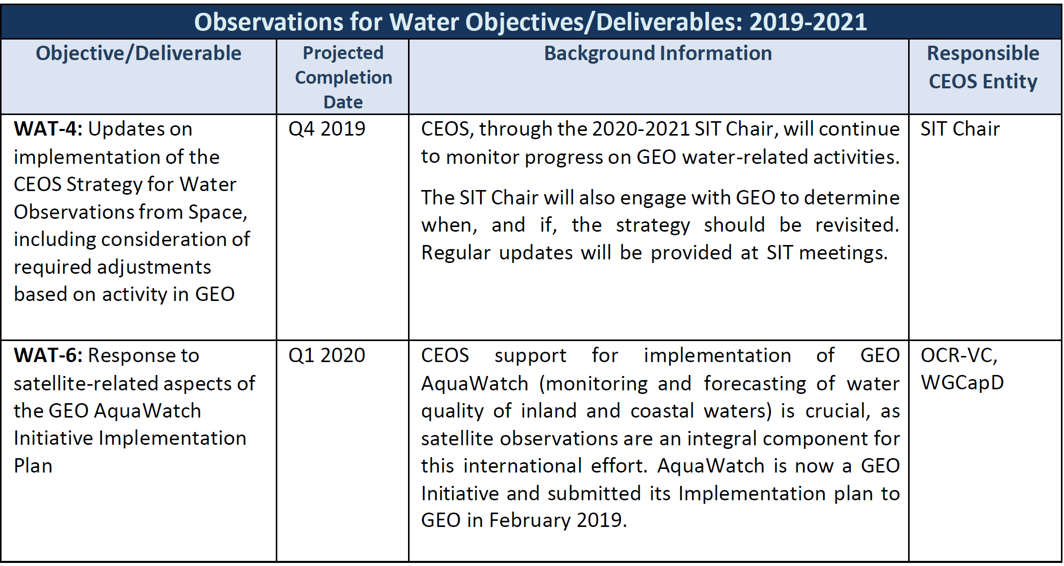
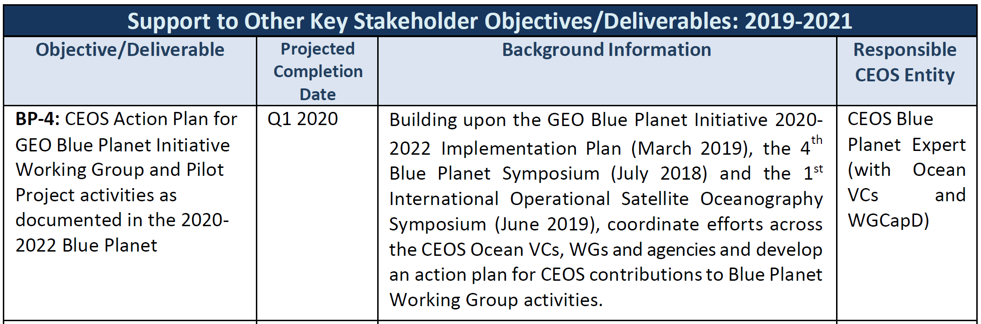
CEOS Water Actions

Slide 10
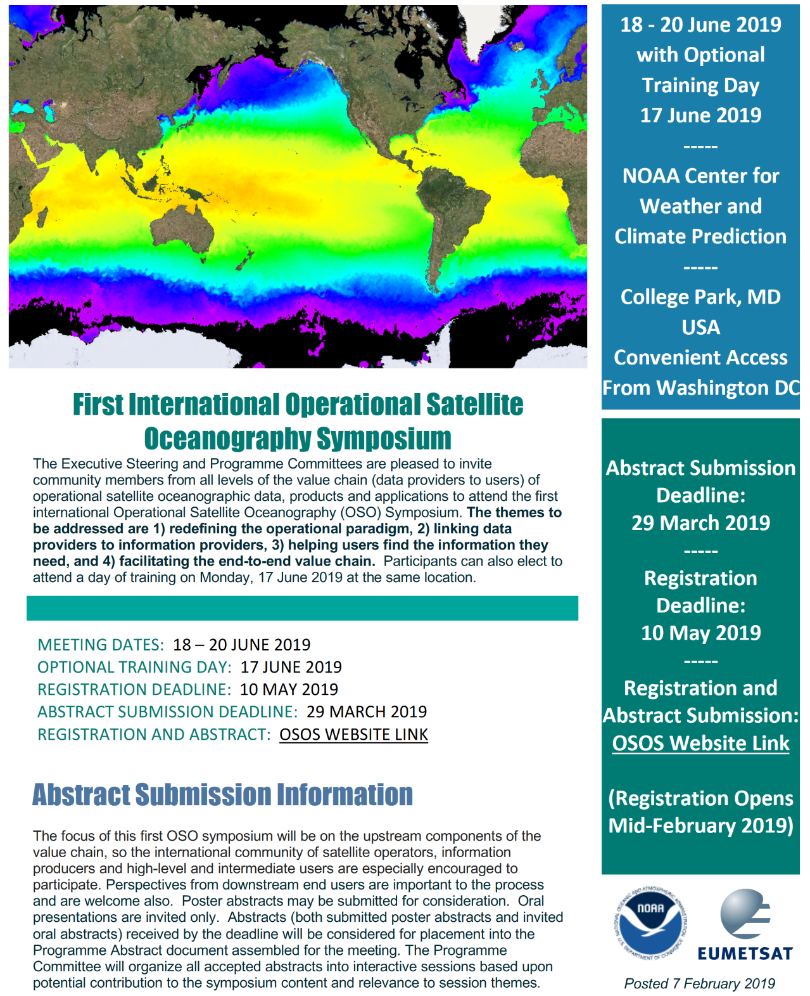
First International Operational Oceanography Symposium
18-20 June 2019
College Park, MD USA
Registration now open!
Go to coastwatch.noaa.gov
for further information

Slide 11
Summary and Next Steps
There is a crucial need for CEOS water (inland, estuarine and marine) observations to support monitoring and forecasting activities for GEO and broader international user communities (SDGs et al.)
There has been significant progress the past year to coordinate the various freshwater observation requirements for these various communities (NB: Agenda item 6.12, A. Held)
Similarly, significant ocean activities have taken place (e.g., 4th Blue Planet Symposium, July 2018) and likewise are planned this coming year to better link data providers and users and to improve coordination for ocean and coastal activities (e.g., Ocean Predict ’19 in May 2019; 1st International Operational Satellite Oceanography Symposium in June 2019; Ocean Obs ‘19 in September 2019; UN Decade of Ocean Science, 2021-2030)
As discussed here and earlier agenda items (6.8), the opportunity & need exists for greatly enhanced CEOS engagement; for further discussion…

