Slide 1

LSI-VC
Committee on Earth Observation Satellites
Adam Lewis, Geoscience Australia, CEOS Principal and LSI-VC Co-Lead
CEOS SIT-34
Session 5.5
Miami, FL, USA
3-4 April 2019

Slide 2
Topics
CEOS work plan update
Response to Plenary Action CEOS-32-12:
  Documented approach to leadership
  Synergies among teams
Team Achievements and Recommendation for SIT
(Additional detail, resources, and background)

Slide 3
LSI-VC outcomes
Why Are We Here?
The harmonisation of future mission and existing mission acquisition plans across major international land surface imaging programs based on a reliable understanding of domain-specific requirements, and;
The efficient use of very large land surface imaging datasets, enabled by suitable data architectures and non-domain specific land surface measurements that are ‘analysis-ready’ and interoperable.

Slide 4
Plenary Actions
CEOS-32-09 | NOAA and CSIRO, in consultation with LSI-VC, to explore additional case studies related to the GEO-LEO initiative.
Key finding from work done by Kevin Gallo: NOT having data in an analysis-ready format (e.g., CARD4L) makes the data preparation steps too time intensive
LSI-VC is awaiting further feedback and guidance from CSIRO and NOAA on the next steps.
CEOS-32-13 | LSI-VC to draft a plan forward for the proposed merger of SDCG for GFOI and the CEOS Ad Hoc Working Group on GEOGLAM into LSI-VC. This plan would address the discussions and concerns raised at the CEOS Plenary meeting.
LSI-VC, together with SDCG and GEOGLAM, have developed an option which should be considered alongside other options
Expect this will be covered in SIT-34 Session 2, Organisational Matters

Slide 5
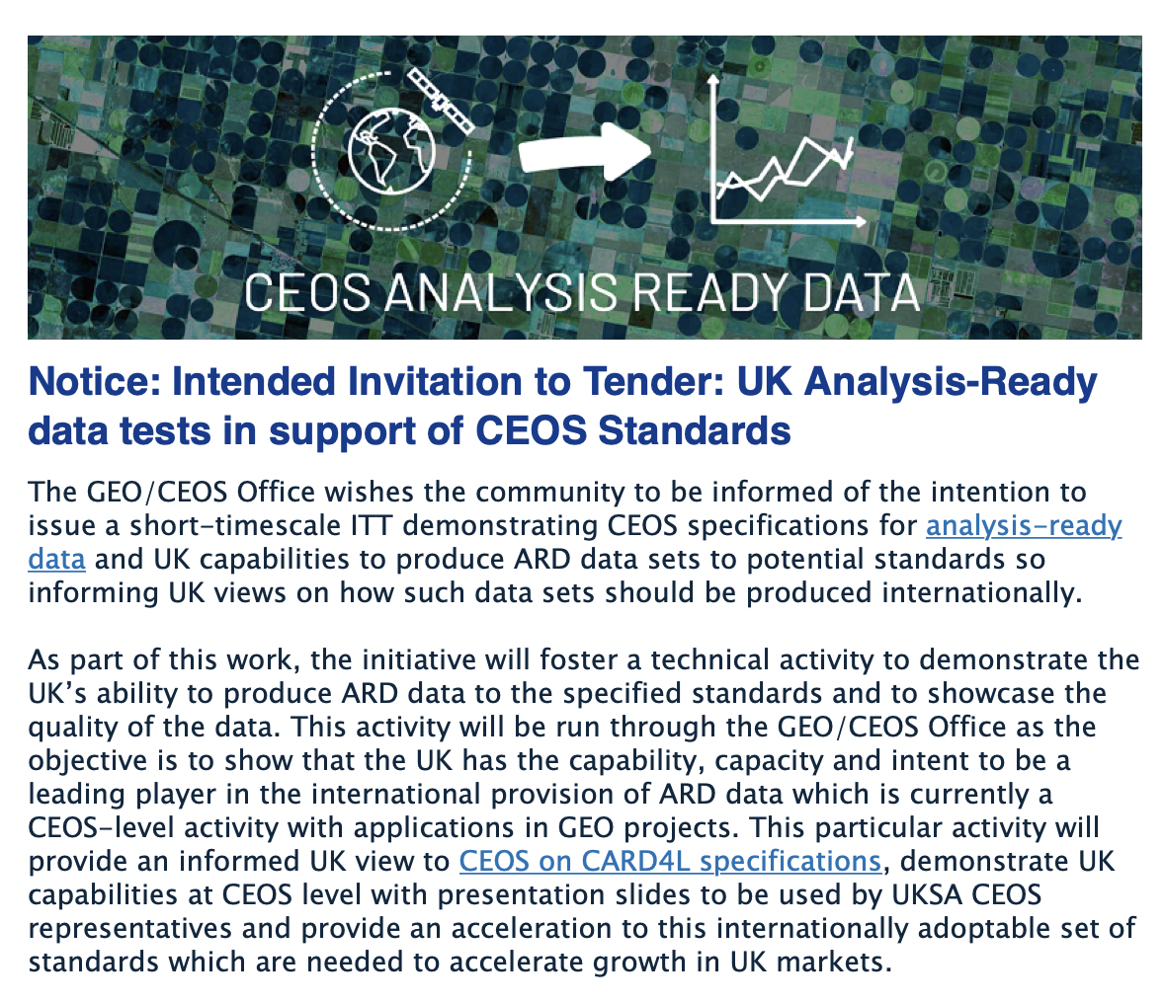
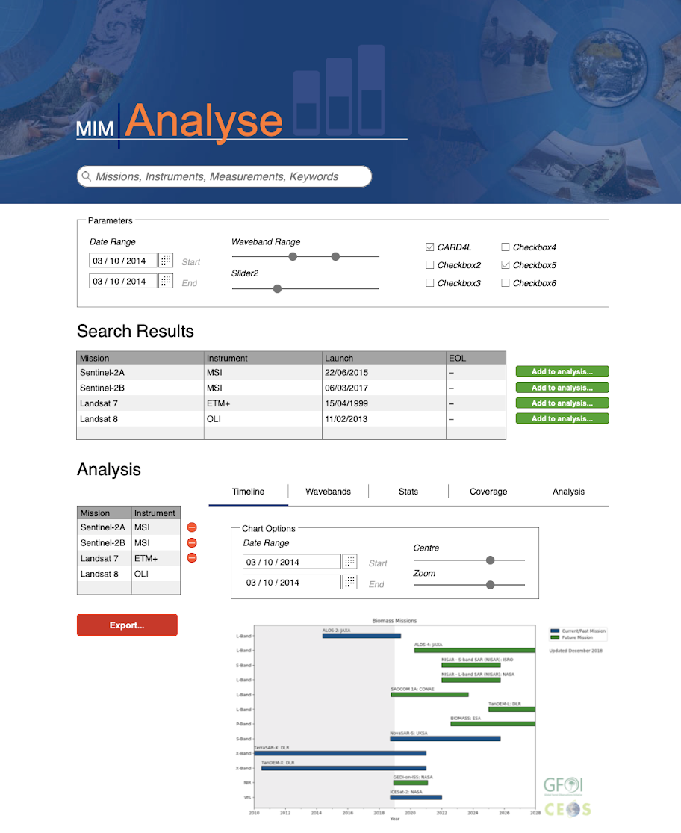
Work Plan
VC-31: CARD4L Supply, Access, Uptake Trials (via Digital Earth Africa, others) – This task is intended to cover aspects such as:
CARD4L production from multiple instruments across the spectrum of available PFS;
Routine publishing of this CARD4L via agency data portals, cloud data stores, other data aggregators/platforms; and,
Investigation and implementation of new data paradigms such as COGs and STAC for CARD4L usability and discoverability.
VC-37: CEOS Information Tool Improvements – modifying the CEOS MIM database to allow complex queries and gap analyses through the addition of an API. Develop a prototype online user interface using an API connected to the MIM.
VC-39: Formally define terms used in the context of the Moderate Resolution Interoperability (MRI) Initiative
VC-42: Open-source library for surface reflectance product generation
Notes:
Expect progress under VC-31 in 2019 through several initiatives:
- The Catapult / UKSA RFT

Slide 6
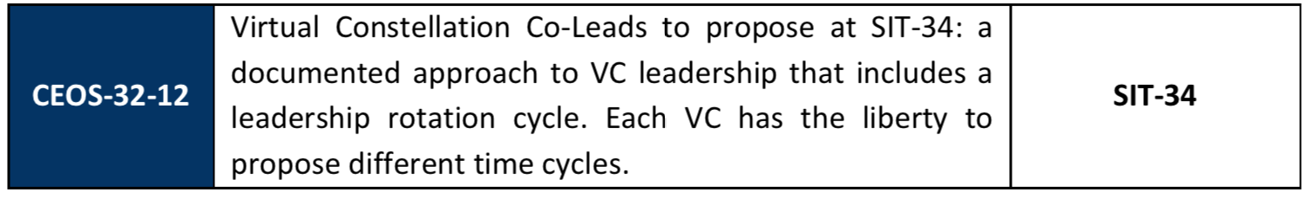
Sustainable Commitment
- Leadership
LSI-VC revised Terms of Reference includes a Leadership Rotation Cycle. The leadership of the LSI-VC:
  Will continue to consist of co-leads endorsed by their agencies
  Will nominally rotate, through an annual call for expressions of interest in joining the co-lead team. However it will not be a strict requirement that the co-lead rotate. In the event of a lack of nominations, for example.
These proposals build on past success to:
  Provide broad representation in the leadership
  Ensure sustainability of group, with co-leads able to jointly provide the level of effort needed to continue the functions of the LSI-VC
  Increase procedural clarity and transparency and around leadership appointments
Notes:
Participation from a wide range of CEOS agencies, including the opportunity to provide leadership, is essential to the work of LSI-VC in all areas – CARD4L, requirements, gaps, observational coordination.
To date, focussing on analysis ready data, representation has been achieved with diverse agencies participating in disussions / negotiations of the CARD4L framework. This will need to be continued, including the opportunity for agencies that are prepared to materially support the leadership to step up to those roles.
The ability of the three co-chairs to provide resources in a form that suits them, and at times that suit them, has been a crucial advantage of the tri-chair arrangement. For example ESA fund the secretariat; GA fund A. Siqueira to coordinate CARD4L; and co-chairs changes of duties have been smoothed over, allowing continuity of effort.

Slide 7
Sustainable Commitment
- Synergies Among Teams
Existing synergies
  SEO is essential to the work of LSI-VC, providing tools, technical capabilities, and at times capacity to ‘get moving’ on key items
  WGCV is an essential part of the CARD4L review processes. There is an excellent relationship between LSI-VC and WGCV
  WGISS work on future data architectures sets a context for CARD4L and for development of the concepts around interoperability
Going forward :
  LSI-VC must begin to engage with “…ongoing national EO program planning processes … in support of CEOS commitments in relation to the ECV inventory and Sustainable Development Goals” *
  Therefore synergies must be much further developed with:
  Thematic teams including GEOGLAM, SDCG, and future thematic land and water groups likely to be formed around the SDGs.
  * Strategic Directions for CEOS discussion paper March 2018

Slide 8
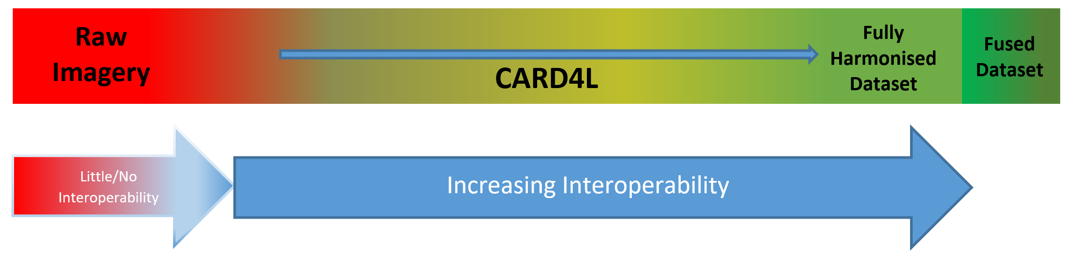
LSI Achievements and Planned Outcomes
CARD4L Specifications were Agreed in February 2019
  Land Surface Reflectance; Land Surface Temperature; Normalised Radar Backscatter. This is a major step forward.
  Communications materials developed and published (ceos.org/ard)
  Processes to assess datasets against the specifications have been agreed and initiated. These include self-assessment, and an independent review process through the WGCV.
Definitions work progressing “the interoperability spectrum”
  This work is capturing what is meant by the term “interoperability”, the different ways in which it can be achieved, and how CARD4L data fits in as a necessary step
Notes:
Slides in this deck under ‘background materials’ provide additional background on CEOS Analysis Ready Data for Land (CARD4L) and details of the next steps.
The Agreement of the PFS is the culmination of over 2 years of work since the agreement of the definition of CARD4L at Plenary in November 2016. It demonstrates the resolution of diverse points of view, and the emerging acceptance of the concept of analysis ready data and the value proposition of CARD4L.
The Specifications are an essential step for analysis ready data. In the absence of Specifications analysis ready data can be ‘all things to all people’.
Four further PFS are under development specifically for SAR.
CEOS Agencies are now self-assessing their products against the specifications and adjusting as necessary.
The CEOS WGCV will be engaged to undertake peer reviews of these self-assessments.
Following approval, CARD4L datasets will be catalogued for promotion and ease of access for users. Sentinel-2 L-2A and Landsat Collection 2 are great examples.
LSI-VC also plans to conduct data supply and user access trials – pushing data to large online storage and analysis hubs to further ease access and use.
Effort to date has been driven by LSI-VC for land applications, however CEOS has identified the need for a broader CEOS strategy for ARD, and the CSIRO/GA SIT Vice Chair intends to take this on as a priority in 2020-2021.

Slide 9
Recommendation to SIT
LSI-VC Recommends to the SIT that:
  CEOS Agencies note the completion of the Product Family Specifications for Normalised Radar Backscatter, Land Surface Temperature and Land Surface Reflectance. These specifications demonstrate CEOS leadership as a forum, and have been developed to support CEOS mission to deliver value from Earth observations.
  CEOS Agencies work toward adopting these specifications in processing and re-processing of globally significant datatsets, such as Landsat, Sentinel 1-2, and ALOS/ALOS-2. Further development of leading processors, such as CNES PEPs, could also support CARD4L.
Notes:
Data produced to CARD4L specifications will support rapid uptake of CEOS data by a wider range of users to address global challenges.
NOVASAR is aiming to be the first mission to specify CARD4L data products in the mission development phase.

Slide 10
Questions?

Slide 11
Background Materials

Slide 12
Sustainable Commitment
- Levels of engagement
LSI-VC has active engagement from :
  CSA; EC; ESA*; Geoscience Australia*; JAXA; NASA; NOAA; UKSA; USGS*; VNSC. Furthermore, members of GEOGLAM and GFOI actively support the work of LSI-VC, as does the SEO, CEO.
  And a much larger group supporting the development of CARD4L
LSI-VC meets face-face biannually, coordinated with SIT & SIT-TWS
LSI-VC is meeting its objectives in analysis ready data
  Through the CARD4L framework, and engagement with data producers
LSI-VC will begin to focus effort on observational requirements and gaps, through:
  Agreeing high level outcomes, confirmed in Terms of Reference
  Focussing on key areas of need (new thematic observing areas)
  Building capacity through relationships with other CEOS groups
LSI-VC welcomes new participants
  Agencies committing to the production of CARD4L products.
  *Co-Leads
Notes:
More detail on these points:
Engagement is indicated by direct resourcing of work, leadership of activities, and participation in meetings in 2018
LSI welcomes engagement from data producing CEOS agencies to commit to delivery of CARD4L datasets and to support work to capture the benefits of CARD4L data, such as increased uptake by a wider range of users. This work would also help to further develop the CARD4 framework, for instance to assess the accessibility of datasets in practice to a third party user, or guidance on the best file formats to allow uptake.
Increased participation bringing expertise in thematic applications areas may be benficial to LSI-VC.
Closer organisational relationships with GOGLAM, GFOI and other teams can help to empower LSI to progress work on requirements and gaps.
LSI work on gaps and requirements should be prioritised according to the interests of CEOS agencies, for example in CO2 or biomass estimation as emerging priorities, or in the areas of the quality, sustainability and future requirements of land surface observations needed to underpin SDG products.

Slide 13
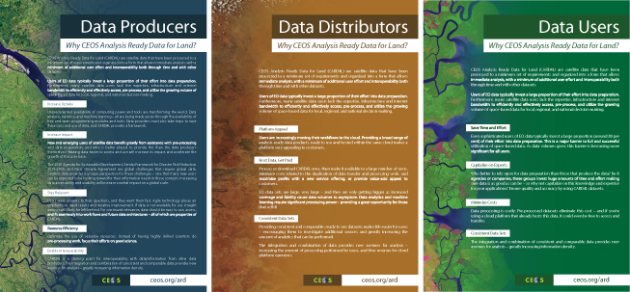
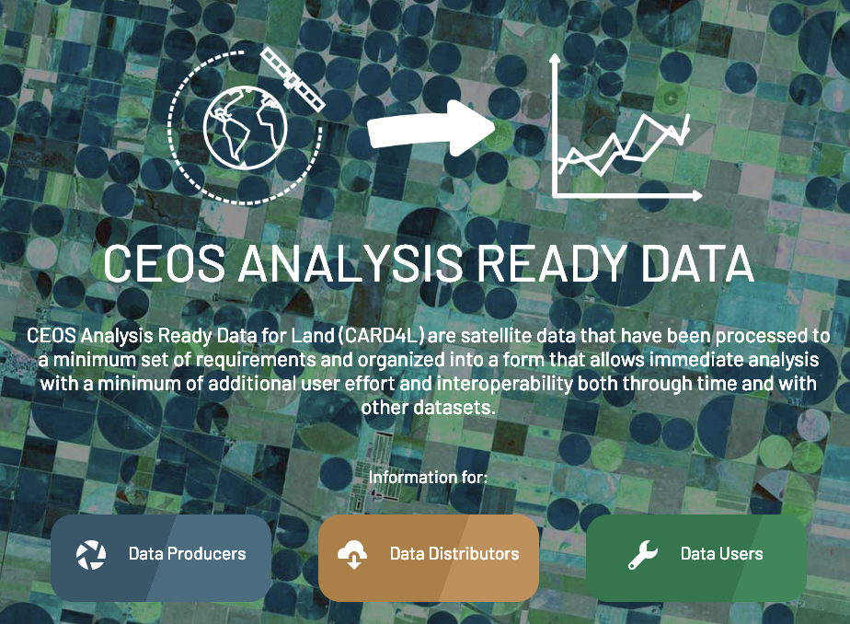
CARD4L Introduction
CEOS Analysis Ready Data for Land (CARD4L) are satellite data that have been processed to a minimum set of requirements and organized into a form that allows immediate analysis with a minimum of additional user effort and interoperability both through time and with other datasets.
CARD4L offers numerous benefits for data producers, data distributors, and data users.
Data Producers Increase Uptake Increase Impact Stay Relevant Resource Efficiency Enable Interoperability | Data Distributors Platform Appeal Consistent Data Sets | Data Users Save Time and Effort Capitalize on Experts Minimize Costs Consistent Data Sets
More info:
http://ceos.org/ard/

Slide 14
CARD4L Status – further detail
CEOS LSI-VC endorsed the first three CARD4L Product Family Specifications: Normalised Radar Backscatter, Surface Reflectance, and Land Surface Temperature in February 2019.
Four further PFS are under development specifically for synthetic aperture radar (SAR).
CEOS Agencies are now self-assessing their products against the specifications and adjusting as necessary.
The CEOS WGCV will be engaged to undertake peer reviews of these self-assessments.
Following approval, CARD4L datasets will be catalogued for promotion and ease of access for users.
LSI-VC also plans to conduct data supply and user access trials – pushing data to large online storage and analysis hubs to further ease access and use.
Effort to date has been driven by LSI-VC for land applications, however CEOS has identified the need for a broader CEOS strategy for ARD, and the CSIRO/GA SIT Vice Chair intends to take this on as a priority in 2020-2021.

