Slide 1
Observations for Forests
Committee on Earth Observation Satellites
Osamu Ochiai, JAXA, GFOI Lead for CEOS, Stephen Ward, Alternate Lead & SDCG SEC
CEOS SIT-34
Session 4.7
Miami, FL, USA
3 – 4 April 2019

Slide 2
GFOI
Continued momentum in attracting major forest donors for coordination and efficiency in using structured and IPCC-compliant methods to guide national forest monitoring systems
Germany joined as Lead (GNU donor bloc now all Leads)
Growing adoption of GFOI tools
Methods and Guidance Documentation
REDD Compass (reddcompass.org)
New Country Needs Assessment (CNA) process
GFOI Tools Inventory (CALM maturity index)
More confused on the data aspects with the ‘Data Component’
FAO Co-Lead (promoting SEPAL)
World Bank Co-Lead
SilvaCarbon/USGS promoting GEE
Vacant Data Component Manager role (CEOS led Space Data Component)
GFOI LT agreed to submit an IP to the GEO WP 2020-2022
Await progress on: R&D Programme Phase 2; Early Warning module

Slide 3
GFOI
GFOI Plenary next week in Mozambique
Discuss priorities for GFOI and its partners for the period 2019-20
Update participants on recent progress of the GFOI and its partners
Convene GFOI Component and Leads meetings
Consult and seek input to Country Needs Assessment (CNA) process
Further enhance and streamline support to implementing countries
CEOS will report on Space Data and Platform developments
Landsat Collection 2
Copernicus Global Land Service & Sentinel-2 L2A Global production
CARD4L and GFOI pilots
Agency development platforms (eg DIAS), Open Data Cube
Recommend CEOS continue watching brief and stay alert for opportunities
ARD pilots
Biomass datasets requested by GFOI
World Bank and policy support

Slide 4
SDCG Update
Regrouping and refocusing to reflect GFOI Phase 2 activities
New Work Plan in development
Continued focus on the core business of assurance of data suitable for annual NFMS reporting
Healthy supply allows time to focus on additional value
data access, formats, ARD
SDCG-15 and Biomass Day held last week in VA

Slide 5
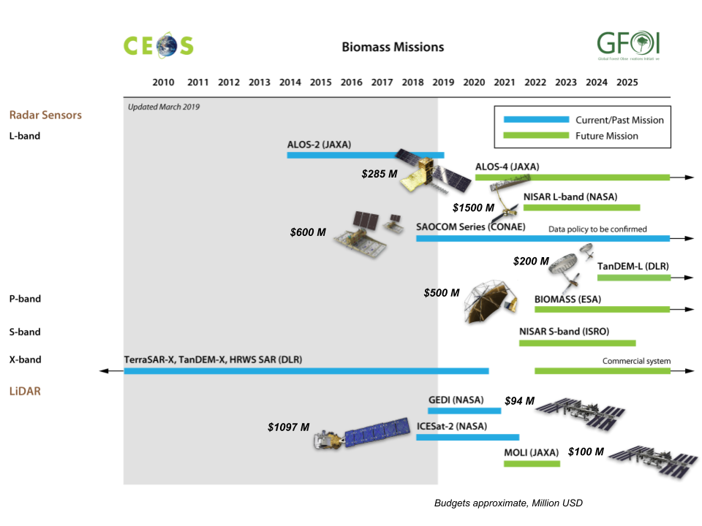
Biomass Day
GFOI request to CEOS for Global satellite based Biomass (AGB) acquisition and provision
Substantial investment ($4.5Bn) in launch of above ground biomass relevant missions from 2018 to 2024
Strong interest in biomass from sectors related to carbon emissions and forests
Substantial technical work in WGCV-LPV (CEOS Biomass Protocol) in ensuring these datasets are fit for purpose
Biomass day brought together CEOS agencies and groups to explore the proposition of ‘accelerating the policy relevance of CEOS agency biomass datasets’ using GFOI and convention frameworks
EO datasets can take years to find recognition in IPCC methods etc
World Bank keen to collaborate on capacity building in GFOI for understanding and application of biomass data

Slide 6
Issues for SIT attention
CEOS missions relevant to GFOI are changing
NASA, CONAE, DLR - active representation desireable
SDCG-LPV collaboration - with USGS SilvaCarbon (& WB and FAO):
utilise GFOI Capacity Building Component
represent biomass in GFOI Methods and Guidance
Promote the CEOS Biomass Protocol
Consider integrated and pro-active engagement of convention frameworks, for national inventories and global stocktakes (2023, 2028…)
Pursuing GFOI ARD pilot in support of CEOS ARD strategy with LSI-VC
CEOS agencies invited to register their forest-related tools in the GFOI Tools Registry and assessment process (http://www.earthobservations.org/article.php?id=346)
Feedback is welcome on the SDCG stated goal for a new thread focused on ‘accelerating the policy relevance of the new generation of biomass measurements from space’ - and participation from relevant programmes

