Slide 1

CEOS AHWG on GEOGLAM
Committee on Earth Observation Satellites
Bradley Doorn, NASA
Philippe Maisongrande, CNES
CEOS SIT-34
Session and Agenda Item #4.6
Miami, FL, USA
3 – 4 April 2019

Slide 2


GEOGLAM Update
GEOGLAM & G20
  Renewed Mandate
  2019 G20 Stocktaking Report submitted
  Relationship with AMIS strong – economists increasingly seeing value of EO.
GEOGLAM & Policy Frameworks
  Deepening connections with SDGs, Sendai, Paris
  Connections with Regional Integration groups
GEOGLAM Secretariat Status:
  Geneva Staff through 2019 – seeking renewed funding for Director
  Remote secondments (Crop Monitor, CEOS) thru 2022
  New WG on CapDev launching May 2019
  Regional networks steady & growing
We undertake to continue support for GEOGLAM’s activities on enhancing national and global agricultural monitoring using Earth observations. We recognize this is amongst the key mechanisms to promote transparent markets and food security.
GEOGLAM User Panel at AMIS Rapid Response Forum
AMIS formally requested GEOGLAM to observe countries where there is high uncertainty in production forecast ahead of harvest.
Notes:
NASA Harvest in its capacity as a key contributor to GEOGLAM will be working on the AMIS request. Most AMIS representatives participated in this panel. This is exactly what we need to be doing - we need to have high level policy discussions that drive the requirements and development of remote sensing and applications, with participants who fully understand capabilities and limitations of applying the technology.

Slide 3

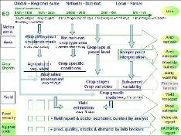
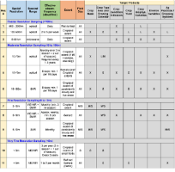
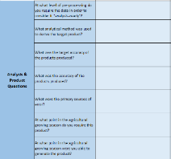


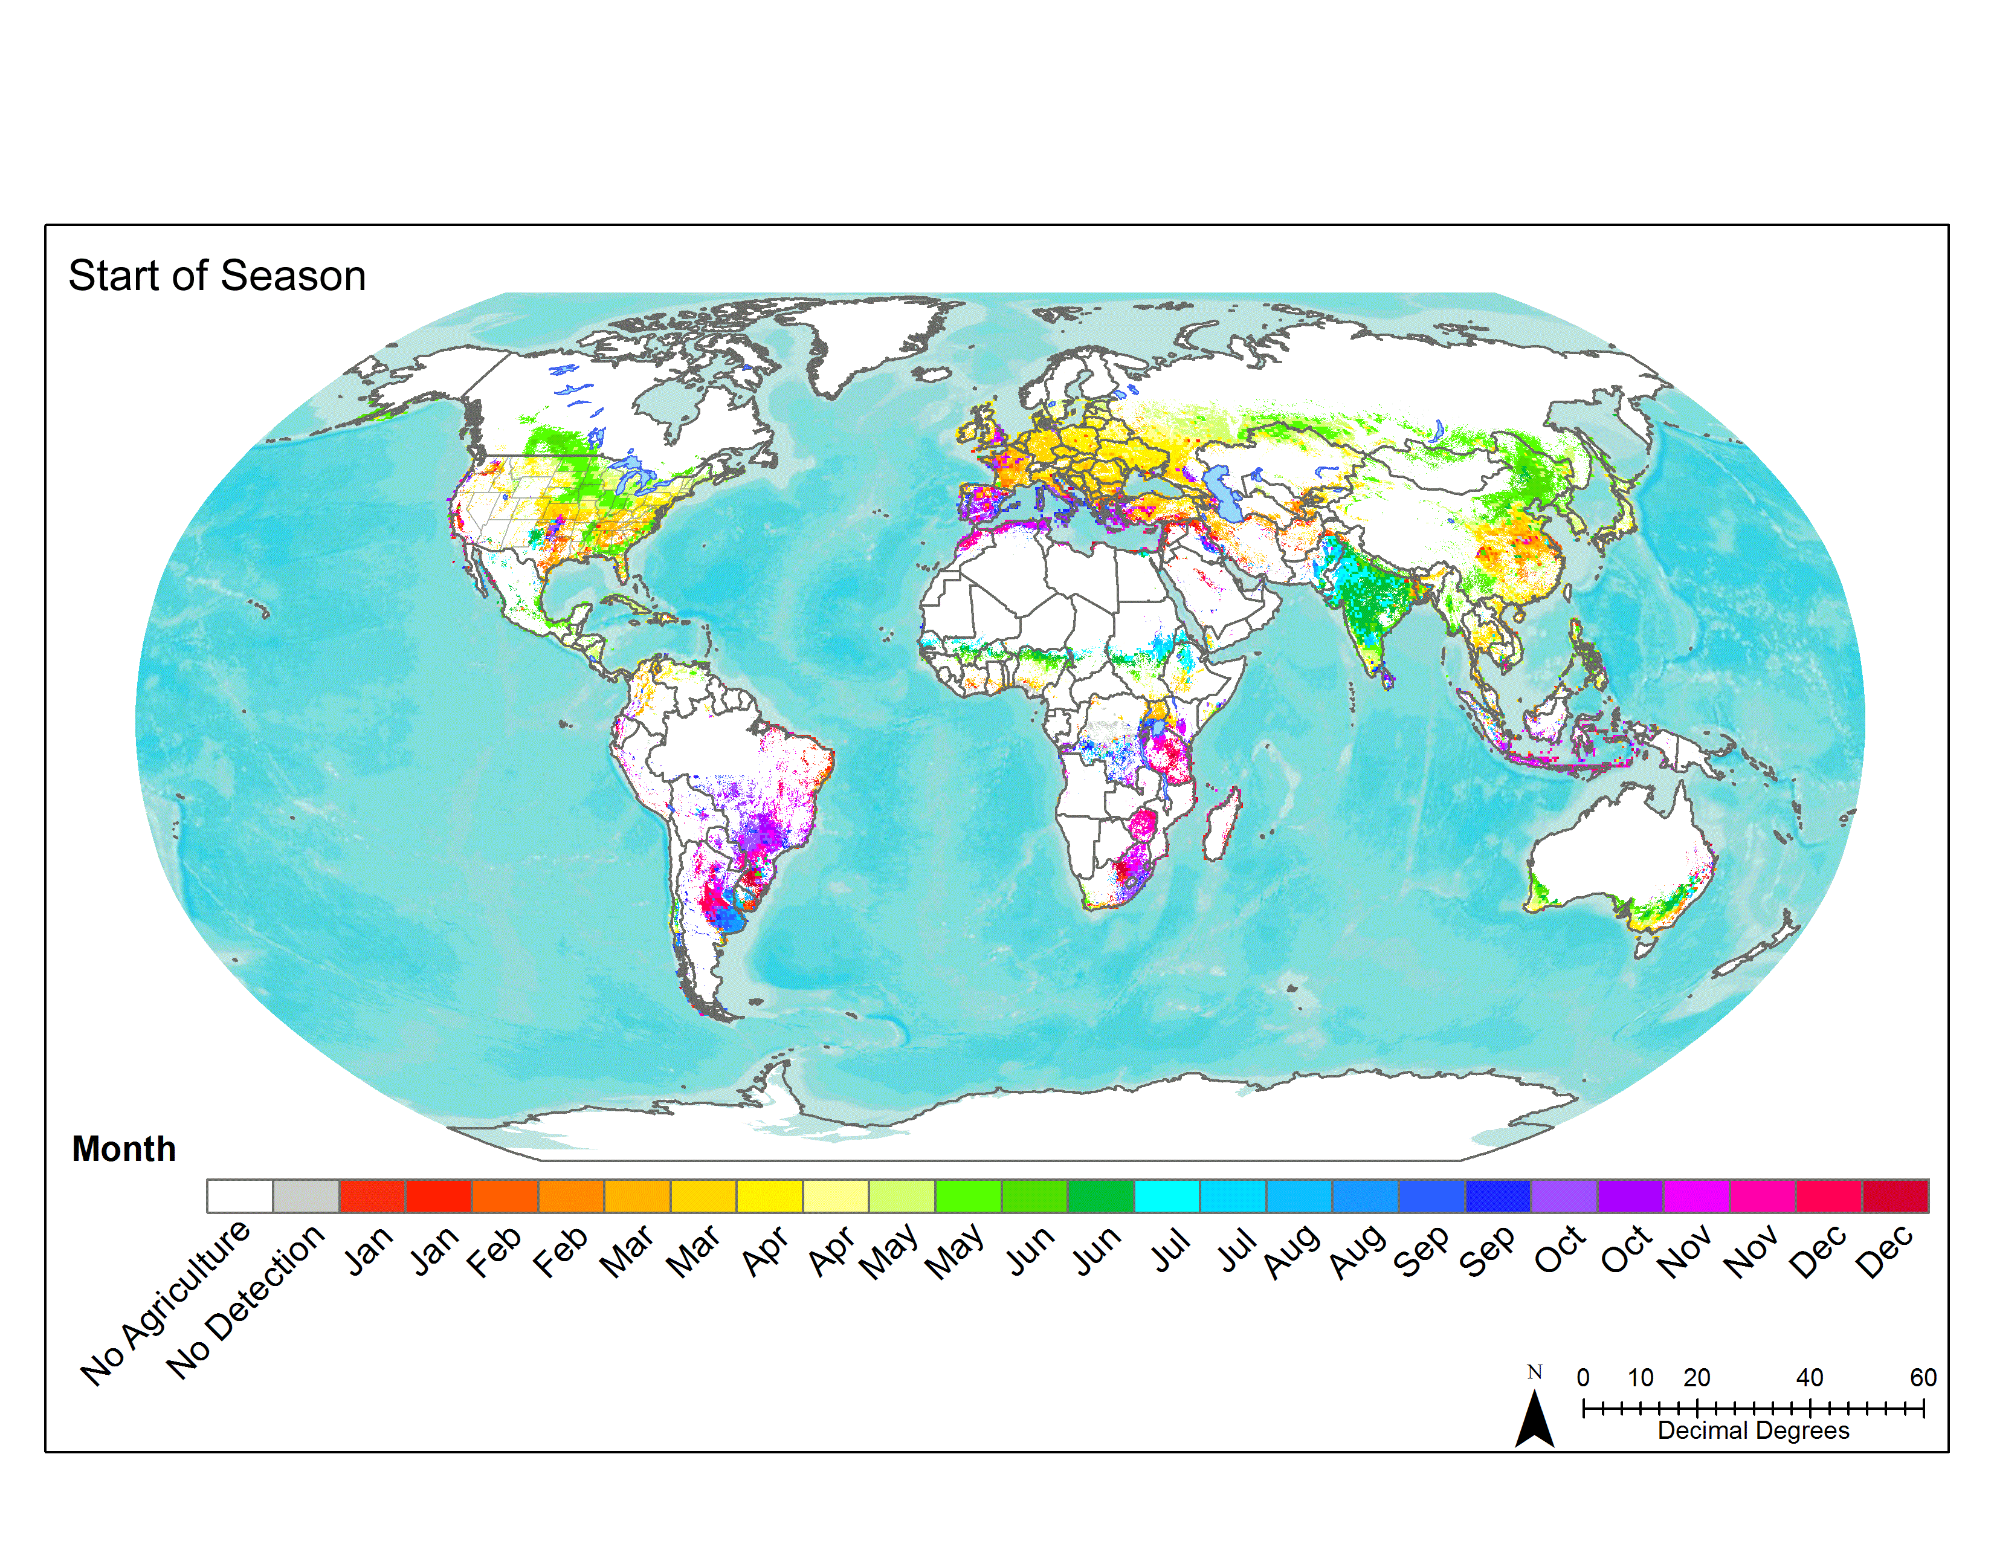
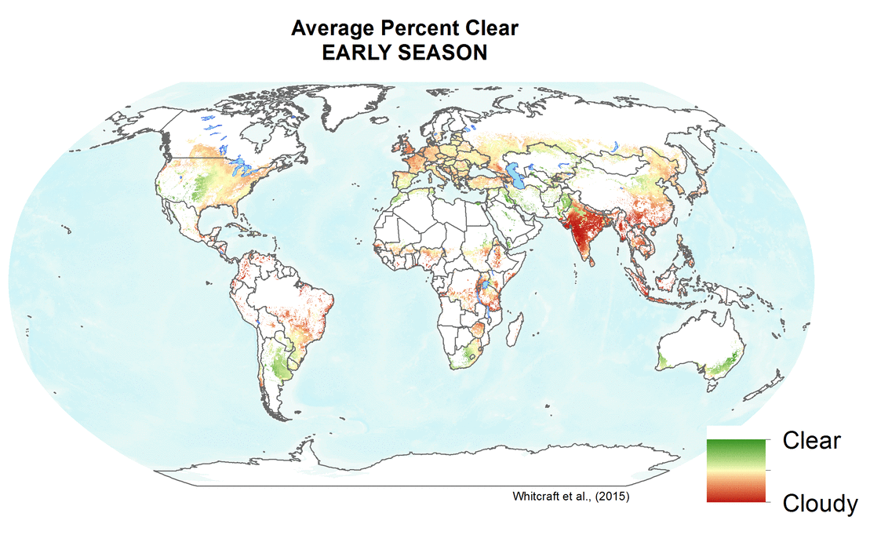
Requirements Summary: Timeline
2005-2010 Defourny Diagram
2012-2014 GEOGLAM Reqs v1
2016-2017
Reqs. v2
2017
Reqs. v2 process Update
2018
Finalize Reqs. v2
  Conceptual requirements
  Spatially explicit requirements by product/variable and by sensor type
  CEOS AHWG on GEOGLAM
  Question template to R&D sites
  New variables
  Minimum vs. preferred
  LSI-VC Coordination
  Discussion of R&D results, recognition of need for operational perspective
  State of use unknown
  LSI-VC Coordination
  Survey deployed
  National, Regional, and Global Users
  Platforms for Use
  LSI-VC Coordination

Slide 4


Timeline of Meetings, Actions, and Decisions on the question of the future of the
CEOS Ad Hoc Working Group on GEOGLAM
Sep-18 Oct-18 Nov-18 Dec-18 Jan-19 Feb-19 Mar-19 Apr-19 May-19 Jun-19 Jul-19 Aug-19 Sep-19 Oct-19
Telecon
Annual Meeting
CEOS Plenary
Core Group Meeting on Future Options
CEOS SIT
CEOS SIT TWS
CEOS Plenary
Meetings
Respond to Req. v.2 and Evaluate CEOS-Ag future Options
Present Update on Req. v.2 Response and Fut.
CEOS-Ag Options to SIT
Present Req. V.2 Response and Future CEOS-Ag Recome-ndations to SIT
Final Present-ation to Plenary
Actions
Develop Draft of Response to Req. v.2 and Develop Options for Future CEOS-Ag, including interactions with other groups in CEOS
Evaluate Req. v.2 Response and Future CEOS-Ag Options, with SIT comments.
Feedback from CEOS on GEOGLAM AHWG
Finite Set of Options Developed
SIT feedback on Req. v.2 Response and Future CEOS-Ag Options
SIT Assess Req. v.2 Resp. and recom-mend a CEOS-Ag Option
Approve Req. v.2 Resp. and Decision on CEOS-Ag Future
Decisions

Slide 5
Requirements and AHWG Future

Slide 6
Requirements V.2 Highlights
GEOGLAM Requirements V.2 Complete
CEOS Strategic Response by Plenary 2019
Highlights for CEOS:
Large demand for dense, moderate-high resolution optical time series [usually requested as NDVI]
  To realize this, interoperability (space, time) in moderate resolution domain is critical
Integrated observable/advanced products growing
  Need for curation of EO data to ensure product quality and usability
  Need standard agricultural products in support of policy drivers
  Need understanding of CEOS agency plans for - “the Cloud”, big data, machine learning, expanding open data, commercial providers
In situ data remains as a critical need
Need to coordinate across lifecycle of data & use (inc. Cap Dev)
Direct impact of non-optical data growing (Thermal, LiDAR, Radar, Microwave, etc)
Increasing communication between info producers and end users is a priority
  Value of EO needs continued attention from the GEOGLAM – CEOS collaboration

Slide 7
Original Requirements Table (2012-2014)

Slide 8
Updated GEOGLAM Observation Requirements

Slide 9
Requirements that can be traced to use
 | Table 1: Core Information Product (TBC) | Spatial Resolution, Accuracy, and/or Precision | Frequency of Production | End Use: Knowledge & Sustainable Decisions Supported
1 | Cropland mask | 300m to 3m | Monthly within season | State and Change: Federal/State land use policy; infrastructure investment; statistics; SDGs, climate change impacts
2 | Irrigated vs non irrigated cropland | 300 to 3m | seasonal | Water management and monitoring; SDGs (water use efficiency)
3 | Crop type map | 300m to 3m | Monthly within season | Fed/State/Int’l Market information; infrastructure investment; supplement/replace survey statistics; SDGs, climate change impacts
4 | Crop type area | Admin Level 1, +/- 10% | Every 2 months within season | Market information; supplement/replace survey statistics on production; logistics planning; food security-early warning
5 | Crop condition | 300m to 3m | 1-2 weeks | Market information; food security-early warning; Fed/state policy and program response; production insurance
6 | Crop yield forecast | Admin Level 1, +/- 10% | Monthly throughout season(s) | Market information; supplement/replace survey statistics on production; logistics planning; food security-early warning; SDGs; climate change impacts
7 | Crop Yield Estimation | field level | Seasonal, post-harvest | Market information; supplement/replace survey statistics on production; logistics planning; food security-early warning; SDGs; climate change impacts
8 | Rangeland and pasture mask | 300m to 3m | Seasonal | State and Change: Federal/State land use policy; statistics; SDGs, climate change impacts
9 | Rangeland and pasture condition assessment | 300m | Monthly throughout season(s) | Food security-early warning; SDGs; climate change impacts

Slide 10
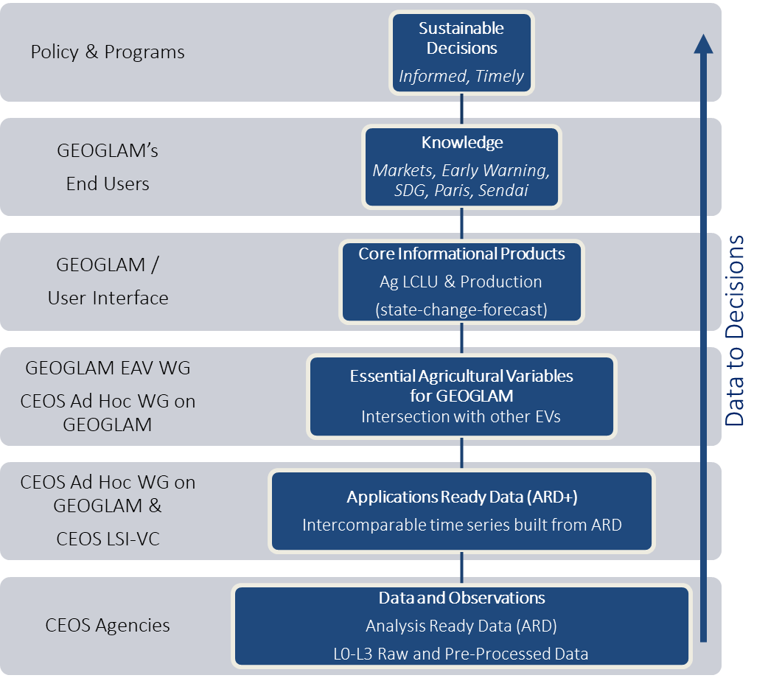
Tracing Data to Decisions
GEOGLAM EO Process Vision
EO Data Coordination TCT within GEOGLAM
UMD, VITO, UCL, AAFC, JRC, RADI, CESBIO, INTA
Next steps:
GEOGLAM to ratify ARD+ definition, EAV definition, Core Information Products Definition
For CEOS GEOGLAM AHWG:
Initial mapping to relevant actors at left side of graphic → in review
Objective: Extend the value of CEOS observations into specific services, leveraging current CEOS agencies satellite assets
Broader collaboration on Data Services needed (e.g. Cube, WGISS)
In Review
Notes:
The template asked for activities beyond the AHWG’s capacity and what activities could uniquely be supported by CEOS – I think this is a key example, and we’ve mapped how we see it on the left side of the diagram.
To support the development of EAV’s a coordinated effort between GEOGLAM and the CEOS Working Group Calibration/Validation’s Land Product Validation (LPV) sub-group would be enormously beneficial to enable GEOGLAM to provide information support to the various users of GEOGLAM data as well as to the global policy frameworks enumerated in the previous paragraph. The GEOGLAM JECAM sites, which have the benefit of coordinated CEOS data acquisitions, would be ideally positioned to initially facilitate LPV activities associated with the EAV’s. The JECAM sites could be augmented by additional sites in nations that are already doing operational monitoring (e.g. China, Canada, Ukraine, Argentina). Such a coordinated effort would inform best practices, enhance rigor, and promote clarity around the value of EO to the SDG community, which is currently led and dominated by the statistical census and field survey community. It is suggested that the joint CEOS Ad Hoc WG on GEOGLAM be tasked with developing the community requirements and outlining validation protocols for these variables.

Slide 11
Actions
GEOGLAM AHWG preparing response to GEOGLAM updated requirements
  Preliminary internal review on-going
  Preparation for CEOS space agency requests for feedback initiated
  Preparation for CEOS working group requests for feedback initiated
GEOGLAM AHWG preparing resource/responsibility plan for CEOS Workplan
  Identify agency support for CEOS Workplan actions

Slide 12
Ad-Hoc Transition Options
Transition GEOGLAM Ad-Hoc Working Group activities to LSI-VC
Transition GEOGLAM Ad-Hoc Working Group to another existing or new Working Group
Transition GEOGLAM Ad-Hoc Working Group to stand-alone GEOGLAM Working Group
Terminate GEOGLAM Ad-Hoc Working Group at 2019 Plenary
Continue as an Ad-Hoc Working Group
Evaluation Criteria
Permanent and Recognized by CEOS Principles
Sustainable / Efficient
Effective

Slide 13
Ad Hoc Lifecycle Potential Options
with preliminary review
Transition GEOGLAM Ad-Hoc Working Group activities to LSI-VC
  VC not structured to address robust user interactions - ToR in Review
  LSI-VC reporting different from GEOGLAM AHWG - ToR in Review
  LSI-VC coordination and co-meetings provide efficiencies
  LSI-VC observations currently cover a majority of GEOGLAM needs
Transition GEOGLAM Ad-Hoc Working Group to another existing or new Working Group
  No current WG that could absorb GEOGLAM activities without significant reorganization
  Recently proposed WG structure still in review
Transition GEOGLAM Ad-Hoc Working Group to stand-alone GEOGLAM Working Group
  Significant effort needed by space agencies to support a new WG
  Significant current and potential redundancies with other thematic activities
  GEOGLAM has growing interactions with SDG’s, Sendai, Paris

Slide 14
Ad Hoc Lifecycle Rejected Options
with preliminary review
Terminate GEOGLAM Ad-Hoc Working Group at 2019 Plenary
  GEOGLAM loses an formal CEOS relationship, which is an effective and efficient method of coordinating and communicating needs and capabilities between multiple space agencies.
  CEOS loses a successful interface with an important global application and community
Continue as an Ad-Hoc Working Group
  Contrary to CEOS organizational framework and guidelines
  Difficult to attract support and ownership from space agencies as a “temporary” WG

Slide 15
Actions for Plenary
For Endorsement: the CEOS Strategic Response to GEOGLAM Requirements
For Decision: Future of CEOS AHWG on GEOGLAM

Slide 16
BACK-UP

Slide 17
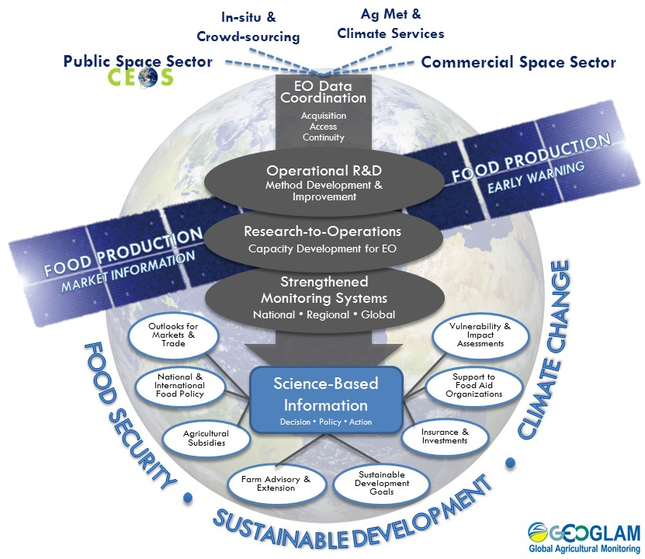
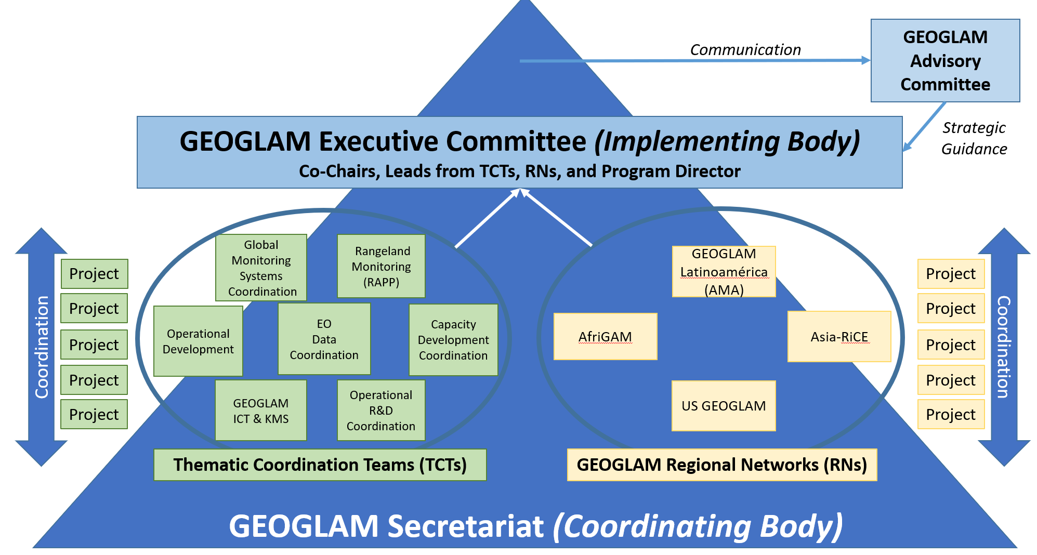
EO Data Coordination Central to GEOGLAM
Reference Information Links
Summary of the GEOGLAM Workshop on Data Systems Requirements for Operational Agricultural Monitoring
Brief Summary of GEOGLAM Requirements Reboot
GEOGLAM’s G20 Stocktaking Report 2019
GEOGLAM
focused on EO Coordination

Slide 18
GEOGLAM now has a Thematic Coordination Team on
“EO Data Coordination”
This is where the main tasks that have been handled by the AHWG will live.
  Collecting acquisition Requirements
  Strategic interactions with space agencies and CEOS
  Work on things like ARD+, EAVs definition
  Link to space agencies
CEOS support is still integral.
  Characterizing CEOS capacity to support acquisition and access requirements
  Coordinating acquisition and access to satellite data
  Collaboration on ARD+ and EAVs – e.g. via LSI-VC and LPV
  Coordination across capacity development efforts
  Coordination on “the cloud”

Slide 19


Teams
General Coordination Facilitated by GEOGLAM EO Data Coordination lead & a designated CEOS Lead
Teams
Capacity Development
Agriculture EO Cap Dev
WG Cap D
R&D
EAVs (LPV)
WG Cal Val
ICT
Operational Systems Enhancement
- “The Cloud”
- Data Cubes
- Data Requirements
- Data Requests
- QA/QC
LSI-VC, SEO, FDA
EO Data Coordination & Management

