Slide 1
WG Disasters Observation for Disasters
Committee on Earth Observation Satellites
Simona Zoffoli, ASI, WG Disasters Chair
CEOS SIT-34
Session 4, Agenda Item 4.5
Miami, FL, USA
3 – 4 April 2019

Slide 2
Linkages to CEOS Work Plan
CEOS Workplan 2019-2021 v1 – WG Disasters, 9 deliverables
GEO Initiatives
GSNL, DIS-10 Data coordination for GSNL
GEODARMA, DIS-15, Identification of DRM priorities
CEOS WG Disasters DRM Initiatives
Landslide Pilot, DIS-16, Final report
Recovery Observatory, DIS-12 (early evaluation), DIS-22 (final rep.)
Volcano Demonstrator, DIS-18 (report)
Seismic Demonstrator, DIS-21 (report)
CEOS WG Disasters Cross-cutting Initiatives
GeoHazards Lab, DIS-19 (e-collaboration), DIS-20 (standardiz.)
WG Disasters has no open SIT and Plenary actions. Coordinates with NOAA and WGCapD on the flood monitoring initiative for GEO-LEO (see session 3, item 3.7)

Slide 3
WG Disasters Achievements
Major achievements since SIT-33
Thematic products for Recovery
Products for landslide monitoring and deformation mapping
Advanced science products for crisis response (i.e. Hawaii/ Sulawesi, Indonesia/ Zakynthos, Greece, Nepal)
Validation of methodology for new products generation
Facilitated data access and processing
Launch of the Generic-RO ad hoc team (UNDP/GFDRR/WB/EC)
Approved the continuation of Hawaii and Enceladus Supersites
Engagement with End Users
Collaboration with mission operators to optimize EO coverage
Promoted awareness raising (Understanding Risk, Cities on Volcanoes, AGU, LPS, EGU) and capacity building activities (on site training in Haiti, South America, Greece)

Slide 4
WG Disasters Planned Outputs
Planned future outputs
Review existing Working Group Terms of Reference
Review and update of Consensus Report/ EO for DRM Strategy (consider new themes, e.g. coastal risk, climate change impacts, cascading risk, risk vs hazard,..)
Input to GEO workplan, Community Activity “EO for DRM”
Consolidate cooperation with Charter
Landslide final report
Recovery Observatory early evaluation report
Advocacy paper on G-RO, and planning collaboration with UNDP, GFDRR/WB, and EC on future recovery efforts
Volcano Demonstrator Implementation Plan
GSNL review of SAF NL, Virunga and Southern Andes Supersites

Slide 5
Synergies Among Teams
Started the practice to invite others WGs to WG Disasters meetings
Remote participation of WGISS Chair the WG Disasters #10
Joint Session (by telcon) with WG CapD at WG Disasters #11.
Shared deliverables of mutual interest. WG CapD will consider WG Disasters collaboration in their next CEOS workplan.
Coordination with NOAA and WG CapD on GEO-LEO flood monitoring initiative
Started looking at synergies between CEOS ARD effort and WG Disasters initiatives
Coordination and exchange of good practises between working group Disasters teams

Slide 6
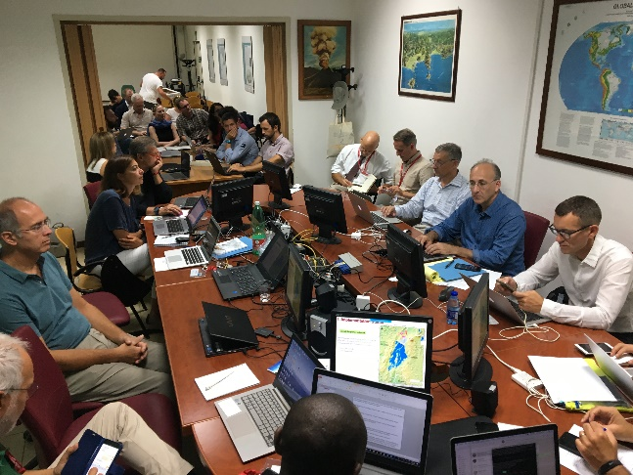
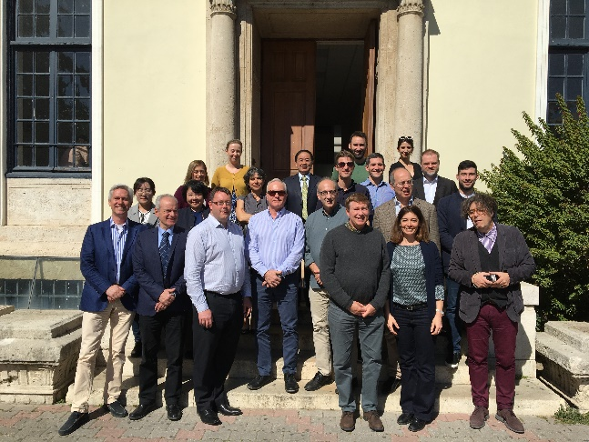
Sustainable Commitment
WG Disasters meets two times per year, bimonthly telecon.
Last two meetings held in September 2018 in Naples, Italy and March 2019 in Athens, Greece.
Total of 20-25 attendees
Strong implication of organisations outside CEOS as intermediary and end users (e.g. BRGM, INGV, NOA, WB, Universities, Volcan. Observatories…)
Active Agencies:
America: CONAE (recently joined), CSA, NASA, USGS
Europe: ASI, CNES, DLR, EC, ESA, UK SA
Asia-Pacific: CAS
Africa: none
Global organizations: GEO, UNOOSA, UNDP, World Bank/ GFDRR
Opportunity for dedicated efforts on CEOS activities is always a challenge (as is the case for all WGs)

Slide 7
Consideration for SIT TW and Plenary deliverables
Need increased engagement from other CEOS agencies
Right time: WG Disasters is reviewing its ToR and DRM observation strategy – new agencies with disaster activities are welcome!
Varied participation/different level of commitment
Gap Analysis
Demonstrate methodologies, techniques and tools
Data contribution (i.e. L-band SAR, high resolution DEM, high resolution radar and optical data, ..)
Capacity building and awareness raising
Draft ToR planned for discussion at the next SIT TW

Slide 8
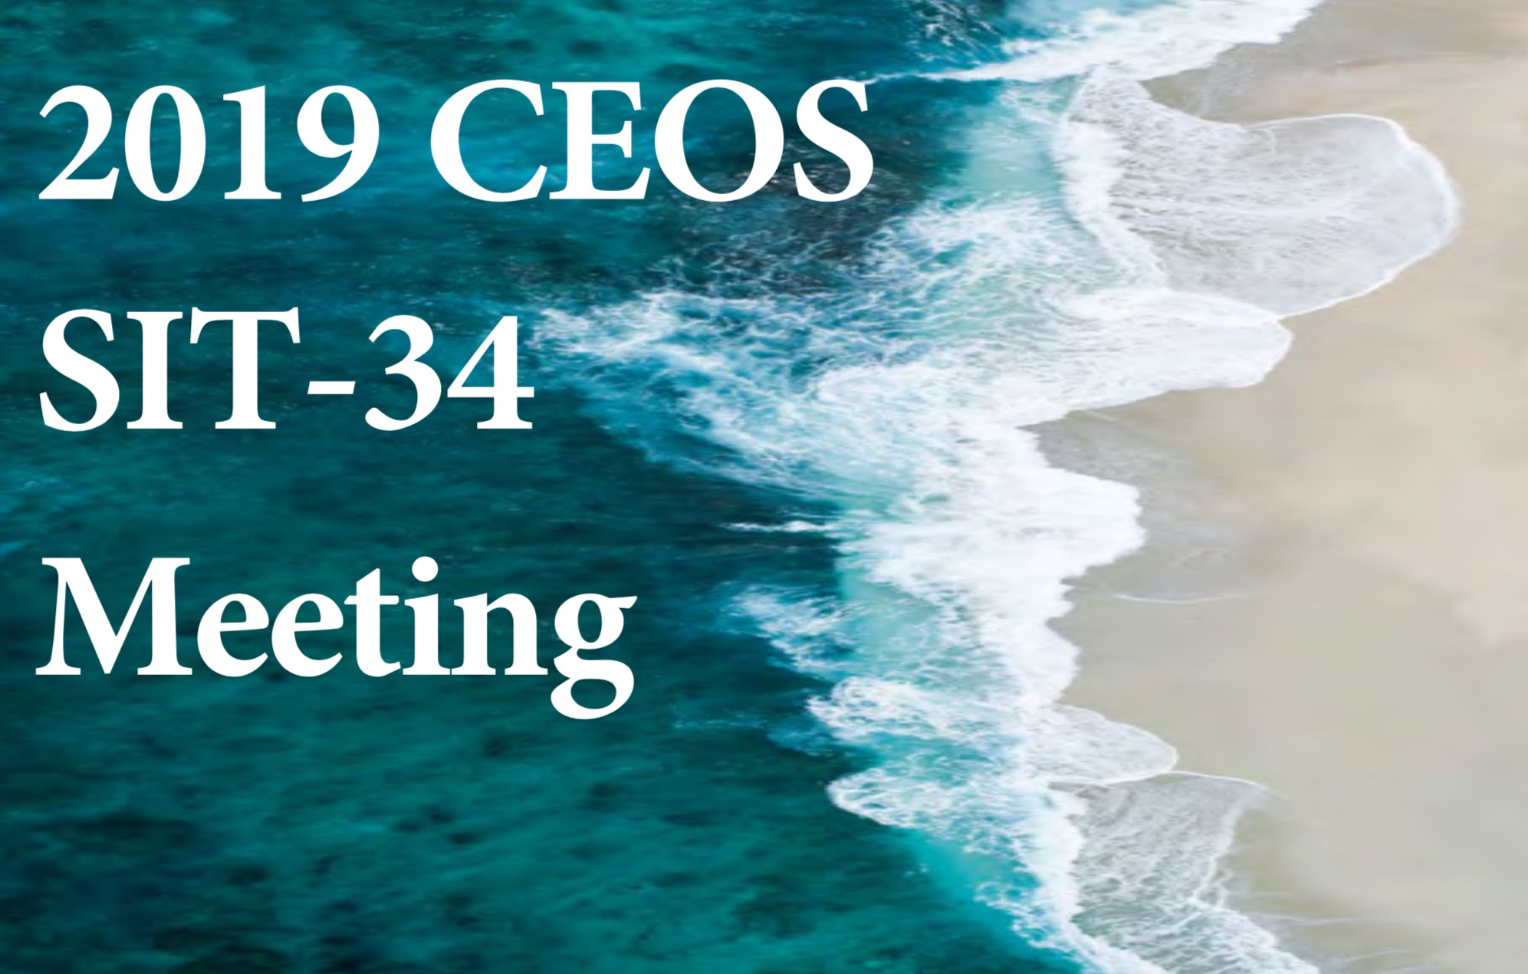
Thanks!
Questions?
simona.zoffoli@asi.it
david.green@nasa.gov

