Slide 1

Space Climate Observatory
Committee on Earth Observation Satellites
Dr. Selma CHERCHALI, CNES
CEOS SIT-34
Session 4 Observations for End Users
Miami, FL, USA
3 – 4 April 2019

Slide 2
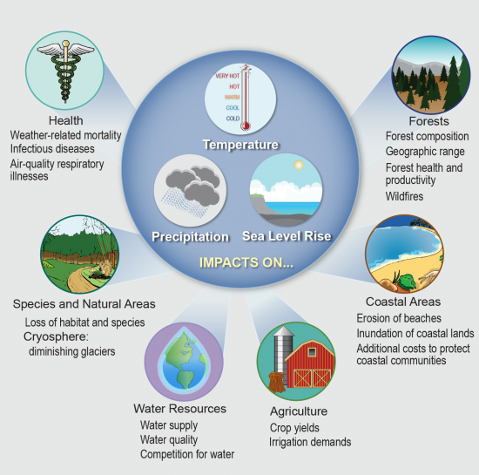

Space Climate Observatory
SCO Concepts – Need for a coordinated assessment of Climate Change Impacts
Potential effects of climate change
What are we going
to do?
Source. Climate Change Impacts in the United States: The Third National Climate Assessment

Slide 3
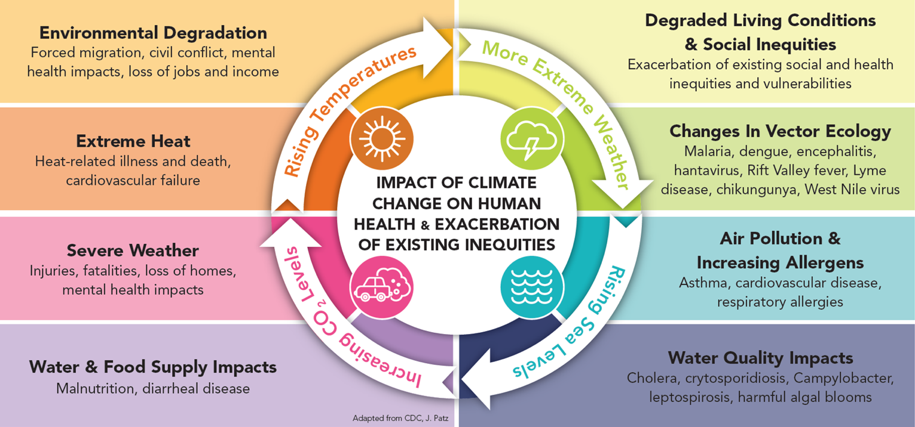
Space Climate Observatory
SCO Concepts – Need for a coordinated assessment of Climate Change Impacts
Societal Impacts

Slide 4



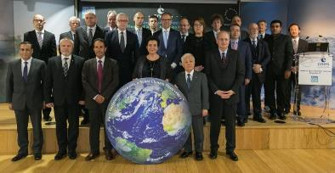
Space Climate Observatory
SCO Concepts – Need for a coordinated assessment of Climate Change Impacts
SCO Policy Drivers
Illustration by David Parkins
Nature 514, 30–31, Oct. 2014
…
One Planet Summit – Paris, December 11th, 2017
October 2018 : CEOS Statement of Space Agency Contributions in Support of the Paris Agreement : Adaptation : confirm the crucial role of space observations and
Their role helping to establish facts that can be used to determine key impacts on vulnerable sectors, geographical zones, and also incurred cost resulting …

Slide 5
Space Climate Observatory
SCO Concepts – Main Objectives
“Space Climate Observatory”
A world observatory of
the climate change and its impacts
  Satellite data
      Earth observations at regional, national and local level
      … and in-situ data, research modelling
  Climate change and its impacts
      Humankind, both as anthropogenic causes and as the victims of the impacts (temperature increase, sea level rise and hazards…)
  a joint Observatory
      A World Heritage system
  http://spaceclimateobservatory.org
  With Use cases (9 scenarios)

Slide 6
Space Climate Observatory
SCO Concepts – Main Objectives
  Respond to Adaptation needs through international coordination
  A global monitoring of CC impacts is so far poorly structured
  Case studies in various contexts have been developed but
    Many methodological approaches are challenging and/or not shared
  Contribute to the assessment of impacts of CC in different SBA (water, food security, coastal areas, air quality,..)
  Precise impact’s CC monitoring
    Regional, National, Local scale
    Will raise awareness, stimulate and support decision making
Required international coordination specifically focused on impacts of Climate Change

Slide 7


Space Climate Observatory
SCO Concepts – Main Objectives
Principles
  Science based Program
  Not alone !
      A country, an agency, an institution…
      could not make it for all the World/Planet
  Involvement and cooperation with wide range of bodies
      GEO, CEOS, CGMS and UN Agencies
      National organizations, Ministries, local entities…
  Building on the exiting capabilities and programs
  Co-construction
      At international but also national level
        Across sectors, institutions, research community, and sub-national area (territories)
      At level of populations
        Metrics and social indicators to measure the appropriation and acceptance by stakeholders
      Communities of development (Sharing of capabilities (expertise, computing)
      Make available to others, freely
      Exchange of use, best practice
CO DESIGN

Slide 8
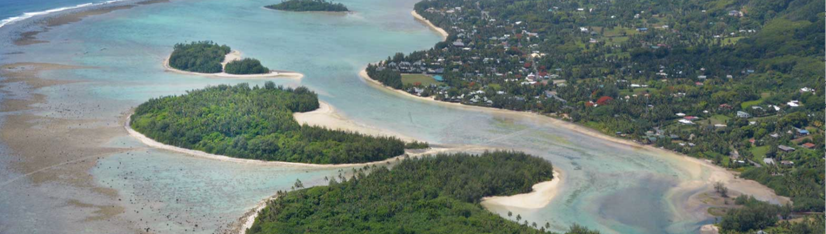
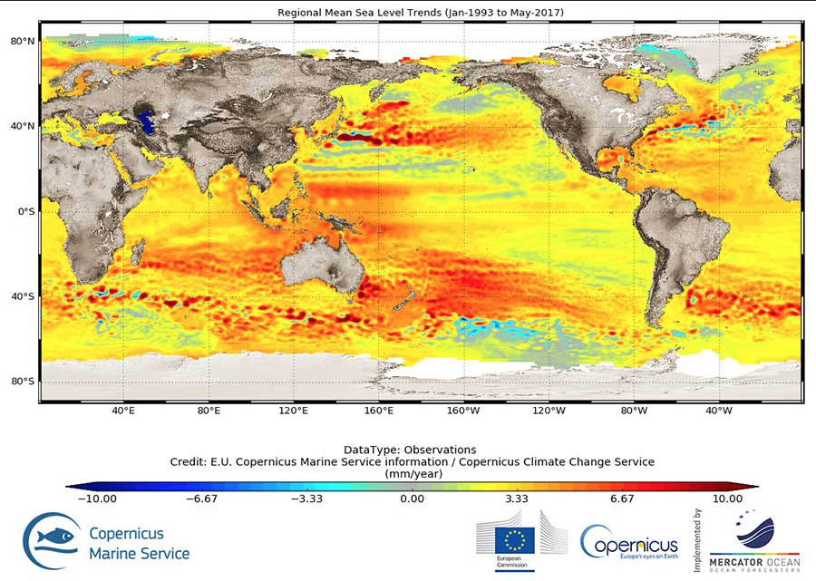
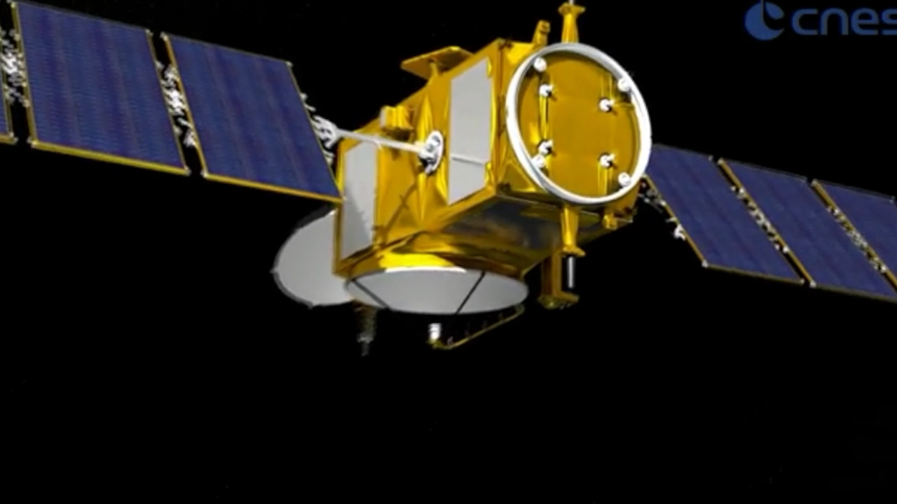
Impact of climate change on sea level rise
and the coastal vulnerability of the South-East French coast in Palavas-les-Flots
Sea level rise from 1993 to 2017
Altimetry, imagery, geodesy: 34 satellites in play
to observe seas and coasts.

Slide 9
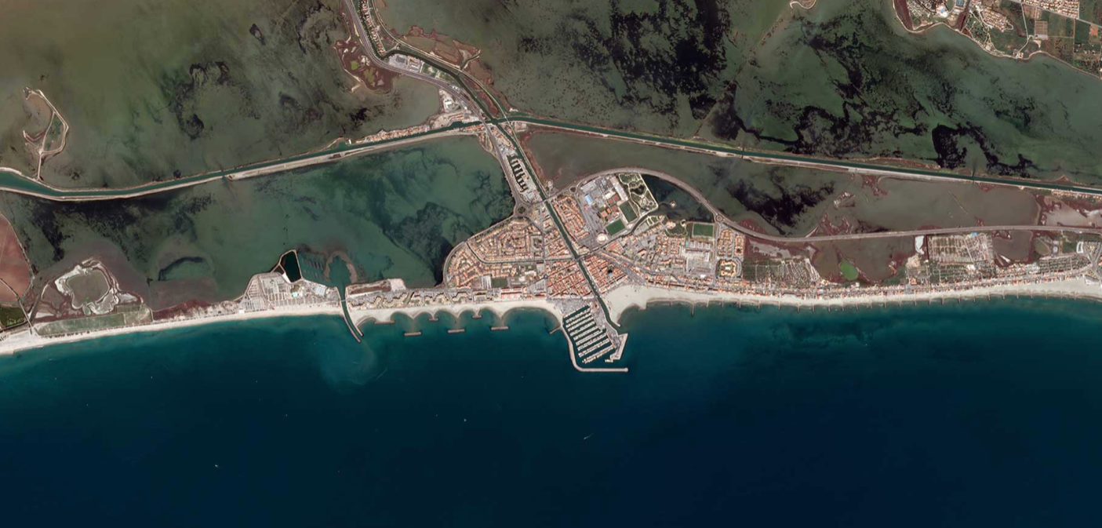
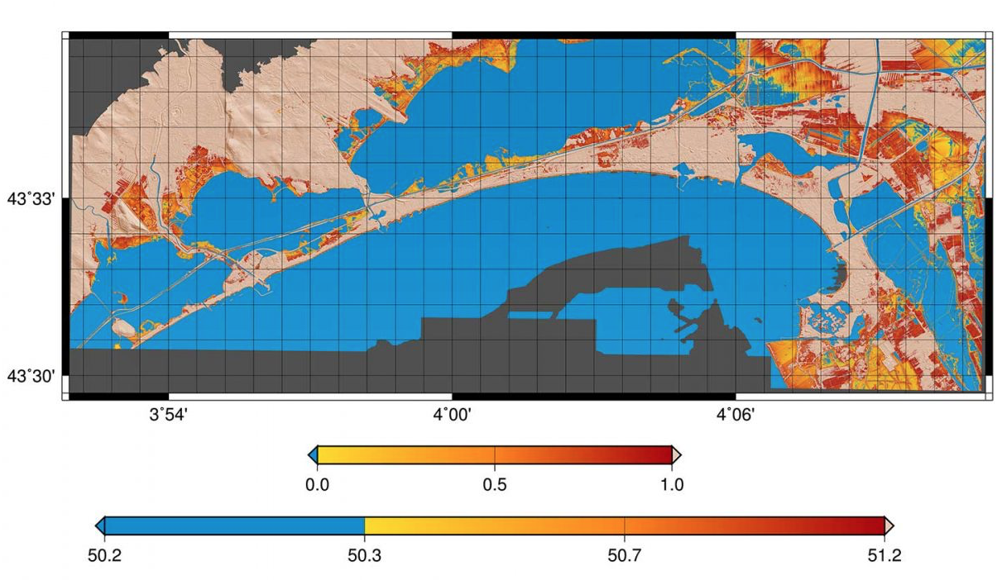
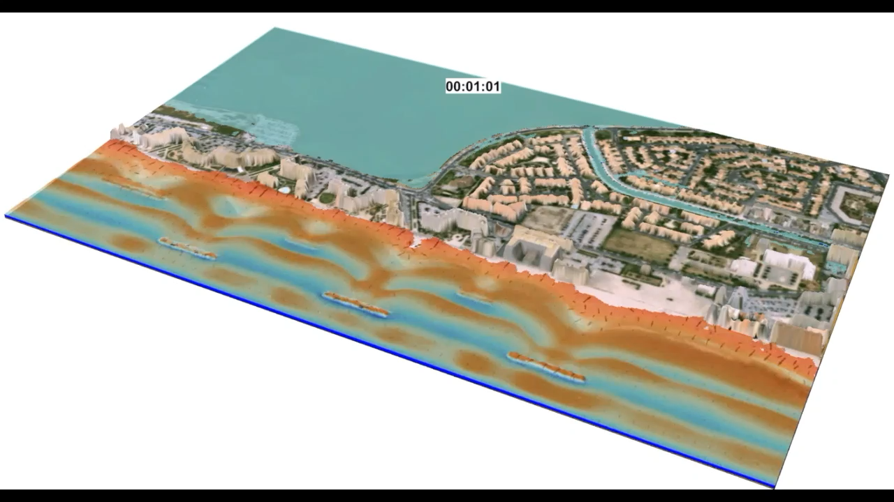
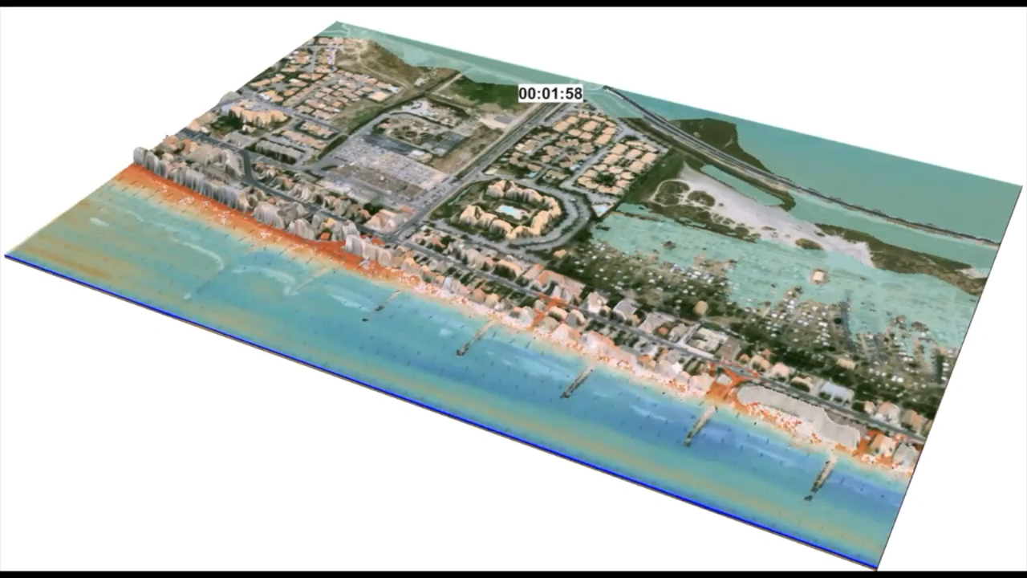











DTM made from a couple of Stereoscopic Pleiades images
Sea level and DEM combination for the assessment of the local vulnerability to submersions under 1 m rise in sea level
Sea level and DEM data combination for the assessment
of the local vulnerability (Simulation of the 1983 storm + 35 cm)
Modeling of the 1983 storm (c)
R. Pedreros, S. Lecacheux, C. Vinchon - BRGM
Le Cozannet G., Garcin M., Yates M., Idier D., Meyssignac B. (2014), Approaches to evaluate the recent impacts of sea-level rise on shoreline changes, Earth-Science Reviews, 138, 47-60. doi: 10.1016/j.earscirev.2014.08.005

Slide 10
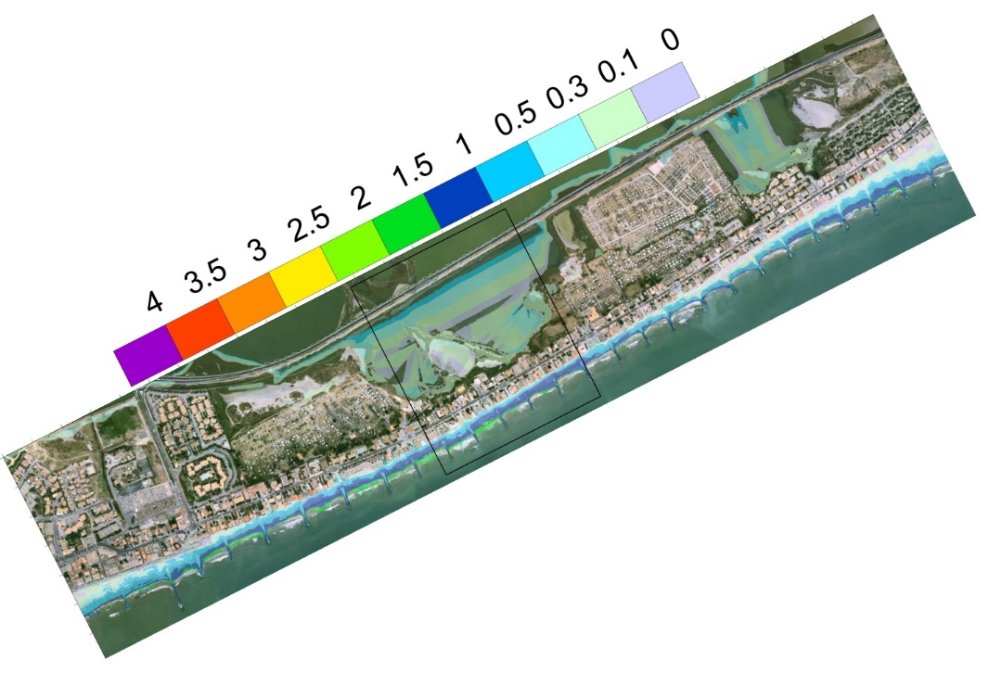
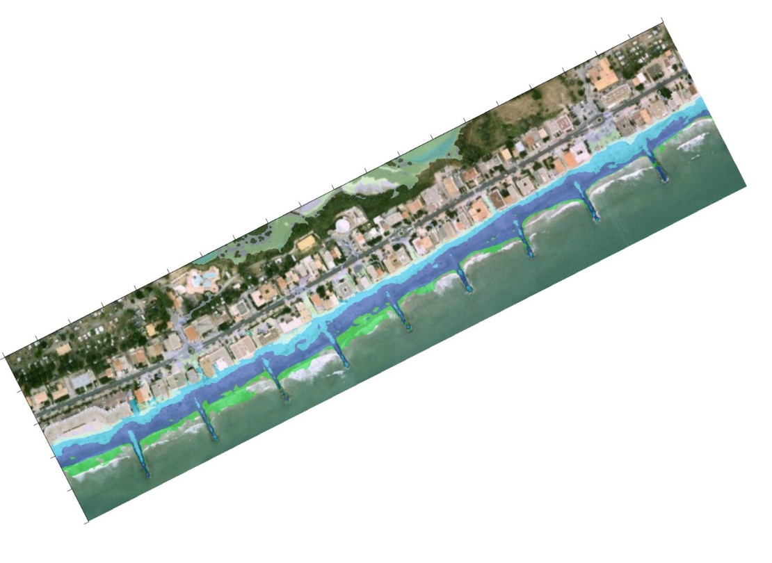
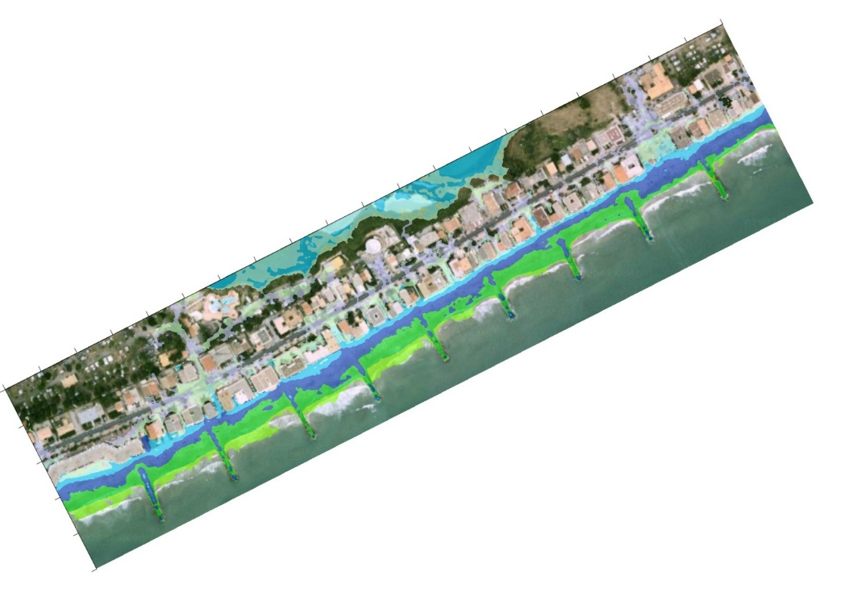

Impact of medium/high sea level scenarios
Nicholls and Cazenave (2010), Sea-Level Rise and Its Impact on Coastal Zones, Science18 Jun 2010 : 1517-1520
Cazenave, A. and Cozannet, G. L. (2014), Sea level rise and its coastal impacts, Earth’s Future, 2: 15-34. doi:10.1002/2013EF000188
m
With +1m Sea level rise, the entire urbanised sand-spit could be almost completely flooded during a 1983-like storm !
Simulation of 1983 storm
+35cm Sea level rise
Courtesy of R. Pedreros,
S. Lecacheux, C. Vinchon (BRGM)
+1m Sea level rise

Slide 11
Space Climate Observatory
SCO Concepts – Main Objectives
Precise impact’s CC monitoring
    Regional, National, Local scale
  By making full access, use and benefit of multi-source data
    Best use of synergies between data providers (from satellite, in-situ, model, socio-economic research)
  Co-construction of both knowledge and expertise (scientifically, technically and geographically)
    Products and services
  Develop effective and relevant communication/outreach activities and educational measures
    Will raise awareness, stimulate and support decision making

Slide 12
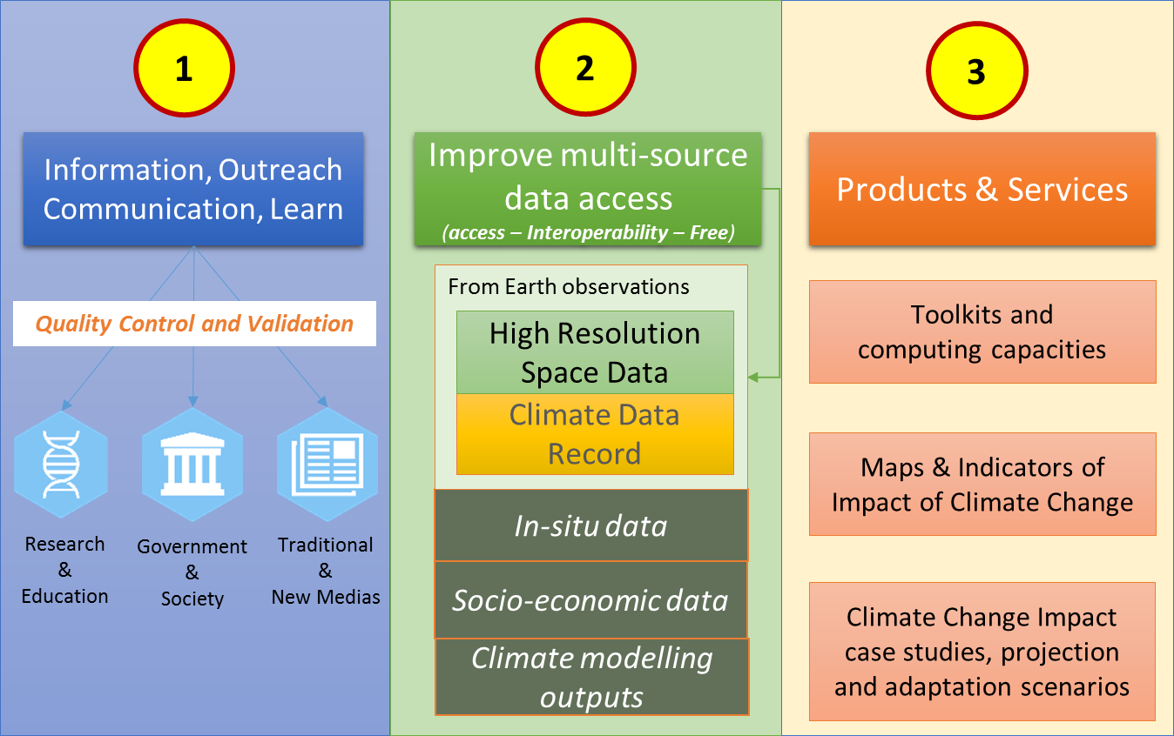
Space Climate Observatory
SCO Concepts – Main Objectives

Slide 13
Space Climate Observatory
2 – Data access
By making full access, use and benefit of multi-source data
Satellite EO data
(global & fine scales)
Derived EO Products
(Land use, DEM, water…)
ECVs
In-situ data
Models data
Climate Data Records
Climate Change Impact
Maps &
Indicators
of Impact of CC
+
Socioeconomic data
Climate Projections
CEOS letter response on a better clarification of SCO outputs

Slide 14
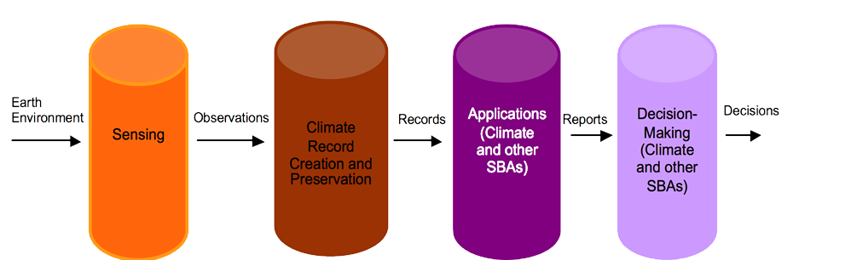
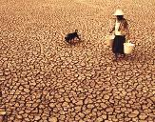

Space Climate Observatory
SCO Concepts – SCO the international landscape
Feedback
ECVs
ECV inventory and gap analysis
Regular updates carried by CEOS-CGMS WG Climate (last exercise : 2016 - 2017)
Improvement / extension of the datasets (e.g. CCI / CCI+)
C3S : ECV provider
Adapted from WIGOS-ICG 18/03/2013
Feedback
Reference Document: “Implementation of the climate monitoring architecture from space”, 2013

Slide 15
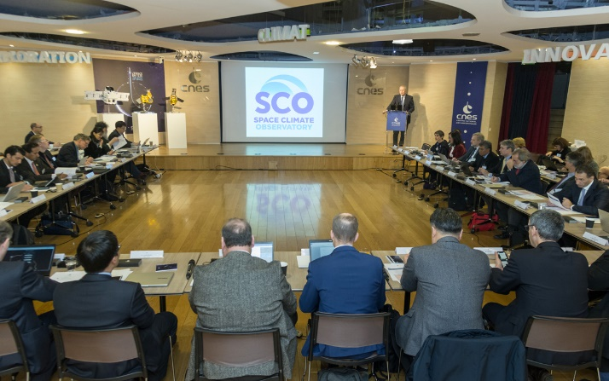
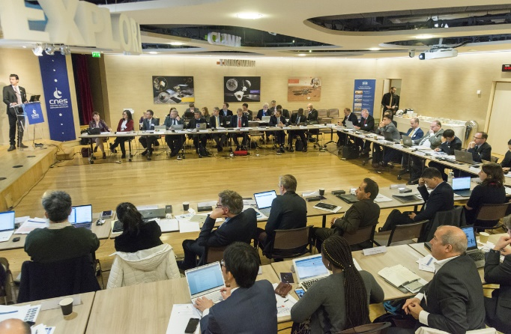
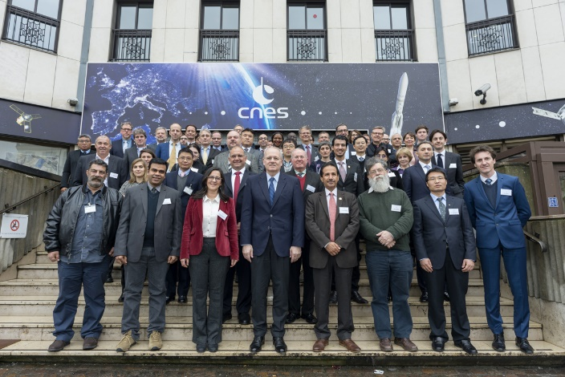
Space Climate Observatory
Space Climate Observatory Meeting Friday, 1st February 2019 - CNES, HQ, Paris
As requested by many partners, a SCO Program Definition Document has been elaborated and distributed before the meeting : international endorsement and open to contributions
    Ceremony Signature of the SCO
    Joint Declaration of Interest, Biarritz
    August 24-27, 2019
    Set up of a Steering Committee
SCO 1st International Meeting – CNES HQ Paris, 1st February 2019
  SCO 1st International Meeting – CNES HQ Paris, 1st February 2019
  More than 50 participants from all over the world
  Representing more than 25 national space and national agencies, and 4 international organizations (EC, UN entities, African Union)
  Very fruitful interactions which clearly demonstrates a common willingness to act together towards a common goal → joining forces and collaborating to address the monitoring of climate change impacts

Slide 16
Space Climate Observatory
Summary of the meeting – Concept , Perimeter and objectives
    Program definition document greatly appreciated
    The articulation of SCO with other international programs and initiatives is better understood (“pulling the same rope in the same direction”, “SCO really bridges a gap“, …)
    The focus on the climate change impacts (pillar 3 of the space-based architecture for climate monitoring) is highly appreciated ;
    It is recognized that there is a strong need to structure international collaboration on climate change impact monitoring
    Need to adopt the high-quality standards and guidelines that have ben developed (in particular in the frame of WG Climate for the production of the ECVs) for all information generated within SCO. Important for the credibility of the community and the consistency of the communication.
    SCO seen as a very good way to bridge the gap between science and society, and to develop trans-disciplinary collaborative research and development
    Essential to build upon local (e.g. traditional knowledge) / national expertise / tools / initiatives / infrastructures
    SCO could be a unique opportunity (“multiplier”) to “industrialize” or “replicate” local climate change impacts studies / use cases and generalize them massively.
    SCO is seen as a means to also catalyze national coordination and effort on CC impacts;
    SCO is seen as a very good way to obtain more feedbacks from end-users, maximize the use of CDRs and gain insight into the needs for future space programs and related observations (e.g. develop of new indicators).

Slide 17
Space Climate Observatory
Summary of the meeting – National experiences in CC impact assessments
  Contribution of spatial technologies/space capabilities in understanding, monitoring impacts of CC
  Develop of indicators for decision making processes
  Strong involvement of the research community in the development/validation/use of indicators
  Regional/national/local scales of key importance:
    Key interests/requests from local stakeholders,
    Easier coordination (e.g. implementation of regional RI Datahub/platform)
    Ready to use applications (end-users requests);
    Methods and best practices transferable.
    Make best use of existing initiatives and programs related to impacts CC (e.g C3S)
  Free and open data access promoted
  SCO program definition document : contributions from partners are very much welcome
  Everybody was invited to react to the draft Joint Declaration of Interest that has been proposed just after the meeting.

Slide 18
Space Climate Observatory
CEOS Response to SCO proposal – March 18th
Further definition of SCO Outputs :
    Improved multi-source data web-based access
      Free access to existing Data products generated outside the SCO
      Free access to Data products generated by the SCO and SCO Contributors
    Full description of Climate Change impact Case Studies performed
      Climate change impact descriptive sheets
      Open source code implementing the specifically designed impact study
The role of space agencies in particular within the national landscape ->SCO open to all partners , up to them to identify the representative at international level (see next slide – France example)
    Many countries are facing crucial lack of observations : space observations are key data to monitor impacts
    We could not manage what we could not measure
Avoid duplication with the existing climate services and data distribution mechanisms : SCO data distribution platform
    The architecture has to be defined and established taking into account the existing capabilities
GCOS, CEOS, CGMS, WMO members of the Observer Committee
    Already proposed in the SCO document : partners wish to discuss governance aspects within the Steering Committee
Future CEOS engagement on SCO will remain with the WG Climate chair as the governance structures are elaborated and become more mature
CDR, ECV are freely shared on a full and open basis: reaffirmed in the SCO program definition and in the Declaration

Slide 19









Space Climate Observatory
National contribution – France example
National
International
Cognitive
Science
AI
Human, Social and Economic Sciences
Pôle de données et de services
« IR Système Terre »
Climate Change
&
Impacts
I-Fr-SCO
Pôle de données ECOSCOPE
Structures Nationales
Big data
Socio-Economic
Data
Structures Européennes

Slide 20
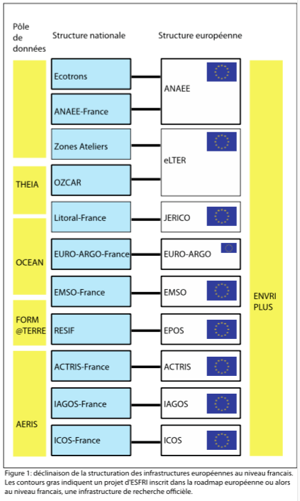
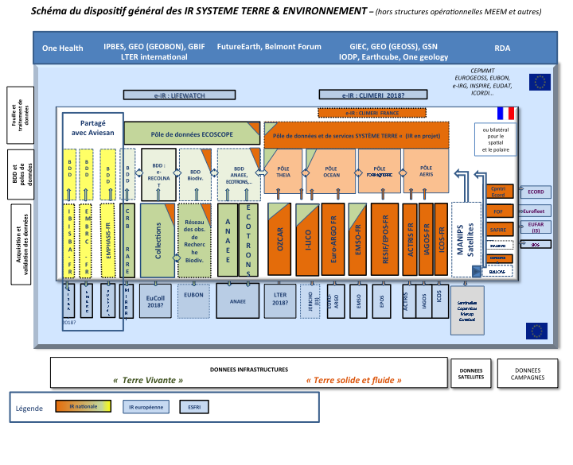
National Research Infrastructures – environment and earth system
Notes:
This slide, from the Ministry of Higher Education, Research and Innovation, is cult in France. It shows the complexity of the field of environmental sciences and the Earth system but also the coherent and original strategy put in place by France to structure and coordinate national research infrastructures as part of the IR and TGIR roadmap. national, European (ESFRI) and international.

Slide 21




Space Climate Observatory
SCO in the international landscape
Nairobi 8-10 March 2019 - 2nd Global Session of the
UN SCIENCE-POLICY-BUSINESS FORUM ON THE ENVIRONMENT
SCO Presented at the opening and closing of the 2nd SPB Forum Session
SCO Confirmed as a model project by the SPB Forum Data Working Group chaired by Gilberto Camara (GEO)
GEO Secretariat proposed that SCO GEO Initiative (under evaluation) participates to the GEO Knowledge Hub
Nairobi 8-10 March 2019
SCO Presented on the SPB Forum Stand with scenarios and use cases presented
SCO Presented on the World Situation Room Stand as an example of scientific & data input
Nairobi 14 March 2019
3rd Edition of the One Planet Summit

Slide 22
Space Climate Observatory
Next steps
  SCO proposed as a GEO initiative : workprogram 2020-2022, under evaluation
  A final version of the Joint Declaration of Interest submitted to partners and open for signature from April to end of June : Founding Partners
  ESA PBEO : May 21st , 22nd : SCO Declaration and document updated
    SCO presented at the previous PBEO to Member States
  Ceremony of the signature in Biarritz (25-27 August) next to G7 meeting
    Ocean topic : a scenario of the impact of sea level rise reproduced in different costal areas (France, Africa)
  Set up the Steering Committee
    Update the Program Definition Document
    Implementation Plan for the next two years : use cases
    Governance : put in place the different governing structures (General Assembly, Scientific – Users -Observers Committees).
    Develop concrete outputs (e.g. indicators and scenarios) in targeted areas and defined them as “proofs of concept” : pilot use cases
      Develop an “extensive” knowledge on impact case studies worldwide
SCO list of connection with CEOS activities : WG Climate, WGISS, WGCAPD, WG Disasters, AHT SDG, AHT FDA…
  Enhance the added value of Earth Observations to provide the right information for CC impacts.
  Provide feedback to CEOS and CEOS agencies on requirements for space-based Earth Observations in strong relationship with GCOS and facilitate the collaboration across all the agencies in addressing those requirements.
  Collaborate with CEOS in developing the tools and environment needed to expand the use of satellite data

Slide 23
Space Climate Observatory
SCO Users and Service
SCO Added-Value
  Key role of Earth Observation data (Satellite and in-situ)
    ECV, High resolution data, multi-missions data, Expert tools and processing chains
    In-situ data
  Data, results and indicators produced from studies
    Study reports
    Specific indicators and scenarios
  International coordination
    Facilitating agreements between different initiatives and partnership
    Methodology reproduced, adapted in quasi similar contexts
    SCO missions/objectives will be deployed in each country by national stakeholders through their dedicated infrastructure and organization
  An international shared Data portal
    Sharing input data, protocols, knowledge and processing methodology
    International dissemination – products and associated expertise
    Improving global knowledge and awareness about the impacts of CC – available to all

Slide 24

Thanks! See you in Miami!
Questions?
  Selma.cherchali@cnes.fr

