Slide 1
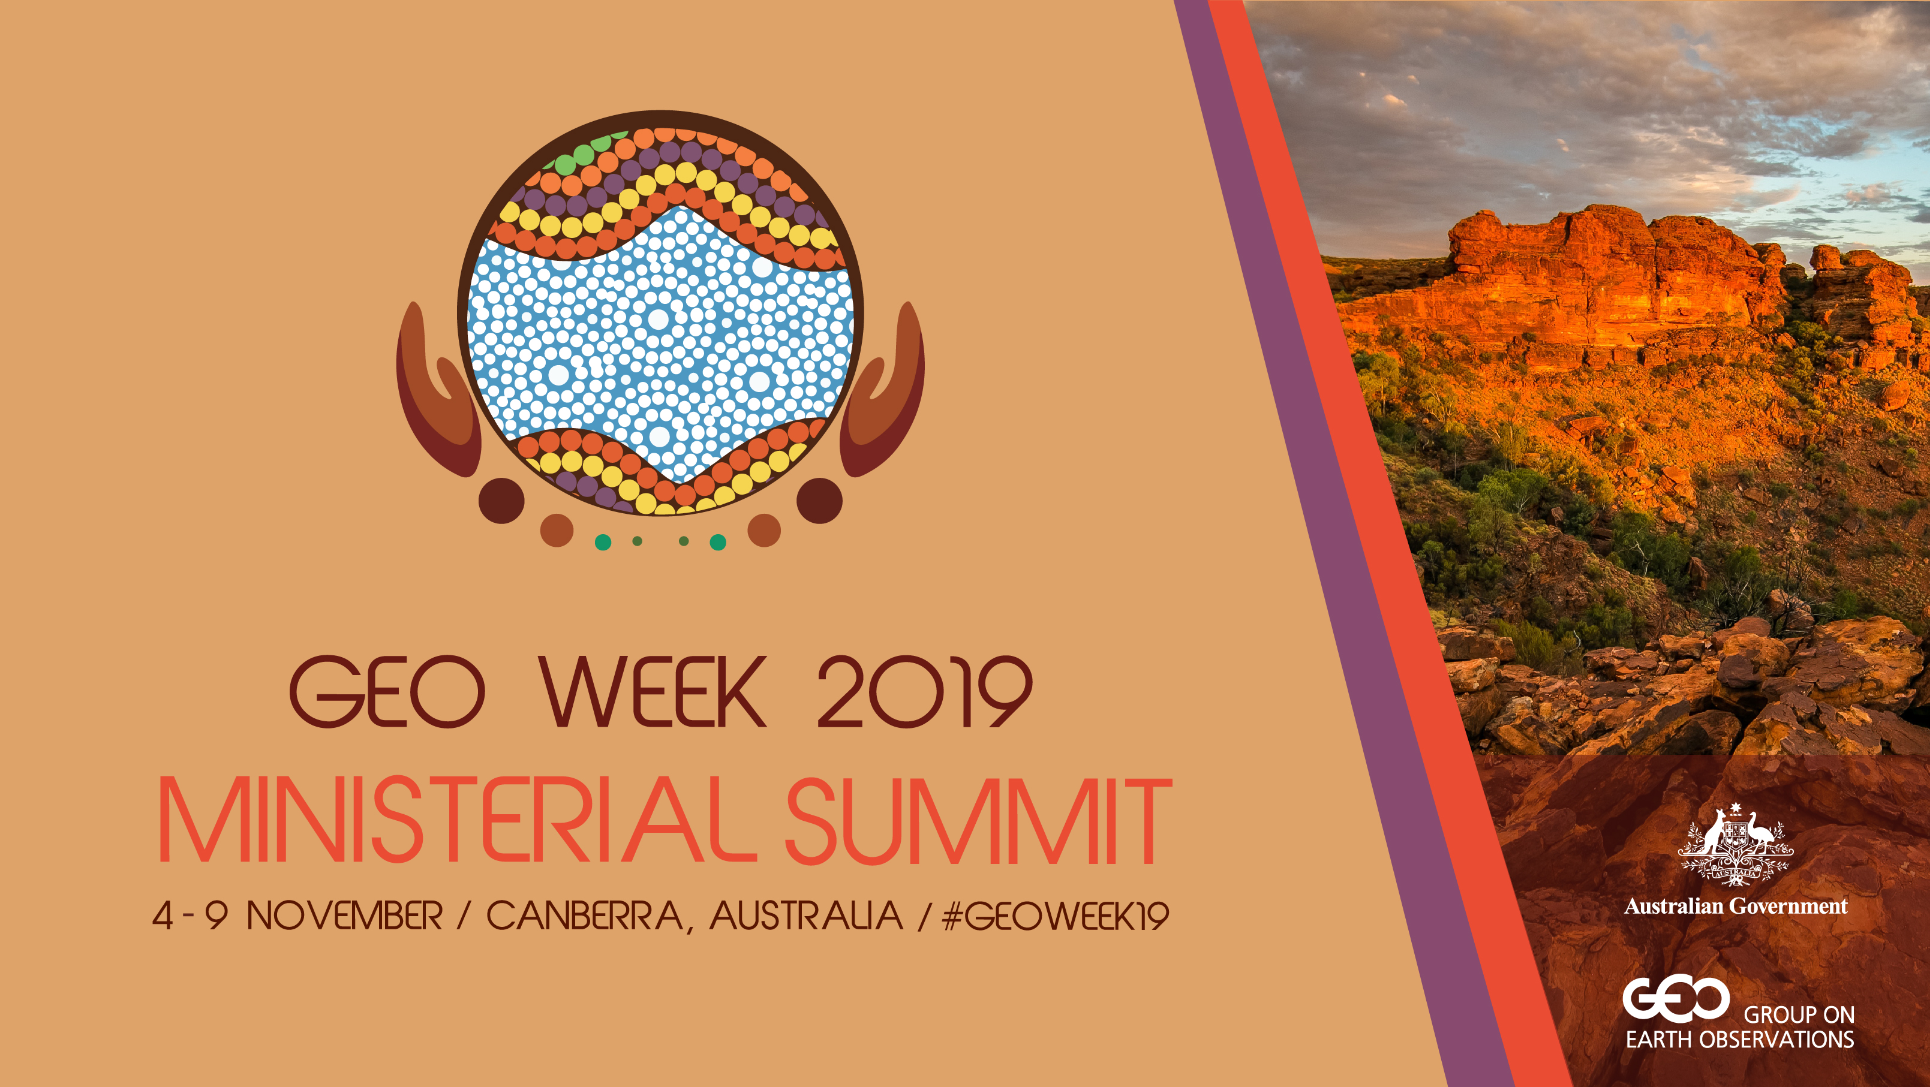

Slide 2
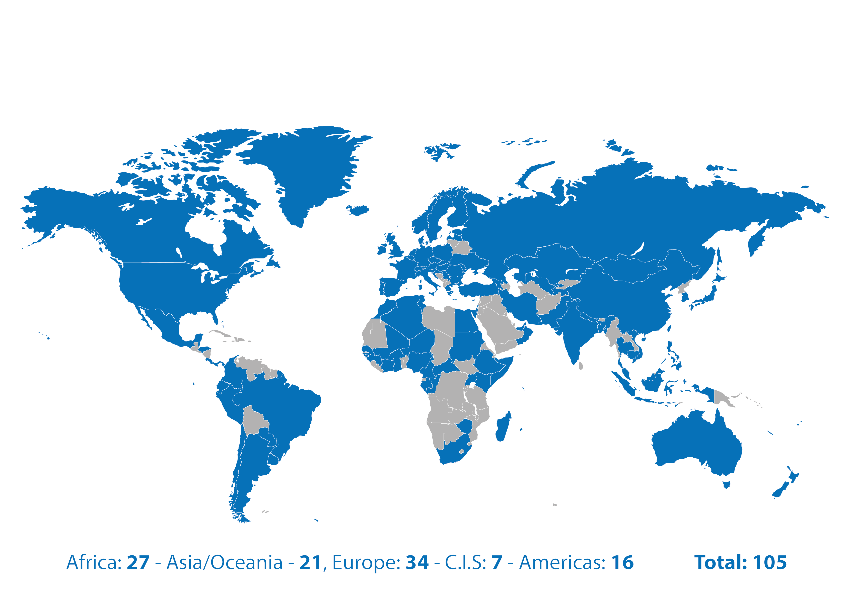

Group on Earth Observations
Global partnership of governments.
Improving the use of Earth observations for the benefit of society.
Notes:
Established in 2005, GEO is an intergovernmental partnership of 105 Member countries and 127 Participating Organizations that improves the availability, access, understanding and use of Earth observations for the benefit of society. GEO’s convening power is its strength: it provides a flexible framework through which governments, not-for-profits, the commercial sector, the research community and others collaborate.

Slide 3
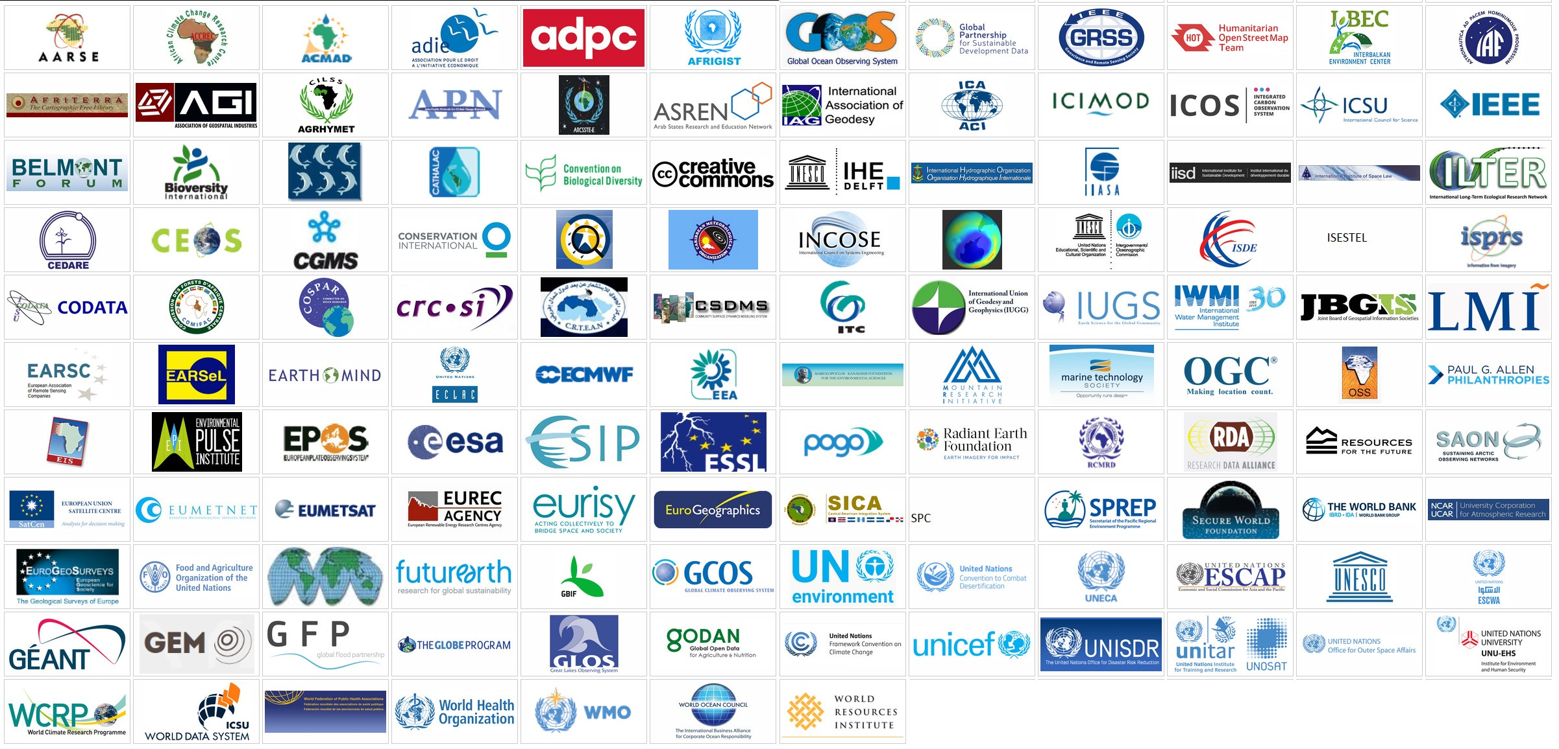
Convening Power
GEO brings together global partners to solve complex problems for the benefit of all.
Notes:
In addition to working with over 1000 government agencies across its 105 Member countries, GEO has 127 Participating Organizations, including UN agencies and other key international organizations working to apply Earth observations to environmental and development challenges. Through GEO, these organizations work together to collaborate on projects, share knowledge and solve problems.

Slide 4
Earth observations:
Investments in the digital economy

Slide 5
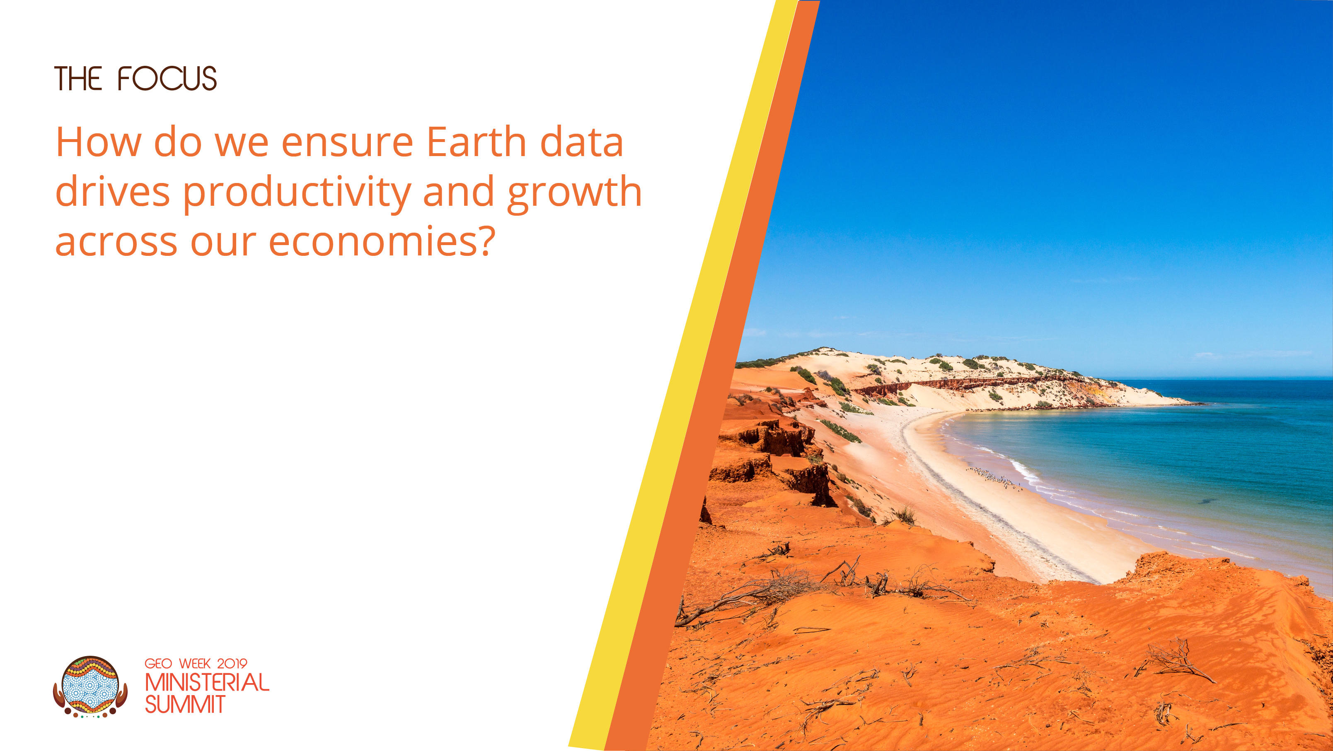
Notes:
In November 2019, Ministers from GEO’s 105 Member governments, business leaders, heads of international non-profits and passionate experts will meet in Canberra, Australia for GEO Week 2019 and the GEO Ministerial Summit.
They will engage with this fundamental question: How do we ensure data about our dynamic and changing planet becomes a core input to our strategic economic decision making and our day-to-day business, environmental and economic development decisions.

Slide 6
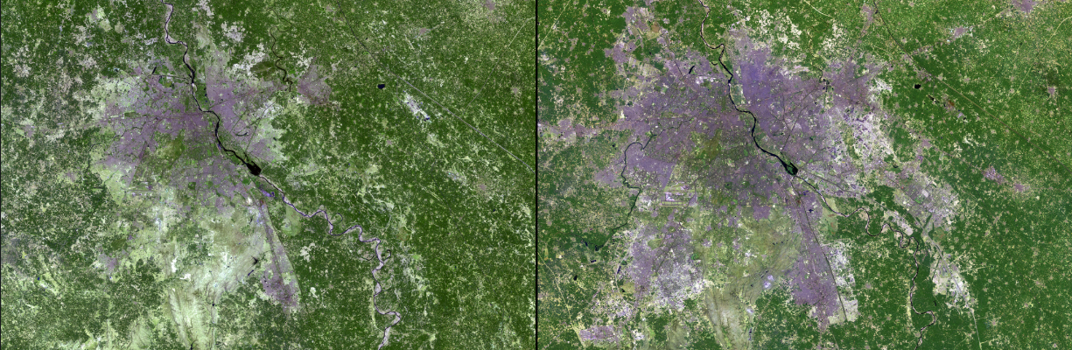
Sustained and inclusive economic growth on a changing planet?
Urbanization
Urban expansion in New Delhi, India, March 14, 1991 - March 2, 2016
Source: NASA Images of Change
Notes:
But why is this a topic that needs their attention, and why now?
In our rapidly changing world, almost all economic activity and almost all business decisions must consider how the planet on which we depend is changing. At the same time, digital technologies are disrupting our societies and economies, changing how we work and how we live. This change is happening at an extremely rapid pace, and presents us with new challenges and opportunities to deliver sustained and inclusive economic growth.

Slide 7
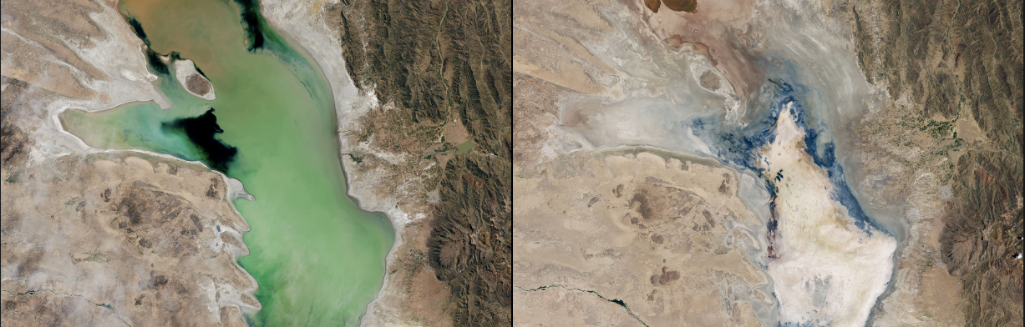
Sustained and inclusive economic growth on a changing planet?
Water scarcity
Drying Lake Poopó, Bolivia, April 12, 2013 - January 15, 2016
Source: NASA Images of Change

Slide 8
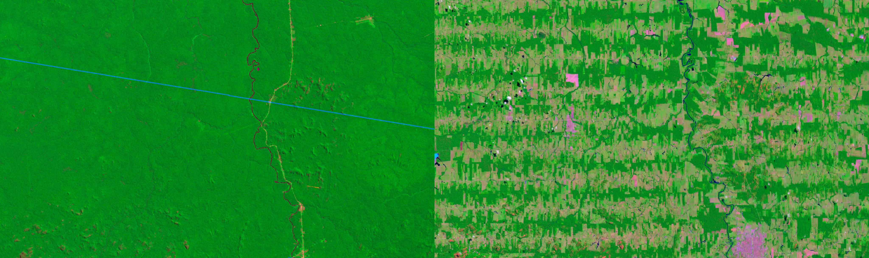
Sustained and inclusive economic growth on a changing planet?
Deforestation
Rondonia, Brazil, 1975 - 2012
Source: NASA Images of Change

Slide 9
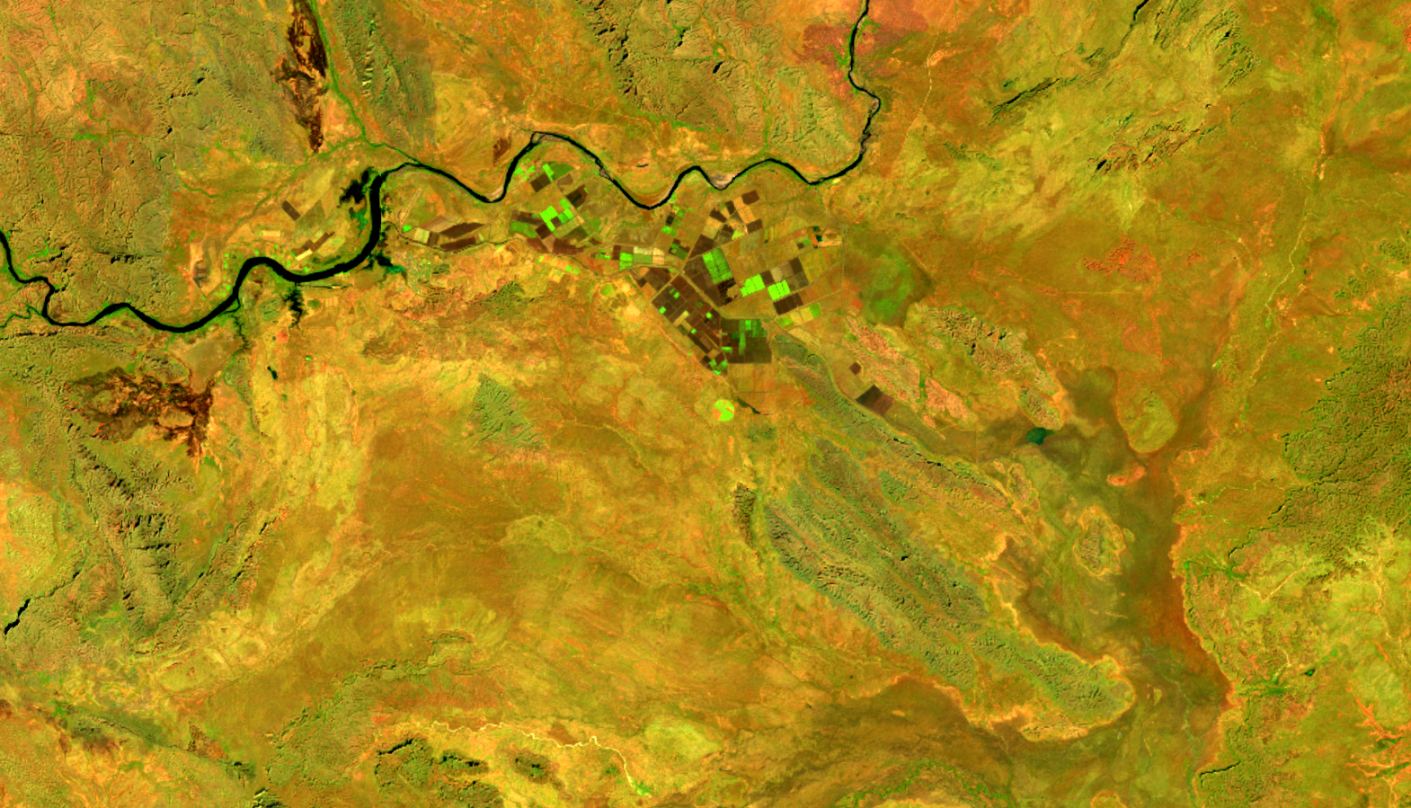
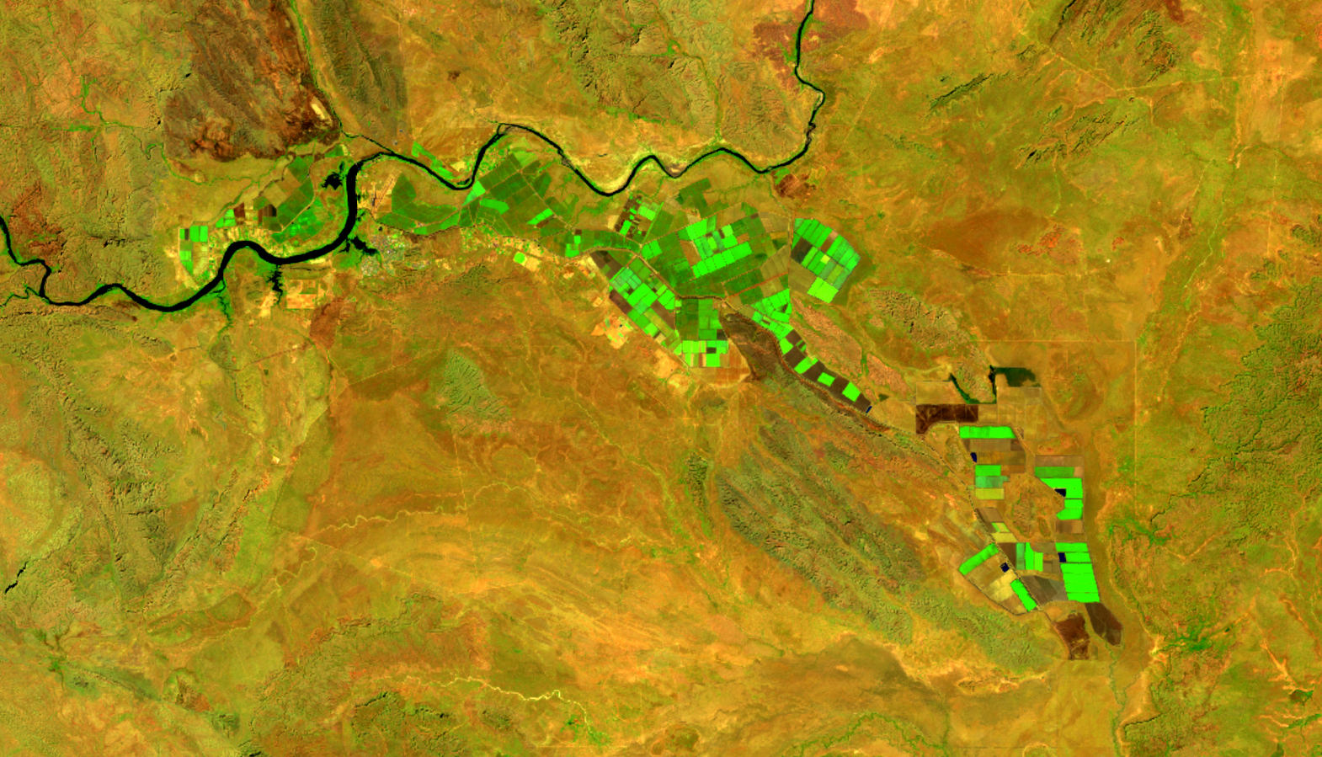
Sustained and inclusive economic growth on a changing planet
Source: Digital Earth Australia,
c/o Geoscience Australia
Feeding growing populations; new areas for agriculture
Ord River Irrigation Scheme, Western Australia, 1997-2017

Slide 10
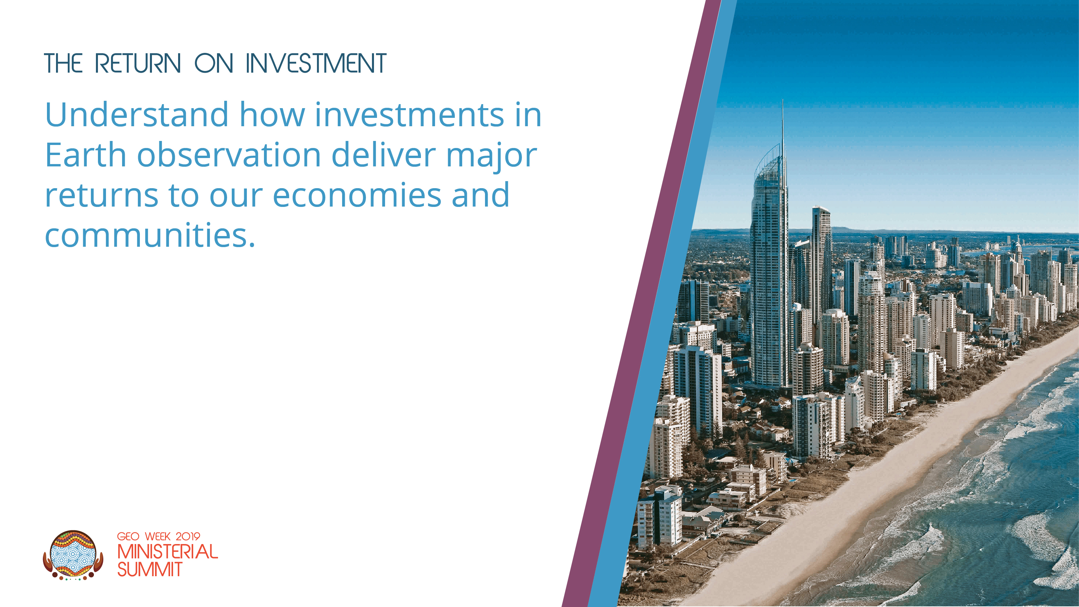
Notes:
This sounds like a big and costly problem, right, rather than a positive? But the historical perspective of Earth observation as a ‘cost sink’ of scientific interest only is just that – historical.
The business case for Earth observation as a driver of economic growth has become clearer in the minds of those outside the Earth observation community. This means that new investments and actions in GEO can be explained in terms of the substantial return on investment we can expect to gain.

Slide 11
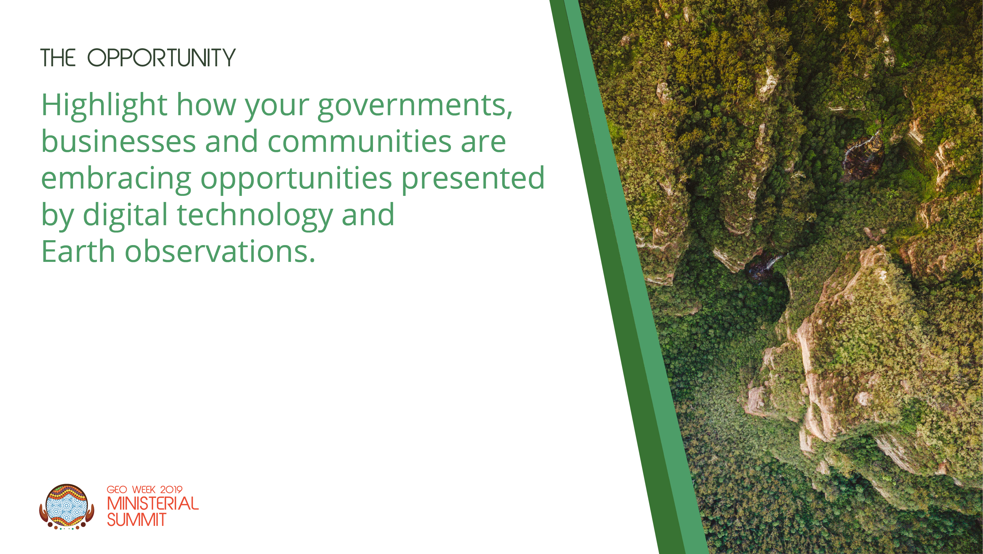
Notes:
Moreover, we are at a point now where we have the data and the technology to make it happen. The digital economy provides the tool to integrate this incredibly complex source of information into tools that enable us to make better decisions.
Not only will this help drive sustained and inclusive economic growth, it will crease new economic opportunities, including the development of advanced new technologies to sense the world, and new digital products and services that use the data they collect.

Slide 12

Notes:
The 2019 Summit also comes at an important time for GEO itself.
In 2015, Ministers adopted a new Strategic Plan for GEO focused on three key priorities: sustainable development, climate change and disaster risk reduction. GEO’s efforts in these areas support three key global commitments:
-The 2030 Agenda for Sustainable Development
-The Paris Climate Accord
-The Sendai Framework for Disaster Risk Reduction
But how do we make this happen?
We need to discuss how we can work together to ensure data about or changing planet is fully integrated into the digital economy and, through it, into the real economy where it can support our efforts to deliver on these types of big and ambitious agendas.

Slide 13
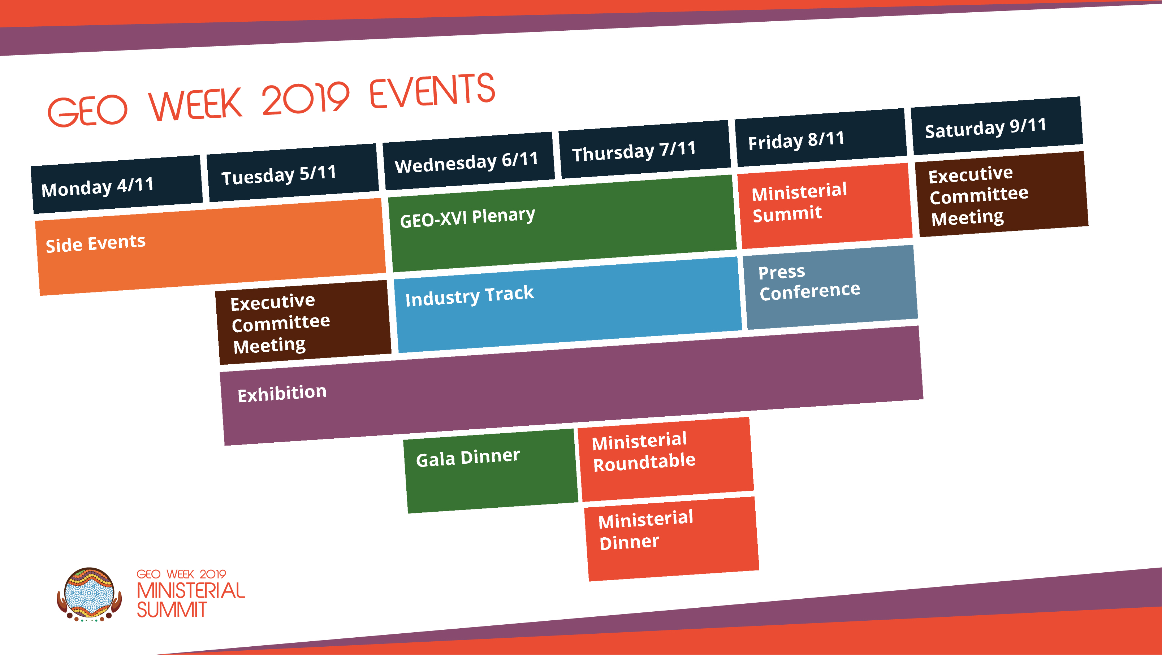
Notes:
Ministerial Summits enable Ministers to connect GEO to the bigger picture.
Topics at the Summit and Plenary will include:
Engagement of GEO with the multilateral economic cooperation architecture
Engaging with vulnerable and developing nations
Including people from vulnerable, minority or disadvantaged backgrounds
Inspiring industry investment in the success of GEO
At the Roundtable Ministers will have the chance to discuss how bigger picture policy issues will influence GEO’s ability to deliver over the longer term:
Future of Work
Trade in Digital Services
Privacy in a Big Data World
Sharing Economy
A major feature of the Plenary and the Summit will be the announcement of new initiatives, partnerships, capabilities and investments. One of our key goals as Hosts will be to provide platforms for Ministers, businesses, NGOs and others to announce their support for GEO.

Slide 14

Notes:
The commercial sector drives much of the digital technology that will make all this possible. And critically it is through the commercial sector that the benefits of Earth observation will reach individual regions, businesses and communities.
As such, GEO Week 2019 will include a dedicated Industry Track for the world’s leading tech, space and geospatial companies to come together with businesses that need Earth observation-enabled digital products. A series of events worth attending in its own right, the track will enable businesses to promote their capabilities, to network and create new partnerships, and to make deals and announcements.

Slide 15
Industry Track
The EO Exhibition Tuesday 5th to Friday 8th | A showcase for EO and related activities and technologies, including space, spatial and tech. Providing informal and flexible collaborative spaces to enable networking of GEO Week attendees. Ministers will walk through on evening of Thursday 7th.
AO @ GEO Day Wednesday 6th | Expose attendees to what is happening in the region, including innovative capabilities and smaller businesses not often seen outside the Asia-Oceania region.
Industry & GEO Day Thursday 7th | Bringing leaders from industry together with the GEO community, encouraging and facilitating partnerships that support GEO’s objectives. Opportunities for networking with the GEO community and attendees of the Ministerial Summit.
Commercial Sector Policy Dialogue Timing TBD | Discuss the challenges and barriers to greater commercial sector involvement in delivery of GEO’s mission, framing issues for discussion by GEO Principals
Industry Breakfast Thursday 7th | Breakfast to provide an opportunity for Ministers and business leaders (including SMMEs) to interact.
Notes:
Lead by the Australian Space Agency, with support Australia’s national science and technology agency CSIRO, the Industry Track will include the GEO Week Exhibition, networking events, pitch sessions and the facilitation of bilateral meetings.

Slide 16
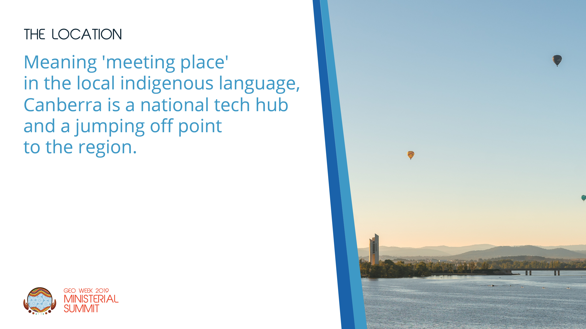
Notes:
GEO Week 2019 will be hosted by the Australian Government in Canberra, Australia’s capital city.
For 20,000 years, the Indigenous Ngunnawal community has called Canberra home. The region’s harsh climate has meant that its inhabitants have needed great knowledge of the environment, skilful custodianship of it, and close cooperation with each other in order to survive. The knowledge and skills of first nations people – the first Earth observers – is critical to the success of GEO.
Today, Canberra is a dynamic and modern city that provides plenty of opportunities for delegates to interact socially while experiencing Australia’s natural beauty and relaxed culture.
Visiting Ministers can engage with their Australian counterparts and establish productive working programs around their commitments to the Summit. They will be able to engage with Australia’s national government agencies and national institutions, including the newly formed Australian Space Agency. Commercial sector participants will be able to connect easily with representatives from Australia’s space, spatial and tech industries.

Slide 17
Side Event Program
12 High Impact Events
Over 2 Days
Tackling big challenges and opportunities for GEO
Big data
Sustainable development
Advanced technology
Climate change
Disaster risk reduction
The digital economy
Economic growth

Slide 18
Plenary Program
  A Platform for Action
Delivering on policy priorities
  2030 Agenda for Sustainable Development
  Paris Climate Agreement
  Sendai Framework for Disaster Risk Reduction
Expanding GEO’s impact
  Connecting GEO to the multi-lateral economic cooperation framework
  Delivering GEO’s impact at regional and local levels
  Engaging enabling communities: stats, eco and tech
  Stepping up GEO
  A new three-year Work Programme
  Delivering a Results-Oriented GEOSS

Slide 19
Ministerial Summit
Shaping GEO’s future | Scaling up GEO
Earth observation as a critical driver of economic growth and development in a changing world | Members investing in GEO’s success
Engaging with vulnerable and developing nations | Inspiring industry to invest in GEO
Including people from vulnerable, minority or disadvantaged backgrounds | Open access, open data

Slide 20
Organising GEO Week 2019: A Team Effort
Ministerial Summit Working Group
  Participation:
    Member Reps: Aus, China, EC, Germany, Japan, Mexico, Africa, Switz, USA, UK
    PO Reps: SPREP, ITC, ILTER, Cons. Intl
  Co-Chairs: UK, USA and Australia
  Key responsibilities:
    Declaration
    Program / Agenda
  Key next steps:
    Circulate draft Declaration to Principals
    Continue development of agenda, including refining session descriptions
Political Leadership Team
  Membership: Co-Chairs, Australian GEO Principal and the GEOSEC Director
  Key responsibilities:
  Shape high-level political and strategic framing for the Summit
  Leverage personal and professional networks
  Current focus:
  Identify ‘headline’ business and industry players they can attract to Industry Track
  Understand mechanisms to enhance links between GEO and multilateral economic cooperation fora
Programme Board
The GEO Work Programme
Is The Key
GEO Secretariat
Australian Government Summit Taskforce

Slide 21
Key Milestones
March | Ministerial Invitations
 | Zero-order Declaration
April | Program Overview
 | Call for Side Events
 | Launch of Industry Track Prospectus v1
 | Release of Admin Circular v1
 | First Call for Delegation Lists
May | GEO Symposium in Geneva
 | Launch of Industry Prospectus v2
June | Summit and Plenary Program v1
 | Side Event Program
July | Draft Declaration v1
Notes:
Delivering local impact
It is through the commercial sector that the benefits of Earth observation will reach individual regions, businesses and communities.
Supporting the commercial sector to grow for GEO
A dedicated ‘industry track’ will enable the commercial sector to showcase their capabilities, to meet and connect. It will be an event worth attending in its own right.

Slide 22


