Slide 1
CEOS Engagement with GEO
Committee on Earth Observation Satellites
Steven Hosford, CEO
European Space Agency (ESA) / Centre National d’Etudes Spatiales (CNES)
Kerry Ann Sawyer, CEOS SIT Chair Team
National Oceanic and Atmospheric Administration (NOAA)
CEOS SIT-34
Session 3, Agenda Item 3.4
Miami, FL, USA
3 – 4 April 2019

Slide 2
Summary
A look back at how it was done 10 years ago …
Status of recorded CEOS involvement in GEO WP
Proposed approach to improve coordination and information on CEOS contributions to GEO WP

Slide 3
GEO Task Tracking in 2008 …
Let’s take, for example, SIT-22 (September 2008)
Meeting highly focused on reviewing CEOS actions for GEO by
Agency
CEOS entity – WG, VC, AHT
CEOS SBA coordinators
Approx. 70% of meeting time was set aside for status reporting on CEOS-GEO actions.

Slide 4
CEOS Engagement Current Status
No appetite to return to this heavily CEOS-GEO actions focus for SIT or SIT TW, however ….
Links from CEOS work into GEO Work Programme have become too tenuous
Changes in CEOS WP 2019-2021development process:
Explicit call to CEOS WP responsible entities to identify how their deliverable contributes to GEO WP
Only 22 of 103 CEOS WP deliverables have identified contributions to GEO WP
Illustrates a disconnect
~20% does not fully reflect CEOS contributions to GEO

Slide 5
CEOS Work Plan and GEO
By the numbers
Analysis of 2019-2021 CEOS Work Plan provides 175 (162) citations of GEO
Includes GEOSS, GEOGLAM, AmeriGEO, GEOHazards, GEO-DARMA, GEOBON, GEO Blue Planet, AfriGEOSS, AOGEO, …
Notes:
The figures on the previous slide are contradicted by the number of citations of GEO in the CEOS work plan …
This is contradication is also true if we look at the connections as defined by citations of CEOS agencies/entities that lead or are contributors according to the GEO FTs/Flagships/Initiatives/CA (run through in the next few slides?)
Conclusion – clear need to more rigorously map the contributions from CEOS into the GEO activities.

Slide 6
Mapping - CEOS Connections to GEO 2017-2019 WP
Flagships
GFOI – Contributor (SDCG: ESA, UKSA, JAXA +SDCG Secretariat)
GEOGLAM – Contributor (NASA, CNES)
Initiatives
AquaWatch – Contributor (NOAA, also co-Lead)
GEO-DARMA – Contributor (ESA, also Lead)
EO4SDGs – Contributor (SDG AHT: CSIRO, ESA)
GEO Carbon and GHG Initiative – Contributor (EUMETSAT)
GSNL – Contributor (DCT: DLR; WGDisasters)
GEOSS-EVOLVE – Contributor (WGISS)
Blue Planet – Contributor (CSIRO)

Slide 7
Mapping - CEOS Connections to GEO 2017-2019 WP
Foundational Tasks
Capacity Building Coordination – Lead & Contributor (NASA)
Advancing GEOSS Data Sharing Principles – Contributor (ESA/CNES)
GEOSS Satellite Observation Resources** - Lead & Contributor (NOAA and ESA/CNES)
Community Activities
Earth Observations for Disaster Risk Management – Lead & Contributor (ASI)

Slide 8
Mapping - CEOS Connections to GEO 2017-2019 WP
Reference to CEOS but no Lead/Contributor
Global Flood Risk Monitoring – Contributor (NASA is Lead)
States CEOS is contributor but no reference to any CEOS activity
GEO Global Ecosystem Initiative (GEO ECO)
States CEOS is contributor but no reference to any CEOS activity
DIAS
States smooth access to data will be continued via CEOS Water Portal
Earth Observations for Managing Mineral Resources
States contacts with CEOS and space agencies for design of future high spectral resolution missions.
In-Situ Observations and Practices for the Water Cycle
States close linkage will be kept between new CA and satellite component through cooperation/coordination with CEOS.

Slide 9
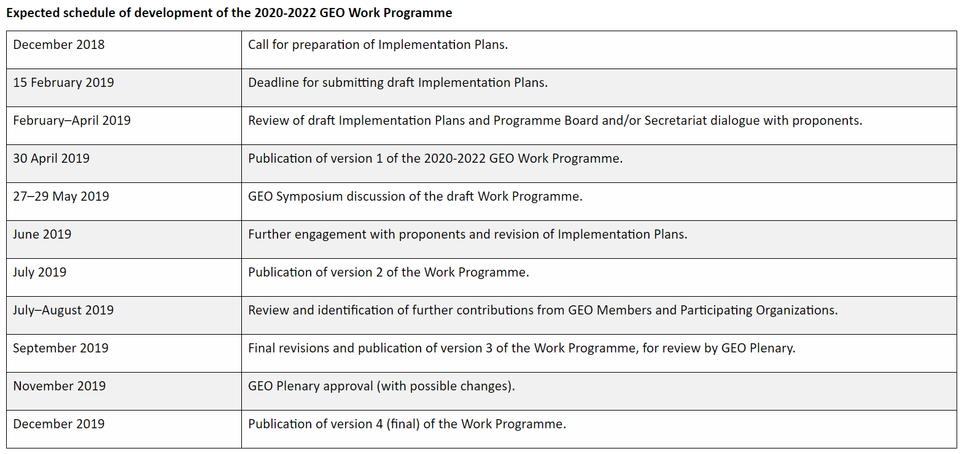
Development Schedule of
2020-2022 GEO WP
CEOS & Agency participants to GEO Programme Board heavily involved in GEO WP development
Notes:
Conclusion slide 5 – clear need to more rigorously map the contributions from CEOS into the GEO activities.
Proposal to this is here.

Slide 10
CEOS-GEO Coordination
Action at CEOS-GEO Bilateral for CEO and GEO WP Coordinator to initiate an exchange on work plan – work programme links
Analysis of
How does CEOS 2019-2021 Work Plan feed into GEO Work Programme under development? (building on reporting from slide 4)
What deliverables would be required in CEOS 2020-2022++ Work Plans to deliver GEO WP contents
Notes:
Conclusion slide 5 – clear need to more rigorously map the contributions from CEOS into the GEO activities.
Proposal to this is here.

Slide 11
CEOS-GEO 2019 Bilateral Actions
ACTION: GEOSEC will facilitate scheduling a 15-minute slot for CEOS at the 2019 GEO-XVI Plenary to highlight how Earth observations can help countries address needs by measuring and showing change related to a few Sustainable Development Goals.
ACTION: GEO agrees to use CEOS to carry out a “technical feasibility evaluation” of the proposals received in response to the GEO-Amazon Credits Programme. CEOS will provide feedback related to CEOS Agency datasets and data technology solutions. This feedback is intended to identify those proposals with the greatest chance of success. GEO will not be bound to take into account these elements of evaluation from CEOS in its final decisions.
ACTION: CEOS will relay to the CEOS community the clearly expressed GEO requirement for a Sentinel-1 and Sentinel-2 analysis-ready data (ARD) data flow solution and that CEOS SEO and GEOSEC will collaborate on such a data flow solution with the intent to demonstrate the critical necessity of this output in support of Open DataCube prototypes and Digital Earth Africa.
ACTION: GEO will identify a focused “demonstration use case” to better articulate the functioning of the GEO Knowledge Hub. CEOS will evaluate the requirements for this demonstration and identify how they can contribute towards its success.
ACTION: GEO will facilitate a session for Essential Variables at the 2020 GEO Symposium and invite GWP activities which have created or discussed EVs to present on their efforts.

