Slide 1
GCOS update
CEOS SIT – 34
3 April 2019
Miami, FL, USA
GCOS Secretariat
Carolin Richter
(remote presentation)

Slide 2
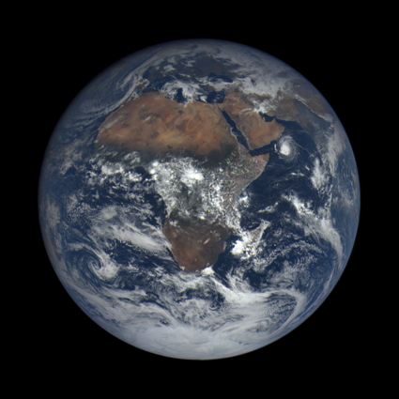
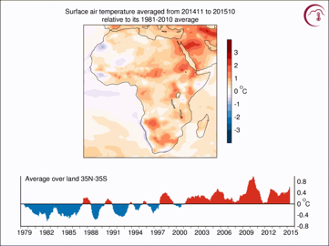
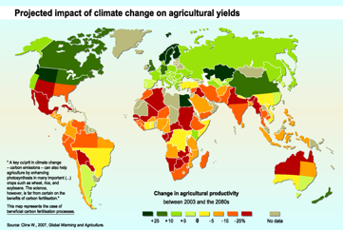
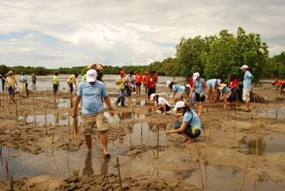
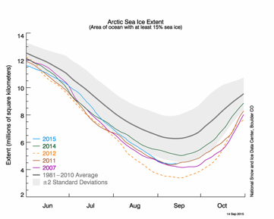
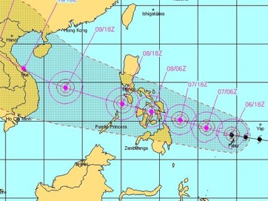
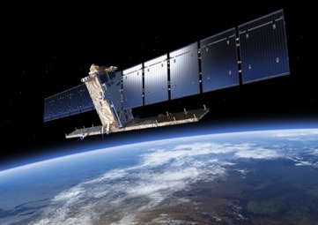
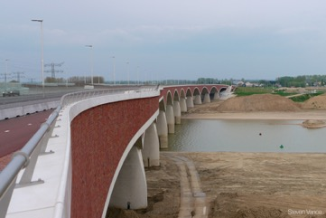
From observations to implementation
Sensing
  Observation of the Earth System
Data Records
  Preparation of Climate Data records
  Archiving,
  Reanalysis,
  Production of long datasets
Delivery of Services
  Delivery of targeted information for specific applications or to inform decisions
Decision Making and Implementation
  Implement actions based on the information
GCOS Supports observations and production of climate data records that underpin service delivery
Feedback from users
Notes:
Systematic observation of the climate system provides the necessary foundation for science-based decisions in the UNFCCC process.
The full value of climate observations is only derived through implementing actions grounded on a scientific understanding of the climate.
The figure here illustrates this chain, from observations to decision-making.
GCOS view on an architecture for climate monitoring from space, 4 pillars: sensing & observation of the Earth system, data records (research&assessment), delivery of services (GFCS) and decision making and implementation (UNFCCC/COP & Paris Agreement).

Slide 3
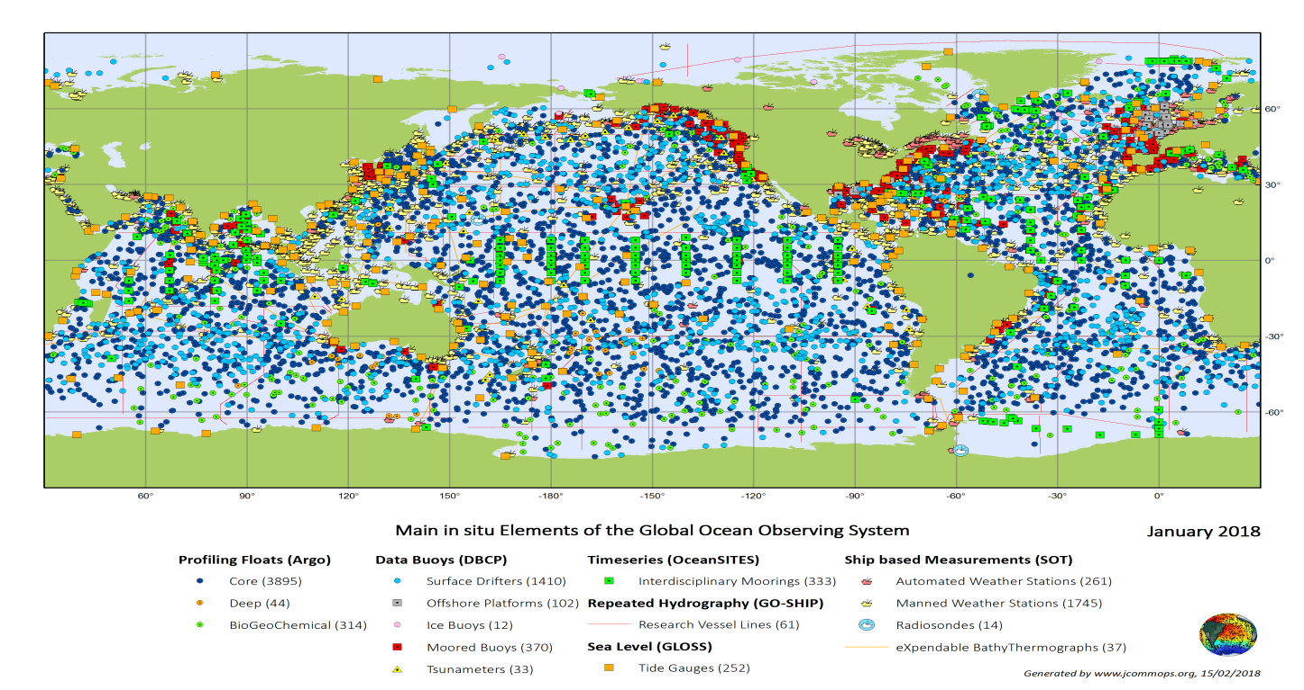


Engagement on Oceans with WMO Cosponsored GOOS
Work with Joint WMO and IOC Commission on Marine Meteorology (JCOMM) on observing systems
Engagement with GOOS.
  OOPC acts as an ‘information broker’ between GCOS and GOOS, drawing across other GOOS activities in Chemistry and Biology of relevance to climate; important in delivering observations required for ‘Earth System Approaches’.
Notes:
Engagement with Joint Commission on Marine Meteorology (JCOMM)
Assessing observing system implementation and performance.
Evolving observing system design.
Establishing a process for bringing new technologies into the sustained observing system.
Secretariat work closely with WMO Observations Department and IOC to guide and support JCOMM Observations Coordination Group
Engagement with GOOS.
Acts as an ‘information broker’ between GCOS and GOOS, drawing across other GOOS activities in Chemistry and Biology of relevance to climate; important in delivering observations required for ‘Earth System Approaches’.

Slide 4
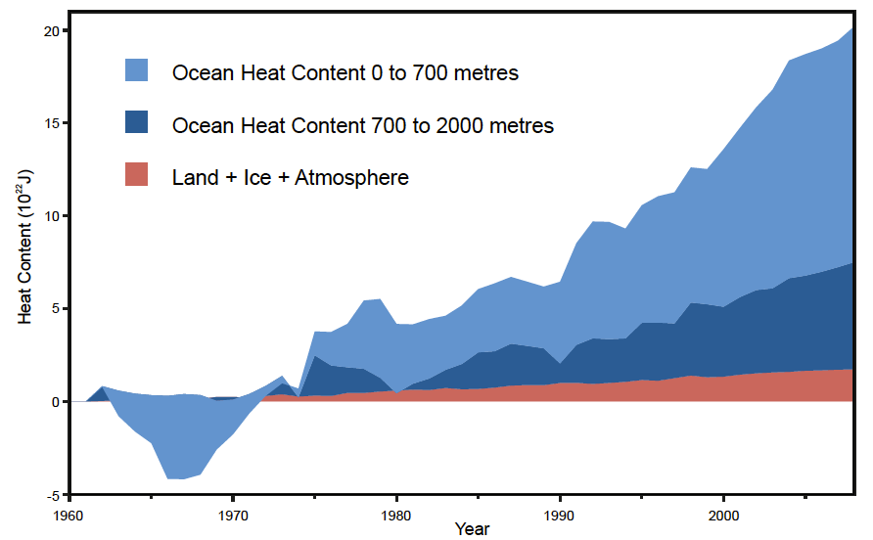
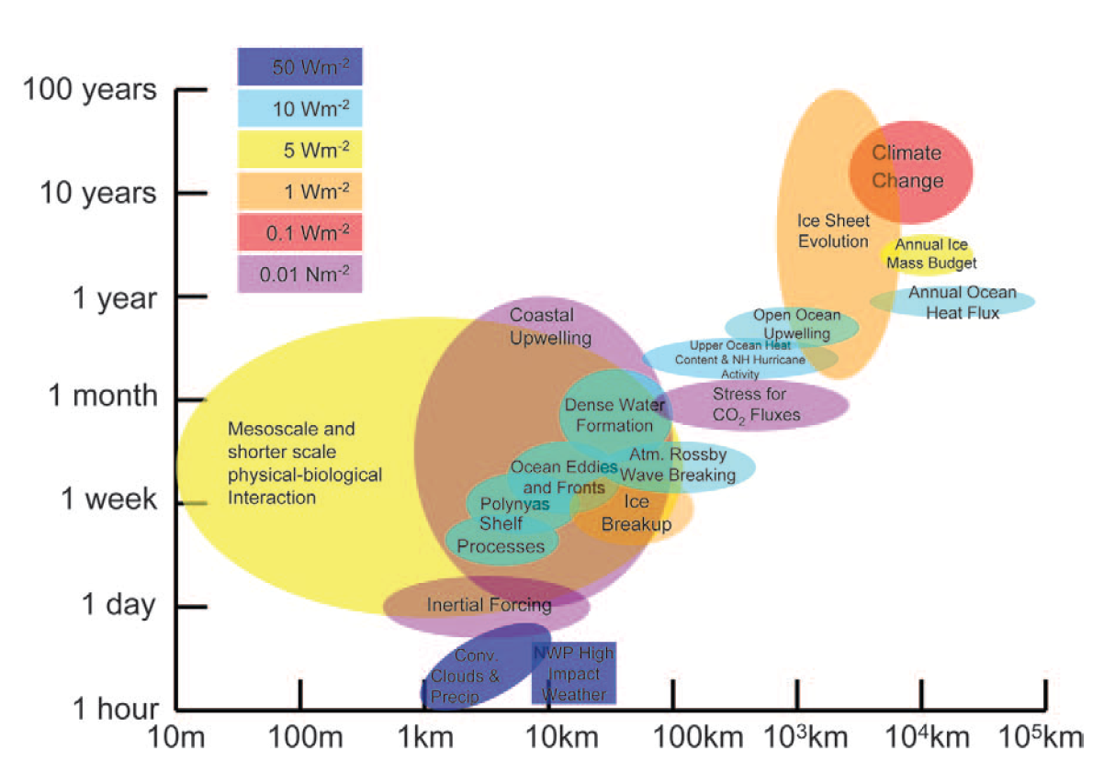
Ocean Observing Systems Review
Focussed activities to advance the observing system, with strong engagement from WCRP programme experts.
  Reviewing the Observing System to track changes in Ocean Heat and Freshwater Storage.
  Developing a strategy for advancing global Air-Sea Fluxes observations.
  Developing a global plan for observing Boundary Currents and their interaction with the shelf: an important feedback mechanism in the climate system.
  (OceanObs’19 Whitepapers on these topics)
Future:
  Potential collaboration on a workshop focussed on Regional Sea level change and Coastal Impacts (being planned by WCRP).
  Future priority (with TOPC and GOOS), regarding connecting up observations in the coastal zone. Links to Climate Adaptation, Services.

Slide 5
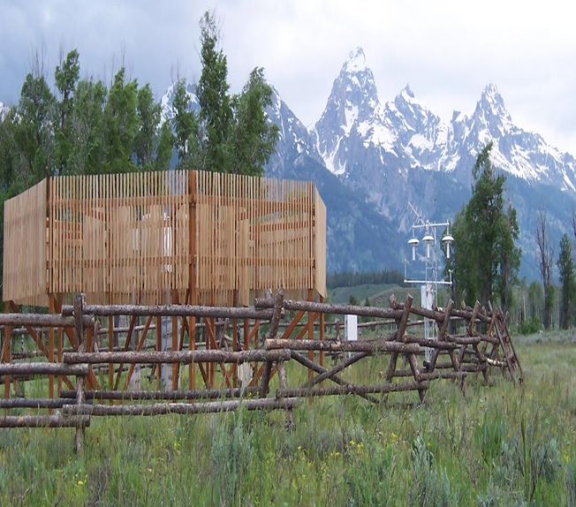
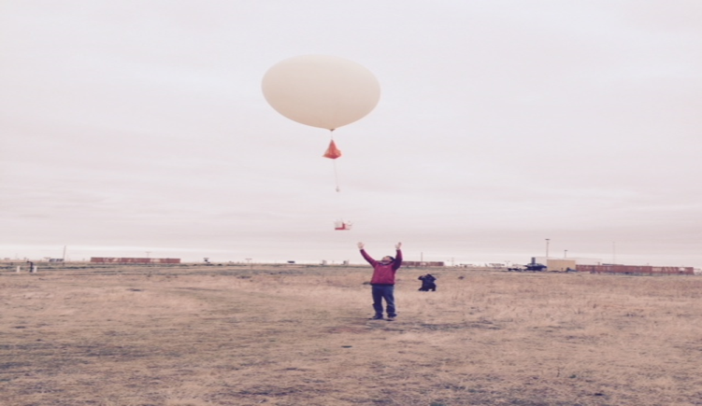
Improving the quality of observations
The GCOS Surface Reference Network (GSRN):
GSRN will support WMO Integrated Global Observing System aiming to meet the “goal” requirements in the WMO OSCAR requirements database. It is proposed that the GSRN be sponsored by WMO and the Bureau International des Poids et Mesures (BIPM).
Its implementation will require:
Approval of the proposed GSRN
An offer to host and staff appropriately the proposed Lead Centre
Offers of suitable sites for an initial GSRN
The GCOS Upper-Air Network Task Team (GUAN TT)
The ongoing value of the GUAN was supported by the Global Basic Observation Network meeting (July 2018). WMO reinforced the benefits of GUAN. GCOS will work on an updated GUAN in collaboration with the GBON proposal.
Notes:
To support WIGOS, CCL, CIMO and GCOS are planning the GSRN which will be the reference network of the tiered network system aiming to meet the “goal” requirements in the WMO OSCAR requirements database. It is proposed that the GSRN be sponsored by WMO and the Bureau International des Poids et Mesures (BIPM).
Its implementation will require:
Approval of the proposed GSRN
An offer to host and staff appropriately the proposed Lead Centre
Offers of suitable sites for an initial GSRN
The ongoing value of the GUAN was supported by the GBON meeting (July 2018). Several WMO meetings, most recent the CIMO TECO (Oct 2018) reinforced the benefits of GUAN. GCOS will work an updated GUAN in collaboration with the GBON proposal.

Slide 6
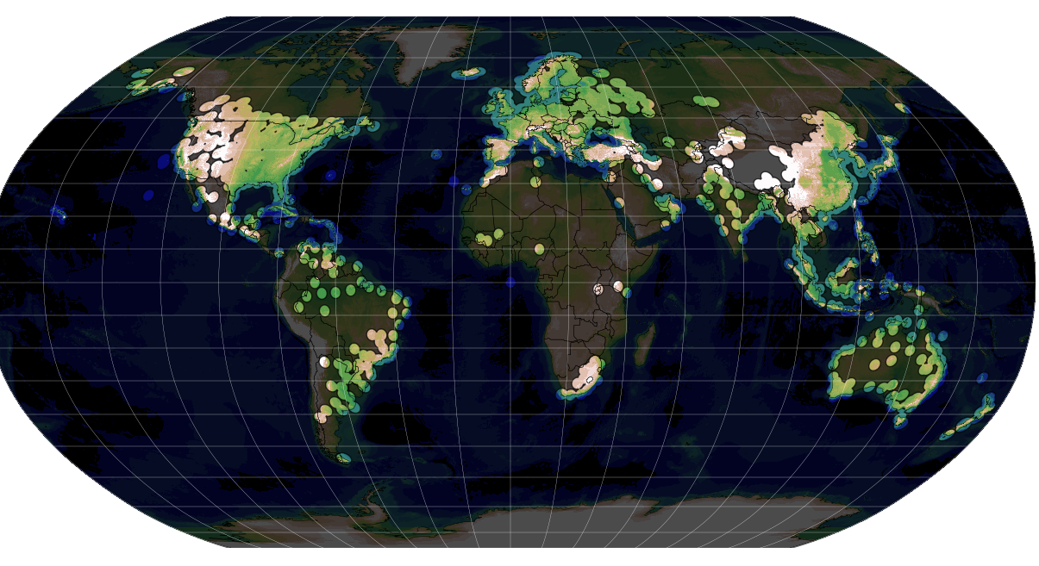
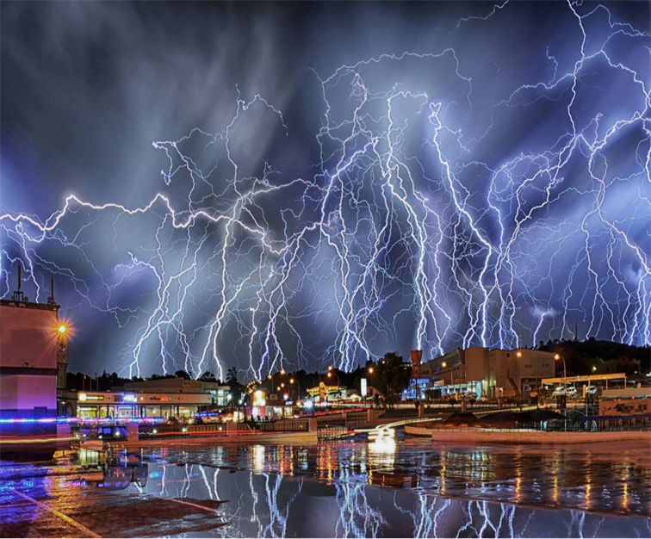
Improving the quality of observations
Radar for Climate
In collaboration with WMO, requirements for radar data for use in climate monitoring have been defined. Recommendations include an international portal to allow harmonized access to radar data, metadata and documentation.
Lightning Observations for climate
With WMO, current observation requirements were reviewed. Metadata standards and global standards for data management were defined.
Next step: to explore how this can be operationalized.
Notes:
In collaboration with CIMO IPET-OWR and CCL requirements for radar data for use in climate monitoring have been defined. Recommendations include an international portal to allow harmonized access to radar data, metadata and documentation. Next step: include WIGOS and IPET-OWR to coordinate future work.

Slide 7
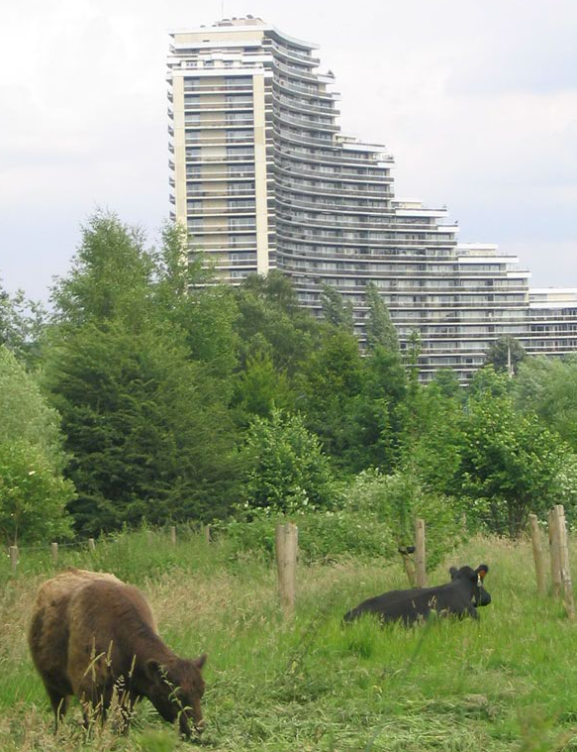
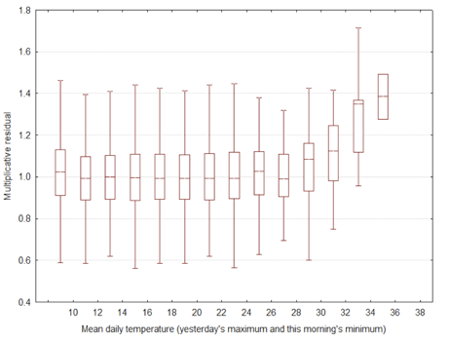
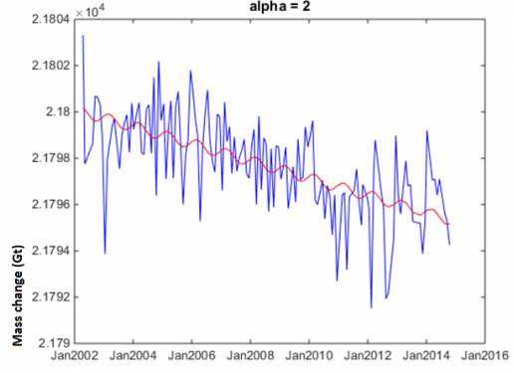
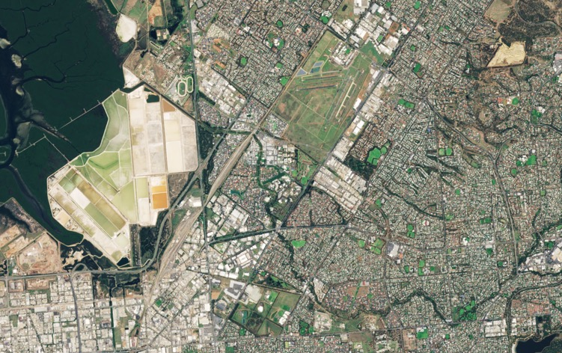
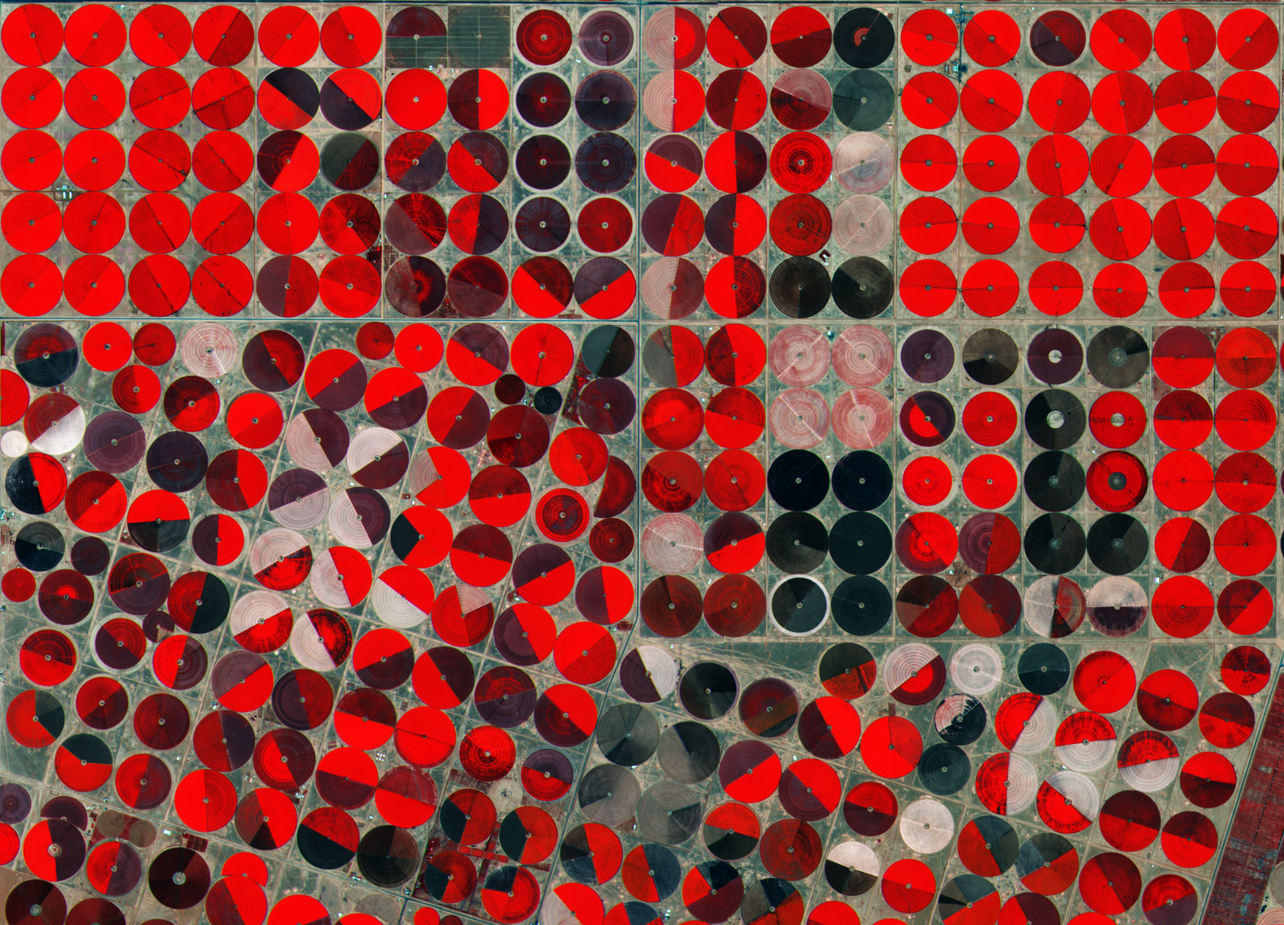
Examples of remote sensing of responses to climate changes
Mortality increases with average temperature
Ground water depletion in Saudi Arabia, GRACE measurements
Expected Mortality leads to Actions to cool Cities
Overall impact of these actions can be monitored remotely
Over extraction by agriculture
ECVs include:
Land Cover
Land Surface temperature
Ground water
Anthropogenic water use
Anthropogenic GHG
Adelaide. SOURCE: modified Copernicus Sentinel data (2017), processed by ESA, CC BY-SA 3.0 IGO
Notes:
Changes in global surface biosphere-related ECV, such as land cover or LAI, may be the result of many factors including climate change, economic changes or directed adaption measures (e.g. to improve the urban environment). Changes are already observable, and the TOPC Task Team, led by Nigel Tapper (U Monash, Australia) is looking at global ECV data to see how the observed changes can be attributed to implementation of national adaptation or mal-adaptation.

Slide 8
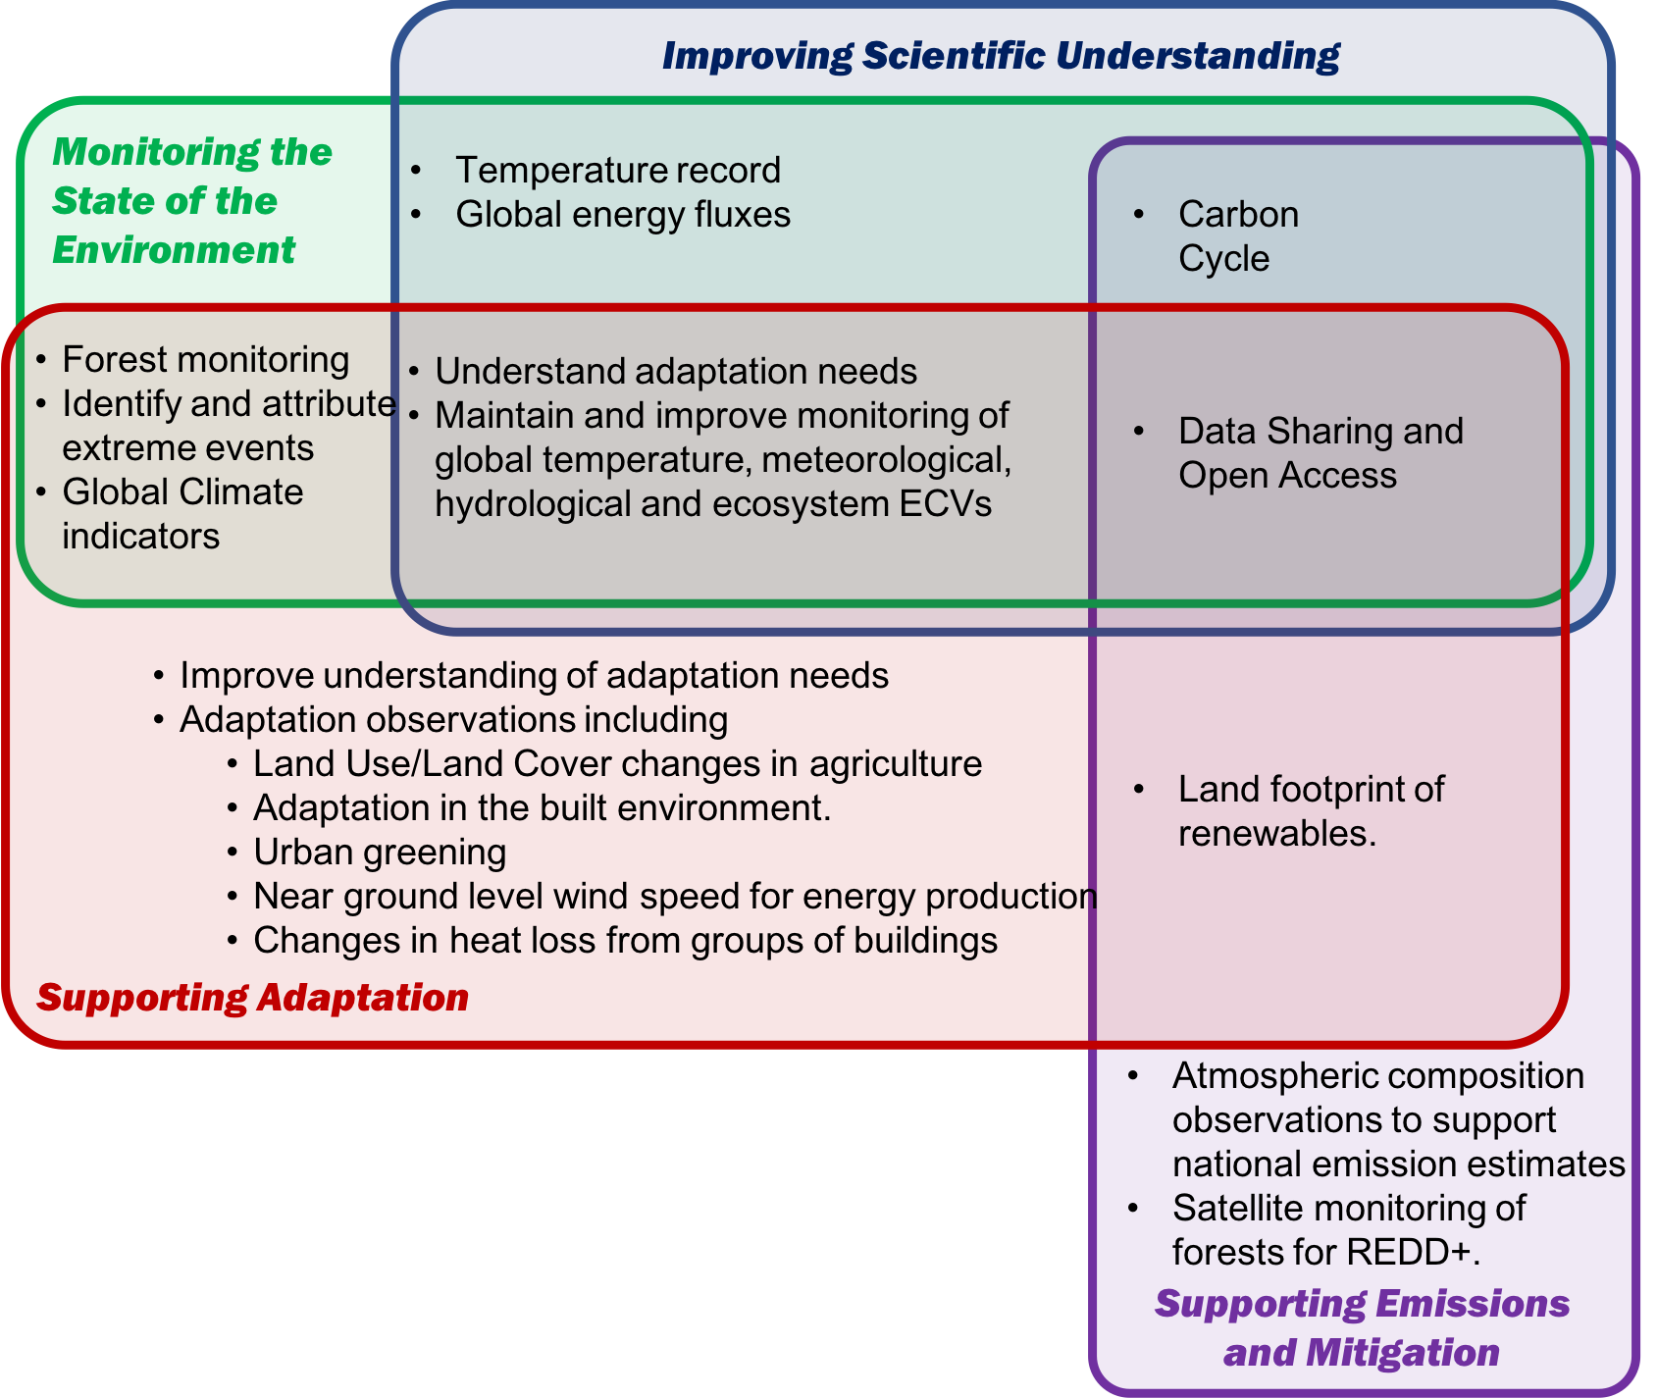
Summary of the monitoring needs identified by GCOS contributing to implementation of Paris Agreement & Global Stocktake
Inputs into WCRP and IPCC
Reporting to UNFCCC and input to the Global Stocktake
To help planning and to monitor implementation
Notes:
Many of the details of the Paris Agreement are still being discussed, and GCOS will need to undertake a detailed consideration of adaptation efforts, however a series of improvements to the current global climate observing system can already be identified, both to report on the state of the climate system or to underpin specific actions in the Agreement. They have been identified in this document and are summarised in this Figure here.
Most of these actions and monitoring needs contribute to several different issues including:
Improving scientific understanding – inputs into to WCRP and IPCC
Monitoring the State of the environment – reporting to UNFCCC and as input into the Global Stocktake
Supporting Adaptation – both to help planning and to monitor implementation
Supporting Emissions and Mitigation

Slide 9
Climate Indicators
Global Indicators
Indicators under development
Supplementary Indicators
Temperature and Energy
Atmospheric Composition
Ocean
Cryosphere
Biosphere
Surface Temperature
Atmospheric CO₂
Ocean Acidification
Glacier Mass Balance
Ocean Heat
Sea Level
Arctic and Antarctic Sea Ice
Water
Heat Waves
Heavy Precipitation
Ecosystem change
Droughts
Methane
Top of atmosphere energy balance
N₂O
Snow extent
Halocarbon GHG
Notes:
The GST may benefit from using the GCOS climate indicators, identified to characterise the state of the climate and its trajectory.
The figure here lists the agreed GCOS Global Climate indicators as well as indicating candidates being considered to cover extreme events and the biosphere.
Global indicators: WMO global statement on climate, presented to the UNFCCC COP.
Indicators under development: extremes and biosphere (discussions at Marrakesh meeting)

Slide 10
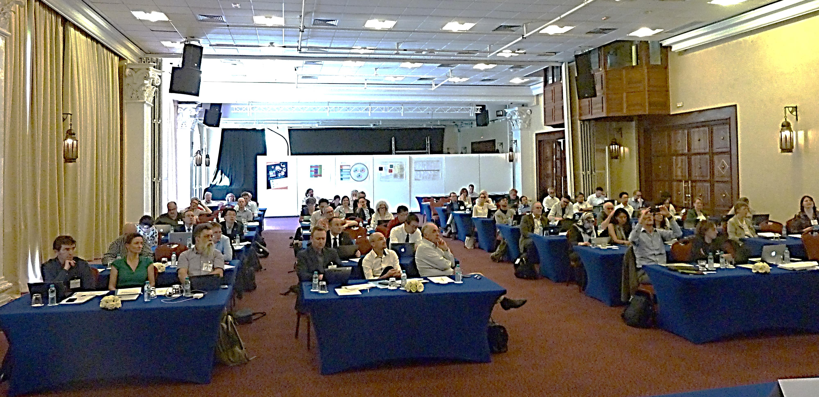
GCOS Joint Panels Meeting Marrakesh
Morocco 18-22 March 2019
https://gcos.wmo.int/en/gcos-joint-panels-meeting

Slide 11
GCOS Joint Panels Meeting Marrakesh
Morocco 18-22 March 2019
Part 1 – Information on gaps and needs:
Presentations on:
IPCC reports and implication for observations
  AR6 WGI: ocean and cryosphere, and land
  AR 6 Chapter 11 extremes
Earth observations in support of the UNFCCC and its Paris Agreement
Observational needs for the national GHG inventories

Slide 12
GCOS Joint Panels Meeting Marrakesh
Morocco 18-22 March 2019
Part 1 - Information on gaps and needs:
GCOS community discussion on Observation and science priorities to inform GCOS and WCRP
Main overarching conclusions:
need for commitment to long-term, sustained climate observation systems
need for open access to climate observations, irrespective of source
need to have traceable observations for accurate long-term monitoring
Conference on Observations for Climate (Partnership GCOS + GOOS / Copernicus / WGClimate)
  Report in next GCOS Status Report, and include actions in revised Implementation Plan

Slide 13
GCOS Joint Panels Meeting Marrakesh
Morocco 18-22 March 2019
Part 2 - Studying:
Ensure that climate observations are enhanced and continued into the future,
in order to fully monitor the Earth’s water and carbon cycles, energy balance and biosphere:
Break-out groups
(1) Carbon
(2) Water
(3) Energy
(4) Biodiversity / Life
Scoping papers to be further developed, Published? IPCC AR6 cut-off date 31 Dec 2019.
Discussion need to be continued (workshops, task teams…)
Big ticket questions to the EO community will be formulated
Cross-Panel discussions:
(a) Air/sea energy fluxes
(b) Coastal-Land-Ocean-Water Fluxes
(c) Extremes

Slide 14

Radiation Budgets, Temperature Wind speed & direction
Closing the global energy balance
Targets | Balance energy budget to within 0.1 Wm⁻² on annual timescales
Who | Operators of GCOS-related systems, including data centres
Time frame | Ongoing
Performance indicator | Regular assessment of imbalance in estimated global energy budget
Energy
Ocean Surface Heat Flux, Sea Surface & Subsurface Temperature,
Albedo,
Latent and Sensible Heat fluxes, Land Surface Temperature

Slide 15
Closing the global water cycle
Targets | Close water cycle globally within 5% on annual timescales
Who | Operators of GCOS-related systems, including data centres
Time frame | Ongoing
Performance indicator | Regular assessment of the uncertainties in estimated turbulent flux of latent heat
Precipitation, Cloud Properties,
Water Vapour Surface Temperature
Water
Sea Surface & Subsurface Salinity, Sea Level, Sea Surface Temperature
Soil Moisture,
River Discharge,
Lakes, Groundwater, Cryosphere, Water use

Slide 16
Carbon Dioxide,
Methane,
Closing the carbon budget
Targets | Quantify fluxes of carbon-related greenhouse gases to +/- 10% on annual timescales. Quantify changes in carbon stocks to +/- 10% on decadal timescales in the ocean and on land, and to +/- 2.5 % in the atmosphere on annual timescales.
Who | Operators of GCOS-related systems, including data centres
Time frame | Ongoing
Performance indicator | Regular assessment of uncertainties in estimated fluxes and inventories
Carbon
Inorganic Carbon,
Soil Carbon,
Above-ground Biomass, Fire, GHG Fluxes

Slide 17

Biosphere
Explain changing conditions of the biosphere
Targets | Measured ECVs that are accurate enough to explain changes of the biosphere (for example, species composition, biodiversity, etc.)
Who | Operators of GCOS-related systems, including data centres
Time frame | Ongoing
Performance indicator | Regular assessment of the uncertainty of estimates of changing conditions as listed above
Precipitation, Cloud Properties,
Water Vapour Surface Temperature
Carbon Dioxide,
Methane,
Water
Carbon
Sea Surface & Subsurface Salinity, Sea Level, Sea Surface Temperature
Soil Moisture,
River Discharge,
Lakes, Groundwater, Cryosphere, Water use
Inorganic Carbon,
Soil Carbon,
Above-ground Biomass, Fire, GHG Fluxes
Biosphere
Biosphere
Radiation Budgets, Temperature Wind speed & direction
Energy
Ocean Surface Heat Flux, Sea Surface & Subsurface Temperature,
Albedo,
Latent and Sensible Heat fluxes, Land Surface Temperature
Biosphere

Slide 18
Next (4th) Assessment Cycle : 2017 - 2022
Need to update requirements by 2022 (aligned to IPCC AR6 publications and UNFCCC Global Stocktake)
Close collaboration with space agencies through CGMS & CEOS
working closely with WCRP and WIGOS on requirements
OSCAR / RRR / ECV inventory / work on inventory that includes in-situ observations with Copernicus
Requirements follow same approach as in the past
Guidance on climate monitoring requirements for mission planning
Review of the status of climate observing systems (2021) and update (2022) of the GCOS implementation needs

Slide 19
Time Plan
 | 2017 |  |  |  | 2018 |  |  |  | 2019 |  |  |  | 2020 |  |  |  | 2021 |  |  |  | 2022
 | Q1 | Q2 | Q3 | Q4 | Q1 | Q2 | Q3 | Q4 | Q1 | Q2 | Q3 | Q4 | Q1 | Q2 | Q3 | Q4 | Q1 | Q2 | Q3 | Q4 | Q1 | Q2 | Q3 | Q4
Workshops (obs4adap, cycles, fluxes) |  |  |  |  |  |  |  |  | TOPC adap |  |  |  | ? |  | ?
Regional Workshops |  |  |  | Pac |  |  | Afr |  |  |  | Car |  |  | TBD |  |  |  | TBD
Strategy & Comm. Plan
Indicators
Science Conference
Revise Status Report in 2021 |  |  |  |  |  |  |  |  |  |  |  |  |  |  |  |  |  | AR6 WG I | AR6 WG III | AR6 WG II
Revise IP in 2022
Review of ECV rqmts, Review of adequacy of ECV observations, Monitor progress on IP actions
.

Slide 20
Thank you

