Slide 1


CEOS Work Plan 2019-2021
Committee on Earth Observation Satellites
Steven Hosford, ESA/CNES, CEO
CEOS SIT-34
Agenda Item #2.2
Miami, FL, USA
3 – 4 April 2018

Slide 2
Summary
CEOS Work Plan purpose & development
WP development cycle
Status 2018-2020 Work Plan
Evolution 2018 to 2019
The endorsed CEOS 2019-2021 Work Plan
CEO suggestions to CEOS leads

Slide 3
CEOS Work Plan purpose
What?
The 3 year CEOS Work Plan is one of CEOS’s 4 Governing documents
Records the near-term actions of all CEOS entities
Provides a work planning tool for all levels of CEOS
All WP deliverables shall be consistent with CEOS goals and achievable
How?
The WP is DEFINED in the November – February window by CEOS Entity Leads, SUPPORTED by CEOS Executive Officer. It is then PROPOSED by CEOS Chair and ENDORSED by CEOS Principals
Work planning tool for CEOS ENTITIES
Should:
              Flow from work defined by CEOS Entities
    Provide high level visibility of important work for CEOS entitities
Shouldn’t:
Be a reporting burden
Notes:
The 3 year CEOS Work Plan is one of CEOS’s 4 Governing documents
Records the near-term actions of all CEOS entities in their contribution to achieving the goals outlined in the CEOS Strategic Guidance document
The WP deliverables shall be consistent with these goals and in consideration of the capacity and resources of CEOS Agencies
The actions shall be defined in agreement between the CEOS entities (actionees) and CEOS leadership (principals)
Actions considered for termination if they are
No longer aligned with strategic goals
No longer benefit stakeholders
No longer feasible or affordable
Actions are considered for termination at the appropriate CEOS meeting

Slide 4
CEOS WP Annual Cycle
July
June
August
May
SIT TW
April
Deliverable
Updates
September
SIT-34
WP Progress
Report (CEO)
March
2019-2021
CEOS Work Plan
ENDORSED 22nd
March
October
CEOS 33rd Plenary
November
February
December
January
Work Plan development

Slide 5
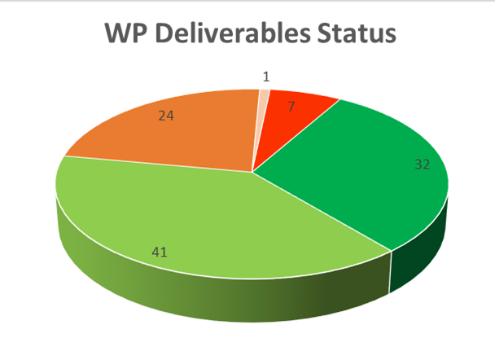
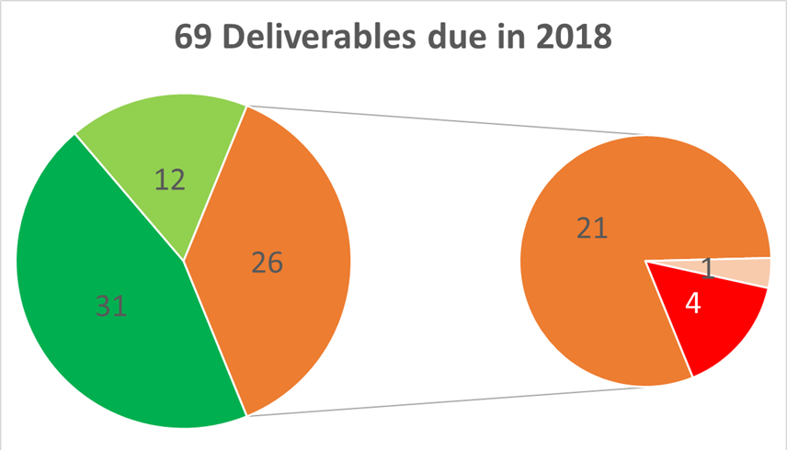
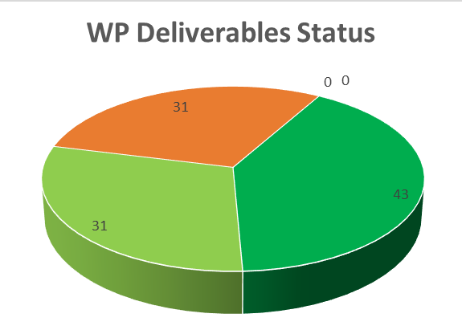
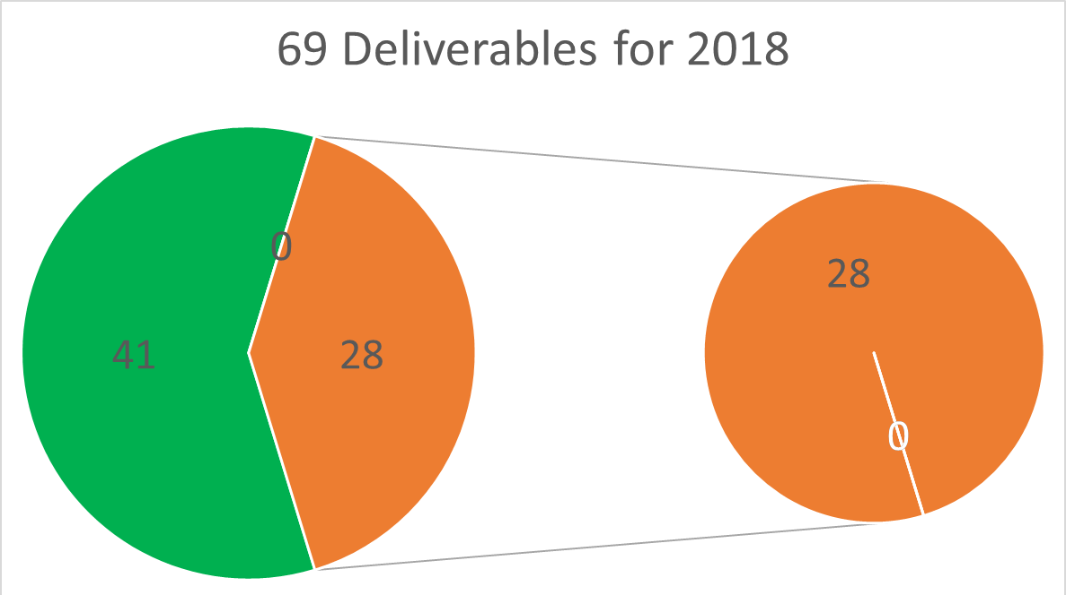
Progress against 2018-2020 WP
Status on 30/09 - Presented at CEOS Plenary
Status on 31/12

Slide 6
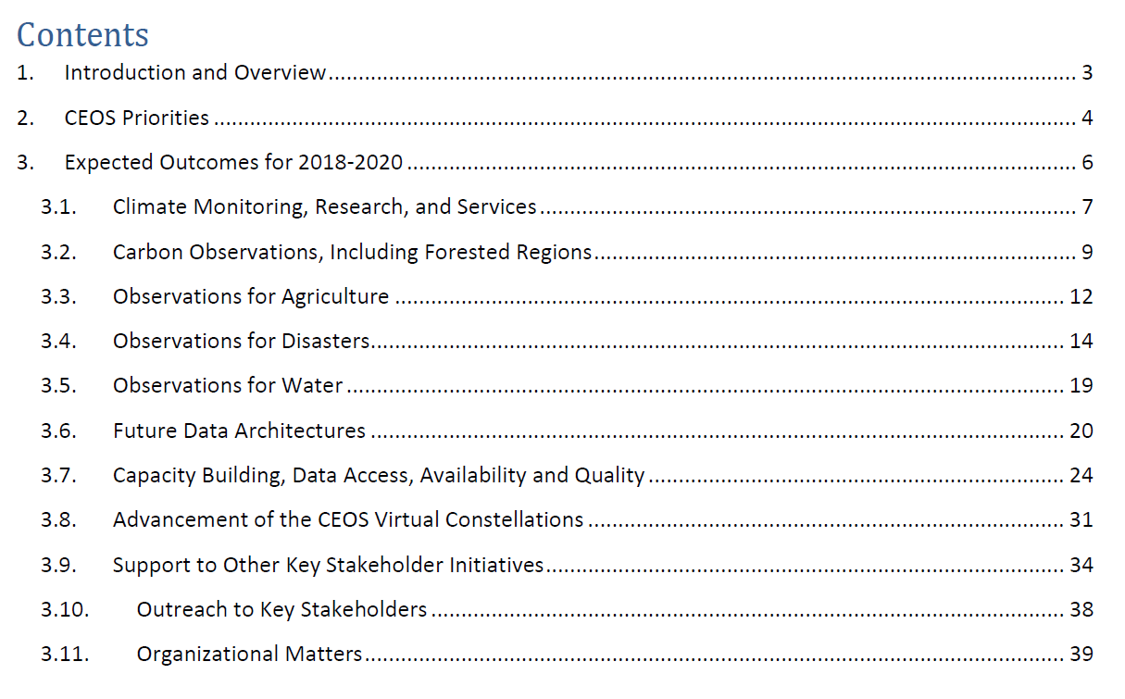
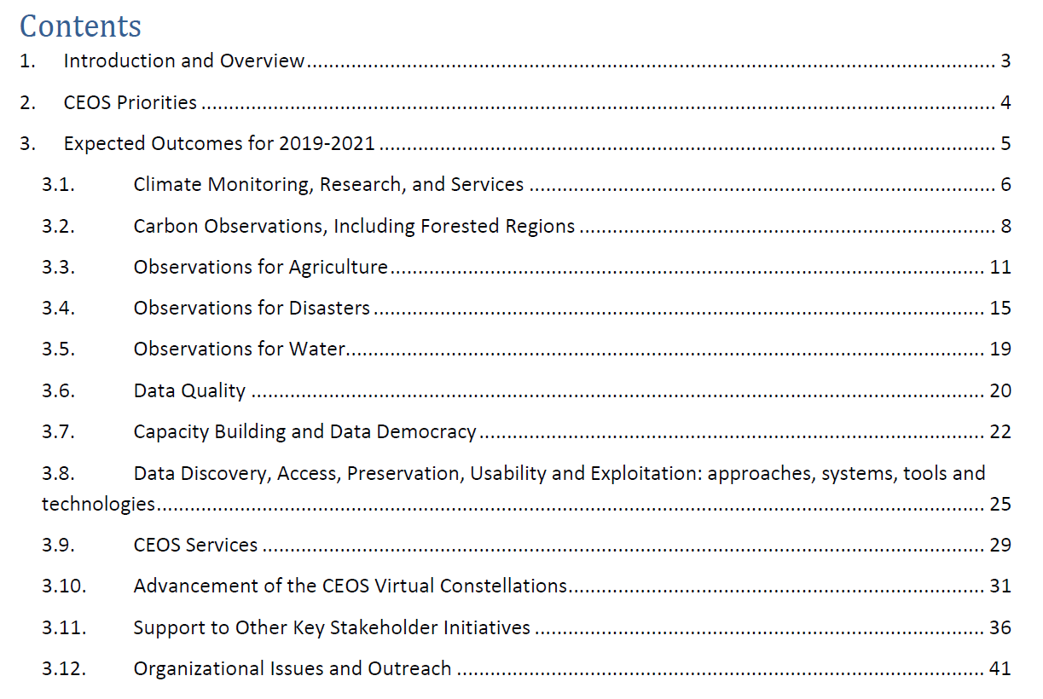
Status of CEOS 2019-2021 WP
Some changes to the structure
Thematic: Climate, Carbon, Agriculture, Disasters, Water, SDGs, Oceans and coasts, Polar, Biodiversity
Cross-cutting: Capacity building, Data access, Data quality, VCs, Outreach
2018
2018
2019
2019

Slide 7


2018 to 2019 …
Evolutions 2018 to 2019 …
103 open deliverables
(91 in 2018, 88 in 2017)
  76 deliverables to be closed in 2019 (69 in 2018)
  42 newly created in 2019 (29 in 2018)
~28 open 2018 deliverables had completion data pushed back (29 in 2017)
+ 13%
+ 10%
+ 38%
+ 0.3%

Slide 8
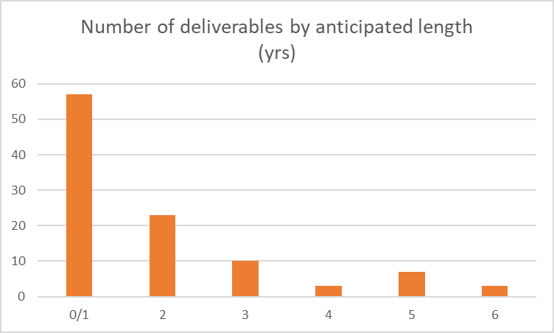
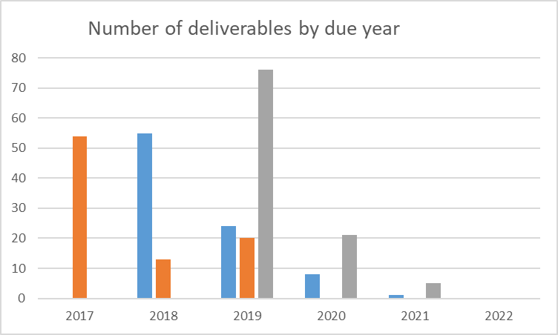
WP 2019-2021 in figures
103 open deliverables of which 42 newly created in 2019
Of these 42 new deliverables
  83% scheduled to be
  completed in 2019
  16% in 2020
  1% in 2022
WP 2017-19
WP 2018-20
WP 2019-21

Slide 9

Status of CEOS 2019-2021 WP
CEOS 2019-2021 Work Plan was submitted to principals on 14th March
Virtual endorsement completed on 22nd March
Endorsement 3 weeks earlier
than in 2018
Endorsed version now available.

Slide 10
Work Plan Dos and Don’ts
Good practice
… distinguish Work Plan development phase (November to February) to Work plan progress reporting phase (September)
Work plan development: check relevance of current deliverables and propose new ones if required
Work plan progress: provide information on progress made on deliverables in the current work plan
… be rigorous when closing Work plan deliverables – provide a record of completion and deliverable documents
… the rest ….
Deliverables shouldn’t significantly evolve over a 12 month period
Avoid modifying substantially deliverable title or description: small changes are acceptable, but deliverables should not be rewritten thereby losing traceability

Slide 11
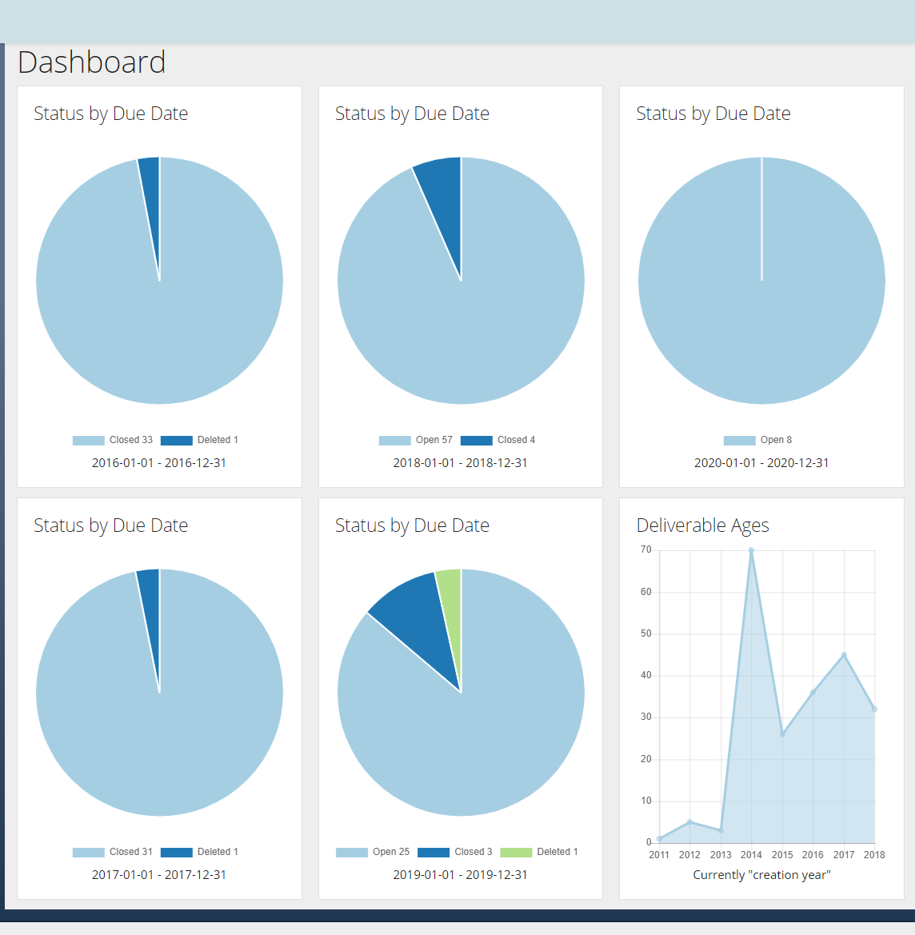
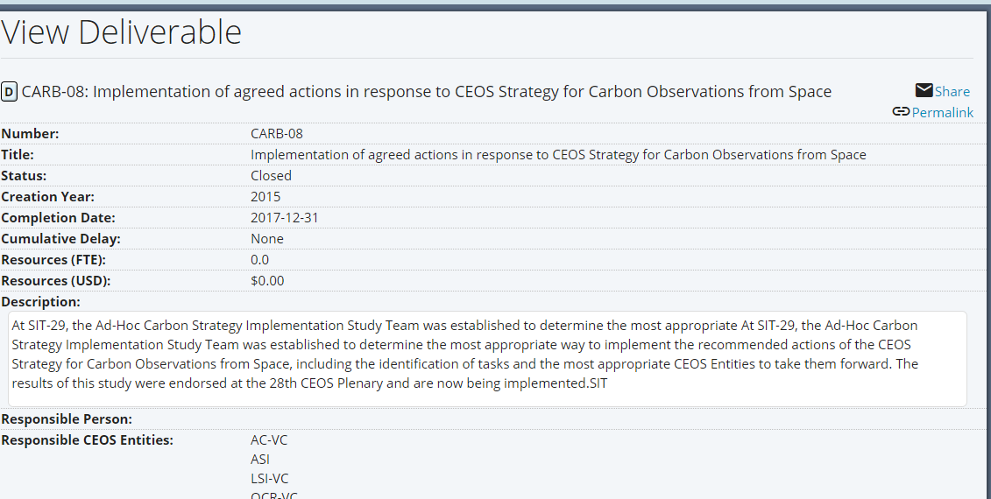
Coming soon …. to your desktop
Development of a new CEOS Deliverables database with added functionality

Slide 12
Takeaway messages …
Continue to steer the WP as a tool for CEOS leadership at all levels to monitor progress against commitments
Overall good progress on WP in 2018:
  43% deliverables completed, 29% On Track, 29% Delayed
WP 2019-2021 endorsed 3 weeks earlier than 2018 despite difficult circumstances
WP 2019-2021 has +15% deliverables in all and +10% to be delivered this year

