Slide 1
Satellite Data for the Oceans
Joe Sienkiewicz,
NOAA Ocean Prediction Center
College Park, Maryland
CEOS-SIT
Notes:
Thank you for the opportunity to address this important committee. I want to represent two perspectives in this brief talk. The first is of an operational marine meteorologist with wind warning responsibility over large ocean areas with complex weather and interactions. The second is as a member of a training team that shares knowledge about remote sensing capabilities for oceans for key parameters of winds, waves, and imagery.

Slide 2
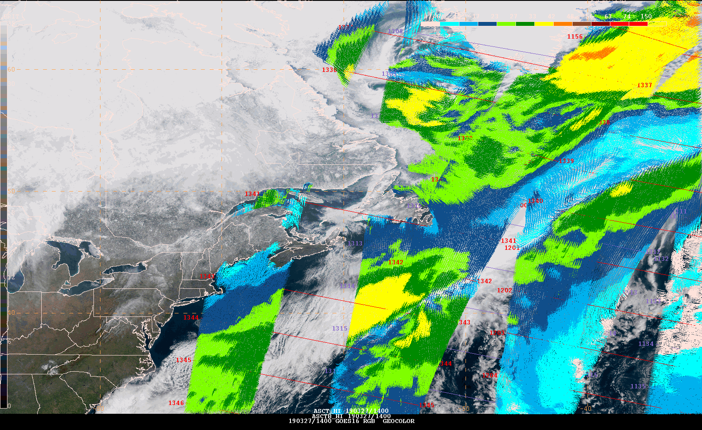
Data user perspective
Data formats
accepted
anticipated Latency – as low as possible
Notes:
Thanks to many of you in this room and the governments and agencies around the world we live in an age of remarkable remote sensing capabilities from earth observing satellites in geostationary and low earth orbits. This geocolor image from GOES-16 or E is just a single snap shop that reveals the cloud structures over a very dynamic North Atlantic. We can combine that with low earth orbiting data from the METOP-A satellite scatterometer and can have an good indication of the surface wind field.

Slide 3
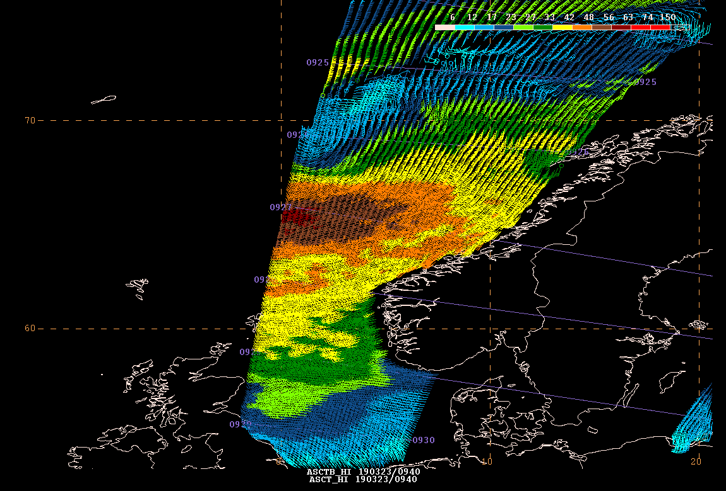
Displays
Easily interpreted
Data acquisition time
QC or appropriate flagging
Can distinguish criteria
(Beaufort scale)
Standardized displays
Observations
Numerical model output
Can thin for legibility
Be careful not to thin relevent signals
We make decisions based on a single piece of data
Notes:
To optimize displays we worked with our forecasters to create displays that are easily interpreted. Specific wind speed ranges are colored coded with anything yellow and warmer are critical criteria requiring wind warnings. Ranges match the Beaufort categories with yellow being GALE and and orange Strong GALE. Brown is storm with reddish brown being violent storm Force 11.

Slide 4
Notes:
We copied those displays for numerical model output so that our forecasters could easily overlay satterometer winds over the model analysis or short term forecast and do a quick assessment of model short term skill. In this example the winds field of storm force is larger than the US GFS and stronger with the scatterometer winds of violent storm force.

Slide 5
Hurricane Force Extra-tropical Cyclones - Detection and Warning Trend using QuikSCAT 2000-2009
Hurricane Force Warning Initiated Dec 2000
Detection increased with:
Forecaster familiarity
Data availability
Improved resolution
Improved algorithm
Improved wind
algorithm and
rain flag Oct 06
12.5 km QuikSCAT
available May 04
25 km QuikSCAT
Available in N-AWIPS
Oct 01
Totals
A-289
P-269
558
Hurricane Force
Wind Warning
Initiated Dec 00
QuikSCAT
Launch
Jun 99

Slide 6
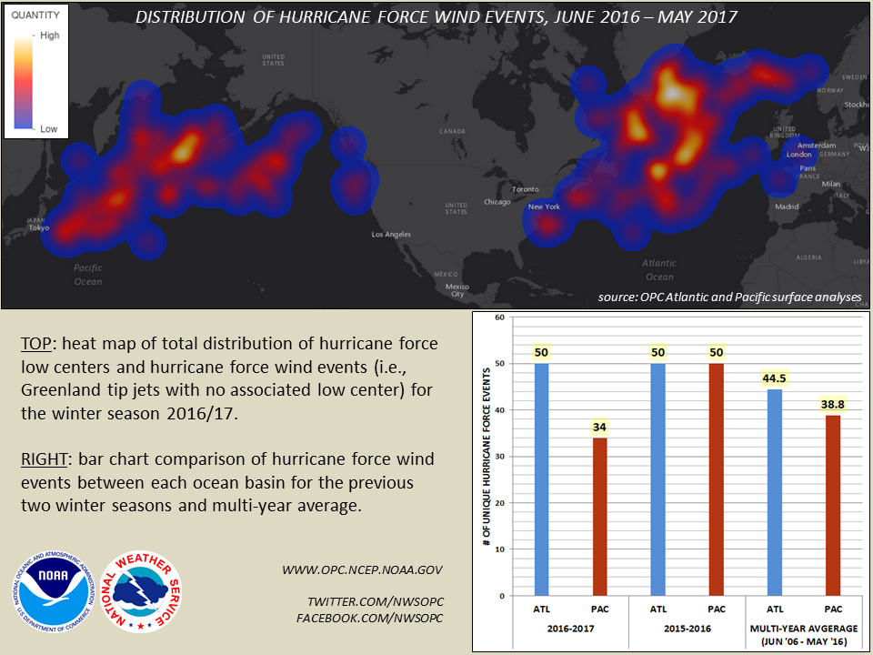
Extreme Maritime Weather Storms of Hurricane Strength
ATL PAC
2017-18 47 26
2018-19 39 30
6
Notes:
Location of storms that produced Hurricane force winds
The number of extreme storms is phenomenal
We are able to observe these conditions via the Metop scatterometers via consistent and standardized ocean vector winds measurements that have been validated using buoys and NOAA P-3 flight data.

Slide 7
GOES-16 Sea Surface Temperature
Notes:
We looked at clouds and winds and this example is meant to illustrate the sea surface temperature and wind relationship. First – the 2 km IR capability of the GOES-R series with the ABI imager is a big advancement in being able to being to observe the complexity and dynamic nature of the ocean surface. This is a 4 day composite of SST with the most recent pixel being displayed… the starting point is one hourly image with the volume being 24 per day over 4 days. We are changing that to 10 min imagery over 4 day period and displaying the most recent to take full advantage of the capability. I do think that this capability is underappreciated and we will grow with it as it become available and cloud separation schemes improve and become more definitive. SST is a challenge to display as fixed ranges over the year can mask ocean features… more dynamic capabilities to highlight features such as SST fronts is really needed but is also dependent on use.

Slide 8
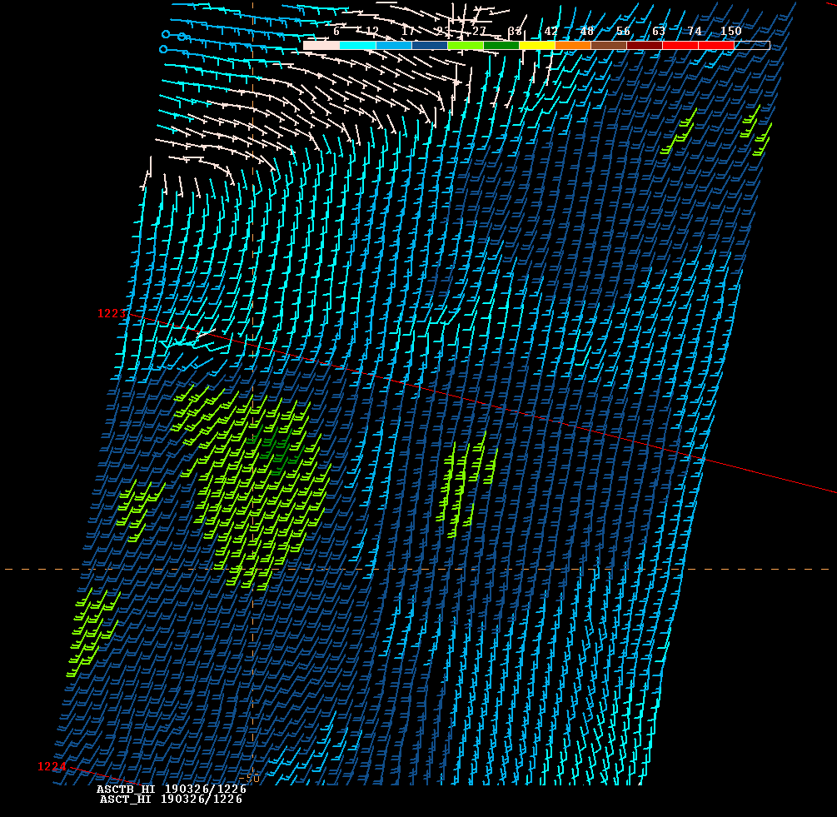
GOES-16 Sea Surface Temperature
Notes:
In this example the Wind speeds from ASCAT-B show a blotchy wind field with large blobs of higher winds from the Gulf Stream / North Atlantic Drift southward over the warmer water. The the north of the GS the winds are much lower. This is due to well mixed PBL over the warmer water and a highly stratified PBL with a very shallow inversion over the cooler water restricting mixing.

Slide 9
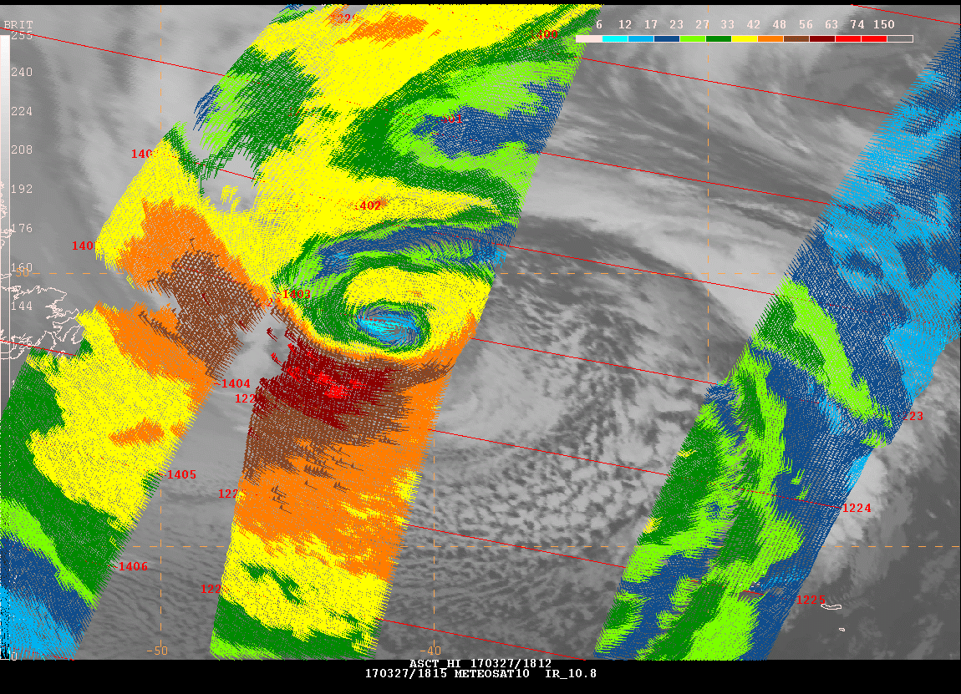
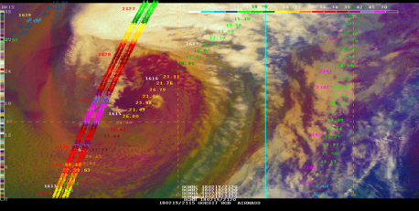
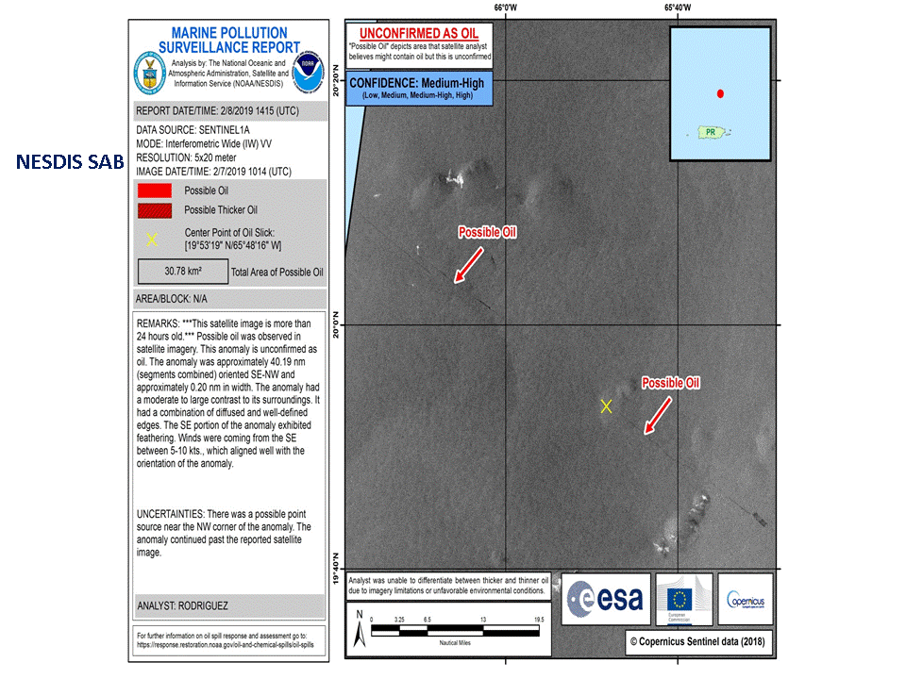
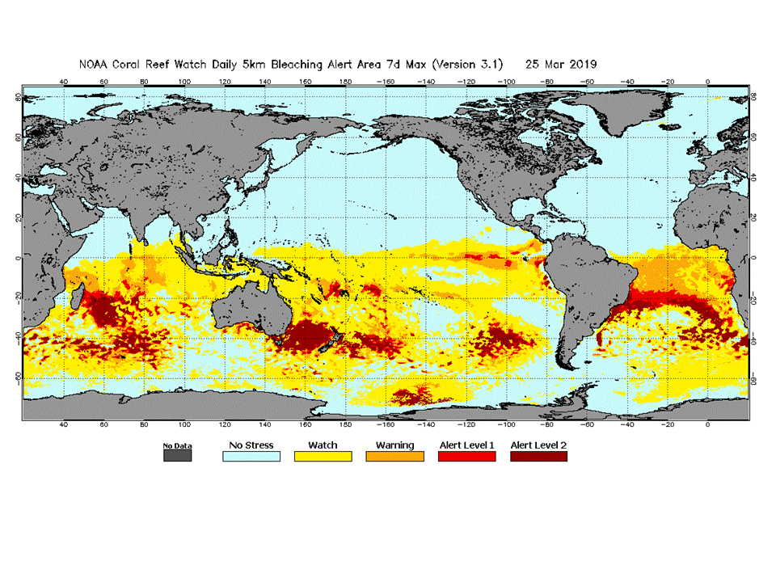
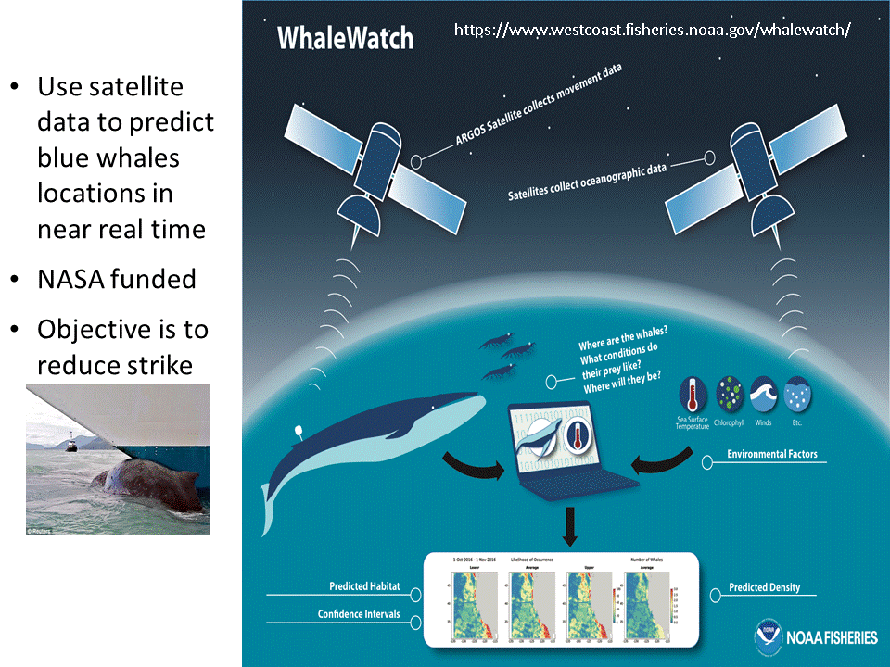
Applications
Hurricane Force Winds
Wind Warnings
Oil Detection
Phytoplankton
Sea Ice
Sea Ice Coverage
Coral Reef Bleaching
Limit Bycatch
Snow and Sea Ice
Parameters
Ocean Vector Winds
Waves
Sea Surface Height
Sea Ice
SAR NRCS
Sea Surface Temperature
Ocean Color/Chlorophyll
Eddy Kinetic Energy
Mammal Protection Harmful Algal Blooms
Notes:
Sampling of applications of imagery and the parameters and combinations of parameters observed/retrieved.

Slide 10
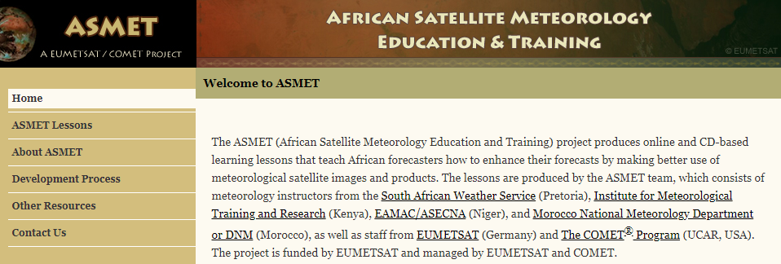
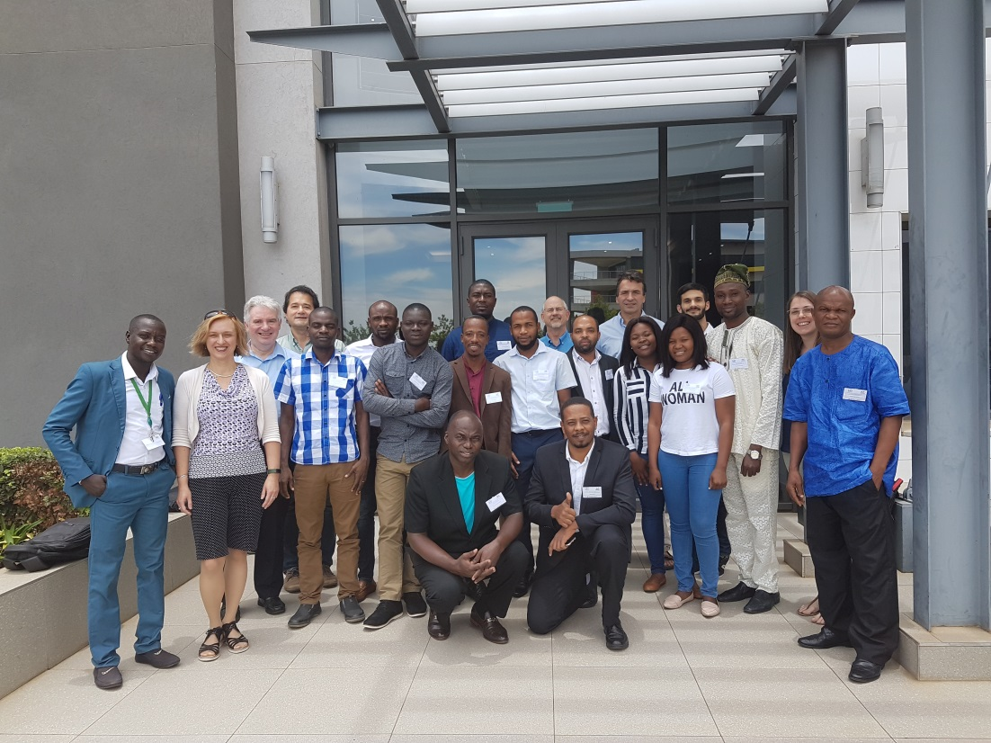
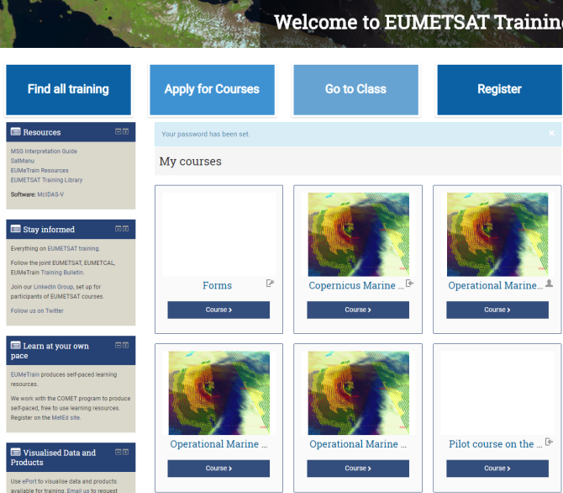
Training
Hands on
Integrated displays
data
models
observations
Interaction w/SMEs
Students
depart with data and application
No guarantee post course
Notes:
Training efforts sponsored by EUMETSAT and supported by NOAA via contributing instructors. This class was last Dec in Centurion South Africa at the temporary SAWS facility. A good facility with segregated server for the training room to most efficiently access and display data and use a common display software package.

Slide 11
Thoughts…
What are spatial and temporal sampling needs for phenomena of interest?
Orbit phasing, repeat cycle, diurnal cycle
Having similar sensors
Low data latency
Data sharing of satellite capabilities to enhance or create a constellation
Altimeters
Ocean winds
Usage – forecasters make critical decision based on one data point
requires display of representative resolution (instrument capability)
Validation
Example – ocean winds in extreme conditions – P-3 flights
Integrated observations (collocation in space and time) of atmos and ocean
Determine dependencies (EX: Wind, SST, Rain)
Training
Co-located with Subject Matter Experts (not so for most)
Requires validated and consistent data (similar answer from similar instruments)
Data access and readability needed – understand strength and weaknesses
Post training – access and utilization (continues a big challenge)

