Slide 1
WG Title Goes Here
Committee on Earth Observation Satellites
Name (s), Organization, CEOS Affiliation
CEOS SIT-34
Session and Agenda Item #
Miami, FL, USA
3 – 4 April 2019

Slide 2
Structure of Template
Slides 3 – 6: Background and Context
SIT-34 background reading, context, and process
Information only - remove these from your final PPT
Slides 7 – 11: Content Requested
Reflect on progress since SIT-33, discussion at SIT TW 2018
Specific content and inputs to provide
Provide max total of five slides to address these points in your final presentation

Slide 3
Background and Context

Slide 4
Background Reading
Please review and reference v2.0 the STRATEGIC DIRECTIONS AND PARTNERSHIPS FOR CEOS DISCUSSION PAPER prepared by the NOAA SIT Chair Team
2018 paper v1.0 here
2019 updated v2.0 will be circulated with the SIT Agenda materials and available at ceos.org/meetings/sit-34

Slide 5
Context: SIT Chair Objectives (2018)
Ensuring tangible outcomes from and sustainable commitment to our Virtual Constellations and Working Groups (VCs and WGs). NOAA will place emphasis on ensuring the necessary support is in place for our existing thematic teams to flourish and to deliver, and to provide productive opportunities for VC-VC and VC-WG interactions at SIT technical meetings and other ad hoc gatherings. NOAA SIT will bring attention of the VCs and WGs to the ongoing national EO program planning processes, including the Copernicus Next Generation planning, the US National Academies Earth Science Decadal Survey, NOAA’s space architecture studies, and Japan’s future EO frameworks, among others, and in support of CEOS commitments in relation to the ECV inventory and Sustainable Development Goals.

Slide 6
Presenter Submission Guidance
Presenters should name their files using the following convention:
AgendaItemNumber_LastName_Subject_Version.pptx (e.g., 1.5_Holloway_Communications_v2.pptx)
Reporting to support discussion or decision is encouraged, but historical context and detailed reporting should be provided as pre-meeting reading material or in background slides.
Materials should explicitly highlight the decisions, outcomes, or actions you are seeking
Feel free to propose draft action text for consideration – it may be revised, but will help with the efficient preparation of the actions record.
Materials should be sent to george@symbioscomms.com and kerry.sawyer@noaa.gov
Documents for endorsement: no later than Wednesday March 20th
Presentations: no later than Tuesday March 26th

Slide 7
Content Requested

Slide 8
Content Requested
Provide max total of five slides to address these points in your final presentation
Suggestion - 1 slide each to address
Linkages to CEOS Work Plan (e.g. action numbers), open SIT and Plenary actions
Indication of required decisions and discussion points
Team Achievements and Planned Outcomes [See slide 9]
Synergies amongst teams (e.g. VC-VC, VC-WG, WG-VC, WG-WG, other) [See slide 10]
Sustainable commitment [See slide 11]
Proactive Consideration of SIT TWS and Plenary deliverables and discussion items

Slide 9
Team Achievements and Planned Outputs
Focus on activities, outcomes and lessons learned since SIT-33, reflecting 2018 SIT TW discussion
For clarity on the team contribution to the global observing architecture and national planning purposes, please summarize major past achievements and planned future outputs in terms of:
Specific datasets, products, or standards
ECVs
Architecture studies
Gap analyses / advocacy
Comment on the availability of these to contribute to future coordination efforts by CEOS or agency mission planning activities
Identify items that can be followed-up in the next year

Slide 10
Synergies Among Teams
For your team, please identify synergies that exist, or should exist, between the VCs and the WGs to support the broader CEOS objectives
including opportunities for the framework provided by WG activities to align with and support the thematic activities and aspirations of your VC or all VCs
Identify also any obstacles/barriers to progress and suggestions for how to overcome those obstacles/barriers.

Slide 11
Sustainable Commitment
Identify the active agencies in your team and whether this implies a viable team for your objectives
How frequently does your team physically meet?
Are their any obstacles to the future viability of your team meeting its objectives?
A full and frank understanding of the status and outlook for each group will help CEOS understanding of their potential contribution to the observing strategy

Slide 12
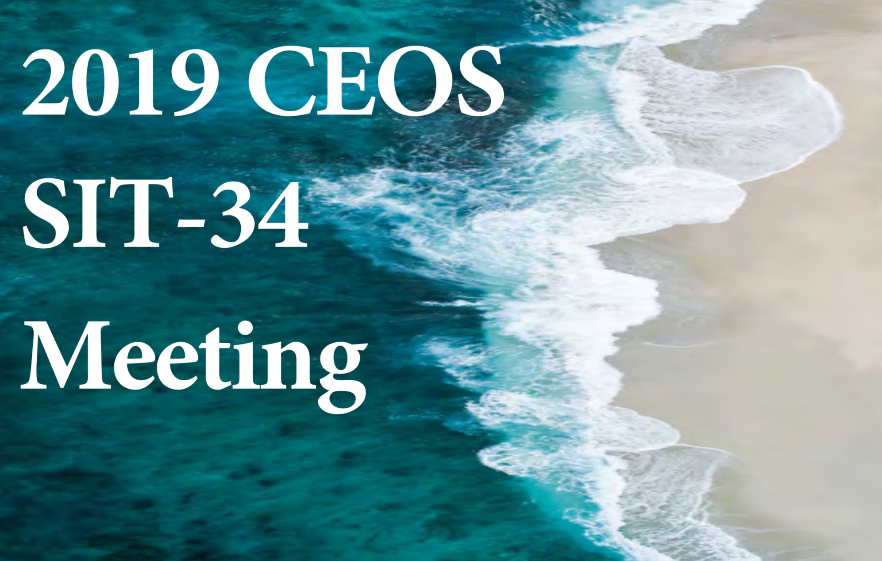
Thanks! See you in Miami!
Questions?
Kerry.Sawyer@noaa.gov
george@symbioscomms.com

