Slide 1
AHT Title Goes Here
Committee on Earth Observation Satellites
Name (s), Organization, CEOS Affiliation
CEOS SIT-34
Session and Agenda Item #
Miami, FL, USA
3 – 4 April 2019

Slide 2
Structure of Template
Slides 3 – 5: Background and Context
SIT-34 background reading, context, and process
Information only - remove these from your final PPT
Slides 6 – 9: Content Requested
Reflect on progress since SIT-33, discussion at SIT TW 2018
Specific content and inputs to provide
Clearly addressing plan for ad hoc lifecycle closure (slide 9) and as applicable related Plenary actions (slide 10)
Provide max total of five slides to address these points in your final presentation

Slide 3
Background and Context

Slide 4
Background Reading
Please review and reference v2.0 the STRATEGIC DIRECTIONS AND PARTNERSHIPS FOR CEOS DISCUSSION PAPER prepared by the NOAA SIT Chair Team
2018 paper v1.0 here
2019 updated v2.0 will be circulated with the SIT Agenda materials and available at ceos.org/meetings/sit-34

Slide 5
Presenter Submission Guidance
Presenters should name their files using the following convention:
AgendaItemNumber_LastName_Subject_Version.pptx (e.g., 1.5_Holloway_Communications_v2.pptx)
Reporting to support discussion or decision is encouraged, but historical context and detailed reporting should be provided as pre-meeting reading material or in background slides.
Materials should explicitly highlight the decisions, outcomes, or actions you are seeking
Feel free to propose draft action text for consideration – it may be revised, but will help with the efficient preparation of the actions record.
Materials should be sent to george@symbioscomms.com and kerry.sawyer@noaa.gov
Documents for endorsement: no later than Wednesday March 20th
Presentations: no later than Tuesday March 26th

Slide 6
Content Requested

Slide 7
Approach and Reading
In your materials, please address:
tangible outcomes (outputs, products) your ad hoc Team adds beyond standing CEOS activity (e.g. VC and WG work)
maturity and viability of supported initiative (e.g. outlook and anticipated evolution)
unique and enabling support provided by CEOS via your AHT
blockers, required decisions, and suggestions to resolve
assessment of AHT trajectory and life cycle
sustainment and expectations of CEOS and CEOS members
Suggestions for transition process/retirement plan

Slide 8
Ad Hoc Teams - Activities
Focus on activities, outcomes and lessons learned since SIT-33, reflecting 2018 SIT TW discussion
Outline AHT support to emerging topics beyond CEOS VCs and WGs capabilities and activities
Highlight upcoming activities that uniquely require CEOS support to progress
Provide status of activities, including an assessment of maturity and viability of supported initiatives, with consideration of a transition from ad hoc to standing CEOS support, if appropriate

Slide 9
Ad Hoc Teams - Lifecycle
Ad hoc teams asked to:
address Plenary actions in relation to AHTs (see slide 10);
reflect and report on their group trajectory and lifecycle in relation to the initiatives they support;
present a clear outlook and the expected evolution of those initiatives, including long-term, sustained activity;
expectation for CEOS and CEOS member agency participation; and,
confirm suggestions for CEOS around how a regularized transition process for ad hoc Teams might look.

Slide 10
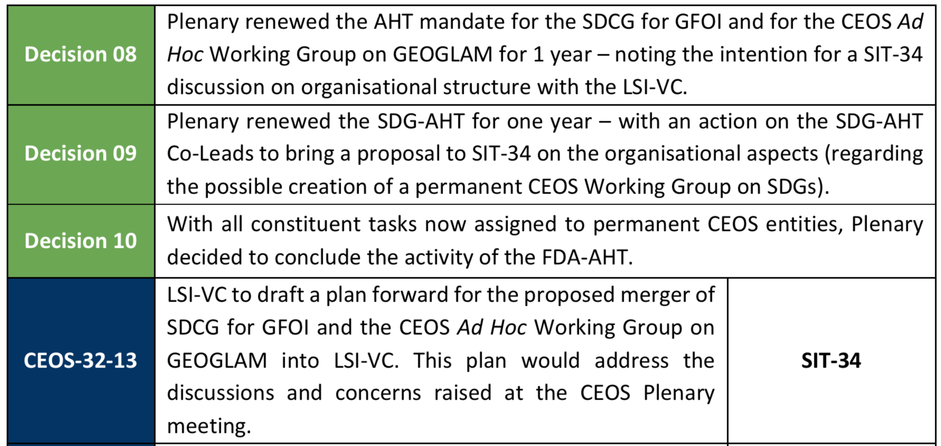
Ad Hoc Teams – Plenary Actions

Slide 11
Thanks! See you in Miami!
Questions?
Kerry.Sawyer@noaa.gov
george@symbioscomms.com

