Slide 1
CEOS Ad Hoc Working Group on GEOGLAM
Committee on Earth Observation Satellites
B. Doorn (NASA), S Cherchali (CNES)
CEOS SIT-33
Session 6 and Agenda Item 6.5
Boulder, CO, USA
24 – 25 April 2018

Slide 2
GEOGLAM: Continued Strong Mandate
Re-endorsement of GEOGLAM by G20
Signaling ever greater support, strengthened political mandate
EO for timely, reliable information
Contributing to the UN Sustainable Development Goals
Short Term: Leverage existing activities
Medium Term: quantitative metrics from R&D activities; accelerate RtO continuum
Long Term: strengthen international cooperation and identify institutional homes for activities

Slide 3
Changing EO Landscape
In 2011, at GEOGLAM’s inception, we were constrained by acquisition of data at appropriate resolutions
Now – in 2018, we are in a “big data” world, constrained by access and use (computational environments),
EO solutions are expected,
multi-platform solutions are common,
in-situ agriculture validation data is a growing constraint to EO adoption

Slide 4
CEOS Agencies Support Agriculture
Many CEOS agencies have strong programs in support of agriculture monitoring
Key societal benefit cited by almost all civil space data providers
Land cover, meteorology, commercial imagery - all apply
No single provider or VC addresses all aspects
Unique requirements which require space data provider stewardship and support to develop
Large, diverse, and fast moving data streams required for EO’s full potential to be realized
Maximizing the benefit of EO requires community coordination and CEOS is uniquely placed to provide that coordination function

Slide 5
Requirements Meeting Outcomes
TBA following meeting

Slide 6
Tangible Outcomes
Curated agricultural monitoring data requirements
AGRI-4: CEOS Strategic Response to GEOGLAM Requirements
Started in 2012 with stewardship of GEOGLAM EO Requirements and Strategy
To be updated based on GEOGLAM requirements v.2 in 2018
Coordination of prototype Data Cubes in support of Asia-RiCE (Mekong), JECAM (South Africa, SAR Inter comparison Study)
Coordination and deployment of CEOS and national data across JECAM research sites
More outlined in Scope of Work presented at CEOS Plenary 2017

Slide 7
GEOGLAM Maturity and Viability
Well supported GEO Flagship with strong policy mandate and broad agriculture network
Project Office supported within GEOSEC for at least 2-3 years
Explicit priority on EO coordination and an active EO point of contact (Boulder’s own Alyssa Whitcraft)
G-20 Ministerial profile
CEOS EO coordination function highly complementary with other CEOS efforts
Acquisitions
Data products (e.g. optimised ARD formats)
Tools (e.g. Data Cube)
Community (e.g. LSI-VC, SDCG, Leadership forums, Disasters, Capacity Building)

Slide 8
Lifecycle - General Views
CEOS needs a responsive capability to address emerging topics which may not require permanent / structural support
Including activities whose support requirement needs to be assessed
CEOS ad hoc WG lifecycle could be coupled to the CEOS Work Plan horizon
i.e. 3-year initial lifespan with 3-yearly reviews
Structure annual Plenary item around reporting
Permanent status may help with attracting AHWG membership and resources
AHWG is currently seeking expanded membership and more comprehensive engagement with CEOS agency activities

Slide 9
Lifecycle - GEOGLAM Ad Hoc WG Views
AHWG prefers to focus on maintaining and improving outcomes
Support agriculture as a space agency priority
Consolidate EO for agriculture/food security programs supported by space and agriculture agencies
Better connect the agriculture community in EO activities
Better connect space data provider activities to agriculture community
Organisational nature of AHWG a secondary concern, though may need to be addressed after six years of ‘temporary’ status
Long term assumption has been an evolution towards LSI-VC
No objection, so long as outcomes remain the priority
Concerns
Expertise overlap between LSI-VC and AHWG
LSI-VC is preparations for a merger

Slide 10
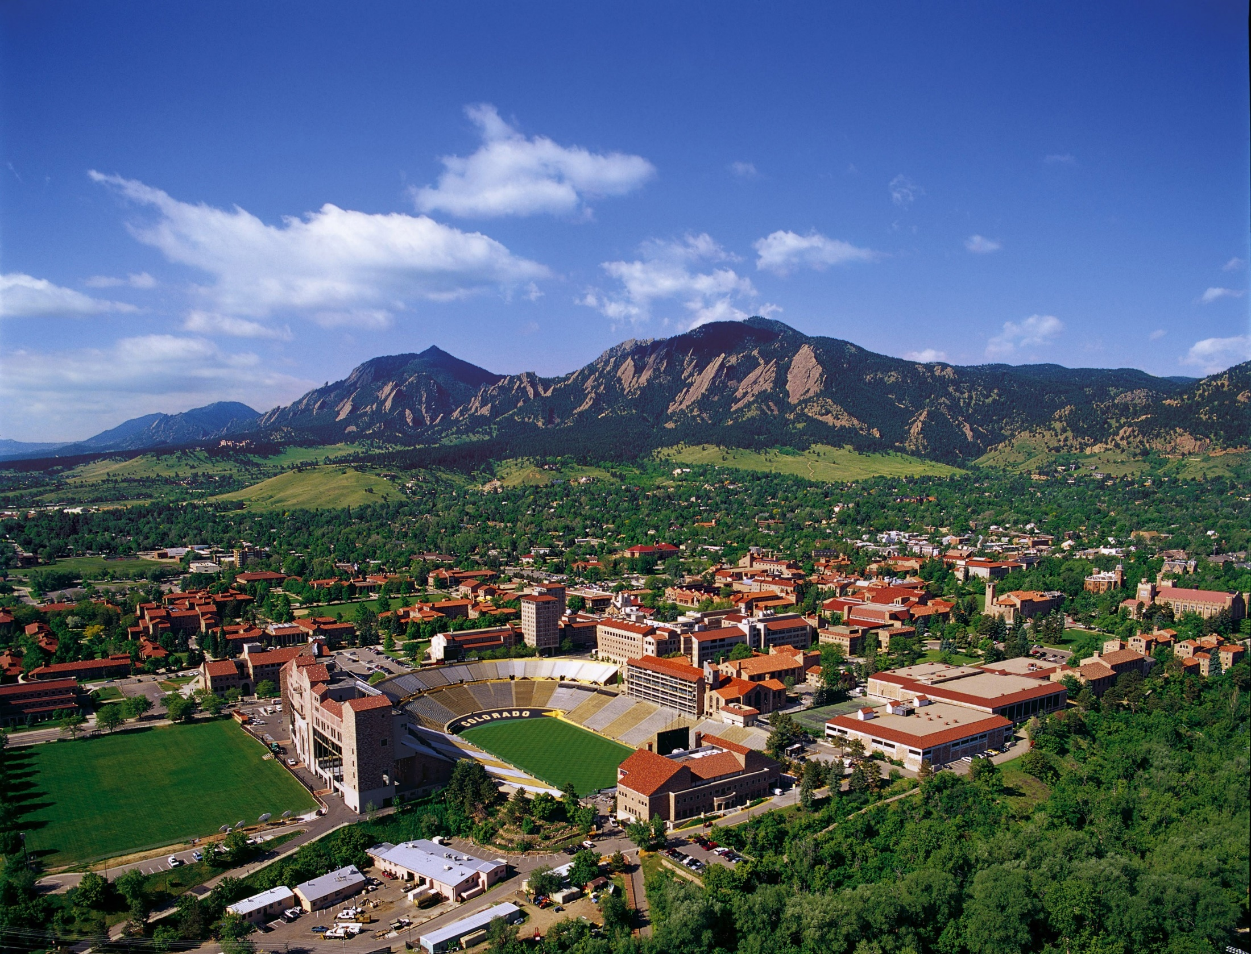
Questions?

