Slide 1

WG Disasters Report
Committee on Earth Observation Satellites
Simona Zoffoli, ASI, Chair WG Disasters
CEOS SIT-33
Session 4 and Agenda Item # 4.4
Boulder, CO, USA
24 – 25 April 2018

Slide 2
Overview
WG Disasters activities
Team Achievements and Planned Outcomes
Synergy among teams and outreach to other CEOS members
Sustainable commitment
Items for decision at SIT-33:
  Proposal for a CEOS Volcano Demonstrator
  Proposal for a CEOS Seismic Hazard Demonstrator
  Proposal for the 1st GEODARMA pilot project

Slide 3
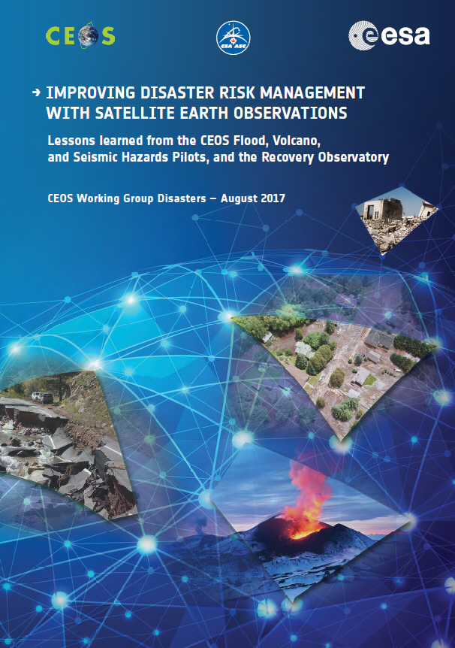
WG Disasters Coordination Effort
Coordinates disaster-related activities undertaken by CEOS Agencies and acts as an interface between CEOS and the community of stakeholders and users involved in DRR
Thematic areas (floods, seismic hazards, volcanoes, landslides) – pilots and demonstrators
Haiti Hurricane Matthew Recovery Observatory
GEO-DARMA
Geohazard Supersites and Natural Laboratories (GSNL)
Geohazards Laboratory
CEOS Workplan 2018-2020 cap.3.4, Obj/Del DIS 10/12/15/16/17

Slide 4
Team Achievements and Planned Outputs
Major past achievements:
  Showcased to end users the value of EO derived information for DRR
  Validation of methodology for new products generation
  Generation of advanced science product for emergency response
  Facilitated data access and processing
  Collaboration with mission operators to optimize EO coverage
Items that can be followed-up in the next year
  Fill gaps where satellite observations are not being fully exploited
  Awareness raising and Capacity Building
  Engage more CEOS members

Slide 5
WG linkages to SIT Strategic Directions
Ensure tangible outcomes and sustainable commitment in planning and implementing WG Disasters activities
  e.g. transition from pilots to demonstrators to increase visibility of actions and identify and secure long-standing partnerships that lead to sustainable contributions;
Increase synergy and complementarity with international coordinating groups such as GEO
  e.g. GEO Work Plan synergies, leveraging GEO partnerships, reviewing SBA activities that complement WG activities such as water cycle work;
Study increased synergy between next-generation geostationary satellites and LEO satellites
  e.g. Flood Demonstrator team examining how to improve scalability of user access to observations (from global to local).

Slide 6
Synergies among teams and outreach to others CEOS members
8th CEOS WGDisasters in Buenos Aires as part of the Disaster Risk Reduction (DRR) Across the Americas Summit.
CONAE joined the WG disasters
Sinergies among WG disasters teams: RO & Landslide, multi-hazard approach, GEODARMA & Flood Demonstrator Team
WG CapD : presentation of the RO at the WGCAP meeting. Exploring potential support for the RO project from WG CapD, but also for the other WG projects
WGISS:
  collaborate to support the realization of a WGISS pilot (GEP)
  ‘dotcloud’ platform used by the RO is an implementation of another WGISS pilot activity.

Slide 7
Sustainable Commitment
Many agencies are contributing to the success of the WG Disasters
WG Disasters relationships include a wide range of relevant non-CEOS actors: research institutes, volcanic observatories, but also World Bank/ GFDRR, UNDP, Red Cross, European Commission/Copernicus and others
Possible obstacles:
  The growing emphasis on user-led activities (e.g. GEO-DARMA, RO) places a challenge on CEOS ability to steer projects towards objectives, especially without dedicated budgets
  CEOS agencies increasingly called upon to contribute more than data (capacity building, value-adding) in order to bridge knowledge and awareness gap
Involvement of donor agencies early in process is challenging but critical to sustainability (e.g. RO with World Bank and UNDP)

Slide 8
Linkages to CEOS Work Plan, open SIT and Plenary actions
No open actions (SIT and Plenary)
Workplan 2018-2020
DIS-10: Implementation of data coordination for the GEO-GNSL initiative. Q42020.
Deliverables: Proposals/Reports
DIS-12: Report on survey of donors for post-2017 operation of a Recovery Observatory. Q4 2018.
Deliverable: Report
DIS-15: Support for GEO-DARMA identification of major hazards and DRR issues for each selected region. Q2 2018.
Deliverable: Report
DIS-16: Report on Landslide Pilot and follow-on actions. Q4 2019
Deliverable: Report
DIS-17: Demonstrators Implementation Plan. Q1 2018
Deliverable: Demonstrators Proposals and IP
Notes:
DIS-13 (Report on follow-on actions to DRM pilots) CLOSED
DIS-15 GEO-DARMA Latin America Caribbean major hazards and DRR issues will be completed Q2/3 2018. Africa and Asia completed.
DIS-17 Flood Demonstrator will be presented in Q3

Slide 9
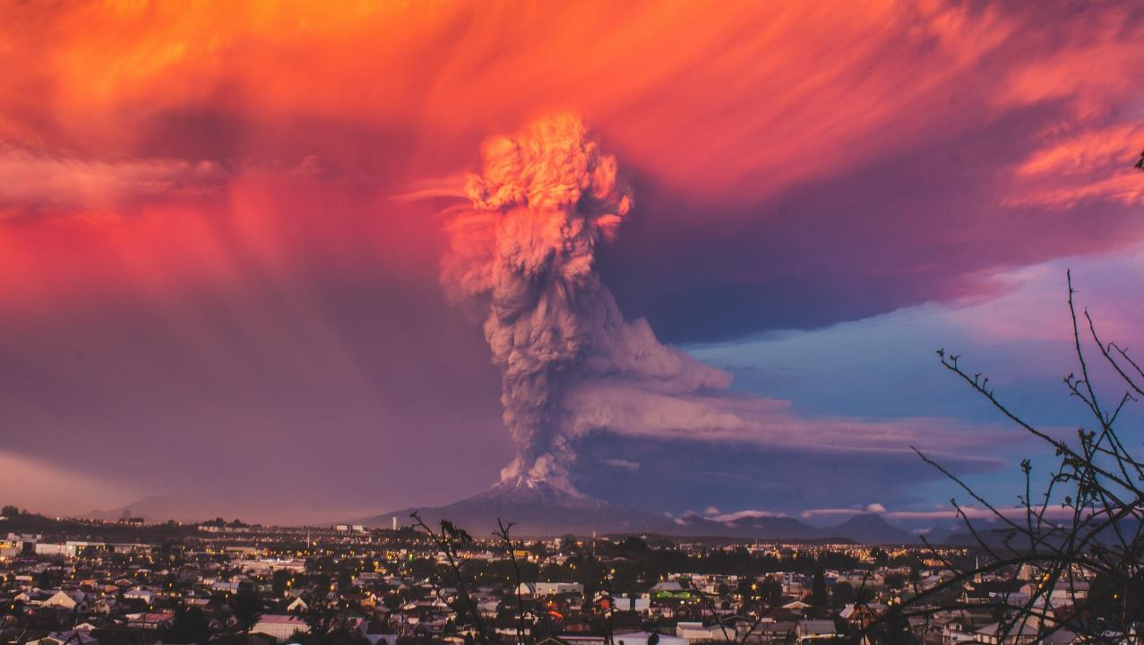
The CEOS Volcano Demonstrator
Rationale and Implementation
For more information and comments, please refer to CEOS Volcano Demonstrator ppt

Slide 10
Leveraging CEOS Volcano Pilot results
The 2014–2017 CEOS Volcano Pilot: Goals & Achievements
Identify volcanoes in Latin America that are in a state of unrest
Track unrest and eruptions using satellite data to support hazards mitigation
Assess data needs in terms of volume, repeat times, spatio-temporal resolution, wavelength, etc., to improve satellite-based monitoring techniques
Develop a strategy for capacity-building in countries that do not currently have access to abundant EO data and/or the ability to process and interpret such data.
Identified restless volcanoes that would not otherwise be known (for example, Cordón Caulle, Chile)
Comprehensive tracking of unrest and eruptive activity
Demonstrated need for a diverse approach (multiple satellites, multiple capabilities)
Helped inform decisions about alert levels and response (for example, Chiles-Cerro Negro, Chile; Masaya, Nicaragua; Sabancaya, Peru)

Slide 11
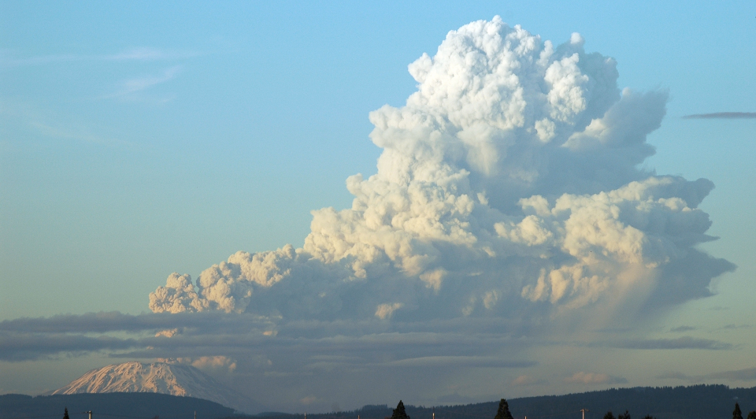
Volcano Demonstrator: an evolution from the Volcano Pilot
~100 volcano observatories around the world with a range of heterogeneous needs
More observations are needed at a diversity of volcanoes to understand the nature of precursors and manifestations of eruptive activity
Focus on integrating SAR with IR, UV, and visible observations to develop a comprehensive approach to satellite monitoring of active volcanism.
Goals:
Fill gaps where satellite observations are not being fully exploited
Learn more about volcanoes to aid forecasting and risk reduction
Aid with crisis responses
Build capacity in developing nations
Demonstrate a sustainable volcano monitoring system

Slide 12
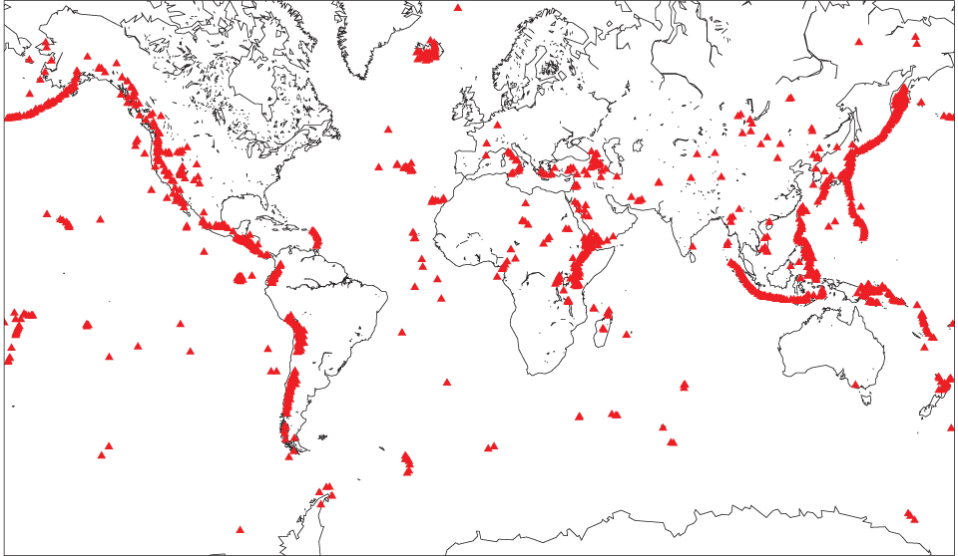
Volcano Demonstrator: areas of focus
The CEOS Volcano Demonstrator will focus on areas highlighted in gray, where volcanic risk is highest and there is the most need for remote sensing resources to better understand volcanoes and monitor their behavior. These areas contain ~50% of all volcanoes that are considered potentially active.
Map of volcanoes with Holocene eruptions

Slide 13
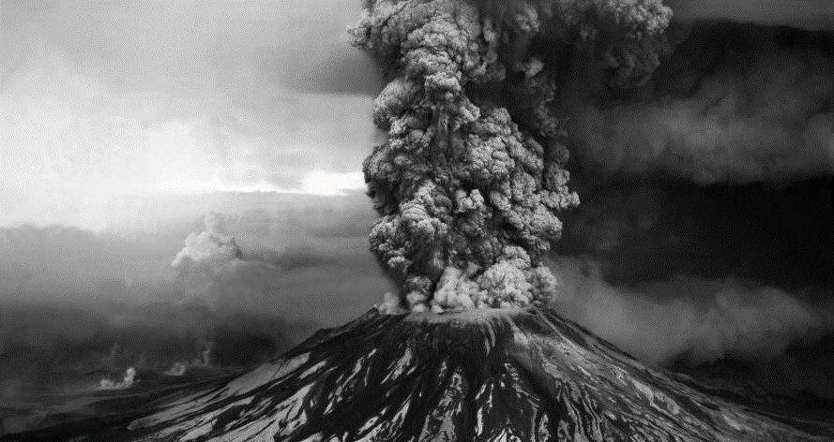
Volcano Demonstrator:
implementation strategy
Partner with established international agencies and universities, including global consortiums (like the IAVCEI Commission on Volcano Geodesy), to cultivate a community of contributors, facilitate capacity building, and broaden demonstrator reach/impact
Use established archives and data distribution systems to ensure data accessibility (Volcano HDDS, GEP, WInSAR, etc.), with access governed by space agency license agreements
Make use of the comprehensive suite of remote sensing wavelengths and capabilities: SAR, visible, thermal, and UV
Leverage existing efforts, like COMET (U.K.) and ARIA (NASA JPL) to process data and assess results

Slide 14
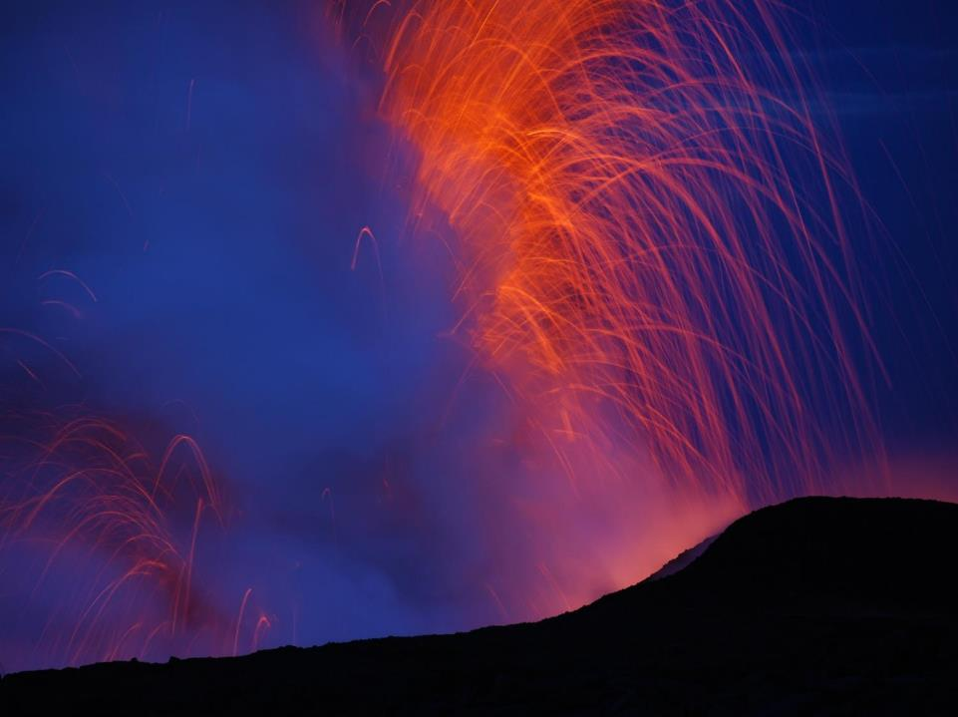
Volcano Demonstrator: implementation timeline
Year 1
  Recruit partners for data analysis
  Establish strategy for capacity building operations (schedule site visits and recruit students for in-depth training)
  Begin studies of restless and erupting volcanoes in Indonesia, Africa, Philippines, Papua New Guinea, Latin America
Year 2
  Implement comprehensive studies of restless and erupting volcanoes in Indonesia, Africa, Philippines, Papua New Guinea, Latin America
  Begin studying quiescent volcanoes in those countries
  Initiate capacity building in via site visits and support student training
Year 3
  Demonstrate capability for monitoring of all Holocene volcanoes in Indonesia, Africa, Philippines, Papua New Guinea, and Latin America
  Complete student training and site visits to participating volcano observatories

Slide 15
Proposed data volumes
Agency | ASI Cosmo-SkyMed | CNES Pleiades | CSA RADARSAT | DLR TerraSAR-X | EU Sentinel-1 & 2 | JAXA ALOS-2
Number of Images per year | 1000 | 200 | 200 | 300 | open | To be accessed through ALOS PIs
CSK: take advantage of frequent repeat intervals and large archive from background mission
Pleiades: focus on restless and erupting volcanoes, update DEMs to aid with SAR processing and hazards assessment
TSX: tight orbital controls ensure interferometric capability, focus on new acquisitions due to lack of background mission
RADARSAT-2: quad-pol capability; higher bandwidth gives better InSAR coherence
Notes:
Volcano Pilot is discussing with DLR possibility of adding TanDEM-X request.
ALOS-2: critical in areas with dense vegetation, increased coherence

Slide 16
The CEOS Seismic Hazard Demonstrator
Rationale and Implementation
For more information and comments, please refer to CEOS Seismic Hazard Demonstrator ppt

Slide 17
The 2014–2017 CEOS Seismic Hazard Pilot: Objectives vs Achievement
Objectives | Achievements
A. Generation of globally strain rate estimates and the mapping of active faults at the global scale | Feasibility of strain rate estimate calculation demonstrated over large area (Turkey and California) and several smaller test case areas; active fault mapping using VHR imagery also demonstrated
B. Support and continue the GSNL | The GEP successfully supported the GSNL experts for data delivery, on demand processing and the integration of chains dedicated to GSNL activities The pilot supported the Gorkha earthquake Event Supersite, with the additional analysis of ALOS-2 data (not provided through the GSNL).
C. Develop and demonstrate advanced science products for rapid earthquake response | The seismic pilot provided support to 8 earthquakes with magnitude > 5.8 in 5 countries worldwide. Uptake by operational end users in Greece and Italy

Slide 18
CEOS Seismic Hazard demonstrator: Way Forward
Intends to expand the precursor Seismic Hazards pilot activities:
              Expand coverage (larger AOI’s, response to a higher number of events)
              Expand the user base to achieve more impact:
                Continue working with the Pilot team
                Take on board new EO practitioners and other (non-expert) geoscience centers with strong links to End users
                Reach End users through geoscience centers.
  New concepts:
  Develop a collaborative framework with geoscience centres to achieve adoption of new EO approaches by decision makers: more cost effective solutions, establish a consensus methodology for product generation
  Support capacity building: expand the use and acceptance of EO products by geoscience centres and decision makers, facilitate end users to interpret EO products.

Slide 19
CEOS Seismic Hazard Demonstrator Objectives
  Not on an emergency basis
  Pursue global tectonics mapping that is a long process
  Expand active fault mapping from regional to global coverage primarily with VHRO for fault reconnaissance mapping
  Develop a collaborative framework with geoscience centres to achieve adoption of technology by decision makers, establish a consensus methodology for product generation and dissemination to decision makers
  Support local capacity building in coordination with GSNL and other initiatives to broaden the use and acceptance of advanced EO products by geoscience centres and academia and facilitate end users with their interpretation.
  On an emergency basis
  Exploit EO data to derive advanced tectonic products for earthquake response: expand to target of at least 10-12 EQ per year
  Articulate with EO disaster response capabilities e.g. the Charter to make sure users are aware of and use it.

Slide 20
User Benefits
It is needed to better address the different segments of the user base:
Academia: able to access data for scientific research.
Expert users from geoscience centers (e.g. those from the Seismic pilot activity): will be able to:
    access EO data that many wouldn’t afford to procure
    provide accurate information to support end users
Geoscience centers doing research or operations (e.g. with a mandate to provide technical advice to national Disaster Response authorities) will retrieve advanced science products from expert users (B) to analyse the events and the impact and better support the decision making process.
Decision makers (e.g. Civil Protection agencies) that typically would receive results (e.g. scientific advice & reports) from the CEOS activity without necessarily being formally engaged.

Slide 21
Proposed data volumes
Agency | ASI Cosmo-SkyMed | CNES Pleiades | CSA RADARSAT | DLR TerraSAR-X | EU Sentinel-1 & 2 | JAXA ALOS-2
Number of Images per year for Seismic Hazards | 200-400 | 50-100 | 50-100 | 60-120 | open | To be accessed through ALOS PIs
Other EO data collections (SAR and Optical including VHRO) to be exploited with processing without download (EO data are accessed by the processing environment but the user can only download the value adding product).
Comparison with Quota provided to the Seismic Hazards Pilot:
Agency | ASI | CNES Pleiades | CSA | DLR | EU | JAXA ALOS-2
Number of Images per year for Seismic Hazards | 300 | 50 | 2 | on request | open | 100

Slide 22
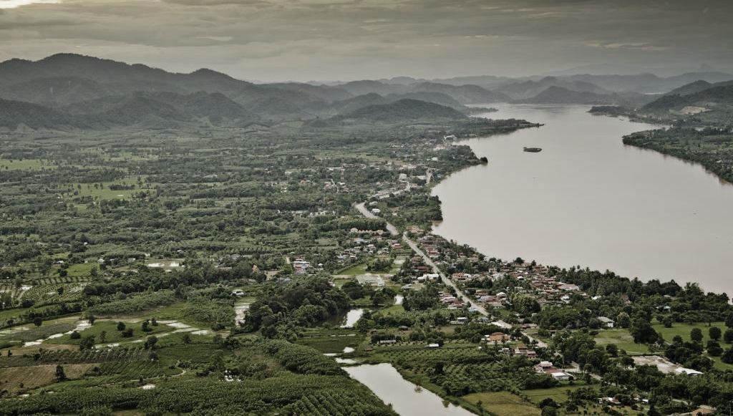
GEO-DARMA 1st pilot SERVIR Mekong: developing a collaborative tool for flood monitoring in Myanmar
For more information and comments, please refer to the CEOS GEO-DARMA Mekong proposal ppt
Notes:
This 1st GEO-DARMA project brings a change in approach. The project put forward is led by a regional centre in Southeast Asia, in close coordination with a national government body responsible for flood management. This user-driven approach will be critical to success and showcasing the value of satellite data, but raises issues of capacity and awareness with regard to the use of the satellite data. By placing users in control fo the project, CEOS loses some leverage but moves much close rot sustainable action as users have full ownership of results.

Slide 23
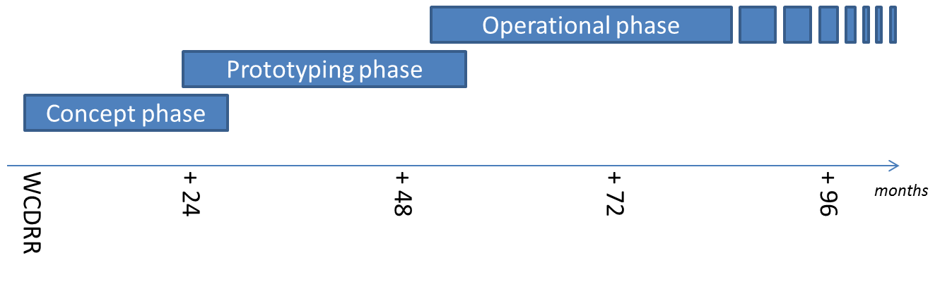
GEO-DARMA:
a framework for developing use of satellite data for risk management
Concept phase (DRR Priorities) completed for two of three regions: Asia and Africa. ADPC’s SERVIR Mekong project is first GEO-DARMA Pilot to go forward.
Iterative process means new projects welcome at any time, but must fit within identified DRR priorities.
if extra resources and funding
identified
8
24

Slide 24
GEO-DARMA SERVIR Mekong Project Background
Championed by Asian Disaster Preparedness Centre (ADPC);
Leverages existing NASA/USAID-funded SERVIR Mekong project; fully-funded for five years;
Part of larger international SERVIR network;
Incorporates new data types, faster service delivery, higher resolution flood maps, capacity building;
Financing for project in place, but some partners still to be confirmed (e.g. on-going discussion with CEOS Flood Demonstrator Team);
First GEO-DARMA test area will be in Myanmar, then Mekong lower basin;
Vision to extend to larger SE Asia area if successful.
Notes:
While some partnerships are still being firmed up, the core partnerships are in place. For CEOS data contributions, the current plan is that Deltares, a funded SERVIR Mekong partner, will process data to generate products for inclusion in the on-line platform tool.
ADPC began discussion with GEO-DARMA in 2017, as part of regional assessment of DRR priorities.
ADPC proposed SERVIR-MEKONG as a GEO-DARMA pilot project at January 2018 GEO-DARMA Steering Committee meeting.
Improved access to satellite data through CEOS/GEO-DARMA will increase temporal revisit and improve resolution and accuracy of flood products, as well as supporting archive of past flood events for better risk assessment.
SERVIR MEKONG proposes to use imagery for validation of proposed NRT service in Myanmar starting in the 2018 flood season – July till September 2018.
SAR data will be processed and integrated into system by SERVIR partner Deltares (discussions underway for further support from NASA as pre-cursor to Flood demonstrator)
This data can be further utilized in later versions of this product which will enhance spatio-temporal coverage.

Slide 25



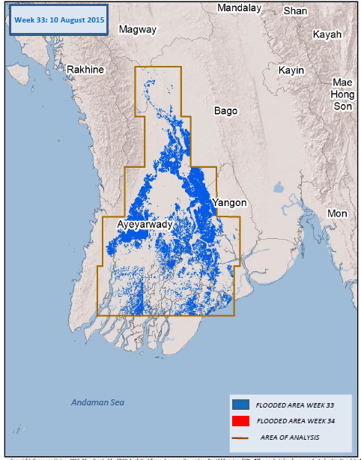



Why Flood Mapping for Myanmar?
Provide information through on-line platform:
  Extent of flooded areas
    Possible severity of flood (e.g., depth, duration, size)
Visualization tool to assist planning for emergency response and relief

Slide 26
GEO-DARMA data request - data types
For the 2018 flood season, the project plans to use the following sensors:
District level – high resolution optical data and high resolution SAR data
SPOT 10m resolution and higher
Sentinel-2 20m resolution
Sentinel-1 20m resolution (systematic extraction each pass)
RADARSAT Scan SAR Narrow and Scan SAR Wide 50m and 100m resolution in 350-500km swath
Urban Flooding (very high resolution optical data and very high resolution SAR data)
SPOT 1.5m
Pleiades 70cm
Cosmo-SKYMED 1m
Analysis of results will be conducted after the flood season and a new request will be made for 2019-2020
Notes:
2018 season will be a test bed for integration of satellite imagery. Sentinel-1 data will be key satellite of interest, but other sensors used to expand temporal coverage between passes, and to explore possibility of higher resolution flood maps in urban areas.
Additional Data Sources
■ Inundated areas from multiple sensors
○ RiverWatch - streamflow estimates derived from passive microwave
○ Updated daily - Global Flood Monitoring System
● Contextual information from other Lower Mekong systems
○ Updated daily - MODIS-based NASA Project Mekong
● Inundation depth
○ TIN Based Approaches
● Precipitation conditions
○ SERVIR-Mekong Virtual Rain and
Stream Gauge

Slide 27
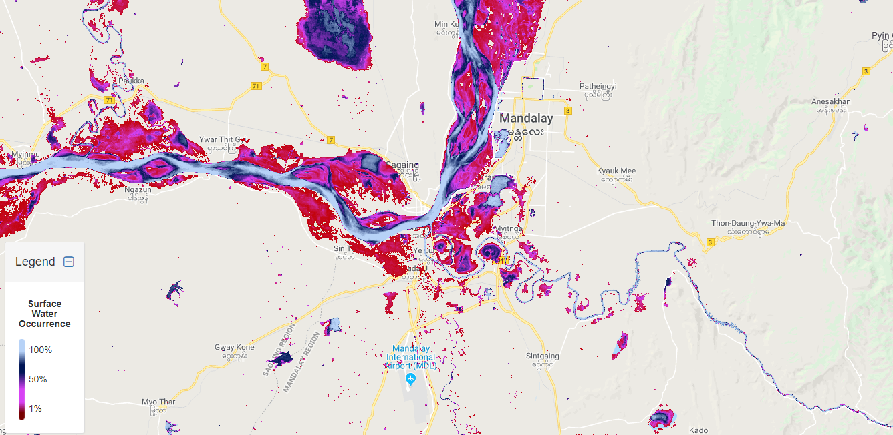
Suggested Area of Interest for urban flooding, Myanmar
Mandalay – areas prone to floods based on surface water occurrence maps
(based on 2000-2015 Landsat imagery)

Slide 28
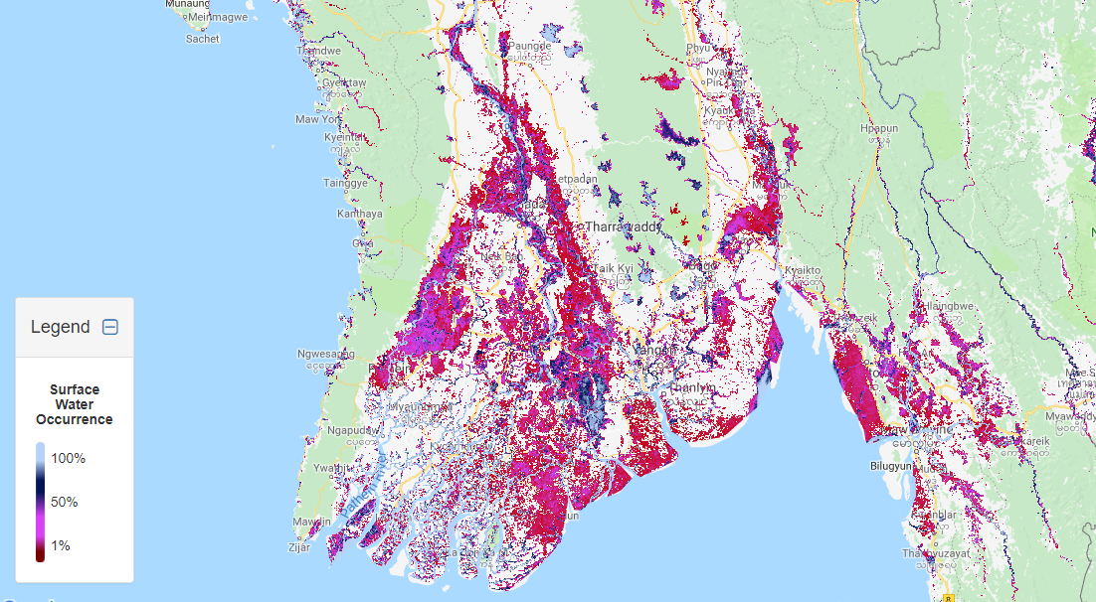
Suggested Area of Interest for Wide Area flooding, Myanmar
Irrawaddy Delta – areas prone to floods based on surface water occurrence maps
(based on 2000-2015 Landsat imagery)

Slide 29
GEO-DARMA data request - data volumes
For 2018:
Agency | ASI | CSA | CNES | CNES | EU
Satellite | CSK | RADARSAT-2 | SPOT | Pleiades | Sentinel-1
Archived and new images | 30 | 15 | 20 | 15 | All passes, available archives of past events of interest

Slide 30
Decision @ CEOS SIT-33
Required decisions by SIT-33:
New Projects
1. Endorsement: CEOS Volcano Demonstrator proposal
2. Endorsement: CEOS Seismic Hazard Demonstrator proposal
3. Endorsement: CEOS GEODARMA first pilot – SERVIR Mekong

Slide 31
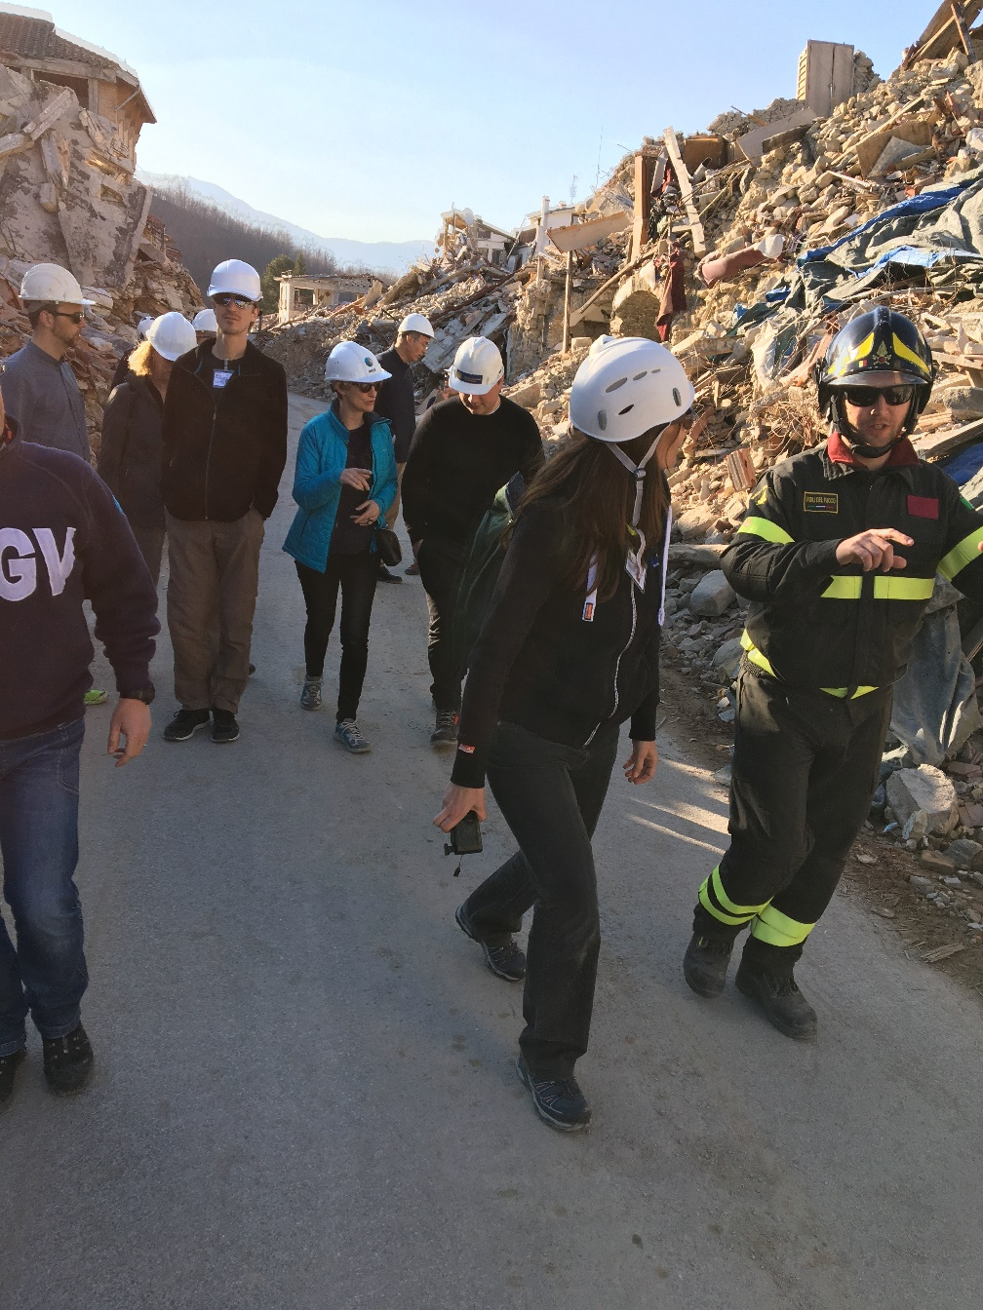
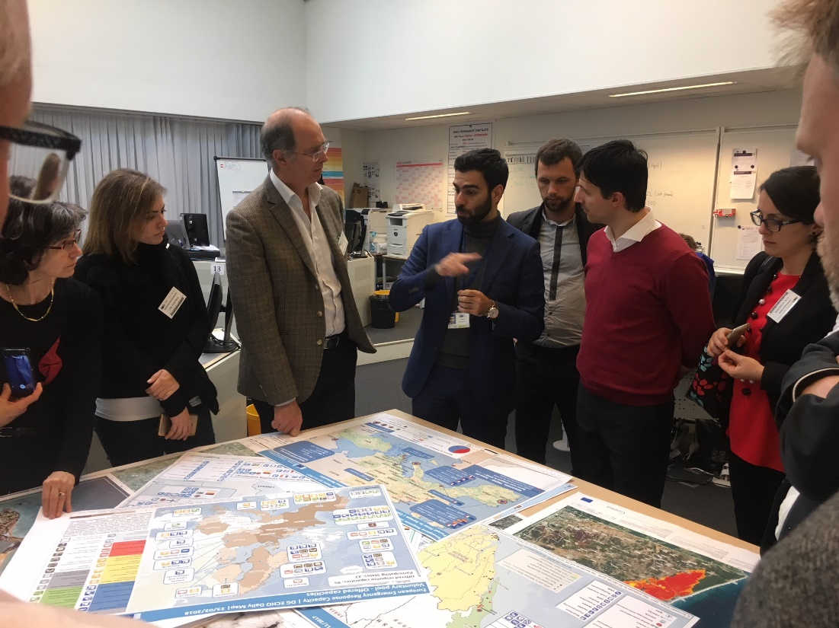
THANK YOU!

Slide 32
Back up slides

Slide 33
Pilot vs Demonstrator
 | Pilot | Demonstrator
Users | End users asked for documented input on usefulness and benefit | End users and practitioners help define demonstrator and work with CEOS teams to achieve sustainability
Area of interest | Limited geographic areas | Driven by user demand – may be limited or global in reach
Duration | Three years | Three years
Leadership | CEOS and technical partners | Overall demonstrator led by CEOS but strong users role in the projects
Technical elements | Prime driver | May be components but mostly builds on successful elements of pilots
Financing | In-kind contributions of data and services | In-kind contributions of data and services
Role of science | Science-driven, showing technical feasibility | Science-driven, linking technology and sustainable applications

Slide 34
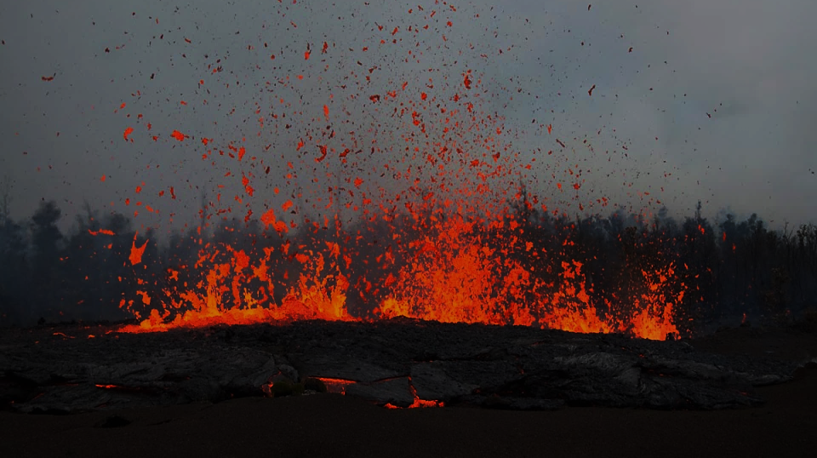
Volcano Demonstrator:
proposed data request
Request is based on Volcano Pilot experience from Latin America
Volcanic activity in the target areas and proposed satellite monitoring:
  About 120 volcanoes have erupted since 1990 [WEEKLY MONITORING]
  About 135 volcanoes have experienced unrest since 1990 but have not erupted [MONTHLY MONITORING]
  About 475 volcanoes have no detected unrest or eruptions since 1990 [QUARTERLY MONITORING]
Volcanoes will be prioritized based on their current activity and the presence of a population at risk
Data requests should include both archive data (to understand the development of unrest at volcanoes that become active) and new acquisitions
Most UV, visible, and IR data are freely available, so we focus our data request on SAR and high-resolution optical

