Slide 1

Closing Remarks
Committee on Earth Observation Satellites
Steve Volz, CEOS SIT Chair
National Oceanic and Atmospheric Administration (NOAA)
CEOS SIT-33
Session 9, Agenda Item 9.6
Boulder, CO, USA
24 – 25 April 2018

Slide 2
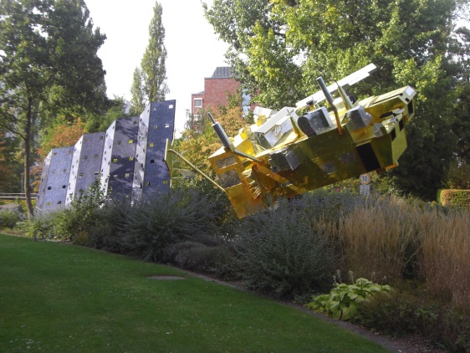
SIT 2018 Technical Workshop
2018 SIT Technical Workshop
September 10-14, 2018
Location: Darmstadt, Germany (host - EUMETSAT)

