Slide 1
Review of CEOS leadership roles
Committee on Earth Observation Satellites
Steven Hosford, ESA/CNES, CEO
CEOS SIT-33
Session and Agenda Item #9.3
Boulder, CO, USA
24 – 25 April 2018

Slide 2
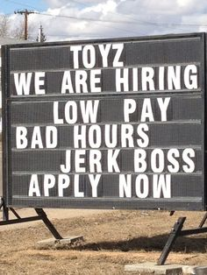
CEOS Chair & SIT Chair
CEOS Chair from 2021
CEOS SIT Vice-Chair from 2020
GREAT

Slide 3
CEOS Working Groups

Slide 4
CEOS Working Groups
WGCapD Vice-Chair from 2020
WGClimate Vice-Chair from 2020
WGDisasters Vice-Chair from 2020
WGISS Vice-Chair from 2020
WGCalVal Vice-Chair from 2019
At least 1 candidate has
been identified.
Decision at WGCV-44
GREAT

Slide 5
CEOS Virtual Constellations

Slide 6
CEOS Virtual Constellations

Slide 7
CEOS Virtual Constellations
No issues currently identified

