Slide 1
Geo/Leo Combined Products
Committee on Earth Observation Satellites
Dan Lindsey, NOAA, SIT Chair Team
CEOS SIT-33
Session 7.4
Boulder, CO, USA
24 – 25 April 2018

Slide 2
Background
SIT Chair Priority: Enhancing the utility of new observations from next generation of geostationary satellites and exploring development of GEO/LEO combination products and data processing capabilities.
This topic was a nominated theme for the CSIRO CEOS Chairmanship in 2016 – culminating in a report presented to the Brisbane Plenary of that year.
CGMS Working Group 2 reinforced the importance of Geo/Leo integration, and three Pilot Projects were proposed at the 2017 CGMS Plenary:
Aerosol/Dust Observations
Fire Observations
Flood Observations

Slide 3
Background
Here we’ll highlight how combined Geo/Leo observations, particularly from the new, next generation sensors, can be used to address these focus areas. We also consider additional focus areas.
Note: SIT Chair suggests removal of “Non-Meteorological Applications” wording in order to prevent placing unnecessary boundaries. We agree this is a good idea – we can continue to focus on the non-met applications

Slide 4
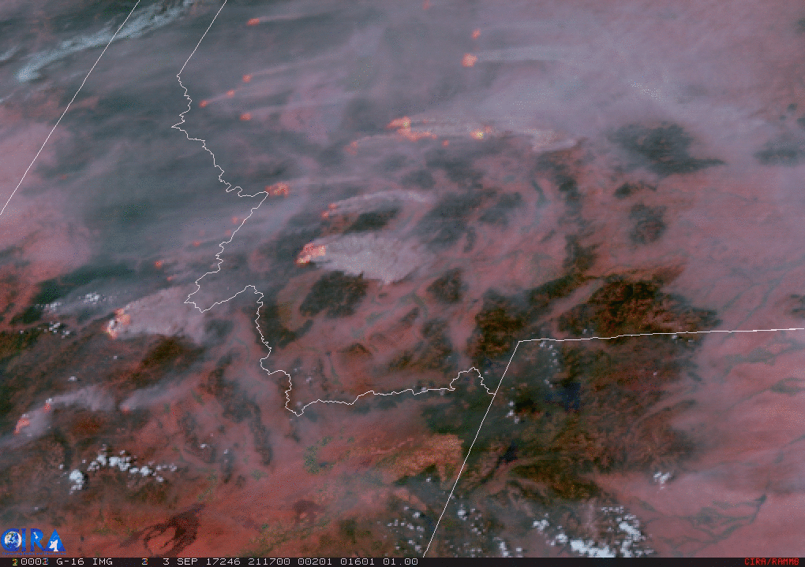
Fire Observations
GOES-16 ABI Fire and Smoke Detection

Slide 5
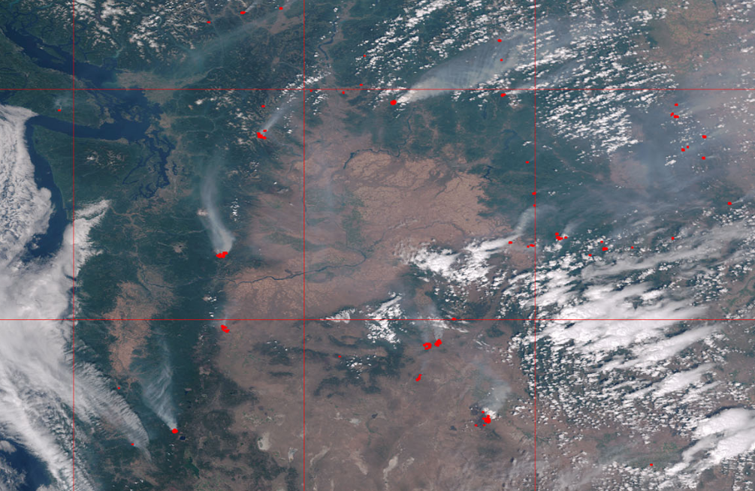
Fire Observations
Suomi NPP VIIRS Fire Detection

Slide 6
Fire Observations
Sensors aboard polar-orbiters able to detect newer, smaller fires given better resolution than GEO sensors
Geostationary sensors can fill in the temporal holes and track the fire hot spots at up to 30-second sampling
This information can be combined for early detection (LEO) followed by hot spot tracking (GEO) to help protect lives and property

Slide 7
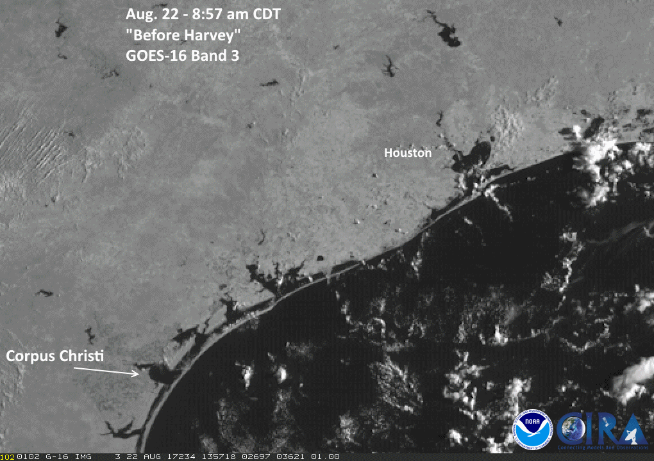
Flood Monitoring
Flooding following Hurricane Harvey

Slide 8
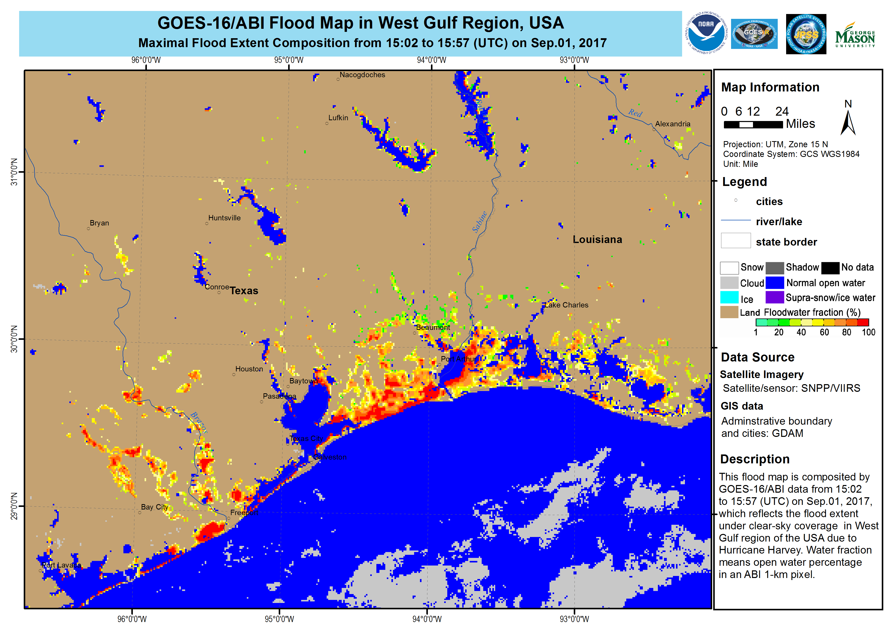
Flood Monitoring

Slide 9
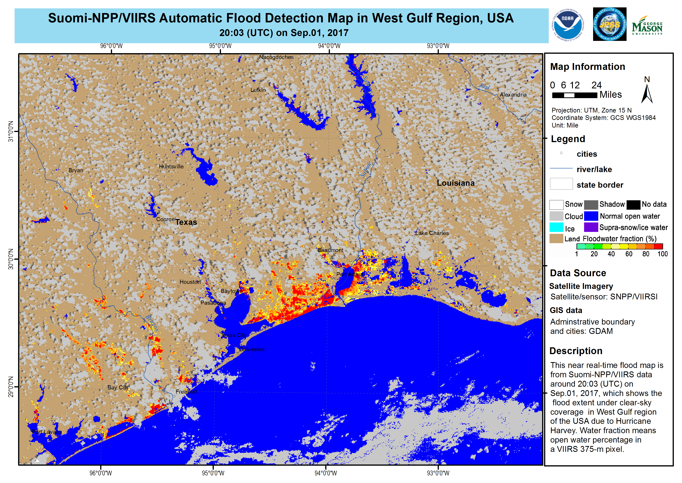
Flood Monitoring

Slide 10
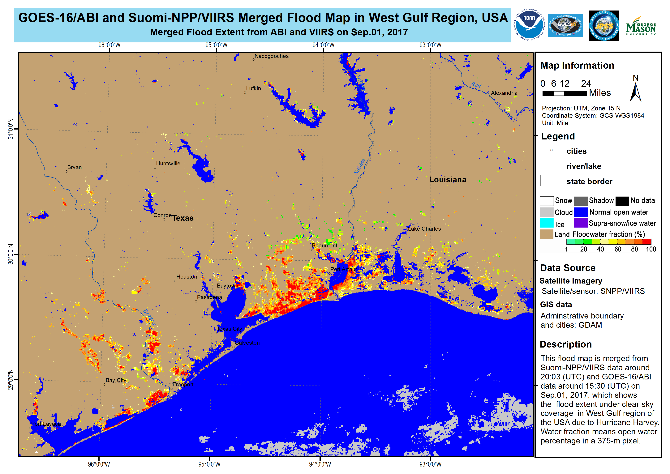
Flood Monitoring

Slide 11
Flood Monitoring
NOAA and CMA are planning a pilot project on this topic
Proposals for flood case studies for members to do inter-comparisons for capacity building
This project represents a nice opportunity to fulfill goals of both CGMS and CEOS-SIT

Slide 12
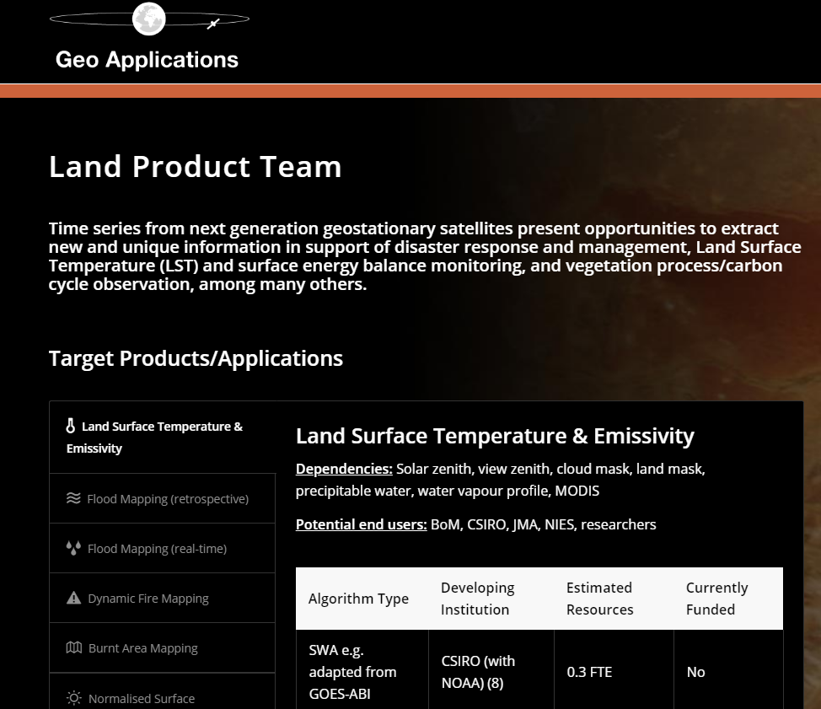
Land Surface Observations
http://geoapplications.org/product-teams/land/

Slide 13
Land Surface Observations
CEOS Analysis-Ready Data for Land (CARD4L) provides geophysical quantities such as surface reflectance, temperature, or backscatter amplitude facilitating the use of observations from multiple platforms and sensors
Some LEO products are planned for development within the LSI-VC, so we propose that matching GEO products be added as well
GEO products must be made available in the Analysis Ready Data (ARD) format to facilitate inter-comparisons and integrated product development
Consider starting with Surface Reflectance and Land Surface Temperature

Slide 14
GEO/LEO Recommendations from CEOS-SIT
CEOS should follow up on several years of effort on Land Surface Imaging using data from both GEO and LEO
Select a case study and bring in multiple datasets from multiple platforms (Landsat, Sentinel, GOES, Himawari, JPSS, etc.)
Coordinate across appropriate CEOS Virtual Constellations and Working Groups
Coordinate with users/customers
Make both LEO and GEO data available from a single location in the same format (ARD)
CEOS-SIT Action on POCs to develop a detailed proposal for SIT Technical Workshop

Slide 15
GEO/LEO Recommendations from CEOS-SIT
2. Coordinate with CGMS on development of combined GEO/LEO products for Fire, Flood, and Aerosol Monitoring
Next generation sensors provide potential for combined products that have the potential to benefit society and save lives
CGMS to continue to develop fire monitoring pilot studies
Some coordination is already underway in development of a Flood Monitoring pilot project
CEOS-SIT Action: Identify members for inter-comparison studies
SIT Chair Action: Bring info to the CGMS Plenary at the June meeting in Bangalore

