Slide 1

CEOS Ad-hoc Space Data Coordination Group (SDCG) for GFOI
Committee on Earth Observation Satellites
Osamu Ochiai, CEOS Lead for GFOI, JAXA
CEOS SIT-33
Session and Agenda Item #
Boulder, CO, USA
24 – 25 April 2018

Slide 2
Contents
GFOI Phase 2
SDCG status and plan (SIT Chair’s report template)

Slide 3
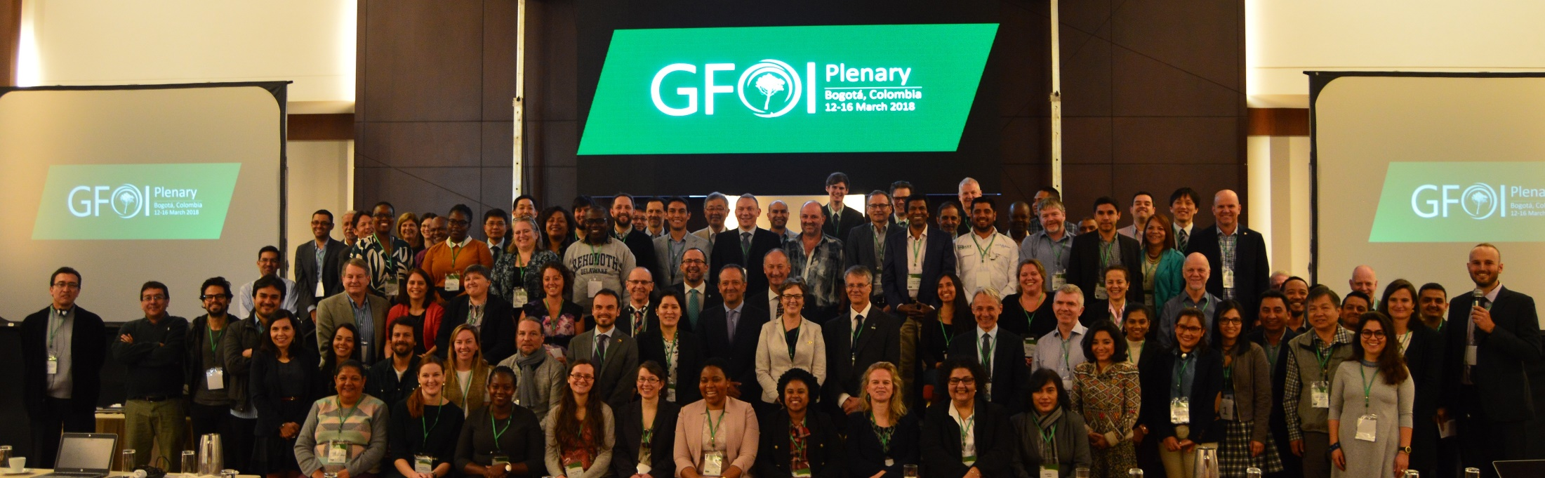
GFOI Phase 2
GFOI Plenary – Mar 2018 Bogota
Joint assessments of country needs and collaboration to address them
Complementary and consistent Capacity Building activities
IPCC- and UNFCC-compliant country guidance for REDD+ reporting (MGD)
Expanded data support to put more emphasis on access, uptake and application and the relevant tools
Coordinated R&D activities to support above
Expanded participation and leadership (WB, ESA and UK as new leads)

Slide 4
GFOI Phase 2
Data Component is a key evolution

Slide 5
GFOI Phase 2
GFOI Expectations to CEOS
A letter was sent from GFOI lead to CEOS SIT Chair on April 12th.
Recognizes the vital contribution CEOS has made to improve forest monitoring capabilities globally and specifically for the benefit of developing countries
Highlights the desire for strengthening the relationship with CEOS to include ongoing advocacy for free and open availability of core satellite data and also the accessibility and capacity to use satellite data for forest monitoring purposes.
As countries move from readiness to implementation of their climate change policies and programs, the GFOI will take an increased focus on the implementation of forest monitoring systems - which will result in the further uptake and increased sophistication in the use of satellite data.

Slide 6
GFOI Phase 2
GFOI Expectations to CEOS
New areas of collaboration could include:
  Increased ability to access, store and process satellite data via secure and stable cloud processing public infrastructure;
  Provision of Quality Assured Analysis Ready Data to simplify data handling for the community;
  Improved access to cost-effective high resolution satellite data
  Facilitate uptake of new sensors into operational forest monitoring systems;
  Improvements to biomass estimation, including vegetation height;
  Continuing collaboration on early warning for forest cover change detection.

Slide 7
GFOI Phase 2
Survey to SDCG agencies
Reached out to SDCG agencies to gather their views on GFOI Phase 2 plans and prospects – responses from ASI, CNES, CONAE, CSA, DLR, INPE and USGS
Key drivers for GFOI and SDCG involvement:
  User requirements, community interaction
  Promoting agency data flows and related R&D
  Promotion of SAR uptake
  Feedback and validation on product development (e.g. ARD)
  Support to and from other national government departments, e.g. Forestry, Foreign Aid
Clear appetite for one SDCG meeting a year
  Differing views on value of joint meeting vs. GFOI Plenary

Slide 8
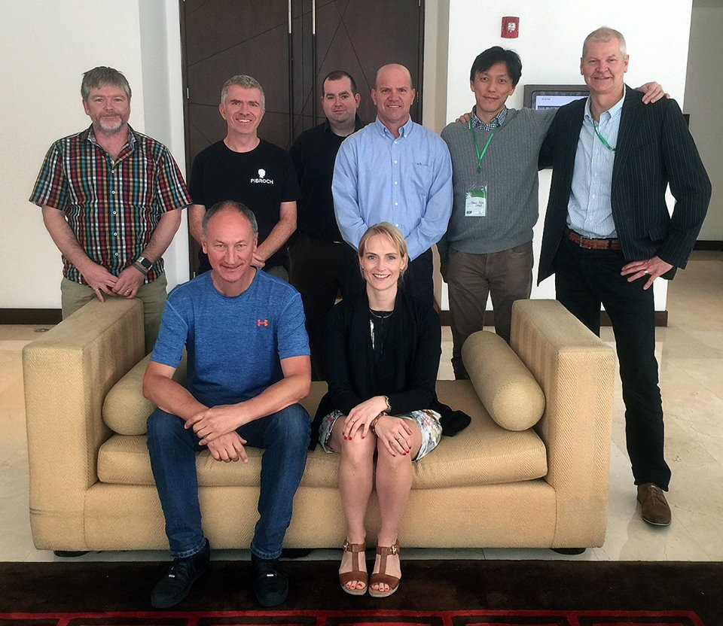
SDCG status and plan
Activities
2017 Tangibles
Annual global baseline coverage from 2017 (Element-1)
FDA pilots: Colombia, Vietnam (Element-2)
Data provision to GFOI R&D activities (Element-3)
Evolution of the CEOS Space Data Strategy towards GFOI Phase 2 through:
  GFOI expectations to CEOS (GFOI letter)
            Survey to CEOS agencies
            New SDCG co-chairs (ESA and UKSA)
            New SDCG 3yr work plan development with SDCG resource action

Slide 9
SDCG status and plan
Lifecycle & obstacles
Lifecycle
  Ad-hoc team SDCG approaches its 7th birthday! GFOI Phase-1 has made significant progress with strong contribution by SDCG. This success made GFOI as a GEO Flagship and GFOI office moved to FAO as an operational.
  Forest is still a vital theme for many CEOS member agencies and many new missions are planned (optical, LiDARs, P/L/S/C/X-band SAR)
  Since GFOI Phase 2 expects to strengthen CEOS contributions. Therefore, SDCG defining its second 3-year Work Plan
  2016-17 discussions among SDCG, GEOGLAM, LSI-VC concluded continued need for individual groups – but with annual joint meeting (just before SIT TW)
Obstacles
  GFOI evolution of The Space Data Component to be The Data Component – with more focus on tools and systems for data application in supporting country needs.
  Loss of USGS representation (given importance of Landsat)
  Loss of Australian Govt funding for SDCG Sec

Slide 10
SDCG status and plan
SDCG Work Plan
Being updated to address GFOI Phase 2 design
Key elements
  Data Component tools and systems support to countries
  Forest community CARD4L reference group feedback
  Biomass measurements global acquisition strategy
  Work with R&D Component on focused, funded R&D activity
  Early Warning programme (e.g., detect illegal logging)
  Facilitate to link other GFOI components
Co-Chairs are undertaking resourcing study tasked by Plenary/SEC – starting with investigating support from Chair agencies

Slide 11
SDCG status and plan
GFOI Data Component
Capacity Building (User Needs Assessment)
MGD
GFOI Data
Coordination Component
R&D
Capacity Building
CEOS
FAO
COMMERCIAL
GROUND
OTHERS
SDCG
Data access
Intl. standards & methods
Data cubes
SEPAL
Reporting tools (FLINT)
High res (PLANET, …)
Forest Inventory
Google EE
Amazon WS
Data cubes
Architecture Study
Pilot Activities with countries
Workshop is planned to scope the new GFOI Data Coordination Component (Japan, Early July 2018, TBD)

Slide 12
SDCG status and plan
Biomass and EW Observation Methods
Current Method
Complement
with Optical
Current Method
Complement
With In Situ
Optical
Landsat, Sentinel-2, ALOS-3 etc
SAR
Sentinel-1, ALOS-1/2, etc
In Situ
Forest Height/Diameter/Type
Lidar
Forest Height/Biomass
Tier1. General
Forest Carbon Stock
And Change
(Every 1-5 years)
NFMS
REDD+
MRV
10-30m resolution
Cloud Free Area
10m resolution
Global Coverage
×
＝
Tier2. National/Local
Tier3. Model and Validation
Forest Area
(Activity Data)
Biomass(per unit)
(Emission Factor)
Biomass
(National)
Near real time
Data
EW systems
(GFW, JJ-FAST, GLAD, etc)
Forest Change Detection
(Near real time)

Slide 13
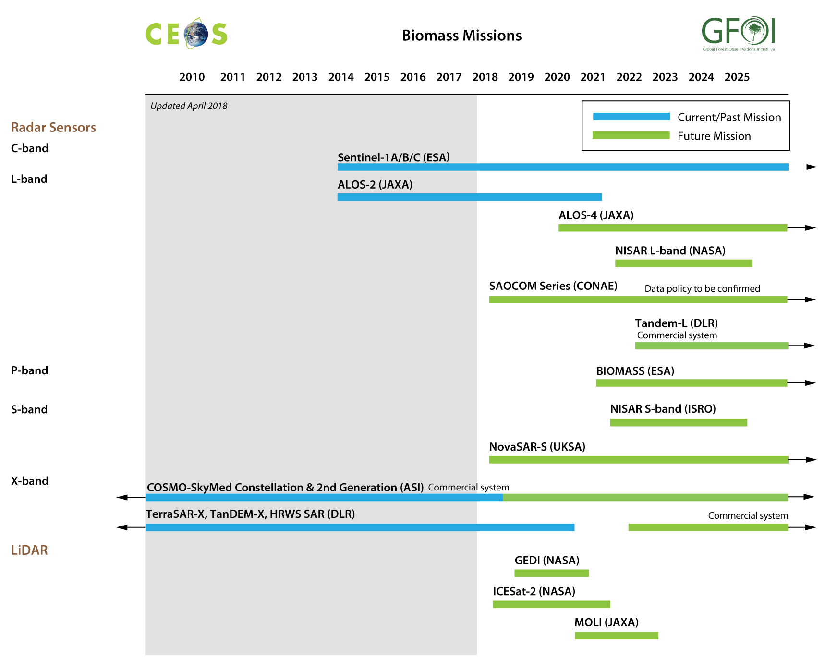
SDCG status and plan
Biomass related missions

Slide 14
SDCG status and plan
Transition
SDCG not focused on ad-hoc or permanent status but recognises need for cleaner logic
Seeking clarity on context of SDCG role in Phase 2 among other contributions to the Data Component
General thoughts on Ad-hoc Team Transition:
Ad-hoc Teams might benefit from more systematic contact (eg with SIT Chair) as do the VCs and WGs
Ad-hoc Teams could be reviewed at 3 years of age to debate whether they might be made standing entities
And reviewed 3-yearly thereafter

Slide 15
SDCG status and plan
For SIT attention
Documents submitted for information:
  GFOI Plenary outcomes document
  Draft 3yr work plan outcomes (in progress) – comments welcome from all stakeholders
  Updated Element 3 (R&D) document
  R&D teams technical report
Note continued SDCG Co-Chairs consideration of resourcing until CEOS Plenary (for SIT Technical WS agenda)
Request a CEOS SIT response to GFOI leads (ASAP)

