Slide 1

UNFCCC/IPCC Engagement Update
Committee on Earth Observation Satellites
Akiko Suzuki
Japan Aerospace Exploration Agency (JAXA)
SIT-33
CEOS Strategic Implementation Team
University of Colorado, Boulder, USA
24th April 2018

Slide 2





“Road to IPCC Guidelines”
Support coordination with IPCC
IPCC Guidelines
（to be refined in 2019）
Methodology document
Satellite-based GHG Data
Develop methodology document to support for national statistician to use GHG data for the accuracy of the greenhouse gases inventory.
Provide high accurate data set and documents (ATBD)
Calibrations and validation for quality control
CEOS
Provide and share GHG data
Space Agencies
Ministry of Environment/NIES
Ministry of Education, Sports, Culture, Science and Technology
JAXA
GOSAT/
GOSAT-2(*)
NASA
OCO-2
GeoCarb
ESA
Sentinel-5p,
FLEX
CNES
IASI, MicroCarb, MERLIN
DLR
MERLIN
CMA
TanSat
*GOSAT/GOSAT-2 are joint projects by Ministry of Environment, NIES and JAXA .

Slide 3
Summary of Progress
“Road to IPCC Guidelines”
Support coordination with IPCC
IPCC Guidelines
（to be refined in 2019）
C
Engagement with International Bodies
CEOS Review
Methodology document
Satellite-based GHG Data
D
Develop methodology document to support for national statistician to use GHG data for the accuracy of the greenhouse gases inventory.
Provide high accurate data set and documents (ATBD)
Calibrations and validation for quality control
MOE/NIES “Methodology Document”
B
WGCV
CEOS
AC-VC
Quality Control and Accuracy of GHG Data
Provide and share GHG data
A
Space Agencies
Ministry of Environment/NIES
Ministry of Education, Sports, Culture, Science and Technology
JAXA
GOSAT/
GOSAT-2(*)
NASA
OCO-2
GeoCarb
ESA
Sentinel-5p,
FLEX
CNES
IASI, MicroCarb, MERLIN
DLR
MERLIN
CMA
TanSat
Engagement with Space Agencies
*GOSAT/GOSAT-2 are joint projects by Ministry of Environment, NIES and JAXA .

Slide 4
Activity Report in 2017
October 2016
  CEOS approved “UNFCCC/IPCC Engagement” in its GHG Initiative.
April 2017 to March 2018
  JAXA initiated the proposed enhancement of engagement
  Shared the goal with space agencies and international organizations (GEO, WMO, CGMS).
  Shared the goal: to be defined satellite data as a tool to support accuracy of national GHG emissions in IPCC Guidelines for GHG Inventories.
  Shared the technical and scientific advancements of satellite monitoring at UNFCCC/COP23.
  JAXA/NIES concluded GHG agreements with ESA, CNES and DLR.
  NIES developed GHG guidebook and CEOS reviewed the draft.
  JAXA, in support of CEOS Chair and AC-VC, submitted expert comments to the first order draft (FOD) of IPCC guidelines.
Completed
Completed

Slide 5
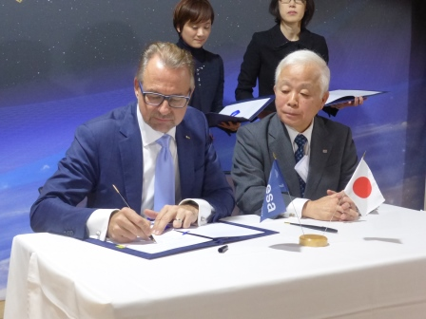
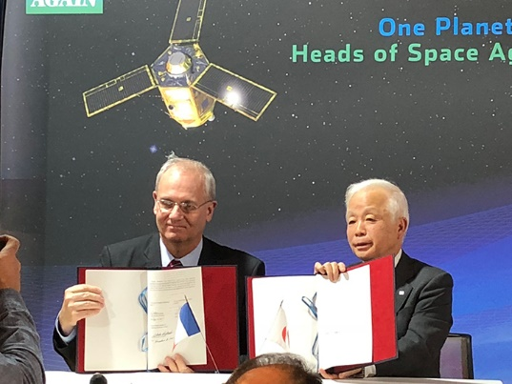
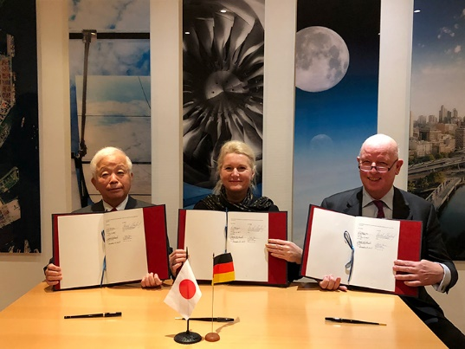
JAXA/NIES concluded agreements for Cal/Val of satellite GHG data
JAXA/NIES and ESA, CNES and DLR concluded agreements for:
Provision of reliable and consistent satellite GHG data for governments, UN organizations and scientists for effective implementation of Paris Agreement;
Promotion of satellite GHG data utilization and cooperation with governmental agencies/research institutes responsible of environment.
B
C
JAXA/NIES: GOSAT/GOSAT-2
ESA: Sentinel-5P, FLEX
JAXA/NIES: GOSAT/GOSAT-2
CNES: IASI, MERLIN, MicroCarb
JAXA/NIES: GOSAT/GOSAT-2
DLR: MERLIN

Slide 6
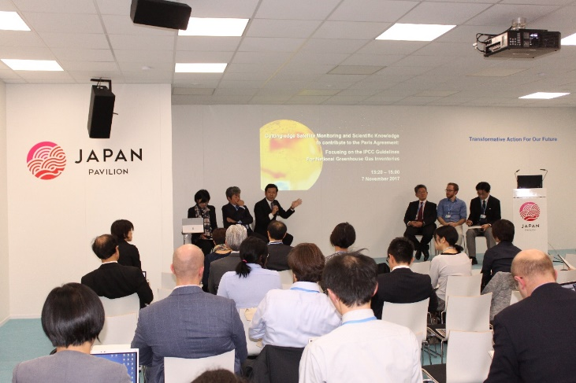
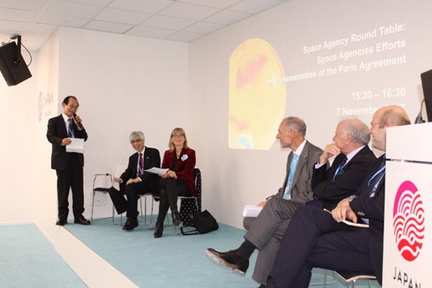
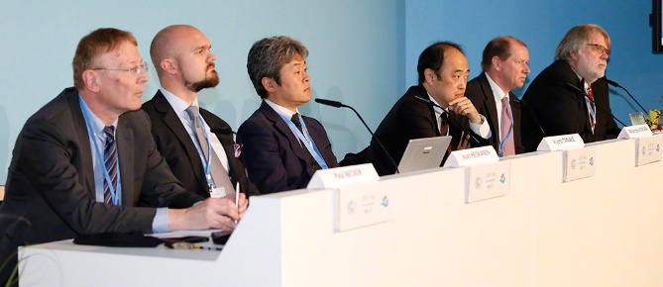

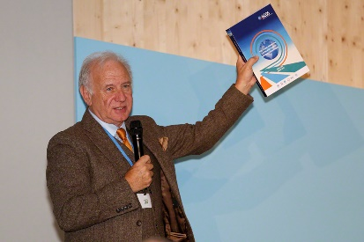

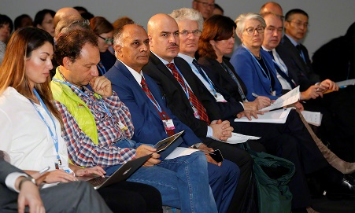
Side events at COP23
❖ “Cutting-edge Satellite Monitoring & Scientific Knowledge to contribute to the Paris Agreement: Focusing on the IPCC Guidelines for National Greenhouse Gas Inventories”
(hosted by MOE, NIES, MEXT, JWA, JAXA on November 7)
❖ “Space Agency Round Table: Space Agencies Efforts for Implementation of Paris Agreement”
(hosted by JAXA on November 7)
❖ “Integrated observations for mitigation and adaptation & Practical support to Parties”
(hosted by GEO, GECOS, RESTEC/JAXA on November 8)
© IISD Reporting Service
© IISD
Reporting Service
© IISD Reporting Service
© IISD Reporting Service

Slide 7

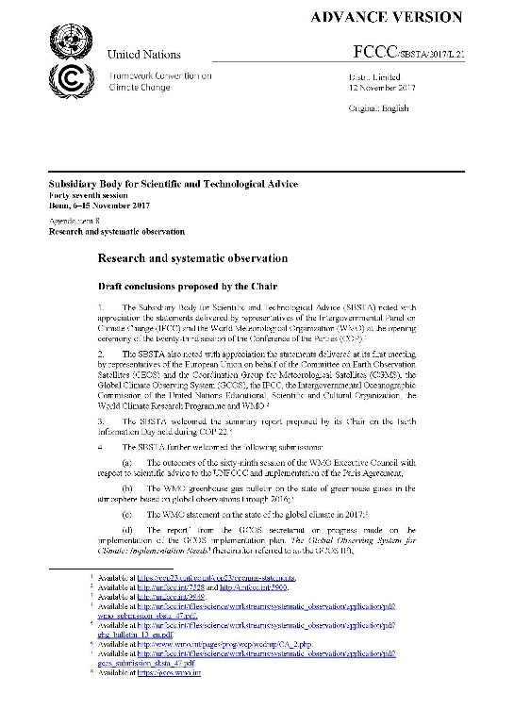
Key Notes at side events, COP-23
  SBSTA Chair recognized in his conclusion, “.....the increasing capability to systematically monitor greenhouse gas concentrations and emissions, through in situ as well as satellite observations, and its relevance in support of the Paris Agreement”.
  IPCC/TFI Chair noted during the official side event that chapters in relation with satellite observation was expected to be updated due to technical advancements of observation since 2006.

Slide 8
Inter-Comparison between GOSAT & OCO-2
B
C
< 0.18 ppm over Ocean
< 0.57 ppm over Land (high gain)
< 0.19 ppm over Land (desert)
Calibrated GOSAT and OCO-2 radiance spectra agrees within 5% for all bands (386 match up data).Katoka et al. (2017 MDPI, Remote Sensing)
2014/09～2016/05 XCO₂ Level2 matchup
Agreement: (ACOS-GOSAT B7.3 vsOCO-2 B7)
Demonstrated the reliability of CO₂ remote sensing from space by comparing radiances and retrieved XCO₂ from different types of spectrometers.
Through improvement of individual data processing and calibration, GOSAT and OCO-2 can provide long-term uniform quality data and consistent retrieval accuracy from dark ocean to bright desert targets.
8
Improvement of cross-calibration on-orbit is indispensable the future satellite observation network of greenhouse gases with multiple instruments.

Slide 9
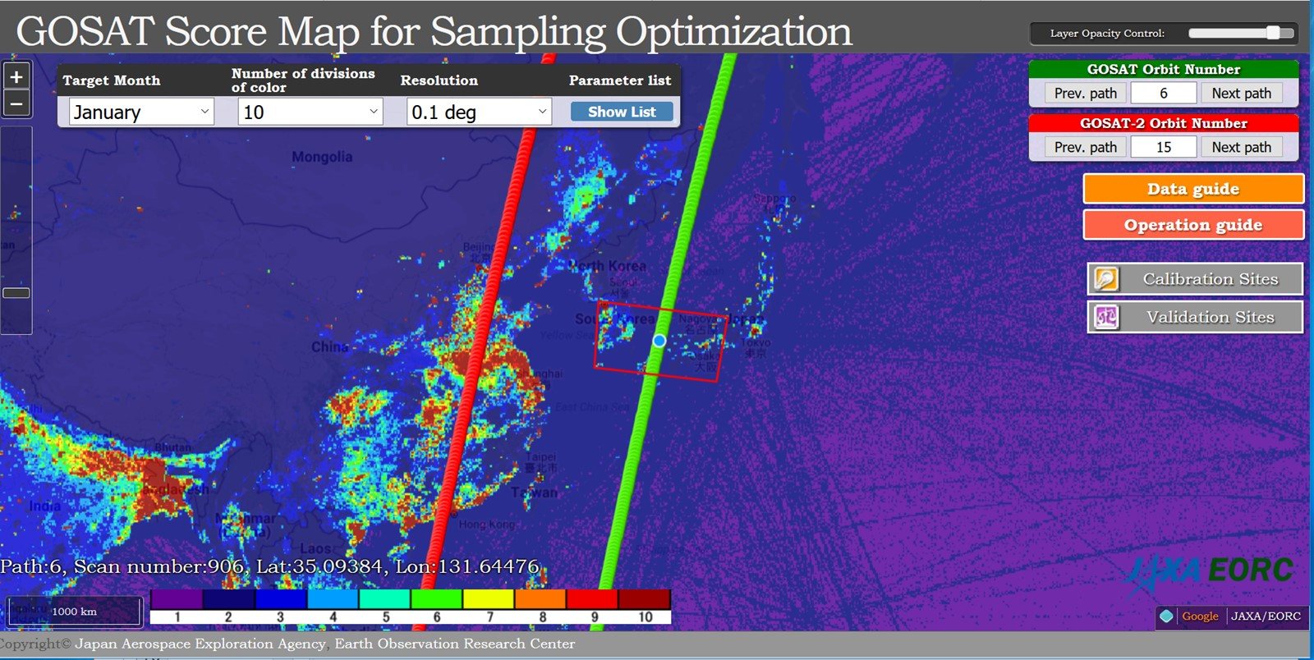
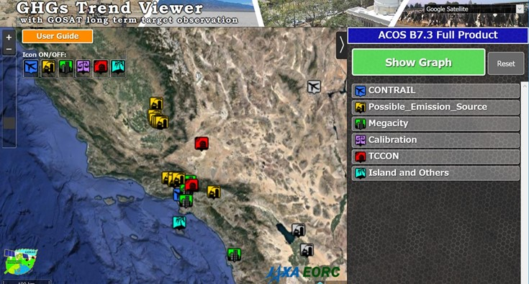
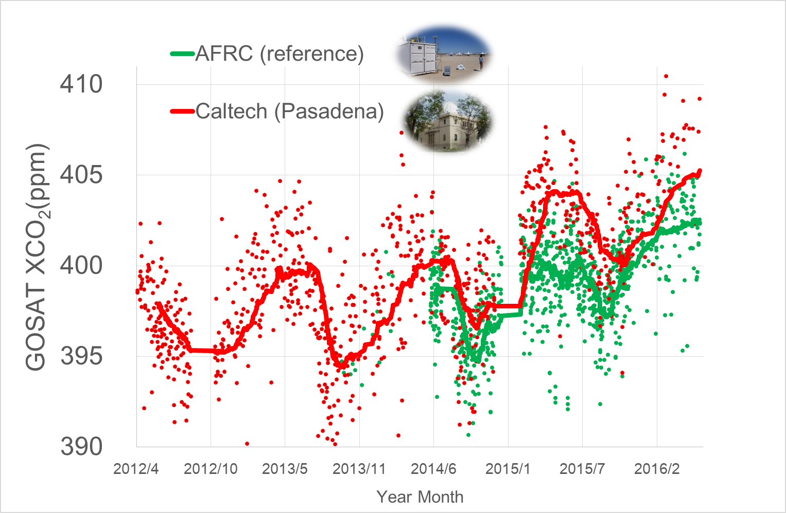
GOSAT Long Term Trend and Their Data Availability
New Tools from JAXA
In addition to conventional data of
Level 1: Radiance Spectra
Level 2: CO₂ and CH₄ density
Long-term trend data of the selected targets, observations of selected mega cities, large point sources of methane (CH₄), calibration and validation sites.
CH₄ emission inventory and GOSAT path
http://www.eorc.jaxa.jp/GOSAT/GOSAT_Optimization/index.html
http://www.eorc.jaxa.jp/GOSAT/CO2_monitor/index.html
http://www.eorc.jaxa.jp/GOSAT/CO2_monitor/index.html
The maps of possible emission sources, vegetation, GOSAT observation results, and successful retrieval are available at:
http://www.eorc.jaxa.jp/GOSAT/CO2_monitor/index.html
Contents: Long term
CO₂, CH₄, SIF, AOD measured by GOSAT
Solar-Induced chlorophyll Fluorescence (SIF), Aerosol Optical Depth (AOD), Population density
9

Slide 10
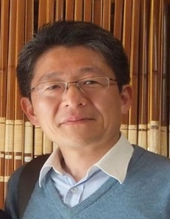
Candidate for Vice Chair of WGCV
Dr. Kuze/JAXA: Candidate for vice chair of WGCV.
Has worked for the Greenhouse gases Observing Satellite (GOSAT) project for 15 years for developing on-board instruments, calibrations and operation, Level 0-1 processing of GOSAT data and the GOSAT Level 1 products.
Will lead WGCV with his expertise of Cal/Val from GOSAT-OCO-2 cooperation and future cooperation with ESA, CNES and DLR.
B
His interests are;
  Demonstrating reliability of remote sensing from space for newly-retrieved geophysical parameters.
  Interpretation of the data from the near-future satellites with unique instrument designs from different space agencies.
  Validation of vertical profiles of atmospheric constituents using airplanes and balloons in addition to ground measurements.

Slide 11
Expert comments to the draft of IPCC Guidelines
❖ Expert Review on First Order Draft (FOD) of 2019 Refinement to the 2006 IPCC Guidelines for National Greenhouse Gas Inventories (December 4, 2017 – February 11, 2018)
JAXA submitted comments:
  A series of GHG monitoring satellites on orbit in operation.
  Their observations and the result data available openly and freely.
  Continuity of future GHG satellite missions in next decade.
  Importance of high quality GHG information integrated with ground based measurements and models in supporting a monitoring and verification system for NDCs and stocktaking, and CEOS and CGMS started activity to define an optimum constellation of satellites to meet requirements of such a monitoring and verification system.
  Further engagement of partnerships/collaboration: CEOS/CGMS for the space component aspects; GEO/WMO on the broader framework; GCOS, UNFCCC and IPCC in better defining the role for space-based observation in the inventory guidelines process.
Notes:
The first order draft of 2019 IPCC Guidelines

Slide 12
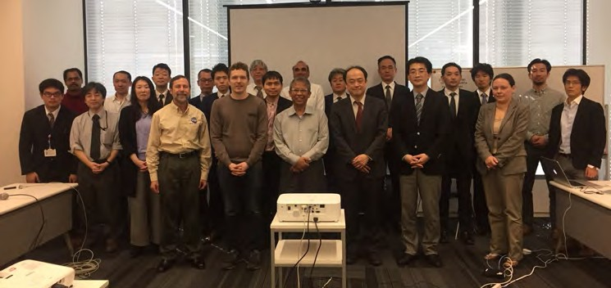


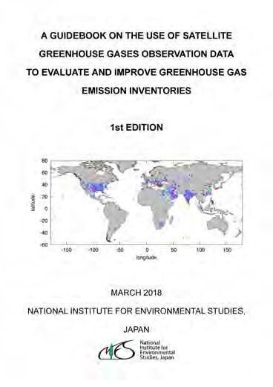
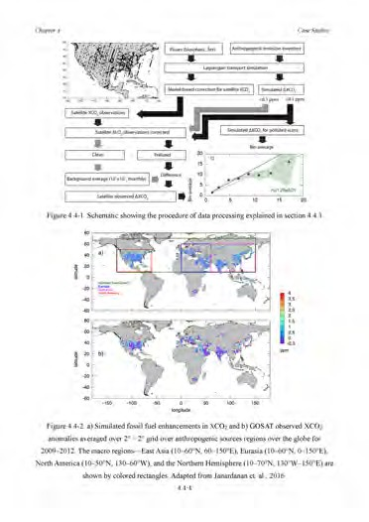
About Guidebook
To promote the use of satellite GHG data and contribute to 2019 Refinement to the 2006 IPCC Guidelines for National Greenhouse Gas Inventories.
Schedule
  Draft
  Open review
2nd Expert Meeting in Tokyo
= Oct. 2017
= Nov. 2017
- Feb. 2018
UNFCCC COP23 = Nov. 2017
2nd Expert Mtg = Feb. 2018
1st edition = Mar. 2018
New guidebook title : “GUIDEBOOK ON THE USE OF SATELLITE GREENHOUSE GASES OBSERVATION DATATO EVALUATE AND IMPROVE GREENHOUSE GAS EMISSION INVENTORIES”
1st Edition can be downloaded from : http://www.nies.go.jp/soc/en/documents/

Slide 13
Comments on Draft Edition of Guidebook
Received During Open Review Period
 | Date | Name (Affiliation) | Comments
1 | Nov. 7 | Stephen Briggs (ESA, at UNFCCC COP23) | “Verification” in the title of Guidebook is a dangerous word and it is better to consider replacing it with “Validation” or “Support for verification”
2 | Nov. 20 | Michael Buchwitz (Univ. Bremen) | • Table 2.2-1: SCIA footprint size: 215 km -> 60 km Several typos
3 | Nov. 21 | Tazu Saeki (NIES) | Several corrections in References
4 | Nov. 28 | Paul Counet (EUMETSAT) | Add Sentinel-4 and Sentinel-5. Add some of the (TIR) capabilities of the future MET mission in Page 2-1.
5 | Dec. 28 | Ray Nassar (ECCC) | English corrections in Chapter 1 – 3.
6 | Jan. 5 | Tomohiro Oda (NASA) | Comments on differences between national inventories using IPCC 2006 guidelines and global gridded inventories.
7 | Jan. 30, Dev 16 | Yuko Nakamura (JAXA) | Comments and Suggestions from CEOS compiled by D. Crirp (JPL).

Slide 14
Activities in 2018-2019
April 2018 to March 2019
  Continue Cal/Val to enhance reliability of data
  Literature cut-off date in June, and the second order draft (SOD) of IPCC Guidelines in July to September
  ⇒ Relevant papers should be issued before the cut-off date, and CEOS should submit expert comments to SOD.
  UNFCCC/COP24@Katwice in December
  ⇒ Intensify engagement for the final review (governmental review) of IPCC Guidelines (space agencies, international organizations, governments, research institutes and public sector）
  IPCC Plenary in Japan in May
  ⇒ Adoption of the refined IPCC Guidelines!
◄ We are here!

Slide 15


Beyond Refinement of IPCC Guidelines
Future
The Paris Agreement
Monitoring, Mitigation, Adaptation
Model
In-Situ
Space-based GHG Observation
2019
Refinement of IPCC Guidelines
Now
Notes:
JAXA activities will focus on contributing to Space-based GHG observation
and GFOI

Slide 16
Timeline for Guidelines Refinement
29 – 31 Aug 2016 @Minsk | Scoping Group meeting
17 – 20 Oct 2016 @Bangkok | IPCC decision on outline
Feb 2017 | Decision on selection of Authors
7 – 14 Jul 2017 @Bilbao | First Lead Author Meeting (LAM1)
25 – 28 Sep 2017 @Victoria Falls | Second Lead Author Meeting (LAM2)
4 Dec 2017 - 11 Feb 2018 | First Order Draft (FOD) Expert Review
10 - 13 Apr 2018 @Cairns | Third Lead Author Meeting (LAM3)
June 25 2018 | Literature Cut-off
2 July - 9 Sep 2018 | Second Order Draft (SOD) Government & Expert Review
4w of Oct 2018 | Forth Lead Author Meeting (LAM4)
14 Jan – 10 Mar 2019 | Final Government Distribution (FGD) Government Review
May 2019 @Japan | IPCC adoption/acceptance
Issue AC-VC White Paper
before the cut-off date
Submit Expert
Comments

