Slide 1
CEOS/CGMS Working Group Climate
Committee on Earth Observation Satellites
Jörg Schulz, EUMETSAT, Chair WGClimate
John Dwyer, USGS, Vice-Chair WGClimate
CEOS SIT-33
Working Groups, Agenda Item 4.6
Boulder, CO, USA
24 – 25 April 2018

Slide 2
Achievements (I)
ECV Inventory 2.0 published Oct 2017;
Fully describes current and planned implementation arrangements (ECV-by-ECV) within the Architecture;
Almost 1000 data records;
Content fully verified;
Gap analysis performed;
25 Recommendations and 28 Coordinated Actions defined;
Related documents for endorsement after discussion at CEOS SIT-33;
Financial support by the EC for the Inventory gratefully acknowledged.
Coordinated Action Plan
CMRS-16
ECV Inventory
Gap Analysis & Recommendations
CMRS-15
✓
✓
✓
http://climatemonitoring.info/ecvinventory

Slide 3
Achievements (II)
Recommendations and Coordinated Actions address:
Improved link of GCOS ECV user requirements to climate applications to ensure a more complete understanding of the intended usage, information chain, and potential impacts on decision-making;
Improved science on CDR quality evaluation and uncertainty characterization;
Production of specific ECV climate data records;
Continuation of and new measurements for specific ECVs providing input to future coordination efforts by CEOS and mission planning activities of its agencies;
Improvement of measurement data bases CEOS-MIM and WMO-OSCAR;
Improvement of the ECV Inventory.

Slide 4
Achievements (III)
Performed small update of Space Agency Response to GCOS-IP 2016 to version 2.2.1 instead of providing a Technical Annex. Document needs to be endorsed after discussion at CEOS SIT-33 (CMRS-19);
SBSTA-47 noted with appreciation the space agency response to the GCOS-IP and recognised the progress made in the development of the ECV Inventory (with explicit link in the conclusions)
WGClimate had broad appearance at COP-23 leading and participating in several side events such as:
CO2 and GHG monitoring event highlighting CEOS contribution;
Climate change monitoring and climate services organised by EC, EUMETSAT and ECMWF where the ECV Inventory was featured as an international coordination tool.
WGClimate #9 adopted new definition for Interim Climate Data Record (ICDR).

Slide 5
Planned Outputs
Open Deliverables 2018:
Deliver statement of space agency contributions in support of each Article of the Paris Agreement (COP-21) by 32nd CEOS Plenary (CEOS Plenary Action-31-01)
Update of Inventory baseline to V3.0 by 31 Dec 2018 (CMRS-17), includes:
Change reference for Inventory and Gap Analysis to the 2016 GCOS-IP and update the inventory content (has partly been addressed already);
Change ECV Inventory to allow distinct analysis for FCDR, (T)CDR and ICDR;
Revitalisation of the climatemonitoring.info website by EUMETSAT;
Continued reporting to UNFCCC SBSTA.
Deliverables 2019:
Second gap analysis and coordinated action plan for endorsement by 33rd CEOS and 47th CGMS Plenaries (CMRS-20, CMRS-21);
Promotion of case studies and workshops supporting the Architecture and its Inventory (CMRS-13);
Continued reporting to UNFCCC SBSTA.
Consider definitions of FCDR and (T)CDR and update if needed;
Support GCOS in the preparation of next GCOS-IP update, in particular in the context of requirement formulation.

Slide 6
Synergies Among Teams
WGClimate had not much interaction with other WGs and VCs so far;
With the Coordinated Action Plan this should change in the near future. Interactions envisaged from the Actions are:
With WGCV on quality evaluation of CDRs, e.g., establishment and use of long term fiducial reference measurements;
With WGISS on interoperability of CDRs in ECV Inventory;
With AC-VC on Carbon, Methane CDRs and new measurements;
With P-VC, CGMS-IPWG, and WMO SCOPE-CM to develop a plan for providing an optimal set of precipitation CDRs;
With SST-VC on future utilization of additional past measurements for SST data records and continuation of measurements, e.g., C-band microwave;
With LSI-VC on LST, LAI and Biomass data products and measurements;
With CEOS MIM team on improvement of the MIM data base
Collaborative activities of WGs and VCs should be true collaborations with full involvement of all sides.

Slide 7
Sustainable Commitment
Contributions of CEOS and CGMS Agencies to the ECV Inventory has been outstanding considering current capabilities to deliver CDRs;
Contributions of CEOS and CGMS Agencies to the two step gap analysis has also been strong;
Engagement with other WGClimate activities needs to be improved, in particular:
Participation from Asian Agencies into WGClimate meetings which are every 8 months. WGClimate plans to held one of the next two meetings in Asia;
It is important that WGClimate is broadening its scope covering the full architecture, i.e., towards the applications of CDRs. We will seek engagement from all CEOS agencies for such activities;
Key to the baseline work on the ECV Inventory including continuous gap analysis is the funding (>2 FTE/year) currently provided by the EC and EUMETSAT;
Key is also that agencies continue to provide support to the people that are providing the inputs to the Inventory and those who devote time in gap analysis activities;
Nomination process for next Vice-Chair will start soon, WGClimate #10 (Winter 2018/19) is expected to endorse selection of a candidate. Agencies nominating candidates need to provide the necessary support for it.

Slide 8
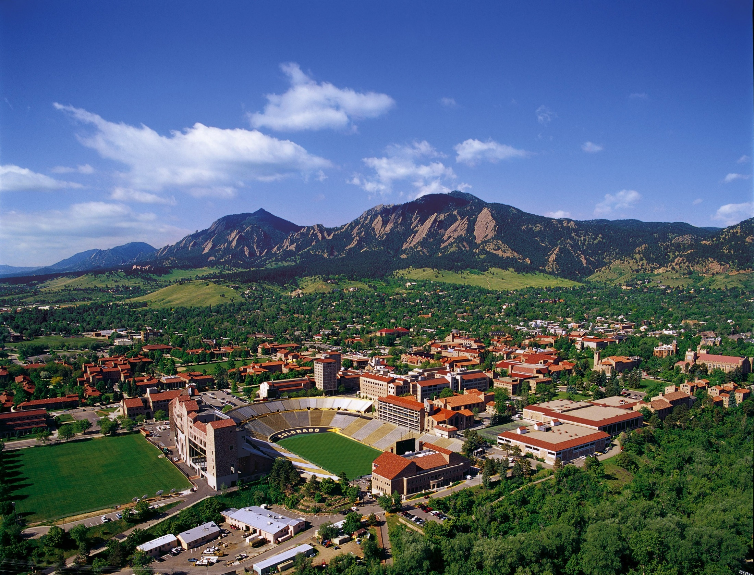
Thanks!
Questions now!
Or later to:
Joerg.Schulz@eumetsat.int
John.Dwyer@usgs.org

