Slide 1

Working Group on Information Systems and Services (WGISS)
Committee on Earth Observation Satellites
Mirko Albani, ESA, WGISS Chair
CEOS SIT-33
Session 4: Working Groups, Agenda Item #4.5
Boulder, CO, USA
24 – 25 April 2018

Slide 2
Background and ongoing activities

Slide 3
WGISS Scope
WGISS is a subsidiary body supporting CEOS
  Promotes collaboration in the development of systems and services that manage and supply Earth Observation data;
  Creates and demonstrates prototypes supporting CEOS and Group on Earth Observation (GEO) requirements;
  Addresses the internal management of EO data, the creation of information systems and the delivery of interoperable services.
The activities and expertise of WGISS span the full range of the information life cycle from the requirements and metadata definition for the initial ingestion of satellite data into archives through to the incorporation of derived information into end-user applications.
Notes:
WGISS promotes collaboration in the development of systems and services that manage and supply Earth Observation data. WGISS also addresses the internal management of EO data, the creation of information systems and the delivery of interoperable services. The activities and expertise of WGISS span the full range of the information life cycle from the requirements and metadata definition for the initial ingestion of satellite data into archives through to the incorporation of derived information into end-user applications.
Recent advances in technology open the floor for new and innovative approaches for data exploitation and use and require an adaptation and evolution of the approaches, infrastructures and services provided by CEOS agencies. WGISS contribution and role in providing a forum for technical exchange and sharing, and for the definition and prototyping of common and interoperable approaches and architectures for data management and exploitation will become more and more central for CEOS agencies and for CEOS as a whole in support to the achievement of its objectives

Slide 4
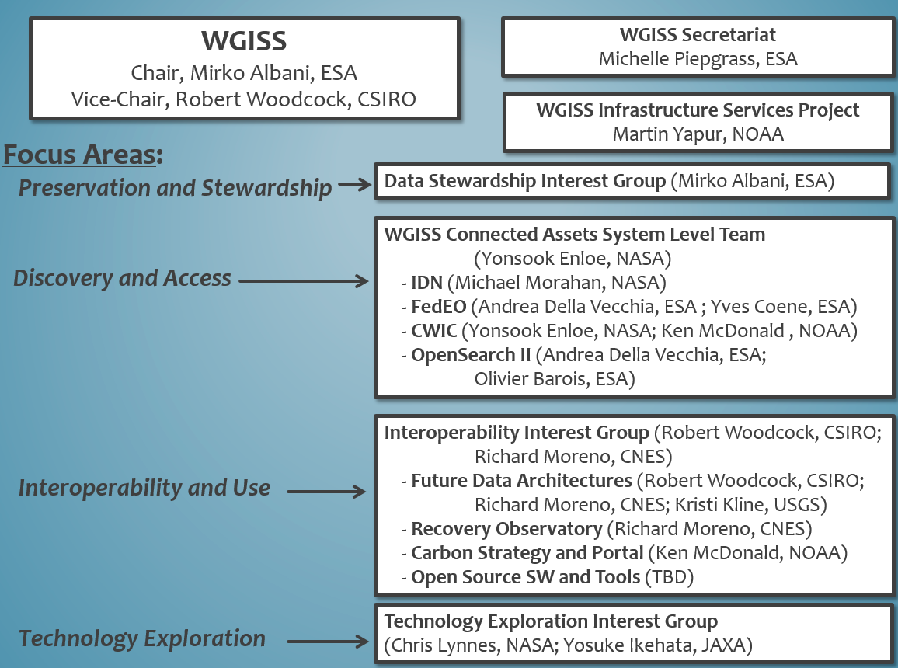
WGISS Structure

Slide 5





Preservation & Stewardship
Best Practices Document Tree
Policy Documents
Individual organizations'
policies (stewardship, access, ...)
EO Data Stewardship
Cooperative Framework
Applied to
CEOS EO Space Data Sets
Data Purge Alert Procedure & White Paper
High level framework documents
Applied to
Technical Documents
Preservation Workflow
Glossary of Acronyms and Terms
General guidelines and best practices
Support
Guidelines and best practices on specific topics
Persistent Identifiers Best Practice
EO Data Preservation Guidelines
Preserved Data
Set Content
Associated Knowledge Preservation
CEOS Maturity Matrix
Reference Model for Data Stewardship
Technical implementation procedures
EO Data Set
Consolidation Process
…
Image Source: http://eastenders.wikia.com/wiki/File:Under-construction.png

Slide 6
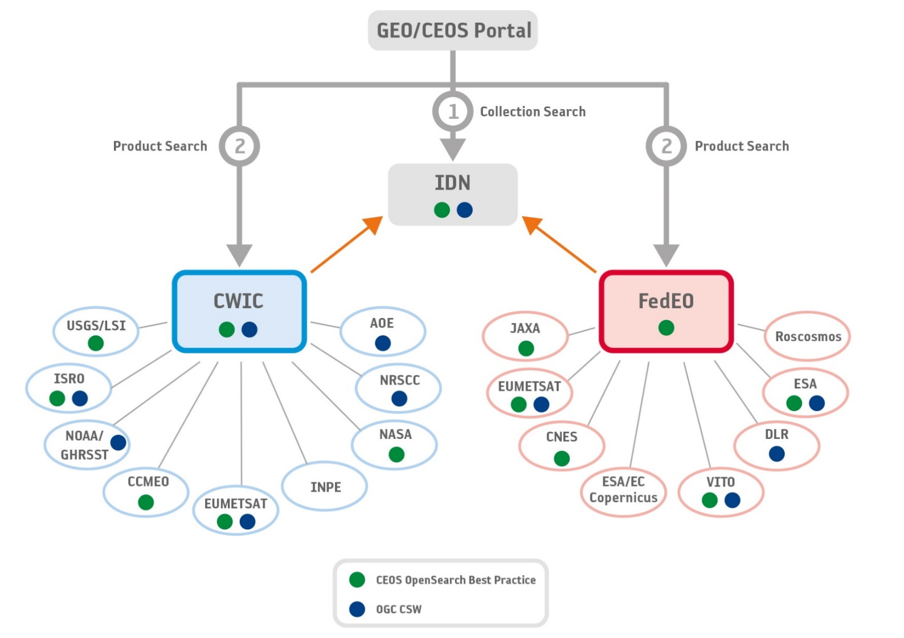
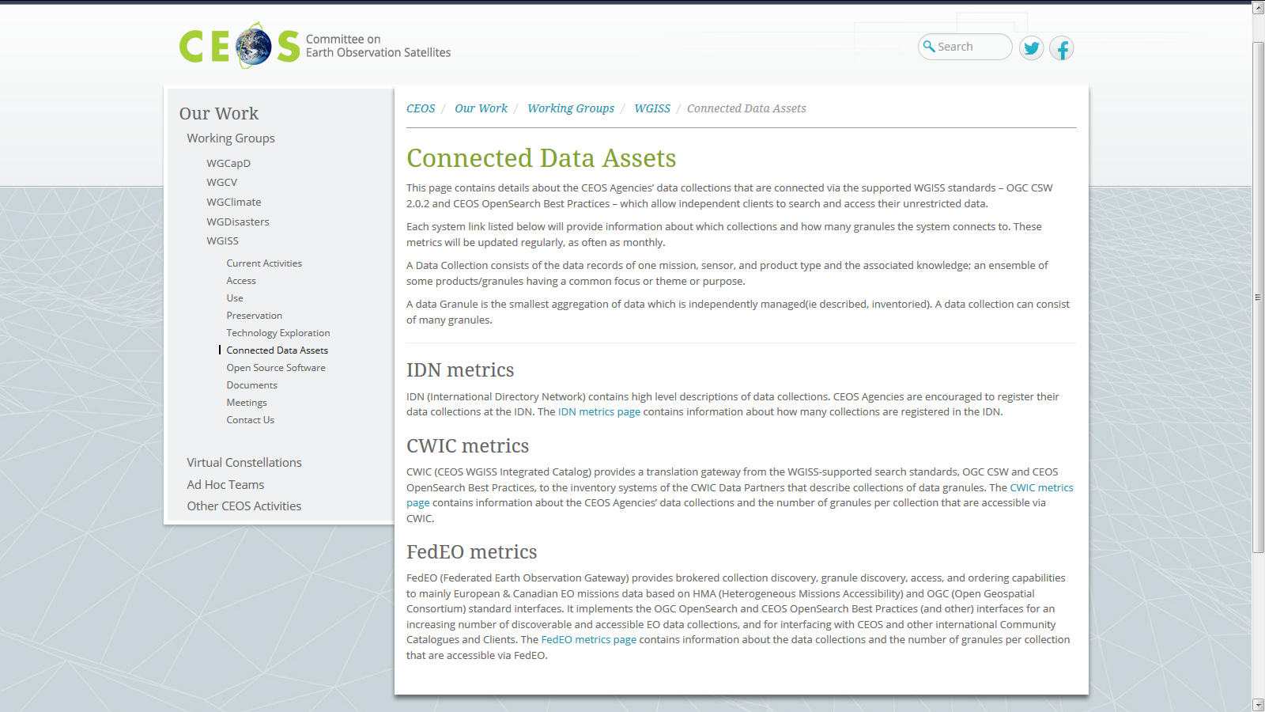
Discovery and Access
WGISS Connected Data Assets
Relying on CWIC/IDN/FedEO, provides a single entry point for external clients to discover and access CEOS agencies data
Search over 32,000 collections in the IDN
Access over 5000 collections with associated over 300+ million granules (granule search)

Slide 7
WGISS Connected Data Assets
Maintained and operated in coordination among different agencies (System Level Team); implementing the OpenSearch Interoperability Best Practice defined by WGISS.
Client Portals:
  GEOSS Platform (GEOPortal and Data Access Broker - DAB)
  AMERIGEOSS Data and Services Portal
  ESA EOPortal
  COVE
  CEOS Carbon Portal
Is being enlarged with new partners and continuously populated with additional data collections, e.g.:
  ECVs/CDRs inventories from WGClimate
  NOAA One Stop testing granule search, over 100 million granules will be accessible soon
  MoU under preparation with NRSCC for ChinaGEOSS (35 millions granules)
Notes:
WGISS Connected Data Assets Operational Systems (IDN, CWIC, FedEO):
Is maintained and operated in coordination among different agencies (System Level Team) and implements the OpenSearch Interoperability Best Practice defined in WGISS.
Provides a single entry point for GEO (GEOPortal) to discover and access CEOS agencies data.
Is being enlarged with new partners and continuously populated with additional Collections (e.g. ECVs/CDRs inventories from WGClimate).

Slide 8
Interoperability and Use
FDA Themes supported via WGISS
CEOS Analysis Ready Data (ARD)
  Develop and provision CARD4L-compliant optical and/or SAR products
  Examine ARD for ocean and atmosphere domains
Interoperable Free and Open Tools
  Continue supporting the CEOS Data Cube (CDC) initiative
  Demonstrate new technologies through ongoing support of ‘pilot projects’ and consideration of alternate candidate architectures
Data, Processing, and Architecture Interface Standards
  Develop standards for pixel-level data discovery, access, and common analytical processing requests (e.g., cloud free mosaics of ARD) exploiting EO satellite data among various CEOS exploitation platforms
Analytical Processing Capabilities
  Prototype portable web-based analytical processing APIs/Web Services that work across CEOS exploitation platforms in full computing environments for time series and other analysis
User Metrics
  Develop a data use metrics framework through which agencies can contribute to how EO data is being used, rather than just downloaded data quantities
Block A: Analysis Ready Data, CARD4L and interoperable products
Block B: Agency roles in stimulating EO “use-environments”
BLOCK B
BLOCK C
Block C: Earth Observation Resources Analysis and User Metrics

Slide 9

Technology Exploration
Webinars
Relevancy Ranking of Data Search Results
  14th of March 2017
    Stefano Nativi (GEOSS EVOLVE)
    Chris Lynnes and James Norton (NASA)
Data Cubes for Large Scale Data Analytics
  19th of June 2017
    Rob Woodcock (CSIRO)
    Brian Killough (CEOS SEO)
Burgeoning Role of Python for Earth Observation Data Analysis
  22nd of August 2017
    Syed Rizvi (Open Data Cube)
    Rich Signell (USGS)
    Alber Sanchez (INPE)
The OGC Coverage Standards Suite: Introduction and Overview
  19th of January 2018
    Dr Peter Baumann (Rasdaman)
Scrum and scale agile methods
  June 2018
Joint webinars and advertising with:
  WGCapD
  NextGEOSS
  GEOSS Evolve
  Federation of Earth Science Information Partners (ESIP)
http://ceos.org/ourwork/workinggroups/wgiss/technology-exploration/
Notes:
Purpose: to serve as a forum for exchange of technical information and lessons-learned experience about current and trending software technologies, services and other WWW / Internet related software technologies.

Slide 10
Future Outlook

Slide 11
CEOS Work Plan 2018-20
Actions Involving WGISS
CARB-15: Carbon Data Portal prototype – Q3 2018
FDA-5: Promote awareness of FDAs (support WGCapD) – Q4 2018
FDA-8: Establish a common description of Future Data Architecture functional blocks and identify interfaces and interoperability approaches. (support FDA AHT) – Q3 2018
FDA-9: Inventory and characterise existing FDAs operated by both public and private entities including the standards and approaches they use (e.g. Data Cubes, Exploitation Platforms, Copernicus DIAS, etc) – Q3 2018
FDA-10: Finalise inventory of Software and Tools available or used at CEOS agencies for EO data exploitation and use focusing on Open Source but remaining as broad and inclusive as possible and implement a mechanism for discovery and access – Q3 2018
FDA-11: Organise several sessions/workshops to share lessons learned and outcomes from FDA systems and platform pilots and Interoperability Projects. With FDA AHT – Q4 2018
FDA-13: Develop a User Metrics Best Practice – Q4 2018

Slide 12

CEOS Work Plan 2018-20
Actions Involving WGISS
DATA-2: Full representation of CEOS Agency datasets in the IDN and accessibility via supported WGISS systems and standards – Q2 2019
DATA-8: Maintain and evolve WGISS Connected Data Assets Infrastructure and Systems for CEOS Agencies data and services discovery and access – Q4 2018
DATA-9: ECVs/CDRs Discovery and Access through WGISS Systems – Q3 2018
DATA-11: Data and Technology Exploration webinars and workshops - Q4 2019
DATA-12: CEOS data holdings reported in GEO – Q3 2018
DATA-14: Develop a White Paper on Single Sign-On (SSO) authentication – Q4 2018
Defining planned outputs to achieve assigned actions

Slide 13
Example of Actions Status
DATA-9
Objective: facilitate discoverability and accessibility of ECV Products and space-born CDRs relevant for the CEOS Carbon Action via WGISS Interoperability Systems & Standards (FedEO/CWIC/IDN, OpenSearch).
Approach: start from WGClimate ECV Inventory, assess what data records are already discoverable/accessible through WGISS systems, fill gaps.
CURRENT ECV
417
204 not in IDN
FUTURE ECV
Providers being contacted for registration in IDN
913 ECV Data Records considered
4 in IDN via CNES
288 in IDN via CWIC

Slide 14
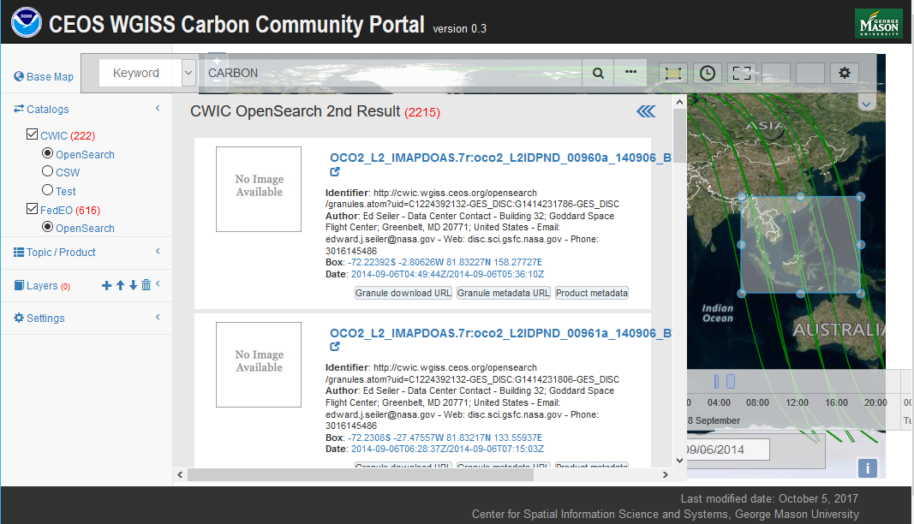
Example of Actions Status
CARB-15
Notes:
Objective: Implement a carbon data portal to facilitate the discoverability and accessibility of ECV products and space-borne CDRs. The portal will seamlessly access data both in CWIC and FedEO to provide necessary data and services to the carbon science community of both CEOS and GEOSS.
Approach: Working with Mark Dowell (CEOS Carbon lead) and Stephen Plummer (WG Climate), WGISS will begin defining a preliminary set of “requirements” for a future Carbon Portal. WGISS will start with the initial list of ECVs that are key for Carbon and start putting together a list of relevant data collections from identified data providers.
Additional Resources: requirements definition and development resources provided by NOAA; support from WGClimate and experts for requirements definition.

Slide 15
Cooperation with other groups
CEOS Carbon Team - Ongoing development of prototype Carbon Portal
WGClimate - Ongoing review of ECV inventory to ensure CDRs access through WGISS Connected Data Assets Infrastructure
WGDisasters – Opportunities: Generic Recovery Observatory (RO), Disaster Risk Management (DRM) Demonstrators
WGCapD
  Ongoing: WGISS Technology webinars publicized through WGCapD
  Opportunities: promote awareness on FDA through WGCapD (FDA-5), storing WGCapD training material / documentation on WGISS Web site, explore joint discovery of data and associated information

Slide 16
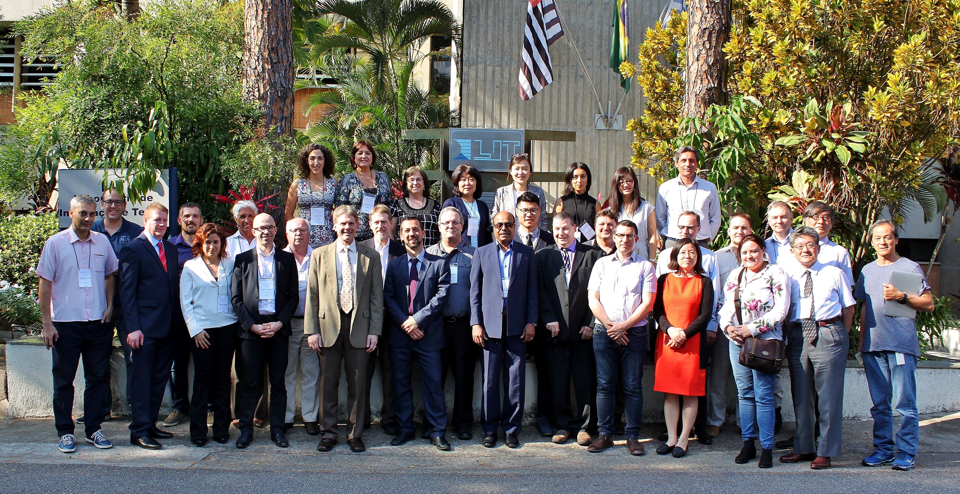
Cooperation with other groups: WGISS-WGCV Joint Session
Four topics discussed and follow-up actions defined during joint meeting held on April 9-10
Data Formats and Interoperability in the framework of FDA
Quality Indicators in Discovery Metadata
CEOS Data Cubes and CEOS Test Sites Data Access in support of WGCV Activities
Standardization and Best Practices

Slide 17
Cooperation with other groups
SEO - Ongoing: COVE tool harvesting metadata from WGISS Connected Data Assets Infrastructure
Virtual Constellations - Opportunities: being addressed at SIT-33
Others:
  GEO - Ongoing: WGISS contributing to GEOSS-EVOLVE initiative in the GEO 2017-19 Work Plan, participation & support to GEOSS Data Providers Workshops (e.g. “User Metrics” session at upcoming 3rd GEOSS Data Providers Workshop)
  CGMS - Ongoing: Working Group (WG) IV Global Data Dissemination
  ESIP - Ongoing: exchange of information and best practices on data stewardship
Notes:
WGISS best aligns with CGMS Working Group (WG) IV Global Data Dissemination. Many members of WGISS (e.g. NOAA, NASA EUMETSAT etc) are also members of CGMS. In the past, WGISS members have participated in WG IV to respond to CGMS action items. As an example, in response to CGMS action item # A44.03 (identify how far WGISS Interoperable standards were adopted), WGISS provided a list of CEOS agencies who have implemented CEOS Opensearch Best Practices: EUMETSAT, NASA, ESA, CNES, USGS, JAXA, ISRO (NRSC) and CCMEO.

Slide 18
WGISS Health Status
Interagency coordination working well, good cooperation spirit
Healthy participation to meetings (average 20 people)
  Some members attending all meetings (e.g. NASA, NOAA, USGS, CNES, ESA, GA/CSIRO, JAXA, RADI, AOE CAS, HUNAGI)
  Others attending sporadically depending on meeting location and topics under discussion
  Stable participation from all agencies would increase WGISS activities impact and capability to respond to CEOS 2018-20 Work Plan
  Organization of targeted events during WGISS weeks proved to attract more participants (e.g. CEOS/GEO technical workshop, FDA)
  Promotional material being developed and actions being undertaken to enlarge engagement

Slide 19

WGISS Vice Chair Nomination
WGISS Vice Chair Nomination for the period October 2019 – October 21

Slide 20


