Slide 1
LSI-VC
Committee on Earth Observation Satellites
Jenn Lacey, USGS, LSI-VC Co-Lead
CEOS SIT-33
Session and Agenda Item #3.8
Boulder, CO, USA
24 – 25 April 2018

Slide 2
Team Status
Active team; tasks viable given participation.
Leads: USGS, GA, ESA
CEOS SEO, EC, NASA, NOAA, JAXA, UKSA, CNES, CSA
New participation from ISRO at LSI-VC-5
Meet physically twice per year – one of these is in a joint setting with SDCG for GFOI and GEOGLAM
Monthly telecons

Slide 3
LSI-VC’s CEOS Work Plan Tasks
1. CEOS Analysis-Ready Data for Land (CARD4L)
Maintain the CARD4L Product Family Specifications (PFS). [VC-33]
CARD4L Product Assessment Framework. [VC-32]
CARD4L Engagement Strategy. [VC-34]
Evaluate CARD4L with target user communities, starting with GEOGLAM and GFOI. [VC-31]
2. Gap and Requirements Analysis
Identify potential modifications to existing CEOS information tools that can be made to help improve their value for gap analyses. [VC-37]
3. Moderate Resolution Interoperability (MRI)
Interoperability case study for Landsat and Sentinel-2. [VC-30]
Monitoring MRI implementation examples. [VC-36]

Slide 4
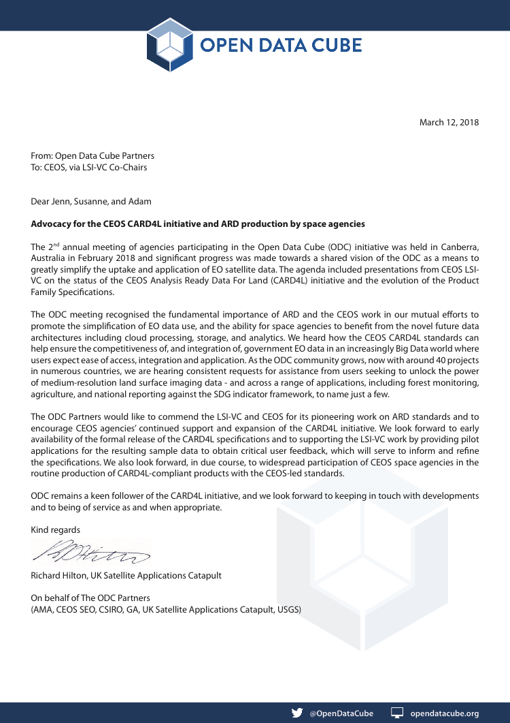
Achievements & Plans for the Next Year
1. CARD4L
2. Gap and Requirements Analysis
3. Moderate Resolution Interoperability (MRI)
Achievements:
CARD4L Definition
CARD4L Product Family Specifications
Surface Reflectance, Land Surface Temp, SAR Backscatter
CARD4L Website: ceos.org/ard
Recognition of utility from user community (ODC, GFOI).
ODC Partners, Planet Labs, and PCI Geomatica are external parties that have expressed a strong interest in CARD4L.
Plans:
CARD4L Product Assessment Framework.
Preliminary assessment of CEOS agency datasets & a register of these on the CARD4L website.
Global stocktake of ARD production.
ARD Strategy to: engage users, convince data producers to generate CARD4L, and encourage big data hosts to serve CARD4L.
Achievements:
Lack of a counterpart on the thematic side prevented progress.
Reached the conclusion that broad, generalised gap analyses do not look feasible – now shifting focus.
Plans:
The LSI-VC, SEO, and CEOS MIM Database team will work together to improve the utility of existing CEOS tools (COVE, MIM) to improve their usefulness for any gap analyses that might arise in the future.
E.g., LSI-VC compile a list of enhancements for consideration by the MIM Database team.
A gap analysis of CARD4L and/or SAR datasets could be useful.
Achievements:
Moderate Resolution Interoperability (MRI) Framework.
Plans:
Furthering the framework under considerations of the agreed principles and expanding it to other sensors with a focus on moderate resolution SAR.
Analysing various past/ongoing implementations (NASA HLS, ESA HLS,…) for MRI framework compliance.
Initiating detailed assessments of various implementation options (common grid, spectral & temporal adjustments).

Slide 5
Possible Contributions to the Global Observing Architecture and National/Agency Planning
&
Potential Synergies

Slide 6
1. CARD4L
Possible contribution to the global observing architecture and national/agency planning:
Standardisation for improved interoperability and ease of use
Leveraging data streams of each CEOS agency
Ensured competitiveness of public EO programmes
Our mp3 moment?
Synergies:
WGCV support requested for the definition of the CARD4L Product Assessment Framework and the assessment of specific products.
LSI-VC experience with CARD4L is a pathfinder for analysis-ready data in other domains (e.g., CARD4Ocean, CARD4Atmosphere) – if there is utility/user pull for such products in other domains. Could support other VCs.

Slide 7
2. Gap and Requirements Analysis
Possible contribution to the global observing architecture and national/agency planning:
MIM: Accurate spectral band information in machine-readable format would be a very useful enhancement (e.g.) – API in development
All other national planning processes invited to lodge feature requests with the SEO & MIM teams
Possible synergies:
WGClimate on ECV Inventory gap analysis
WGISS on data access gaps

Slide 8
3. Moderate Resolution Interoperability (MRI)
Possible contribution to the global observing architecture and national/agency planning:
Interoperability between existing CEOS agency sensors; improved temporal resolution for CEOS priority applications.
Leveraging data streams of each CEOS agency.
MRI Framework provides a wealth of knowledge for consideration in national/agency planning processes.
Possible synergies:
For MRI Framework expansion: WGCV – in particular the SAR subgroup.
MRI case study: testing HLS data with GEOGLAM AHWG.

